Slide 1
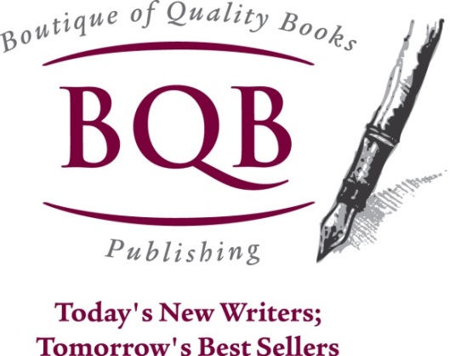
Author Call with guest speaker Shari Stauch of Where Writers Win
Welcome!
Saturday, March 22, 2014
10:00 a.m. EDT

Slide 2


Slide 3
Working With Your Editors
Writing Your Blurb
Series Titles
Book Covers
Know Your
Competition…
Putting Your Best Author Foot Forward!

Slide 4
Working With Editors
Your editor relationship: Yes, you’re married!
Editors are people, too.
First time working with an editor?
What can be learned for a better “repeat” performance?
Notes:
You’ll be working closely together, so establish the ground rules – what are you each looking for and how can you help each other achieve that?
Editors have the toughest job on the planet – help THEM help YOU!
What to expect first go-around
Take the lessons you’ve learned to make for a smoother “next time” – be better prepared – know if you have to “explain it” you didn’t communicate it – trust the process ☺

Slide 5
Writing Your Book Blurb
Dust off that elevator pitch!
“Go” to the movies… AND to bookstores
Who is your reader? Why will they care?
Read:
https://www.standoutbooks.com/five-elements-of-a-book-blurb/
Notes:
Remember that dreaded elevator pitch? Can you still recite it about your book? Does it still stand up?
There’s no substitute for research. Find comparable titles and bestsellers – read their blurbs – start w/ similar and insert your own story
Your work does NOT appeal to everybody, nor should it. Analyze who you wrote it for – speak to THEM when writing your blurb
What motivates YOU to read a book? Capture an emotion (fiction); speak to their pain/value proposition (non-fiction)

Slide 6

Give Your Series a Title!
A lesson from the Rainbow Faeries – Easy Buys
Research is key, but so is your content
Coke & Starbucks: Brand vs. Products
Marketing a series is cost-effective
Notes:
A series hooks people (just look at successful TV melodramas) and are easy to find/buy
Defining a series with a great title gives you a great BRAND with which to work in your individual products
Any brand, from Coke to Starbucks to Hostess is the “series” under which several products exist
A series allows for cost-effective marketing, try-one, buy-one opportunities, etc.

Slide 7
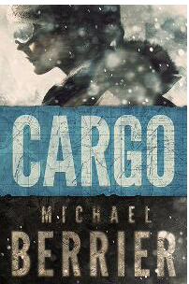
Judge a Book By Its Cover?
Look online: what looks good? Great?
Keep your promise to your reader
Trust your designer AND your gut
GREAT cover design learning resource: http://www.thebookdesigner.com/2011/08/monthly-e-book-cover-design-awards/
Notes:
Book cover design has been turned upside down in the past few years, in no small part due to HOW readers browse for books – so it had better stand out online!
Your genre will – in part – dictate your cover. It’s a promise to the reader; if it’s pink and features stilettos, they’ll expect chick-lit, bare chested men romance, etc.
Your designer WILL appreciate your input, if you come at it from a position of researched knowledge – provide them examples – this isn’t emotional; it’s business!
See the best AND the worst cover designs – checking out several of these will give you a cover-designer crash course

Slide 8


Gifts for BQB Authors!
Join our Winner Circle with promo code VIPW20 for $20 off; with access to vetted book reviewers, book clubs, and more!
10% off any WWW service as a BQB author
Email for
special offer!
Notes:
BQB authors get special pricing from us, AND because BQB publisher Terri Leidich is on the faculty (along w/ us) at this year’s PubSmart – we’re offering attendees a $100 coupon code! Email us at info@pubsmartcon.com for the code and instructions to register!

Slide 9
Terri’s Time
It’s never too late to get book reviews!
Book editor list from top one hundred newspapers in the country
Book conferences, shows, and festivals
PubSmart in Charleston, April 16 to 18
SC Book Festival in Columbia, SC, May 16 to 17
BEA (Book Expo America) in NYC, May 29 to 31
Upcoming author training calls
Saturday, April 12 - Making Twitter Work for You. Guest speaker: Mary Crockett Hill
Saturday, May 24 – Blogging: From Basics to Advanced. Guest speaker: Alice de Sturler

Slide 10
Questions?
Type any questions in the chat feature here!

Slide 11

Thanks for joining us!
Have a great Saturday!

