Slide 1

Author Training Call
3 Ways to Sell More Books
Welcome!
Saturday, October 19, 2013
10:00 a.m. EDT

Slide 2
Agenda
Getting Endorsements
Finding and Interacting with Book Clubs
Finding and Using Book Reviews

Slide 3
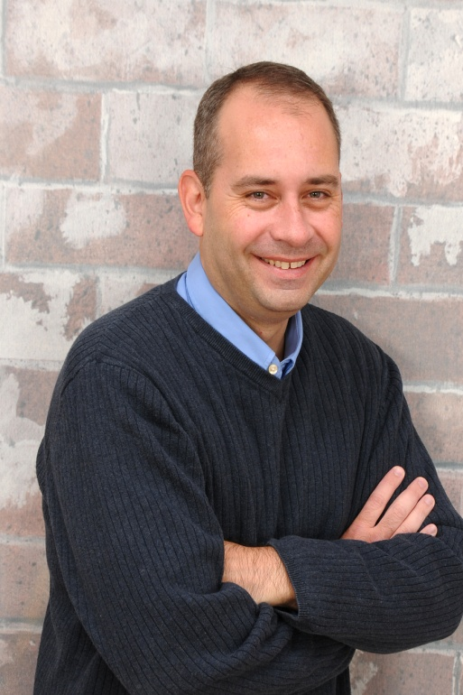
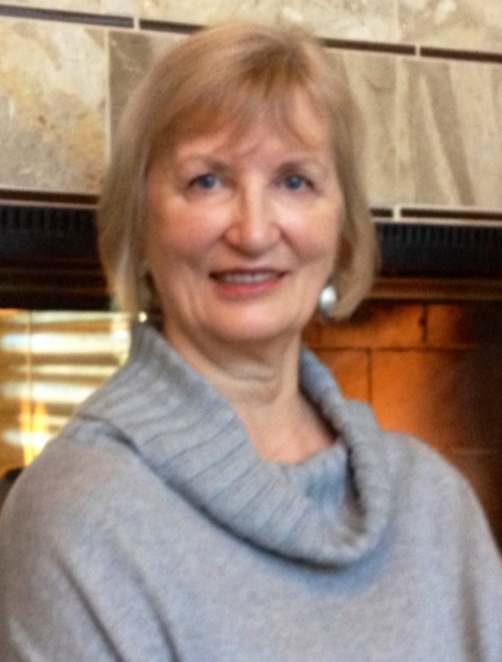
Presenters
Terri Leidich
President/VP of Sales & Marketing
John A Daly
BQB Author

Slide 4
Getting Endorsements
It’s not always what you know, but often who you know
A good comment from a credible source can help get additional reviews as well as sales

Slide 5
Timing
If your book isn’t published yet, go after endorsements about 6 months before release
  In the initial email, give a brief description of your book and offer to send them a pdf of the galley (the book before final proofing)
If your book is already published, you can still go after endorsements
  In the initial email, give a brief description of your book and offer to send them a review pdf or a copy of the print book

Slide 6
Think Big
  Make a List
  In the beginning, don’t censor yourself, just brainstorm
  Whose endorsement on the cover or inside of your book would help sell your book
  Don’t just list people you admire; list people that lots of people know and admire
  Look for people that share something in common with your book or genre
  Think outside of the box
Find Contact Information
  If they have a website, start there
  Search the Internet for information
  If it’s a celebrity, you can use a service such as www.contactanycelebrity.com

Slide 7
Contact Them
  Asking somebody famous or well-known to review your book can be a scary process
    Acknowledge the fear and move forward
  Assume people will be happy to give you an endorsement; think positive
  Send a personalized email or letter
  Make the email or letter short and to the point
    Busy people don’t have time for long emails
  The first sentence must grab their attention
  Ask if they would consider an endorsement
  Include a brief description of your book and offer to send them a pdf or print version (or galley)
  If you’re going after endorsements before the book is released, BQB can provide a pdf of the book before the final proof and mark it as such
    If the BQB Sneak Peek is done and on our website, add the link in your email

Slide 8
  Contact Them - Continued
  Include a brief description of your book and offer to send them a pdf or print version (or galley)
  If you’re going after endorsements before the book is released, BQB can provide a pdf of the book before the final proof and mark it as such
    If the BQB Sneak Peek is done and on our website, add the link in your email
  If you’re going after endorsements after your book is published:
    And your book has won awards, mention them
    If you’ve had media coverage, mention it
  Some authors write 2 or 3 endorsements to include in the correspondence and give the person the option to edit, rewrite, or write one of their own. If you do this, make the endorsement great, but credible

Slide 9
When You Get An Endorsement
  Take time to say “Thank You” to the endorser
    An email is nice, but if you have their mailing address, a thank you card is even nicer
  Provide Katy Whipple of BQB copies of all endorsements so the production team can decide where and how to display them on your book, in the initial pages of your book, BQB author page, etc.
  If they’re strong enough, BQB may add them to the cover
    If your book is already published and an endorsement is strong enough, BQB may redo the cover in order to add it
    Or, if you get several endorsements, BQB may add a page in the initial pages of your book
  Put the endorsement on your author site and use the powerful ones in all of your marketing

Slide 10
Finding and Interacting with Book Clubs
Finding book clubs and readers
  Check your local library and bookstores
  www.facebook.com
    Search for book clubs
  www.goodreads.com
    Are you set up as a member and an author
    How to use Goodreads to find book clubs
  http://bookclub.meetup.com
    Put in zip code and it will list the book clubs in your area along with a description of the club, the types of books they read, and contact and meeting information

Slide 11
  Finding Book Clubs and Readers -Continued
  www.readerscircle.org
    Let’s you put in a zip code and will provide local book club and contact information
      They have over 1,000 book club listings at any given time
    Contact info@readerscircle.org for information on listing your book
    They also connect authors and book clubs for half-hour phone visits–if interested:
      For $50, the listing is featured in three places (on the homepage for a month; in the author database for a year; in the book club database for a year
      For $25, the listing is featured in the author and book club databases for one year
        New listings go up on Mondays and groups respond directly when they find an author they’d like to invite

Slide 12
  Finding Book Clubs and Readers-Continued
  www.librarything.com
    BQB is in the process of uploading all of our titles to this site
    Go to www.librarything.com/about/authors and get set up on the site as an author
      Use the site to connect with readers
      Don’t advertise or push your book—connect
  www.shelfari.com/help
    This book club site is owned by Amazon
    Since your book is on Amazon, find your book, set up your author profile page, and begin interacting

Slide 13
  Finding Book Clubs and Readers-Continued
  Add a “Suggested Book Club Questions” page to your website
  Always carry bookmarks like they are business cards—when you meet someone (at an author event or in casual conversation) that says they are in a book club, give them a book mark
  When you meet someone who is in a book club, make it clear that you would LOVE to meet with their book club to discuss your book and answer any questions
  From time to time, mention on social media that you speak to book clubs and use relevant hash-tags. I use #ColoradoBookClubs

Slide 14
Getting Reviews
About 3-4 months before your book is released, BQB sends out copies, requesting reviews to places like:
  Publishers Weekly
  Kirkus Reviews
  Booklist
  Library Journal
  School Library Journal
  Horn Book Review
  New York Times Book Review
  And others

Slide 15
Where we send your book depends on what is appropriate for your book
  To this point in time, we have not gotten a review on a BQB book before publishing
  These review sources get thousands of books a month, so chances of a review can be slim
  That’s why it’s important to continually seek reviews after publishing from those sources that will review books after the release date

Slide 16
Book Reviews
All reviews are good reviews
Don’t worry about bad reviews
  They still get your book’s title in front of readers
  Many readers will buy a book, even if the review wasn’t favorable
  Even best selling books have gotten bad reviews
Finding Review Sources
Join groups like www.Goodreads.com or www.LibraryThing.com
Watch for local resources such as regional magazines or online magazines that do book reviews
Look for bloggers who review books
Join www.wherewriterswin.com to have access to their Directory of Book Reviewers
Use websites like http://reviewthebook.com

Slide 17
Submitting Review Requests
Place an order of your books to have specifically for reviews—this should be an important part of your marketing plan and budget
Each reviewer has specific guidelines for submission—read them and follow them closely
If a pdf is required, contact Katy and she’ll provide you with a pdf that has been designed specifically for

Slide 18
Once you Get a Review
Thank the reviewer
Use the best reviews on your website and in your marketing materials (Make note of the reviewer and where the review came from, i.e. Jack P on Goodreads, etc.)
Use the review in your social media posts—BQB author John Daly does a good job of this
Accumulate your reviews and send them to Terri at BQB once a month so she can send them on to BQB’s sales rep, put them in the weekly newsletter to booksellers, etc.
Keep a file of all reviews—when several good ones have been accumulated, let Katy at BQB know as she may consider adding the reviews in the front pages of your book

Slide 19
Questions?
Type any questions in the chat feature here!

Slide 20

Thanks for joining us!
Have a great Saturday!

