Slide 1

Author Training Call Setting Up Book Signings and Media Appearances
Welcome!
Saturday, November 16, 2013
10:00 a.m. EST

Slide 2
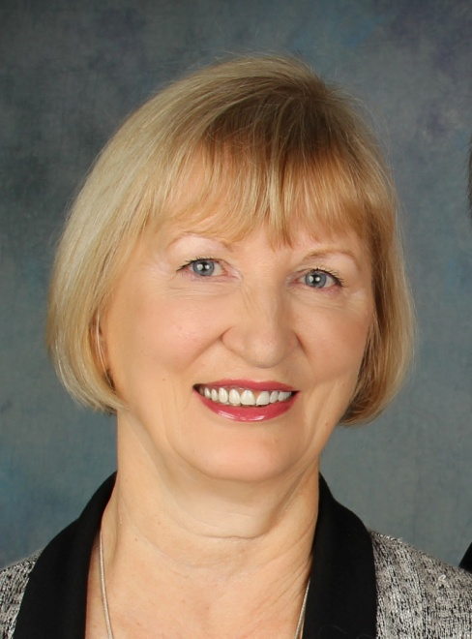
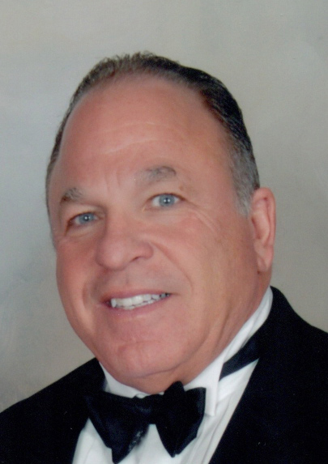
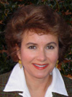
Presenters
Terri Leidich
President/VP of Sales & Marketing
BQB Publishing
Bob Fiacco
Author of Showing Up to Play
Millie West
Author of The Cast Net and Catherine’s Cross

Slide 3
Agenda
Scheduling Book Signings
Making Your Signings Successful
Setting up Media Appearances

Slide 4
Scheduling Book Signings
Do your research
Make a list of the booksellers (or other retailers) in your area with whom would like to do a book signing
Make your initial contact
Email
Phone
In person
Find the approach that works best for you
Expect glitches in the beginning
As a new author with a new book, you may have some glitches in the beginning. Don’t get discouraged.

Slide 5
Scheduling Book Signings - Continued
If you visit in person, bring in a press kit.
Make sure they understand that you are not a self-published author.
With B&N or indie bookstores, your book will be in their system.
They can order the books directly; you don’t have to provide the books for your book signing.
If their system only shows one or two books in stock with either B&N Dist, Ingram, or Baker & Taylor, assure them that the books are in stock at the distributor and if they place their order with their wholesaler, the wholesaler will get the needed amount of books from the distributor.

Slide 6
Scheduling Book Signings - Continued
There are two ways that B&N stores order books for signings:
They let Ingram know the amount of books that are needed and when, and Ingram will get the books into inventory from our distributor and then get them shipped to the B&N store.
If Ingram can’t get the inventory as quickly as is needed, the B&N store can contact B&N Dist and the woman who works with stores on book signings (I believe her name is Michelle). She can order the books directly from our distributor and get a quick turnaround to have the books in the local B&N by the time of the signing.

Slide 7
Scheduling Book Signings - Continued
Books-A-Million is difficult to work with initially on book signings.
Some stores will let you do a book signing with them if your book is in their system.
If your book isn’t in their system, let me know and I’ll contact our sales rep.
Some of the BAM stores require that you go through the process of becoming a “preferred author” with them.
The store can give you the required paperwork to complete.

Slide 8
Millie’s Approach
Started with local, independent book stores and as my experience and confidence grew, I moved on to the chain bookstores.
Visit the store in person and talk with the owner or store manager.
Discuss my books.
Bring a copy of my books with me.
Bring my sell sheets with me.
Some stores are just difficult to arrange book signings with.
Don’t get discouraged.
It took me a year to get a book signing in the local Barnes and Noble.
When I did, in just three and a half hours, I sold all thirty of the books they had ordered in.
It’s an ongoing process.
Once you have a successful book signing with a store, they are typically anxious to have you come back.

Slide 9
Millie’s Approach - Continued
When I set up signings, I try to coordinate the signing with an event that will produce foot traffic in the store.
Once a signing is set up, I promote it via social media.
Some stores will allow me to bring in posters or flyers in advance.

Slide 10
Bob’s Approach
Start by planning what stores you want to approach.
I use the BQB Bookseller list and Google.
Find out who the contact is.
I’ve had the most success by visiting the stores in person.
Dress your best . . . we have only a second to make a professional impression.
Don’t run into the bookstore on your way to the gym.
Have professional material to leave with the owner or manager.
The BQB press kit is perfect:
Bio
Book info sheet
Press release
Show your enthusiasm and excitement about your book(s).

Slide 11
Bob’s Approach – Continued
Be persistent.
Many of my signings have come after several stops and call.
Realize that people are busy.
If they don’t book a signing right away, we just have to contact them again and continue to be excited.
Always be selling why you’re different.
I have said to several people, “Hey, you haven’t had me signing and selling here.” They usually laugh and that sells it.
Offer a promotion.
Barnes and Noble in the Richmond, Virginia, area is allowing me to do signings at five locations and combining all sales for one drawing for a gold driver (golf club).
Don’t get discouraged.
Remember, SUCCESS WILL NEVER ATTACK US, WE HAVE TO GO AFTER IT!

Slide 12
Having a Successful Book Signing
Once your book signing is set up, it’s up to you to make it successful.
Go prepared.
The store will provide the table.
You may want to bring a tablecloth for a better presentation.
Bring accessories to make the table aesthetically pleasing.
Have an easel and author poster to set behind or beside the table.
Bring bookmarks to hand out.
Come prepared with a pen that writes well and will make an impressionable signature.
Get there early.
Interact with people.
Understand that you are there to build your fan base and that’s what will sell your books.
Offer a bookmark to every person who walks by.
It’s a great way to begin a conversation with them.

Slide 13
Millie’s Approach
As people pass by, I engage them with a greeting and offer a bookmark.
That’s a comfortable way to strike up a conversation.
Many people will take a bookmark.
When I hand them the bookmark, I begin discussing my novels with them.

Slide 14
Bob’s Approach
Promote the signing with social media, on your blog, etc.
At the signing, interact with people.
Don’t just push your book; build relationships.
The more interactive you are, the more books you’ll sell.
The more books you sell, the more the bookstore will want you to come back.
The more book signings you set up, the easier it will be to get more book signings.

Slide 15
Getting Interviews on Local TV Talk Shows
Do your research
Know what talk local talk shows air in your area.
What types of interviews do they do?
Have you seen them interview authors?
If so, what types of authors?
Find out who to contact.
Bookings are usually handled by the show’s producer or assistant producer.
Contact them.
Send or leave a professional author press kit.
Include a listing of any local events (speaking events, book signings, etc., that you have planned).

Slide 16
Getting TV Interviews - Continued
Pay attention to the types of shows they do, and then pitch ideas according to their trend.
Don’t go after media if you are uncomfortable with it.
Not everyone will be good at every phase of marketing.
Concentrate on the areas that work best for you.
If want to go after TV interviews, but don’t want to go through the process yourself, consider engaging a publicist to help.
When you’re successful in booking an appearance, go prepared:
Dress the part.
Provide a list of interview questions.
Bring a copy of your book.
Provide your website URL (they may post it on the screen during your interview).
Provide a list of local events you’ll be doing.
Provide a list of where your book can be purchased.

Slide 17
Bob’s Approach
Go in person
Dress your best
Leave professional material
Be persistent

Slide 18
Questions?
Type any questions in the chat feature here!

Slide 19

Thanks for joining us!
Have a great Saturday!

