Slide 1
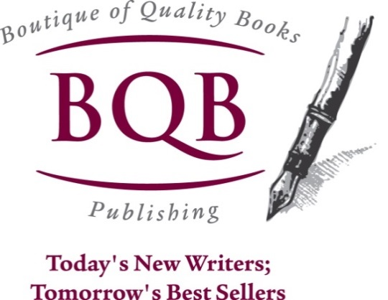
Take Charge of Your Marketing No Matter How Your Book Is Published
Welcome!
Saturday, January 25, 2014
Roanoke Regional Writers’ Conference

Slide 2
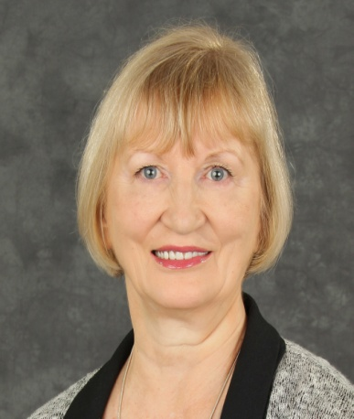



Presenter
Terri Ann Leidich
President, BQB Publishing
Author of three books
Release Date: 10/1/14

Slide 3
Overview of Book Marketing
Book marketing in the past
Mostly Traditional Publishing
Marketing done strongly by publisher
Book marketing today
Variety of Publishing Options
Traditional
Hybrid
Self-publishing
Variety of Publishing Formats
Print
eBook
Audio
Competition greater
Social media has changed the face of marketing
Author involvement is crucial

Slide 4
Overview of Book Marketing
Why Take Charge of Your Book Marketing?
Marketing is about building relationships.
No one knows your book better than you.
As an author, you are the owner of your own business.
You are the leader of your business.
You can influence whether you succeed or not.

Slide 5
Overview of Book Marketing
Two Important Stages of Book Marketing
Before the release
Pre-launch efforts and events
Launch parties
After the release
Ongoing marketing

Slide 6
The First Steps:
Know your target and niche markets
Begin by identifying:
The genre of your book. http://www.bisg.org/
Within that genre, what is the age group most likely to read your book?
With the age group, which sex will your book appeal to more?
Identify any special interests that would draw people to your book.
2. Know your competition
Do a competitive analysis:
What books are selling the most within your genre?
Check out the authors and see what they are doing.

Slide 7
The Six Types of Marketing
Grassroots marketing
Online marketing
Public relations
Affiliate marketing
Direct mail/email marketing
Traditional advertising

Slide 8
The Six Types of Marketing
1. Grassroots marketing: Using existing resources and implementing processes to help you cultivate those resources
Carry bookmarks and hand them out at every opportunity.
Network every chance you get.
Connect with your local libraries and offer to do readings, presentations, etc. Ask them to carry your book or consider donating a copy.
Participate in local events and set up a table to sell your book or hand out bookmarks.
Connect with your local media to let them know you’re a published author. Have your press kit handy to give to them if they are interested.

Slide 9
Grassroots Marketing (continued)
Look for places to donate your book and help build your fan base:
Hospitals
Public libraries
Community college libraries
Local B&B’s
Community centers
Senior centers
Look for places to do book readings:
Local coffee shops
Hospitals
Active retirement communities
Locally owned bookstores
Community colleges
Schools

Slide 10
Grassroots Marketing (continued)
Look for opportunities to speak to local groups:
Ladies Auxiliary groups
Rotary, Kiwanis, Lions, etc.
College alumni groups
Book clubs
Writers’ groups
Civic groups
Continuing education program

Slide 11
2. Online Marketing
In today’s world, online marketing is a strong and essential tool for promoting and selling your book(s). It is difficult to establish yourself as a writer in today’s world without building an online presence.
Author website
Must have one
Use words that grab a reader’s attention, establish credibility, pique their interest
Use links to sites where your book can be purchased
Create a review page
Consider offering a sneak peek
Post your schedule of events
Include contact information
Add social media links
Tell your story with a bio page
Why you became an author
Why you wrote your book

Slide 12
Online Marketing (continued)
Social media
If you don’t understand social media, get some help and training—it’s essential.
Be active on Facebook, Twitter, LinkedIn, Google+, Goodreads, LibraryThing.
You can spend as little as fifteen minutes a day on social media—just be consistent.
Use your author name and a professional photo that is consistent across platforms.
Post your reviews on Facebook, Twitter, LinkedIn, etc.
Join Goodreads as a reader and then an author.
Sign up for Google Authorship.

Slide 13
Online Marketing (continued)
Social media (continued)
Make sure you’re set up as an author on Amazon by going to www.authorcentral.amazon.com.
Host Q&A sessions on Google regarding your book(s) and the process of writing it (them).
Set up weekly Twitter chats with readers.
Host author hangouts or interviews on Google+.
If you are writing or have written a series, consider creating a fan page on Facebook for your main character.
Give away your book on sites like Goodreads, LibraryThing, etc.
Hold contests on Facebook, Pinterest, etc.
Keep up with the changing market of social media sites

Slide 14
Online Marketing (continued)
YouTube
Pictures still impact stronger than words.
Create a YouTube account for yourself as an author.
Create a book trailer or chapter trailers, post them on YouTube, and blast out the links on Facebook, Twitter, LinkedIn, etc.
Ask fans to create their own book trailer for you and your book(s) and post them online.
Record your Google+ hangouts and put them on YouTube
Blog
Create a blog and start consistently blogging. www.wordpress.com
Make sure your blogs are linked to your author website and social media accounts so they post automatically
Offer advanced reading copies of your book for review to bloggers who attract your niche market.
Look for opportunities to be a guest blogger on other blogs.
Consider doing a blog tour for your book.

Slide 15
Online Marketing (continued)
Additional tools:
www.brandyourself.com
www.gigaalert.com
www.googlealert.com
www.klout.com

Slide 16
3. Public Relations
Public relations can be one of the most effective marketing tools an author can have, but one that is the most difficult to cultivate.
The basics of gaining publicity
Create real news about you and/or your book(s)
Locate and cultivate appropriate media contacts
Be persistent
Two primary ways of attaining publicity
Do it yourself
Hire a publicist on an ongoing or per project basis

Slide 17
3. Public Relations (continued)
Tools for getting publicity
Develop a press kit
Go after book reviews
Enter your book in award contests
Write (or have written) strong, effective press releases
Understand the components of a pitch letter and develop one when appropriate
Develop a strong media list
Engage with the media
Local reporters
Specialized columnists
Radio programs
Local television talk shows

Slide 18
4. Affiliate Marketing
This type of marketing involves hooking up with businesses and organizations that share a similar target audience
Online
Offline
Examples
Work with other authors to cross-promote each other’s books using the Amazon or B&N Affiliate programs.
Encourage fans to join the Amazon or B&N affiliate programs and link from their blogs, website, etc.
Connect with local businesses that share your target market and create events, giveaways, promotions, etc.
Look for businesses that might be interested in buying copies of your books at a discount to give to their clients.
Identify charities with which your book is a good fit, and approach them regarding a promotion where they receive a percentage of the sales.

Slide 19
5. Direct Mail/Email Marketing
Direct mail marketing can be an absolute waste of time and money, or a very effective piece of your overall marketing program. The difference is what you send and who you send it to.
Example: For my grief books, I created a list of grief counselors all over the country and sent a postcard. Sales through all venues have increased.
Examples of what to send:
Newsletters
Letters
Brochures
Postcards
Book jackets that are printed on the inside and used as a brochure

Slide 20
What you need to do it right
A good database of addresses
Bookstores
Libraries
Media specialists or principals at schools
Churches
Organizations that would have interest in your or your book
Preschools
Sportscasters
Book clubs
Your target or niche market
Gift or specialty stores
As a part of your direct mail campaign, you can develop your opt-in email database as well.

Slide 21
Who to send to:
Creating your database
On your website, have a signup form for people who are interested in receiving mailings, emails, newsletters, etc., from you.
When you do book signings, appearances, etc., have a sign up sheet.
On social media, let people know when you’re about to send out email or mailed info and encourage them to sign up.
Buy targeted mail lists.
This isn’t recommended for email marketing because most email programs like Mail Chimp or Constant Contact require an opt in from those on your lists.

Slide 22
Email Marketing
This type of marketing is experiencing a revival because of programs like Mail Chimp and Constant Comment, where opting-in is necessary.
What it can do:
Help build your fan base
Great way to stay in touch with your fan base
Keep your fans aware of events, upcoming books, etc.

Slide 23
Email Marketing (continued)
What you need to do
Sign up with an email program like Mail Chimp (which is free for smaller users) or Constant Contact
Begin creating your opt-in email list
Have a signup form at your book signings
Create a signup form or link on your website
Keep your emails informative and useful, not just hard pushes to sell your book(s)
Look for large organizations that send large-volume emails to see if you can get your book reviewed or get interviewed as an author in their email newsletter

Slide 24
6. Traditional Advertising
What paid advertising can do for you and your book
Attract readers and fans
Build credibility, establish and maintain your brand
Promote your book and yourself as an author
Types of advertising
Print
Newspapers
Magazines
Specialty periodicals
Radio
Television
Online
Social media ads
Blog ads
BookBub
Google Adwords

Slide 25
Summary
Take charge of your marketing.
Establish a yearly marketing budget.
Look at what your publisher provides and build from there.
Create a written marketing plan.
Enhance and refresh your marketing each year.
Consider all areas of marketing.
Start with the areas that you are most comfortable with, but don’t stop there.
Remember, the market is always changing, so marketing can never stop.

Slide 26
Summary
Forms that can help you organize your pre-release and post-release marketing:
Six Types of Marketing Planning Form
Competitive Analysis
Marketing Foundation Worksheet
Word Format Marketing Organization Form
Excel Book Marketing Master Spreadsheet
If you are interested in receiving any of these forms, email me at terri@bqbpublishing.com

Slide 27
Questions?

Slide 28

Thanks for joining us!
Have a great Saturday!

