Slide 1

Author Training Call Working with Regional Independent Bookseller Associations
Welcome!
Saturday, January 18, 2014
10:00 a.m. EST

Slide 2
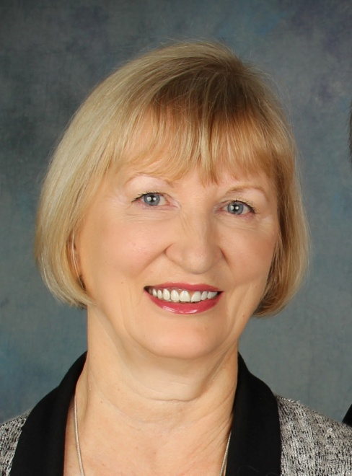
Presenters
Terri Leidich
President/VP of Sales & Marketing
BQB Publishing

Slide 3
Agenda
Regional Independent
Bookseller Associations
What they do
Who they are
Which ones to join
The benefits they provide
Ways you can participate
Tips for selling to indie bookstores

Slide 4
What They Do
Support independent bookstores in their regions
Support regional authors and regional books with a variety of programs, including:
Award programs
Authors on tour calendars
Offer yearly trade shows where authors, publishers, and other vendors can connect with booksellers
Offer customized in-store holiday catalogs or other point-of-sale programs plus consolidated advertising programs

Slide 5
Who They Are and The States They Cover
Great Lakes Indie Booksellers Association (GLIBA)
http://www.gliba.org
Minnesota, Wisconsin, Illinois, Indiana, Ohio, Michigan, Kentucky
Midwest Booksellers Association (MIBA)
http://midwestbooksellers.org
Illinois, Iowa, Kansas, Michigan, Minnesota, Missouri, Nebraska, North Dakota, South Dakota, Wisconsin
Mountain & Plains Indie Booksellers Association (MPIBA)
http://www.mountainsplains.org
Arizona, Colorado, Kansas , Montana, Nebraska, Nevada, New Mexico, Oklahoma, South Dakota, Texas, Utah, Wyoming

Slide 6
Who They Are (Continued)
New Atlantic Indie Booksellers Association (NAIBA)
http://www.newatlanticbooks.com
New York, New Jersey, Pennsylvania, Delaware, DC, Maryland, Virginia, West Virginia
New England Indie Booksellers Association (NEIBA)
http://www.newenglandbooks.org
Connecticut, Maine, Massachusetts, Metro Boston, New Hampshire, New York, Rhode Island, Vermont
Northern California Indie Booksellers Association (NCIBA)
http://www.nciba.com
Northern California

Slide 7
Who They Are (Continued)
Pacific Northwest Booksellers Association (PNBA)
http://www.pnba.org
Alaska, Idaho, Montana, Oregon, Washington
Southern California Indie Booksellers Association (SCIBA)
http://www.scibabooks.org
Southern California
Southern Independent Booksellers Association (SIBA)
http://www.sibaweb.com
Alabama, Arkansas, Florida, North Carolina, South Carolina, Georgia, Kentucky, Louisiana, Mississippi, Tennessee, Virginia, West Virginia

Slide 8
Which Ones to Join
Regional indie booksellers associations help promote regional authors and regional books.
Therefore, check out the association that:
Covers the area you live in
Covers the region(s) in which your book takes place

Slide 9
The Benefits They Provide
Each association varies in what they offer and how.
Some examples:
All associations have yearly trade shows where you can pay to have a table to promote and interact with bookstores
Each association offers advertising opportunities in their catalogs
Several of the associations offer book award programs
Several offer special author programs to put authors and indie bookstores together
GLIBA offers a “Regional Access Program” for books with a regional interest
MIBA has a “Midwest Connections” program
NAIBA gives authors who join their association a page on their website and one free profile in a NAIBA newsletter

Slide 10
The Benefits They Provide (Continued)
Training and tips of how to market your book(s) to independent booksellers
Author speaking opportunities at trade shows
NEIBA offers a “Book Alert” program that gets free review copies of forthcoming titles to buyers and frontline booksellers in their region
SIBA offers free membership to authors who place a “Find an Indie Bookstore” badge above the fold on the homepage of their website.
SIBA also operates a speakers’ bureau for authors
Mail or email lists for all of the bookstores that are part of their membership
You can use these lists as the foundation of your own marketing plans

Slide 11
Ways You Can Participate
Check out the associations for which you qualify
Look at what author programs they offer
Participate in those that will benefit you or your book
Consider the different advertising or catalog promotions
Use any assistance they give for connection with the booksellers in that region
Consider attending their annual trade show
If speaking is your forte, look for speaking opportunities at the annual trade show or other events

Slide 12
Association Tips for Selling to Indie Bookstores
Know the marketplace. Do some research before you approach bookstores so you know what genres they sell and if their customers are in your target market.
Find out who and how to contact before you stop in. Some stores will take “drop ins”; others won’t.
When you meet with a bookstore, be ready with a marketing plan to show what you’re doing to promote your book. Having a marketing plan to show them will greatly increase your chances of convincing the store to carry your book.

Slide 13
Association Tips for Selling to Indie Bookstores (Continued)
Indie bookstores prefer that handouts, bookmarks, etc., don’t say “available on Amazon.com,” but instead say something like “available wherever books are sold,” or “available through booksellers everywhere,” or something similar. (BQB is changing its phrasing on marketing materials.)
Don’t just list Amazon on your website as a purchase option. Consider choosing an independent bookseller or two as your store(s) of choice and become an affiliate of those stores.
Not only will those stores love it, but other indie stores will praise your commitment.

Slide 14
BQB’s Approach to Associations
We belonged to SIBA for two years and attended their conference
We found that author opportunities in the indie booksellers associations are better than the opportunities offered to publishers and are more effective in actually reaching booksellers
We continue to scan and research the conferences and offerings for opportunities for BQB, our authors, and our books.

Slide 15
Questions?
Type any questions in the chat feature here!

Slide 16

Thanks for joining us!
Have a great Saturday!

