Slide 1

Author Training Call: Creative Ways to Use Your Blog
Welcome!
Saturday, May 24, 2014
10:00 a.m. EDT

Slide 2
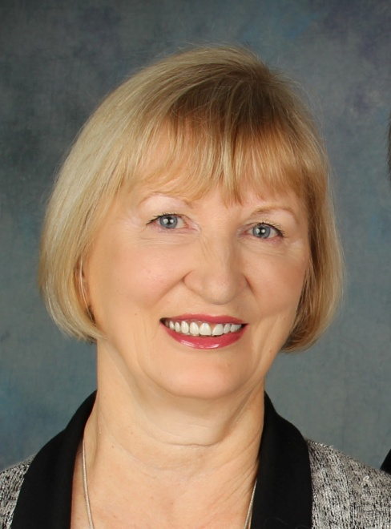
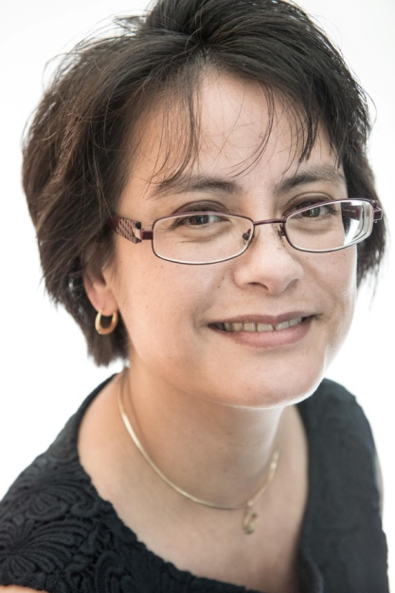
Presenters
Terri Leidich
President/VP of Sales & Marketing
BQB Publishing
Alice de Sturler
Blog Manager and Blog Tour Manager for BQB Publishing

Slide 3
Overview by Terri
Blogging is made for writers
If you don’t have a blog, create one
Wordpress is an easy way to start
Your website may contain a built in blog
If you don’t know how to start, get help
Nervous about getting started?
Participate in the BQB Blog – Alice makes it easy; watch for her emails.
BQB is creating a resource sheet to help you find the right people for each skill you need to learn.

Slide 4
Creative ways to use your blog
Build your brand and market your book
Alice de Sturler, BQB Blog Manager

Slide 5
Blog – Create - Collaborate
Erasmus University, Rotterdam, the Netherlands (criminal law/criminology)
Amnesty International Switzerland (Death Penalty Coordinator, Women’s Rights, Coordinator for the US & Canada)
University of Illinois College of Law, Urbana-Champaign, IL (human rights and discovery courses)
Champaign Police Department, investigations division, cold cases
Virginia Tech, Political Science (death penalty, wrongful convictions, women’s rights, school shootings, and hate crimes)

Slide 6
The Start of a Freelance Career
My first blog “Defrosting Cold Cases” started in Nov 24, 2009
Blogging about the victims’ cases increases their digital footprint
In 2013, my blog and the manner in which I use it to help advance victims’ cases, won the popular vote from the organizers of the law conference series ReInvent Law. I presented my talk in June 2013 in London.
My blog won the 2013 American Bar Association’s Top 100 Blawgs (blogs about law) award in the category criminal justice
The American Investigative Society of Cold Cases selected me to be their blogger
My second blog “Your Blog Coach” started Jan 17, 2014

Slide 7
Clients
AISOCC http://aisocc.wordpress.com/
Geoff Searle http://freedomafterthesharks.wordpress.com/
Peter Turner (http://peterturneronline.wordpress.com/ under development)
BQB Publishing http://bqbpublishing.wordpress.com/
and others

Slide 8
Overview of my Top 10 Tips
1: Widgets
2: Freebies
3: Change this ending!
4: First sentence
5: Q&A for newbie writers
6: Recommended reading
7: Skype
8: Evergreens
9: blogoversary
10: Character swap

Slide 9
Widgets
Add a widget for every book you wrote in the sidebar to showcase your work. How?
Create a normal new post in your dashboard
Add a picture of the book cover and center it
Optional: add the book title
Name this post for example: widget #1 TMP (so it becomes clear that this post is not meant to be published!)
Save draft
Change from visual to text (upper right hand corner)
Copy all the code
Go to appearance, select widgets, add a text widget
Paste the code into the widget’s body and save
Done!

Slide 10
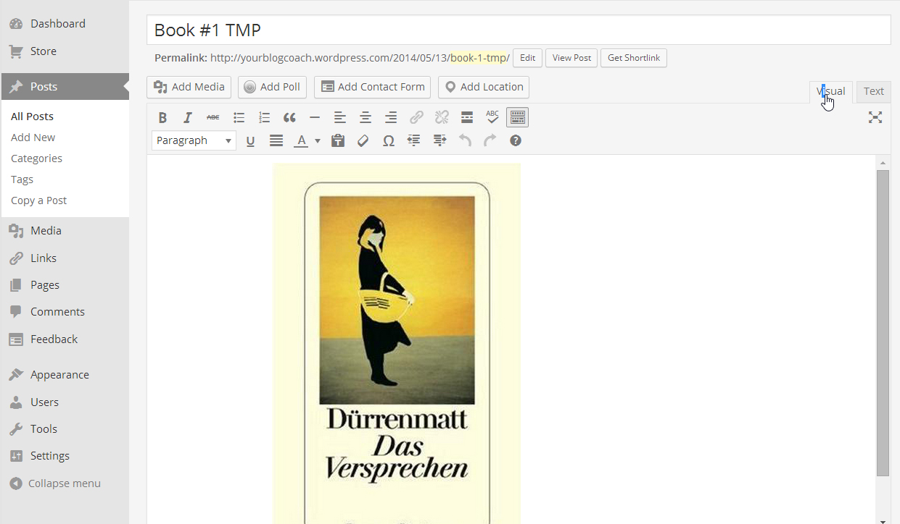
Book Cover inserted as jpg

Slide 11
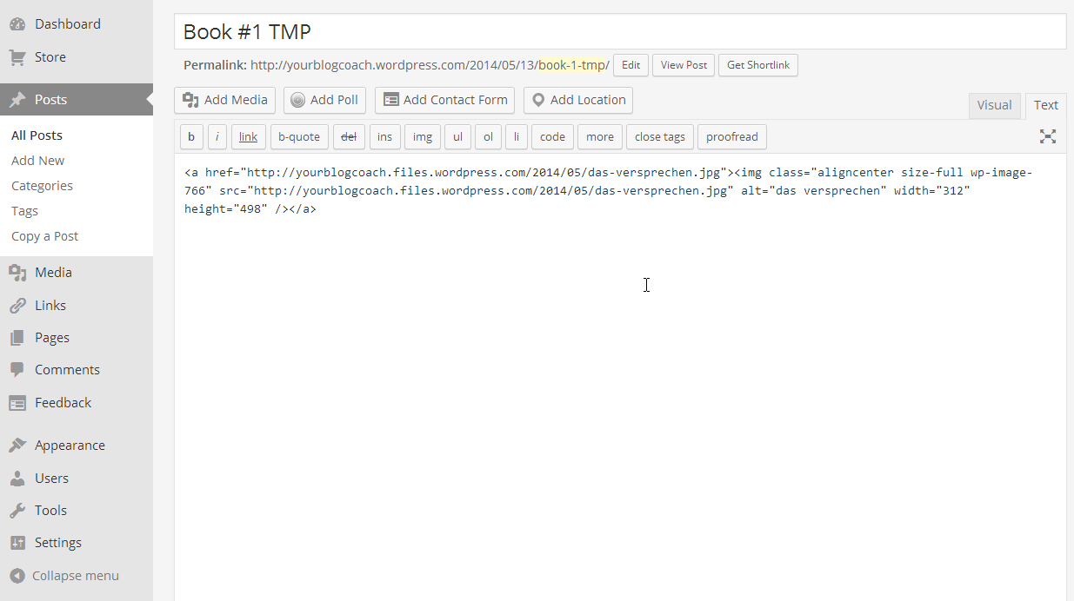
Book Cover in code

Slide 12
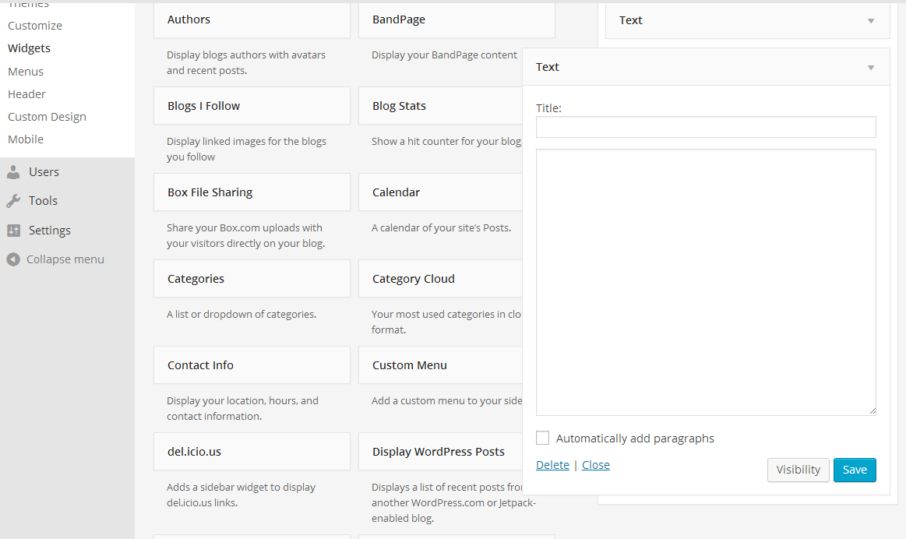
Text widget

Slide 13
Freebies: treat your readers!
Add polls, raffles, and giveaways to reward your readers for their support.
Readers love to know that they mean the world to you. You see, you can try to get people to buy your books but usually that will only get their defenses up. So, be different. First try to get blog readers, then turn them into fans, and watch them inquire about your books all by themselves.
Adding a poll or a raffle is interactive. Readers appreciates the author’s involvement so it is likely to become very popular.
Giveaways do not have to be costly. A free PDF version, special photographs, an unpublished short story, are just examples of what you could give away. If budgets allow consider bookmarks or a special ex libris.

Slide 14
Change this ending!
Consider a yearly competition where you open up one of your books/stories to your readership and allow them to change the ending.
Every story has a turning point where a choice is made. The story follows that line. However, a different choice would have taken the story along another line.
Identify for your readers where that turning point is and allow them to write a new ending.
Open this up on your blog as a competition: give readers enough time, select the best five stories, and then open it up to the public to vote.
Winner gets … ? A collaboration for an epub? A guest blog post on your blog? Free ticket to your next book festival?

Slide 15
First Sentence
True or real: that illusive first sentence. Is it a deal breaker: yes or no?
Explain to your readers what is so special about a first sentence. Does it really draw readers into the story? How quickly do people zone out or loose interest in a book?
Give readers examples of great first sentences and explain the use of strong words, emotional words, etc.

Slide 16
Tips for new writers
Give your readers a frequent update on what did and did not work for you when you started as a writer.
Every new beginning knows their own struggles. The first year at a new job, getting a great storyline out of your head and onto paper, etc.
Did you have a special writing routine? Do you still have that writing routine? If no, explain why.
What disciplines does a reader need to become a writer? Should they write every day?
How crucial is a word count? What to do if the word count becomes a psychological hurdle?

Slide 17
Recommended reading
Books, news articles, and everything else that made an impression on you or that was useful.
Do NOT just make a page and add link after link! Be different and explain WHY you added the link to a certain book. Give the reader a reason to click on that link.
Make a listing of fellow authors’ blogs and explain to your readers what their strengths are and which books you like most

Slide 18
Skype
Hold a monthly roundtable discussion with Skype: it is free, you can call, organize conference calls, or message people. It can be done from a computer, laptop, or mobile phone.
I love Skype (no, I do not have shares in the company) because it allows me to call my overseas family and clients as often as I want without breaking the bank.
Remember to choose your Skype name wisely because as with Twitter, you cannot change it! Calling/messaging between Skype users is free regardless of distance. Set up a time for the conference call, post it on your blog in at least two time zones (I use major cities instead of EST, GMT, etc. Everyone knows New York or London so it takes away any confusion).
Video (on camera) call or not? Mind the dress!

Slide 19
Evergreens
There are always new generations of readers and writers so make sure your blog is a resource for the next generation.
Make your posts timeless so that a new or much younger reader can still use the information decades from now.
Give a new writer an overview of the process from writing that first sentence to seeing your books in the stores. Comment on every phase, what to know, tips and tricks, etc.
Must add: how to deal with disappointment when a piece gets rejected or gets bad reviews. How did you deal with that and what advice can you give others?

Slide 20
Blogoversary
Add a countdown to your blog’s next anniversary (e.g. blogoversary) and plan a special giveaway, virtual party, or contest.
Your blog was born on a certain date. If you do not remember that date go back in your emails to see if you still have that email from Blogger, WordPress, etc. telling you that the site is up.
Countdowns create excitement especially if you add something new the closer we get to the exact date. For example: adding features on the blog, Q&A sessions, accepting requests for guest blogging on your readers’ blogs, etc.
You can make a countdown widget online free: http://www.blogoversary.com/

Slide 21
Character Swap
Make a manual of one of your characters with all available information e.g. family history, where did the character grow up, medical history, school systems, grades, hobbies, friends, sports, love interest, birth marks, speech impediments, fashion sense, pets, likes/dislikes, etc.
Invite your readers to write their own book or short story using your character and the information from the manual.
Ask a few writer buddies to help selected the top five.
Open it up to the public to vote for their favourite.
Consider helping the winner get their story out by using free services such as https://www.smashwords.com/

Slide 22
Questions about Blogging?
Contact Your Blog Coach here:
Email: BQB.Alice@gmail.com
True Crime Blog: Defrosting Cold Cases (defrostingcoldcases.com)
Blogging: Your Blog Coach (yourblogcoach.wordpress.com)
Social media:
Twitter: www.twitter.com/Vidocq_CC
Google+: https://plus.google.com/+AlicedeSturler/about
LinkedIn: http://www.linkedin.com/in/alicedesturler

Slide 23
Thank you!
I appreciate your time and especially your support during my first month at BQB!
Please remain patient with me as this is a new (but terrific) world for me.
Cheers!
Alice de Sturler

Slide 24
Questions?
Type any questions in the chat feature here!

Slide 25

Thanks for joining us!
Have a great Saturday!

