Slide 1

Author Training Call: Bublish: Empowering Authorpreneurs
Welcome!
Saturday, June 21, 2014
10:00 a.m. EDT

Slide 2
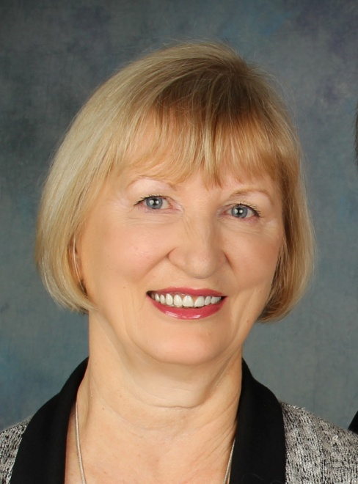
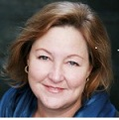
Presenters
Terri Leidich
President/VP of Sales & Marketing
BQB Publishing
Kathy Meis
Founder & CEO
Bublish

Slide 3
Overview
BQB is consistently looking for ways in which our authors can market their books and build their brands.
In today’s publishing environment, connecting with readers is paramount to success.
Bublish is a creative way for authors to tell the backstory behind their books.

Slide 4



About Katy
Professional writer, editor, ghostwriter and editorial manager with more than twenty years of experience.
Founding editor of Forbes MediaCritic
Founding partner of PubSmart
Frequent blogger and speaker on the subject of book promotion, author branding, social media and discoverability
Winner of the People’s Choice Award at the Startup Showcase at O’Reilly’s Tools of Change Publishing Conference
Connect with Bublish: https://www.facebook.com/bublishme
@BublishMe

Slide 5

empowering authorpreneurs

Slide 6
Why We Created Bublish
Need for new types of marketing tools to empower authors in the Digital Age.
Absence of data for authors who want to improve their marketing performance.
Lack of powerful, affordable brand building tools to assist authors and small publishers.

Slide 7
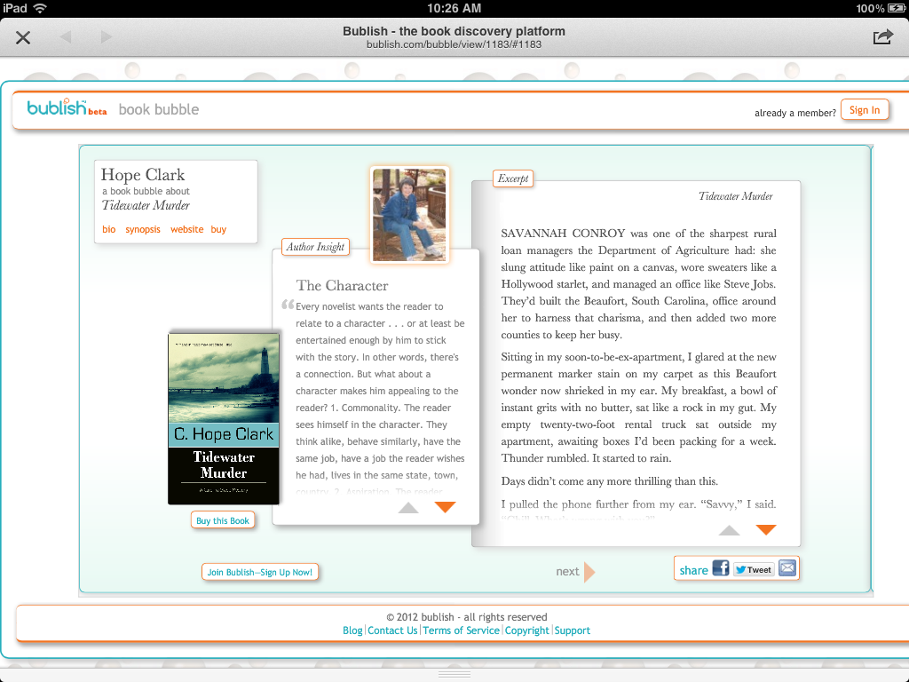
The Heart of Bublish: Book Bubbles

Slide 8
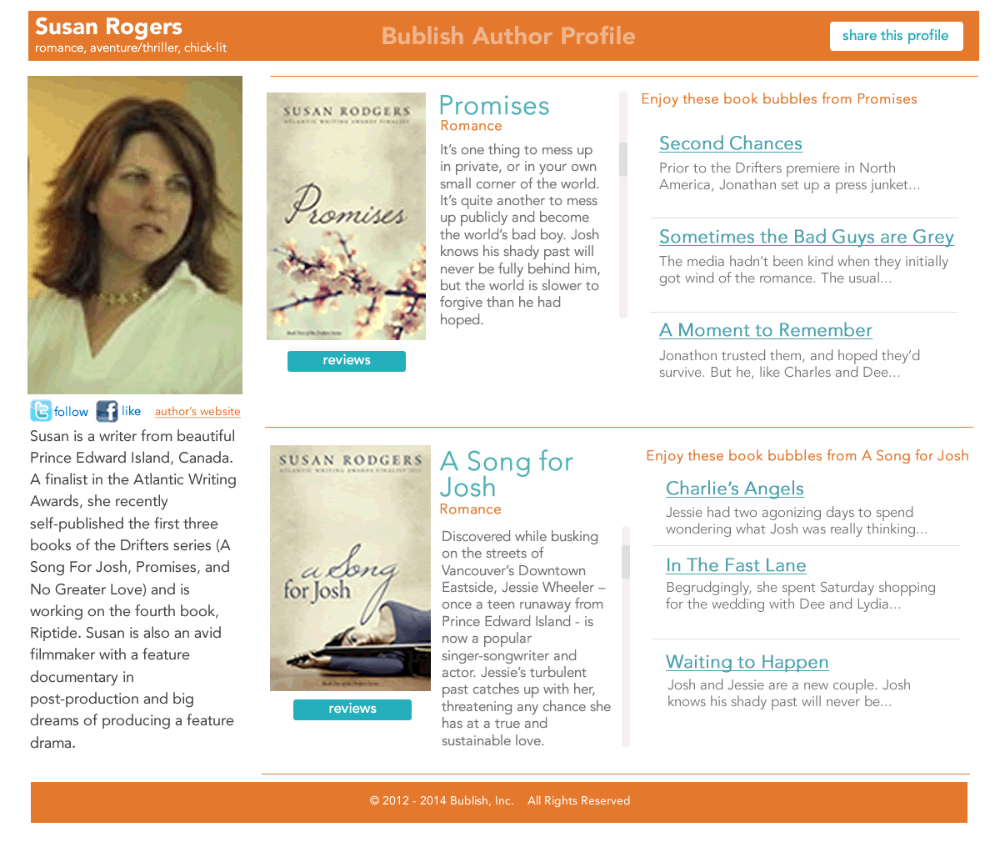

Slide 9
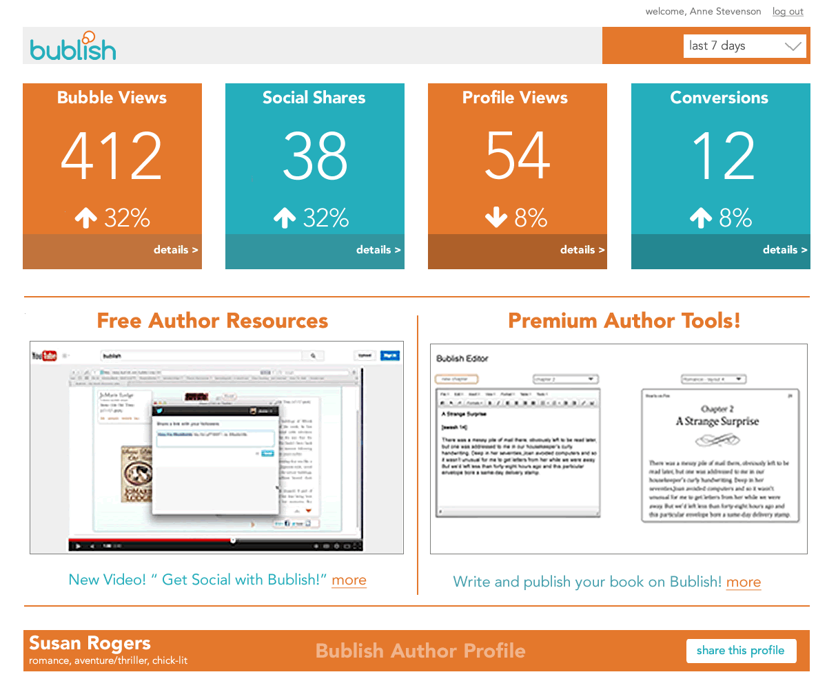

Slide 10
Bublish Weekly Events
How Bublish Supports Authors Each Week
Monday Bublish Floating Bookstore
(latest bubbles showcased across all our networks)
Tuesday Bubble of the Week – our editors choose
Wednesday Educational Blog (Promotion & Brand Building)
Thursday Author Twitter Chats like this: http://ow.ly/yjtzg
Saturday #SampleSaturday reader marathon
Sunday #SampleSunday reader marathon

Slide 11
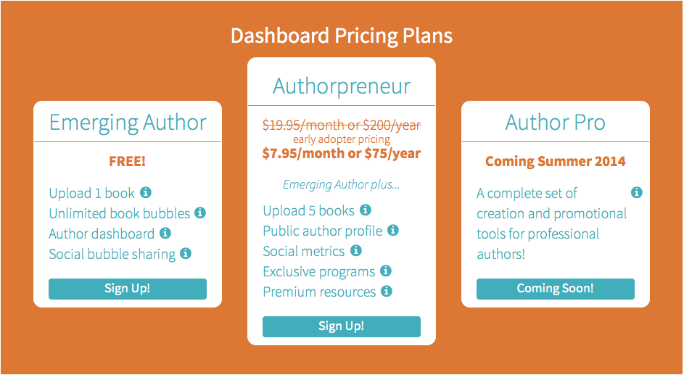
Bublish: Big Benefits/Affordable Price

Slide 12
Links to Bublish Tutorials
Intro to Bublish for Authors:
http://youtu.be/La_2ghNYBq8
Maximize Your Bublish Account:
http://youtu.be/9Ne9S7hpwng

Slide 13
Thank You!
www.bublish.com
contact:
kathy@bublish.com

Slide 14
Questions?
Type any questions in the chat feature here!

Slide 15

Thanks for joining us!
Have a great Saturday!

