Slide 1
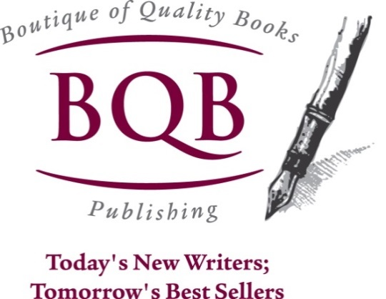
Author Training Call: Author Branding: What it Is and How to Do it.
Welcome!
Saturday, November 15, 2014
10:00 a.m. EDT

Slide 2
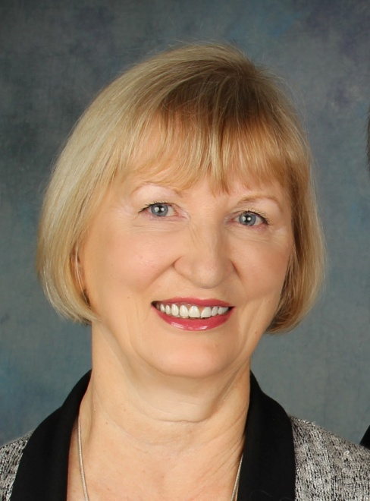
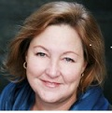
Presenters
Terri Leidich
President/VP of Sales & Marketing
BQB Publishing
Kathy Meis
Founder & CEO
Bublish

Slide 3
Overview
When we hear the names James Patterson, Jodi Piccoult, John Grissom, or Stephen King, we know exactly who they are and what they do.
That’s because they’ve created a strong author brand.
In today’s world, social media is the fastest and strongest way to build an author brand.
It’s not hard. There is a system and a method to create success.
Today, Kathy will explain the system and lead us through some of the steps.

Slide 4

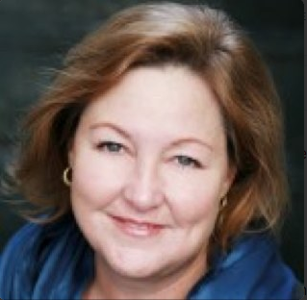
empowering authorpreneurs
Kathy Meis, founder Bublish, the award-winning social marketing platform for authors
20+ years in media & publishing industry
Professional editor, writer, ghostwriter
Founding partner of PubSmartCon in Charleston, SC
Speaks and blogs frequently about book marketing, publishing and author brand-building in the Digital Age
Contact kathy@bublish.com
www.bublish.com
@BublishMe

Slide 5
What We’ll Be Talking About Today
Basics of social book marketing
Setting yourself up for social marketing success
Gaining readers by building social proof
How a dynamic author brand can drive sales
Measuring your social marketing success

Slide 6
Three Pillars of Initial New Book Sales
2
Is the Book Idea Interesting Enough to Buy?
Conversion
1
Do I Know
the Book Exists?
Discovery
Availability
Buyer
Target
3
Is the Book Available to Buy Whenever, However I Want It?
Discovery + Conversion + Availability = New Book Sales
Attribution: Peter Hildick-Smith, The Codex Group
6

Slide 7

How to Research Your Target Audience
Genre-specific associations & bloggers
Social media groups -- talk to readers
Keywords – subgenres (Google trends)
Follow reviewers and influencers who target your audience
Content is king -- continually feed the beast and see what resonates (A/B test)
Cross promote with other authors – share findings

Slide 8


BE DISCIPLINED:
CREATE A CONTENT CALENDAR
AN AUTHOR WEBSITE IS
FOUNDATIONAL TO SUCCESS

Slide 9
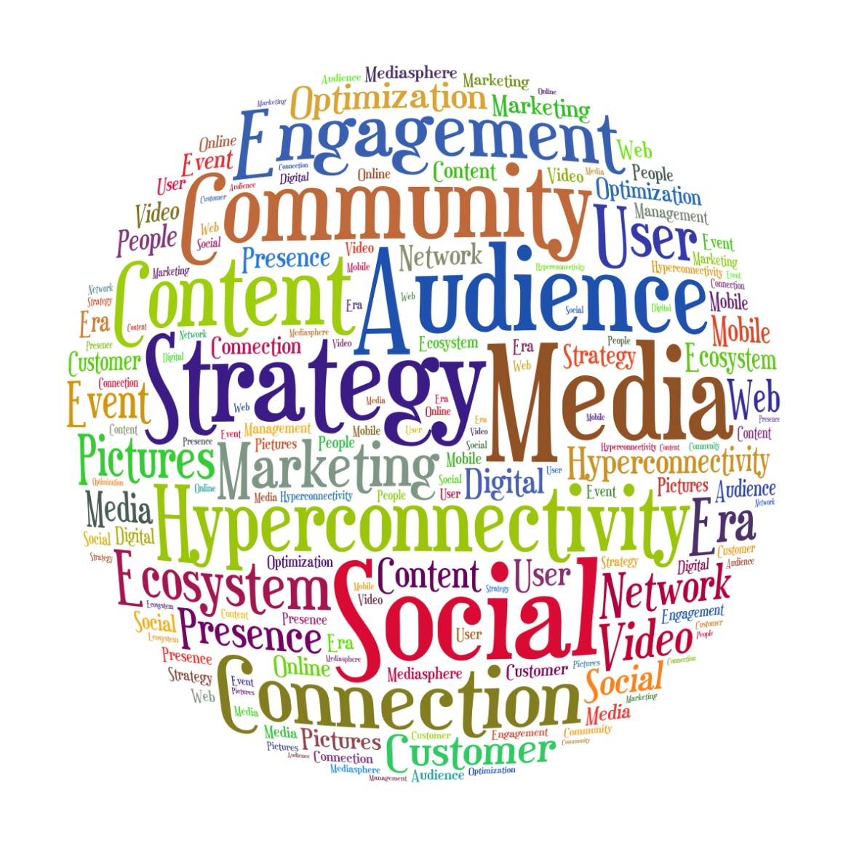
Getting Started With Social Marketing
Listen
Engage
Attract
Give Back
Grow Community

Slide 10

The Connection Economy
&
What Is It?
Why Does It Matter?
Who are you?
What do you do?
What are your interests?
What do you believe?
What is your WHY?
TRUST!
Email Capture
Audience Growth
Recommendations & Reviews
Purchase Decisions

Slide 11
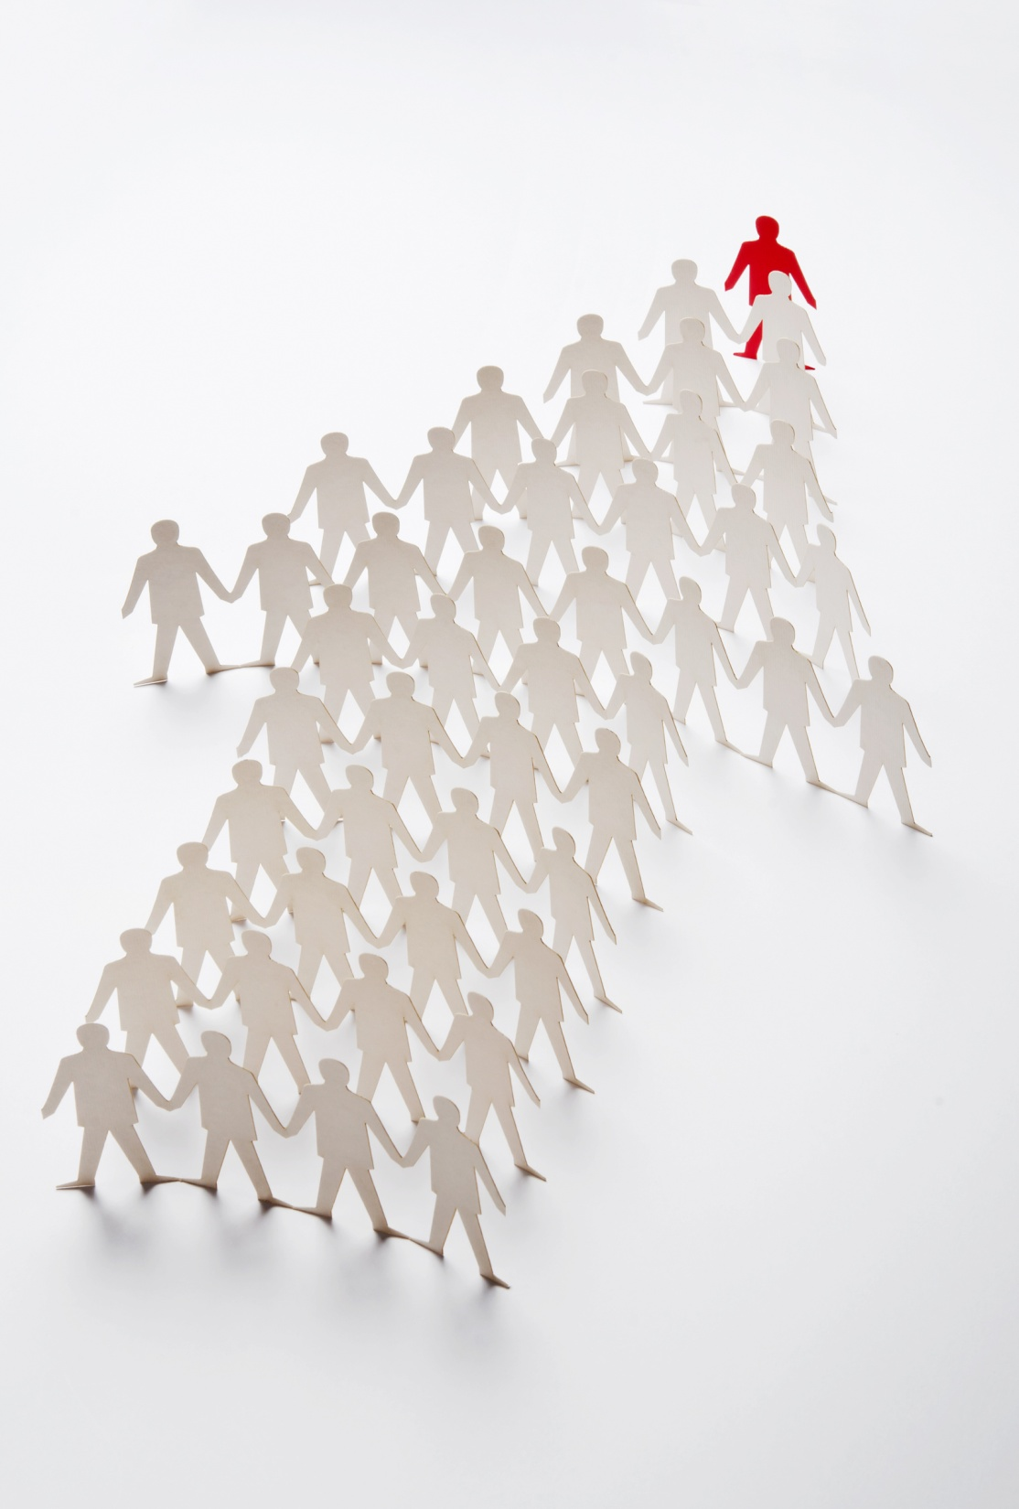
How to Build Social Proof
With Your Target Audience
Be authentic
Be relevant
Be memorable
Be present
Connect people
Connect information
Connect your stories
Connect the dots

Slide 12


Now You’re Ready To Build Your …
What You’ve Accomplished:
Interest
Trust
Community
Where You Need to Go:
Unique Identity
Reputation
Word of Mouth

Slide 13

Building Blocks of a Dynamic Author Brand
“Your Brand is your promise to your audience. It tells them what they can expect from you and your work, and it differentiates what you offer from that of your competitors. Your brand stems from who you are, how you want to be known and who people perceive you to be.”
http://www.yourwriterplatform.com/build-your-author-brand/

Slide 14

Brand Building Tips and Best Practices
A well written, edited and formatted book is your best marketing and brand building tool.
All types of media are part of your brand.
Marketing decisions should be made strategically.
Hard work is necessary to figure out why you write, what your promise is to readers, what differentiates your work and how to articulate it.
Measurement will help you learn what’s working.

Slide 15
empowering authorpreneurs
THANK YOU!
Take a 30-day FREE trial of Bublish:
www.bublish.com

Slide 16
Questions?
Type any questions in the chat feature here!

Slide 17

Thanks for joining us!
Have a great Saturday!

