Slide 1
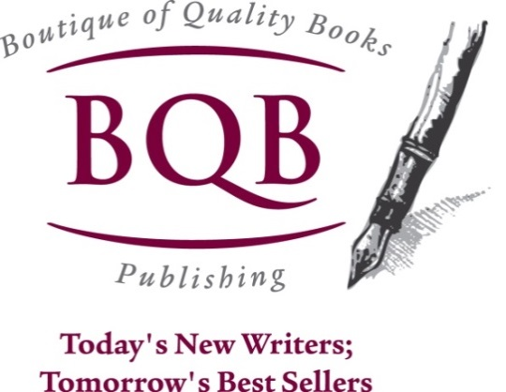
Author Training Call: Book Clubs & Library Reading Groups – Great Marketing Resources
Welcome!
Saturday, April 25, 2015
10:00 a.m. EST

Slide 2
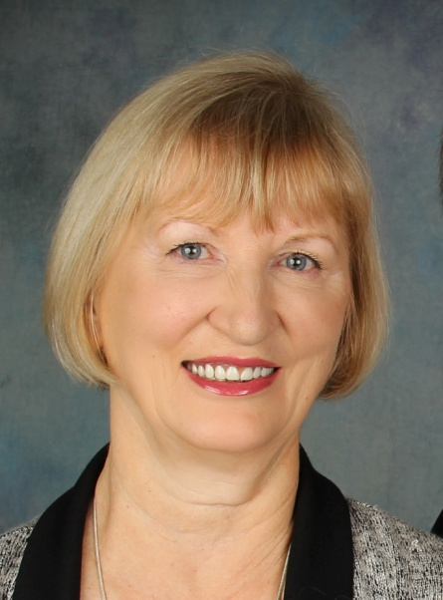
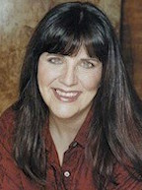
Presenters
Terri Leidich Shari Stauch
President/Publisher CEO/Founder: Where Writers Win
BQB Publishing/WriteLife Publishing Co-Founder: PubSense Writer’s Conference

Slide 3
Overview
Book Clubs and Library Reading Groups are great ways to get your books into the hands of readers.
In today’s publishing environment, connecting with readers is paramount to success and book clubs and reading groups are a great way to do that.
Word-of-mouth is one of the strongest tools we as authors have, and book clubs and reading groups can start word-of-mouth churning.

Slide 4
Finding Library Reading Groups
Connect with your local libraries to find out about their reading groups, what genres they read, and, if appropriate to the genres they read, how you can get your book considered.
Join www.writerswin.com (Use code BQB20 to get $20 off of membership) (free peek: http://bit.ly/1yMFQxU)
Do an Internet search for library reading groups in your area.
Find the person in charge, find out about their reading groups, and connect.
Use resource databases like www.authorsresourcelist.com to find libraries close to you or in areas to which you travel.
Connect with the library to find out if they sponsor reading groups, the genres they read, and how you can get your book considered (if appropriate to the genres they read).
Library reading groups read books from all genres: fiction, nonfiction, children’s, young adult, business books, self-help books, etc.
Find the groups that are best suited for your book and then pitch you and your book to them (more information on pitching in the book club section that follows).

Slide 5
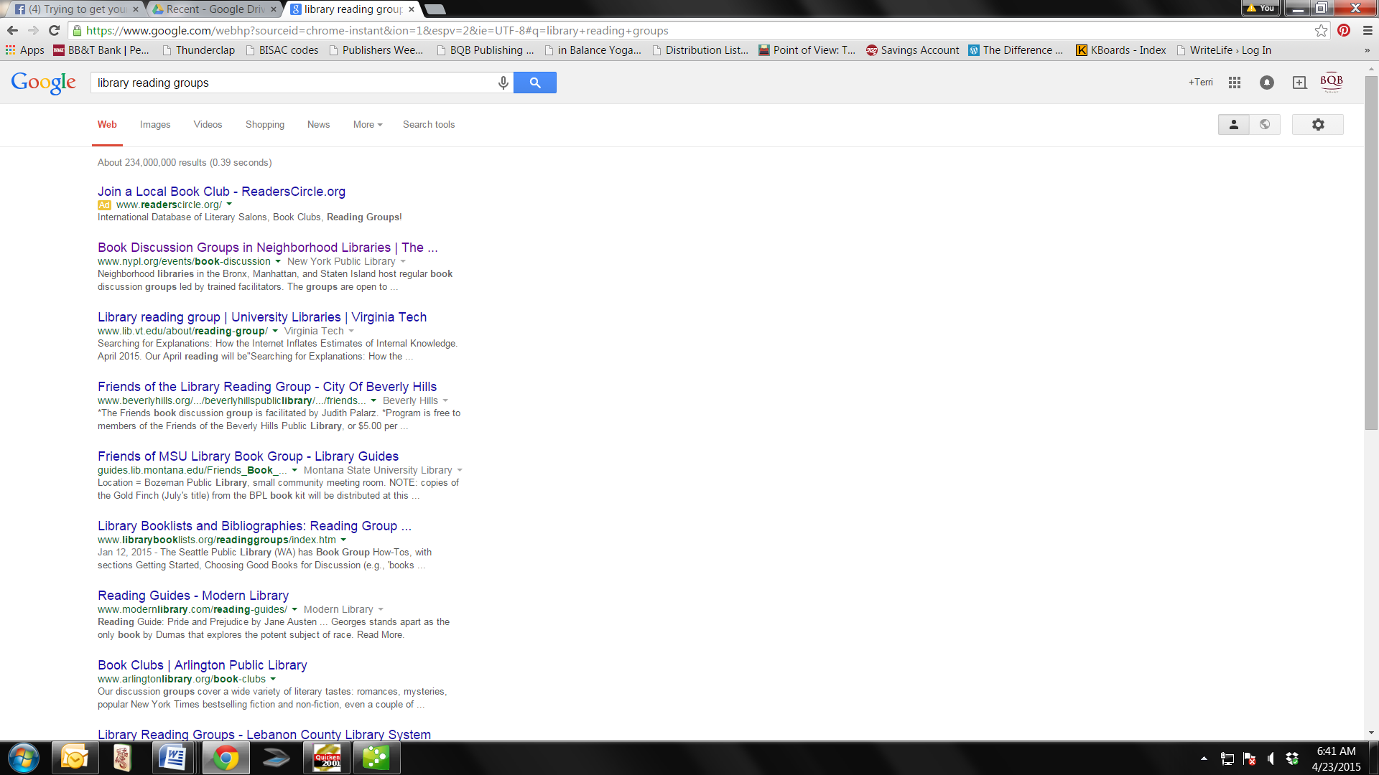

Slide 6
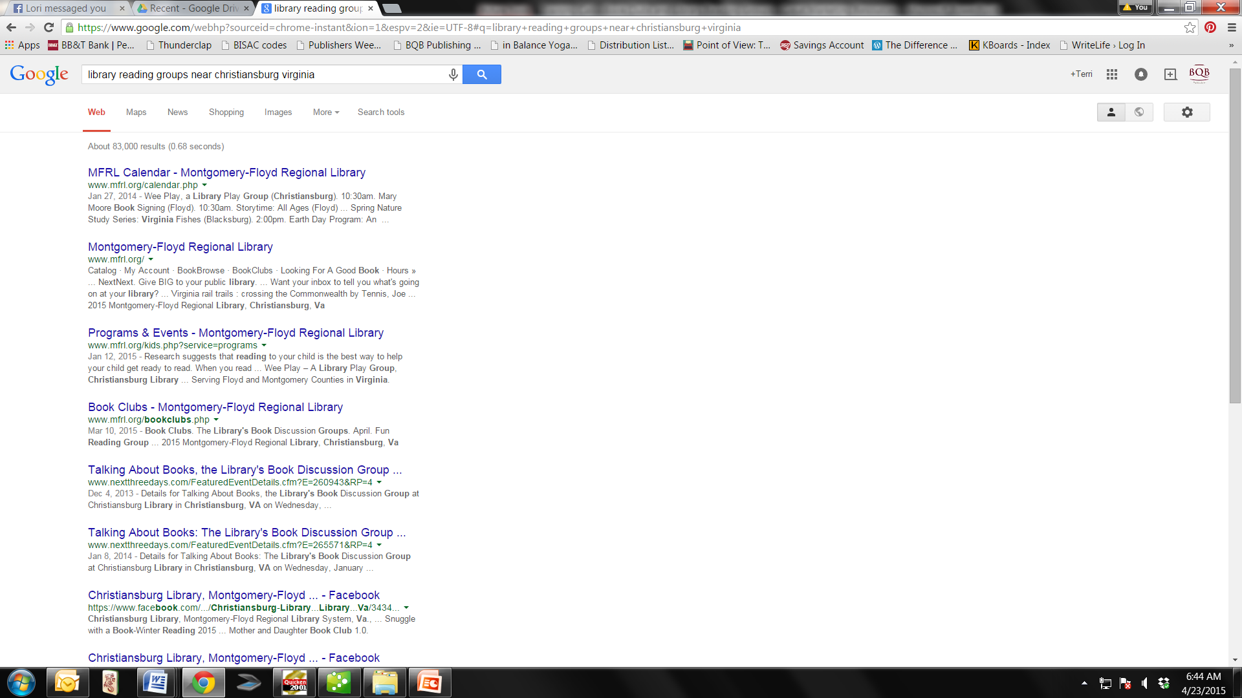

Slide 7
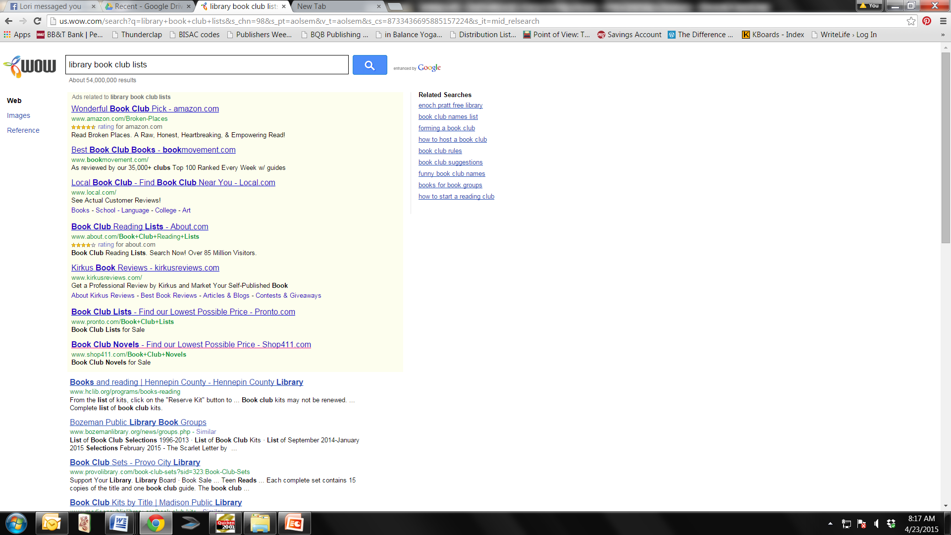

Slide 8
Reaching
These All Important
Super Fans!
How and Why Book Clubs Matter

Slide 9

Why Are Book Clubs Important?
Direct connection with readers
Word-of-mouth advertising
Book club reads shared more often
Readers tend to buy books vs. borrow
Once an author has impacted a club with one book, they’ll tend to read all your work
www.WritersWin.com
Notes:
You’ll be working closely together, so establish the ground rules – what are you each looking for and how can you help each other achieve that?
Editors have the toughest job on the planet – help THEM help YOU!
What to expect first go-around…
Take the lessons you’ve learned to make for a smoother “next time” – be better prepared – know if you have to “explain it” you didn’t communicate it – trust the process ☺

Slide 10
Why Are Book Clubs Important?
Recommended Reading:
https://litreactor.com/columns/reading-with-purpose-four-reasons-every-writer-should-join-a-book-club
http://www.ibpa-online.org/article/book-clubs-part-1-the-benefits/
www.WritersWin.com

Slide 11
Where to Find Book Clubs
Virtual (a la Goodreads.com, Shelfari.com)
Meetups (must join group to be involved)
Bookstores
Where Writers Win’s Winner Circle (www.writerswin.com Use code BQB20 to get $20 off of membership)
Alternative Options (book dependent)
www.WritersWin.com
Notes:
Start local and “ripple out” for best results!
Alternative options can be anything from a garden club to a dog pound, dependent on your genre and subject matter!

Slide 12
How to Pitch Book Clubs
Begin developing connections EARLY
Put a list of Book Club Qs on your website
Make sure the club reads your genre
Be kind and willing to visit
Pitch template available in the “Templates & Tutorials” section of the Winner Circle
www.WritersWin.com
Notes:
Develop a list of book club questions and put it in a PROMINENT place on your website; this is a great subliminal message, too – as in “Oh, book clubs are reading this…” or “This is a book club read…”

Slide 13
How to Pitch Book Clubs
Recommended Reading:
http://www.pubsensesummit.com/how-to-get-your-novel-in-the-hands-of-book-clubs/
http://janefriedman.com/2012/11/13/sell-more-fiction-by-activating-the-power-of-book-clubs/
www.WritersWin.com

Slide 14

BQB/WriteLife Authors!
Join our Winner Circle with promo code BQB20 for $20 off; with access to, book clubs, vetted reviewers and more!
10% off any WWW service, too…
Visit writerswin.com to sign up for free consult, too!
Notes:
BQB authors get special pricing from us!

Slide 15
Questions?
Type any questions in the chat feature here!

Slide 16
Next Month’s Training Call
Saturday, May 16th at 10:00 a.m. EST
With Nancy Baumann of Bookarma
Title: How Karma and Cooperation Create Successful Authors
Description: Over a million books are published each year, and getting yours discovered is a continual effort. Learn how you, Karma, and Cooperation amongst authors can send your books around the world and into the hands of new readers.

Slide 17

Thanks for joining us!
Have a great Saturday!

