Slide 1

Author Training Call Our Two Imprints – Where They’ll Be Separate and Where They’ll Merge
Welcome!
Saturday, October 25, 2014
10:00 a.m. EST

Slide 2
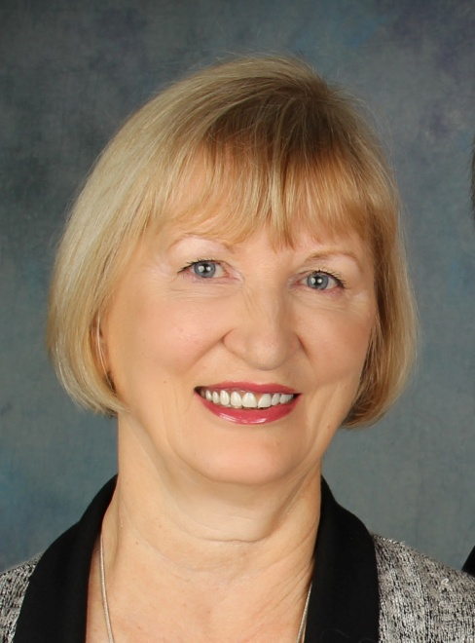

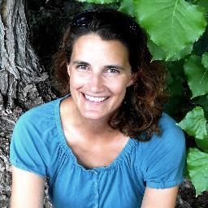
Presenters
Terri Leidich
President/VP of Sales & Marketing
BQB Publishing
John Daly
Author of From a Dead Sleep
BQB/WriteLife Social Media Manager
Holly Collingwood
Blogger for the BQB/WriteLife Blog

Slide 3
Agenda
What Does it Mean to Have Two Imprints?
What are the differences in the imprints?
Where will the imprints be separate?
Where will they merge?
Can an author have a book under each imprint?
How social media can help promote both of our imprints and how you can participate.
Two imprints – one blogger.

Slide 4
What Does it Mean to Have Two Imprints and What are the Differences?
One Company – Two Divisions
Offering products that are similar but in different categories and for different markets
BQB will be our genre fiction imprint
WriteLife will be our literary fiction/nonfiction imprint

Slide 5
Where Will They Be Separate?
Separate company websites
Separate accounts with our eBook distributor
Separate marketing
Separate accounting

Slide 6
Where Will They Merge?
They will be together at our print distributor under the Boutique of Quality Books Publishing umbrella
eNewsletters
Social Media
Blogging
NetGalley

Slide 7
Can an Author Have a Book Under Each Imprint?
Yes. As we move forward, we’ll be shifting our current books so the nonfiction are under WriteLife and the fiction under BQB.
We’ll keep some of the fiction that is currently with WriteLife there for now.
But, if you write both fiction and nonfiction, as we move forward, they will be under separate imprints.

Slide 8
Online Promotion of Your Books
- Websites/Online Stores
- BQBpublishing.com
- WriteLife.com
- Social Media Accounts
- BQB Publishing
- https://www.facebook.com/BQBPublishing
- https://twitter.com/bqbpublishing
- http://www.pinterest.com/bqbbooks/
- WriteLife
- https://www.facebook.com/WriteLife
- https://twitter.com/WriteLifeLLC
- http://www.pinterest.com/writelife/
- Blog
- Email Newsletters
- Online Press Releases

Slide 9
Where our imprints are separate
Websites – Each website features information on our books and authors. This includes synopses, bios, reviews, sneak previews, an online store for purchasing, and more.
The WriteLife.com website has been totally redone, so if your personal websites are referencing URLs from the old WriteLife website, you’ll want to change that.
Social Media Accounts – Social media accounts for both BQB and WriteLife are updated regularly to promote books from both brands, and engage fans/followers.

Slide 10
Where our imprints merge
Social Media Sharing – BQB social media accounts share WriteLife posts, and vice versa. We also share/retweet the posts from our authors across imprint lines.
Blog – Boutique of Quality Books has a single blog that is accessible from both websites. Books from both imprints are referenced in the blog: http://bqbpublishing.wordpress.com/
Email Newsletters – Boutique of Quality Books’ newsletter includes book/author information on both imprints.

Slide 11
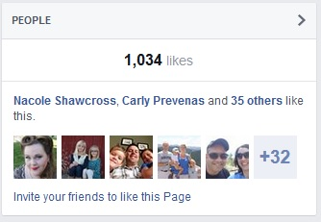
How you can help yourself through our social media accounts
As our Social Media Manager, I follow YOUR social media accounts through OUR social media accounts. The more you post, the more he’ll share what you post through our accounts, gaining you additional exposure.
Don’t be shy about sharing posts from your fellow BQB/WriteLife authors. They’ll most certainly return the favor.
Refer your friends to our Facebook
pages using the “invite” option.
It helps everyone gain exposure.

Slide 12
Community/Contact Info
Boutique of Quality Books has a hidden Facebook group that authors and BQB employees use to share ideas and ask for assistance. Just request to join it, and I’ll let you in: https://www.facebook.com/groups/662300037139762/
You can contact me at: johndalybooks@hotmail.com

Slide 13
About a Blog
Purpose – provide interesting content that encourages readers to return on a regular basis for education or entertainment.
Purpose of BQB/WriteLife Blog:
all about books
connect with readers
different genres
ultimate goal: increase interest in your books so readers buy them

Slide 14
How to Participate
Read the blog
Comment
Share the blog: social media channels, networking and writing groups, family, friends, readers
Participate in future blogs

Slide 15
Your assignment
Halloween Week Challenge: Books that keep us up at night (any genre)
Example:
Holly Collingwood (link to your author page): Gone Girl by Gillian Flynn
This book kept me up reading late because I couldn’t figure out who the biggest villain was. At first I was rooting for one character, and then for the next, and then by the end my brain was so frazzled I just had to keep reading to see if any of the characters would be able to untwist their complicated relationships.

Slide 16
Contact Info
Thank you and if you have blog ideas or topics for the future, I’m always interested in new ideas.
Holly Collingwood – Collingwood Writing Services
collingwoodwriting@gmail.com
970-449-9479

Slide 17
Questions?
Type any questions in the chat feature here!

Slide 18

Thanks for joining us!
Have a great Saturday!

