Slide 1

Author Training Call:
The Latest & Greatest in Book Marketing
Welcome!
Saturday, January 17, 2015
10:00 a.m. EST

Slide 2
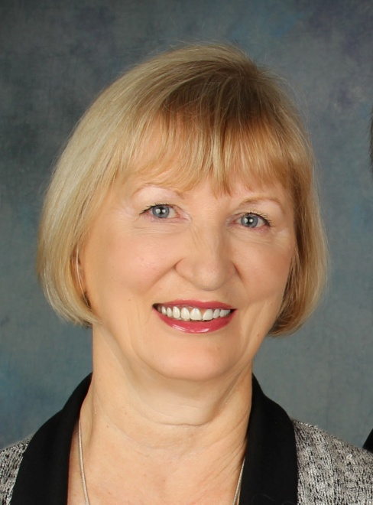
Presenter
Terri Leidich
President/VP of Sales & Marketing
BQB/WriteLife Publishing

Slide 3
Overview
In today’s electronic world, our options for marketing our books is constantly changing.
Different marketing methods work for different authors.
It’s important to stay on top of what’s available.
You may be aware of some of the options we’ll talk about today, they might be brand new to you.
Some may have costs associated with them, some won’t.
I’m consistently looking for marketing tools and help. Some I’ve tried as an author, some I haven’t yet.

Slide 4
Overview
Bublish http://www.bublish.com
Authors’ Resource List http://www.authorsresourcelist.com
DoSplash http://www.dosplash.com
Net Galley http://www.netgalley.com
Noise Trade http://books.noisetrade.com
Book Buzzr http://www.bookbuzzr.com
Freado http://www.freado.com

Slide 5
Bublish
http://www.bublish.com
Many of you already know about and are using Bublish.
One of my favorite marketing tools as it allows authors to tell the “back stories” behind their books.
Costs run from free for one book up to $9.95 a month or $95 a year if you have more than one book or want the updated features.
Offers a conversion option so viewers can buy your eBook.
Bublish has a strong marketing program to help promote book bubbles, books, and authors.
The following slides are from my personal Bublish page.
BQB has a power point presentation of how to use Bublish. (Email me if you want it sent to you.)

Slide 6
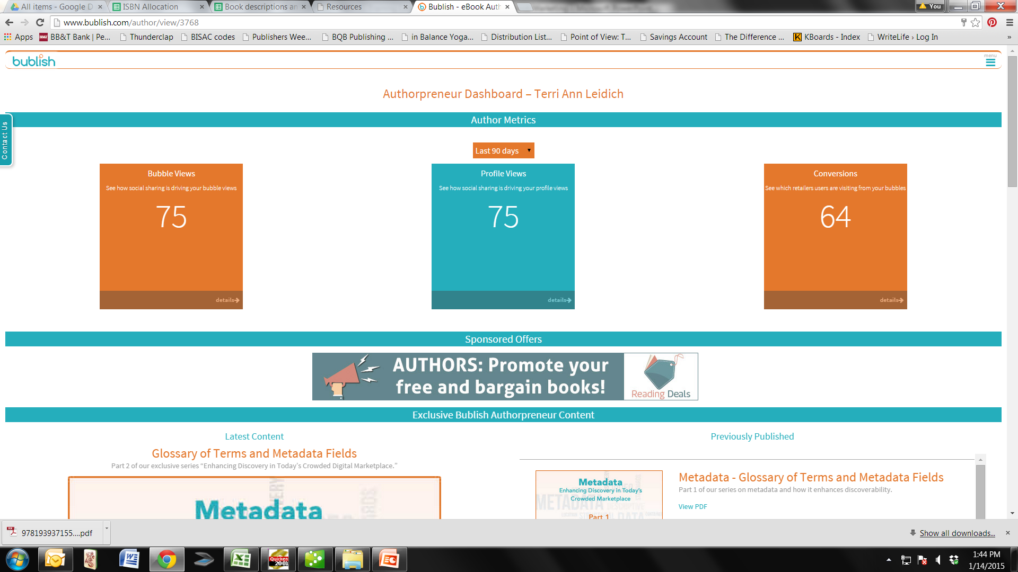

Slide 7
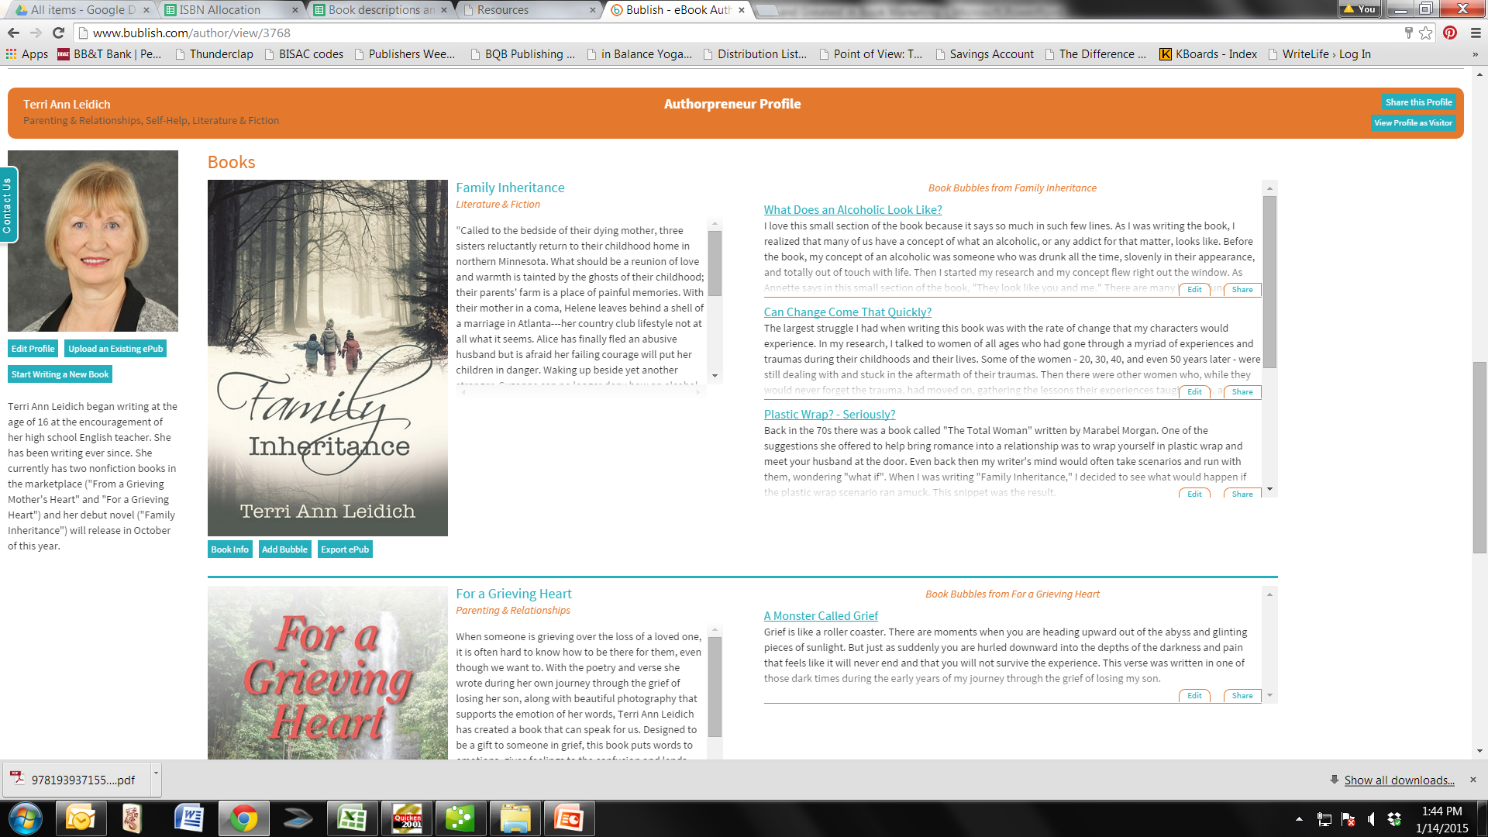

Slide 8
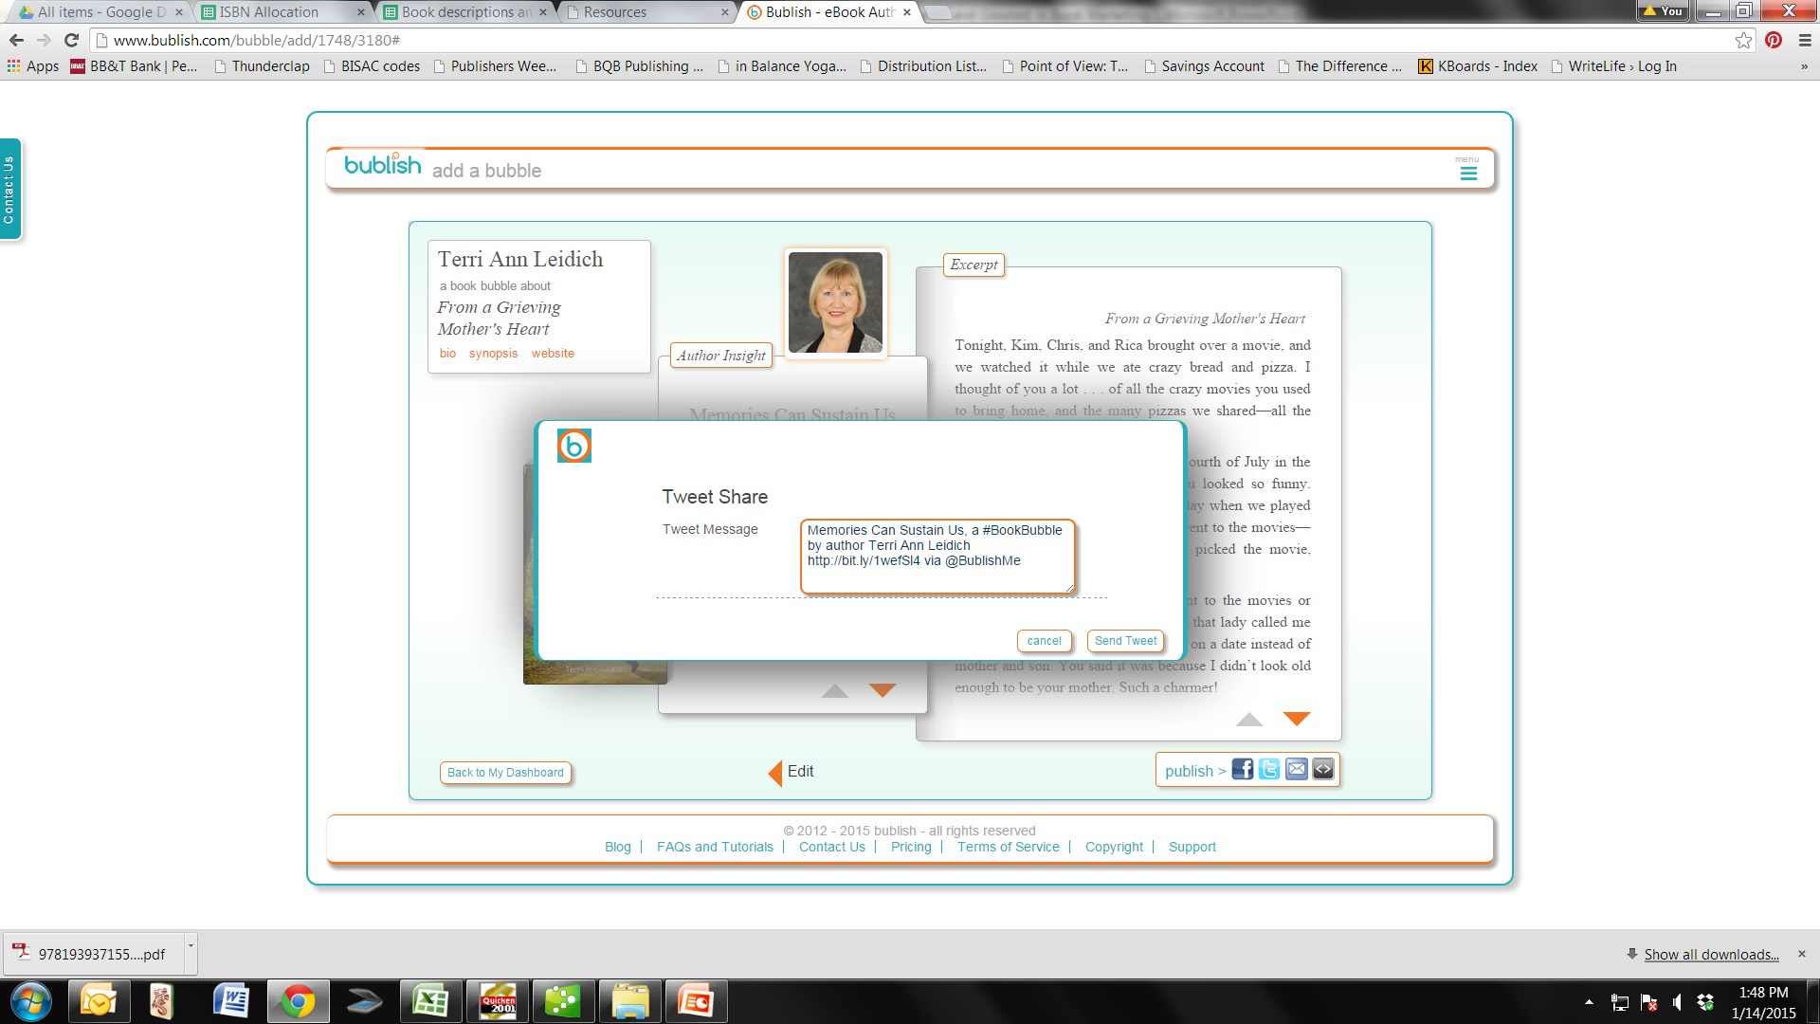

Slide 9
Authors’ Resource List
http://www.authorsresourcelist.com
The site offers a database of information and resources that authors need, (i.e. bookstores, reviewers, book festivals, etc.)
Author members can add comments or new resources as well.
Yearly membership is $45.
BQB & WriteLife Authors can use the discount code of: ARL-17159 for a reduced membership of $25 a year.
These are pages from my personal portal.

Slide 10
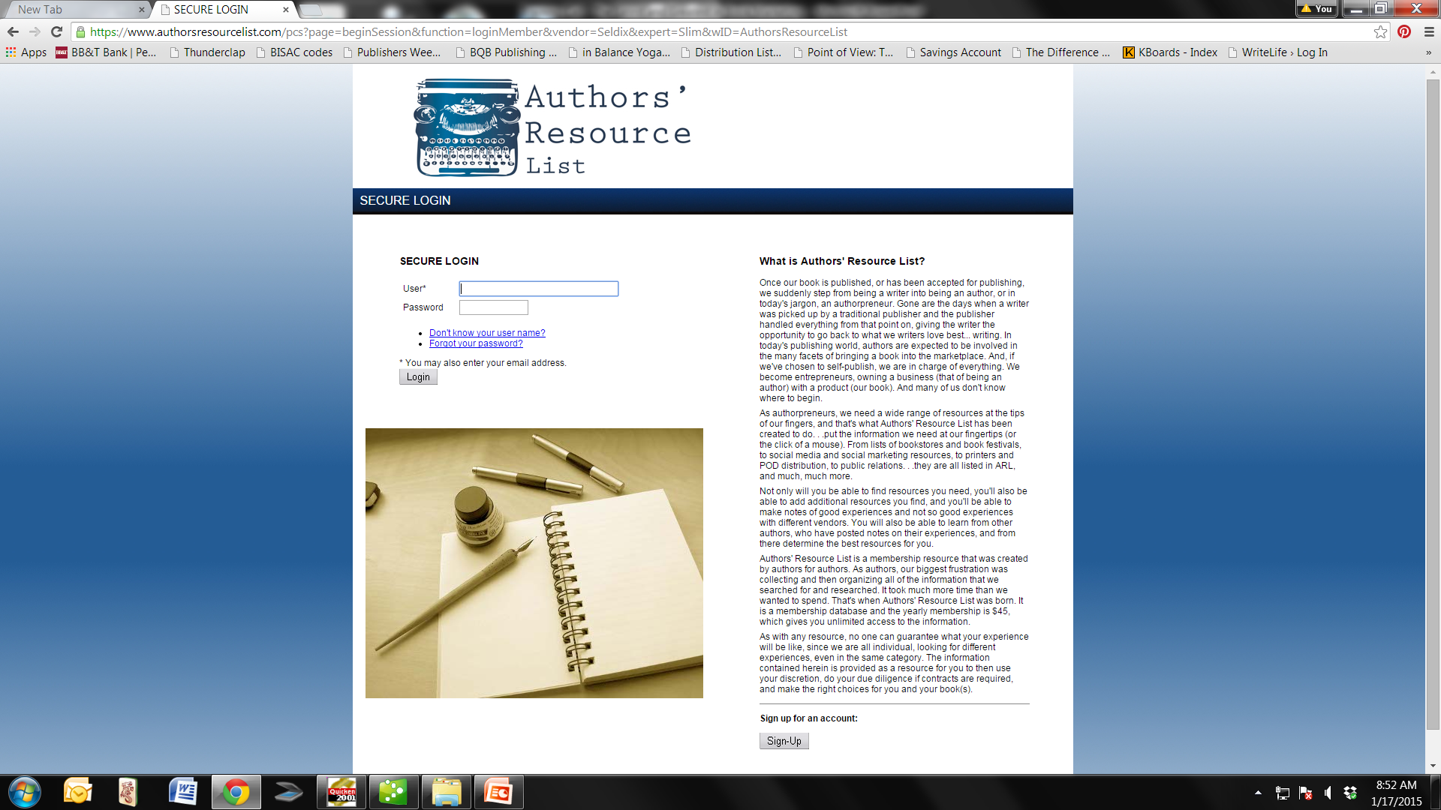

Slide 11
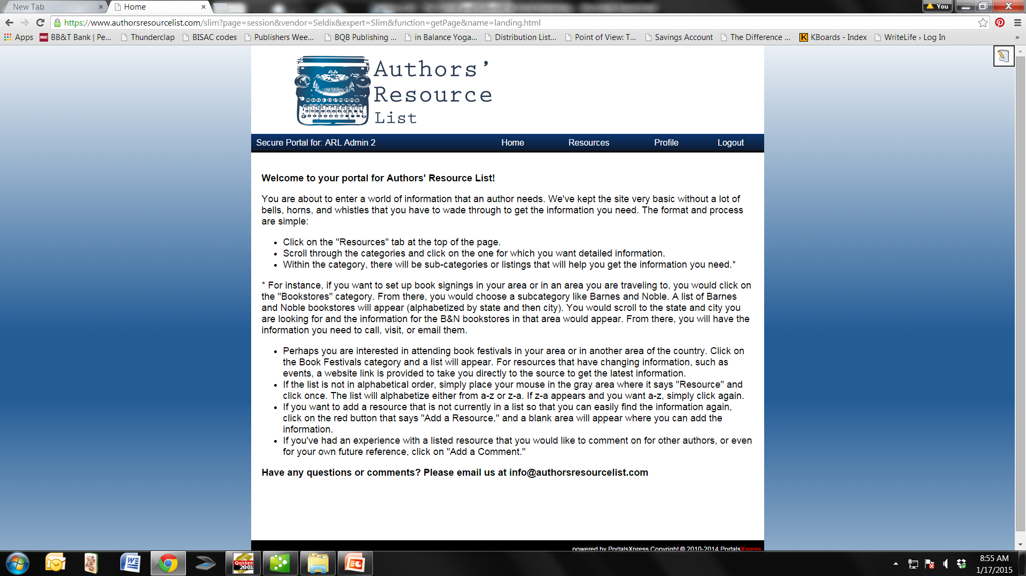

Slide 12
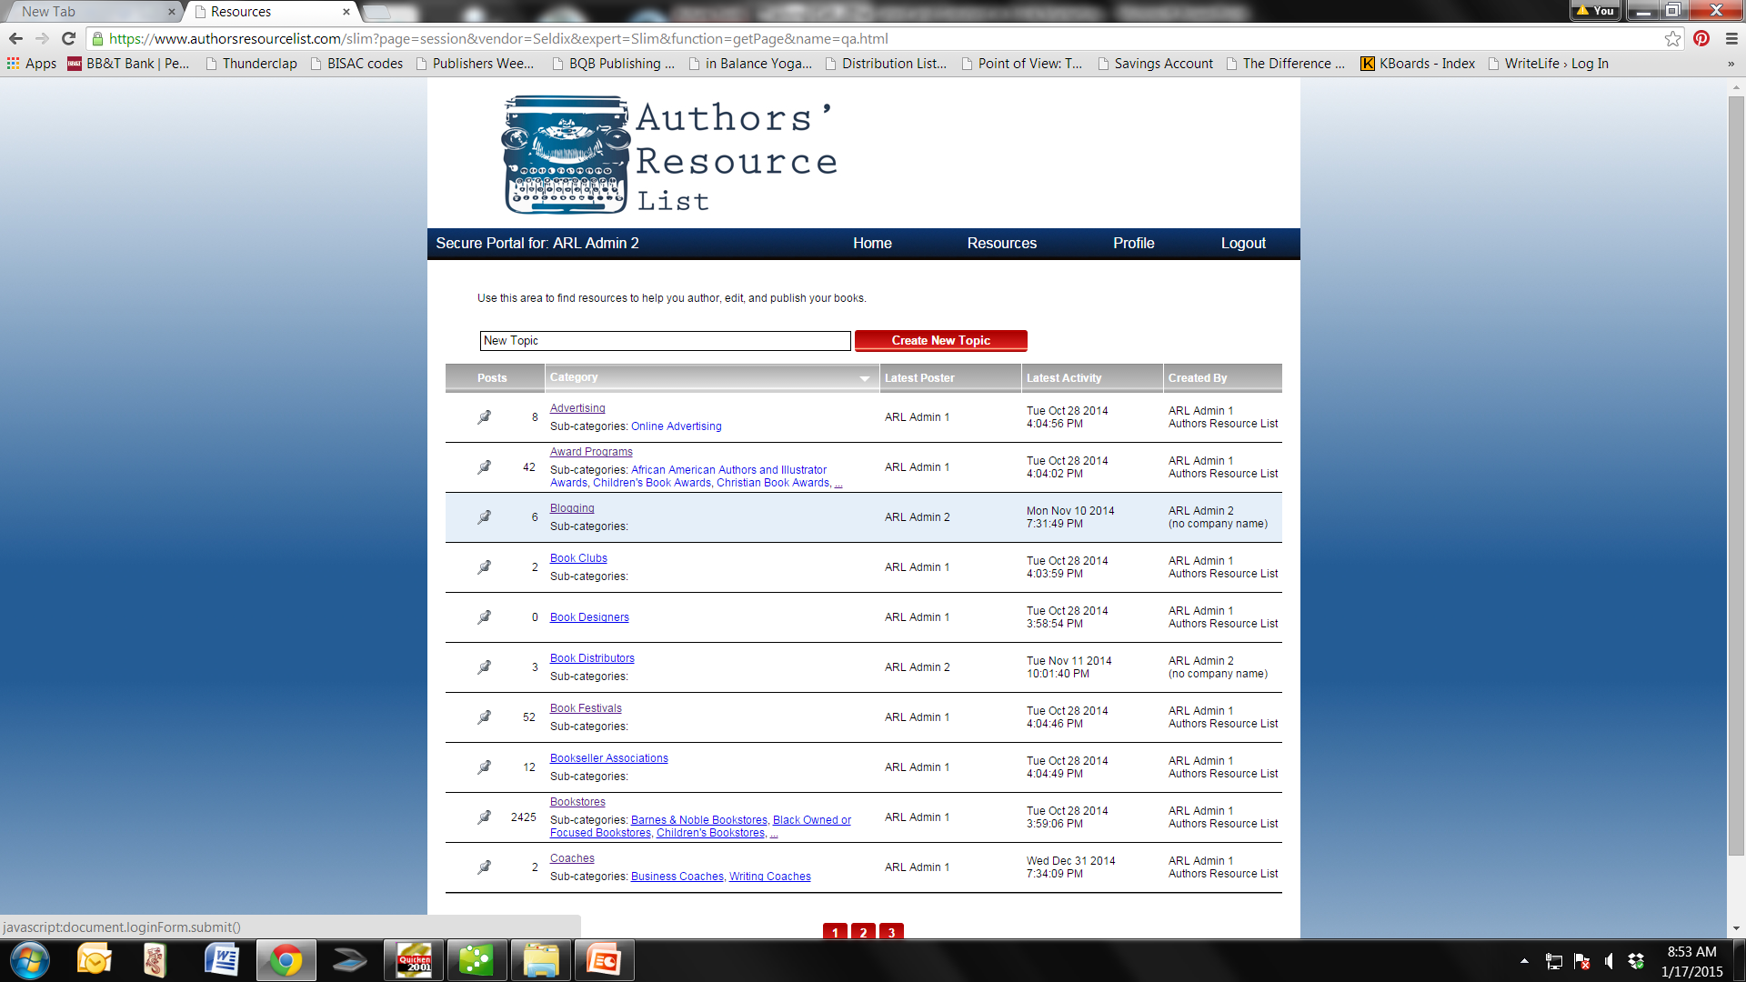

Slide 13
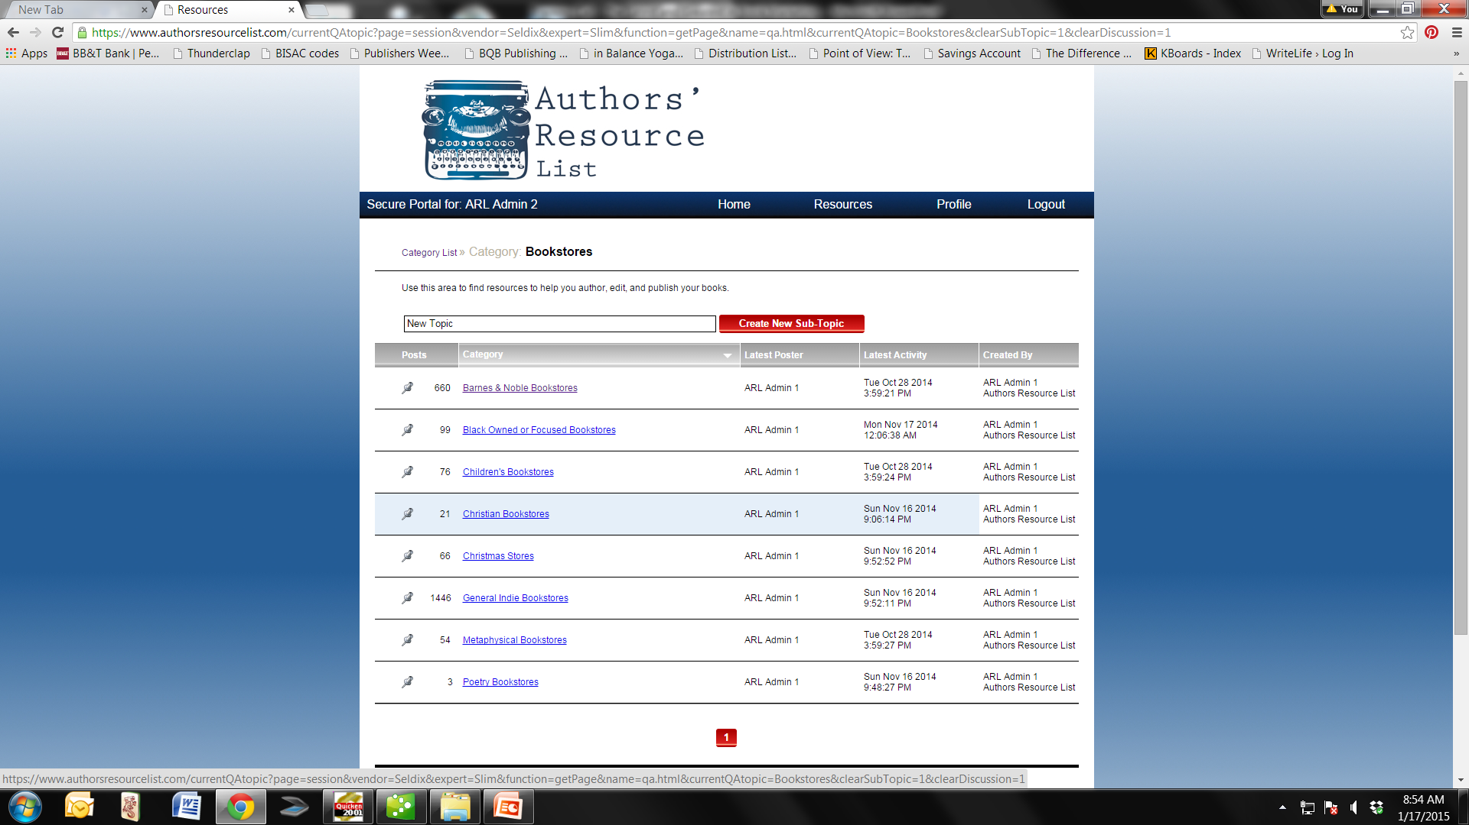

Slide 14
DoSplash
http://www.dosplash.com
A social media site where you can share your blog posts or other interesting information you find to a like-minded community.
Different Categories
  Love & Relationships
  Health & Wellness
  Technology
  Personal Development
  Business
  Internet Marketing
Costs are from free to $10 month depending on the features you want.
A good resource for those of you who blog often and whose books and blogs fall under the offered categories, i.e. Business, Health & Wellness, or Personal Development.

Slide 15
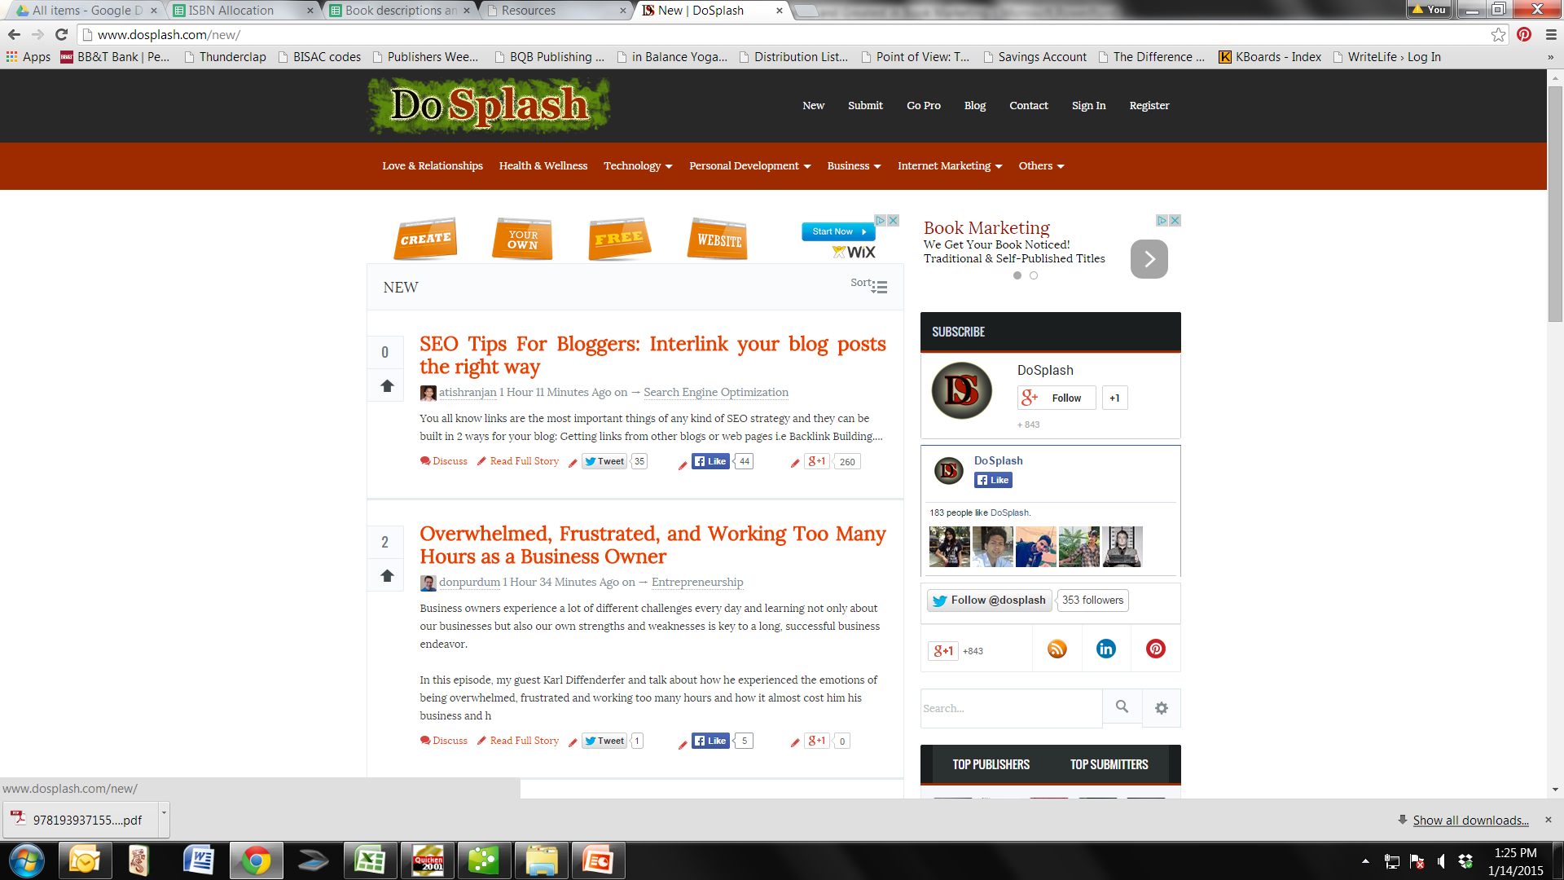

Slide 16
Net Galley
http://www.netgalley.com
A membership site for over 200,000 reviewers, librarians, booksellers, and media professionals.
Booksellers, librarians, reviewers, educators and media professionals browse books by category or favorite publishers to request books to review.
This site does vet their members. To be a reviewer, you must have a blog, write for a publication, etc. or be a bookseller, librarian, educator, or media professional.
Net Galley provides download lists of people who have downloaded your book for possible review.
Reviews, when given, will appear on various sources: Amazon, Goodreads, in a blog, on a website, in a publication, etc.
It’s all digital. Net Galley supports all reading devices and platforms.

Slide 17
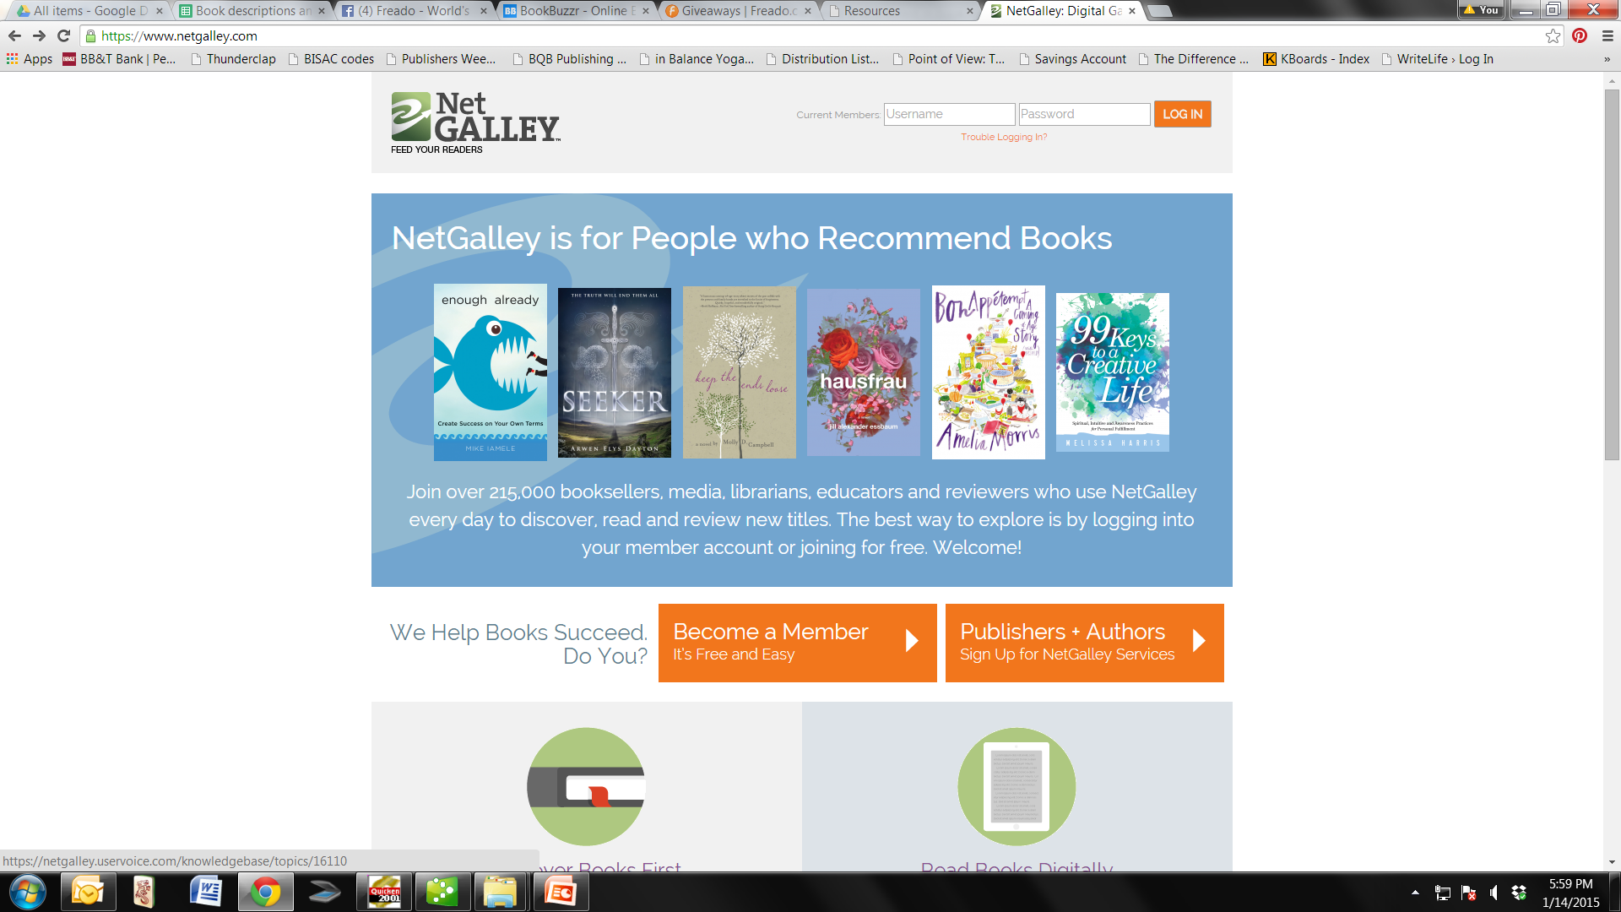

Slide 18
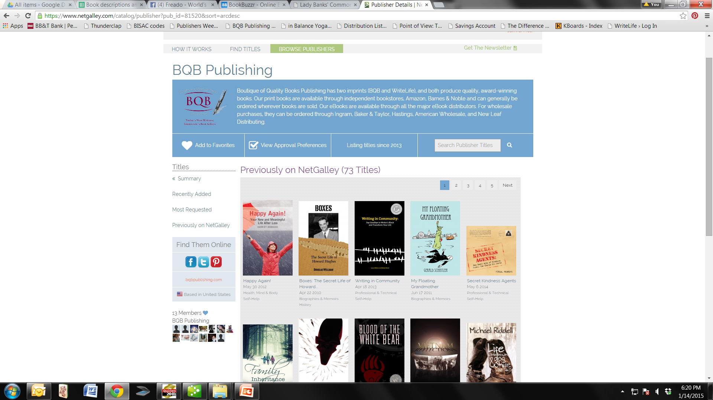

Slide 19
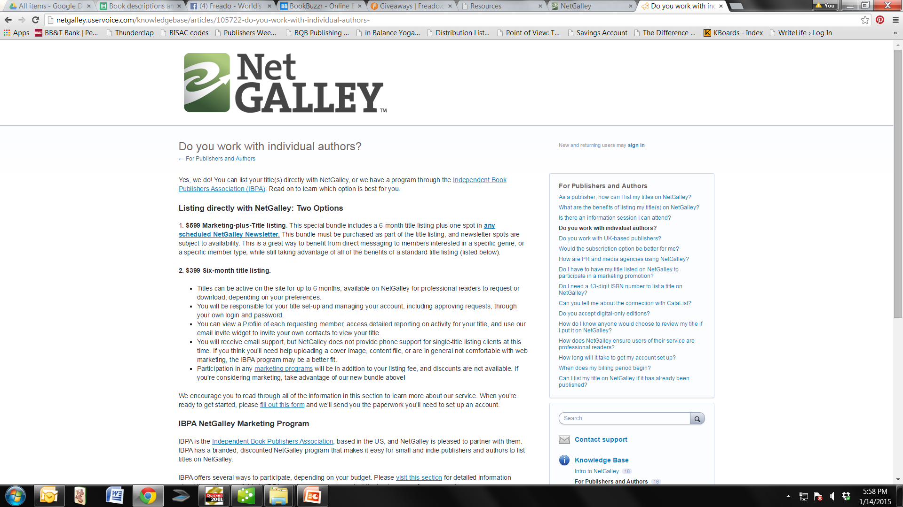

Slide 20
Noise Trade
http://books.noisetrade.com/
NoiseTrade Books helps authors & publishers meaningfully connect with readers through the exchange of free ebooks & audiobooks for email addresses & postal codes.
This information can be good for connecting with book clubs, book buyers, reviewers, along with readers.
Build your audience by giving away full-length ebooks, audiobooks, sample chapters, study guides, or episodic books and graphic novels.
Join the NoiseTrade Books community and find new readers among NoiseTrade’s massive audience who are eager to discover their new favorite author.
Lead with great content, not smoke & mirrors. There’s no better way to build your tribe than by letting your writing speak for itself.

Slide 21
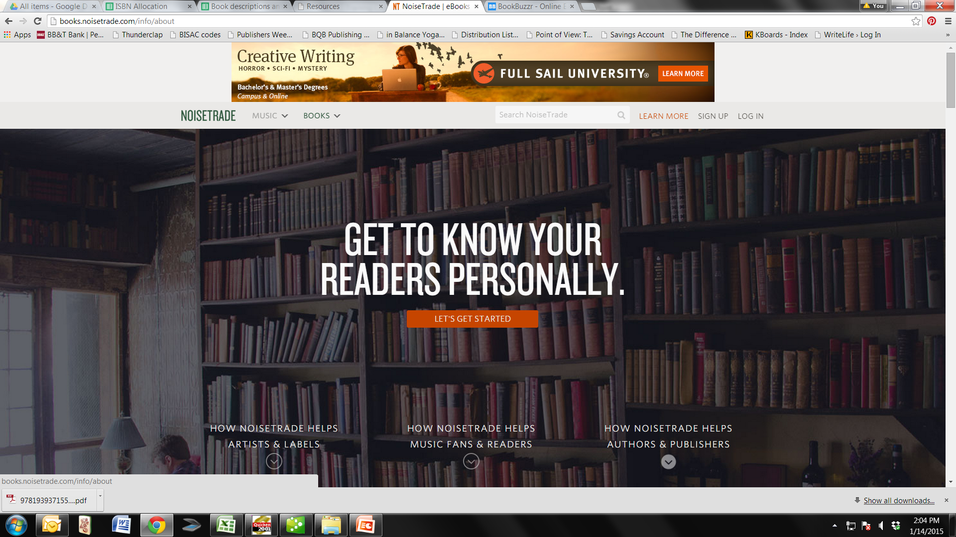

Slide 22
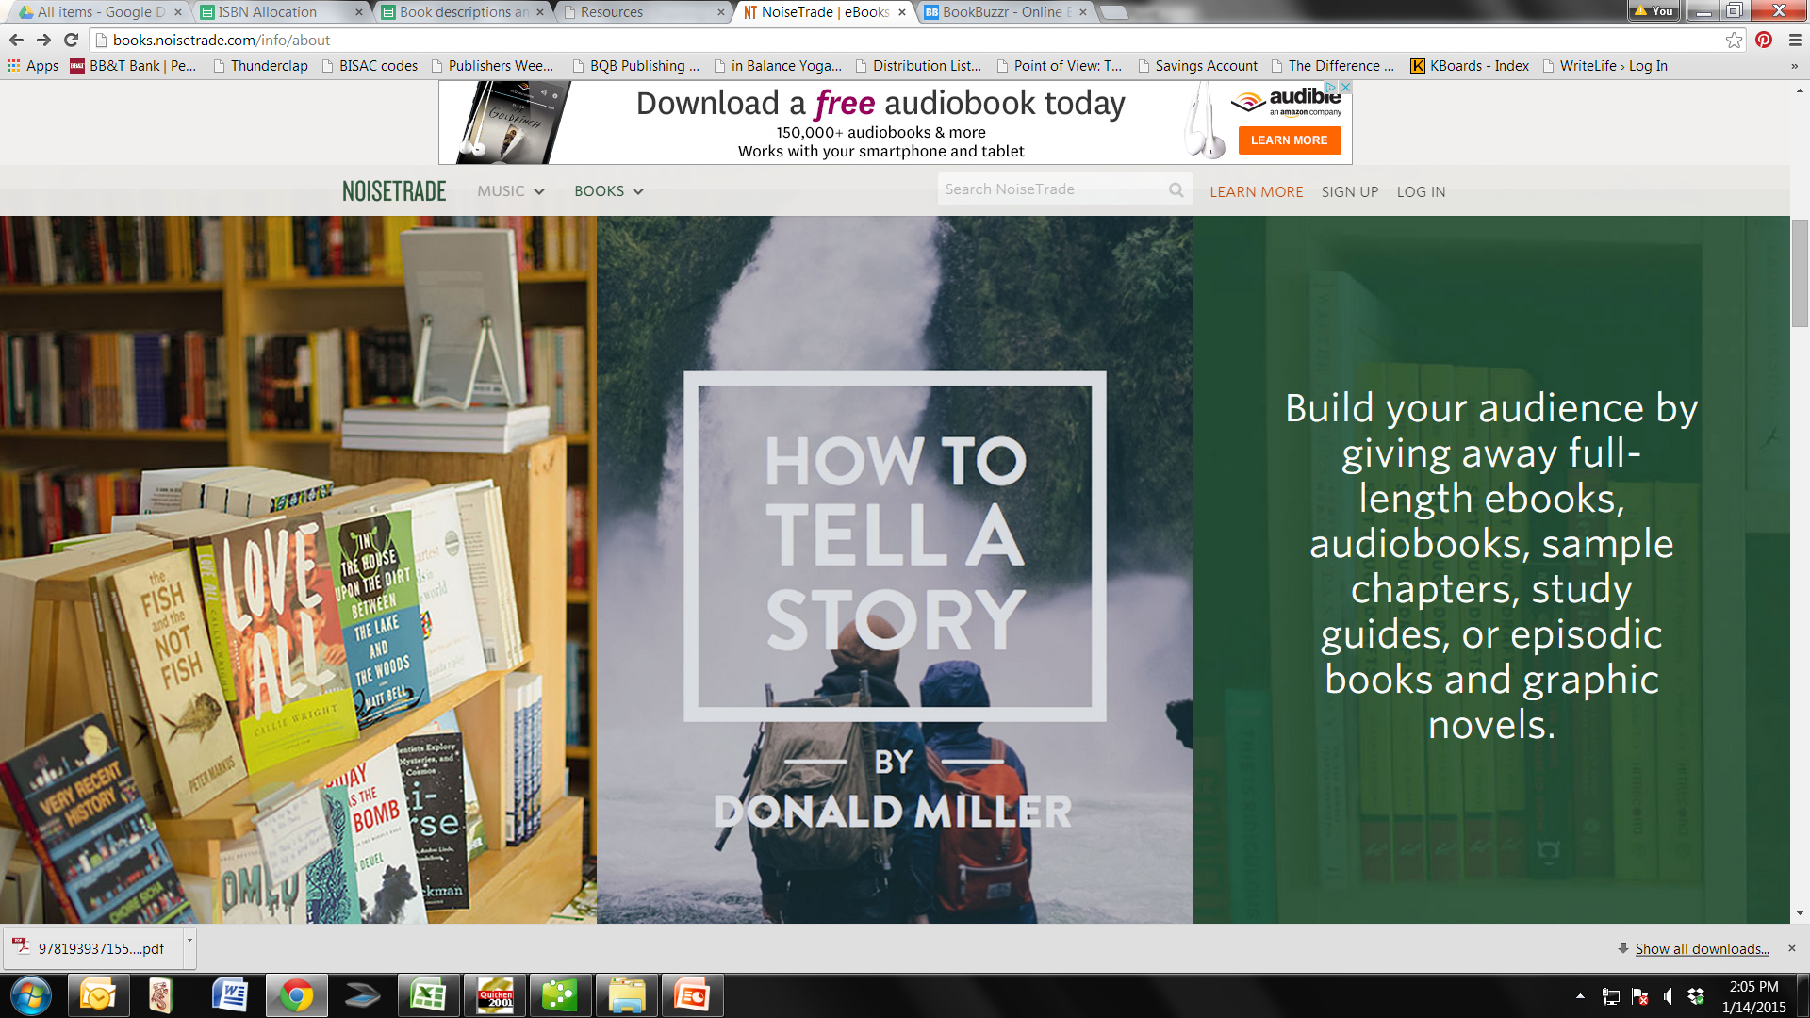

Slide 23
Book Buzzr
http://www.bookbuzzr.com
Online site that offers support in marketing your book through social media
Helps create widgets like the Flip Book widget that allows readers to read sample pages and then provides a link to where they can buy your book.
The widgets can be attached to your emails, social media, on your website, etc.
Prices range from free to $29.99 per month depending on the features you want.

Slide 24
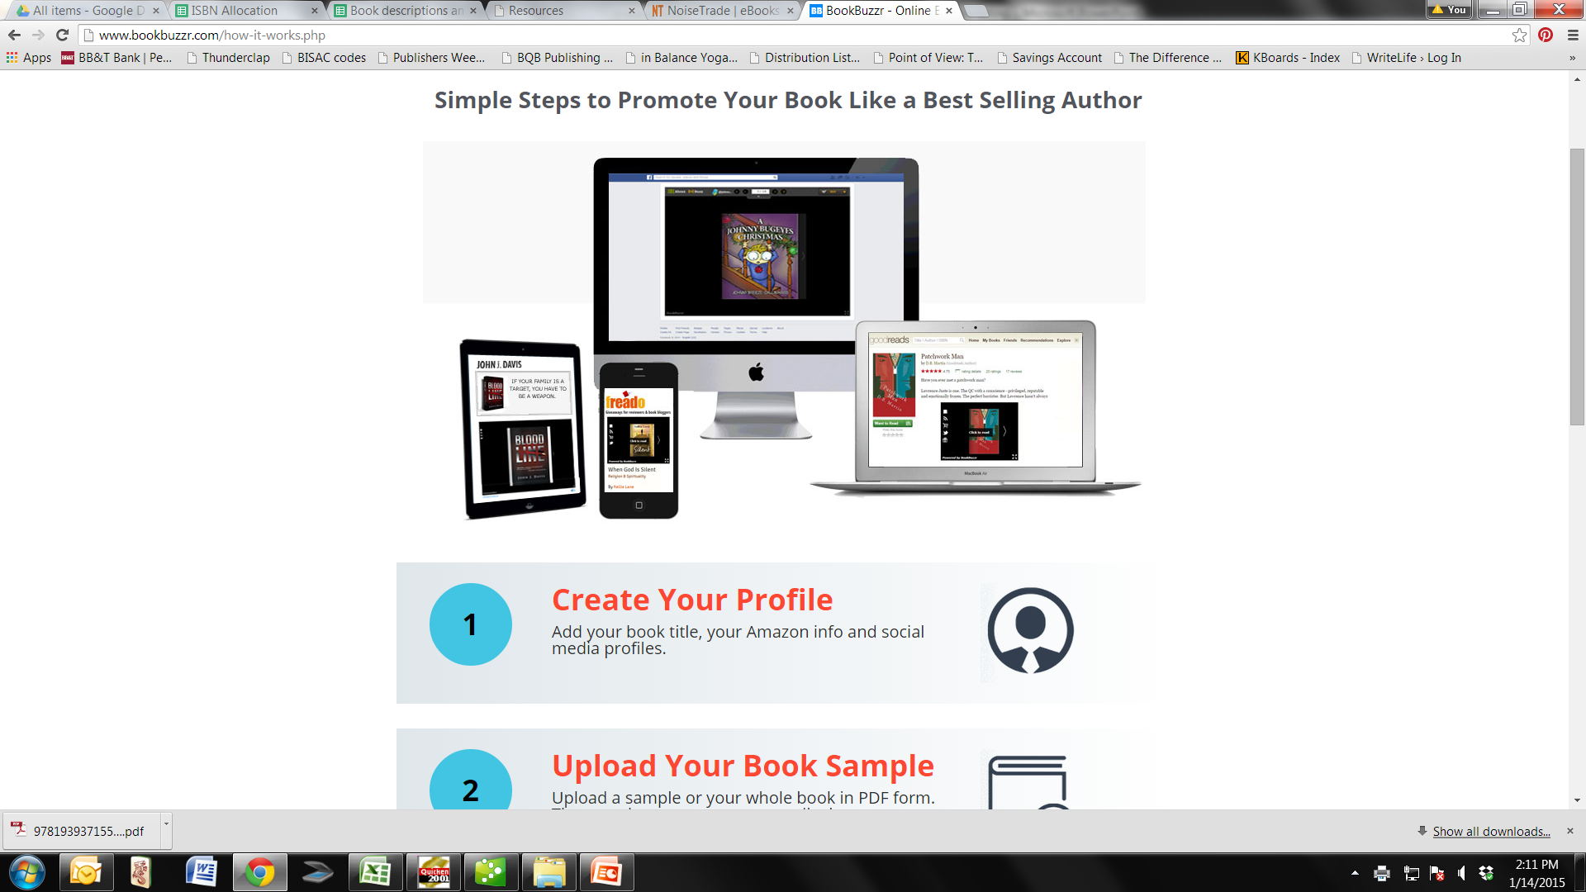

Slide 25
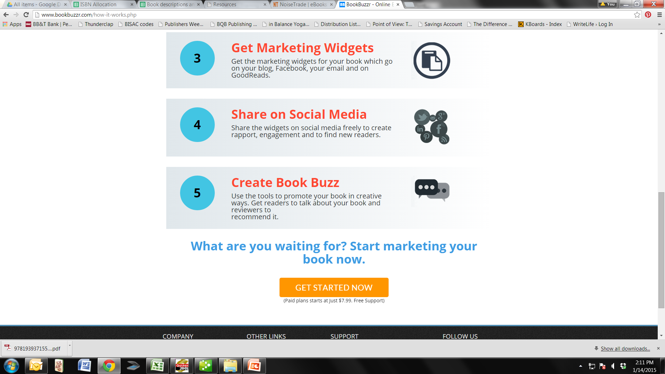

Slide 26
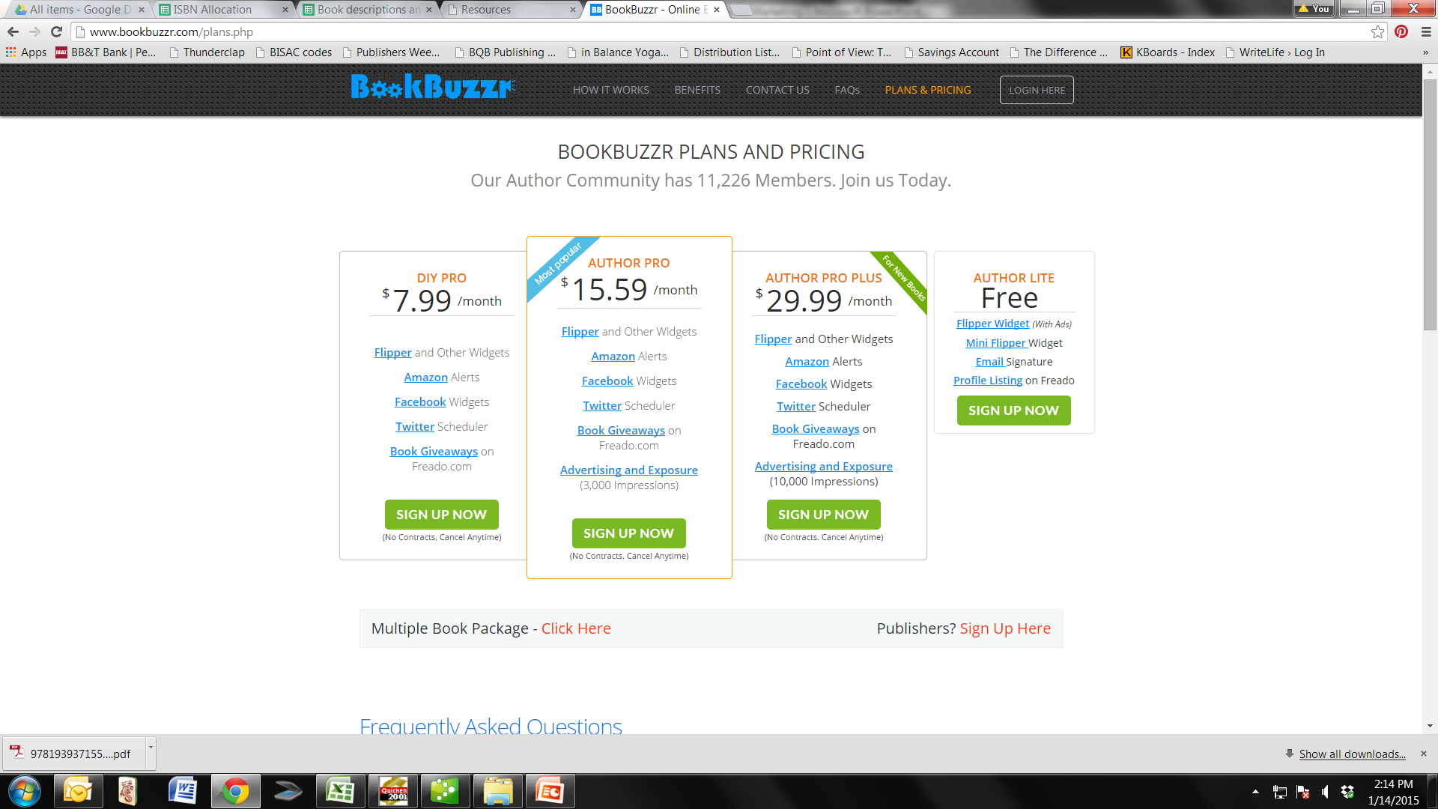

Slide 27
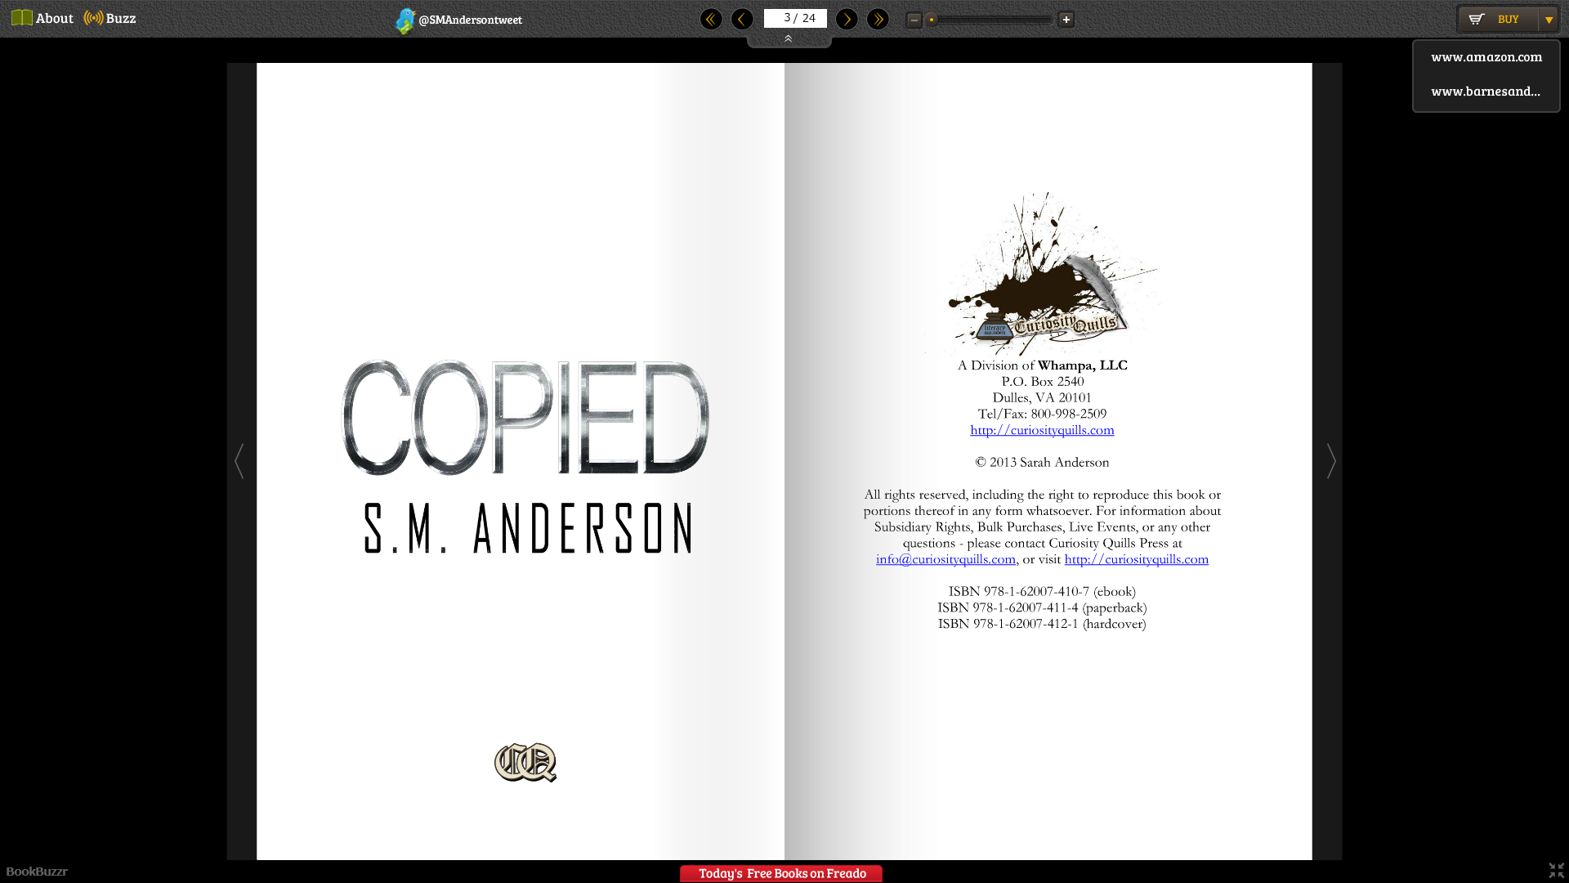

Slide 28
Freado
http://www.freado.com
Freado is a trusted platform that connects book reviewers & bloggers with fabulous book giveaways.
For authors to participate, you must join BookBuzzr with one of the paid plans and you can then participate in Freado giveaways.

Slide 29
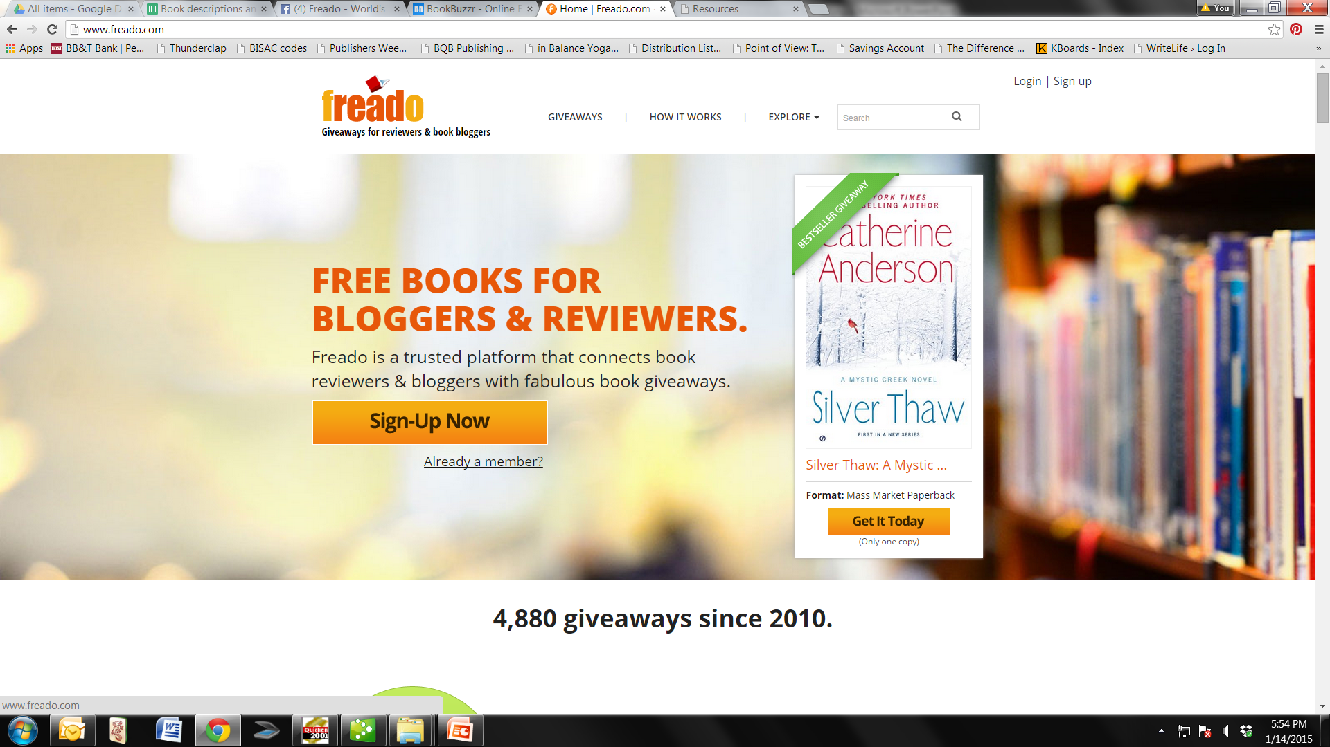

Slide 30
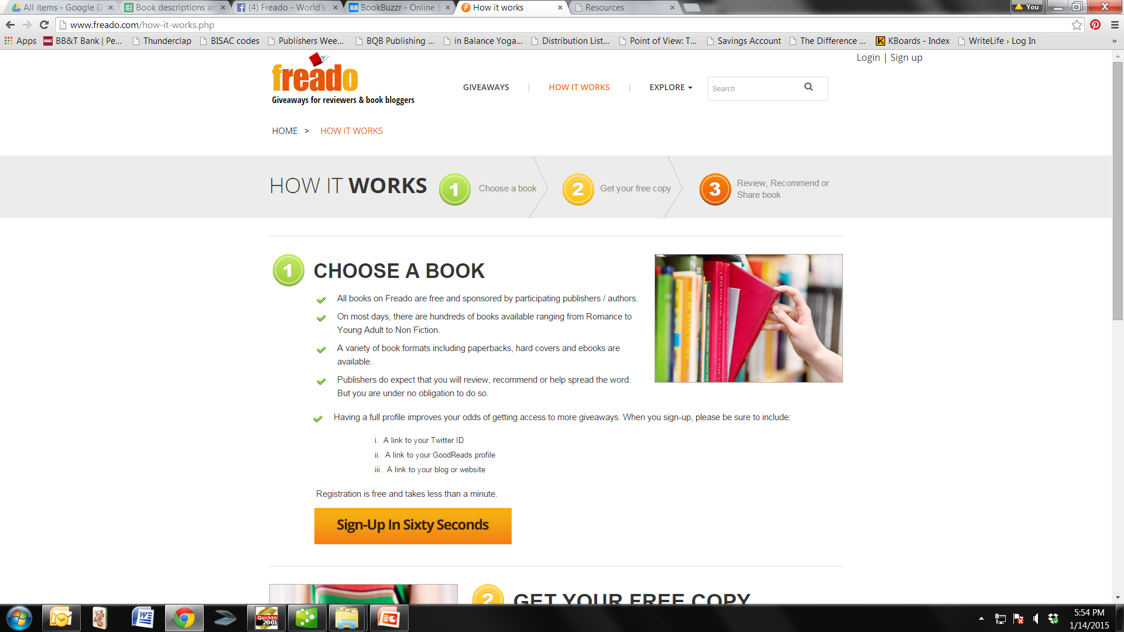

Slide 31
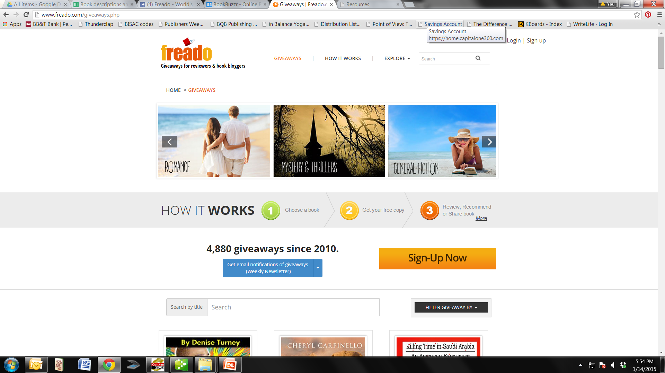

Slide 32
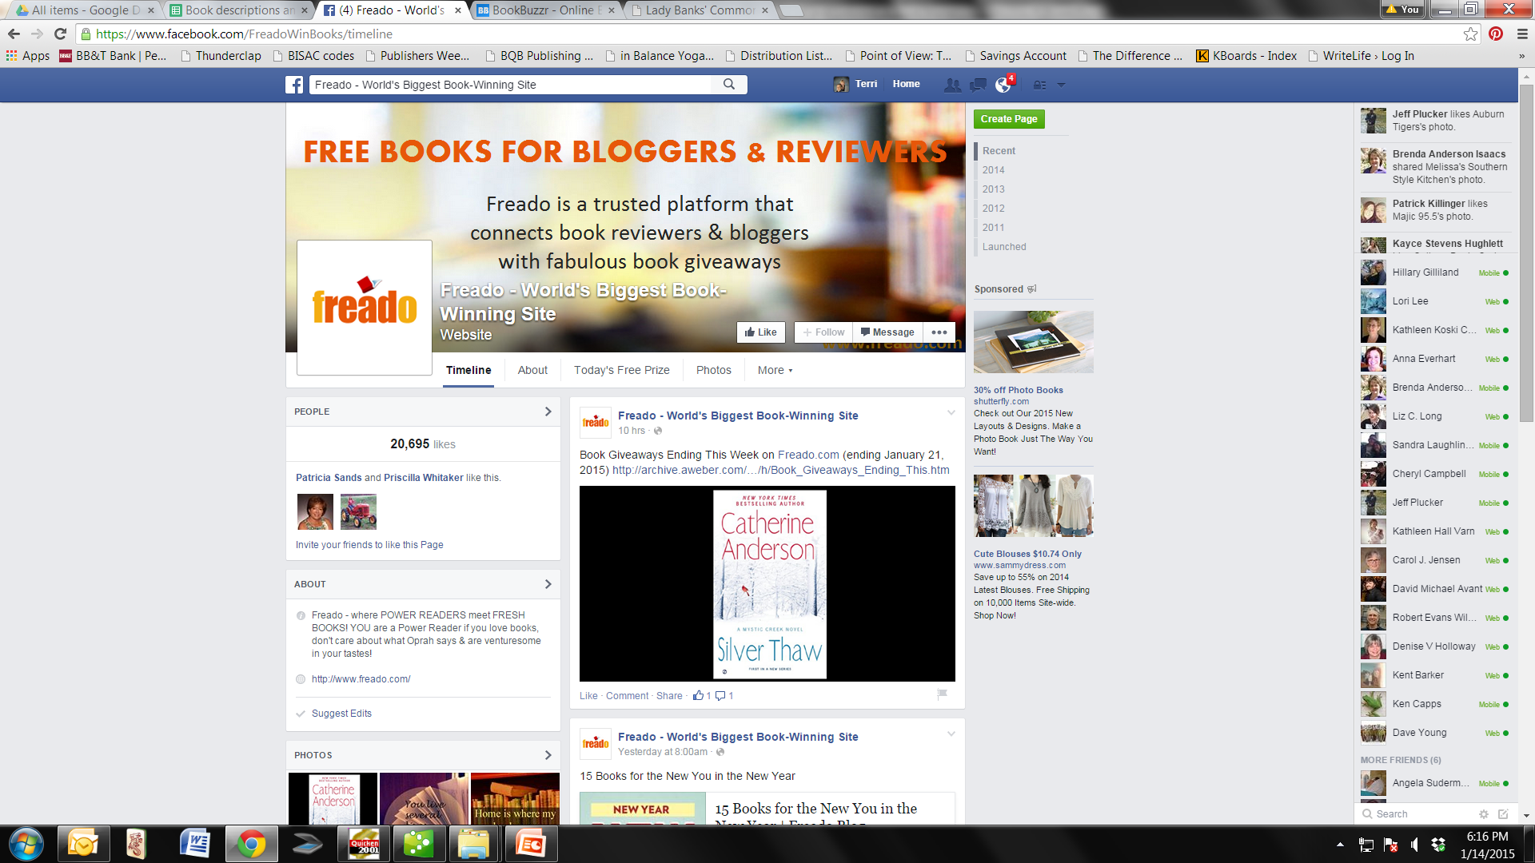

Slide 33
Questions?
Type any questions in the chat feature here!

Slide 34

Thanks for joining us!
Have a great Saturday!

