Slide 1

Author Training Call:
The Marketing Power of Karma and Cooperation
Welcome!
Saturday, May 16, 2015
10:00 a.m. EST

Slide 2
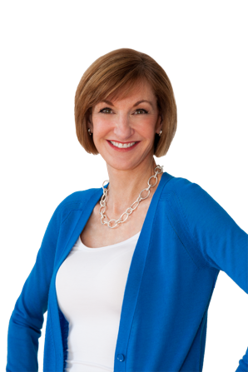
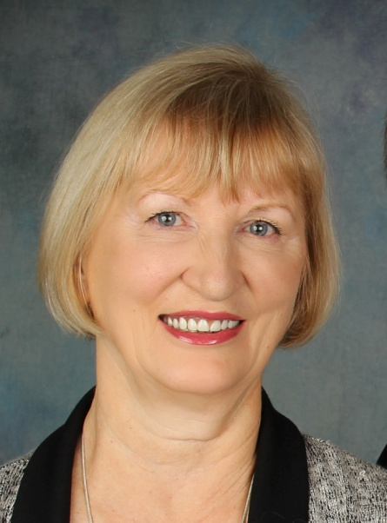
Presenters
Terri Leidich Nancy Baumann
President/Publisher COE (Chief of Everything)
BQB Publishing/WriteLife Publishing Bookarma.net

Slide 3
Overview
In this virtually “social” world of ours, there are always new ways to connect and new ways to promote ourselves as authors and our book(s).
Authors are writers and writers are generally readers, so other authors are a good niche for marketing.
Because readers read more than one book in their lifetimes, other authors are not competition, they can be a great marketing resource.
When authors ban together to read, review, and promote each other’s works, it’s a win/win situation.

Slide 4
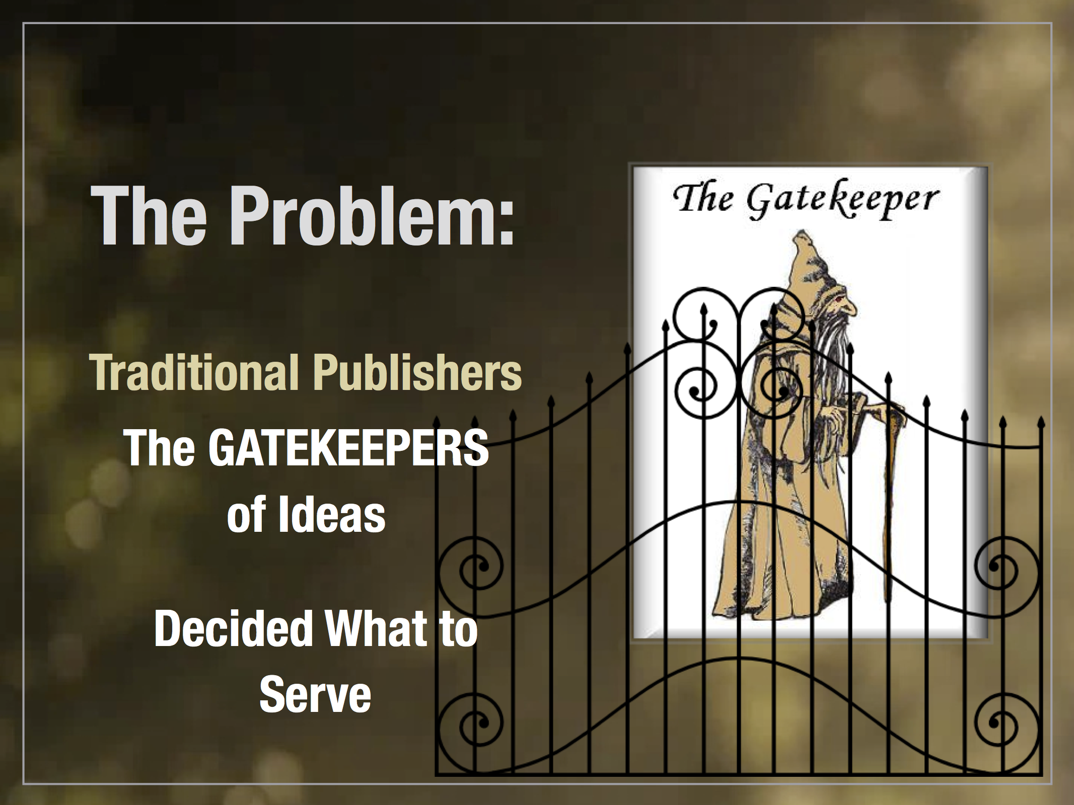

Slide 5
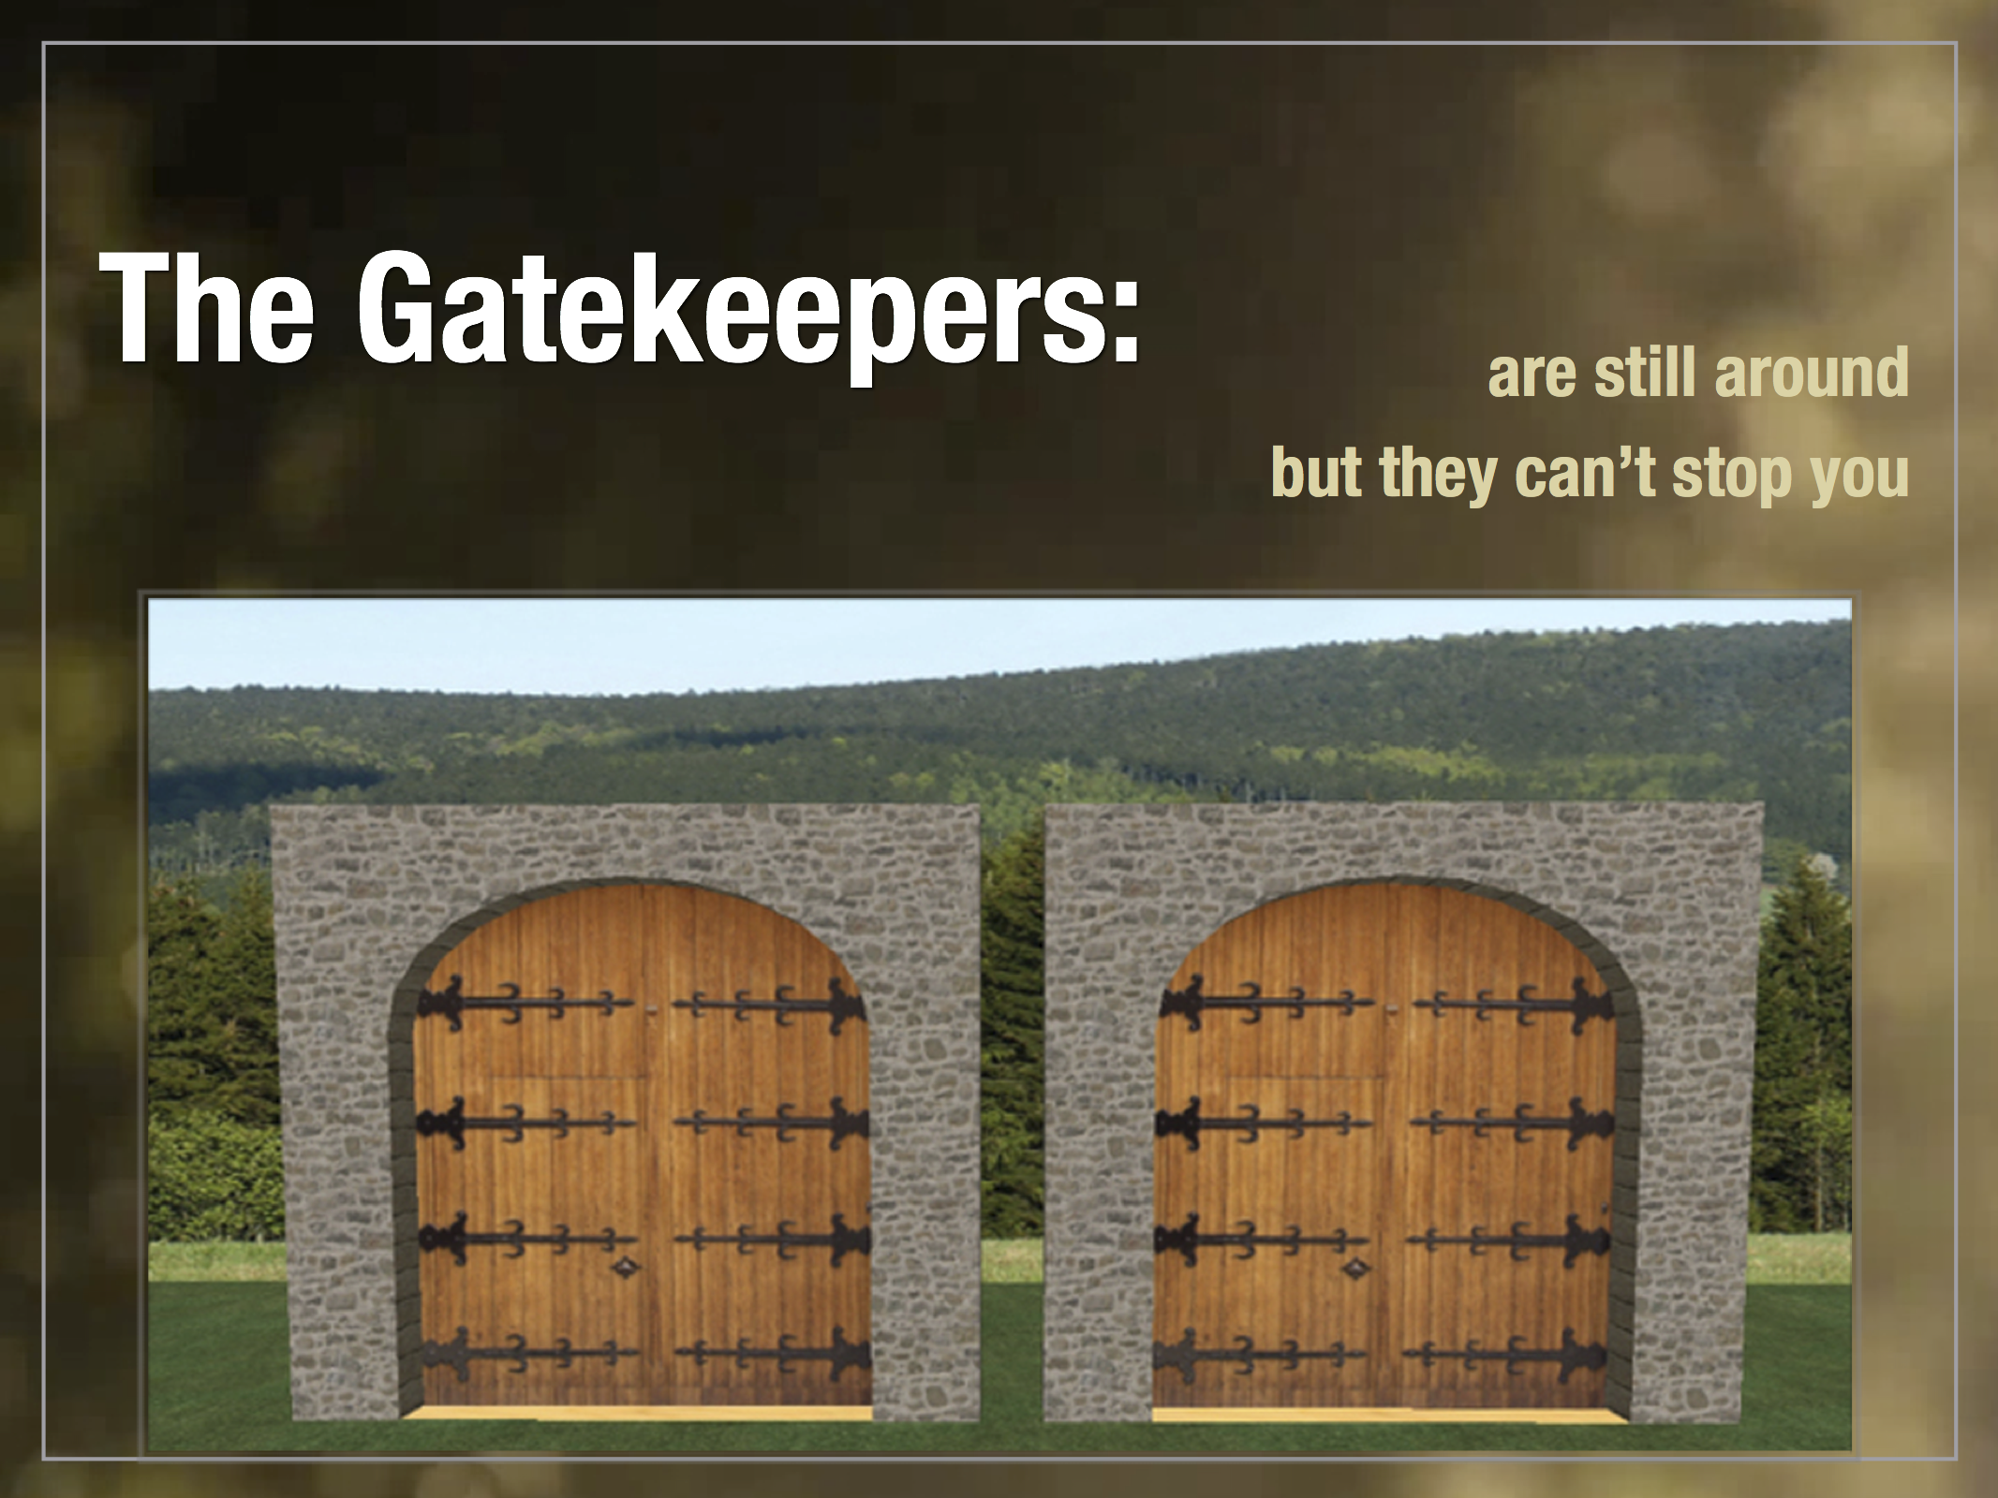

Slide 6
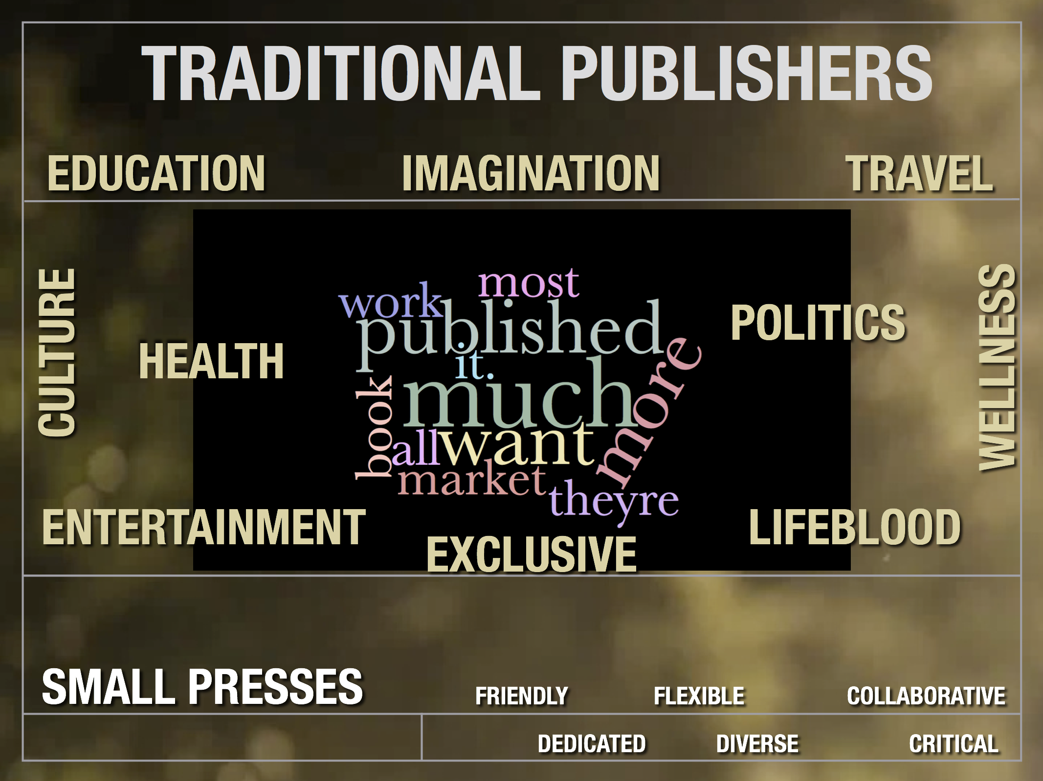

Slide 7


Slide 8
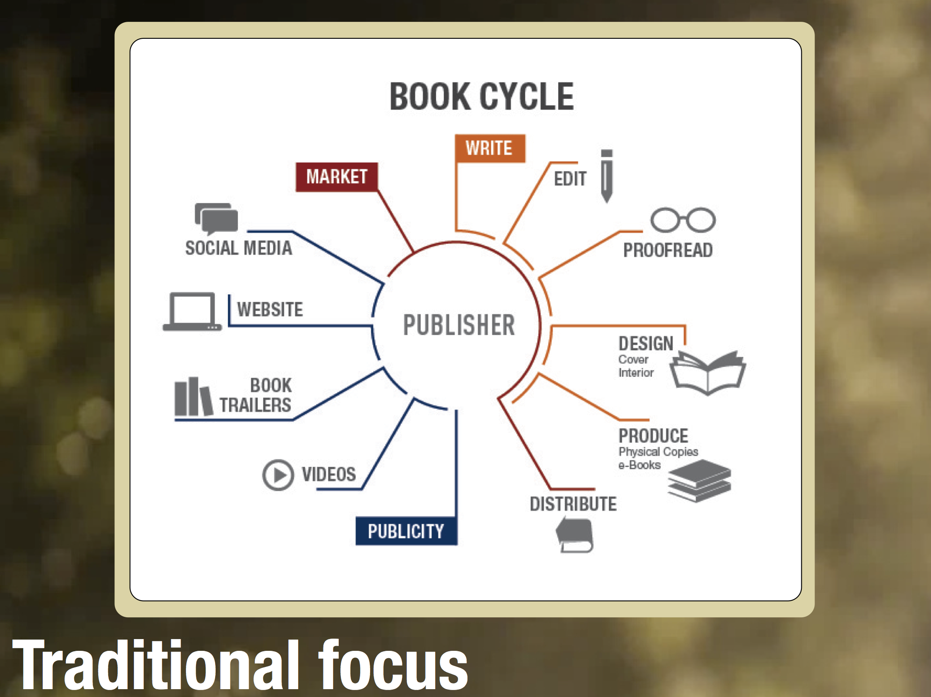

Slide 9
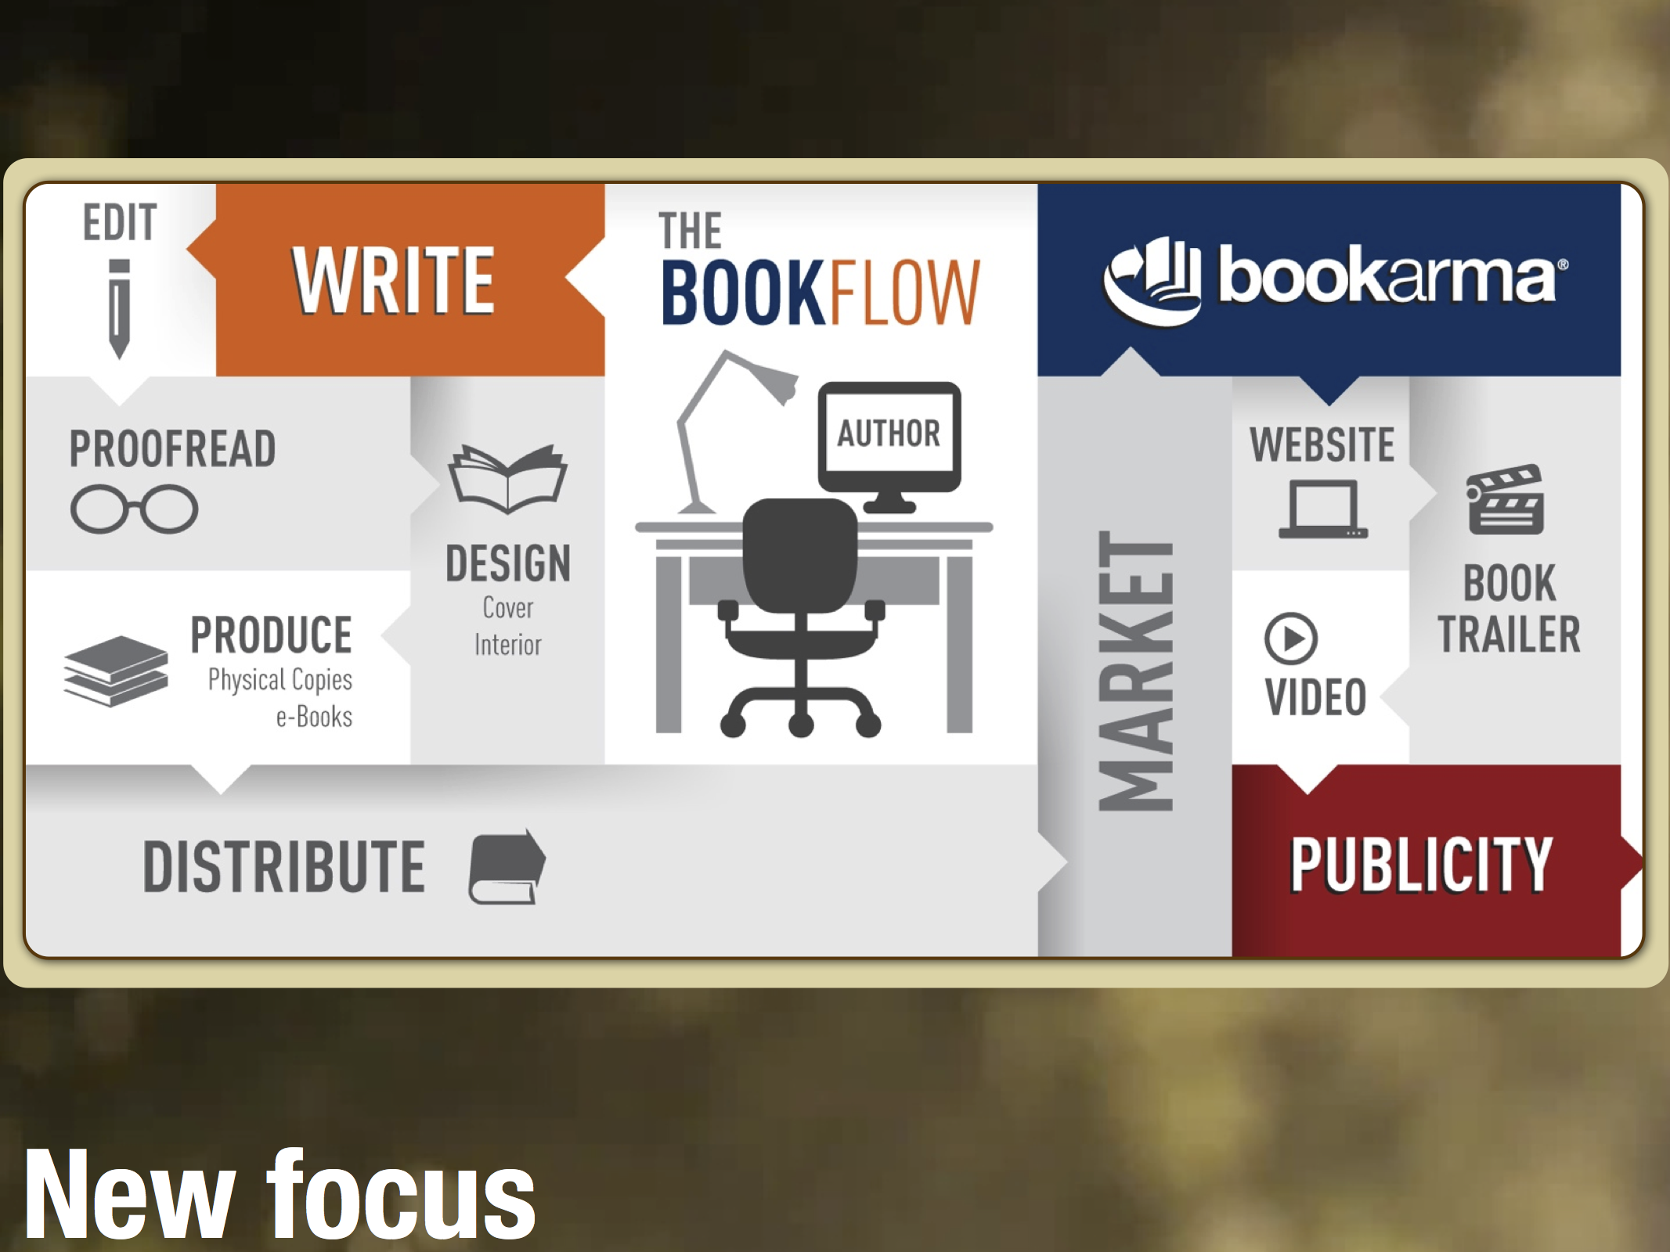

Slide 10
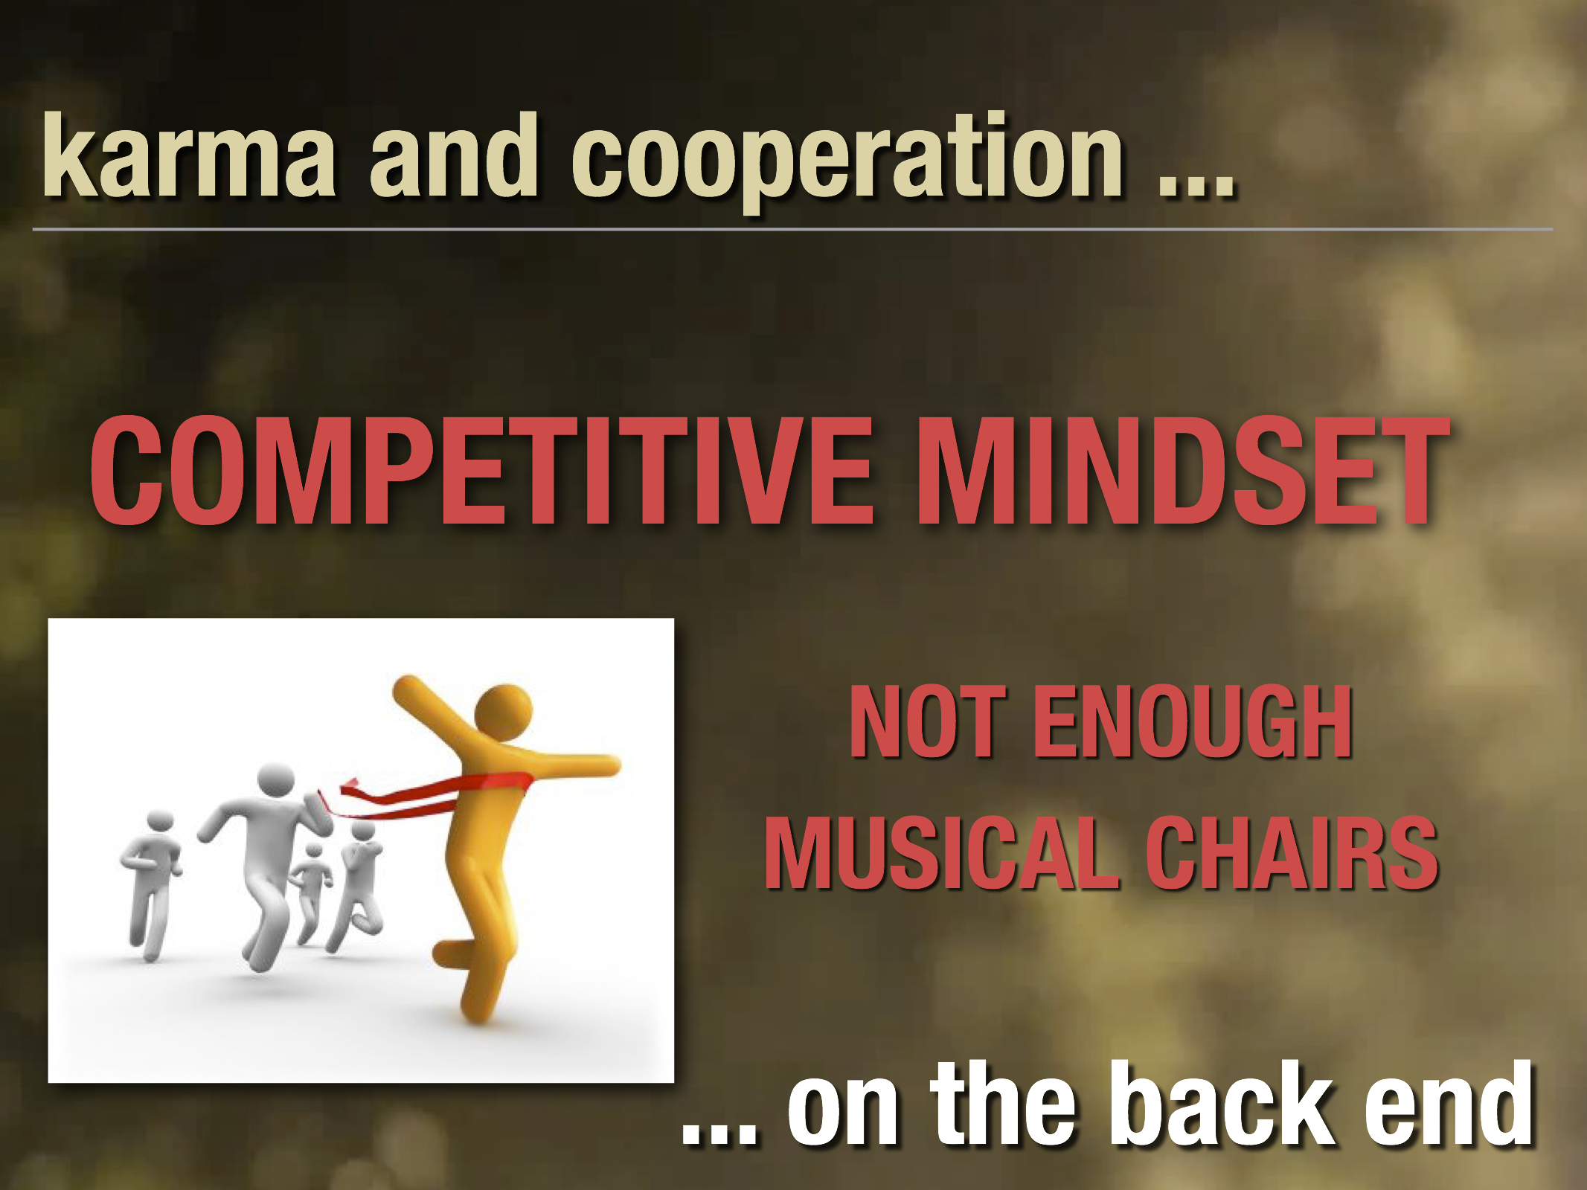

Slide 11
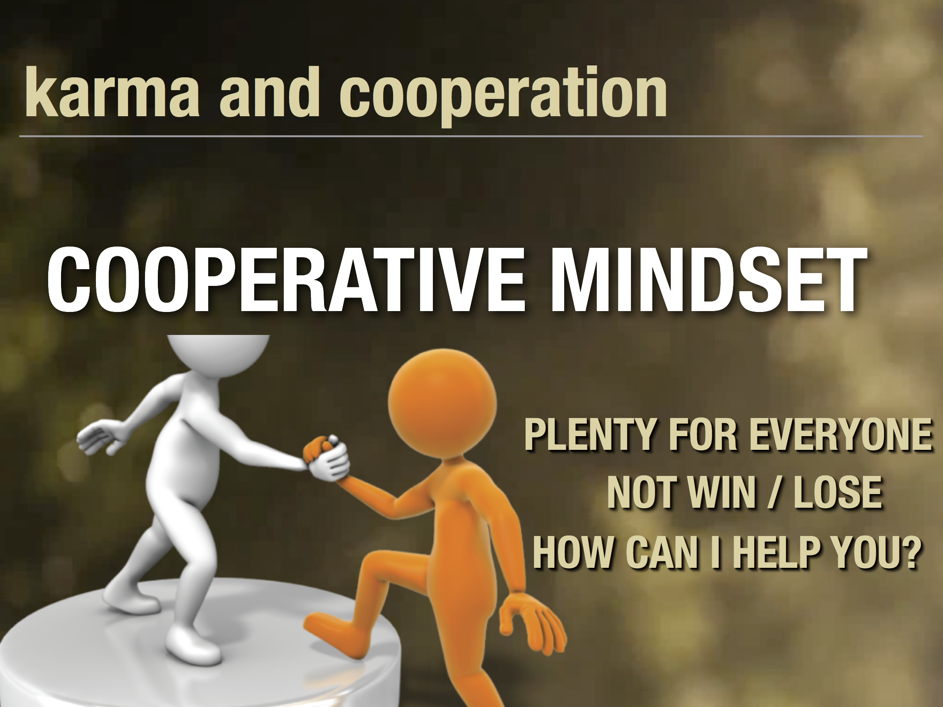

Slide 12


Slide 13
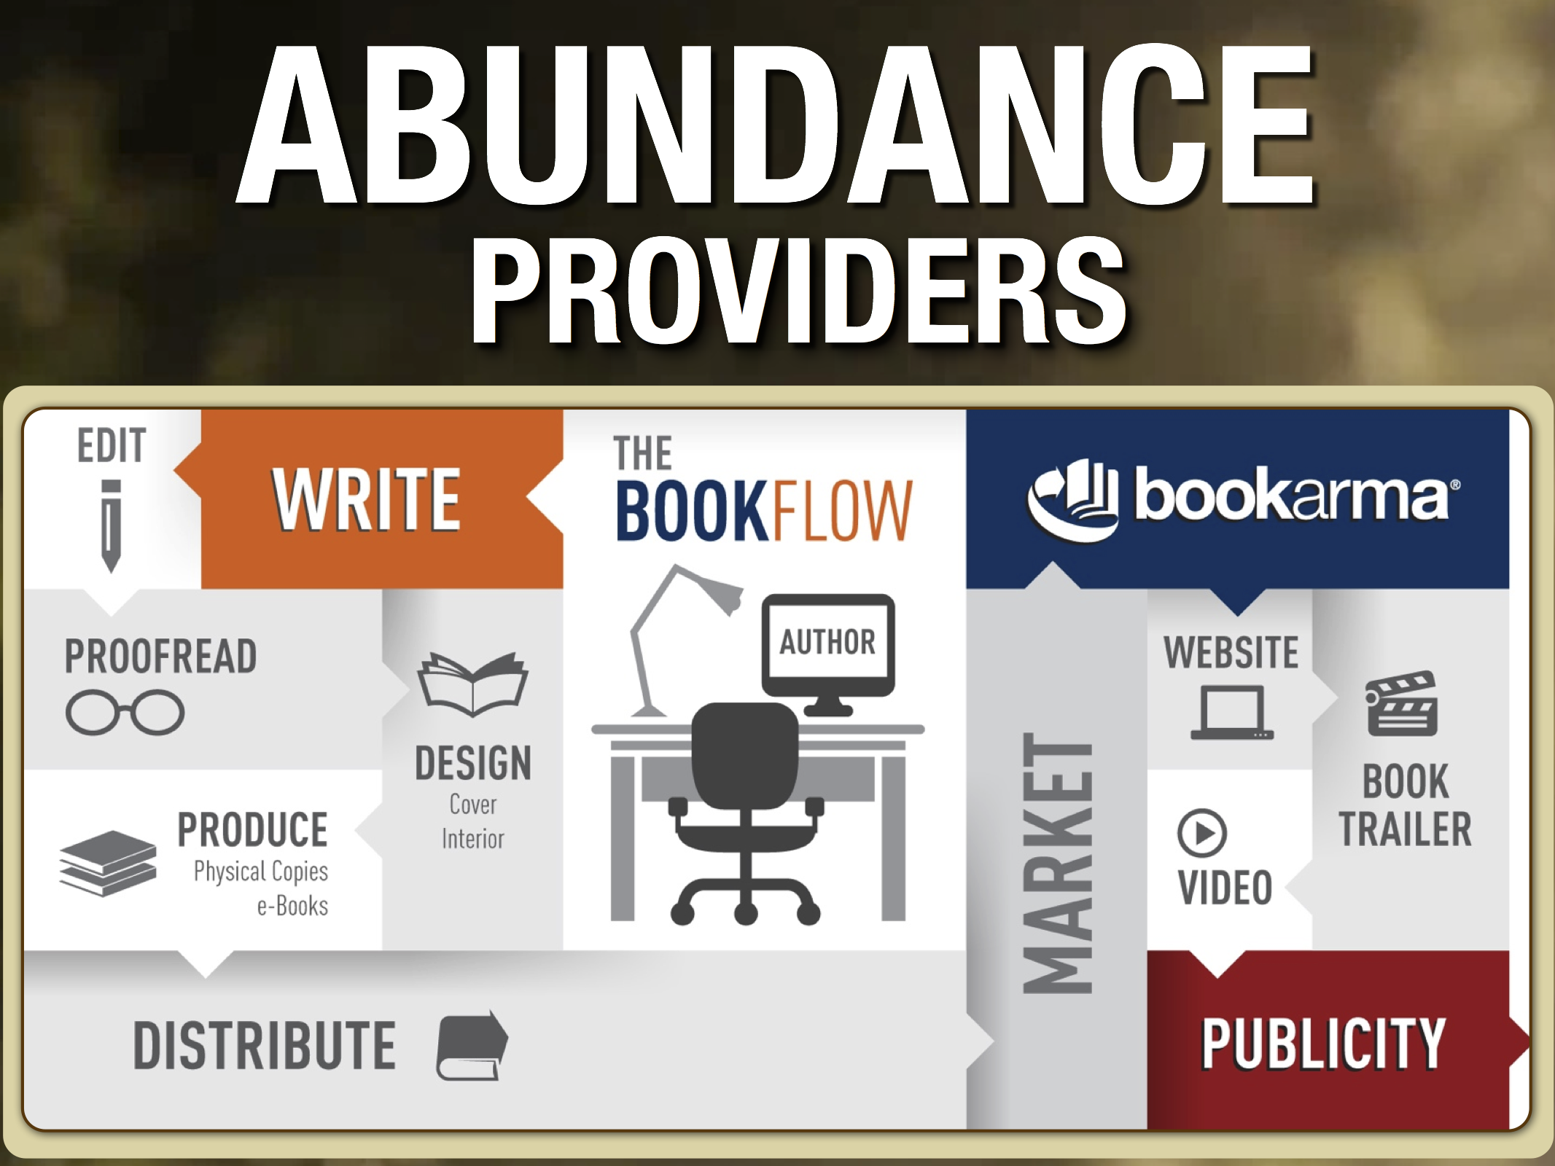

Slide 14


Slide 15


Slide 16
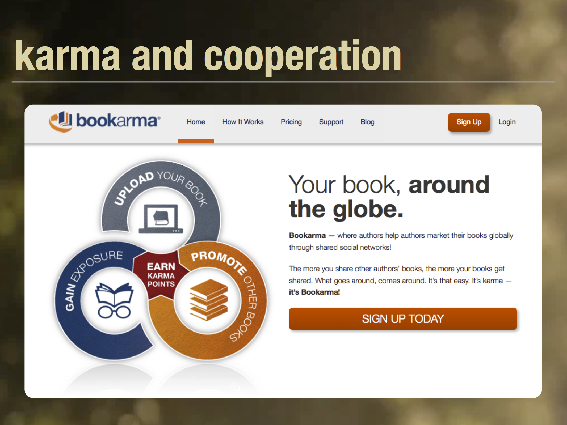

Slide 17
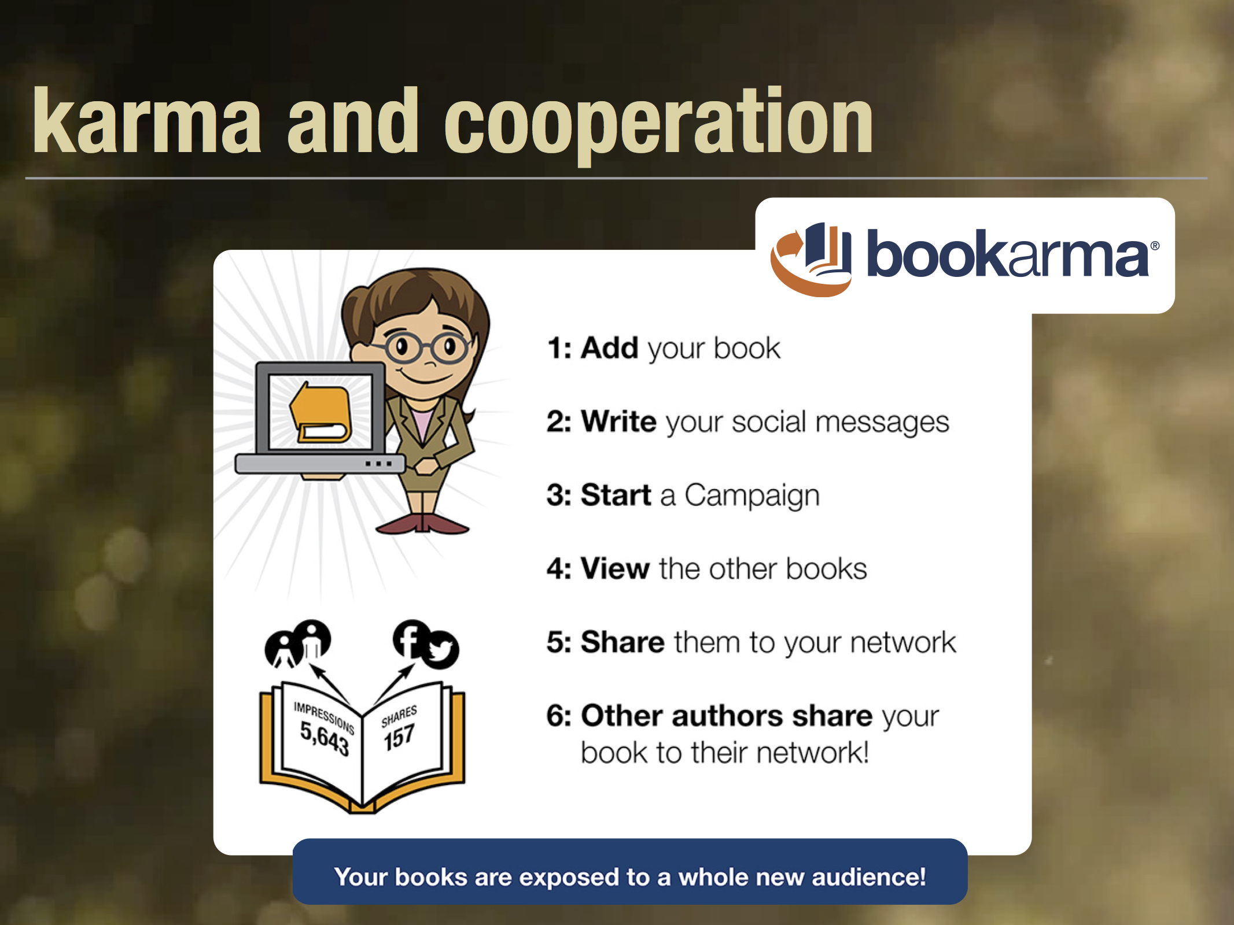

Slide 18
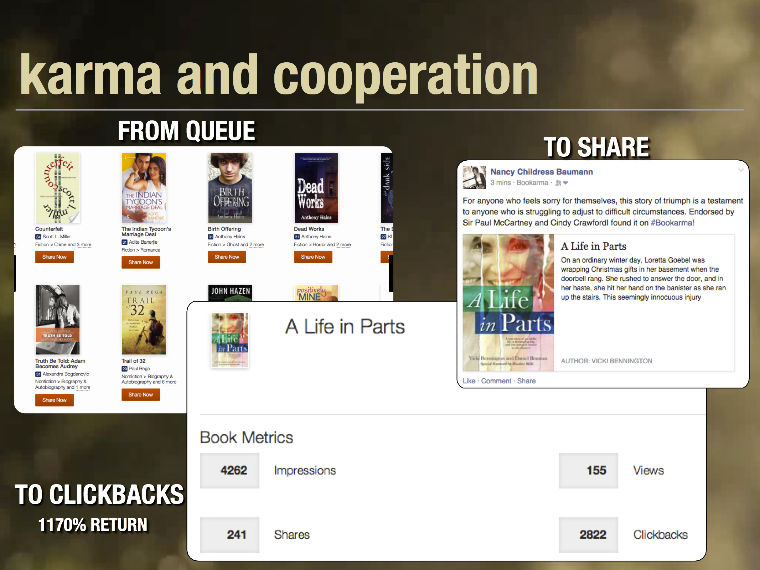

Slide 19


Slide 20
Summary
To summarize and learn more about Bookarma, check out their YouTube video that takes you through the process:
https://www.youtube.com/watch?v=lsXbYNRh4H4

Slide 21
Questions?
Type any questions in the chat feature here!

Slide 22
Next Month’s Training Call
Saturday, June 27th at 10:00 a.m. EST
Title: Marketing Must-Do’s for Success as an Author
Description: There are so many options of what we can do to build our author brand and market our books. So, what’s important. What are the Must-Do’s that help move us toward overall success?

Slide 23

Thanks for joining us!
Have a great Saturday!

