Slide 1

Must-Dos & Other Helpful Tips for Successful Book Marketing
Welcome!
Saturday, June 27, 2015
10:00 a.m. ET

Slide 2
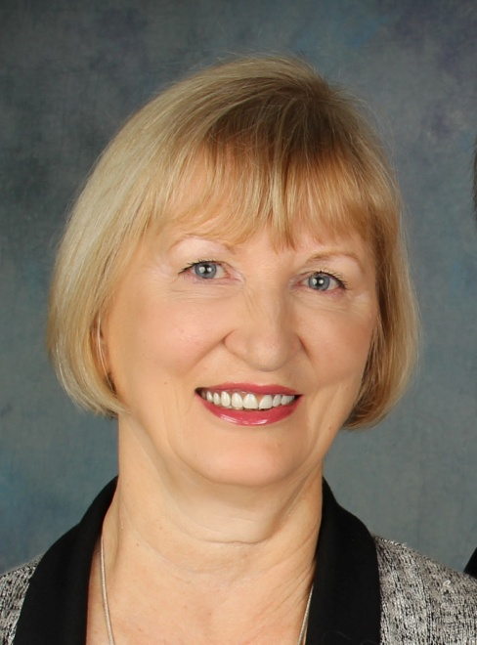
Presenter
Terri Leidich
President/Publisher
BQB/WriteLife Publishing

Slide 3
Overview
Plan on taking charge of your marketing– author involvement in today’s publishing environment is crucial for success.
There are major elements that need to be strongly considered as a part of your marketing plan.
We all have different personalities and approaches to life. Use your personality and likes to help you build a marketing plan that will be effective for you. In today’s world, we have a myriad of choices, but if you want to be successful, not marketing at all is not one of those choices.
Marketing is not “selling.” Marketing is about building a brand and relationships so that people know who you are and what you write. That’s how you build a following and a fan base.
Approach all of the following ideas with a “think outside the box” mentality. You’re competing with MILLIONS – you MUST stand out in a positive, creative way.

Slide 4
Author Website
An author website helps you build your author brand.
It can be a simple 4-5 page site that provides information about you as an author and your book(s).
It should reflect you and your personality.
Keep it professional and clean.
Keep it updated and interesting with fresh content.
Include social media buttons so readers can follow you.
Learn basics of SEO - Search Engine Optimization, so people can find you.
Include direct links to where your book(s) can be purchased (both print and eBooks).
For additional income, check out affiliate programs at Amazon, Barnes & Noble etc. where you are paid a % for anyone who gets to their site (and makes a purchase) through your link.

Slide 5
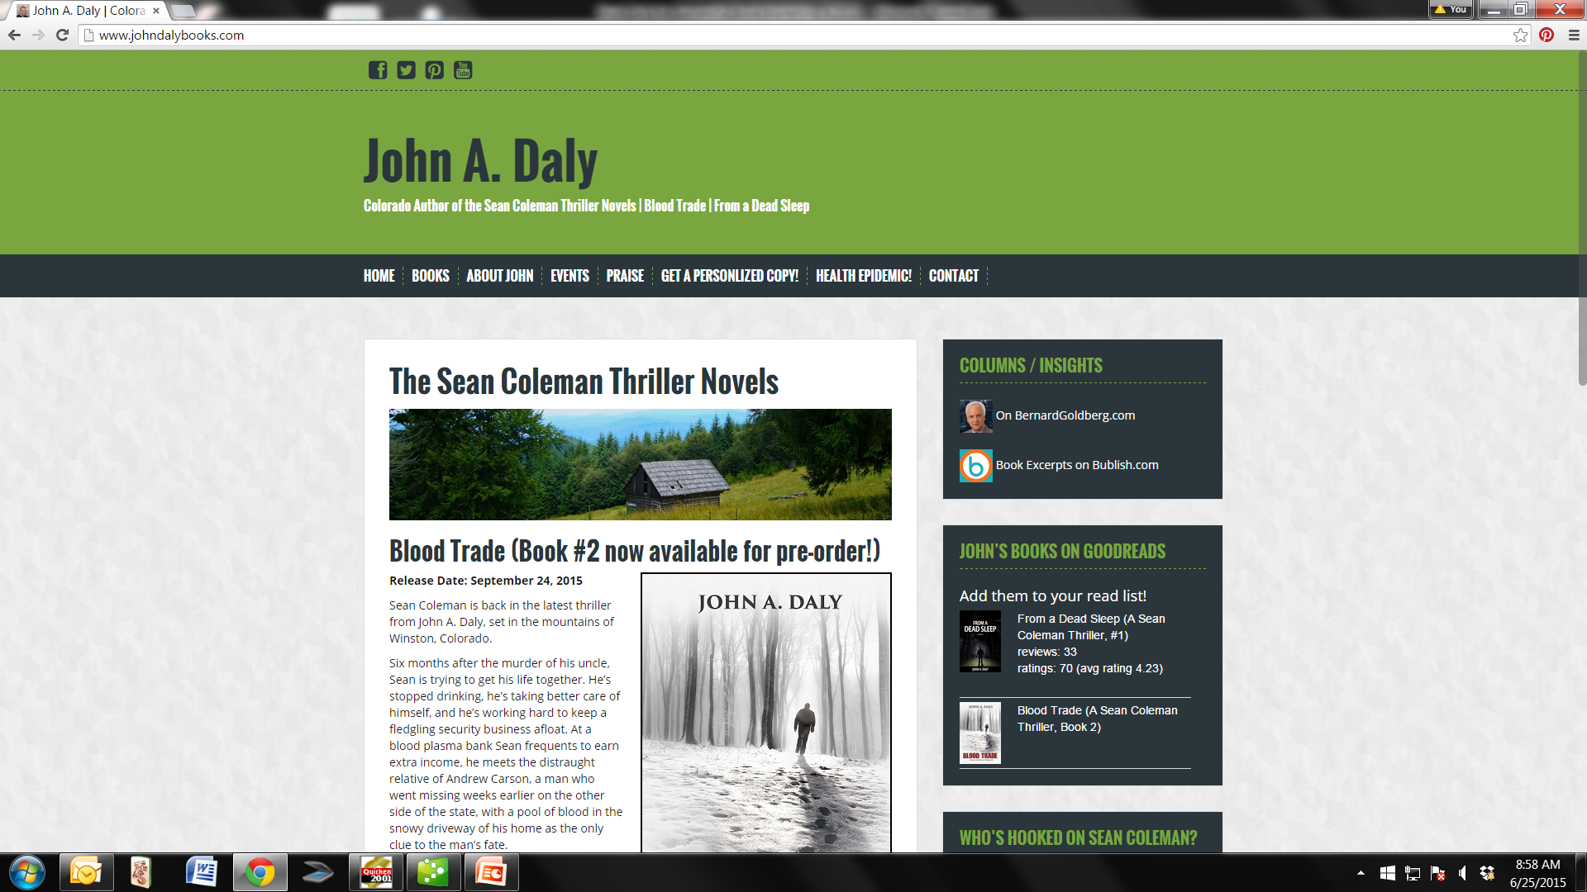
Example A

Slide 6
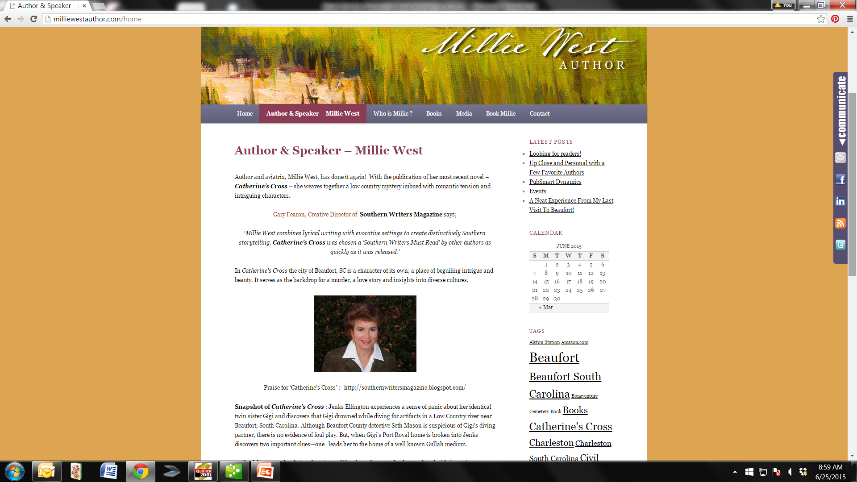
Example B

Slide 7
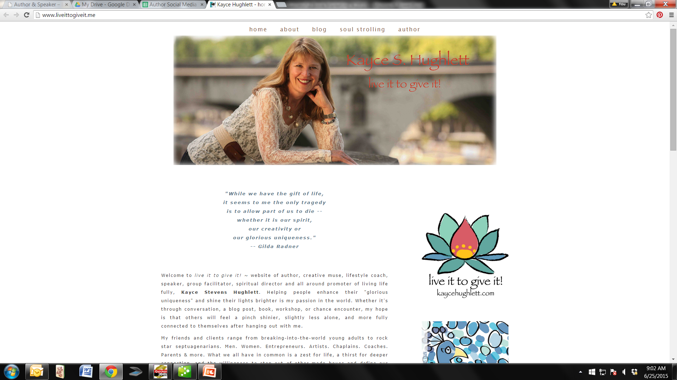
Example B

Slide 8
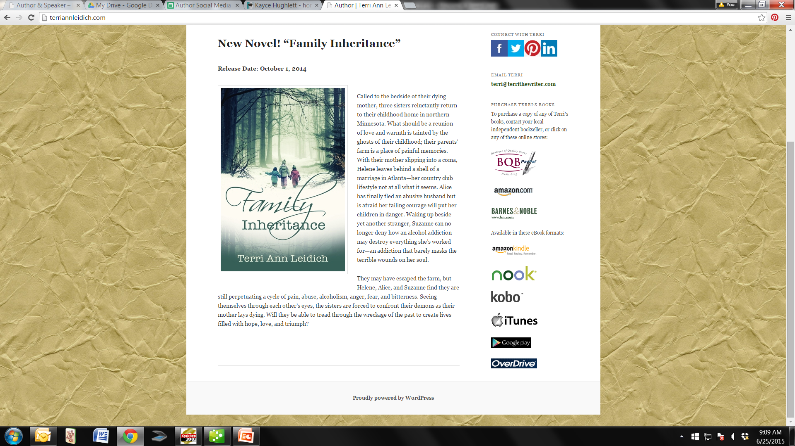
Example B

Slide 9

Social Media
Social media doesn’t necessarily help sell books, but it can help build your author brand and awareness of you and your book(s).
Social media is for connecting and building on-line connections and relationships.
It is also a strong component of SEO and can help people find you and your website.
Have a presence on main sites like Facebook, Twitter, LinkedIn.
Create a separate author page or author account for yourself to help build your author identity and brand.
Consider using a manager tool to link them to one place for ease of use and a single dashboard.
  Examples: Hootsuite www.hootsuite.com, TweetDeck, SocialOomph, Seesmic

Slide 10
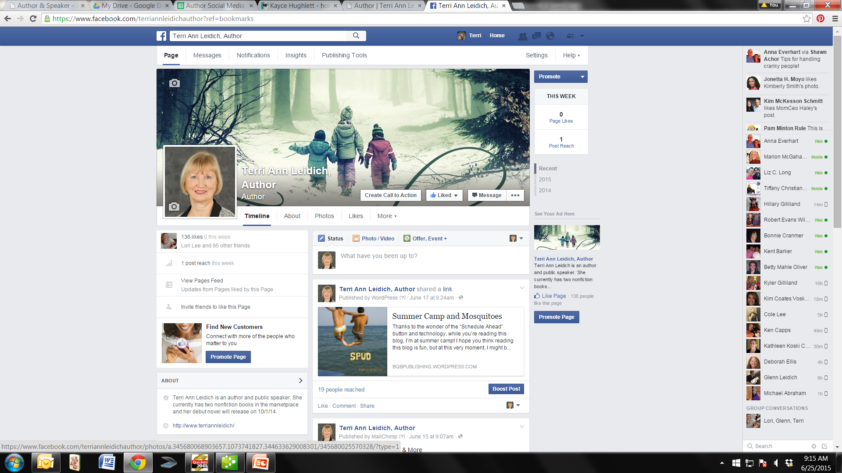

Slide 11
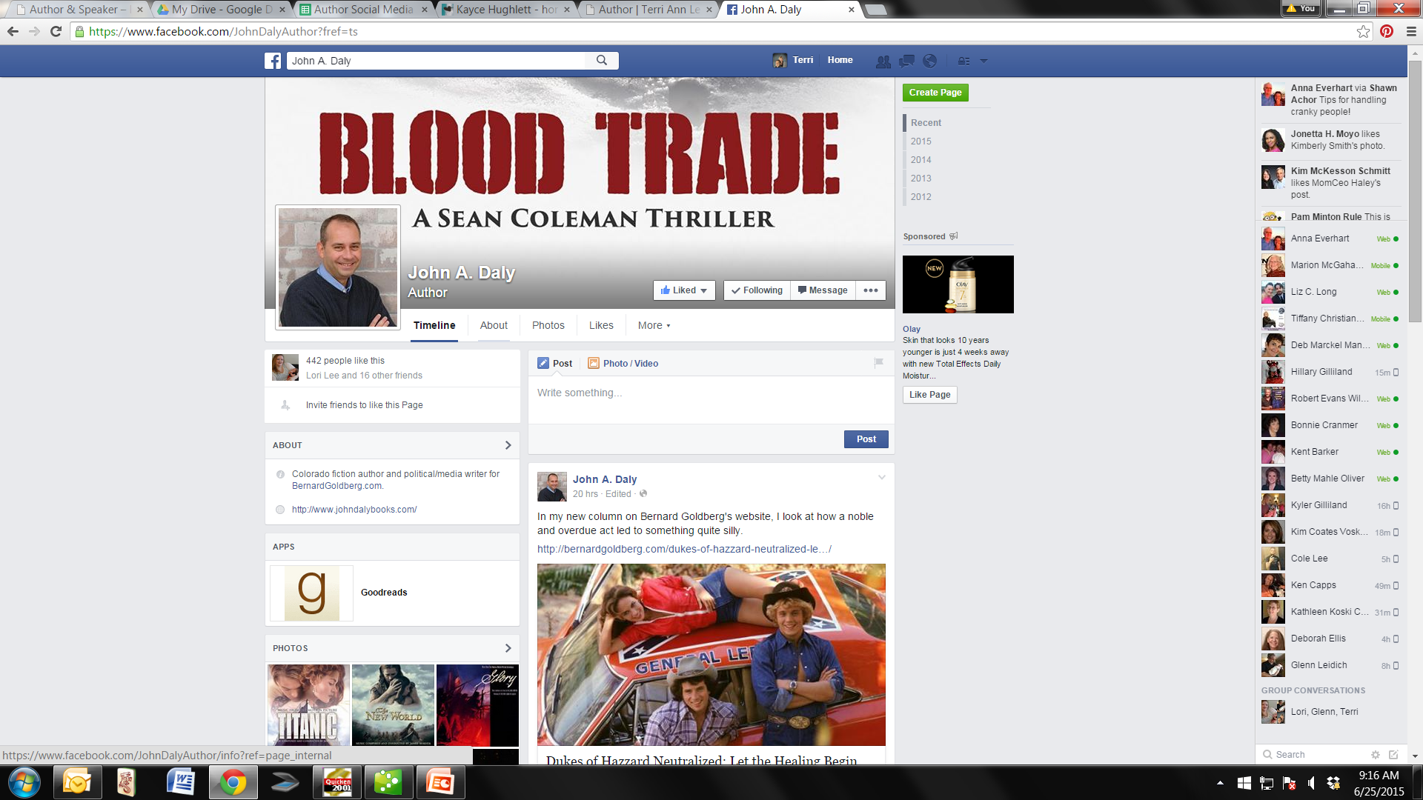

Slide 12
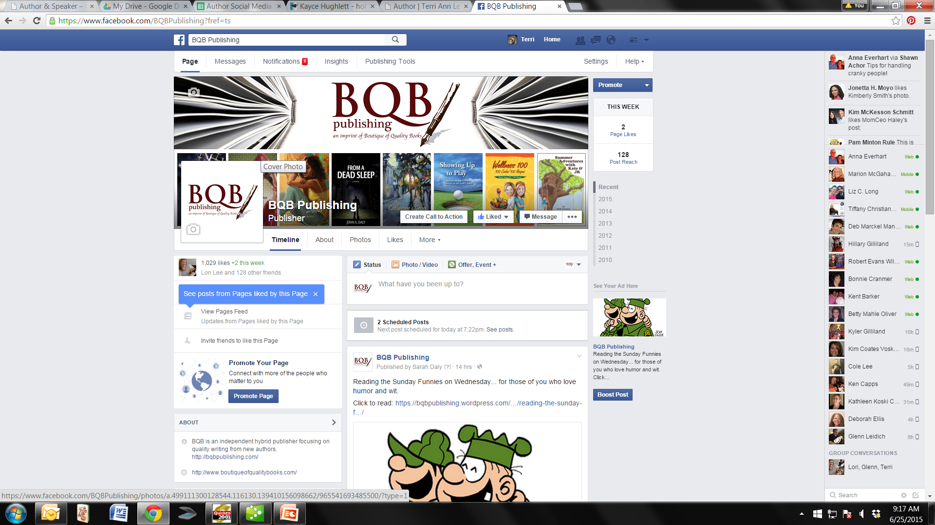

Slide 13
Social Media Continued
Use photos – you, your book, people reading your book . . . photos get more visibility and attention than text only posts.
Videos on YouTube have also become a strong part of social media.
Positive Participation! Share, Comment, Like – Use friendly input, not hard sales, to gain attention.
Follow BQB, WriteLife, other BQB/WriteLife Authors, your favorite authors.
If you are doing book signings, speaking events, etc. make sure you get the information out on your social media.
If you want a simple way to promote your events, get the info to BQB/WriteLife’s social media manager, John Daly at johndalybooks@hotmail.com, he’ll post it on the different BQB and WriteLife social media sites and you can then report, retweet, etc.
Don’t let concern or fear of negative posts and/or people stop you from participating in social media. Those people can be unfollowed, blocked, etc. and the posts can be deleted.

Slide 14

Social Marketing
From my perspective, social marketing is different than social media. Social marketing is focused on helping to sell your book(s).
Many of the sites connect with social media sites such as Facebook and Twitter.
Goodreads is a great social marketing site.
  Begin as a reader and when your book available
  on Amazon, request to become a Goodreads author.
  Promote your book through their author programs and giveaways.
  Join book clubs and groups.
Complete your profile on Amazon so people can click on your name and find out all about you and the books you’ve written.
Amazon is also now including your latest tweets on Twitter as a part of your author profile.

Slide 15
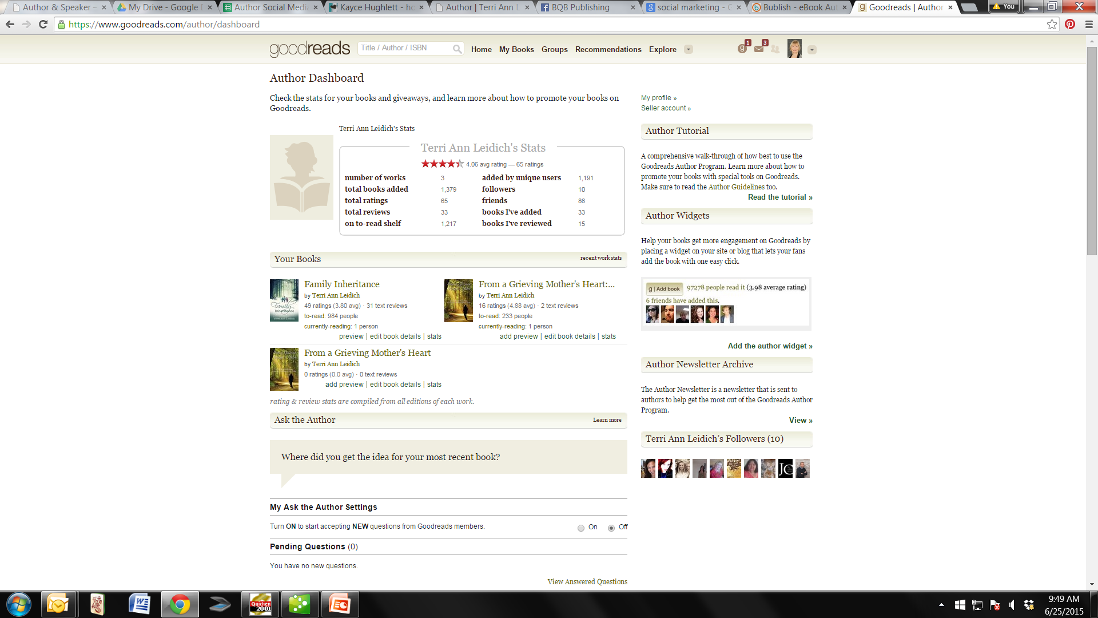

Slide 16
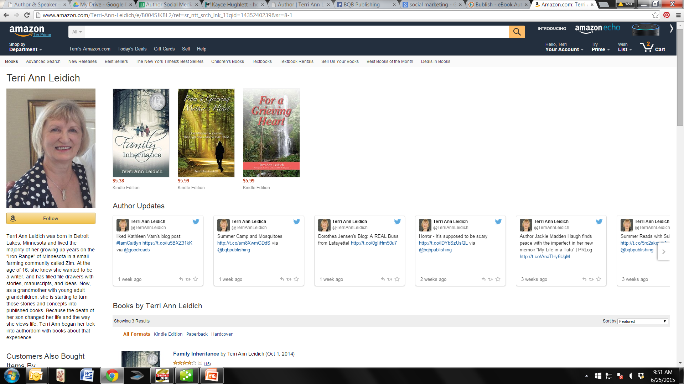

Slide 17
Social Marketing Continued
The sole purpose of Bublish is to promote authors and their books.
Use Bublish (www.bublish.com) to tell the back stories behind your books by creating book bubbles.
  Bublish heavily promotes their authors each weekend through social media.
  Follow them on twitter to get a sense of what they do and how they promote their books.

Slide 18
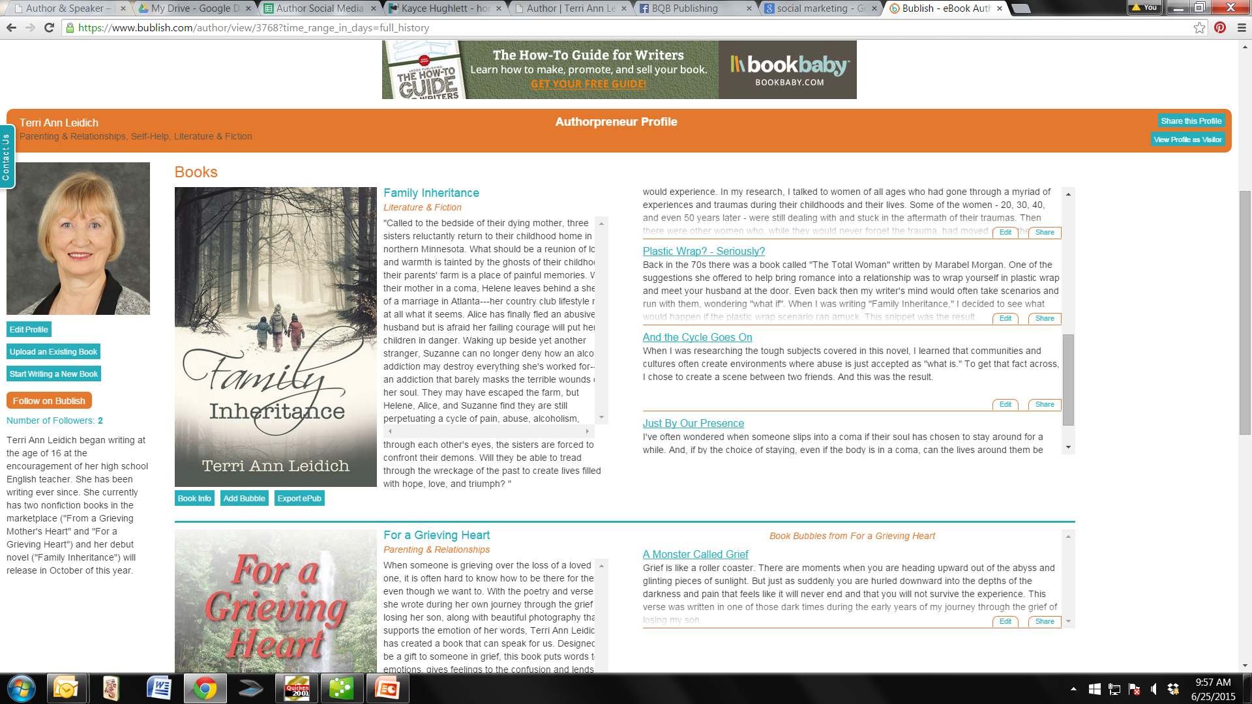

Slide 19
Book Reviews
Book reviews are essential in building a fan base.
Before your book is initially published, BQB/WriteLife sends your book to reviewers like Publishers Weekly, Library Journal, Kirkus Reviews, plus host your book on NetGalley.
There are a wide variety of places where you as an author can submit your books for review:
  Magazines
  Newspapers
  Bloggers
Author Coaching companies like Where Writers Win www.wherewriterswin.com provide lists of reviewers to their subscribers.

Slide 20
Book Reviews Continued
Book reviews don’t have to stop once your book has been published, or if it has been on the marketplace for a while.
Check out paid reviews like Chanticleer reviews www.ChantiReviews.com
Look for bloggers that specialize in backlist books, i.e. https://bookbacklist.wordpress.com/about/
Watch for local resources such as regional magazines or online magazines that do book reviews.
Find magazines that focus on your genre.
Ask your social media circles if they would post reviews on your book on Amazon or Goodreads. You might be surprised how many people have read your book, but just don’t think of posting a review.

Slide 21
Book Clubs
Many well-known authors have kicked up their awareness through book clubs.
Finding them:
Ask your friends and acquaintances.
www.wherewriterswin.com provides a list of book clubs for their Winner Circle members.
Check out your local library, bookstores, or coffee shops where book clubs often meet.
Search for book clubs on Facebook and Goodreads
Search online for book clubs in your city.
Create a Google (Giga) Alert for book clubs.
Check out http://bookclub.meetup.com Put in your zip code and it will list the book clubs in your area along with the pertinent information.
www.readerscircle.org let’s you put in a zip code and will provide local book club and contact information.
Use relevant hash-tags on your social media. John Daly uses #ColoradoBookClubs.
Have a list of “Suggested Book Club Questions” on your author website along with your contact information.

Slide 22
Book Clubs Continued
Many book clubs love to speak with authors (especially local authors) to learn about their craft and chat about their book. But that doesn’t mean it won’t take work to get in front of a book club.
Contacting them:
Research the book club to find out the type of books they read. If they don’t read your genre, don’t waste your time.
Once you’ve researched the club, contact the organizer to introduce yourself, provide a book description, and explain that you’re interested in participating as a visiting author.
Keep in mind that book clubs often plan their reading lists months in advance.
The group organizer may ask you where they can find your book, if it’s available through the library, or if they can get a discount if they buy several at a time for their members. Be prepared to answer these questions.

Slide 23
Book Clubs Continued
If you get invited to a book club. Prepare!
Your appearance:
Be on time.
Decide if you want to prepare a list of discussion points or speak on the fly. If you prepare discussion points, provide the list to the organizer before the event. If you want to speak on the fly, still be prepared to discuss certain topics. Knowing what you want to discuss can prevent moments of awkward silence.
Ask questions. Engage the readers. Ask them what they liked about the book or what didn’t work for them. Be prepared to get both praise and criticism. Don’t take the criticism personally and don’t try to turn their opinion. Just accept it. Keep it cordial. Enjoy the experience.
Remember, whether or not someone liked your book, they can walk away really liking their experience with you and that can add to your author branding.
Bring a bookmark for everyone.
Offer to sign their copies of your book.
Ask if they would consider leaving a review on Amazon or Goodreads.

Slide 24

Publicity
Publicity is everything from print interviews online or in magazines, articles, radio interviews, television interviews, etc.
Think outside the box and beyond your book.
  For instance, Millie West, one of our authors, submitted an article on her flower gardens to a local magazine and was featured with a mention of her book.
  Elena Stowell, whose book is about overcoming grief with Jiu-Jitsu is involved in Jiu-Jitsu and submits articles to Jiu-Jitsu magazines and her book is mentioned in the articles.
  Ted Edlich whose book will release in April of 2016, was recently featured in the Roanoke newspaper in regard to his black belt in Karate.
  Harriet Hodgson is a prolific writer who is involved with a myriad of organizations connected with the genres of her book and she writes articles for them.
Go after low hanging fruit like HARO (help a reporter out) www.helpareporterout.com which seeks sources for articles and media coverage. You can sign up for their email which is sent several times a week.

Slide 25
Publicity continued …
Grace Mortensen, BQB/WriteLife’s press release writer does the initial press release on every book we publish.
But press releases can be an ongoing occurrence as you and your book gain attention, i.e. if you are a presenter, speaker, your book can be connected to a news event, etc.
  Post press releases on the Internet through resources such as PR Log www.prlog.org a free press release distribution resource.
  Research local media sources to send your release to.
  Before you do, know the basics of a good press release.
  If you don’t want to write and post your own releases, contact Grace - grace@bqbpublishing.com to inquire about her services for BQB/WriteLife authors.
Build relationships with media (especially local media).
Use local media posting sites for listing any events you do.

Slide 26
Publicity continued …
Getting Interviews on Local TV Talk Shows
One of our authors, Bob Fiacco, has had great success in book appearances on local TV Talk Shows in both Virginia and South Carolina. This is his approach:
Do your research
  Know what local talk shows air in your area
  Pay attention to the types of shows they do, and then pitch ideas according to their trend.
  Find out who to contact. Bookings are usually handled by the show’s producer or assistant producer.
Contact them
  Send or leave a professional author press kit.
  Include a listing of any local events (speaking events, book signings, etc. that you have planned.)
  Include a video of an appearance (or the link to one).
  One attempt will probably not be enough. Be professional, but it’s okay to be persistent.

Slide 27
Publicity continued …
Your Appearance
When you’re successful in booking an appearance, go prepared:
  Dress the part.
  Provide a list of interview questions.
  Bring a copy of your book. (After the show, it’s always a nice gesture to sign the book and leave it with your host)
  Provide your website URL – they may post it on the screen during your interview.
  Provide a list of local events you’ll be doing in close proximity to your interview.
  Provide a list of where your book can be purchased.

Slide 28
Publicity continued …
Radio Inteviews
Radio or blog radio interviews can help build your author brand.
Do your research
  Start with local radio talk programs.
  Pay attention to the types of shows they do, and then pitch ideas according to their trend.
  Find out who to contact. Bookings are usually handled by the show’s producer or assistant producer.
Contact them
  Send or leave a professional author press kit.
  Include a listing of any local events (speaking events, book signings, etc. that you have planned.)
  Include an audio tape or link of any previous radio interviews you’ve done.
  One attempt will probably not be enough. Be professional, but it’s okay to be persistent.

Slide 29
Publicity continued …
Your Appearance
When you’re successful in booking an appearance, go prepared:
  Arrive early.
  Dress the part. (Even though the listeners can’t see you, the producers and host can.)
  Compile a sheet of bullet points to help keep you on track during the interview.
  If possible, chat with the presenter before you go on the air regarding the questions they want to ask you and the content you’d like to communicate.
  During the interview, maintain good eye contact with the presenter.
  Speak clearly and enthusiastically.
  If you can, let listeners know where your book can be purchased.
  After the show, thank the presenter and ask for a compy of the interview.

Slide 30

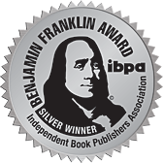


Award Entries
Winning awards for your book(s) can help garner
publicity and help build your author brand.
Research awards for your book(s).
Variety of award programs available – Indie Awards; Ippy Awards; American Library Association Awards; National Book Award, etc.
Helps build recognition.
Generates Media Opportunities.
Helps grow fan base.
Integrate the entry fee costs into your marketing budget.
If you win, try to attend the ceremony.
Get the jpg or eps file of the award and get to Terri so it can be added to the front cover file of your book for all future printing.
Get winning info to our social media manager and post blurbs and pictures on your social media as well.
Consider doing a press release for local media to try to garner publicity.

Slide 31
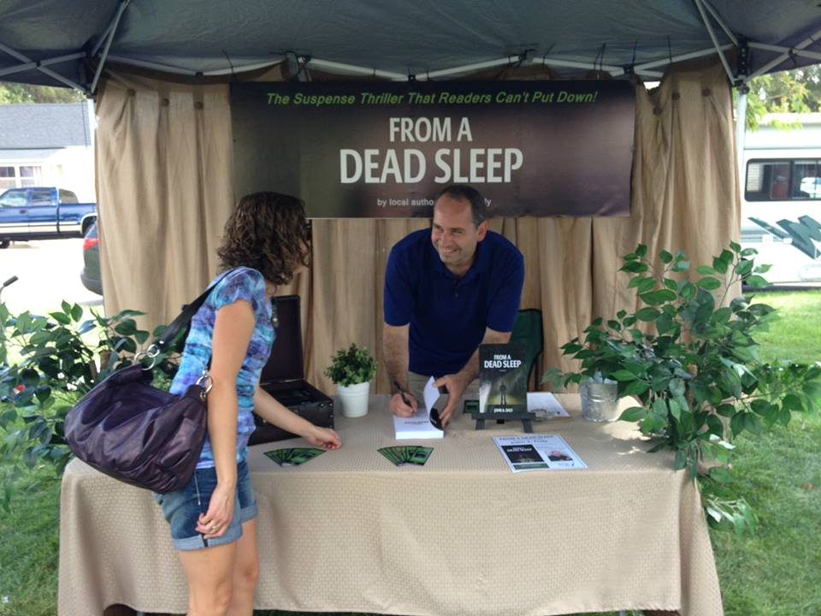
Events
Create and attend events that will
bring attention to you and your book(s):
Signings
Readings
Launch Parties
Try to participate in events being sponsored by local bookstores
Attend and/or exhibit at larger events where people who love books and reading congregate
Festivals (book related and beyond!)
Writers conferences (writers are readers too)
Local events – Arts Fair, Library, Schools
Seek out speaking opportunities

Slide 32
Other Things to Consider
Book trailers.
Blog.
Participate in BQB/WriteLife blog by responding to the questions and themes Holly sends out each week with the link to the current blog.
Do a presentation at a local meetup group.
Give a talk at a local school or business club if your content is appropriate for the group.
Create a discussion on http://www.quora.com. Ask questions, engage users.
Get on a podcast.
Create an event on GoodReads
Create a virtual book tour.
If your book is nonfiction, or fiction with topics that relate to daily life, create short presentations and put them on www.slideshare.com

Slide 33
Other Things to Consider - Continued
Do an ebook signing. This is a new and growing field – here’s some great info to get you started: http://www.nytimes.com/2011/04/14/fashion/14NOTICED.html?_r=0
Here’s a link to a site that allows you to do ebook signings: https://www.authorgraph.com/
Hold a virtual event just like you’d hold physical events – on a Google hangout, a webinar, a Facebook event. Have prizes and giveaways to keep people on the line and engaged, to get them interested enough to spread the news of you, your book(s), and your events.
Run a Google hangout (using your slides from SlideShare) or other pictures and information http://www.google.com/+/learnmore/hangouts/

Slide 34
Questions?
Type any questions in the chat feature here!

Slide 35
Our Next Author Call
Saturday, July 25th
10:00 a.m. ET
“Understanding Twitter and Making it Work for You”

Slide 36
Thanks for joining us!
Have a great weekend!
Bqbpublishing.com
Writelife.com

