Slide 1

Author Training Call: Using Twitter to Build Your Author Brand and Market Your Book(s)
Welcome!
Saturday, July 25, 2015
11:00 a.m. EST

Slide 2
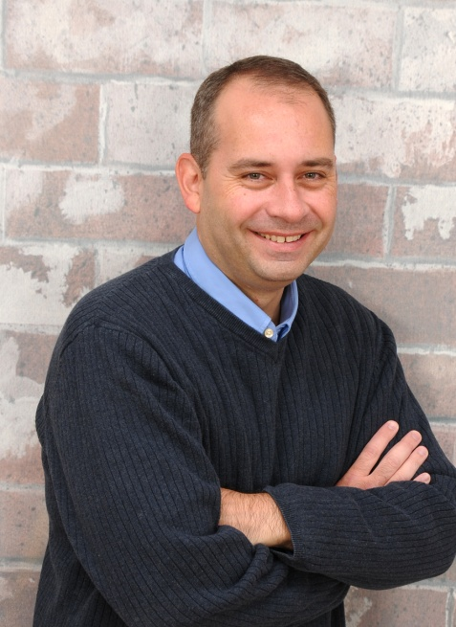
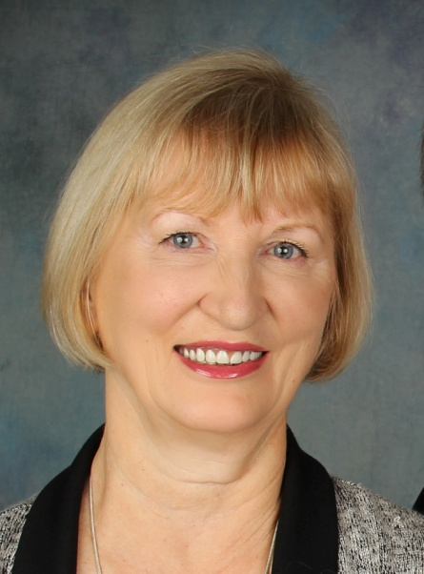
Presenters
Terri Leidich John Daly
President/Publisher BQB & WriteLife Social Media Manager BQB Publishing/WriteLife Publishing Author

Slide 3
Overview
Twitter is one of the strongest and most widely used of the social media apps.
There is a character limit to tweets, so tweeting can be fast and easy.
It’s important to be present on Twitter – don’t just automate your Twitter feed.
Effective tweeting takes creativity – you must be interesting for people to be interested.
This quote really sums up Twitter:
“Twitter is, first and foremost, a platform for personalities. . . You want to come across as a unique individual, not as a mindless spambot or clickbait machine.”

Slide 4
Why Should An Author Have a Twitter Account?
It’s one of the most popular social media sites on the web (around 250 million monthly active users).
Many readers are already interested in text-based media (eBooks), and have joined Twitter to follow their favorite authors.
It’s a quick and easy way to ingratiate yourself to readers and potential readers.
Its free.

Slide 5
Creating a Twitter Account
On a computer, go to www.twitter.com and go through the signup process.
If you use a mobile device, install the Twitter app and go through the signup process.
Use attractive, high-quality photos that represent you.
Your header photo should ideally be 1500 x 500 pixels in size.
Your profile photo should be square and at least 400 x 400 pixels in size.
Make your profile text interesting and personable. You have 160 characters for your bio. Include more than just the fact that you’re an author (add things you like, hobbies, words to live by, etc.).

Slide 6
Tips for Choosing a Username
Author name is best
Keep it simple
Shorter is better
Think personality
Example: @TerriAnnLeidich

Slide 7
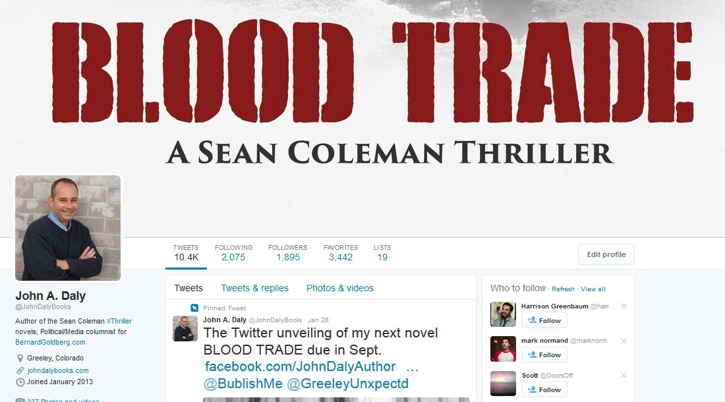
Example of Good Cover and Profile Image for Twitter

Slide 8
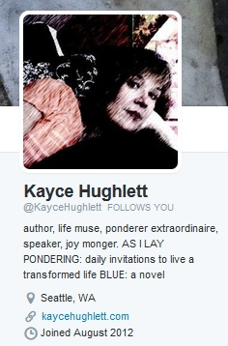
Example of Good Author Bio

Slide 9
Understanding Your Twitter Page
Home – contains the basics
Your name and picture
The number of tweets you have made
How many followers you have
How many people you are following
Your tweet box where you write your tweets
Suggestions of people you can follow
Your twitter feed, where you see tweets from the people you follow (along with your own tweets)

Slide 10
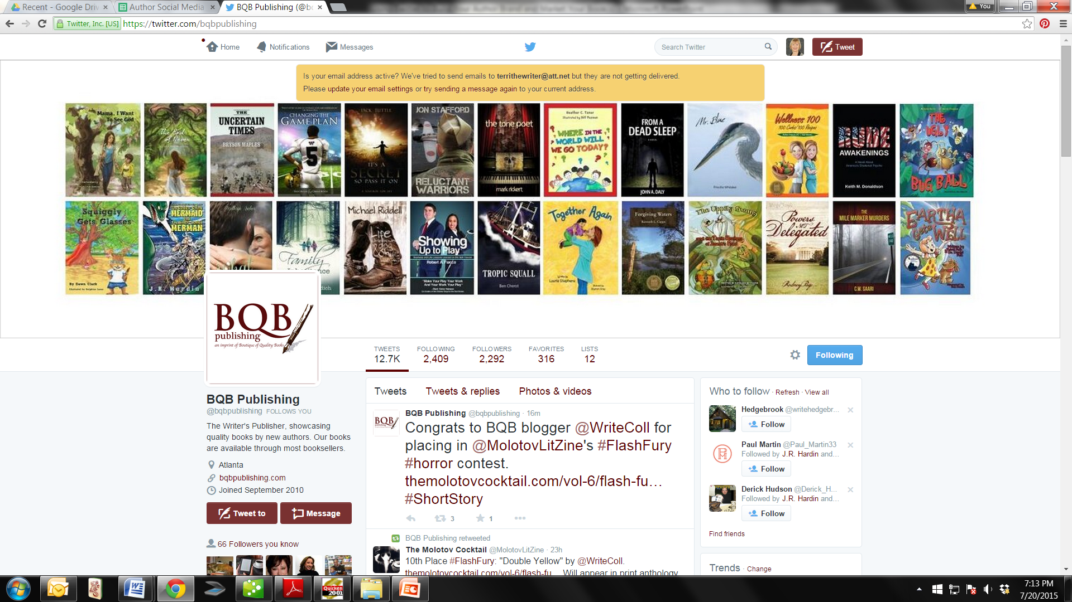
Understanding Your Twitter Page

Slide 11
Understanding Your Twitter Page - Continued
Notifications Page
List of responses to you or your tweets from other Twitter users (new follows, retweets, favorites, replies, etc.)
List of trending topics
You can choose to see all notifications or just those from people you follow
Message Page
Shows all direct messages that come in to you
Allows you to respond directly to the person

Slide 12
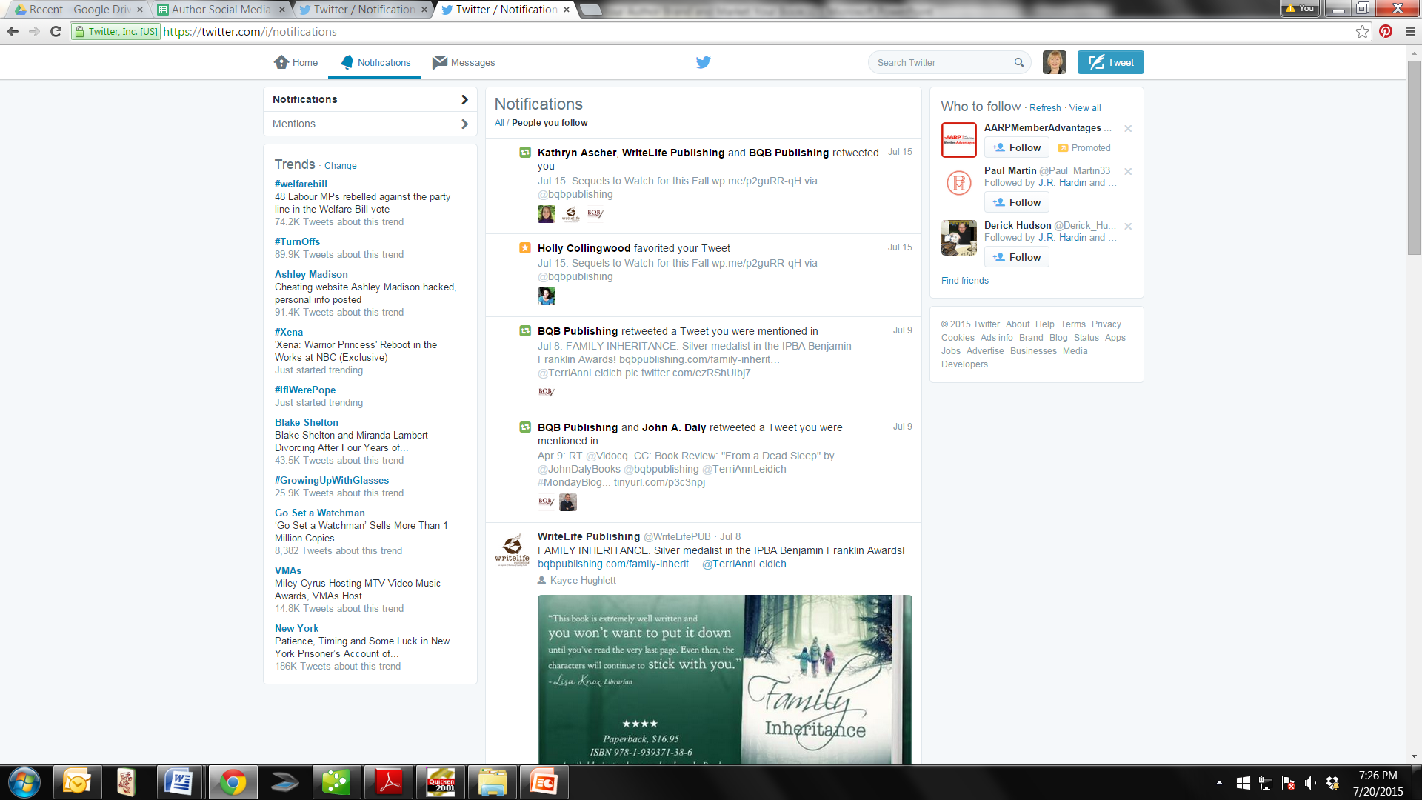

Slide 13
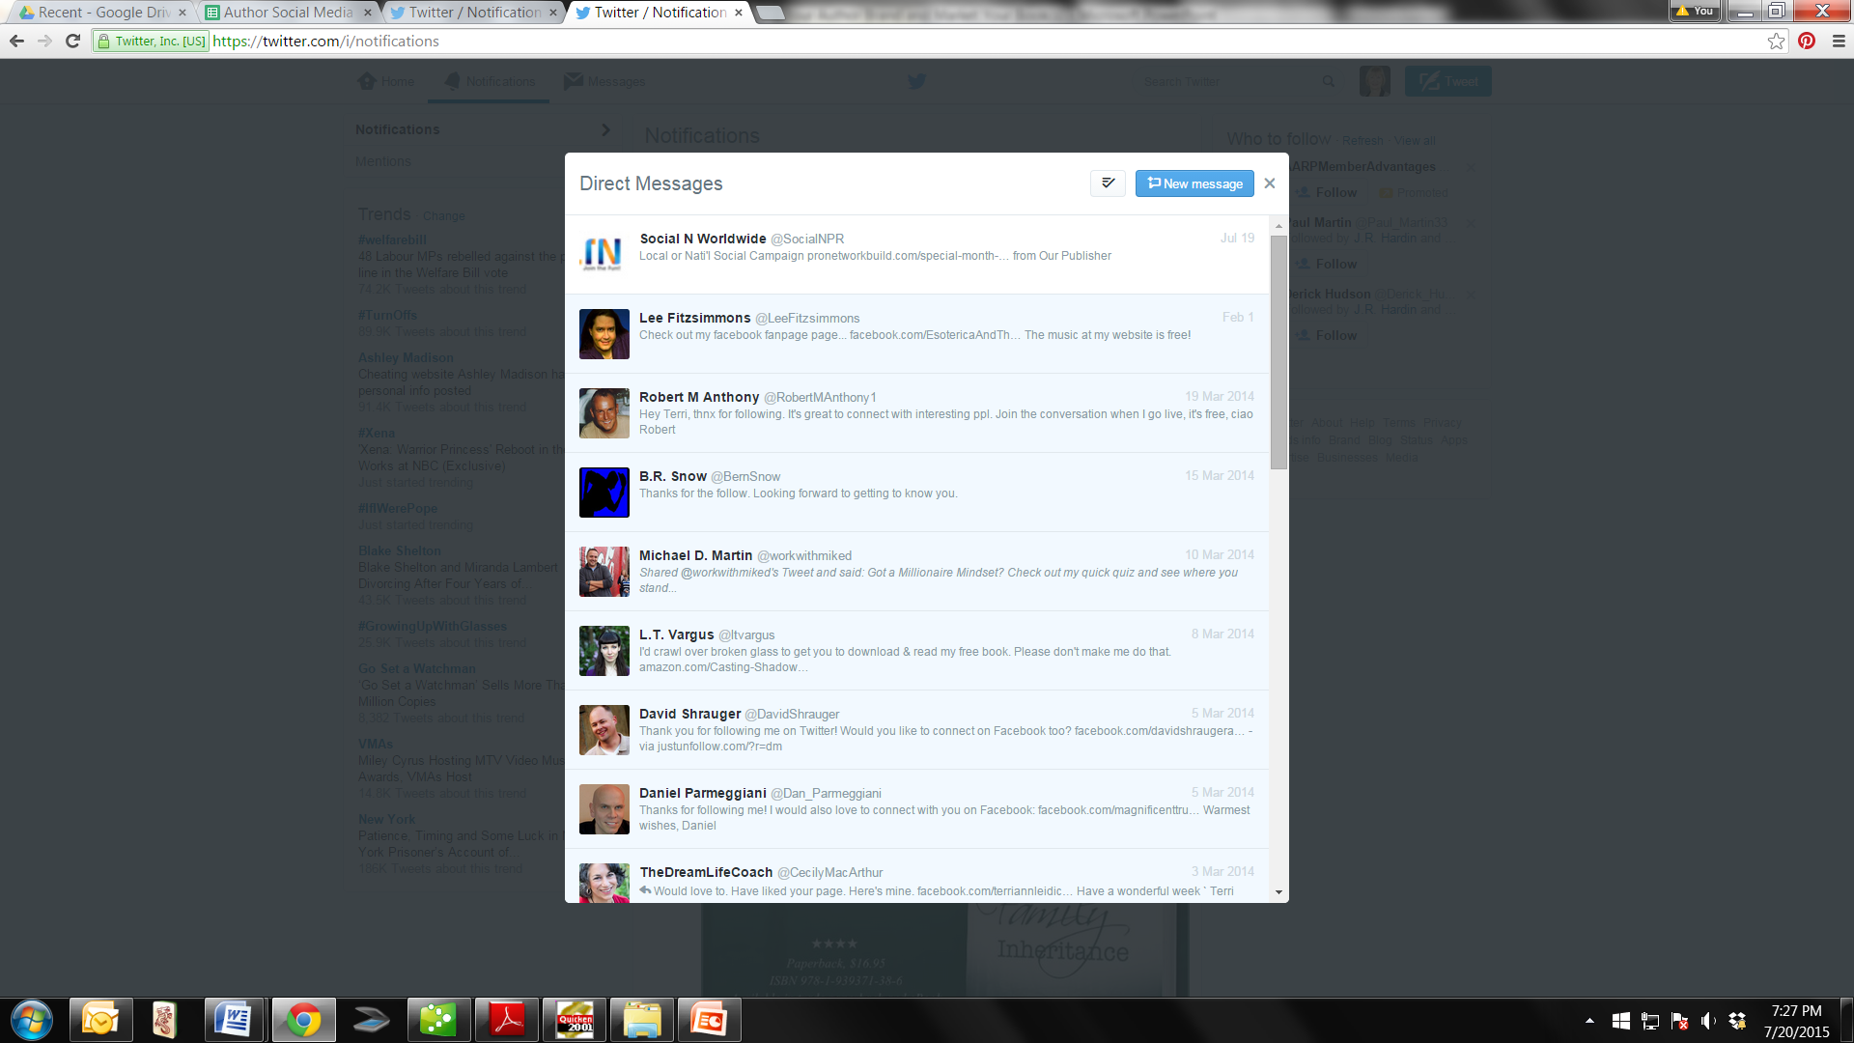

Slide 14
What is a Tweet?
A tweet is a brief message that you type into a text field and post for the world to see.
A tweet can be no longer than 140 characters.
It can be:
A random thought
A link to a webpage
A photo with descriptive text
Really, anything you want it to be
Anyone who “follows” you on Twitter will see your tweet appear in their Twitter feed, where they can retweet it (post it to their own followers’ newsfeeds), reply to it, or “favorite” it, which means they like it.

Slide 15
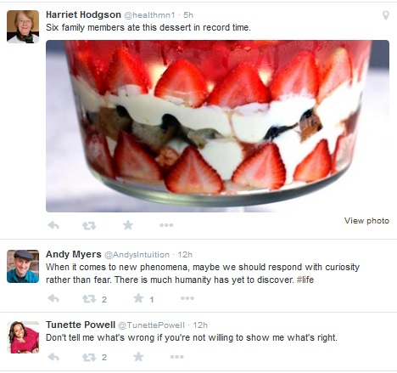
Example of a Twitter Newsfeed

Slide 16
Adding Pictures & Links to Your Tweets
Add pictures to your tweets
To the right of where you type your tweets is a picture of a camera.
Click on that picture, it will open a search box where you can find the picture on your computer, click on it, and it will add to your tweet.
You can use pictures of all types — the cover of your book, a picture of you, a picture of something you enjoy, etc.
Adding a link to your tweet
You can add a link to any tweet by typing it in or cutting and pasting.
For example, the link to your author site, a Goodreads giveaway, a Bubble on Bublish, an article you want to share, etc.

Slide 17
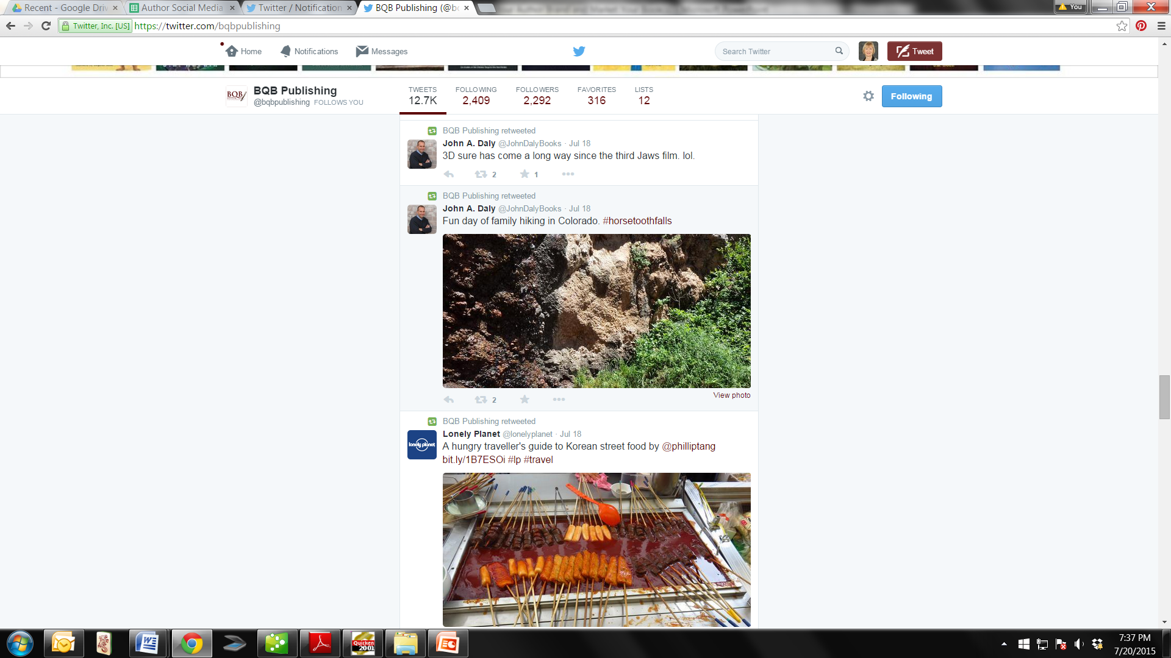
Adding Pictures & Links to Your Tweets
Add pictures to your tweets
To the right of where you type your tweets is a picture of a camera
Click on that picture, it will open a search box where you can find the picture on your computer, click on it, and it will add to your tweet.
You can use pictures of all types — the cover of your book, a picture of you, a picture of something you enjoy, etc.

Slide 18
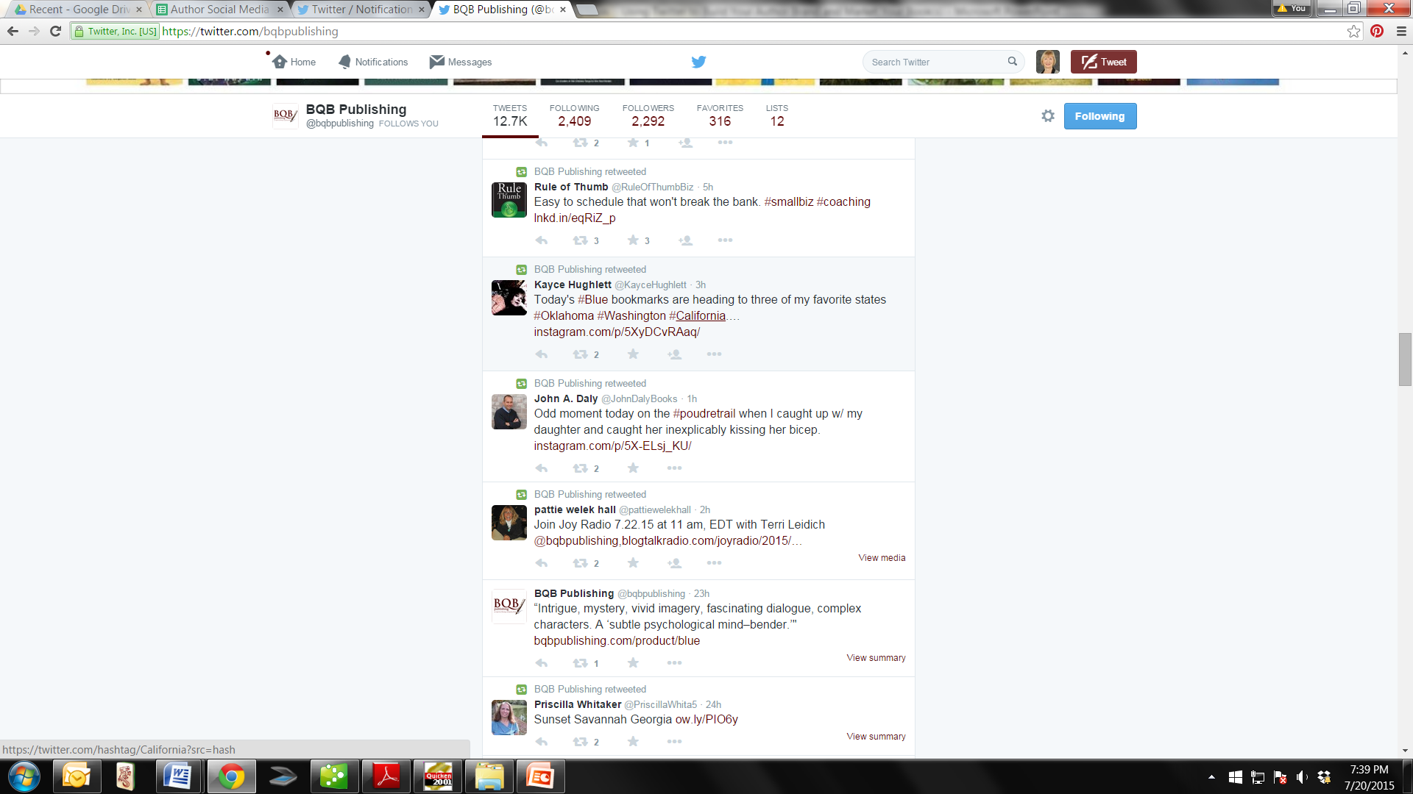
Adding Pictures & Links to Your Tweets

Slide 19
What Does the @ Mark Mean on Twitter?
@ marks are “mentions” – to mention another Twitter user like BQB, you use the @ mark in a tweet (all Twitter user names begin with an @ mark).
Example – You know, @BQBpublishing offered a great author training call today.
That tweet will show up to BQB when they go to their Mentions page and see who was talking about them.
It also allows others to see that BQB was mentioned.
The more you mention others, the more they will mention you — hence, more publicity.

Slide 20
What Does the # Mean on Twitter?
# marks before a phrase or word (with no spaces) creates a hashtag.
A hashtag ties your tweet to a particular sentiment or trending topic.
By using the # in front of common words, you make them searchable to everyone and that makes your tweet searchable to everyone.
Example: @BQBpublishing is a great #publisher of #books and has some fabulous #authors.
Once you make that tweet, anytime someone searches the words “publisher”, “books”, or “authors”, your tweet will show up among all others that have those words in them.
Use hash tags whenever you can.
Watch how others use them and avoid using terms that people wouldn’t typically search for.

Slide 21
How do people use #Hashtags?
Main Subject
#TheWalkingDead #MarchMadness #BookLaunch
To “Speak” to the Subject
Just a quick tweet to let you all know my cancer surgery went well! Thank you for praying and thinking of me! #gratitude
Punchline (not necessarily to connect with others)
Just saw a guy driving a Prius throw a garbage bag out of his window. #ironic
Find People to Follow
#writingtips What’s the best one you’ve read recently?

Slide 22
How Can I Type Anything Meaningful in 140 Characters or Less?
Twitter is intended for simple, short casual connections
Abbreviate
Use hashtags to condense your point
Examples:
It’s 11am and my kids are still asleep. #SummerSchedule
Great #writing day for me!

Slide 23
What do “RT”, “MT”, & Periods Mean in Other People’s Tweets?
RT stands for retweet.
It’s used when someone is including another Twitter user’s tweet in their own tweet.
For example, this is me saying that user @JoeSmith’s joke was funny: “Too funny! RT @Joe Smith: Grape-nuts cereal has neither grapes nor nuts! What gives?”
MT stands for modified Tweet
It’s used when you’re referencing another tweet, but not verbatim.
For example: “Too funny! MT @Joe Smith: No grapes or nuts in Grape-nuts”
Why do some people precede their tweets with a period?
By default, your reply to someone else’s tweet won’t display in your followers’ newsfeed – example: @CampbellSoupCo I like your soup.
If you put a period in front of that tweet, it WILL display for your followers to see – example: .@CampbellSoupCo I like your soup.

Slide 24
What Should I Tweet About my Book?
Very little.
Authors should be concentrating on marketing themselves by building their brand, building a following, and engaging their followers and readers—not broadcasting info on their book.
Your tweets should never make followers feel like you’re force-feeding your book to them. If they feel like you are, they’ll unfollow you.
Rule of Thumb: Fewer than 10% of your tweets should reference your book. When you do reference it, do it indirectly (unless you’re announcing something like a sale, an event, a contest, an award, a milestone, etc.)

Slide 25
If Not My Book, What Should I Tweet About?
Personal anecdotes, observations, humor, inspirational quotes, etc.
Write about what you are doing, thinking, feeling, etc.
A recommendation, a “shout-out”, a quote, a saying, or anything short and sweet that others might find interesting, funny, or fun.
A #shoutout is a way of mentioning a group of people on twitter.
i.e. #shoutout @bqbpublishing @terriannleidich
The shoutout will go out to ALL of your followers and to those you mentioned.
Links to articles you think would interest others (including your own blogs or columns).
Photos of you or others doing fun things.
Your thoughts on current events.
Engage celebrities and other public figures (who have lots of followers) on Twitter. If they reply to you or retweet you, that gives you A Lot of instant exposure.

Slide 26
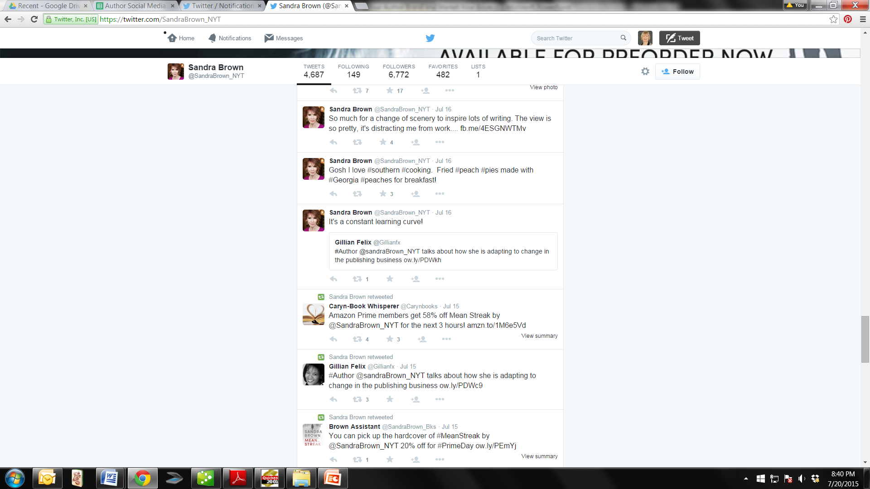

Slide 27
Is There Any Topic I Shouldn’t Tweet About?
Use your own discretion.
Keep in mind that political and religious comments don’t always sit well with everyone.
Yet, people who share your views on such topics might be drawn to your book, especially if the topic is relevant to your book.
Don’t give out personal info like your phone number, home address, photos that show your car’s license plate, etc.

Slide 28
How do I get People to Follow me on Twitter?
Make your posts interesting and fun.
Give them value.
This will compel others to retweet your tweets to their followers, who might then consider following you.
Follow other people.
When you follow someone on Twitter, that person is notified.
In many cases, they’ll follow you right back.
Check out the Twitter “Who to Follow” recommendations that show up on your home page and notification pages.
By writing, fun, quirky, interesting tweets – the more you tweet and the more interesting and fun they are, the more people will start following you.

Slide 29
Who Should I Follow on Twitter?
Popular authors who write in your genre to see what they’re posting, and gather ideas.
People who follow authors who write in your genre. A lot of them will follow you back.
Skip company accounts and accounts with provocative profile info/pictures; those are just marketing hooks.
Search for people who list themselves as an “avid reader” or “voracious reader” in their profile information.
Searching is done by typing those or other phrases into the Twitter search field, and then selecting “Accounts” from the “More options” link. You might want to couple this search with the name of your genre to get more relevant results. Again, a lot of these people will follow you back.

Slide 30
Who Should I Follow on Twitter? - Continued
Public figures you admire.
Bookstores/booksellers that could potentially order copies of your book.
People who are following you (again, skip accounts that don’t look legit).
Followers are less likely to stop following you if you are following them.
Accounts relevant to the subject matter of your books.
Example – my books take place in the Colorado mountains. Thus, I follow accounts associated with the Colorado wilderness.

Slide 31
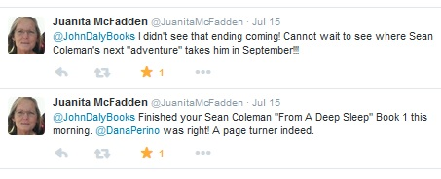
Will My Tweeting Actually Lead to Book Sales?
I’ve had people reply to my tweets to ask me about my book.
Most of them have gone on to buy it.
I’ve seen significant jumps in my book sales right after famous people have retweeted me or replied to my tweets
Example:

Slide 32
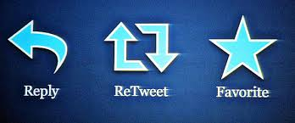
The Symbols at the Bottom of Tweets

Slide 33
Reply
To join a conversation.
Can be seen by anyone who looks at your tweets
Will show up in the feed of those who follow both people involved in the conversation
If you want ALL your followers to see the reply in their feed, you have to put something before the username (like a period).

Slide 34
Retweet & Favorite
Retweet
You send out the tweet on your Twitter feed.
Mix tweets and retweets.
Too much retweeting can annoy followers.
Favorite
By clicking on the “favorite” link on someone’s tweet, you are saving it like you would a favorite website.
It also shows that person you favorited their tweet (very similar to a Facebook “like”).

Slide 35
Direct Messages
You can send direct messages to people who follow you.
These are private messages, unlike replies.
A lot of people do not read direct messages on Twitter.
Don’t use this option for pushing your book.
Often used for spam/people will unfollow you for for this behavior.
Can be used to exchange emails.

Slide 36
The Big Picture
Conversation vs. Promotion (10% promo)
Relationships first
Have something to talk about that is NOT your book
Great way to connect with people all over the world
Build your author brand

Slide 37
Questions?
Type any questions in the chat feature here!

Slide 38
Note:
There will not be a training call in August. We’ll resume our training calls in September.

Slide 39

Thanks for joining us!
Have a great Saturday!

