Slide 1

Author Training Call:
How to Build Your Author Brand and Develop a Fan Base
Welcome!
Saturday, September 12, 2015
11:00 a.m. EST

Slide 2
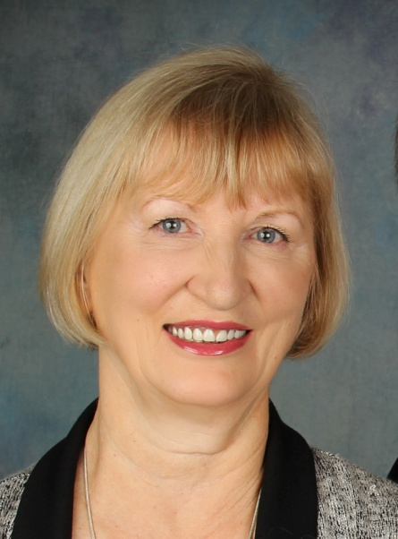
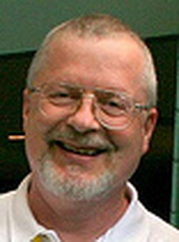
Presenters
Terri Leidich John Kremer
President/Publisher Publisher, Editor, and Author
BQB Publishing/WriteLife Publishing

Slide 3
About John Kremer
John Kremer is an expert on book publishing and marketing. The owner of Open Horizons Publishing in Taos, New Mexico, he is the editor of the Book Marketing Tip of the Week newsletter.
John is the author of a number of books on publishing and marketing, including 1001 Ways to Market Your Books: For Authors and Publishers, Book Marketing 411 for Authors, and Celebrate Today. He has also designed the Book Marketing Magic program and the Blog Tour Palooza program.

Slide 4
Overview
Between 1 -3 million books (print, eBooks, audio books) are released into the marketplace each year.
Why do some mediocre books make it to the bestselling lists while great books languish with few sales?
The difference is how well an author brand is developed and the size of an author’s fanbase.
In today’s world, when writers become published, they become authorpreneurs who are automatically tasked with building their brand and followers if they want to succeed.
Building a brand and fanbase is an ongoing task, but there are steps and tools that should be the core of your marketing plan.

Slide 5
Build your author brand and develop a fan base
John kremer
BookMarketingBestsellers.com

Slide 6
Here are a few things you can do online and offline to build your fan base.

Slide 7
1. Write a Q&A Column for a High-Traffic, Targeted Website.

Slide 8
2. Offer free ebooks to the fans of high-traffic, targeted websites.

Slide 9
3. Do a SuperStar blog tour with top bloggers and targeted websites.

Slide 10
Offline
4. Speak to groups, bookstores, clubs, online radio shows, telesummits, etc.

Slide 11
5. Get on National TV (start local, build to national).

Slide 12
6. Work with Bookstores and Reading Groups

Slide 13
Questions?
Type any questions in the chat feature here!

Slide 14
Check out John Kremer’s Billion Book Initiative and 747 Book Marketing Take-Off Program

Slide 15
BookMarketingBestsellers.com

Slide 16
Upcoming Author Training Calls
Saturday, October 3rd, 11:00 a.m. EST – Creating Book Buzz Your Way with BQB author Kayce Stevens Hughlett
Saturday, November 14th, 11:00 a.m. EST – topic TBA
John Kremer will be back with us in December to talk about 5 Key Things to Do to Get Ready for a New Year of Marketing. Date to be determined.
Saturday, January 23, 2016 with WriteLife author Pattie Welek Hall – title TBA

Slide 17

Thanks for joining us!
Have a great Saturday!

