Slide 1

Author Training Call:
5 Key Things to Do Before the New Year to Increase Your Book Sales in 2016 – with John Kremer
Welcome!
Saturday, December 5, 2015
11:00 a.m. EST

Slide 2
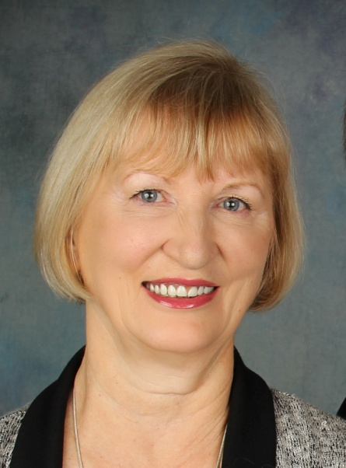
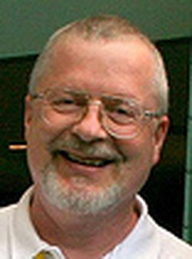
Presenters
Terri Leidich John Kremer
President/Publisher Publisher, Editor, and Author
BQB Publishing/WriteLife Publishing

Slide 3
About John Kremer
John Kremer is an expert on book publishing and marketing. The owner of Open Horizons Publishing in Taos, New Mexico, he is the editor of the Book Marketing Tip of the Week newsletter.
John is the author of a number of books on publishing and marketing, including 1001 Ways to Market Your Books: For Authors and Publishers, Book Marketing 411 for Authors, and Celebrate Today. He has also designed the Book Marketing Magic program and the Blog Tour Palooza program.

Slide 4
Overview
Effective book marketing means thinking outside of the box.
Don’t be afraid to try something different.
Trailblazing can be part of being a successful author.
It takes a village to create success – build your village.
Book marketing tools change almost daily, find sources to help you stay on top of new tools in the marketplace.

Slide 5
5 Key Things to Do Before the New Year to Increase Your Book Sales in 2016
John Kremer
BookMarketingBestsellers.com

Slide 6
1. Test out using Facebook Ads
Facebook ads have often proven effective in reaching people who would like your book.
Target people who have read books similar to yours, or authors who have written books similar to yours. You can pay as little as 10 cents per click to reach people.
Besides targeting people by book or author, you can also target by demographics, gender, age, annual salary, location, interests, etc.
BookMarketingBestsellers.com

Slide 7
Test out using Facebook Ads . . .
Facebook ads have always proven to be the best, but you could test ads or other promotions on other social networks as well: Google+, Instagram, Twitter, Pinterest, etc.
BookMarketingBestsellers.com

Slide 8
2. Do a Crowdfunding Campaign
A crowdfunding campaign can be used to test your book title, test your market, test your author platform, etc.
Plus, of course, a campaign can be used to actually launch your book – and sell many copies.
BookMarketingBestsellers.com

Slide 9
Do a Crowdfunding Campaign . . .
For fiction and children’s books,
you can use the Kickstarter platform.
For non-fiction, use the IndieGoGo platform.
BookMarketingBestsellers.com

Slide 10
Do a Crowdfunding Campaign . . .
For book and authors, these crowdfunding platforms can also work: CrowdSupply, Inkshares, Patreon, Publishizer, Unglue.it, and Upspringer.
BookMarketingBestsellers.com

Slide 11
Do a Crowdfunding Campaign . . .
For more crowdfunding websites, check out this list:
http://bookmarketingbestsellers.com/crowdfunding-websites
BookMarketingBestsellers.com

Slide 12
Do a Crowdfunding Campaign . . .
For running a crowdfunding campaign, see the following tips:
http://bookmarketingbestsellers.com/11-keys-to-crowdfunding-success
BookMarketingBestsellers.com

Slide 13
Find joint venture partners
Take a few minutes each day to find bloggers, websites, social media profiles, email newsletter editors, YouTube channels, etc. that reach the audience you want to reach.
Your goal: To locate people you can support (and they support you!).
BookMarketingBestsellers.com

Slide 14
Find joint venture partners . . .
Start by following their blogs and social media profiles. Comment on their posts. Share them. Pin them. Retweet their tweets. Share their blog posts and articles. Start making connections.
BookMarketingBestsellers.com

Slide 15
Find joint venture partners . . .
Ask for an interview. Start by interviewing them. Once you’ve done the interview, you can ask if they’d like to interview you.
Interview options: written interview, Skype, Google Hangout, Blur, Internet Radio, podcast, teleseminar, webinar, etc.
BookMarketingBestsellers.com

Slide 16
Find joint venture partners . . .
Interviews are a great way to begin relationships.
There’s nothing better than having a conversation with someone to start building a real relationship, build trust, and create partnerships.
BookMarketingBestsellers.com

Slide 17
Find joint venture partners . . .
For more on building relationships in less than an hour a day, see:
http://bookmarketingbestsellers.com/the-i-dont-
have-any-time-hour-a-day-book-marketing-plan
BookMarketingBestsellers.com

Slide 18
4. Get Listed
Many websites will be happy to feature your book (or you as an author) for free. Take one website a day, check it out, and place a listing at that site.
Here are 194 websites where you can get listed (many are free, some have a small fee):
http://bookmarketingbestsellers.com/
101-ebook-listing-and-book-review-websites
BookMarketingBestsellers.com

Slide 19
5. Make a habit of giving
Set aside 5 or 10 minutes a day to give something to someone.
Give a free book via your website (in return for their email address).
Give your help by retweeting someone, sharing their post, etc.
Give a presentation like this one for free.
BookMarketingBestsellers.com

Slide 20
Make a habit of giving . . .
Say a prayer for someone.
Let someone write a guest post on your website.
Give money to someone’s crowdfunding campaign.
Promote someone’s crowdfunding campaign or book launch.
BookMarketingBestsellers.com

Slide 21
Make a habit of giving . . .
Give. Give. Give.
You can get a free set of these slides here:
We’ll begin by sending you these slides after the presentation.
BookMarketingBestsellers.com

Slide 22
Questions?
Type any questions in the chat feature here!

Slide 23
Check out John Kremer’s Billion Book Initiative and 747 Book Marketing Take-Off Program

Slide 24
BookMarketingBestsellers.com

Slide 25

Thanks for joining us!
Have a great weekend!

