Slide 1

Answering Your Questions on Publishing, Distributing, and Marketing Your Book(s)
Welcome!
Saturday, January 16, 2016
11:00 a.m. ET

Slide 2
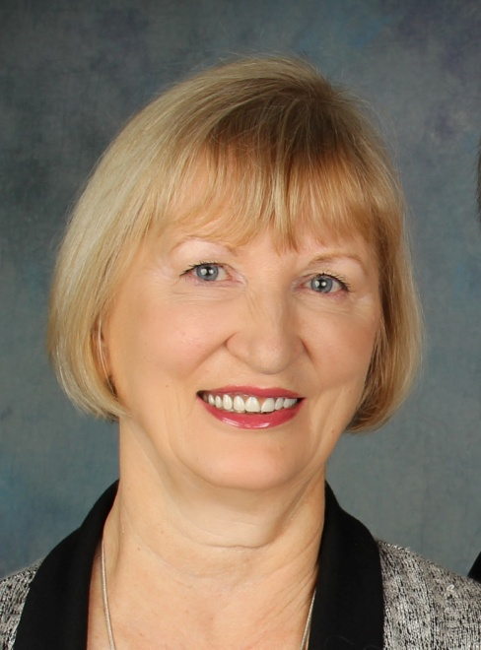
Presenter
Terri Leidich
President/Publisher
BQB/WriteLife Publishing

Slide 3
Overview
I get a lot of emails on an ongoing basis that ask the same or similar questions.
Today I’ll answer these, and other questions you pose during this call.
These slides can be kept and used as a reference for general questions and approaches of BQB/WriteLife Publishing, Distributing, and Marketing of your book(s) and your participation in those processes.

Slide 4
Publishing Questions
How close to our publishing date is our book actually ready for pre-ordering and printing?
Our distributors require that I have the cover, book blurb, and author bio ready about 6 months before release. Once I present our titles (either spring release or fall release) to our distributors, they will upload the information to databases (Amazon, B&N, Ingram, etc.) and on the sites that offer pre-release orders, (like Amazon) and your fans and family will be able to order them. At that same time, your book is setup on our website for pre-order. You are notified when this happens.
At that time, you are encouraged to send out those links to everyone you know, and get them out on social media to help promote pre-release orders. Also put them on your website, email (below signature) etc.
Once the book is set up with the printer, (usually 2-4 months before release),I order initial copies and send you two copies along with a letter explaining how to order copies for your sales and marketing efforts and what you should be doing at that stage.
Inventory for our distributor is typically ordered about 1-2 months in advance and pre-orders to retailers from the distributor are generally fulfilled about 1-2 weeks before the release date.

Slide 5
Printing and Distribution
Our books are professionally printed and distributed.
We do not do print-on-demand.
We keep inventory in a warehouse with our distributor, New Leaf Distributing, and books are ordered from them by bookstores or wholesale companies like Ingram, Baker & Taylor, and Barnes & Noble Distribution Center.
If books are ordered through New Leaf, Ingram, Baker & Taylor, or Barnes & Noble Distribution Center, they are fully refundable to the retailer who orders them in this manner.
If you are working with a retailer or special event that does not order through New Leaf, Ingram, Baker & Taylor, or Barnes & Noble Distribution Center, those book purchases (with a wholesale discount) can be ordered directly through BQB/WriteLife and are ordered via email to terri@bqbpublishing.com If you will connect me with the retailer or person handling the special event, I will handle the rest of the details.
For any books that you sell directly, or any books you use for marketing, you buy them directly from BQB/WriteLife at 50% of the SRP (Suggested Retail Price), plus shipping. Those orders are placed via email to terri@bqbpublishing.com

Slide 6
Amazon
The biggest book seller by far, with great influence on consumers.
Why doesn’t Amazon always have my book in stock?
Everything with Amazon is done via algorithms (computers) and books are automatically ordered when the demand is there.
Amazon is also set up with distributors to have books shipped only every two weeks (to control shipping costs) so no matter how much either we or you pester them, your books will be shipped on the designated shipping date from the distributor.
The best way to ensure that a newly released book will be in stock with Amazon is to help generate a lot of pre-release orders.
Why do my ranking numbers change on Amazon, and what does it mean?
Your ranking numbers can change drastically in a short period of time and are affected by: sales, reviews, even people clicking on your book. A change in ranking does not always mean sales.

Slide 7
Amazon – Cont’d
How can I influence sales on Amazon?
Complete your profile so readers can easily find out who you are and what you write.
Help generate reviews on Amazon. The minimum number of reviews you need to have is 10 to get noticed by Amazon’s algorithms and once you get over 50, the Amazon algorithms really kick in.
Use social media to ask for reviews.
Impress upon friends, family, and fans how important reviews on Amazon are.
If your book has been reviewed by NetGalley reviewers before release, once the book is released, drop them an email and ask if they would post the review on Amazon. (Amazon will not accept reviews until a book is published.
Put the link to your Amazon print and eBook on your author website, your emails (under your signature) and anywhere else where people can easily click on the links to go to Amazon to order your book or even just look at it.
Consider running an Amazon giveaway on your book(s) to increase awareness. Here’s a link to a great article that explains how to do a giveaway with Amazon and the pros and cons http://jodierennerediting.blogspot.com/2015/03/using-new-amazon-giveaway-to-promote.html

Slide 8
Amazon – Cont’d
On a continuing basis, I work with our distributors (especially our eBook distributor) on promotions and sales with Amazon. Each quarter, they send me a list of the promotions and sales they will be doing for the following quarter and I submit book titles that are appropriate for that promotion or sale. If our books are selected, our eBook distributor lets me know and I let the authors, whose books are selected, know so you can help market the sale or promotion.

Slide 9
Ordering Books
Can my books be ordered from other countries? - Yes
Through Amazon.
Our WriteLife website is set up to ship to foreign countries and our BQB website can easily be set up for it as well.
Ordering your books for your own sales and marketing.
Email me at terri@bqbpublishing.com with the amount of books you want to order (minimum order is 25). You pay 50% of the SRP (suggested retail price) plus shipping.
I’ll create an invoice and email it to you. The invoice can be paid via check, credit card, or PayPal.
Once the invoice is paid, the books are ordered and you will receive them in 3-4 weeks.
If you need a rush order, check with me to see if I have them on hand and in smaller quantities, but don’t count on it and wait until the last moment to order books.
How are my books ordered by bookstores and Amazon?
Bookstores order either through wholesalers that get their books from our distributor, or they order directly from our distributor.
Amazon orders directly from our distributor.

Slide 10
Ordering Books – continued
Ordering other BQB or WL books for your own reading pleasure.
Go to either www.bqbpublishing.com/shop or www.writelife.com/shop and find the books you want to order.
When you’re done selecting your books, go to the shopping cart and when your order is complete, put in the coupon code – author30 – to receive a 30% discount of your entire order, even books that are already discounted on our site.
If books are in stock, your order will be shipped out in the next couple of days.
If you order a pre-release book, it will be shipped out about a week before release.

Slide 11
Book Signings and Getting Books for them
Because of our traditional printing and distribution, your books will be in all databases for Barnes & Noble and indie bookstores, which makes ordering them easy, thus setting up a book signing relatively easy (as long as the bookstore is open to doing signings).
If they mention you bringing the books on consignment, let them know that your book is traditionally distributed and is available through wholesalers.
For book signings, bookstores can order your books through:
Ingram
Baker & Taylor
New Leaf Distribution
B&N stores can also order from the B&N Distribution center
Bookstores should know this, but if the wholesaler they use (Ingram, B&T, or B&N Dist) only shows 1 or 2 books in stock, let them know that they can place the order and the wholesaler will get the books from our distributor to fulfill their order.
Most B&N stores will order about a month in advance, but Indie stores might have to be reminded. Indie stores can also set up an account with New Leaf to get the books more quickly. The phone number for the New Leaf call center is 800-326-2665.

Slide 12
Book Signings and/or Book Readings
Setting up book signings or readings is your responsibility. BQB/WriteLife has a large list of bookstores around the country which can be accessed by emailing terri@bqbpublishing.com
BQB/WriteLife also has slides for explaining the best steps to use in setting up a book signings or readings. To receive it, email terri@bqbpublishing.com
Barnes & Noble does a lot of book signings and/or readings with BQB/WriteLife authors, but the ease in which they are done can vary from store to store, depending on how good the CRM (customer relations manager) is. Different stores do different types of signings or appearances, check out their website before making contact.
Independent bookstores can also be a good option for book signings or readings, but before you approach them, check out their websites.
Books A Million stores are very hard to set up book signings with. Unless they are the only bookstore within miles of where you live, I’d bypass them and go for the B&N or indie bookstores.
Think outside the box on book signings or readings and look for retailers that attract your target market. If they don’t order directly from a wholesaler, they can order directly from BQB/WriteLife by emailing me at terri@bqbpublishing.com

Slide 13
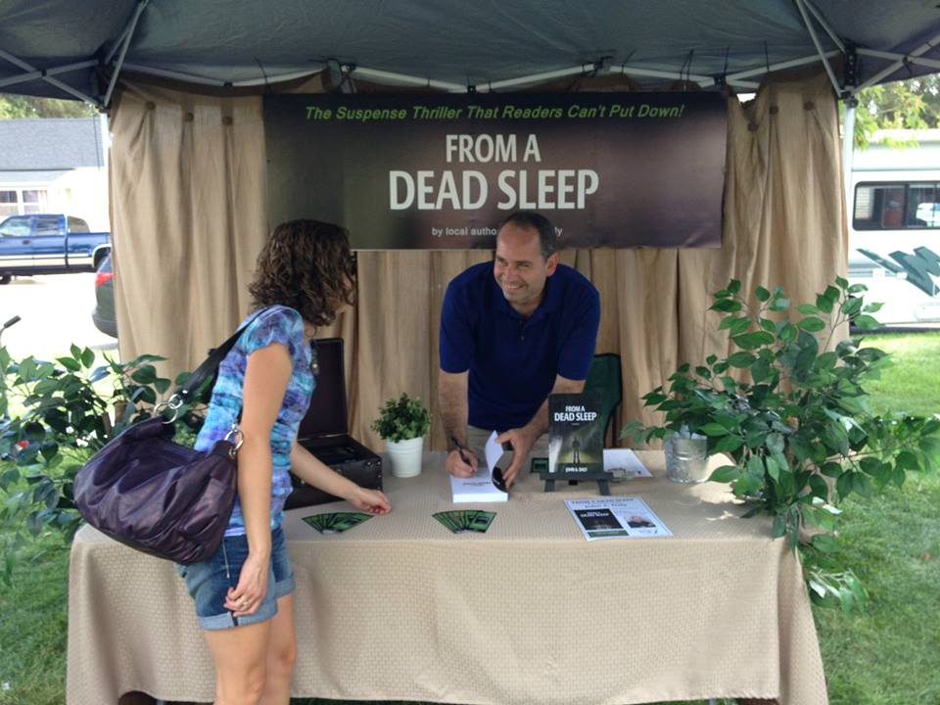
Book Signings or Readings - continued
Once you’ve set up a book signing or reading, the work has just begun.
Communicate with the bookstore to find out how they are going to promote the signing or reading. In many instances, they will leave the promotion up to you, so make sure you use flyers, social media, local event listings, etc. to help pull in a crowd.
For a reading, follow the stores protocol.
For a book signing, be prepared to set up a nice space. The bookstore will provide the table and chair and the books they have ordered in advance, but it’s up to you to make the table look nice. Some authors bring flowers and other accouterments that enhance the setup.

Slide 14
Book Signings or Readings - continued
Make sure you have bookmarks (these can be ordered through BQB/WriteLife or done locally) to hand out to everyone who attends a reading, and for book signings, for everyone who goes by or stops at your table.
Have an author poster (this can be ordered through BQB/WriteLife or done locally) that either sits on a table or on an easel behind the table or the space set up for the reading.
For book signings, don’t sit behind the table, stand and engage people as they go by. Be ready to talk with people, and not just about your book. Remember, people buy from people they like, so be likeable.
Don’t be “in their face” about buying your book. Build your author brand and fanbase by being approachable, nice, and someone they’d like to know.
For a reading, be available and accessible after the reading to talk to people, sign your books, etc.

Slide 15
Marketing & Advertising
Marketing Collateral
We recommend that you have these marketing collateral materials as a minimum:
Bookmarks
An author poster or sign for the table
BQB/WriteLife can create custom marketing collateral for you. We have a list of the marketing collateral that is available through us. Email terri@bqbpublishing.com for the list.
You can have marketing collateral designed and printed locally as long as you keep to professional standards.
Authors can use the BQB/WriteLife logo on marketing collateral or in advertising as long as they are professionally designed and created. The logo is available by emailing terri@bqbpublishing.com

Slide 16
Marketing & Advertising - continued
Launch Parties
They are generally held on the release date, or a day before or after.
The major purpose of a launch party is to celebrate the publishing of your book and to connect with your already established fanbase and sell your book or sign books that have been pre-ordered and received.
The number of books you should have on hand for your launch party will depend on how many people you expect. Generally, you will get from 30-50% of the people you invite to attend. And generally, 50% of those will buy your book. Those are general numbers.
Books for your launch party (and any direct sales and marketing you do, both in the beginning and going forward) are ordered directly me via email terri@bqbpublishing.com for approximately 50% of the SRP (suggested retail price) of your book. (Minimum order is 25 books) You are not paid royalties on books you order for your direct sales and marketing, and for direct sales, you sell them at the SRP (or a reduced rate if you wish for special events. I would not reduce the price of your book at your launch party.
Themes of launch parties differ depending on your author brand and your book genre. If you’re not sure what to do, drop me an email terri@bqbpublishing.com and we’ll set up a time to talk via phone.

Slide 17
Marketing & Advertising - continued
Events That Can Help Build Awareness
Launch Parties
Signings
Readings
Launch Parties
Try to participate in events being sponsored by local bookstores
Attend and/or exhibit at larger events where people who love books and reading congregate
Festivals (book related and beyond!)
Writers conferences (writers are readers too)
Local events – Arts Fair, Library, Schools
Seek out speaking opportunities

Slide 18
Marketing & Advertising – continued
Advertising
There are a variety of advertising opportunities that are offered to us through different vendors. If you are interested in pursuing advertising, email me and I’ll let you know what is currently available. Sometimes an opportunity is so good that I’ll send out an email to all of you.
Some of the ongoing advertising opportunities are:
eBlasts through NetGalley or Foreword Magazine
BQB/WriteLife authors can use the BQB/WriteLife logo in their book advertising and promotions as long as:
All books being promoted have been published and printed by BQB or WriteLife.
The promotion is professionally done.
The logo file can be obtained by emailing terri@bqbpublishing.com

Slide 19
Marketing & Advertising – continued
eBook Promotions
I work with our eBook distributor on an ongoing basis to participate in any promotions that eBook retailers are offering.
You can work with entities such as the Fussy Librarian, BookBub, etc. to set up eBook promotion marketing with the following parameters:
I must know about these promotions at least two weeks in advance to ensure I can get your eBook pricing in alignment with your promotion.
Use caution when doing the free or $.99 pricing because you might hamper or interfere with any eBook promotions that we currently have running or future ones that we won’t be able to participate in because you have offered your book for free or $.99 within a year from that promotion. It’s always a good idea to check with me about any eBook promotions you are intending to do.

Slide 20
Marketing & Advertising – continued
eBook Promotions – continued
It’s very hard to get accepted by BookBub for an eBook promotion, so here are some good alternatives:
Book Sends – http://www.booksends.com/advertise.php Subscriber list of 100,000
Book Gorilla – http://www.bookgorilla.com Subscriber list of 100,000
The Fussy Librarian – http://www.thefussylibrarian.com – Subscriber list of 100,000
eReader News Today – http://ereadernewstoday.com – Subscriber #s not listed
Social Media
Social media is a very important part of marketing. It’s important to have, as a minimum, a Facebook account for you as an author and/or your book plus a Twitter account.
John Daly johndalybooks@hotmail.com is the Social Media Manager for BQB/WriteLife.
Make sure you connect with John so he can ensure that BQB and/or WriteLife are following you to repost and retweet your entries.

Slide 21
Marketing & Advertising – continued
Book Trailers
Book trailers can be a fun marketing tool to start some buzz about your book
Here’s a link to sites on the Internet that describe a video trailer and how to create one. https://www.google.com/webhp?sourceid=chrome-instant&ion=1&espv=2&ie=UTF-8#q=what%20is%20a%20book%20trailer
Once you have a book trailer, send the URL link to terri@bqbpublishing.com so I can get it to our eBook distributor for use in marketing.
Also provide the URL link to John for inclusion on our website and in social media. johndalybooks@hotmail.com

Slide 22
Marketing & Advertising – continued
Book Promotions in General
What does BQB/WriteLife do?
Sends out an eNewsletter on the 1st and 15th of each month to Booksellers, Customers, BQB/WriteLife Authors.
Attends book shows and festivals during the year where are books are featured.
Works with our print and eBook distributors to get included in promotions, sales, and/or advertising, when appropriate.
Works with Independent Bookseller Associations around the country.
Has an active social media campaign that promotes authors and books.
Has a blogger who blogs weekly about a variety of topics that always includes books, BQB/WriteLife books, authors, etc.
Takes advantage of other opportunities as they surface.
What can Authors do?
Know your niche market and find ways to promote your book(s) to them.
Attend local book shows and festivals.
Set up and attend book signings.
Use social media to build your author brand.
Always have bookmarks with you, ready to hand out when the opportunity presents itself.

Slide 23
Giveaways
Goodreads
BQB/WriteLife sets up a Goodreads Giveaway on every book we publish. It generally runs for 90 days before the release date. We handle all details for the giveaway, sending out the books, etc.
As an author, consider setting up a Goodreads giveaway on your book 6 months to a year after it has been released and then every year for about 3-5 years. Remember, it can take 3-5 years for a book and author to get established in the marketplace.
Amazon
BQB/WriteLife does not do giveaways on Amazon.
As an author, consider doing an Amazon giveaway. Here’s a great article that explains the details http://jodierennerediting.blogspot.com/2015/03/using-new-amazon-giveaway-to-promote.html
Other Giveaways
We’ve tried other giveaway sites like Rafflecopter, and haven’t been impressed.
As an author, you can setup giveaways, but be careful where, how many books you give, and how often. Giving away your books too often and in too many places, can affect the perceived value.

Slide 24
Book Reviews
Every book published by BQB/WriteLife is offered on NetGalley for review, generally 2-3 months before the release and will continue to be kept on the site as long as reviewers are downloading it.
We also send out copies of books before the release date to influencers like Publishers Weekly, etc.
As an author, you can send your book out for reviews to marketplace influencers before it is published. If you do so, either send a print copy or if you are sending a digital copy, make sure you get a review pdf copy from BQB/WriteLife that is bookmarked as “review copy.” Do not send out the regular pdf as that makes it much too easy for piracy.
Is it appropriate to provide a “free” copy of my book for a review? Yes, the only way someone can review your book is if you send them: a print copy, a review pdf, or an ePub. I wouldn’t offer anything additional, unless required, and only then if it is a top book consumer influencer.
Let John Daly johndalybooks@hotmail.com know about any book reviews you get on your own so he can get them up on the review page of our BQB or WriteLife website and he can get them out on social media as well.

Slide 25
Book Reviews - continued
It is appropriate for authors to pay for reviews (i.e. Kirkus, Chanticleer Reviews www.ChantiReviews.com, etc.) if they are credible sources.
Bloggers are a great source of book reviews. Here are some links to influential bloggers in different genres:
http://www.blogmetrics.org/romance_novels (Top romance bloggers)
http://www.blogmetrics.org/books (Top 50 Book Blogs)
Book reviews don’t have to stop once your book has been published, or if it has been on the marketplace for a while. Look for bloggers that specialize in backlist books, i.e. https://bookbacklist.wordpress.com/about/
Watch for local resources such as regional magazines or online magazines that do book reviews.
Find magazines that focus on your genre and see if they do book reviews.
Ask your social media circles if they would post reviews on your book on Amazon or Goodreads. You might be surprised how many people have read your book, but just don’t think of posting a review.

Slide 26
Book Clubs
Many well-known authors have kicked up their awareness through book clubs.
Finding them:
Ask your friends and acquaintances.
www.wherewriterswin.com provides a list of book clubs for their Winner Circle members.
Check out your local library, bookstores, or coffee shops where book clubs often meet.
Search for book clubs on Facebook and Goodreads
Search online for book clubs in your city.
Create a Google (Giga) Alert for book clubs.
Check out http://bookclub.meetup.com Put in your zip code and it will list the book clubs in your area along with the pertinent information.
www.readerscircle.org let’s you put in a zip code and will provide local book club and contact information.
Use relevant hash-tags on your social media. John Daly uses #ColoradoBookClubs.
Have a list of “Suggested Book Club Questions” on your author website along with your contact information.

Slide 27
Publicity
General Info:
Publicity is getting appearances on television or radio programs, articles in magazines, newspapers, etc.
At this point in time, BQB/WriteLife does not have a publicist and we do not initiate publicity but we will work with authors who do.
Publicity is handled by each individual author or a publicist they hire.
BQB/WriteLife does have PowerPoint slides to help guide authors on how to obtain publicity. To receive them email terri@bqbpublishing.com
BQB/WriteLife provides files for the contents of a press kit and directions on how to use it. If you don’t have your press kit files and your book has already been released, email terri@bqbpublishing.com If your book hasn’t released yet, you will receive your press kit files before it releases.

Slide 28
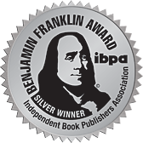

Award Entries
We recommend entering your books in award contests
Because winning awards for your book(s) can help garner
publicity and help build your author brand.
There are a variety of award programs available - do some research
The ones I recommend entering – in this priority
Benjamin Franklin Awards
Ippy Awards
IndieFab Awards
American Library Association Awards
Awards can generate media opportunities.
Integrate the entry fee costs into your marketing budget.
If you win, try to attend the ceremony.

Slide 29
Explaining our Royalty Reports
Your royalty report file has different sheets for print books and eBooks. (Look at the bottom of the screen when the file is pulled up).
If you have more than one book with us, each book will have a sheet for print book sales and a sheet for eBook sales.
Each sheet is divided with a yellow line. Anything listed above the yellow line means that the books have been ordered and we have been paid for the order. Anything below the yellow line means the order has been placed, but we have not yet received payment.
Once payment is made to us, orders are moved from below the yellow line to above the yellow line.
Royalties are recorded from the 5-10th of each month for sales up to the end of the previous month.
Whenever your author royalties (above the yellow line) are more than $50, you will receive a royalty check. (Checks are generally sent out around the 15th)
Payments to us can range anywhere from 30 days after the sale to up to six months after the sale, depending on the retailers and distributor.

Slide 30
Taxes, etc.
Once you become an author, you are an entrepreneur and will need to keep track of income and expenses. Check with your accountant, but generally all expenses you incur to publish, sell, or promote your book are deductible.
This is what we provide:
A 1099 by January 31st that will report all royalties above $10 that have been paid to you in the previous year.
Invoices for any book orders you place.
The contract outlines your production expenses.

Slide 31
New Services for 2016
Each year, BQB/WriteLife works to expand our services, and this year we will be adding Audio Books and Canadian Distribution
Audio Books
We will be working with Audible and ACX to create and distribute our audio books.
Authors will pay any associated fees for production; BQB/WriteLife will manage the production, distribution, and marketing of all BQB/WriteLife audio books. Royalties will be a 50/50 split.
Ways to participate:
Pay for creation of audio files (These fees for creation can run from $500 for a children’s book to $3,000+/- for a good-sized novel or nonfiction book) and if distributed exclusively with Audible (Audible, Amazon, iTunes), Audible pays 40% of retail sales to BQB/WriteLife, which will be split with author.
Pay for creation of audio files and have nonexclusive distribution with Audible, leaving other channels open. Audible pays 25% of retail sales to BQB/WriteLife, which will be split 50/50 with author. The percentage paid by other distributors will vary.
Share royalties with an audio book producer where there are no production payments up front but Audible pays 20% of retail sales to Producer and 20% to BQB/WriteLife, which is split 50/50 with the author.

Slide 32
New Services for 2016 - continued
Have your audio files created locally, or through someone you know, provide BQB/WriteLife with high-quality files and we will upload to Audible and other distributors depending on whether author wants exclusive distribution with Audible or wider distribution.
In General, how much do audio books sell for:
Under 1 hour recorded time - $7 and less
1-3 hours; $7-10
3-5 hours; $10-20
5-10 hours; $15-25
10-20 hours; $20-30
Over $20 hours - $25-35
If you are interested in audio book distribution for your book, email Terri@bqbpublishing.com to discuss the details for your particular book.

Slide 33
New Services for 2016 - continued
Canadian Distribution
We have contracted with a Canadian Distributor and in 2016 will begin limited distribution in Canada. To have your book distributed in Canada, you must:
Have connections and marketing capabilities in Canada so you can help market and promote your book there.
Have the ability to, and be willing to, pursue and setup book signings and appearances in Canada.
If you have both of these, contact terri@bqbpublishing.com
Canadian distribution will include:
Sales rep presentation of your book to Chapters/Indigo buyers
This is done on a spring/fall release scheduleInteraction with indie bookstores in Canada on a recommended basis.
Interaction with Indie Bookstores in Canada on a recommended basis.
Books will be printed and kept in inventory in Canada.

Slide 34
Questions?
Type any questions in the chat feature here!

Slide 35
Thanks for joining us!
Have a great weekend!
Bqbpublishing.com
Writelife.com

