Slide 1
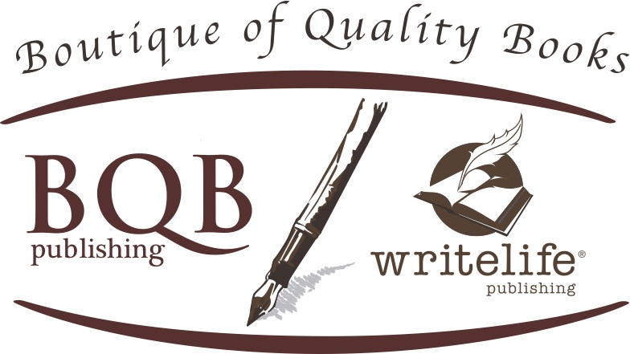
Success is in the Details
Welcome!
Saturday, February 27, 2016
11:00 a.m. ET

Slide 2
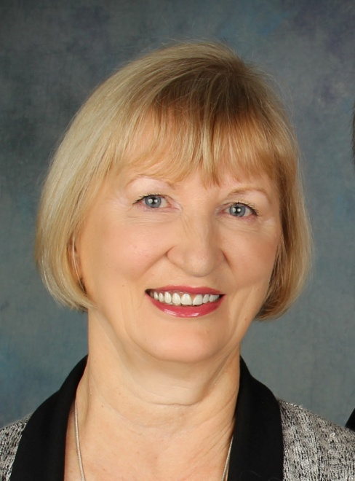
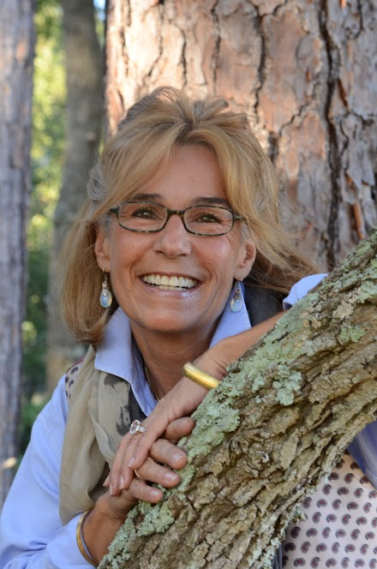
Presenters
Terri Leidich
President/Publisher
BQB/WriteLife Publishing
Pattie Welek Hall
Author of A Mother’s Dance

Slide 3
Overview
Success in any endeavor is always in the details.
It’s one thing to know what it takes to be successful, but it’s quite another thing to get into the details of implementing what it takes.
Behind every step, there are details that will help ensure your success as an author.
Today we’ll talk about some of the things that help authors build their brand and their sales, and the details behind those tasks.

Slide 4
About Pattie
Her book, A Mother’s Dance, released on November 6, 2015.
She has four pages of reviews in her book.
On Amazon, there are 53 reviews of her book.
Her book has been chosen as an alternate book club choice for Pulpwood Queens Book Club in 2016.
The Brain Injury Association is listing her book on their website and considering her as a speaker for their annual conference.
MUSC (The Medical University of South Carolina) is carrying her book in their bookstore and creating opportunities for her to come in for book signings and to speak.
Pattie has learned how to “get into the details” and make them work for her.

Slide 5
Amazon
Things to know about Amazon
Pricing for books is controlled by Amazon and is based on inventory levels, orders, competition, bestseller status, and promotions. Your price may vary from time to time; this is not unusual.
The Amazon Best Sellers calculation is based on Amazon sales and is updated hourly to reflect recent and historical sales of every item sold on Amazon.
The Amazon search engine: For general keyword queries, Amazon searches for the words in the title, author, and subject fields.
Things you can do as an author:
Set up an author account: https://authorcentral.amazon.com/
Create an author page which can include your biography, photos, as well as videos and links to social media.
Add a link for your blog and/or events

Slide 6
Amazon - continued
Things you can do as an author (continued):
Join in the Customer Communities which allow you to connect with readers to share your questions, insights, and views about different books available on Amazon. http://www.amazon.com/gp/help/customer/display.html?nodeId=201145220
Consider immersing yourself in Amazon’s online community by subscribing to Amazon’s book blogs Omnivoracious http://www.omnivoracious.com/ where a lot of opportunities exist including Guest Essays.
Check out the books they recommend for Book Clubs. http://www.amazon.com/Book-Club-Picks/b?ie=UTF8&node=8081575011
On your Amazon Profile page, click on the FB and Twitter icons to share your Amazon author profile page on social media.
Submit your book directly to Amazon for a review. Send review copy to: Editorial Department (Relevant Category), Amazon.com, P.O. Box 81226, Seattle, WA 98108.

Slide 7
Amazon - continued
Understanding and Using your Amazon Link for Your book(s)
Putting your Amazon links for your print and eBooks on your email, your social media, etc. can help promote your books and send readers to your books on Amazon.
But just cutting and pasting the link from Amazon can actually be a detriment because within the link, Amazon has information which tags it to you and the specific time you took the link:
http://www.amazon.com/Family-Inheritance-Terri-Ann-Leidich/dp/1939371384/ref=sr_1_3_twi_pap_2?s=books&ie=UTF8&qid=1456414052&sr=1-3&keywords=family+inheritance
All of the information after “qid” is tracking information and can actually work to your detriment.
So, using the sample above, remove everything starting with ref= and create the URL for your link to look like this: http://www.amazon.com/Family-Inheritance-Terri-Ann-Leidich/dp/1939371384/ It will still take readers to your book without the tracking info.
If you currently have links leading to Amazon, it’s a good idea to clean them up now.

Slide 8
Book Clubs
Many well-known authors have kicked up their awareness through book clubs. Author Kathleen Grissom went from a few thousand sales to over a million sales using book clubs and bloggers. Even as a best selling author, she engages with book clubs on a weekly basis.
www.wherewriterswin.com provides a list of book clubs for their Winner Circle members.
Check out your local library, bookstores, or coffee shops where book clubs often meet.
Search for book clubs on Facebook and Goodreads
Check out http://bookclub.meetup.com Put in your zip code and it will list the book clubs in your area along with the pertinent information.
www.readerscircle.org let’s you put in a zip code and will provide local book club and contact information.
Skype has a program called Skype in the Classroom which offers free skyping to schools with an author. https://education.skype.com/resources/441-authors-who-skype-with-classes-book-clubs-for-free
Authors who are willing to interact with book clubs in person, or via Skype (or similar) or phone, can add their name to a database of authors maintained by Galley Cat http://www.adweek.com/galleycat/resources-for-authors-traveling-to-book-clubs-schools/21401?red=as

Slide 9
Book Clubs - continued
  Have a list of “Suggested Book Club Questions” on your author website along with your contact information.
  Use relevant hash-tags on your social media. John Daly uses #ColoradoBookClubs.
  Once you have contact info for a book club, compose a well-crafted letter introducing yourself and your book. Offer to mail them a copy or your book or provide a digital copy.
  By working with Terri, you can offer a special discount of your book for book club purchases.
  Don’t do a hard-sell push to them. Create a relationship where they will want to read your book.

Slide 10
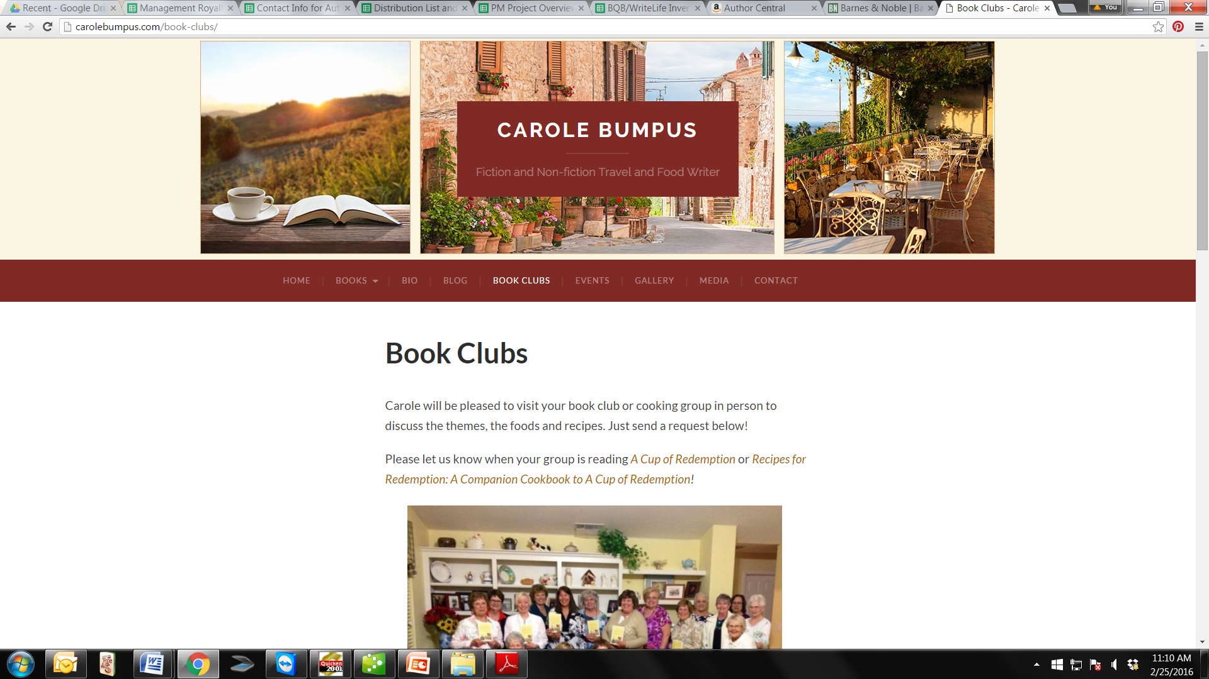
Book Clubs – continued
Have a page on your website that specifically addresses book clubs:

Slide 11
Book Clubs – Pattie’s input
Pulpwood Queens Book Club has over 600 chapters across the world. That’s a huge readership!
Check out their website – www.beautyandthebook.com
Get involved.
Buy a membership.
Read details about sending your book in to be reviewed and possibly picked as one of the selected reads for the year.
Attend their annual Girlfriend Weekend outside of Houston in January because:
  It’s a good way to meet reading groups and authors from across the globe.
  Good way to meet Kathy L. Murphy, the queen of the Pulpwood Queens in person.

Slide 12
Reviews
There are three major types of reviews and how to get them.
From big name reviewers (Kirkus, Publisher’s Weekly, etc.)
  Find their review process information on their website and follow it to the letter.
From bloggers who have a large audience of followers.
  Search out bloggers who write about and review books in your genre.
  Start following their blog to get familiar with what they write about and the types of books they review.
  If appropriate for your book, look for their review submission process and submit.
Individual readers who can post on sites like Amazon, Goodreads, etc.
  Readers don’t always think of posting reviews, so gently ask them or remind them via email, social media, twitter, etc.
  Most readers are very willing to help a favorite author when they know what to do.

Slide 13
Reviews – Pattie’s Input
Midwest reviews answers a lot of author’s questions about reviews with large reviewers: http://www.midwestbookreview.com/bookbiz/advice/advice.htm
  When sending your book to any reviewer, especially the larger ones, send it 14-16 weeks out from pub date.
  If possible, have your book arrive on Thursday or Friday.
  Make sure you send your book with a cover letter.
  Review follow-ups are a good idea. 10 days after mailing a copy of your book to be reviewed, follow up. You can call and ask the following three questions.
    Identify yourself first. Then – With the mail being as uncertain as it is, I’m calling to confirm that you have received (book title).
    Can you tell me the current status of (book title) with respect to your review schedule?
    Is there any further information or assistance I can provide you?
For personal reviews on Amazon, Goodreads, etc., if you recognize someone’s name, be sure to shoot them a message and thank them for taking the time to write a review.

Slide 14
Social Media
Why Twitter?
  It’s fast.
  It’s becoming mainstream.
Why Pinterest?
  98% of users are women.
  More content shared on Pinterest results in a share than other social media.
Why LinkedIn
  Perfect for fiction authors.
  Reach executives and professionals.
  LinkedIn groups have focused conversations and are a great place to promote content from your blog.

Slide 15
Social Media
Why Google+?
  Very easy to meet relevant people.
  Boost in your SEO with social search.
  Google+ communities (Google’s version of a group or forum, built to bring people together around particular topics) are the ultimate in social connections because they are focused, smart, and easy to use.
  Google+ hangouts allow a deeper connection with the benefit of having live events that are recorded and uploaded automatically to YouTube.
  Google Hangouts is a communication platform developed by Google which includes instant messaging, video chat, SMS and VOIP features. Here’s a link to a video on how to setup and run one: https://www.youtube.com/watch?v=AGHdqCkf9Ik
Why Facebook?
  You’re familiar with the platform and it’s easy to get started.
  You may already know people there following you.

Slide 16
Social Media
Improving Facebook Engagement
  The post formats that get the most engagement are questions and images.
  Short form text posts of less than 50 characters get the most interaction
  Videos that are directly embedded get over six times the engagement of embedded YouTube videos.
Promote Your Book Through LinkedIn
  Add your book(s) to the publications section of your profile.
  Add a live link to any articles you publish
  If you have won an award, received an honor, or been featured in a major blog of magazine, list it under “Honors & Awards.”
  Add images, documents, presentations, or videos to your LinkedIn profile.

Slide 17
Social Media - continued
Market Your Book on Pinterest
  Create an author pinboard telling your followers and readers who you are, where you came from, how you came to be a writer, and why you wrote your book.
  Ask your readers to share feedback or testimonials of your book(s) along with a photo of themselves.
  Create a dedicated board for each of your books. Use those boards to pin:
    Praise and reviews – when people write reviews of your book on their websites or blogs, make sure to pin them.
    Any guest posts or articles you’re publishing in support of your launch or your book.
  Pin images (and videos) from your in-person book signings and talks.
  Create a board for other book recommendations. Talk about what you’re currently reading and books you recommend.
  Select the best images, resources, and ideas on the Web about your topic (or genre), then pin the content on your pinboards.

Slide 18
Social Media – Pattie’s Input
Ads on FaceBook are cheap and can blast your message to a larger audience. I’ve done this twice and was amazed by the reach and number of hits I had to my links.
On Twitter – search on newspapers and local news in the area—and follow. Then when you posts #charlestonnews (or whatever your town is), they will receive the tweet too.

Slide 19
Bloggers
Bloggers are a great source of book reviews and for building a fanbase. Here are some links to influential bloggers in different genres:
  http://www.blogmetrics.org/romance_novels (Top romance bloggers)
  http://www.blogmetrics.org/books (Top 50 Book Blogs)
Book reviews don’t have to stop once your book has been published, or if it has been on the marketplace for a while. Look for bloggers that specialize in backlist books, i.e. https://bookbacklist.wordpress.com/about/

Slide 20
Book Launch – Pattie’s Input
Lots of ideas online. Midwest link also has suggestions.
It can be intimate or large. A lot depends on how deep your pockets are.
Suggestion: If you purchased hard cover books, the Book Launch is the time to sell them. Your friends came to support you and will be more willing to buy that hard cover at the event rather than after the event.
Make sure you bring a guest book and have everyone sign in with emails and home address.
You can send out e-vites online that don’t cost a thing and it helps you keep track of those attending.
You can also create a closed group on FaceBook and invite your friends from there. Again, another great way to track attendance.
At the event and after your reading, be sure to encourage everyone there to leave a review on Amazon.
Send Thank You notes or Thank You emails. Your friends don’t expect to be thanked, but the kind gesture goes a long way.

Slide 21
Marketing & Out of the Box Thinking – Pattie’s Input
Contact your high school and university alumni, and send notice of your book release, book launch, book signing, and where they can purchase the book. They might even be interested in doing an article on you in the alumni newsletter. If they have a library, donate your book.
Reach out to your old places of employment. They might be willing to do an email blast with your pub date, title of your book, and a link to order or pre-order your book.
Southern Writer’s Magazine – Prior to your book releasing, you can pay $35 for an ad “Sneak Previews” on your book. After I paid for the ad, Gary gary@southernwritersmag.com offered me the following for free:
  Inclusion in their popular feature “What’s the Story,” where authors share the inspiration that triggered the idea for their latest book or an inspiring anecdote related to the process of writing it.
  Because I purchased the ad, I was included in SWM online bookstore and invited to guest blog on Suite T or be interviewed on editor Susan Reichert’s blog Authors’ Visits.

Slide 22
Resources that Can Help
There are a variety of podcasts that can help you learn the details of success for a myriad of marketing approaches:
Weekly podcast by Amy Porterfield on Online Marketing Mad eEasy: https://itunes.apple.com/us/podcast/online-marketing-made-easy/id594703545?mt=2
Social Media Marketing Podcast by social media marketing guru Michael Stelzner: https://itunes.apple.com/us/podcast/social-media-marketing-podcast/id549899114?mt=2

Slide 23
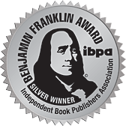
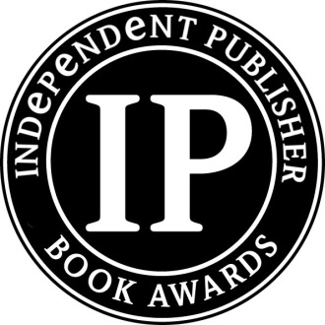
Award Entries
We recommend entering your books in award contests
Because winning awards for your book(s) can help garner
publicity and help build your author brand.
There are a variety of award programs available - do some research
The ones I recommend entering – in this priority
  Benjamin Franklin Awards
  Ippy Awards
  IndieFab Awards
  American Library Association Awards
Awards can generate media opportunities.
Integrate the entry fee costs into your marketing budget.
If you win, try to attend the ceremony.

Slide 24
Award Entries – Pattie’s Input
Submit your form online and pay with a credit card.
Box up the number of books requested and send USPS.
Make sure you have a tracking number.
A week later, be sure to go to usps.com and type in the tracking number to make sure your package arrived.
FYI – I had neglected to follow up and a few months passed and I remembered to track my package (Ben Franklin awards). I almost had a nervous breakdown when I saw the books were still sitting at the post office. They had not been picked up by Ben Franklin awards. I immediately called customer service and they confirmed my books had not been put into the system. The representative I talked to was accommodating and she promised to go the PO later that day to locate my books. The next day, I received an email saying the books were there. Had I not followed up and assumed they had been received, I would have lost the opportunity for my books to be entered for an award. Live and Learn. So. . . Follow up. Follow up. Follow up.

Slide 25
Questions?
Type any questions in the chat feature here!

Slide 26
Thanks for joining us!
Have a great weekend!
Bqbpublishing.com
Writelife.com

