Slide 1
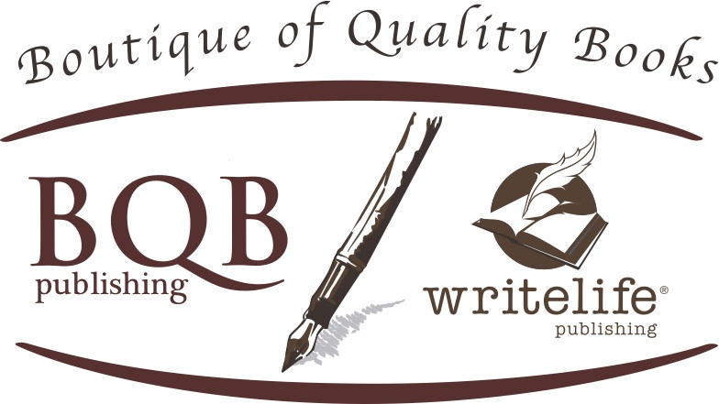
How To Create Author Buzz
Welcome!
Saturday, December 9, 2017
11:00 a.m. ET

Slide 2
Overview
Author Website
Author Profiles
Social Media
Newsletters
Marketing

Slide 3
Author Website
An absolute MUST HAVE
Provide info about author, book, and how to buy book
Have a “contact the author” link on your site

Slide 4
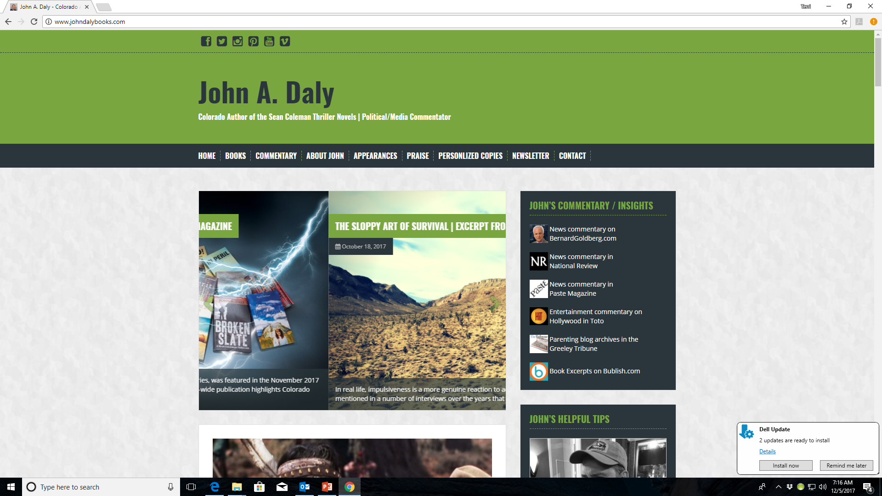

Slide 5
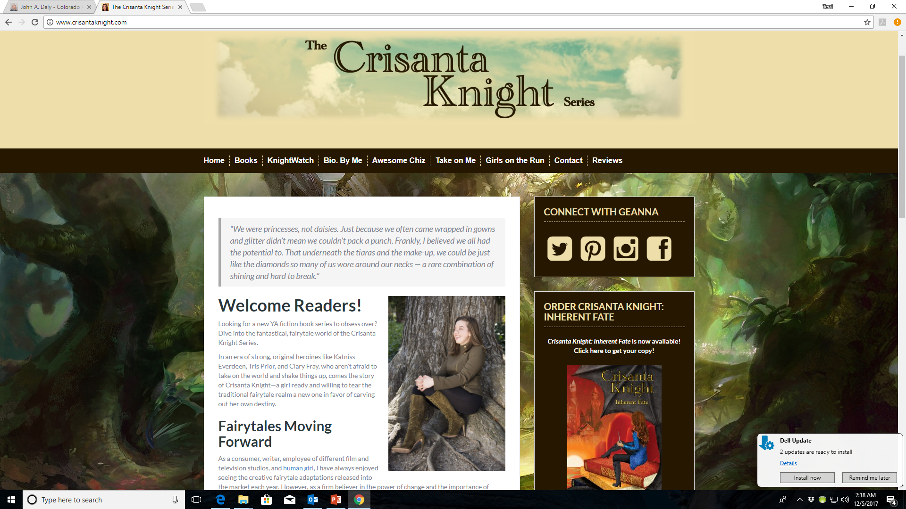

Slide 6
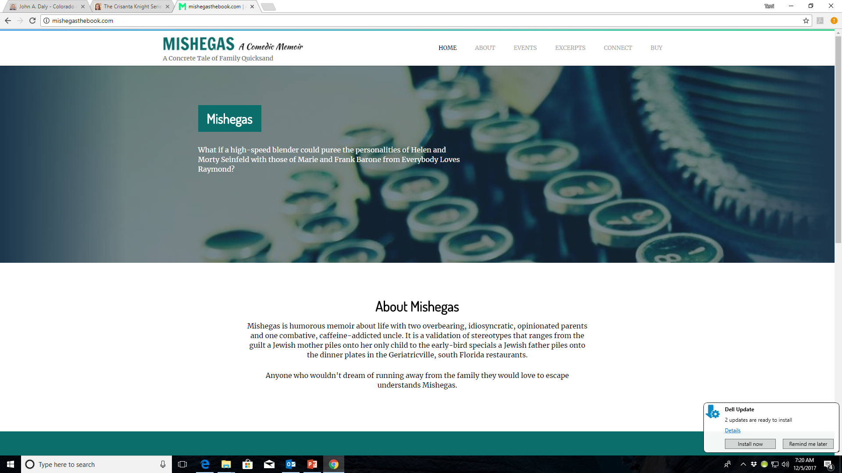

Slide 7
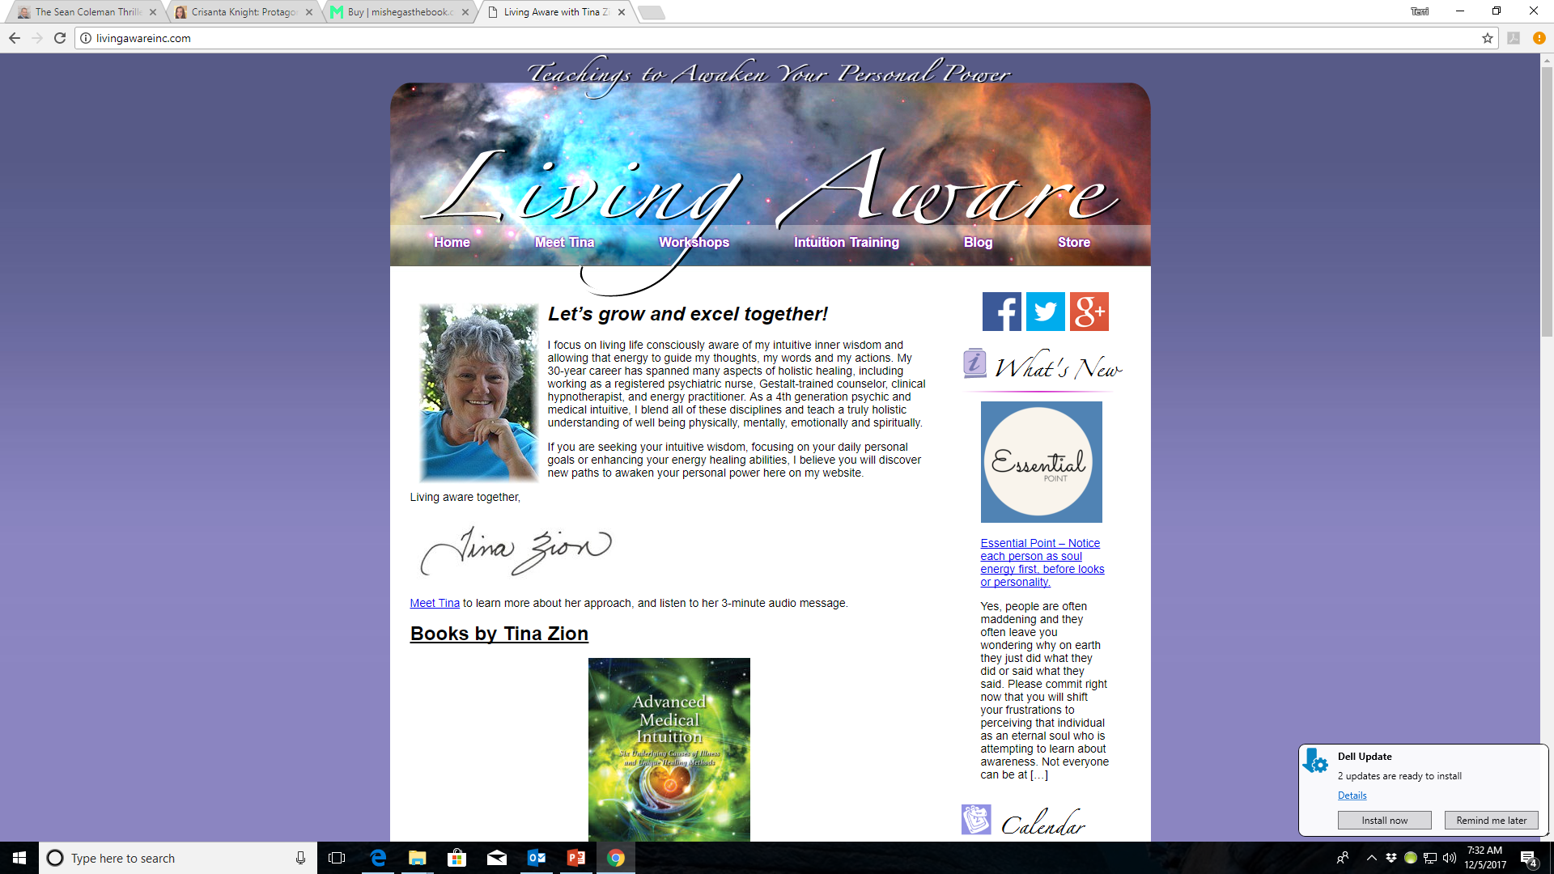

Slide 8
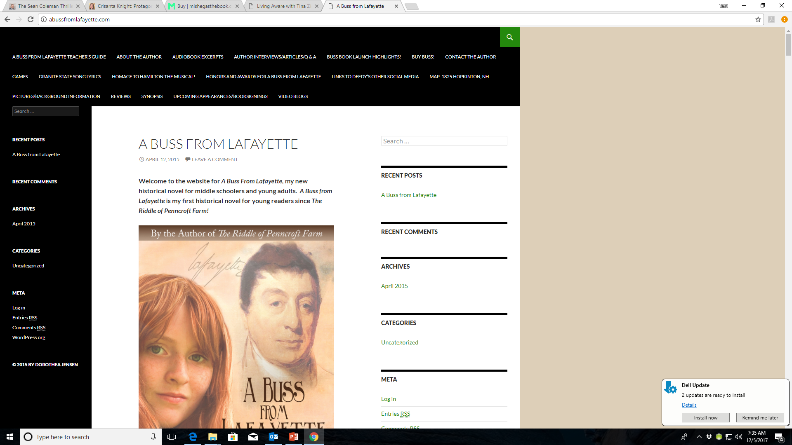

Slide 9
Author Website
Put links to your book on top retailers on your site so it’s easy for people to buy it
Amazon (print, eBook and Audio if applicable)
Barnes & Noble (print end eBook)
iBookstore (print, eBook and Audio if applicable)
Google Play (eBook)
Kobo (eBook)
IndieBound (print book)
Links to BQB or WriteLife are no longer necessary as we are removing our online stores.

Slide 10
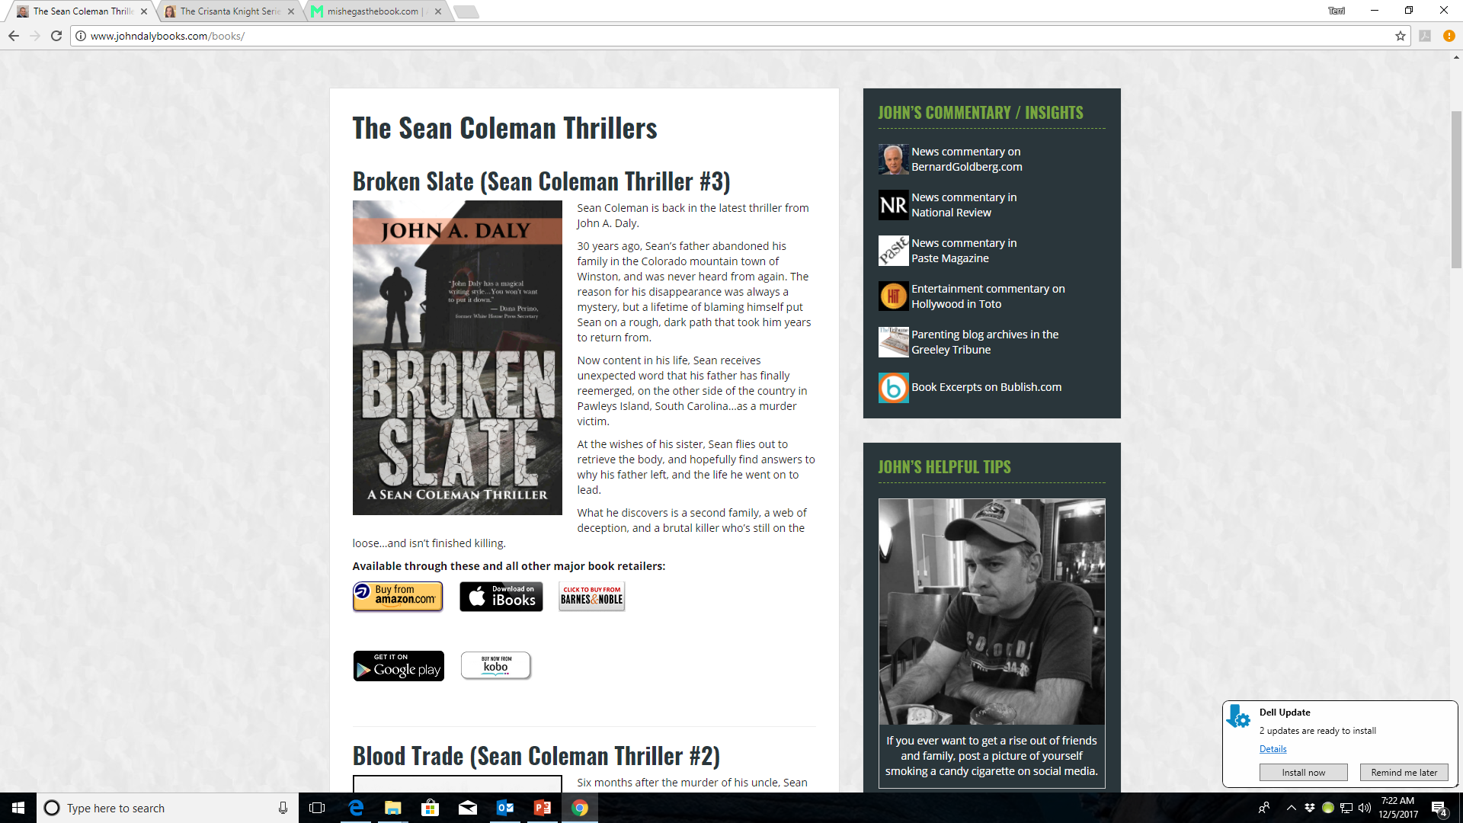

Slide 11
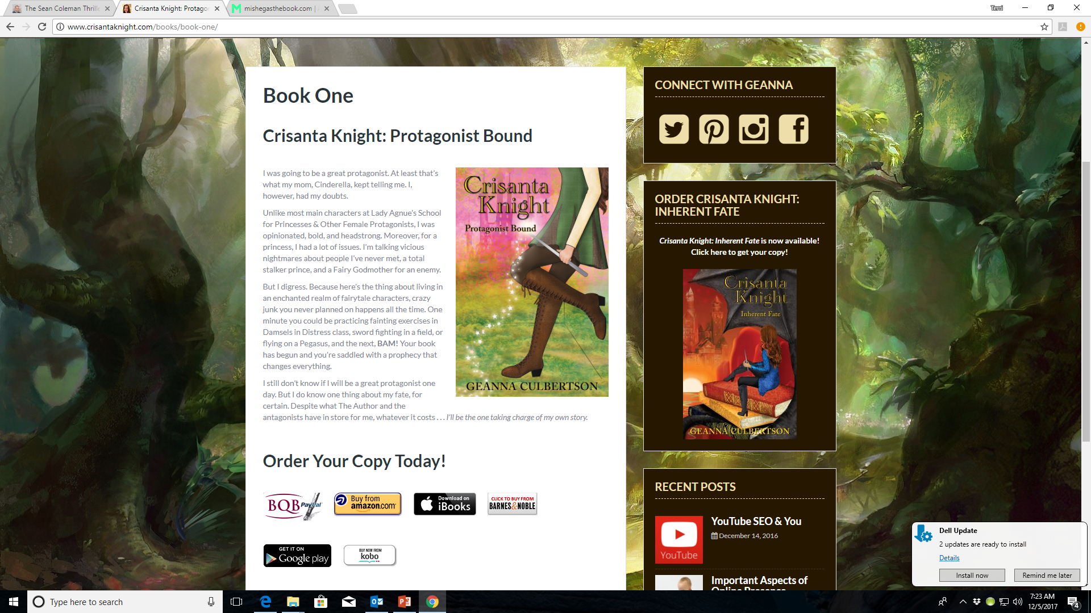

Slide 12
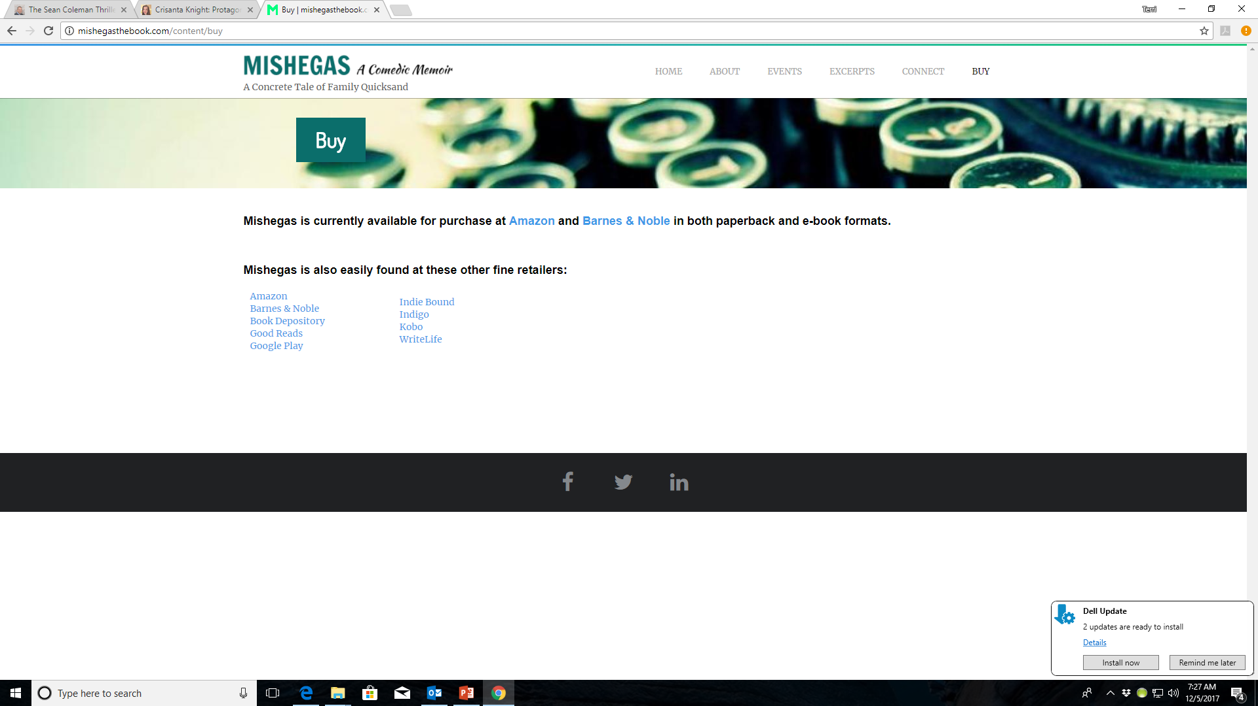

Slide 13
Author Website
Extra Pages to Enhance a Readers Interest
Author Bio (should state who you are: award-winning, bestselling, etc.)
Newsletter
Blogs
Event Calendar
Praise
Personalized Copies
Excerpts
For an excerpt – you can link to your book on OverDrive.com where they provide a link for every book they sell

Slide 14
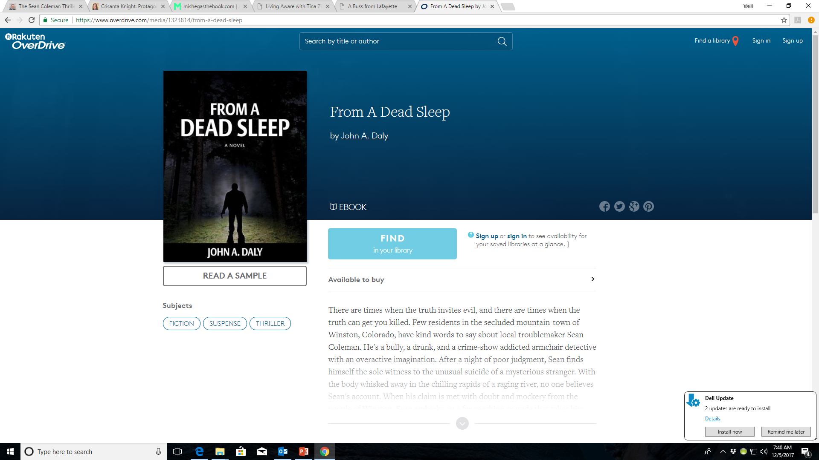

Slide 15
Author Profiles
There are many sites that offer the opportunity to post your website – Get your info on everyone of them:
Amazon
Goodreads
BookBub
LinkedIn
Research other opportunities

Slide 16
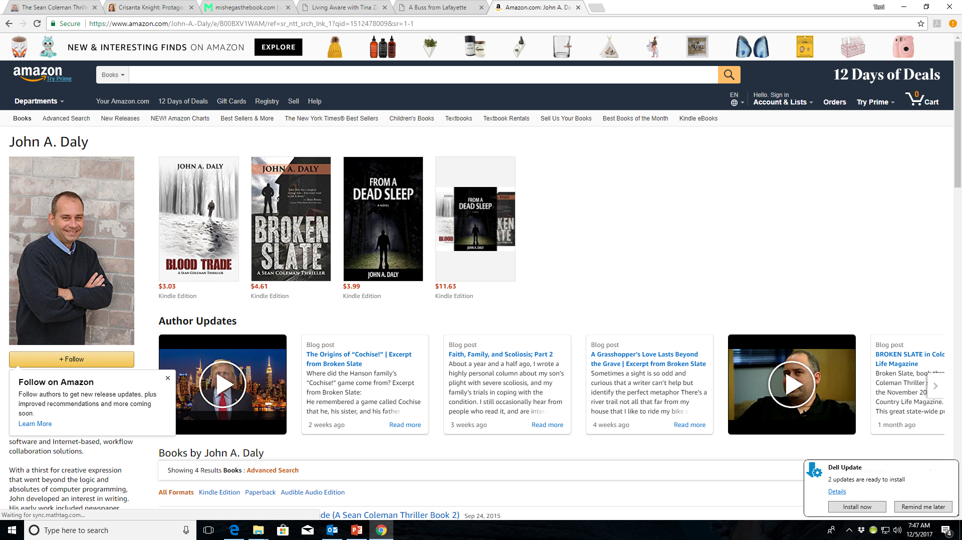

Slide 17
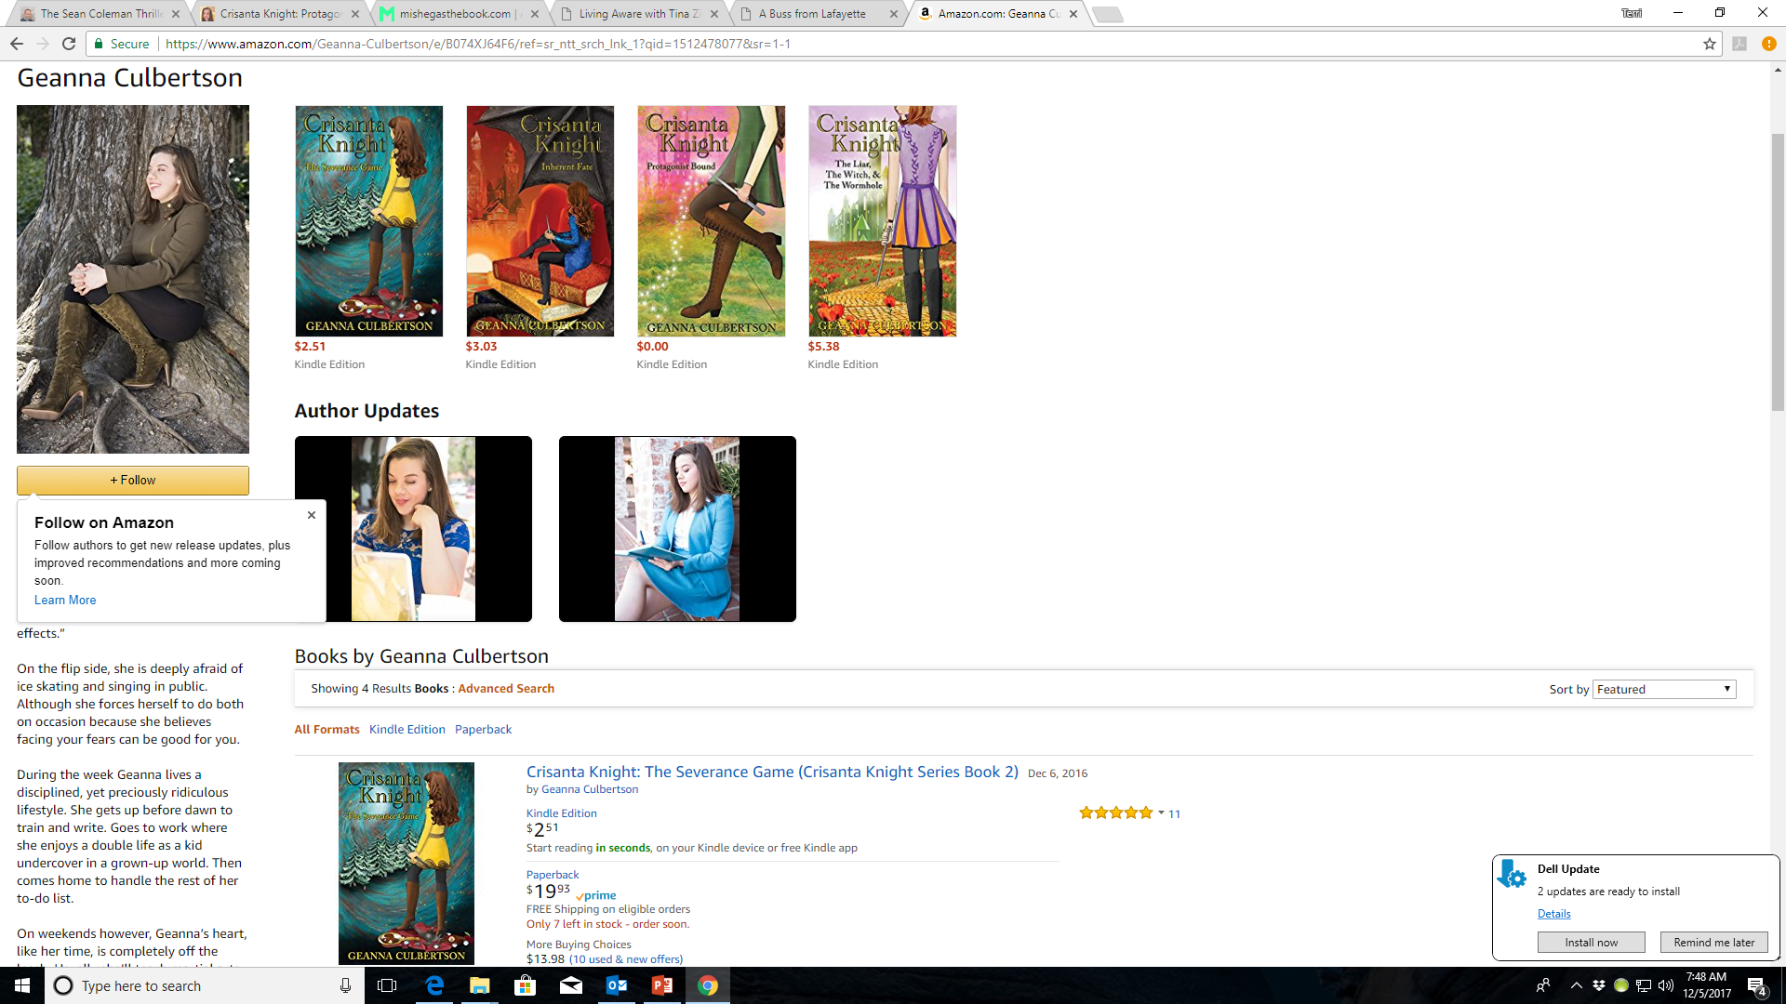

Slide 18
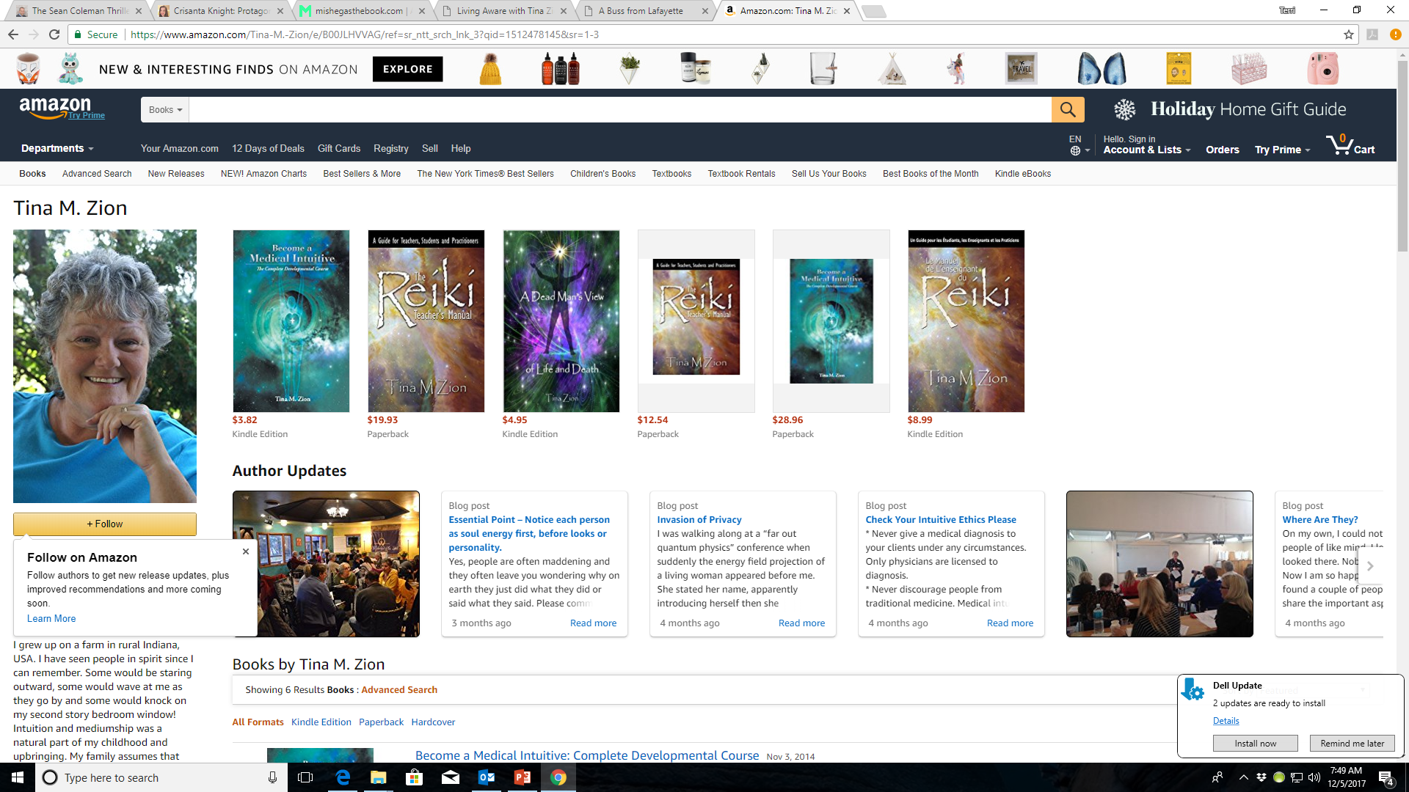

Slide 19
Author Profiles
To set up your profiles:
Amazon – go to https://authorcentral.amazon.com/gp/help and follow the directions
Goodreads – go to https://www.goodreads.com/author/program and follow the directions
BookBub - https://insights.bookbub.com/introducing-bookbub-author-profiles/ and https://insights.bookbub.com/category/author-profiles/
LinkedIn - http://smartauthorsites.com/2013/05/13/why-and-how-authors-should-build-linkedin-profiles/

Slide 20
Author Profiles
You’ll be able to tell if your profile link is activated by whether your name is linked or not.
Check all your books to ensure your profile is activated
Each profile site will allow different information options, but things to watch for are:
Linking all your books
Author info
Linking videos
Posting Photos
Linking your blogs

Slide 21
Author Profiles
Author bio on Amazon is strategic! If you don’t put it anywhere else – put it there!
Author picture is important

Slide 22
Social Media – Another MUST
Top Social Media sites
Social network | Monthly Active Users
Facebook | 2,070,000,000
YouTube | 1,500,000,000
Instagram | 800,000,000
Twitter | 330,000,000
Reddit | 250,000,000
Pinterest | 200,000,000
Vine (In January 2017, The Vine became the Vine Camera) | 200,000,000
Ask.fm | 160,000,000
Tumblr | 115,000,000
Flickr | 112,000,000
Google+ | 111,000,000
LinkedIn | 106,000,000
VK | 97,000,000
ClassMates | 57,000,000
Meetup | 32,300,000

Slide 23
Social Media
A Link that will take you to various social media sites http://www.ebizmba.com/articles/social-networking-websites
Why Facebook?
Familiar
Easy to Get started
You may already know people there

Slide 24
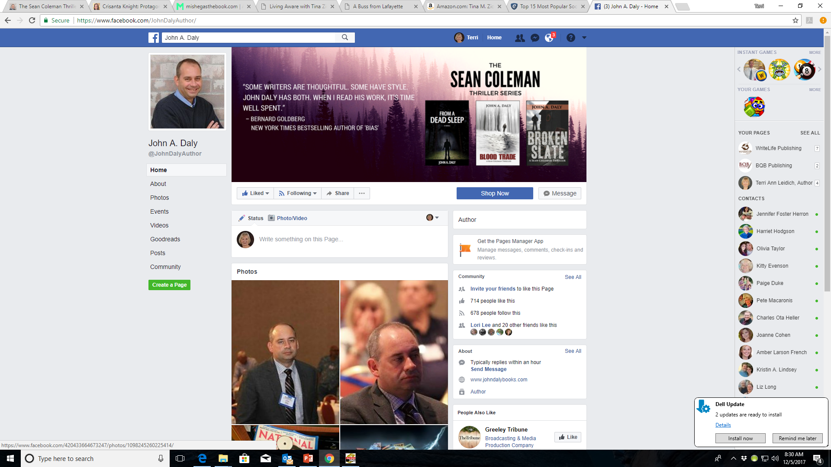

Slide 25
Social Media
Why YouTube?
Very visual
You can post:
Book trailer videos
Author interviews
Chats with authors
Small clips of author workshops

Slide 26
Social Media
Why Instagram?
A Picture is worth a thousand words
Constant fresh and free flowing content
No character or caption limit
You can create a business account for you as an author and your book
Why Twitter?
It’s fast, and succinct
Doesn’t take much time to post

Slide 27
Social Media
Why Pinterest?
98% of users are women
Large % of content shared on Pinterest results in a share on other social media

Slide 28
Not Social Media Savvy?
Free social media tutorials
https://www.gcflearnfree.org/topics/socialmedia/
https://www.diygenius.com/10-free-online-courses-in-social-media-and-inbound-marketing/

Slide 29
Author Newsletters – What they can do
Help you connect to readers
Help you build “super fans”
Continually remind readers about you and your books
Your newsletters stays in the subscribers inbox until they take action
Allows you to continually sell to readers who have already expressed interest in your books
You can do group promotions with other authors

Slide 30
Author Newsletters – What they can do
Quickly get reviews and sales on a new release
Ask for feedback on a book title, book cover, etc.
Re-use content from your blog posts in smaller bits
Quickly turn social media followers into subscribers by offering them something in return
Setting up a newsletter can be free with MailChimp https://mailchimp.com/pricing/entrepreneur/
Some ideas of how to do one https://medium.com/writers-on-writing/i-need-coffee-how-to-create-an-author-newsletter-that-isnt-terrible-650ecf37578

Slide 31
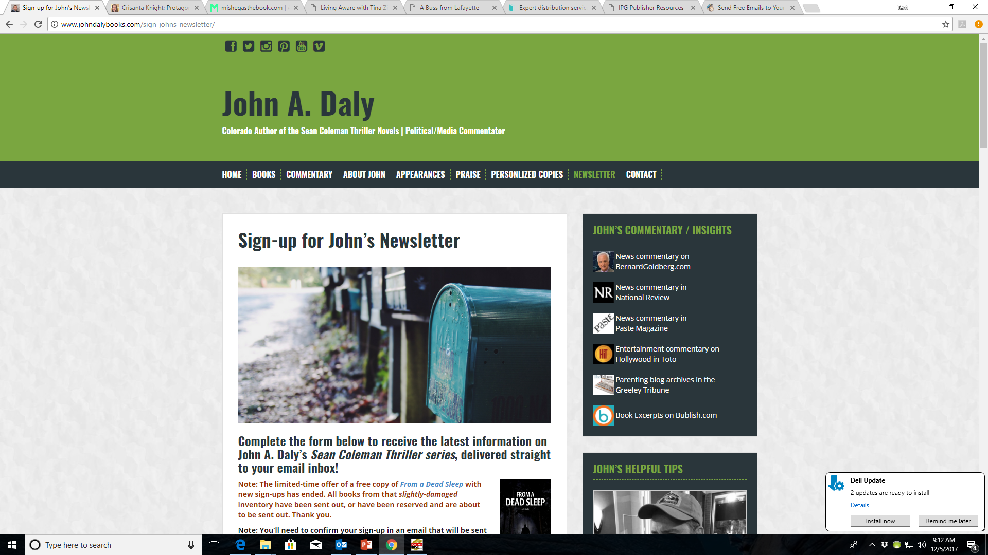

Slide 32
Marketing
Take an Active Role
Set a yearly marketing budget
Focus on discoverability – not selling
Identify your market
Use an author biography that succinctly defines your reason for being (This builds your author brand)
Create a perfect elevator pitch – here’s some help: http://selfpublishingteam.com/think-fast-10-minutes-to-the-perfect-elevator-pitch/

Slide 33
Marketing
Make it easy to buy your book(s)
Attend or write a proposal to present at book festivals, writer’s workshops, etc.
Offer to do book readings or author visits live or via Skype (you can promote this through social media, your website, your newsletter
Record your readings and share the videos on YouTube, Facebook, Google+ and Goodreads.

Slide 34
Marketing
Use marketing collateral like
Bookmarks
Postcards
Author posters
Book signing announcement flyer

Slide 35
MOST IMPORTANT TAKEAWAY FOR TODAY –
TAKE AN ACTIVE ROLE IN MARKETING YOUR BOOK(S)

Slide 36
Questions?
Type any questions in the chat feature here!

Slide 37
NEXT MONTH’S WEBINAR
Saturday, January 13th 11:00 a.m. EST
Using the Power of Giveaways

Slide 38
Thanks for joining us!
Have a great weekend!
Bqbpublishing.com
Writelife.com

