Slide 1

The Power of Giveaways
Welcome!
Saturday, January 20, 2018
11:00 a.m. ET

Slide 2
Overview
Reasons for Giveaways
Types of Giveaways
Types of Prizes
Sites for Giveaways
Help with Giveaways
Hosting a Contest
Establishing Rules

Slide 3
Why Giveaways?
For a book launch – engage readers
Gain Interest in Your Book
Drive Sales
Create New Readers
Treat Your Existing Readers
Keep Your Fanbase Wanting More
Promote Your Blog and/or Social Media Platforms
Growing your audience
Obtaining consumer data

Slide 4
Types of Giveaways (legal stuff)
Sweepstakes
A winner is chosen at random. No purchase is necessary to enter
Contest
A winner is chosen on merit. (Photo, writing, etc.)
Lottery
Purchase is necessary. Winner chosen at random

Slide 5
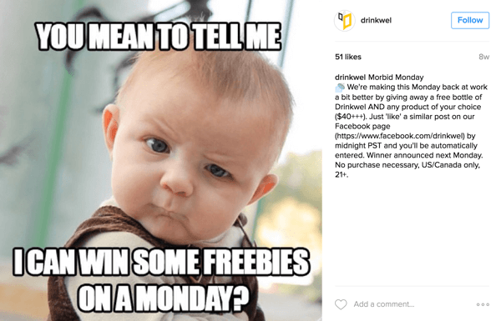

Slide 6
Types of Prizes
Strategies www.janefriedman.com/book-giveaways/
Your print book (signed)
If you’re an unknown author, this might not be incentive enough
Your eBook to everyone who enters
For each eBook we have on the iBookstore, we can get up to 250 free codes. The codes expire in 30 days and can be gotten in small quantities. (Email Terri)
The goal here would be to get reviews for your book
$25 coffee giftcard (or something similar)
Join with other authors, run a joint contest, and offer a larger prize
Offer a BOGO (Buy One Get One)
Ask readers to email a proof of purchase and the email of a friend they’d like an eBook copy gifted to.
Ask readers to email you a proof of purchase to get the first 3-5 chapters of your upcoming book in advance.
With proof of purchase, you’ll send them:
Character profiles or background info that isn’t in your books
For nonfiction, you can send: quizzes, super short workbooks

Slide 7
Sites for Giveaways
Amazon
Goodreads
Your Blog
Facebook
Twitter
Instagram
Twitter
YouTube

Slide 8
Help With Giveaways
Rafflecopter www.rafflecopter.com
Shortstack www.shortstack.com
Gleam https://gleam.io/app/competitions
KingSumo http://kingsumo.com/apps/giveaways/
Wishpond https://www.wishpond.com/social-promotions/

Slide 9
Hosting a Contest to Promote Your Book
Find a creative idea that helps spread the word
Research other author contests to see what makes them appealing
Publicize
Set Clear Rules
Choose your prize
Keep it simple
Follow the guidelines and regulations on the different media sites
Follow up with your winner. Don’t leave them hanging. Get that prize out immediately and announce the winner.
Consider featuring an interview with the winner on your blog, YouTube etc.

Slide 10
Establishing Rules for Your Giveaways
Always check out the rules of the program you’re using for your giveaway, i.e. Amazon, Goodreads, Instragram, FaceBook, YouTube etc.
Create your own rules for your giveaway and make sure they are easy and clear.
Identify prize
State when contest will begin and end
Who can enter
How the winner will be chosen
How the winner will be notified
How the prize will be delivered

Slide 11
Amazon Giveaways
https://www.amazon.com/b?node=11715260011
You’re using the strength of Amazon’s pull
You can giveaway your print book, your eBook, or other items on Amazon
You can require that entrants:
Follow you on Amazon
Watch a video short
Watch a YouTube video
All prizes have to be purchased by you from Amazon

Slide 12
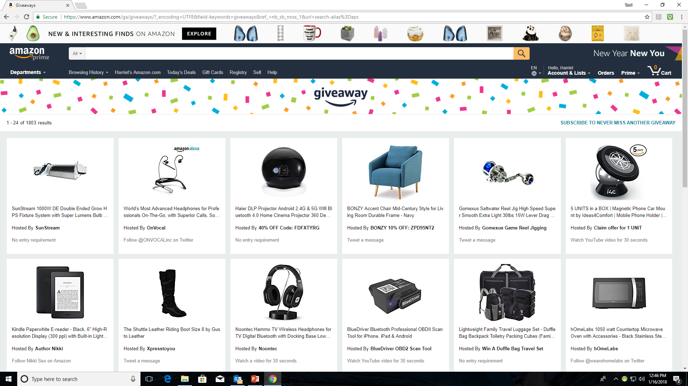

Slide 13
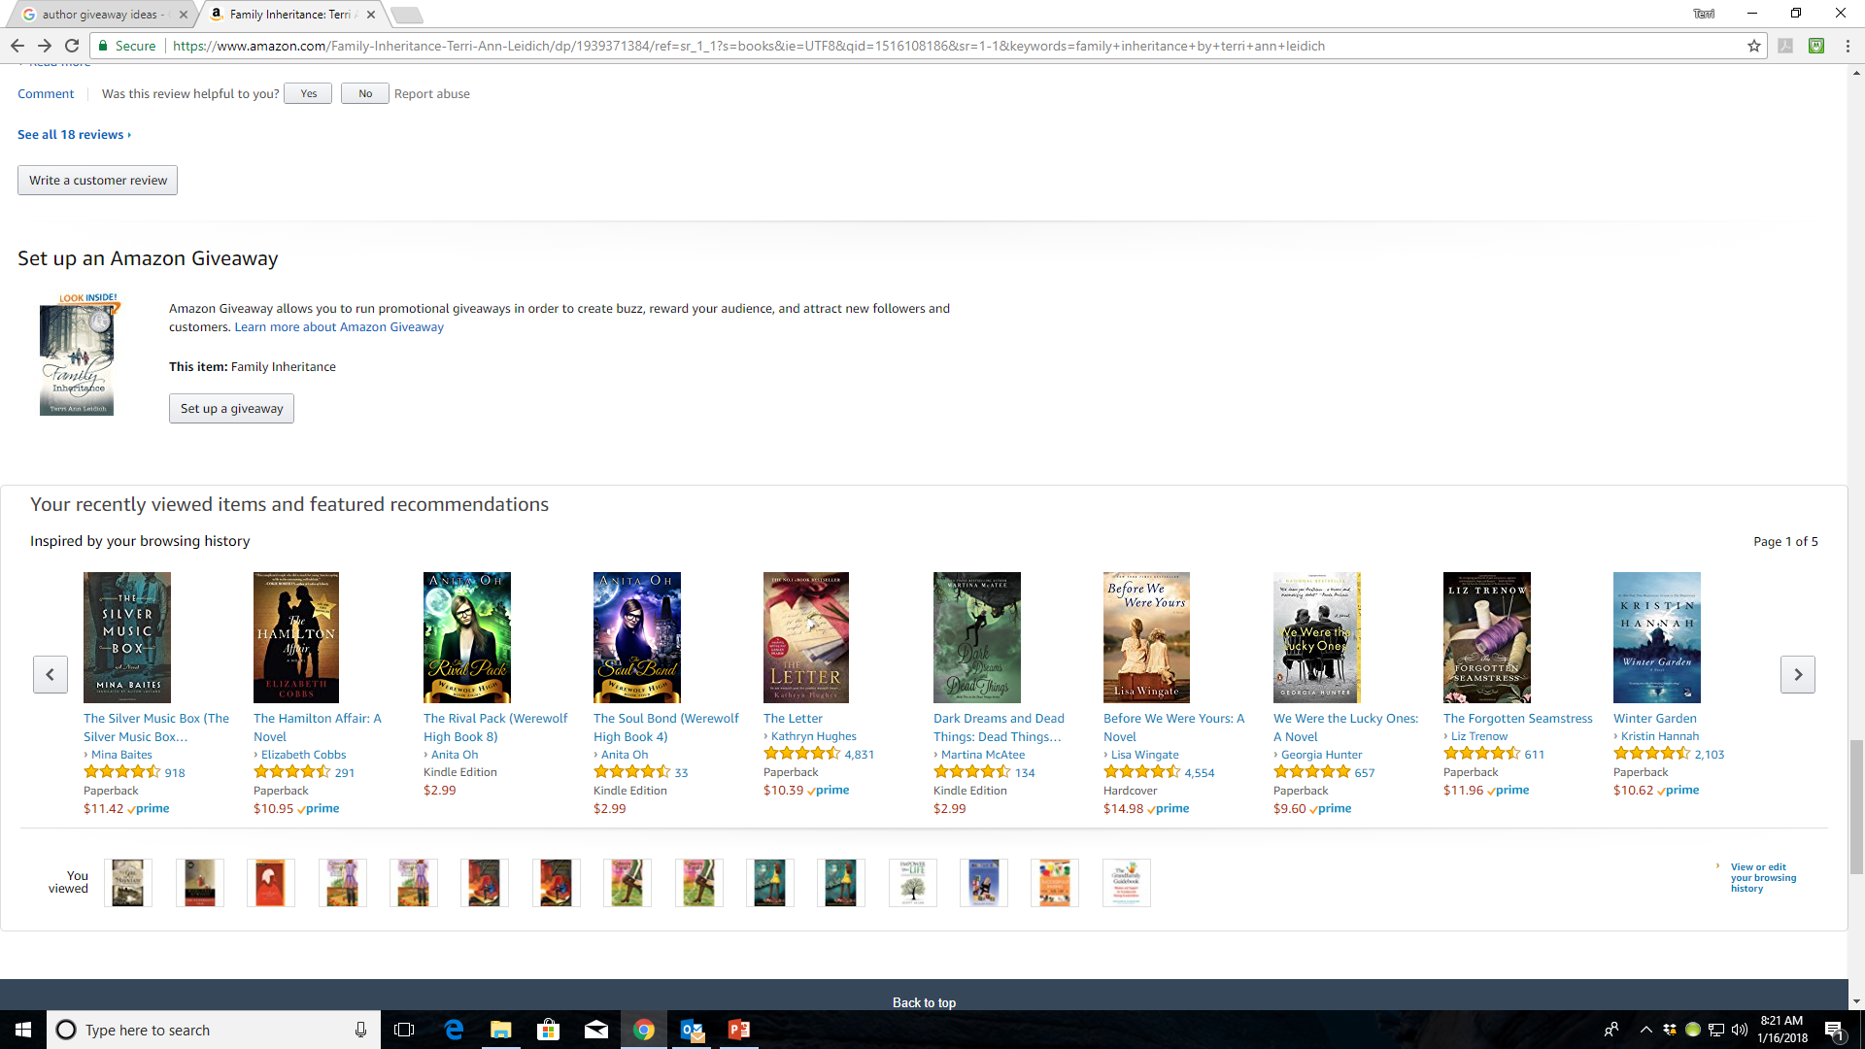

Slide 14
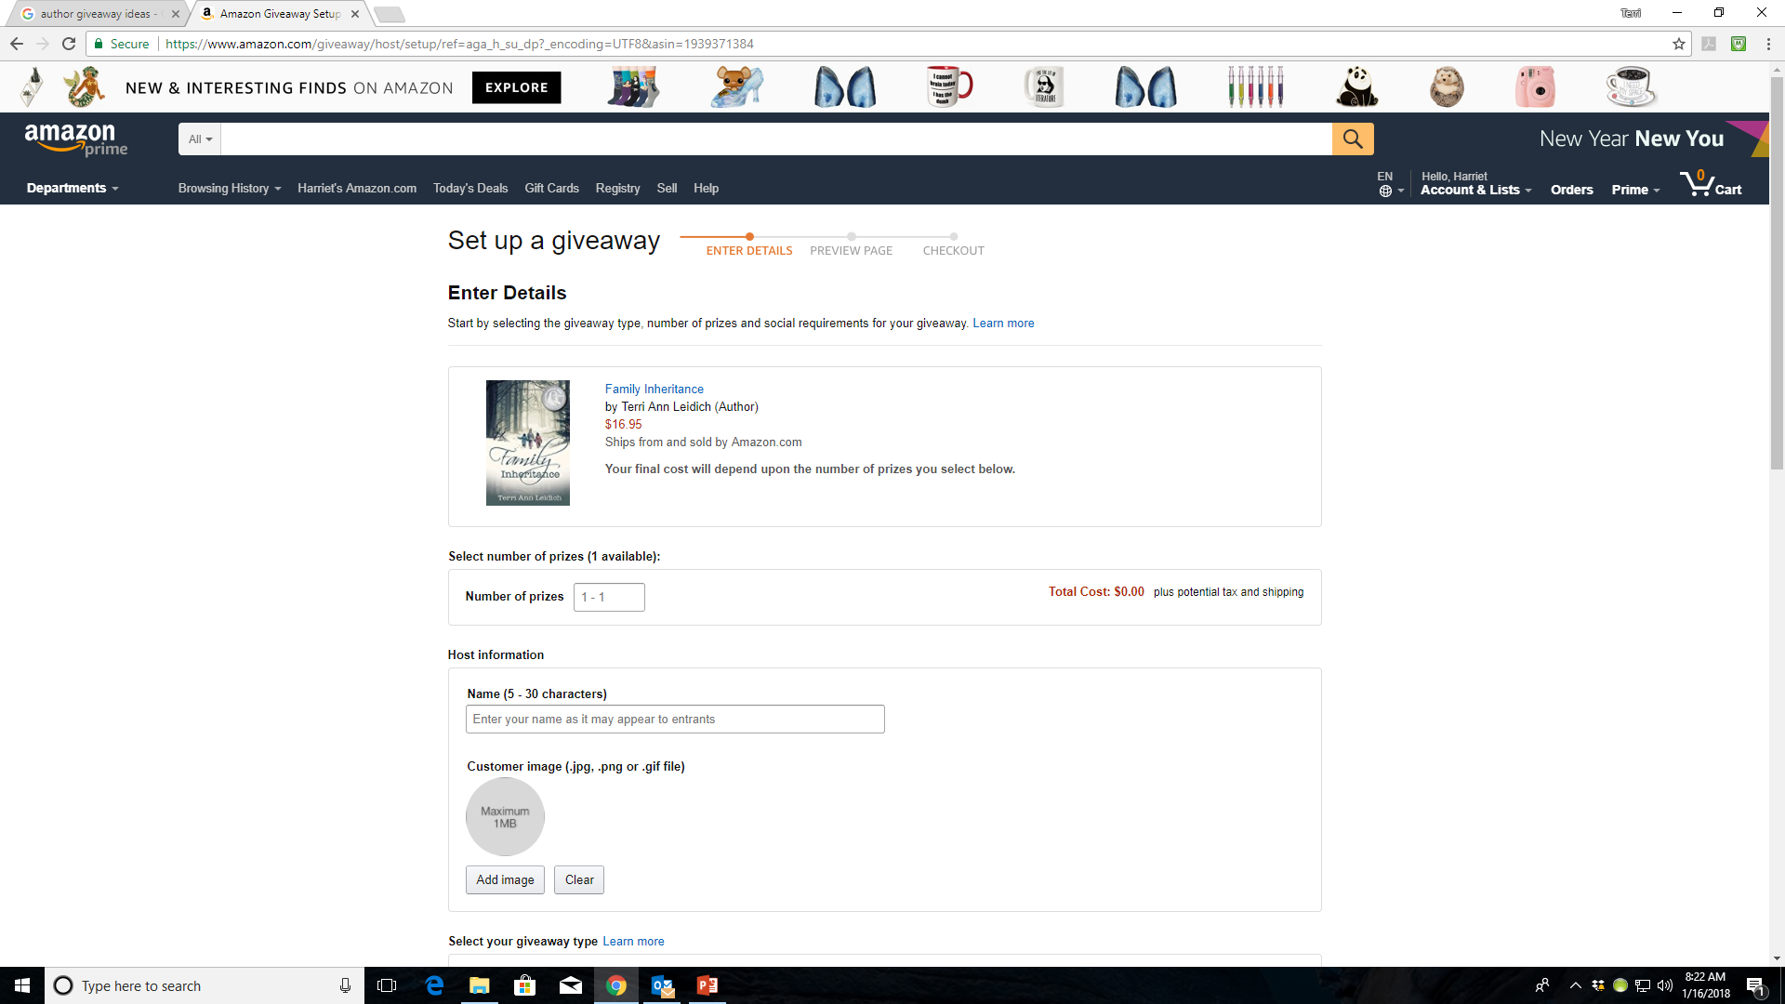

Slide 15
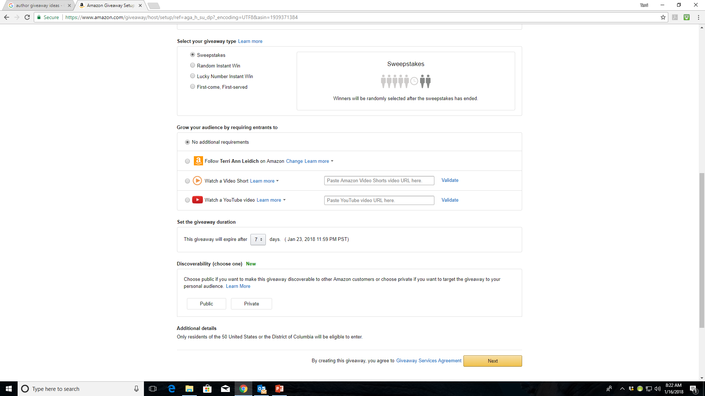

Slide 16
Goodreads Giveaways
You’re using Goodreads’ already established following
Used to be free – now has a cost. As of 1/9/18, Goodreads giveaways has a cost of $119 for a Standard giveaway and $599 for a premium giveaway
From 1/9-1/31 standard is being offered at an introductory price of $59 and Premium at $299)

Slide 17
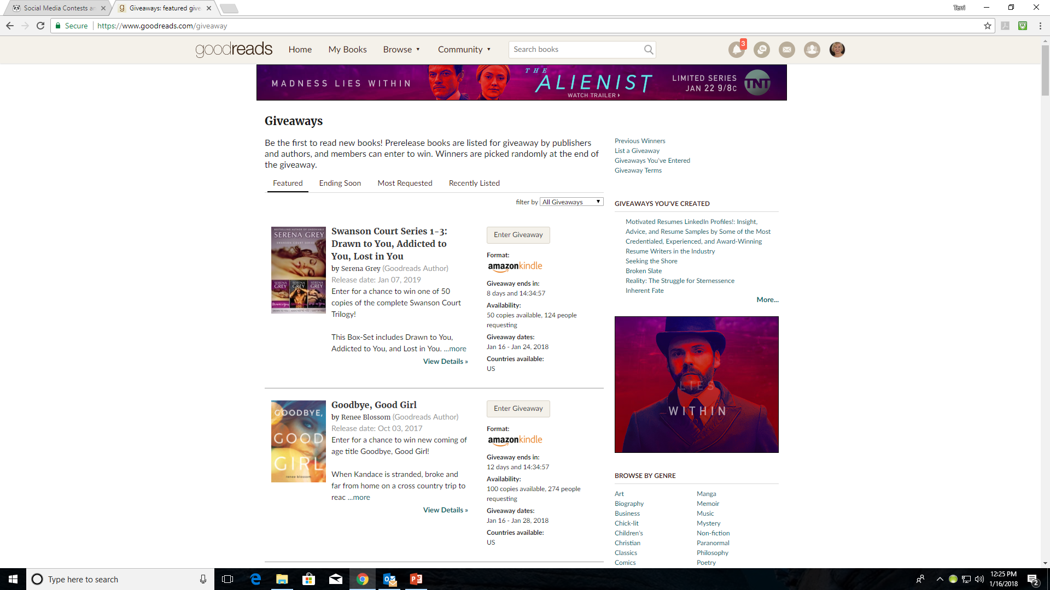

Slide 18
Goodreads Giveaways
Rules for Standard Giveaway (either print or kindle book)
Everyone who enters automatically adds the book to their Want-to-Read list, helping build an audience for your title
The author’s followers and anyone who has already added the book to their Want-to-Read list gets a notification, letting them know there’s a giveaway happening
About eight weeks after your giveaway ends, winners receive an email from Goodreads reminding them to rate and review your book.
Giveaways are featured in the Giveaways section of Goodreads.com

Slide 19
Goodreads Giveaways
Rules for Premium Giveaway
Premium placement in the Giveaways section with tens of millions of visitors each month.
Everyone who enters automatically adds the book to their Want-to-Read list, helping build an audience for your title
The author’s followers and anyone who has already added the book to their Want-to-Read list gets a notification, letting them know there’s a giveaway happening
About eight weeks after your giveaway ends, winners receive an email from Goodreads reminding them to rate and review your book.
Giveaways are featured in the Giveaways section of Goodreads.com

Slide 20
Giveaways on Your Blog
Use Rafflecopter www.rafflecopter.com to set up and run your giveaway
Clearly define what you are giving away
Write a great blurb for your giveaway
Promote your giveaway on all your social networks

Slide 21
FaceBook Giveaways
Choose a prize
Decide on a giveaway theme
Build and publish your Facebook giveaway page
Promote and share your giveaway
Update your profile and include a link to your giveaway
Send periodic emails
Add a banner or popup to your website to alert visitors about your giveaway
Cross promote your giveaway on all social media channels
At the end of the giveaway – follow up

Slide 22
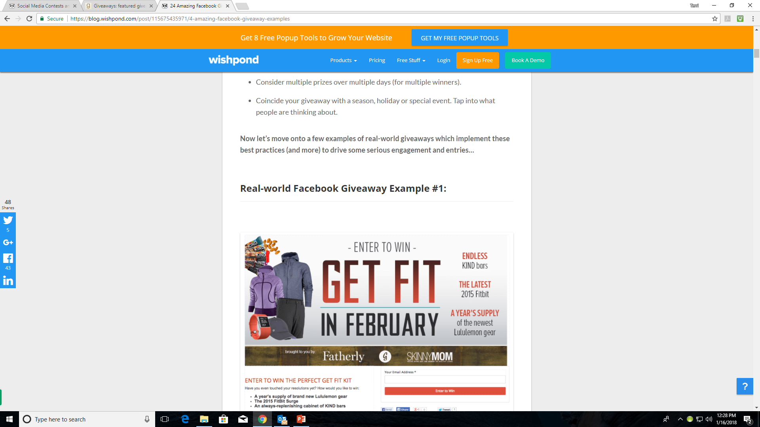

Slide 23
Instagram Giveaways
Choose the Type of Contest
Like-to-Win Contests – ask users to like your photo to be entered to win
Post an image
Tell people to like it to win
Pick a random winner
Comment with Winner’s handle
Comment Contests – users need to comment on photo to be entered to win
Tag a Friends
They must comment on your photo and tag one or more users in the comment section of the contest photo
Create a Selfie Contest
Invite people to post photos of themselves with your book or a picture of your book posing in unique locations
Announce the winner with an image on your Instagram because people love to see that someone won

Slide 24
Instagram Giveaways (cont’d)
Voting Contests
Ask Instagram users to submit photos to your hashtag and then have other people vote on the best photos
On a contest like this, offer something compelling as a price and explicitly spell out the rules on your Instragram
Pick a Theme
For a book it could be: mystery, romance, healthy habits, etc.
Photo challenge contest – users must post a photo on their personal account and use a specific hashtag you designate (so you can find and note the entry)
#winfromadeadsleep

Slide 25
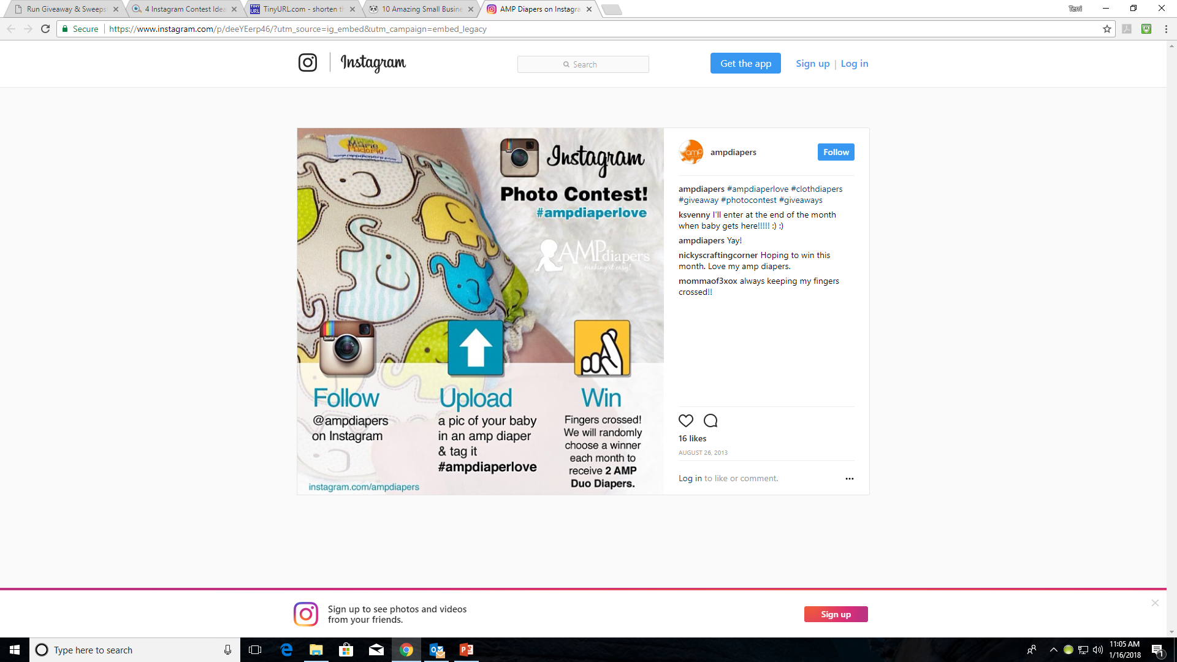

Slide 26
Instagram Giveaways (cont’d)
Share the Rules
Acknowledge that promotion isn’t sponsored, endorsed, or administered by, or associated with Instagram
Don’t inaccurately tag content or encourage users to inaccurately tag content
Create your own rules (like, comment, tag, repost, etc.)
Choose a Relevant Prize
Spread the Word
using hashtags in your Instagram post and comment sections is imperative for tracking entries and boosting exposure
#JohnADaly
#InstragramContest
#Instagramgiveaway
Instagram’s broad promotion guidelines let you create and host giveaways without a lot of hassle
For more guidance and examples https://tinyurl.com/ycqqwwpe

Slide 27
Twitter Giveaways
Create a giveaway page on your website
Tweet various and diverse fun tweets of the giveaway info and the link to your giveaway page

Slide 28
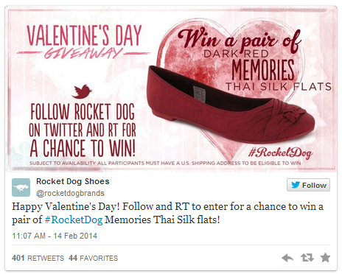

Slide 29
YouTube Giveaways
https://blog.hootsuite.com/secrets-youtube-contest/
YouTube has over 1 billion users
If you use Hootsuite, you can use the YouTube integration with Hootsuite to streamline your contest stragegy
Types of Contests
Commenting contest
As viewers to leave a comment as their entry
Subscription-based contests
Can enter by subscribing to your YouTube channel
Advocate video contest
Invite customers to upload a video of themselves holding your book or a picture of your book, or talking about it.
Upload and vote video contest
Users submit their own videos and ask users to vote on their favorite

Slide 30
YouTube Giveaways
YouTube Key rules
You must have a set of “official rules” which include links to the YouTube Community Guidelines, state all disclosures, are wholly complaint and consistent with YouTube Terms of Service (check out YouTube Contest guidelines on their site)
Contest must be conducted and awarded as outlined in your rules
You are responsible for your rules and contest administration
You must include a legal compliant privacy notice in your Official Rules and adhere to it.
You may not pay a third part or parties to manipulate metrics

Slide 31
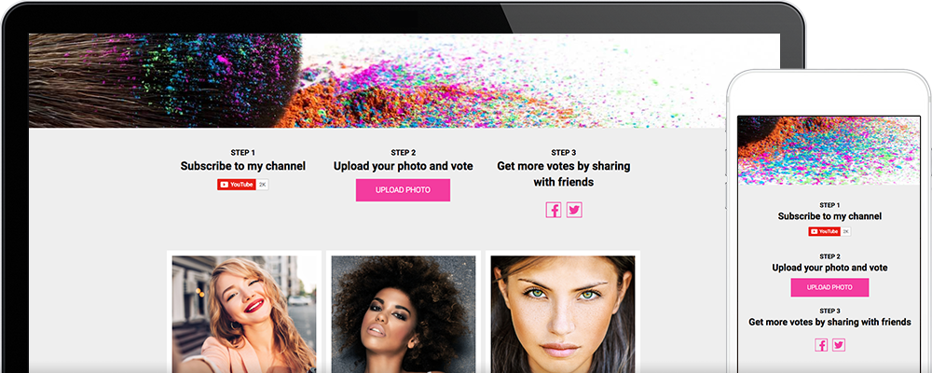

Slide 32
Promote Your Giveaways
Your social media
Your website
Through your email
Using giveaway helpers like wishpond.com rafflecopter.com etc.
Online forums like www.online-sweepstakes.com

Slide 33
Summary
Contests are popular
They can be effective
The prize is important
Promotion is vital
There are sites that can help

Slide 34
MOST IMPORTANT TAKEAWAY FOR TODAY –
TAKE AN ACTIVE ROLE IN MARKETING YOUR BOOK(S)

Slide 35
Questions?
Type any questions in the chat feature here!

Slide 36
NEXT MONTH’S WEBINAR
Saturday, February 10th 11:00 a.m. EST
Using the Internet as a Marketing Tool

Slide 37
Thanks for joining us!
Have a great weekend!
Bqbpublishing.com
Writelife.com

