Slide 1

What We Do To Promote Your Books and What You Can Do To Expand On It
Welcome!
Saturday, February 10, 2018
11:00 a.m. ET

Slide 2
Overview
Distribution
Advance Review Copies
Reviews
Social Media
BookBub Ads
Newsletter

Slide 3
Overview – Cont’d
Book Shows
Promotions Through IPG & Inscribe
Author Webinars
Marketing in General

Slide 4
Print Distribution – What We Do
IPG
Our print book distributor
They sell to
Amazon
Wholesalers (Ingram, Baker & Taylor)
Bookstores
Retailers (Target, Walmart)
Libraries
Online book sellers
Etc.
We keep print inventory with them
They have both inhouse and field sales reps who present our books two seasons a year
Spring/Summer (April – August)
Fall/Winter (September - March
I present our books to them twice a year (May/November) and am presenting 6-8 months before the book releases
The cover and metadata of your book will begin appearing online at places like Amazon, Barnes & Noble, etc. around 6-8 months before its release

Slide 5
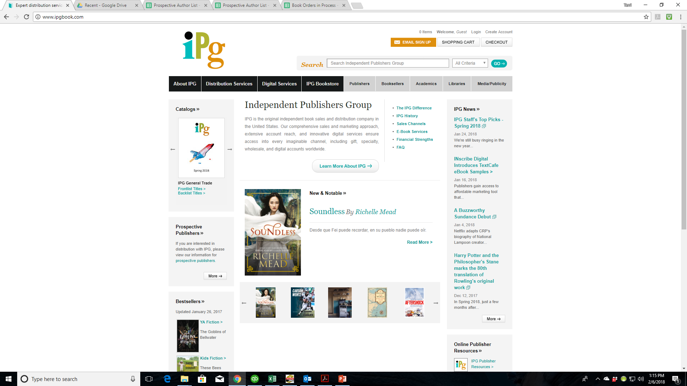

Slide 6
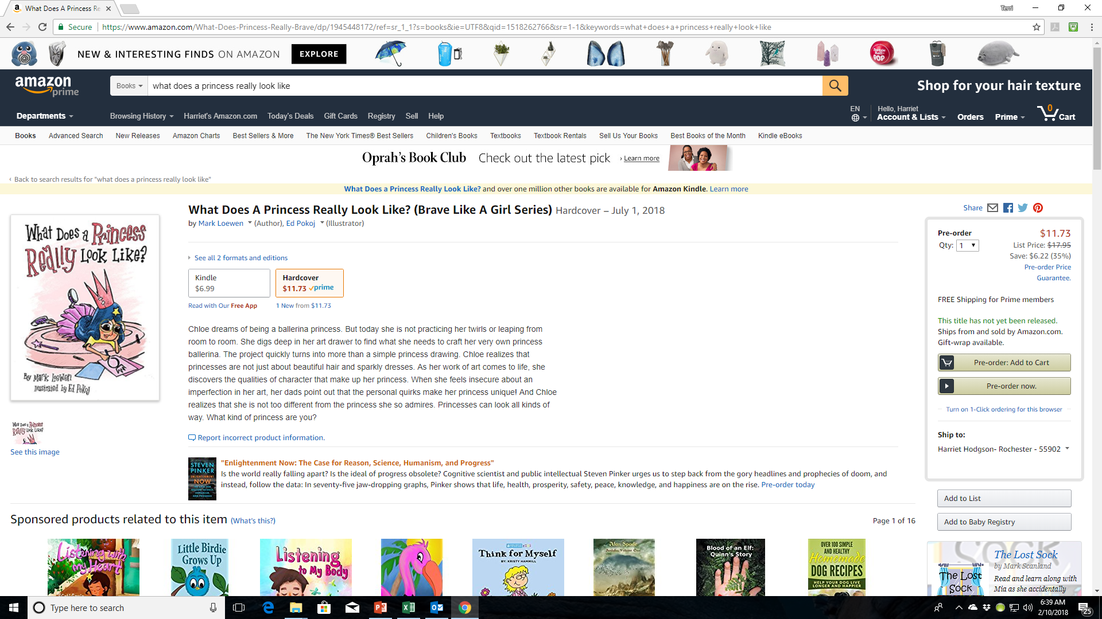

Slide 7
Print Distribution – What You Can Do
Let retailers know your print books are available through IPG (Independent Publisher’s Group
Have links on your website and social media that readers can click on to go directly to booksellers
Watch your metadata, etc. on the different websites and let Jennifer know if there are typos, etc. so we can get them fixed.
Set up booksignings with bookstores so they buy your books from IPG and its wholesalers, etc.
Build your author brand and promote your book to help drive business to bookstores, wholesalers, IPG

Slide 8
eBook – What We Do
Inscribe
Our eBook Distributor
They sell to eBook retailers all over the world
Amazon
iBookstore
Barnes & Noble
Bookazine
Wheelers
Overdrive (and other library eBook retailers)
Etc.
We convert all print books we publish into eBooks and upload them to Inscribe
We pay yearly fees to keep your book active on Inscribe
The cover and metadata of your book will begin appearing on some eBook retailer sites about 6 months before release
We work with them on an ongoing basis on promotions
We have access to 250 free eBook codes for each iBook we publish

Slide 9
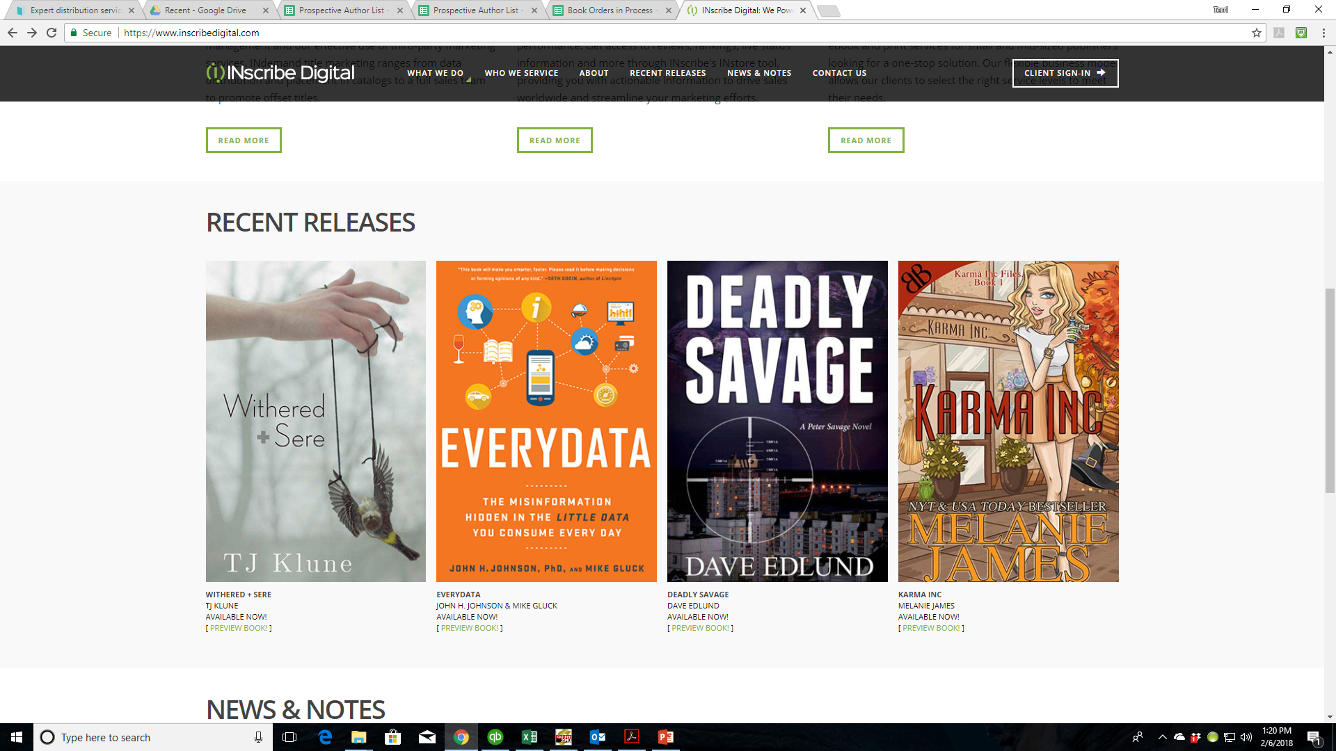

Slide 10
eBook Distribution – What You Can Do
Continually promote your eBook(s) via links from your website, on your social media, etc.
Watch your metadata, etc. on the different websites and let Jennifer know if there are typos, etc. so we can get them fixed.
Use the information from last month’s webinar on giveaways to help promote your eBook.
Create marketing campaigns that can use the iBookstore codes for your eBook(s).

Slide 11
ARCs (Advance Review Copies)
About six months before your book releases, we create an ARC (Advance Review Copy) of it.
The cover has a banner that says “Not For Sale . Uncorrected Proof . Advance Reading Copy”
The back cover contains the book blurb as well as an overview of the marketing campaign for your book
We send 27-53 copies (depending on the genre) to IPG for distribution to their sales reps
About 3-4 months before release, we send ARCs to top reviewers such as:
Publisher’s Weekly
Kirkus
Library Journal
School Library Journal
Horn Book Magazine
BookList
Etc. (We choose different options for each book depending on the genre, age range, etc.)
A copy of the ARC is sent to the author and ARCs are made available for purchase by the author for your marketing and early review efforts

Slide 12
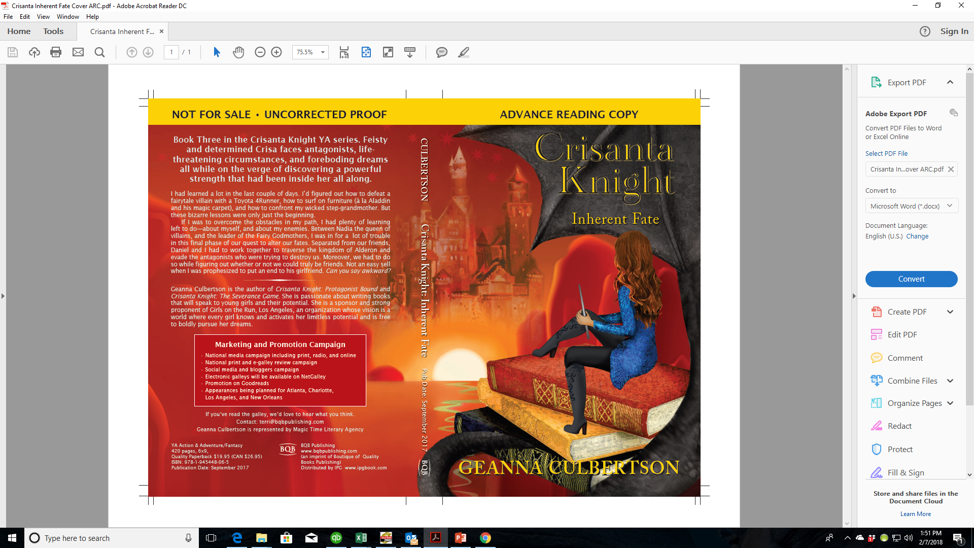

Slide 13
ARCs– What You Can Do
Create your own review list of entities and people of influence that you can send ARCs to
When you get your copy of your ARC, let Terri know how many ARCs you want to order and use them to gain reviews and influence for your upcoming title

Slide 14
Reviews – What We Do With Them
When reviews come in, we use them in various ways:
Some are used for the front cover, back cover, or interior first few pages of your book
They are posted on our social media
We have a special section on our websites for reviews – the best ones are posted there
They are sent to IPG for the sales reps to use

Slide 15
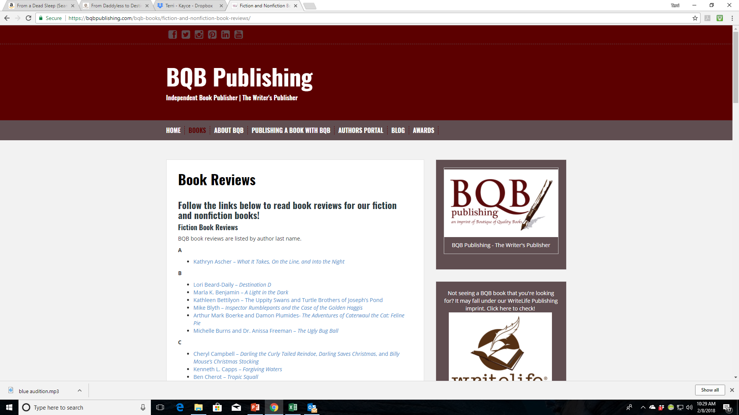

Slide 16
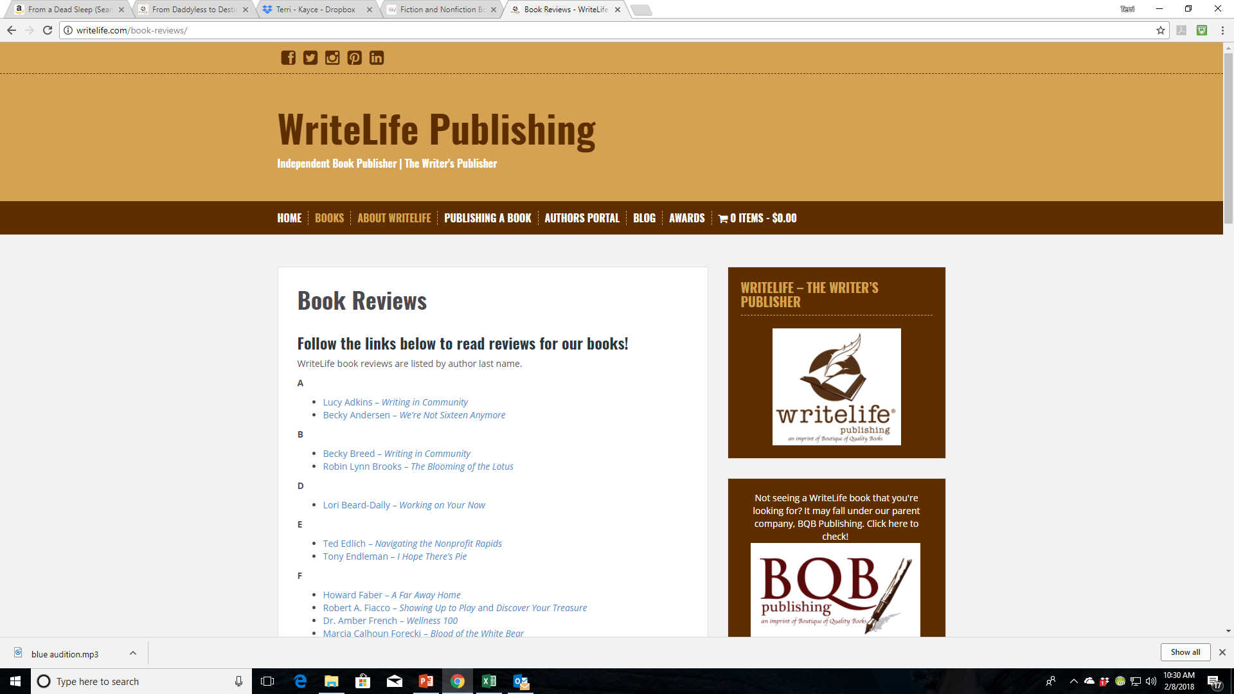

Slide 17
Reviews – What You Can Do With Them
Post them on:
Your Website
Goodreads
Your Blog
Facebook
Twitter
Instagram
Twitter
YouTube
For reviews in general:
Keep asking for them, even after your book is in the marketplace or has been for some time
A review posted on social media can retrigger interest in your book.
Reviews on your website can help trigger SEOs which get you listed in searches
Reviews on Amazon are important
People who buy in other places still look for reviews and author profile on Amazon
Reviews on Amazon impact the number of your books they stock and act in triggering the marketing features (people who bought this, bought these, etc.)
You need at least 10 reviews on Amazon for their algorithms to recognize your book
It takes 100 reviews on Amazon for all marketing features to kick in

Slide 18
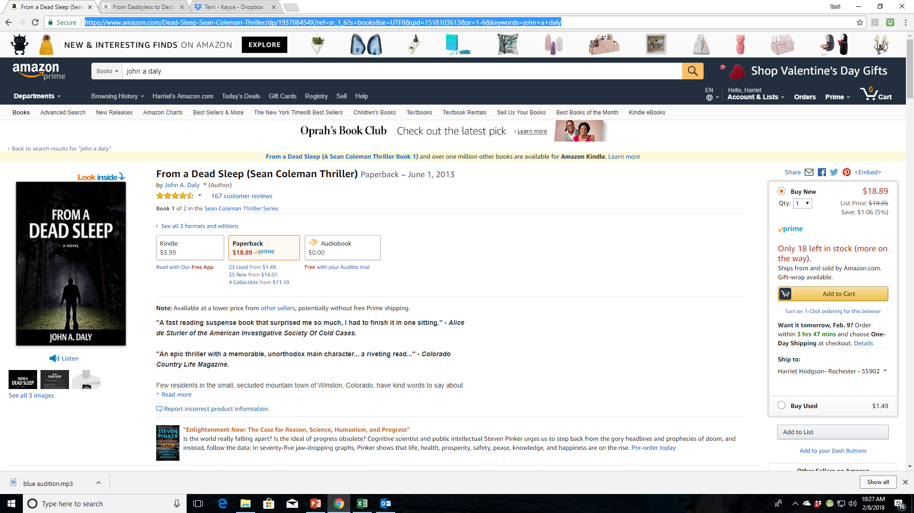

Slide 19
Social Media
Our Social Media Manager, John Daly, maintains social media accounts for both BQB and WriteLife on the following sites:
Facebook
Twitters
LinkedIn
Pinterest
Instagram
He creates posts for our books and authors on an ongoing basis and covers both new releases and back list titles.
John follows the majority of our authors and reposts, retweets, etc.
I follow BQB and WriteLife and repost and some of my followers repost as well
This is how we continue to get a larger following to you, your book(s), and your events
We have a BQB/WriteLife group on Facebook where our authors can interact with each other, ask questions, etc.

Slide 20
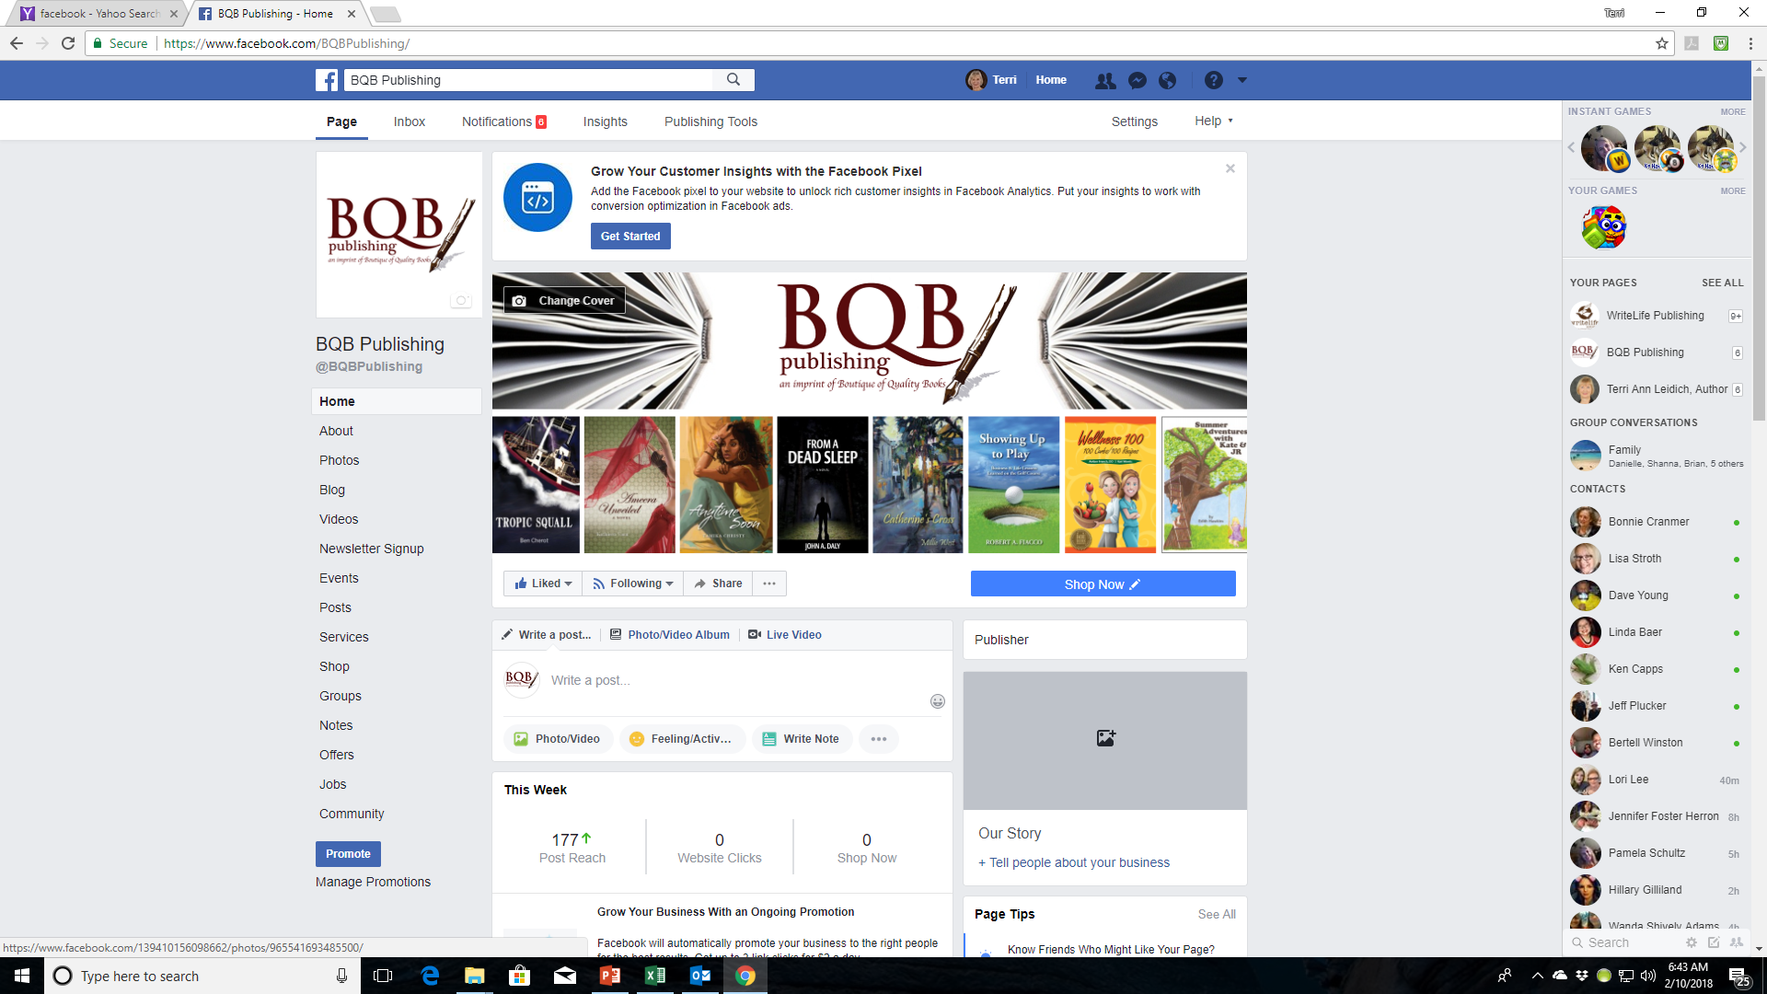

Slide 21
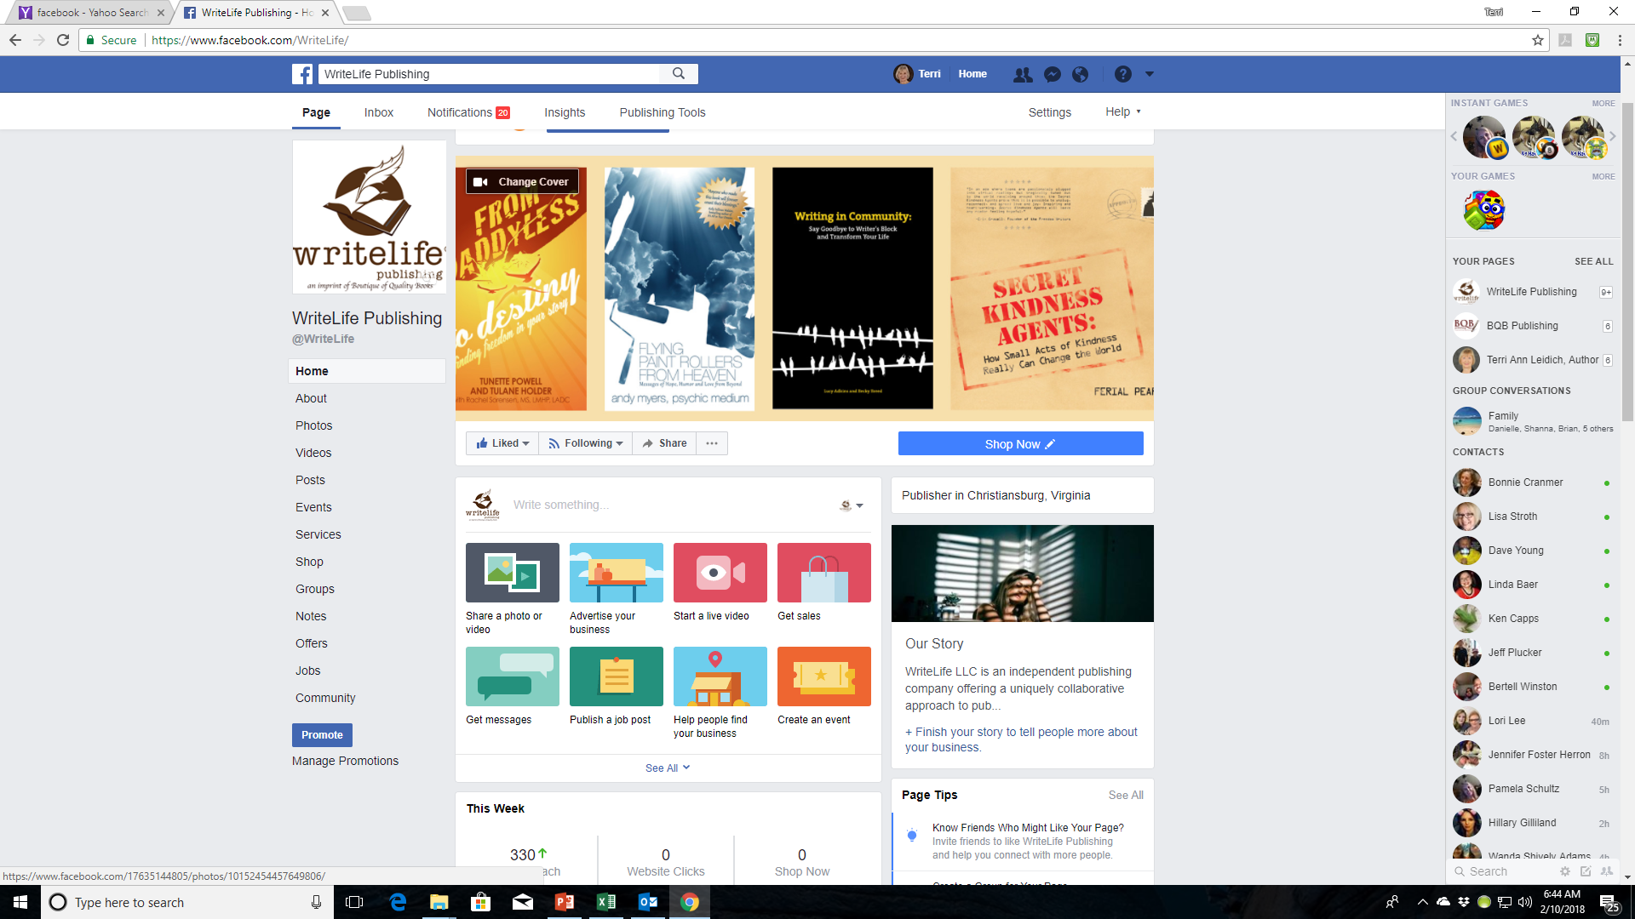

Slide 22
Social Media –What You Can Do
Make sure you follow both BQB and WriteLife on the following sites:
Facebook
Twitters
LinkedIn
Pinterest
Instagram
Repost, retweet, etc.
Follow your fellow BQB/WriteLife authors and ask them to do the same for you
Make sure John has information on your events, your reviews, any appearances, publicity, etc. so he can put the info out on social media
Join theBQB/WriteLife group on Facebook where you can interact with each other, ask questions, etc.
To join the group on Facebook. Search groups for BQB/WriteLife Author Group and submit a request to join.
If you are a BQB/WriteLife author, John will accept your request and you can start interacting.

Slide 23
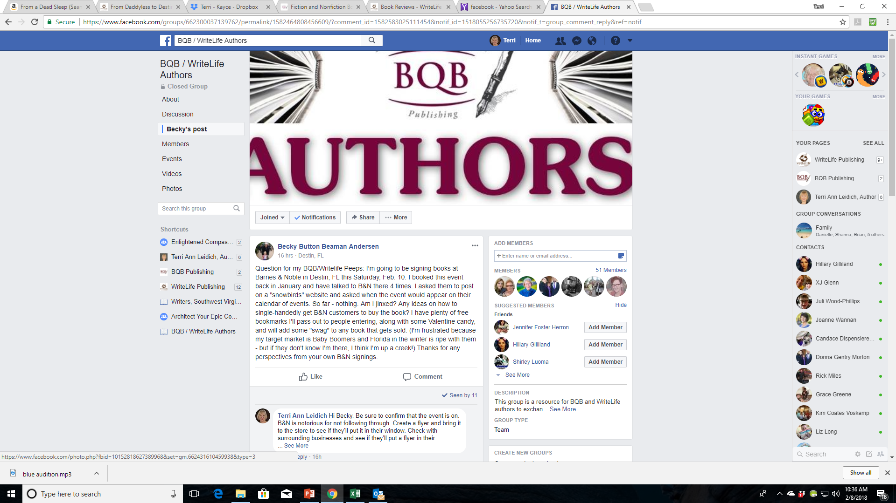

Slide 24
BookBub
BookBub is a site that has newsletters it sends out on an ongoing basis to promote sales or giveaways of eBooks.
Their newsletters are very powerful and reach a large audience.
They sell ads in their newsletters and publishers submit applications for the ad space.
We send submissions on an ongoing basis and when we are accepted, we run a promotion on the book either as a free eBook, selling for $.99, or selling for $1.99. The book and the genre determine how to submit it.
Ads in a BookBub newsletter can really get attention to a book.
They have newsletters for the US market and for the International market (Canada, Great Britain, Australia, India, etc.)
The category and territory of the ad is determined by BookBub. It is up to us to either accept or reject the ad offer.
Prices on ads can run from as low as $40 to into the thousands depending on the genre category and the territory.
If we are successful in securing a BookBub ad, BQB/WriteLife pays for it and then the fee is put in the book royalty report for that particular author and BQB/WriteLife and the author split the fee and it goes against the royalties that are gained from the ad.

Slide 25
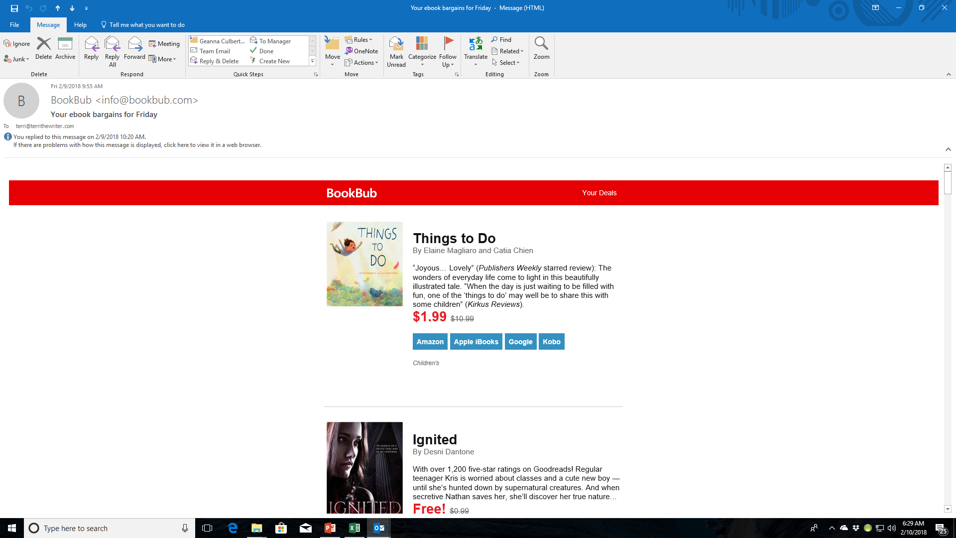

Slide 26
BookBub – What You Can Do
Register for BookBub as a reader so you are familiar with what they do and what books they feature.
Claim your author profile on BookBub.
When you claim your author profile, you will have the opportunity to nominate ads, please don’t do that because it can mess with the submissions we have going on this end.
When we do get a BookBub ad for your book, promote it heavily on social media and retweet, repost, etc. the social media blurbs that John puts out about it.
If you have an email list or newsletter, promote the special we are advertising through those means.

Slide 27
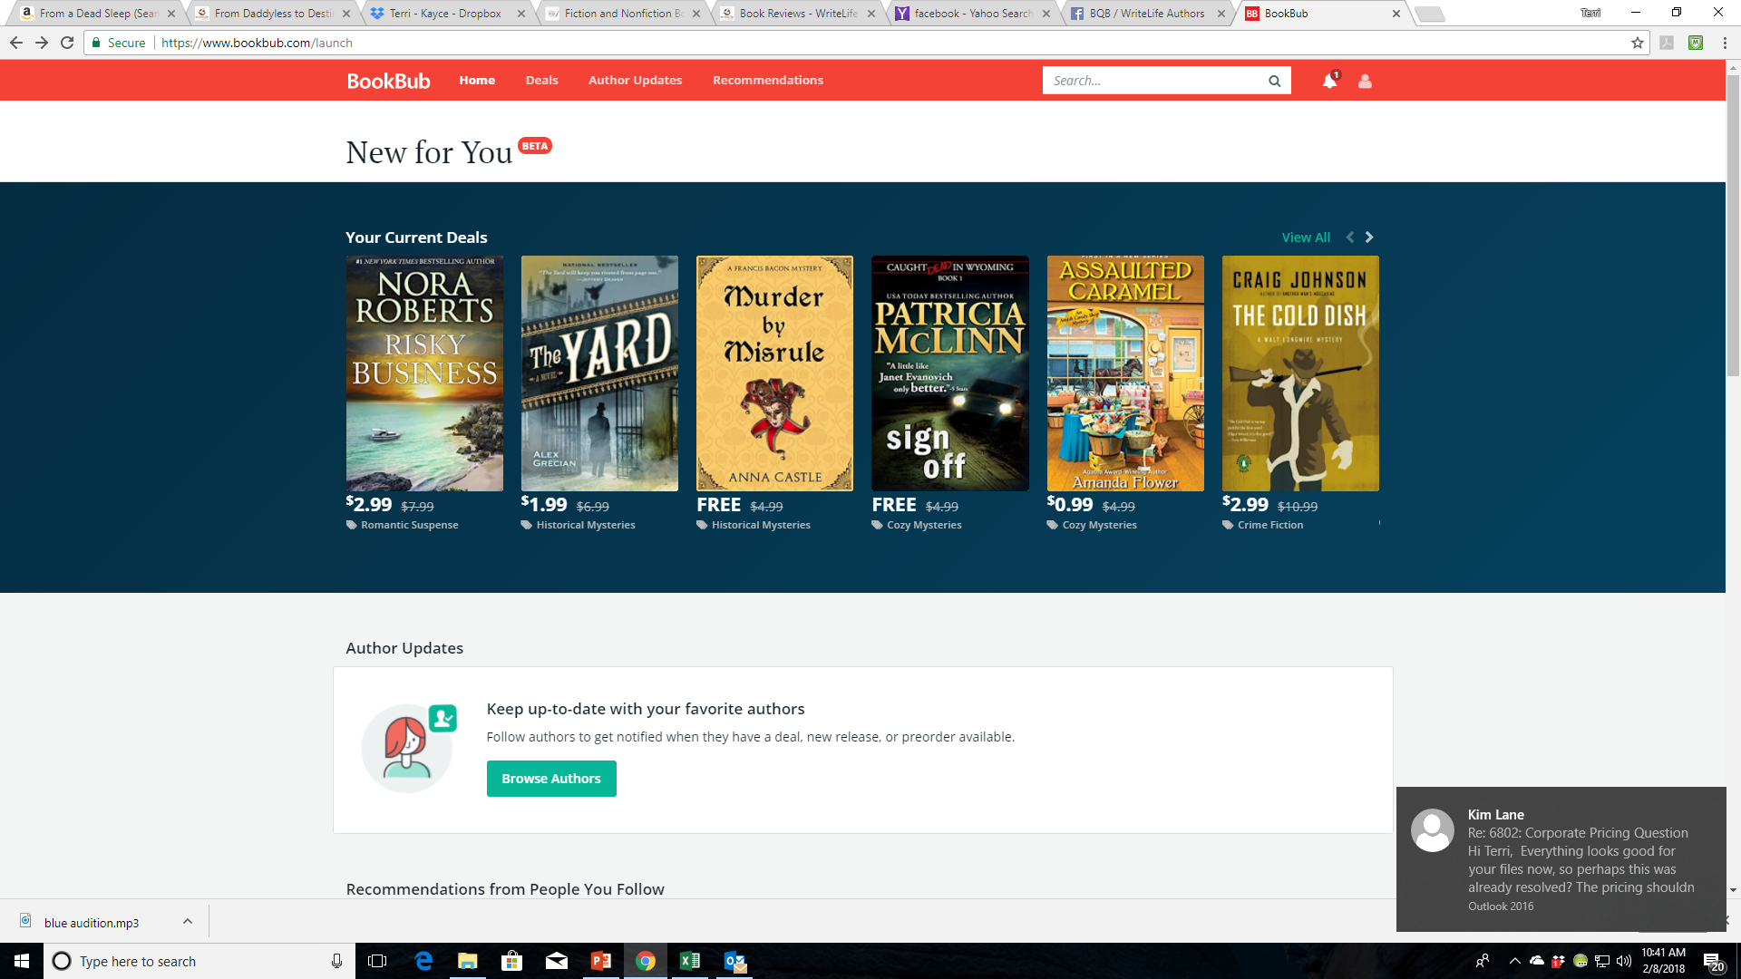

Slide 28
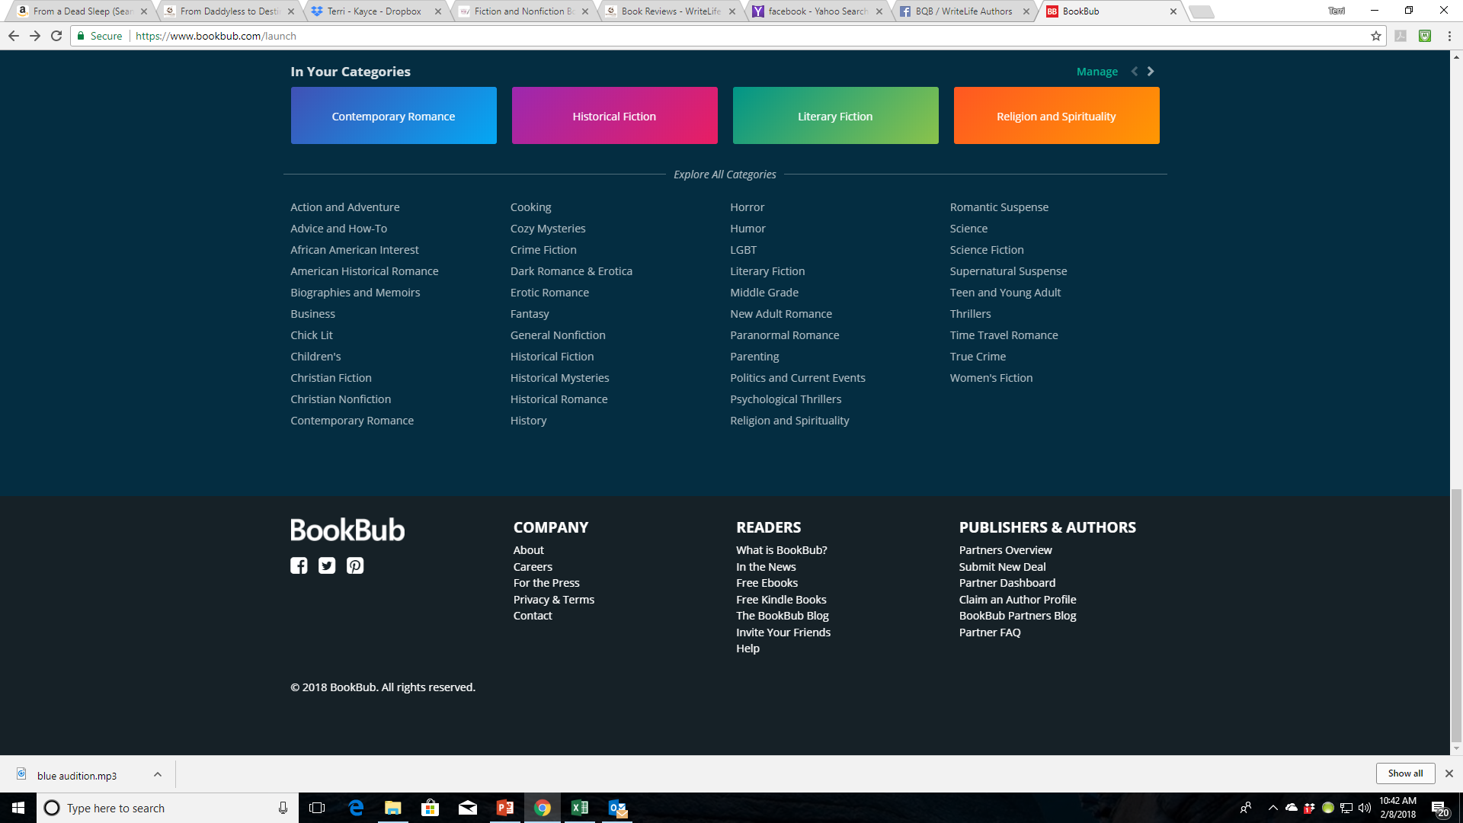

Slide 29
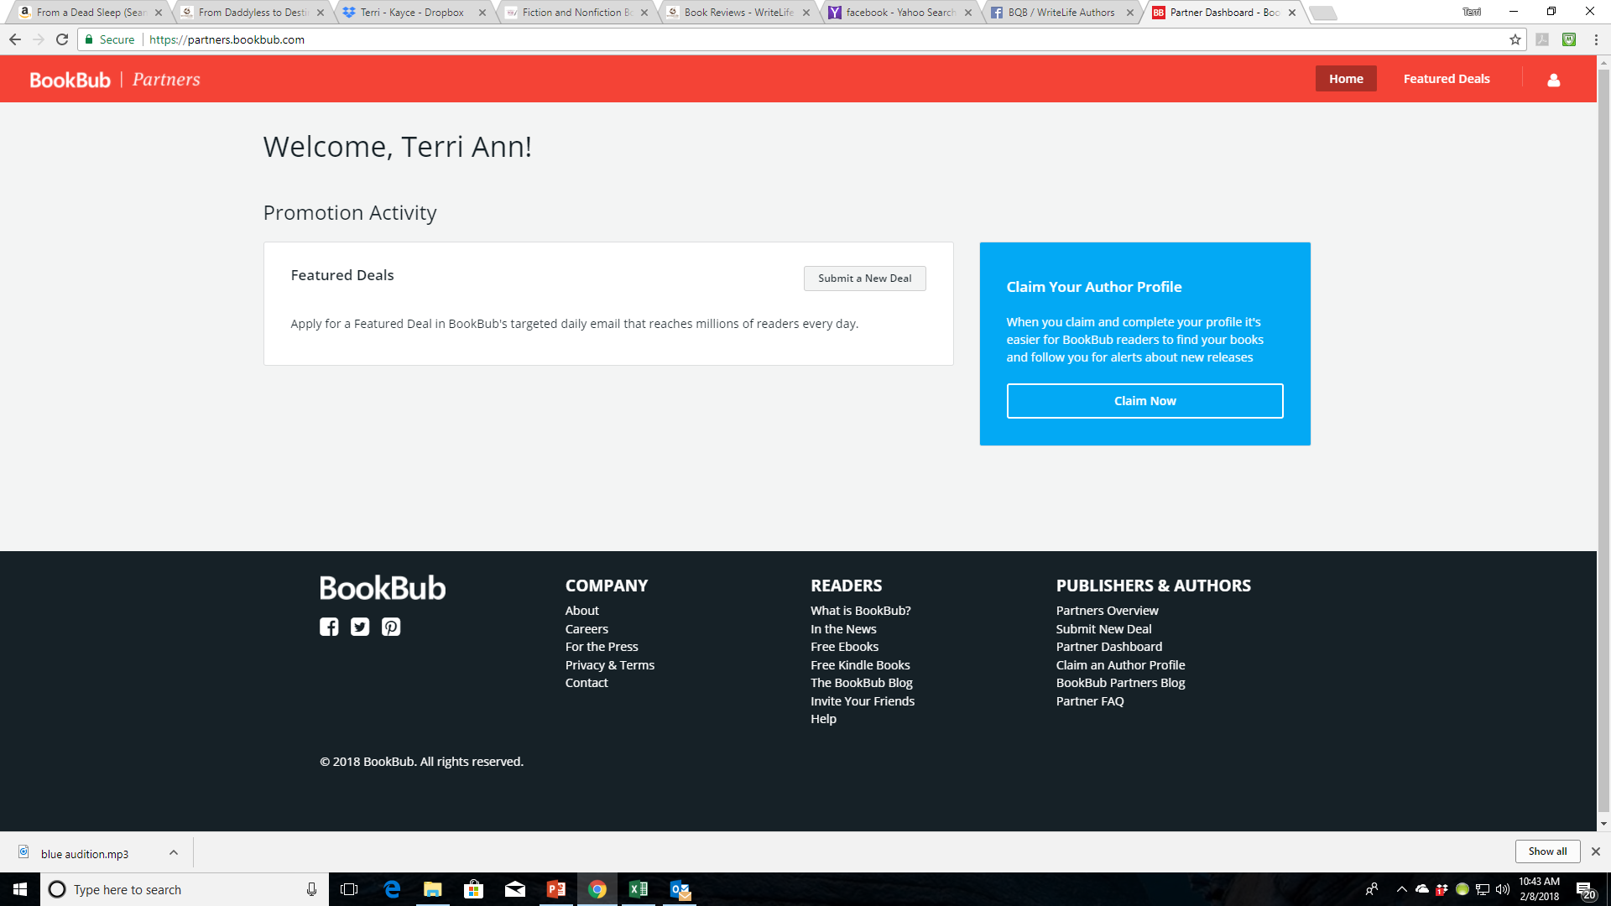

Slide 30
Newsletter
On the 15th of every month, BQB/WriteLife sends a newsletter to
Booksellers
BQB/WriteLife Customers
BQB Authors
WriteLife Authors
In this newsletter we put:
New release information
Breaking news
Awards, etc.
Plus a list of events that our authors are attending or presenting
We also take the information from the newsletter and upload the different categories (awards, events, etc.) to IPG so the sales reps have this information available.
The newsletter is also linked to our Facebook and when it appears, John reposts the info from BQB/WriteLife, plus I repost and so do many of my followers.

Slide 31
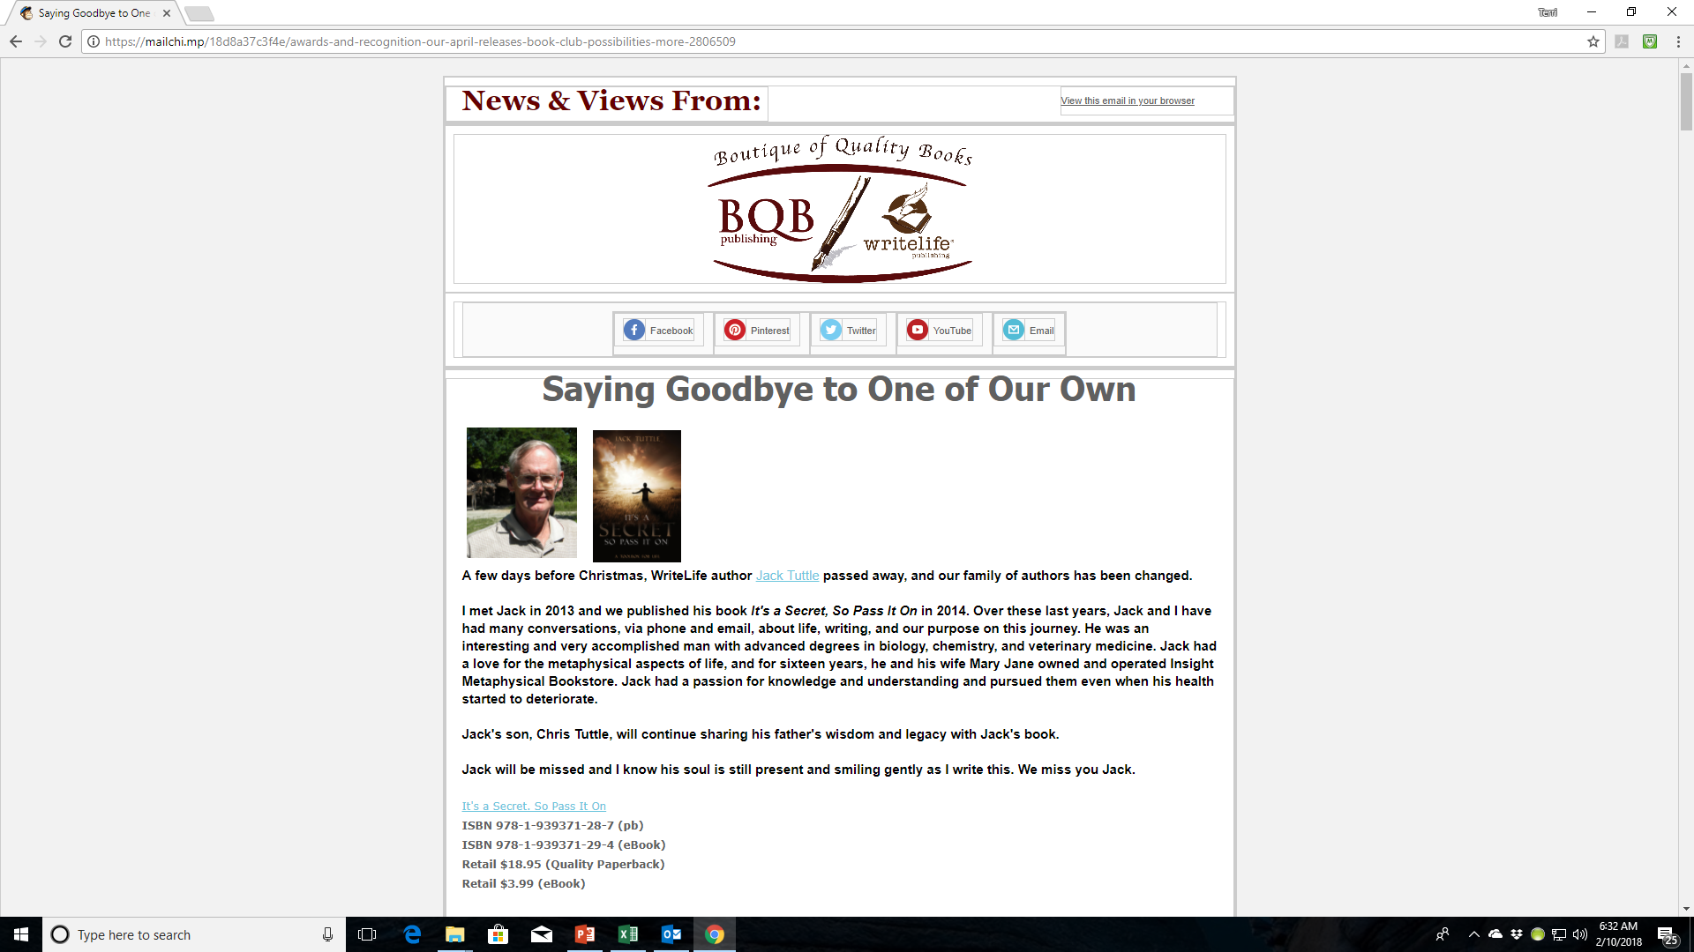

Slide 32
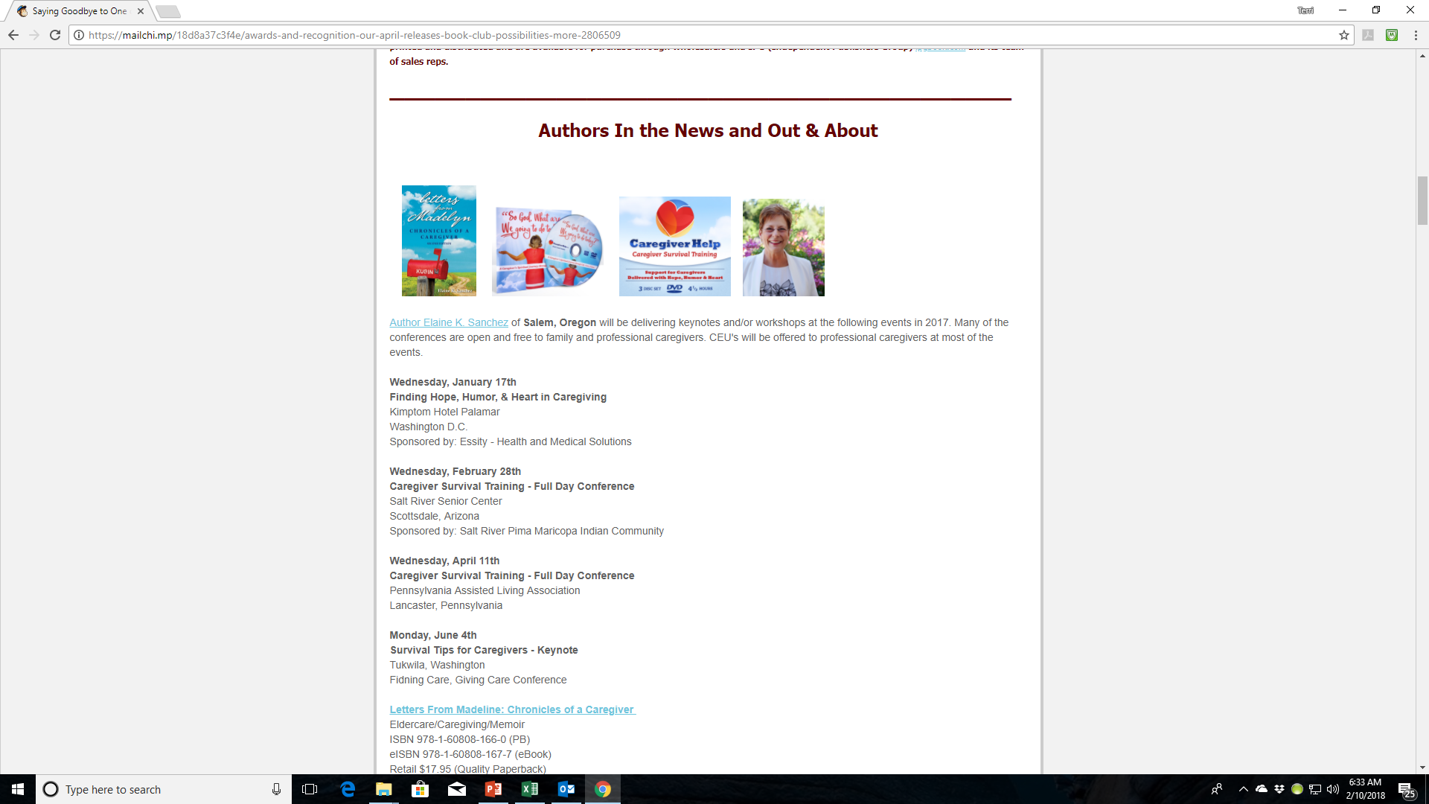

Slide 33
Newsletter – What You Can Do
The beginning of each month, send an email to Jennifer and cc Terri with the following:
Awards you’ve won
Events you’ll be doing
Anything else that is newsworthy about you and/or your book
Repost the newsletter info when it appears on your social media
Tell the bookstores you interact with and your fanbase about our newsletter and suggest they follow it.
There are links in each newsletter that will take people to the spot where they can sign up.

Slide 34
Book Shows
Each year, BQB/WriteLife either attends book shows or works with IPG to secure spots for our authors at them. Some of the shows we focus on are:
ABA Winter Institute
ALA Conference
Bologna Book Fair
TLA (Texas Library Association)
BEA and BookCon
SIBA Fall conference
Other Independent Bookseller Assoc covnerences if we have new releases int hose areas
Frankfort Book Fair

Slide 35
Book Shows – What You Can Do
Be open to the expense and time of attending or having your book represented if approached by Terri or Jennifer
Check out local book shows in your area or state
For speaking opportunities
For exhibit opportunities for you and your book or join with other authors to exhibit at some of the bigger, more expensive ones.
Become familiar with the Independent Bookseller Association for your region and stay on top of events they feature and how you could participate. The associations are:
PNBA (Pacific Northwest Booksellers Association) http://www.pnba.org
SCIBA (Southern California Indie Booksellers Association) http://www.scibabooks.org
GLIBA (Great Lakes Independent Bookseller Associaton) www.gliba.org
MIBA (Midwest Booksellers Association) http://midwestbooksellers.org
MPIBA (Mountains & Plains Indie Booksellers Assoc) http://www.mountainsplains.org
NCIBA (Northern California Indie Booksellers Association) http://www.nciba.com

Slide 36
Promotions Through IPG & Inscribe
Each week, I get a newsletter from both IPG and Inscribe describing the most recent promotion options including:
Advertising
eBook promotions
Publicity call outs
Award program announcements
Many of them, we just handle on this end. For others, we send out emails to either all authors, a group of authors, or a specific author
Most of the print promotion opportunities are for frontlist titles (those that are releasing in the current year).
eBook promotions are generally inclusive of both frontlist and backlist titles
Inscribe, our eBook distributor offers opportunities to enter books into KU (Kindle Unlimited) and because we have a publisher account, entering books into the program does not prohibit us from selling to other retailers the way an individual KU program does. If we feel your book is a good fit for this program, or others, we automatically enter it.

Slide 37
Promotions Through IPG & Inscribe – What You Can Do
Watch for emails from BQB/WriteLife or specific emails to you from Terri or Jennifer and carefully consider the opportunity being offered. Then respond accordingly.
When you become aware of promotions that are set up for your book(s), help spread the news

Slide 38
Author Webinars
Each month we offer an author webinar like this one to help educate our authors on all the many facets of marketing and how you can each participate.
The subjects vary and we try to help keep you up-to-date on the newest trends in the industry.
The webinars are set up to take place on the second Saturday of each month at 11:00 a.m. EST (10:00 CST; 9:00 MST; 8:00 PST)
Occasionally, we will have speakers from within the industry who will share their knowledge and insights.
All webinars are recorded and a couple of days after the webinar, the recordings can be found on the author portal on our websites.
The day of the webinar, after the webinar is over, the PowerPoint slides are emailed out to all BQB/WriteLife authors.

Slide 39
Author Webinars – What You Can Do
Mark the second Saturday of each month at 11:00 a.m. EST (10:00 CST; 9:00 MST; 8:00 PST) on your calendar to try to schedule it in to your life.
If you can’t be on the webinar in person, take time to either review the PowerPoints or listen to the recording.
If you have questions, get on the BQB/WriteLife Facebook group and ask questions of those who did attend.
Follow up and implement as much as you can of the information that is provided in our webinars.

Slide 40
Marketing in General
We are continually changing and improving our inhouse marketing and the opportunities we provide to our authors.
As she becomes more and more familiar with BQB/WriteLife and what we do, Jennifer will be handling a lot of our marketing and will be working to expand and grow that side of our company.
Teaching each of you, our authors, how to market is a big part of what we do to help you succeed. We will continue to look at additional ways to do that.

Slide 41
Marketing in General – What You Can Do
Take an active role in building your author brand and marketing your book(s).
Create a marketing budget each year so you can time and resources to participate. The more you participate in marketing, the more your royalties will increase.
If you discover new marketing opportunities, share them with Terri and Jennifer so we can explore their viability for BQB/WriteLife.

Slide 42
MOST IMPORTANT TAKEAWAY FOR TODAY –
TAKE AN ACTIVE ROLE IN MARKETING YOUR BOOK(S)

Slide 43
Questions?
Type any questions in the chat feature here!

Slide 44
NEXT MONTH’S WEBINAR
Saturday, February 10th 11:00 a.m. EST
TBD

Slide 45
Thanks for joining us!
Have a great weekend!
Bqbpublishing.com
Writelife.com

