Slide 1

Using the Internet for Marketing --- Existing Tools You Might Not Know About
Welcome!
Saturday, March 10, 2018
11:00 a.m. ET

Slide 2
Using the Internet to:
Learn technologies you aren’t familiar with
Find Your Competition and Learn From Them
Manage Your Social Media
Build Your Social Media
Get Marketing Ideas
Tracking You and Your Book(s)
Creating Images
Creating and Using Videos

Slide 3
Learn Technologies You Aren’t Familiar With
Not familiar with social media or how to use the different sites like FaceBook. Twitter, Instagram, etc.?
https://www.gcflearnfree.org/topics/socialmedia/
Want to know more about using social media for marketing:
https://blog.hubspot.com/marketing/social-media-marketing-resources
Understanding your Wordpress Website and How to Edit it
https://wpshout.com/quick-guides/login-wordpress-site/
https://xmission.com/blog/2014/08/13/how-to-edit-your-wordpress-site-content

Slide 4
Find Your Competition and Learn From Them
Identify them through Amazon
Search for them on the Internet
Find them on Social Media
Follow, Watch, Learn
Check out websites
Pay attention to posts

Slide 5
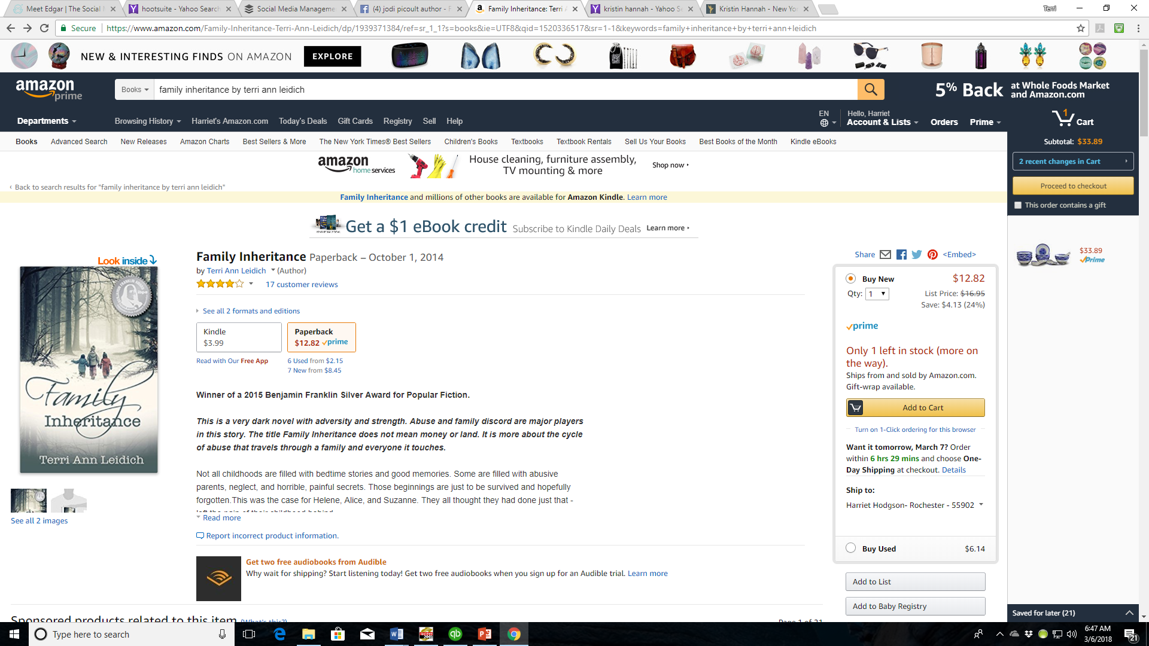

Slide 6
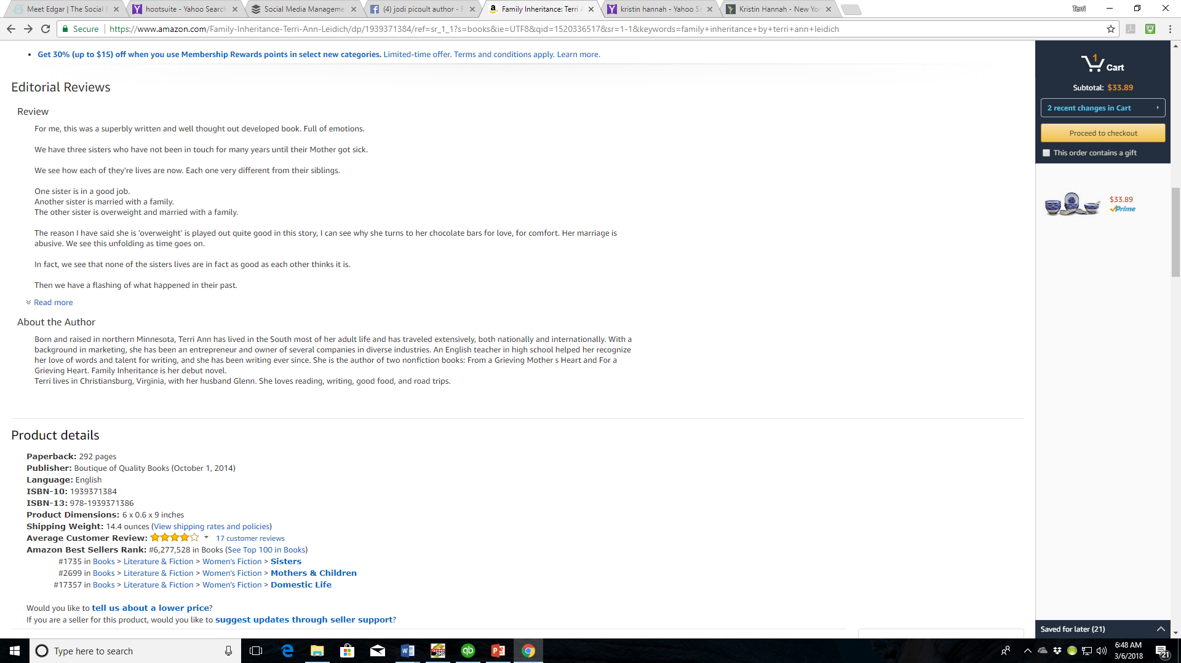

Slide 7
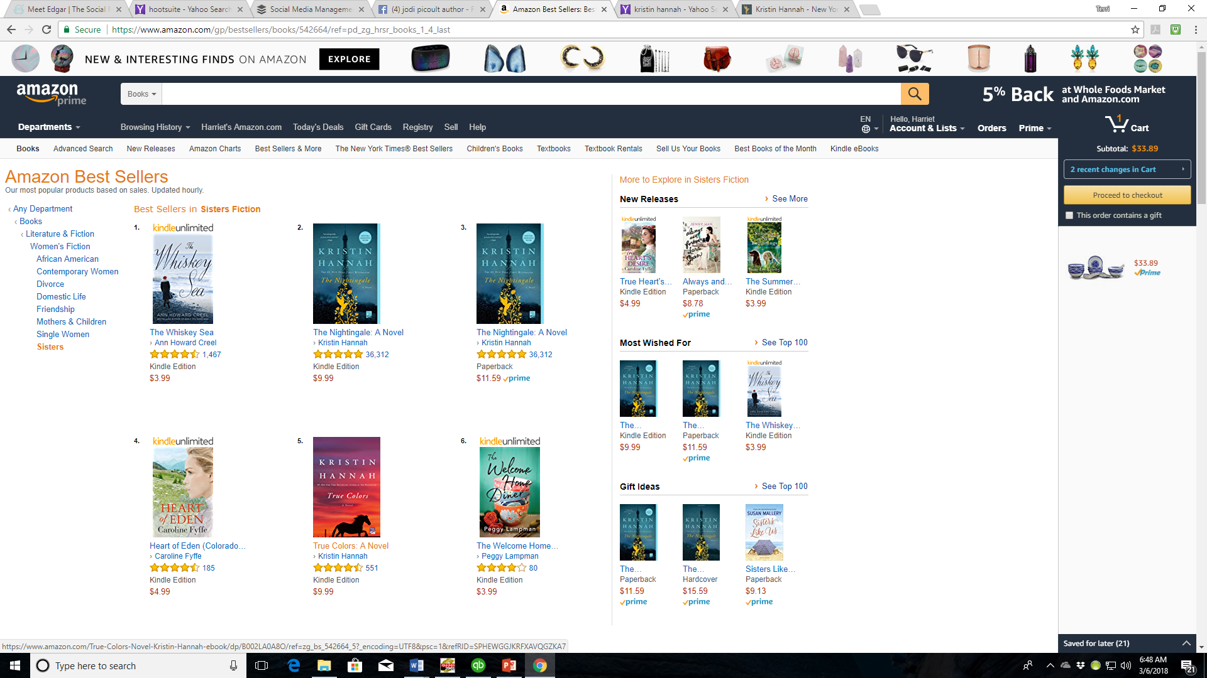

Slide 8
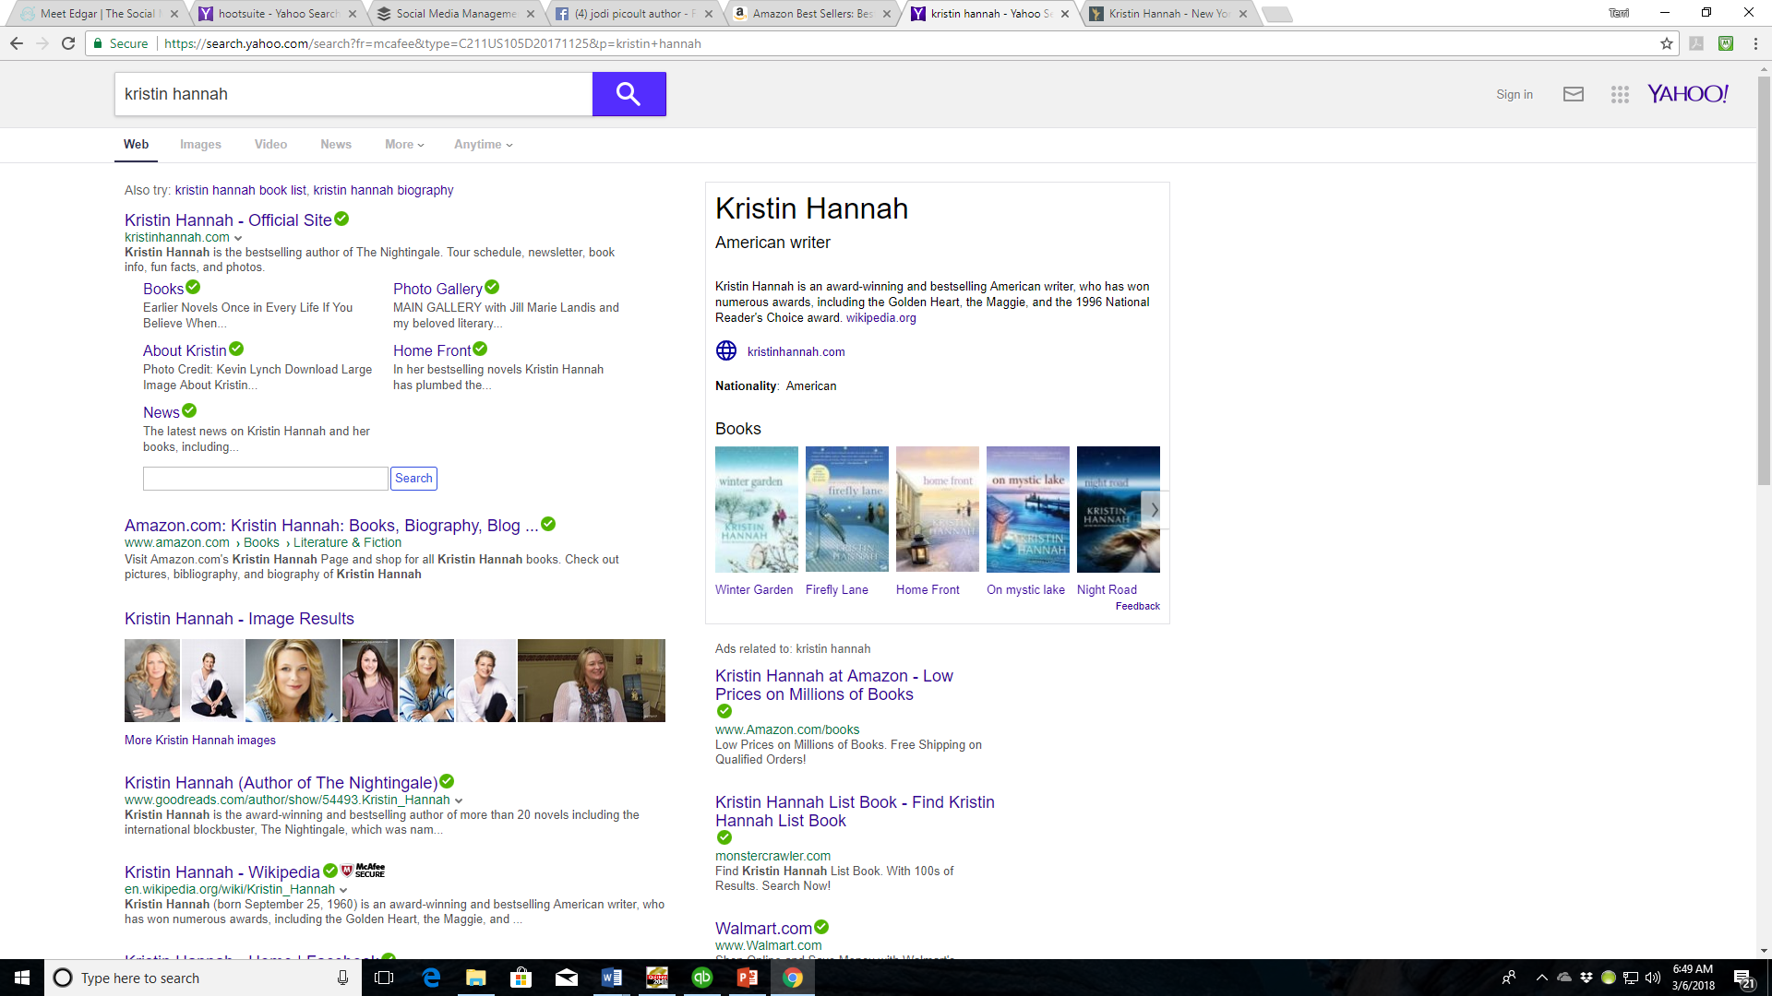

Slide 9
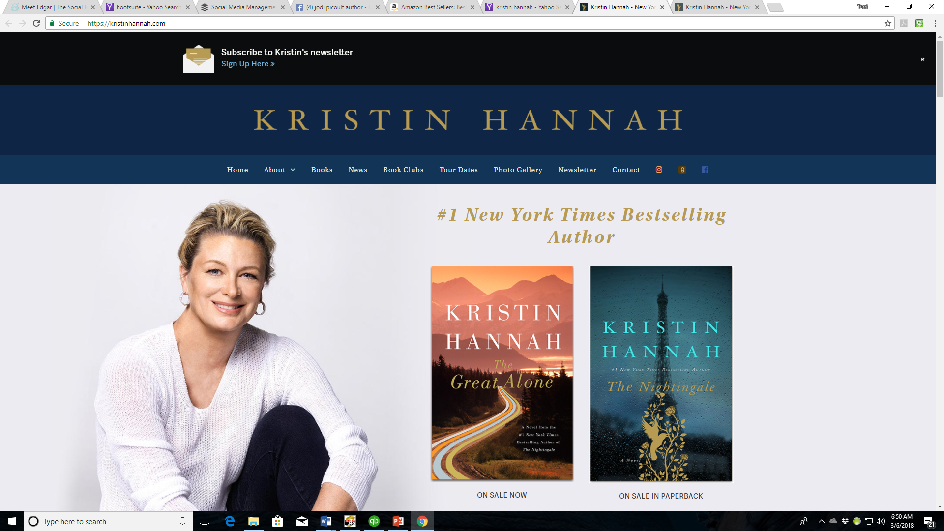

Slide 10
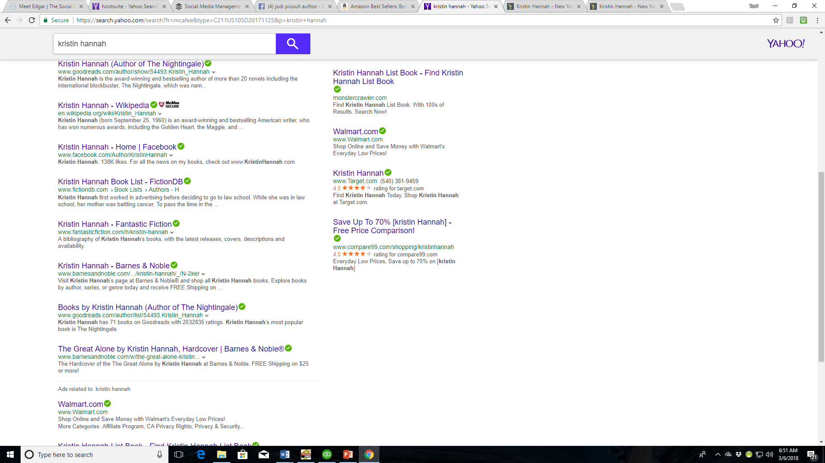

Slide 11
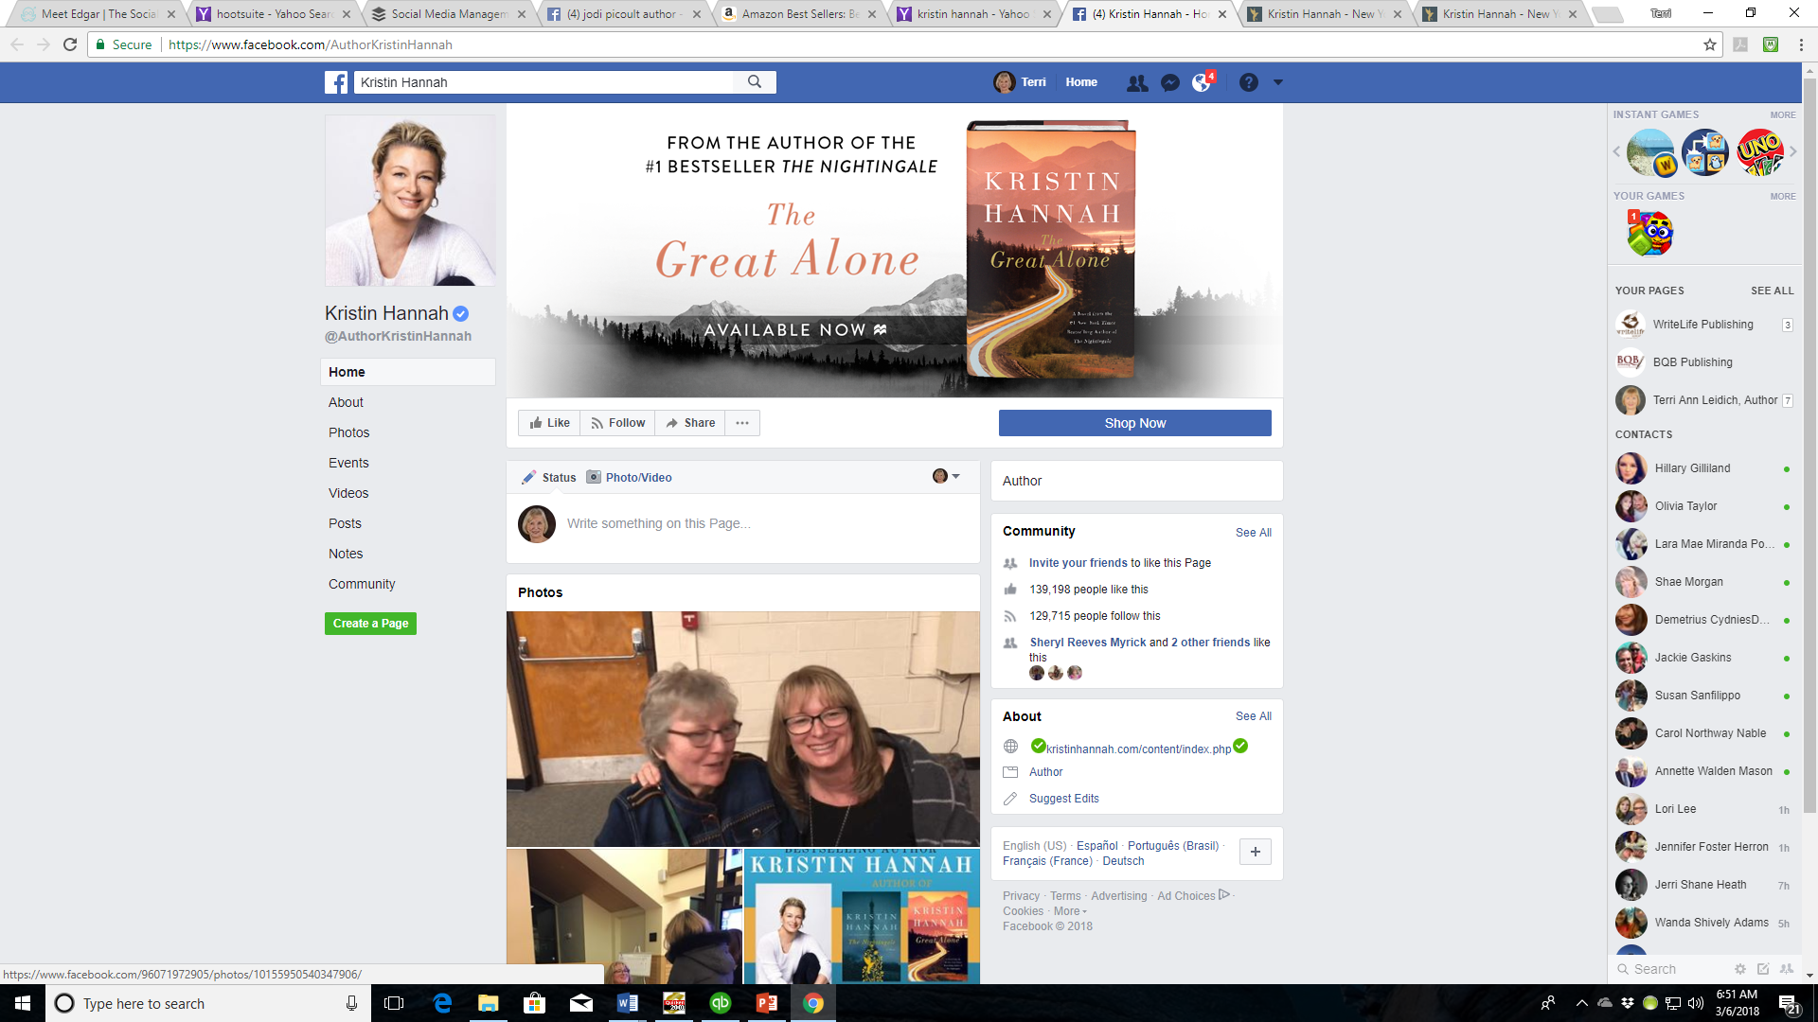

Slide 12
Manage Your Social Media
Social media is an important part of marketing, but keeping up with it can be time consuming. There are sites to help by scheduling posts ahead of time. Some are free, some have a cost. Find the one that most appeals to you and one that you will use.
Hootsuite https://hootsuite.com/
Buffer https://buffer.com/
Sprout Social https://sproutsocial.com/
MeetEdgar https://meetedgar.com/
Manage and Grow Twitter:
Crowdfire https://www.crowdfireapp.com/about-us
Tweepi https://tweepi.com/
Manage Flitter https://manageflitter.com/

Slide 13
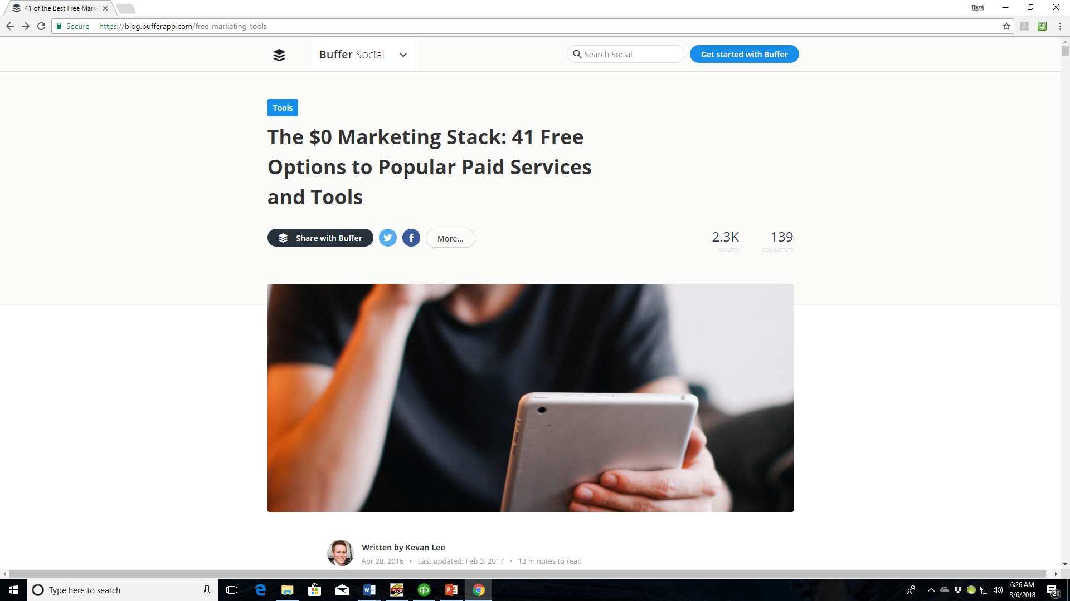
Great Site for Finding Free Options
https://blog.bufferapp.com/free-marketing-tools

Slide 14
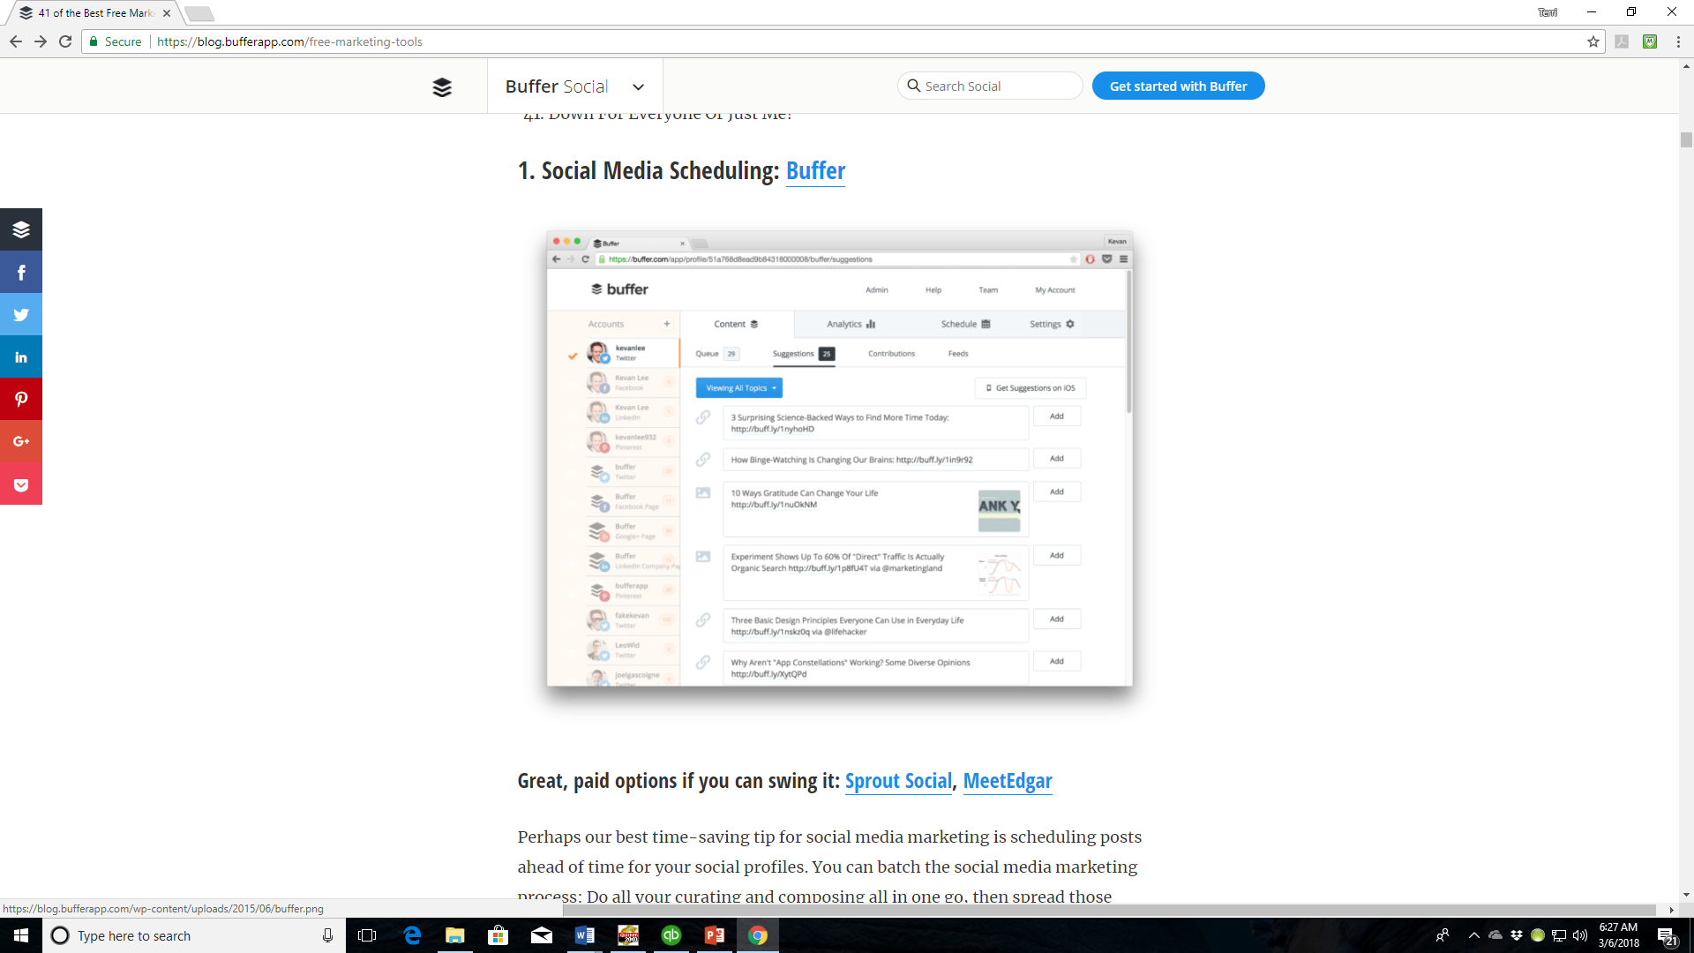

Slide 15
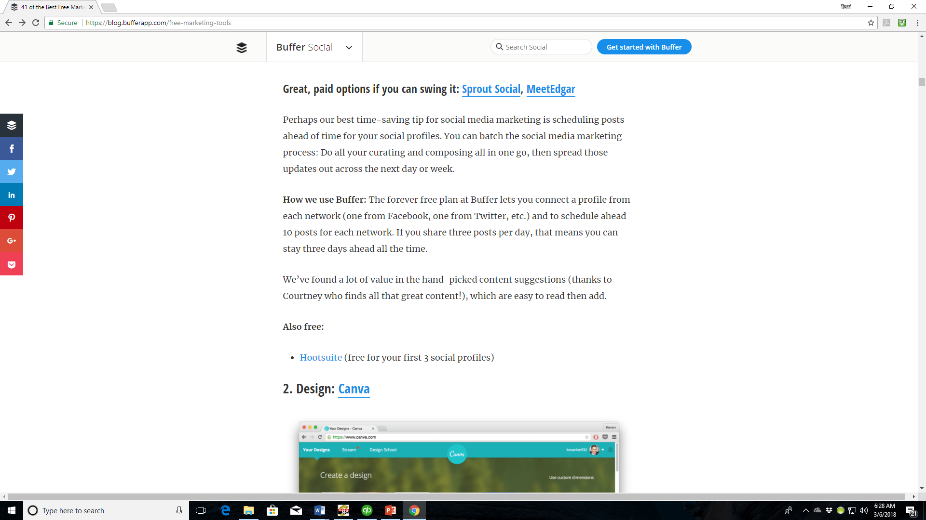

Slide 16
Build Your Social Media Effectiveness
Make sure your social media usernames are consistent
Include a social media call to action on your business card
Reach out to Influencers
Put your social share buttons on each blog post, newsletter, email signature, etc.
Periodically channel your email subscribers to your social media accounts
Link your social media accounts on your Contact and About Us pages of your website
Be responsive
Tell stories
Post often
Use humor
Reshare other people’s content
Be relatable
Great Article that expands on these options and gives more: https://www.inc.com/jayson-demers/39-ways-to-get-more-social-media-followers.html

Slide 17
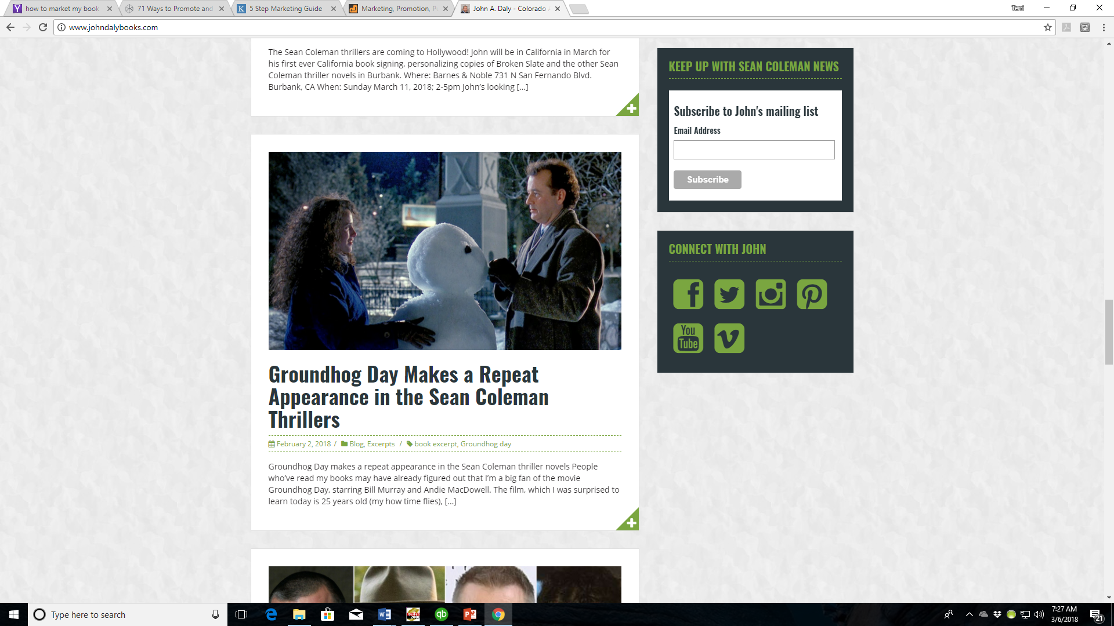

Slide 18
Get Marketing Ideas
The Internet abounds with ideas for book marketing. Search, read, learn.
Focus more on discoverability rather than selling
Accept responsibility for the marketing and promotion of your book
Write articles that tie your book topic or genre to current popular interests
Create Bookmarks
Attend live networking events, conferences, and expos
Connect with readers offline – book signings, book clubs, writing groups, school visits, workshops, library readings, and local area meet-ups
Make your vacations works for you – set up readings or book signings at local libraries, schools, or bookstores
Cross promote with other authors
Consider donating your book to hospitals, shelters, churches, libraries, doctor/dental offices, hair salons, organizations or clubs (great options for creating discoverability)
Great articles that expands on these ideas https://www.yourwriterplatform.com/promote-and-market-your-book/
http://www.webdesignrelief.com/marketing-promotion-social-networking-writers/

Slide 19
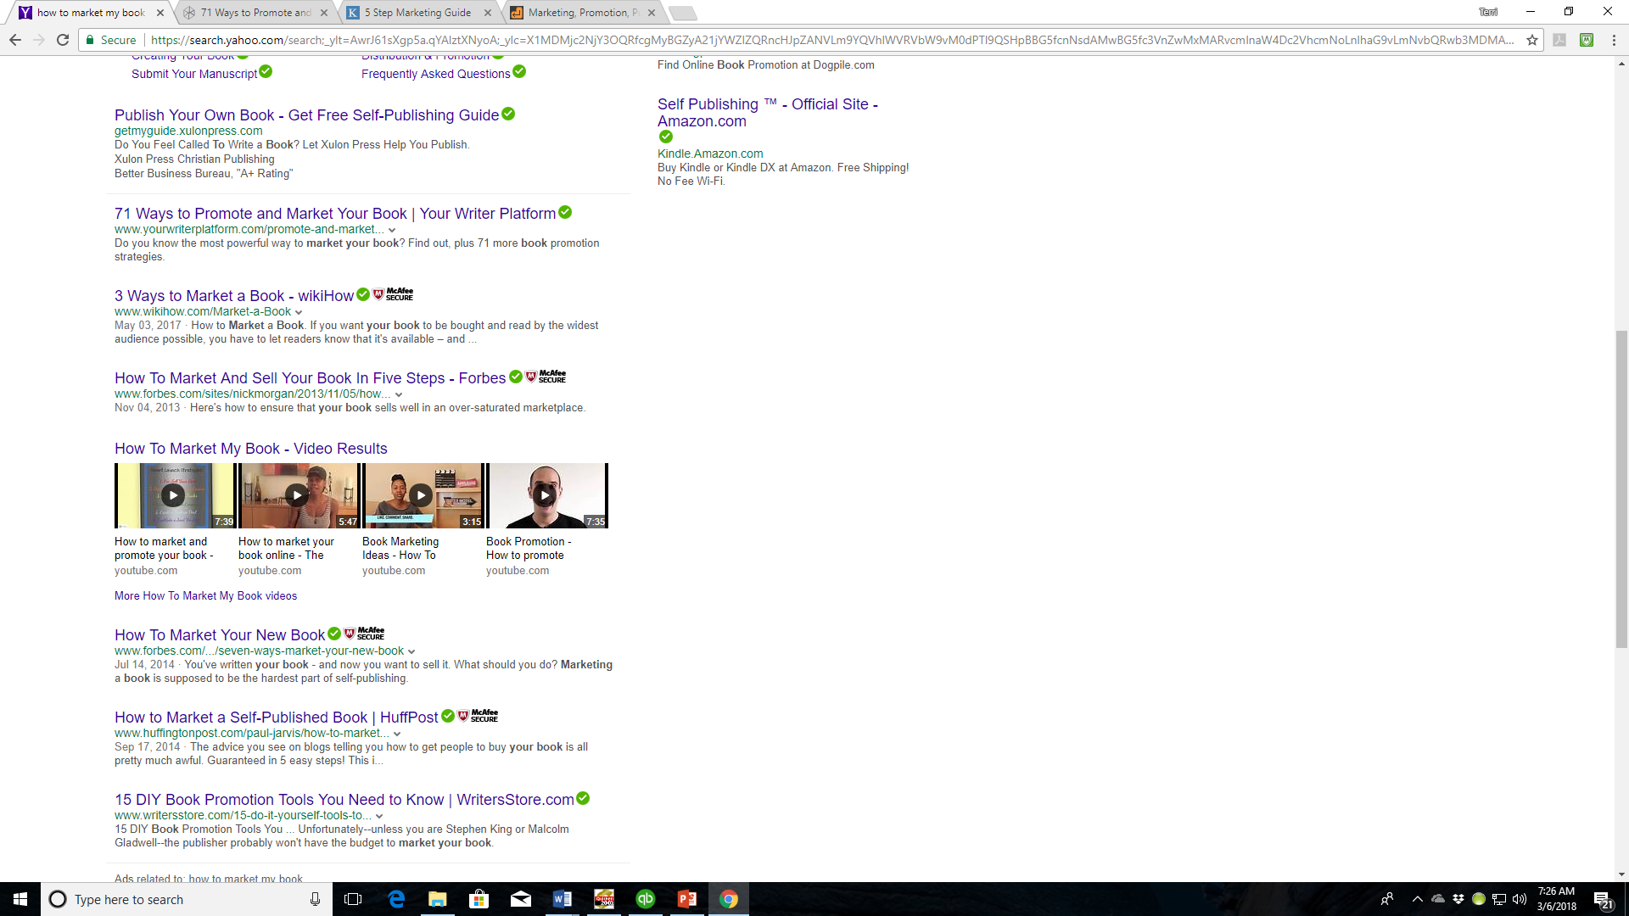

Slide 20
Tracking You and Your Book(s)
Are you and/or your book(s) being talked about on the Internet? You’ll want to know and setting up a Google Alert is the best way to do that. You can even track authors you follow to see what they are up to.
Google Alerts is a service that generates search engine results, based on criteria provided by you, and delivers the results to your e-mail.
https://support.google.com/websearch/answer/4815696?visit_id=1-636559365029153915-3740675698&hl=en&rd=1

Slide 21
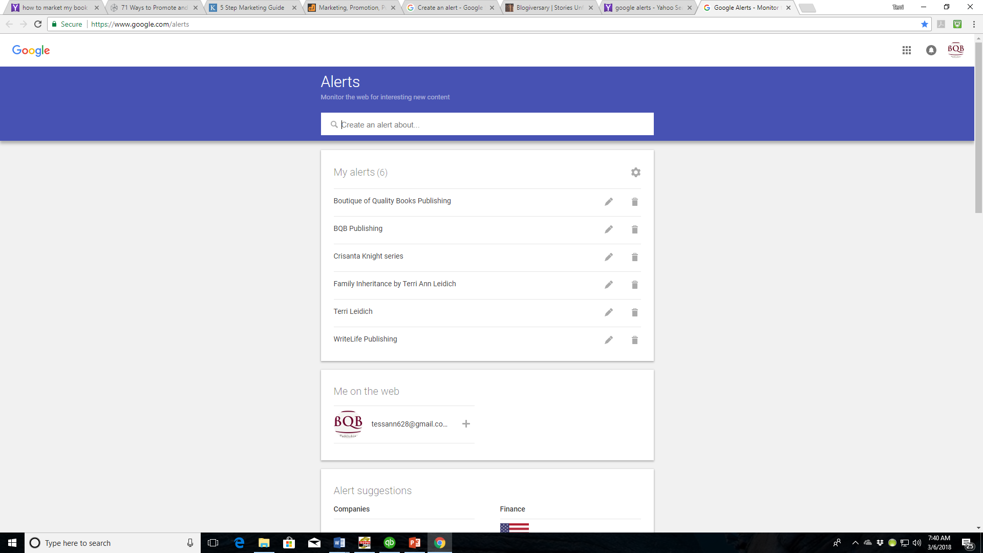

Slide 22
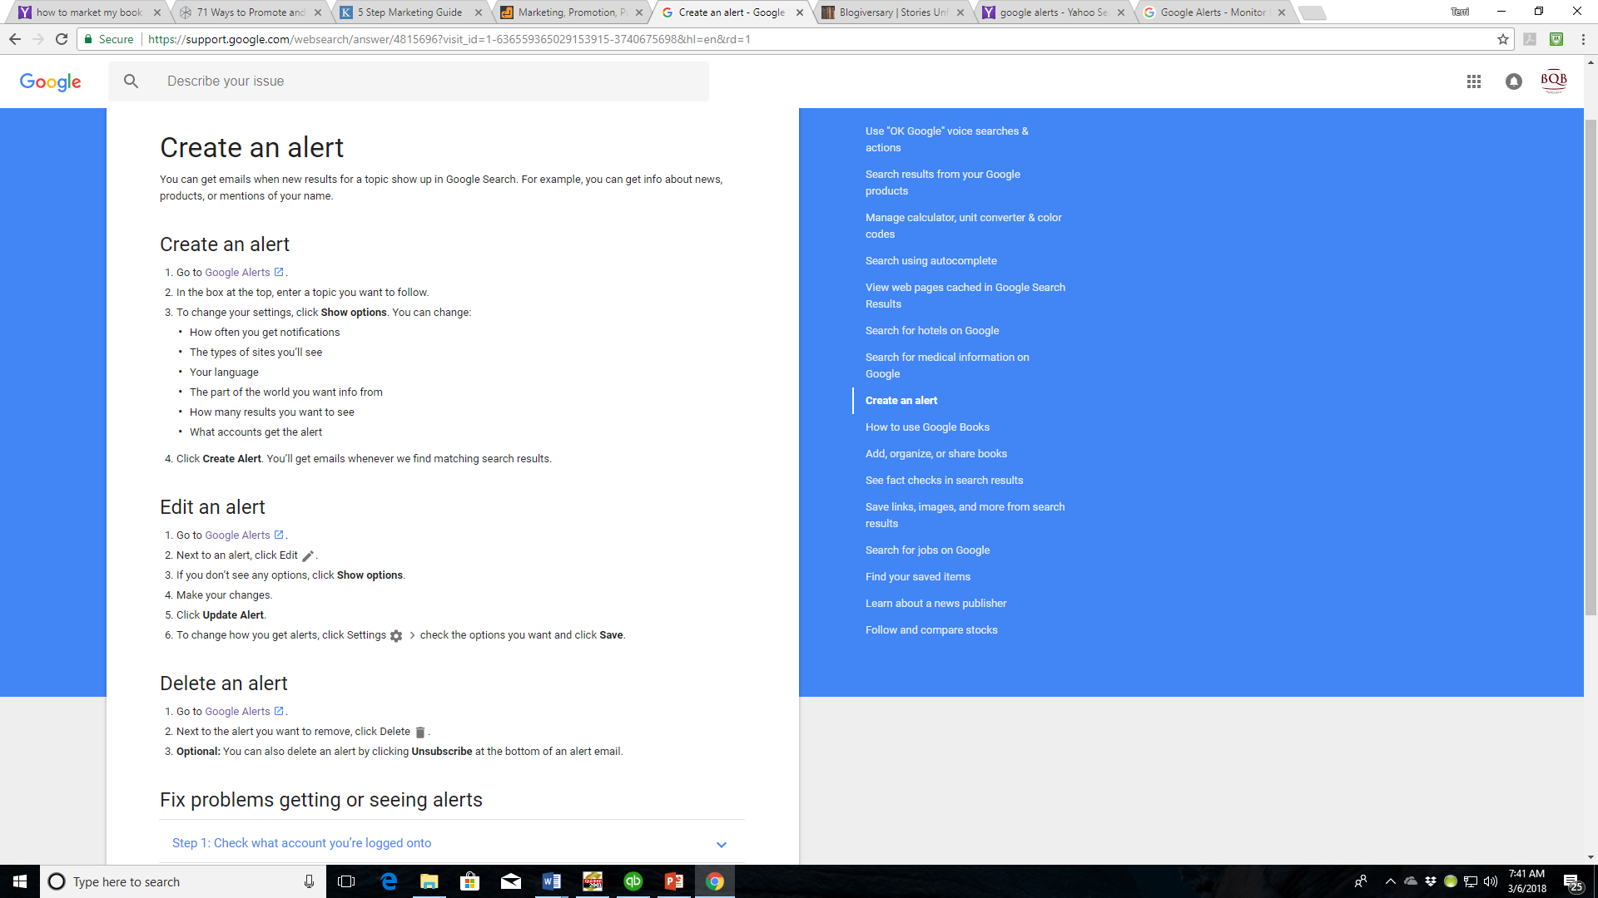

Slide 23
Creating Images
The Internet, social media, and marketing in general thrive on images
We need more than pictures of our books to keep our social media relevant
Memes are popular on social media to add humor
There are sites (some free, some not) that will help you build images:
For meme creation:
https://makeameme.org/
https://www.memecreator.org/create
Images are crucial for not only social media but for marketing pieces like:
Flyers
Postcards
Presentations
You can make your own through websites (some are free, some not)
Canva www.canva.com (free)
Photoshop www.adobe.com/products/photoshop
InDesign www.adobe.com/products/indesign.html

Slide 24
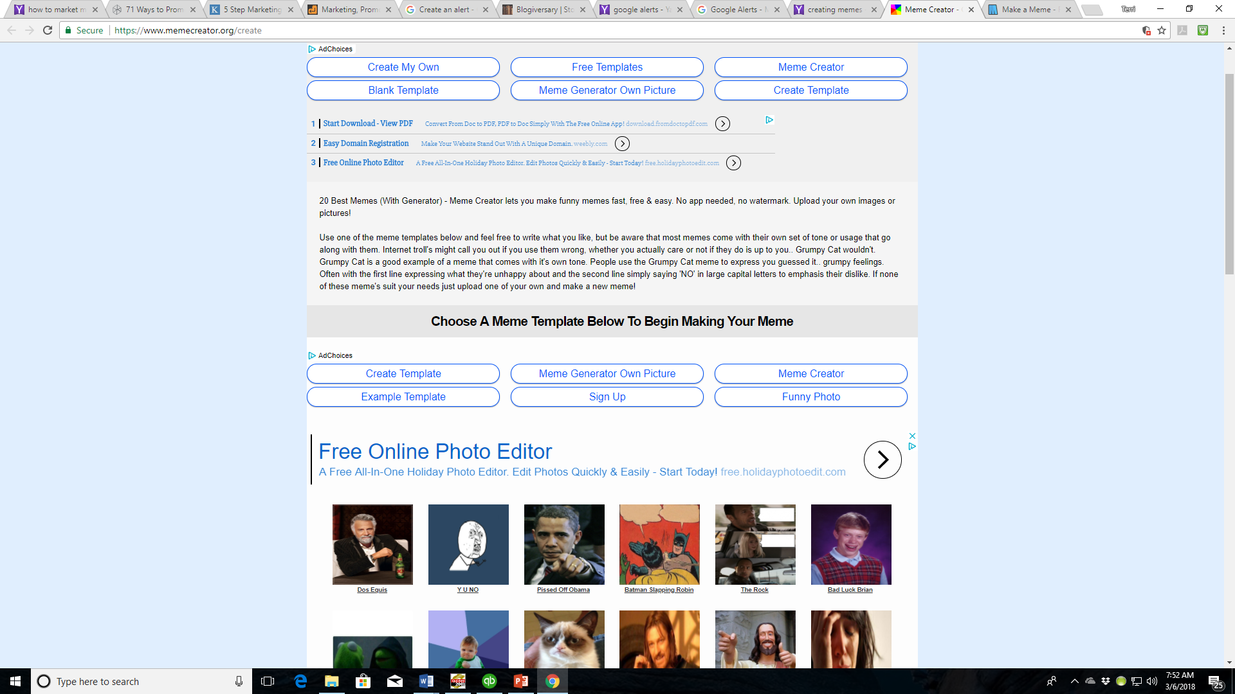

Slide 25
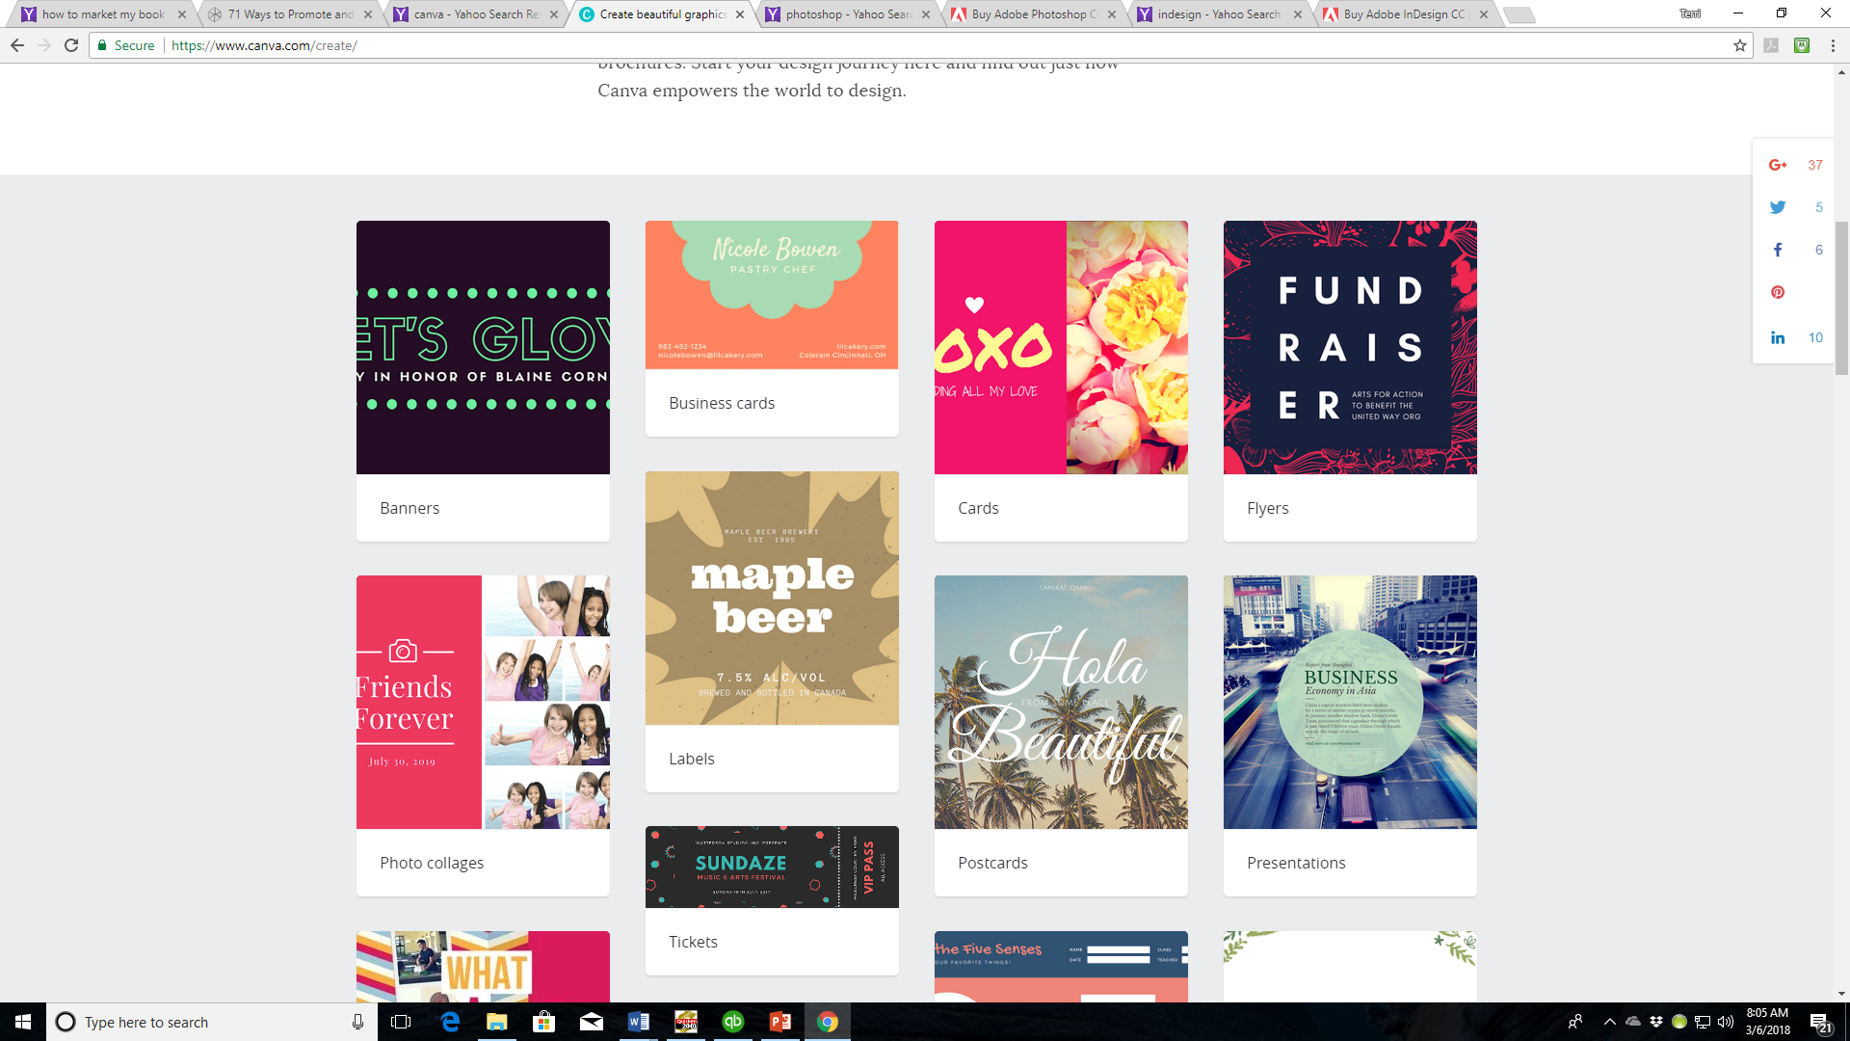

Slide 26
Creating and Using Videos
Videos are a powerful marketing tool in our culture
You can create your own video without the expense of hiring someone
Wistia www.wistia.com
Slide-ly https://slide.ly/
Once you have a video, share it:
Wistia www.wistia.com
YouTube www.youtube.com
Vimeo www.vimeo.com
YourWebsite
Link through social media

Slide 27
MOST IMPORTANT TAKEAWAY FOR TODAY –
TAKE AN ACTIVE ROLE IN MARKETING YOUR BOOK(S)

Slide 28
Questions?
Type any questions in the chat feature here!

Slide 29
NEXT MONTH’S WEBINAR
Saturday, April 14th, 11:00 a.m. EST
Our guest speaker will be:
Kelly Peterson of Inscribe
“What Authors Can Do To Help Us Sell Their eBooks.”

Slide 30
Thanks for joining us!
Have a great weekend!
Bqbpublishing.com
Writelife.com

