Slide 1

Independent Publishers Group
How Authors Sell Books

Slide 2
The Basics
#IPGSummit18

Slide 3
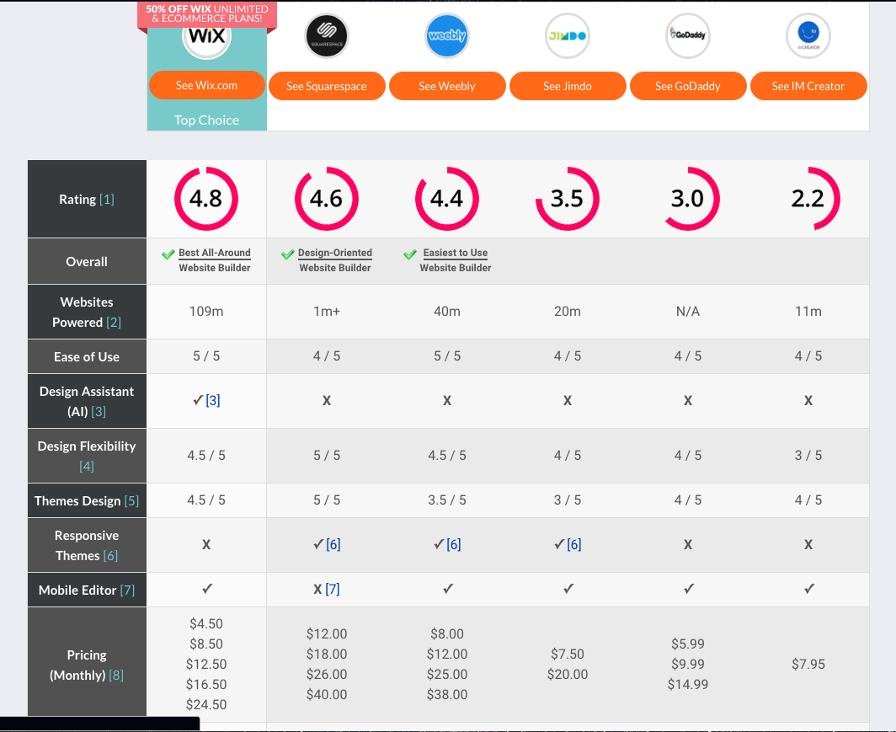

The Basics: Website
Wix
Wordpress
Weebly
Squarespace
You CAN make this yourself. You can also outsource: do what is right for you!
PRO TIP: Don’t forget to buy a spam filter!
https://www.websitebuilderexpert.com/website-builders-comparison-chart/?omcanvas=isqizcs1p2-canvas

Slide 4
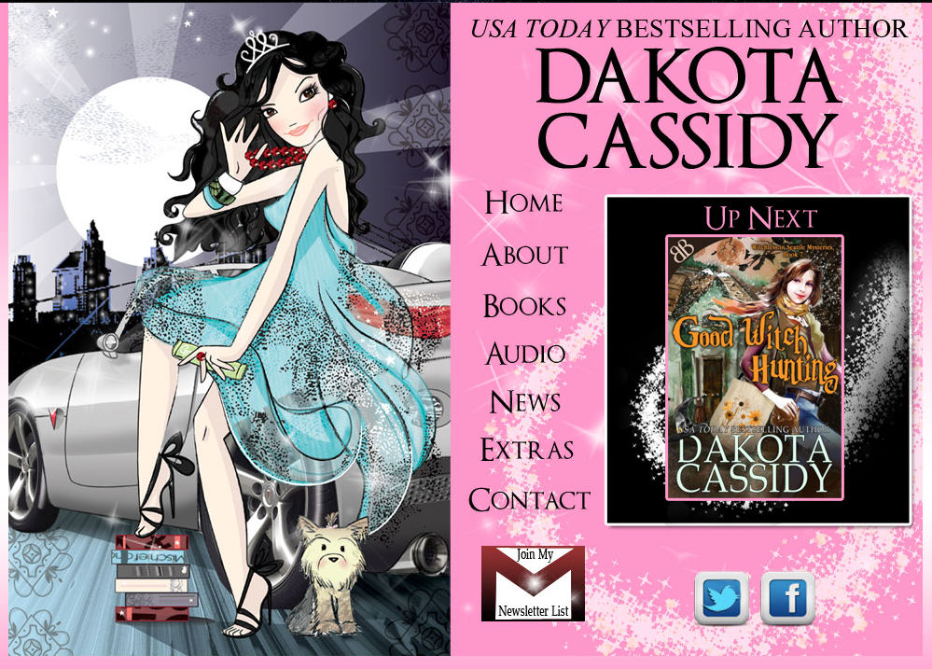
The Basics: Website
Your readers want to learn more about you
You need a place to build your community
You need a place for your affiliate links/direct sales
Social media is not enough
You want to look like you are interacting with your readers
PRO TIP: Offer Samples on site to engage customers!
https://www.huffingtonpost.com/fauzia-burke/making-my-case-why-author_b_5708455.html

Slide 5
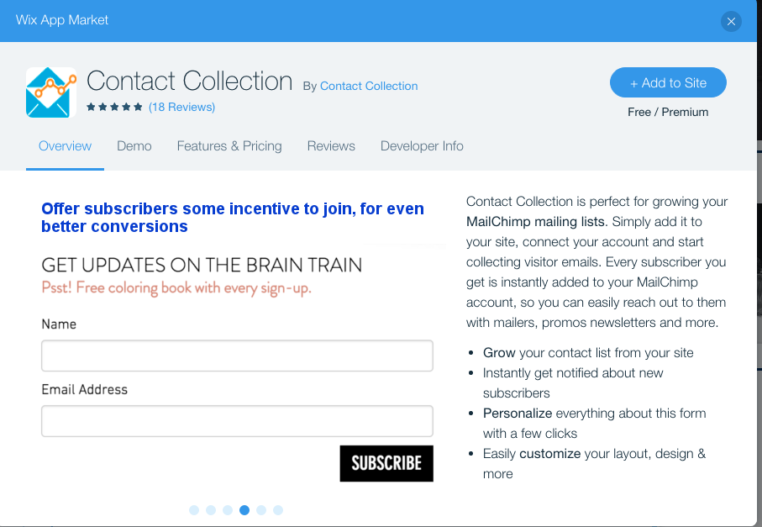
The Basics: Newsletter
Choose an email provider
ConstantContact
MailChimp
IConnect
Embed a Signup link
Link to it on EVERY PAGE of your website
Send out relevant content every month, minimum
PRO TIP: Decide what your “BRAND” is before you sign people up!
http://contentmarketinginstitute.com/2010/07/an-email-newsletter-that%E2%80%99s-as-easy-as-blogging/

Slide 6
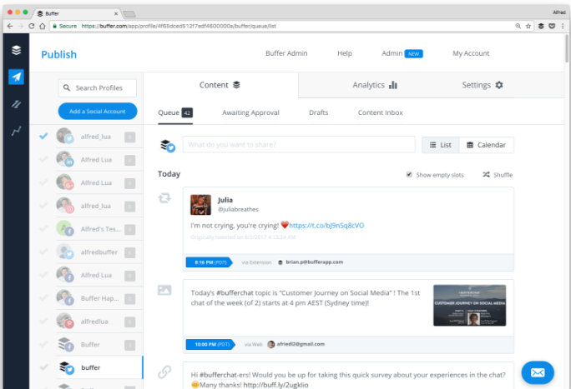
The Basics: Blog and Social Media
When you know your brand, you can focus:
Blog entry on a scheduled cadence
2 forms of social media (Twitter, Facebook, Instagram)
Use a scheduler
HootSuite
Sprout
Hubspot
Meet Edgar
Tweetdeck
Buffer
Pro Tip: if you set up an RSS feed, your blog can be your newsletter!
https://sproutsocial.com/insights/social-media-scheduling-tools/ and https://blog.bufferapp.com/social-media-management-tools

Slide 7
Defining Your Brand
#

Slide 8

Who Are You? And Who is Your Reader?
Knowing your ideal reader allows you to target your brand.It’s called a ”customer persona” and allows you to direct your messaging.
What Does that Do?
Promise to the Customer
Name Recognition
Engage Readers
Build Street Teams
Engage Influencers
Some resources
Quick Guide to Building Your Identity as an Author
How to Build Your Author Brand and Why
7 Best Ways to Build an Author Brand

Slide 9
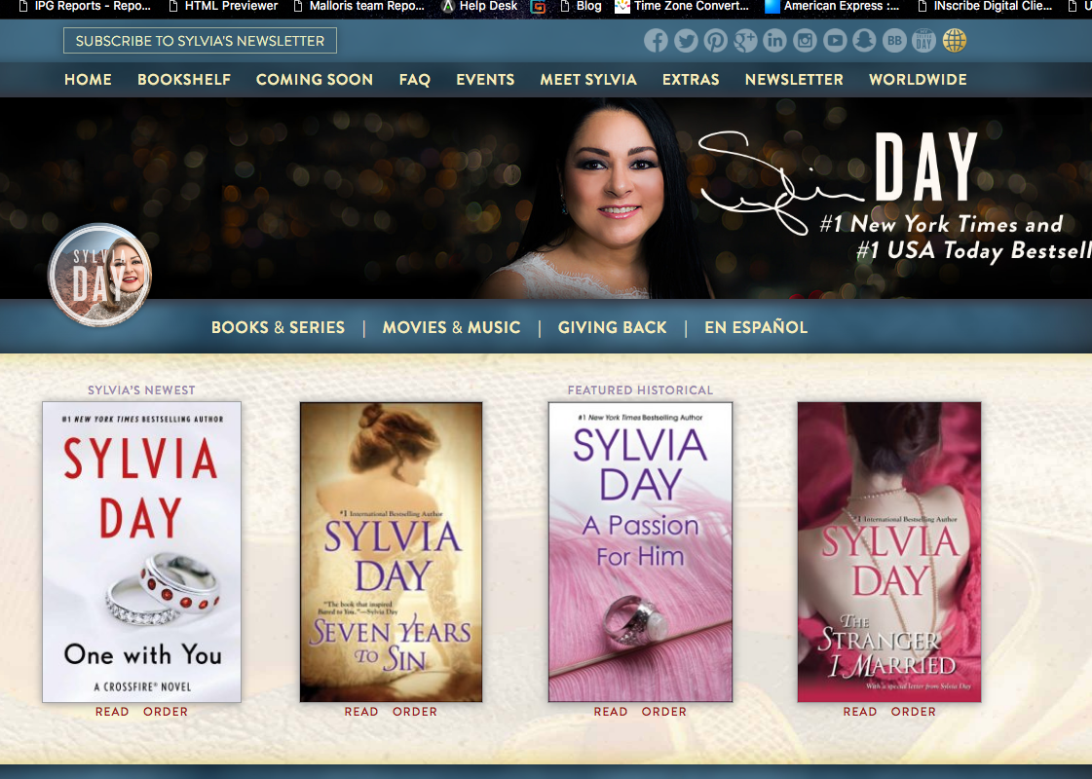
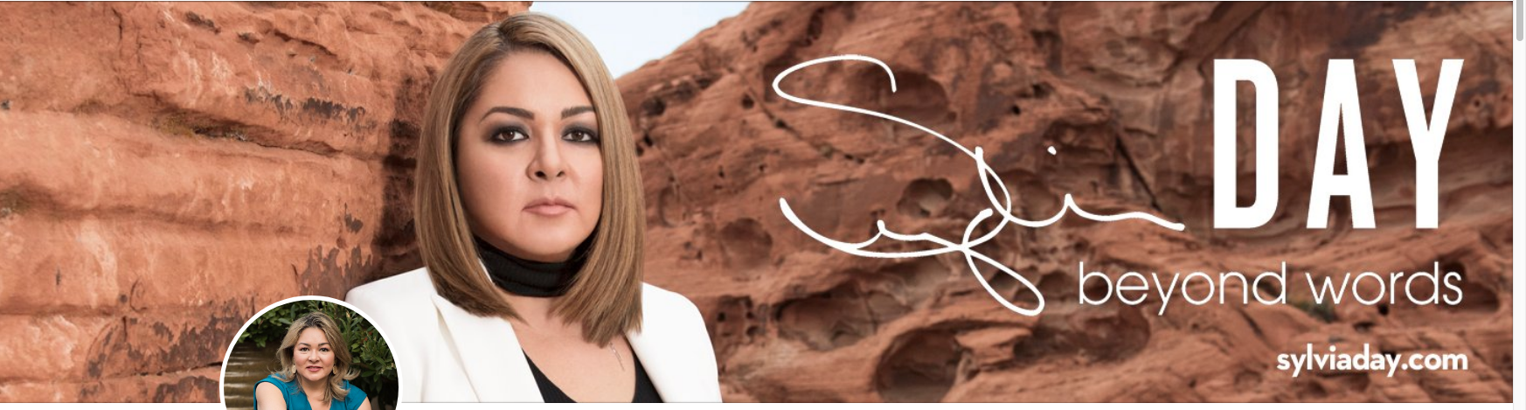
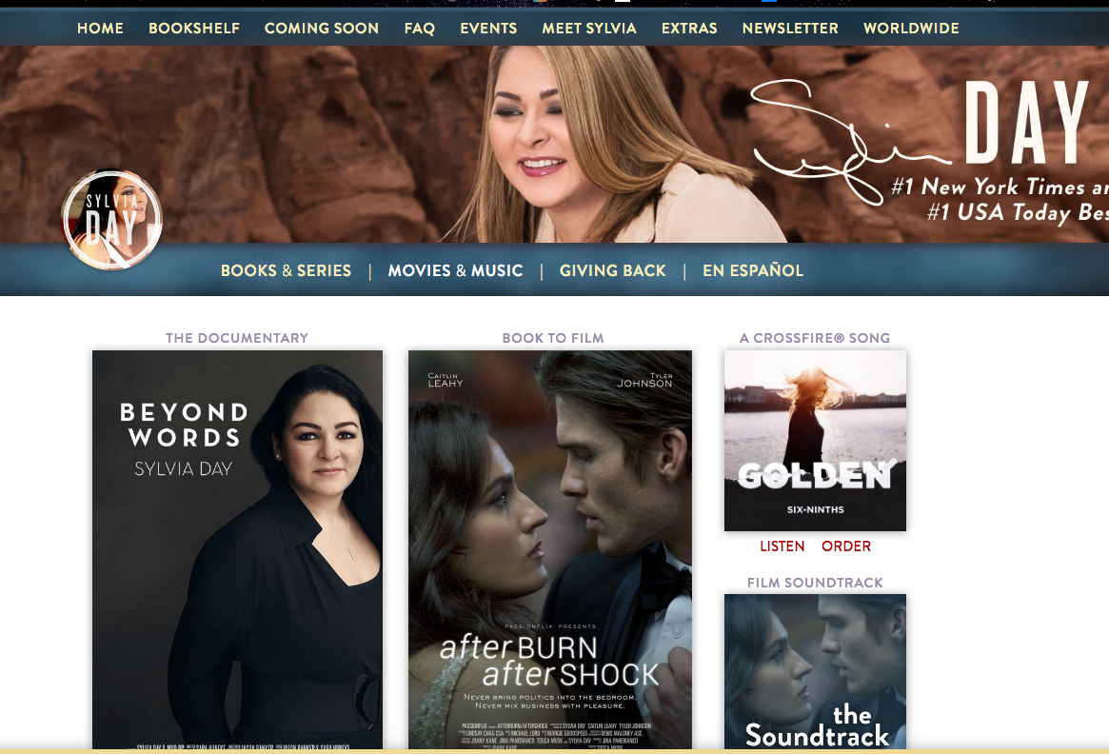
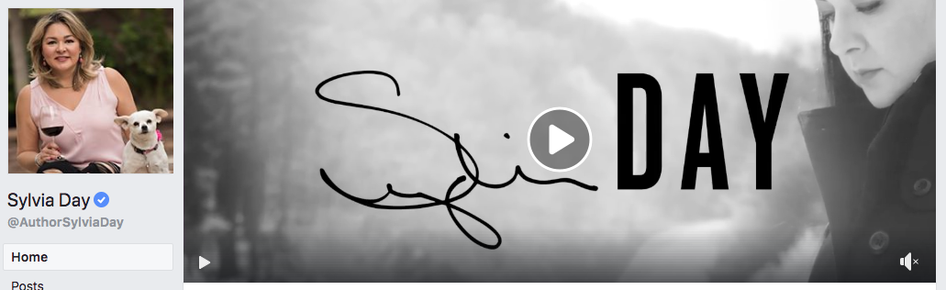
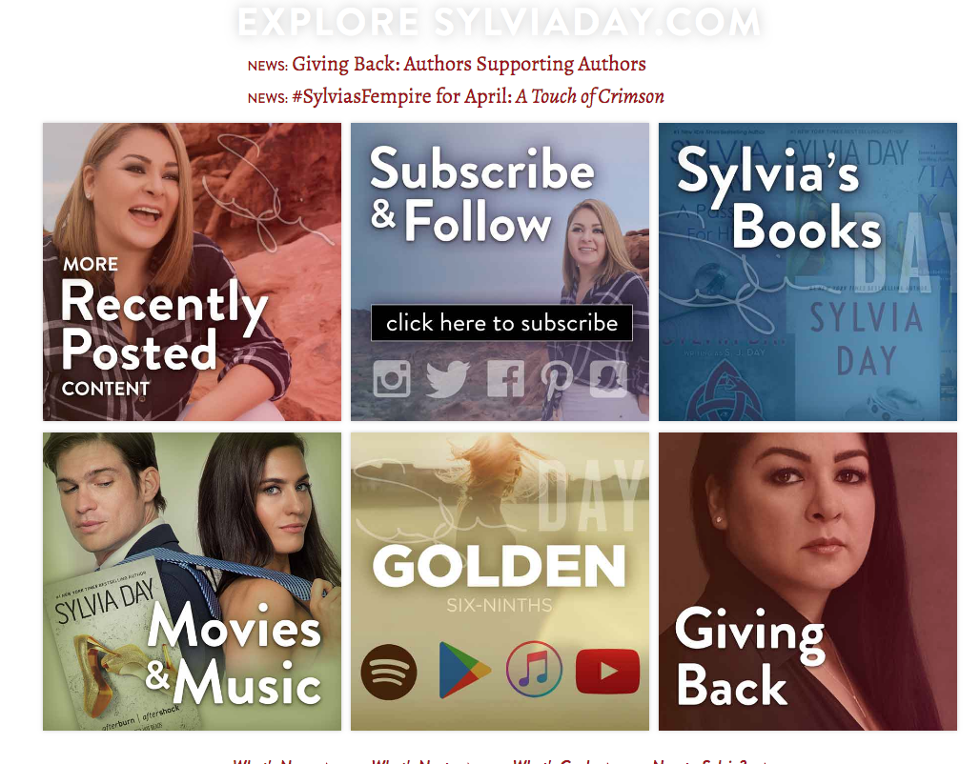
Author Brand Study

Slide 10
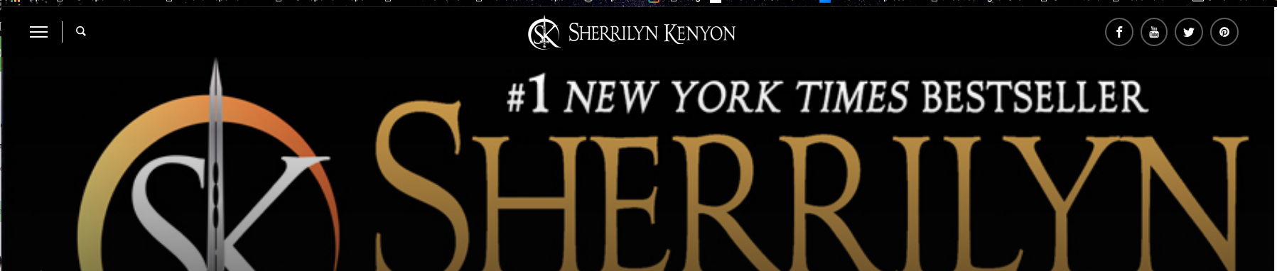
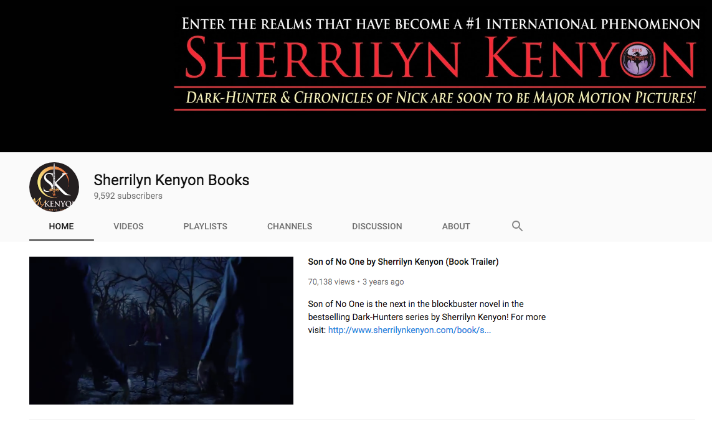
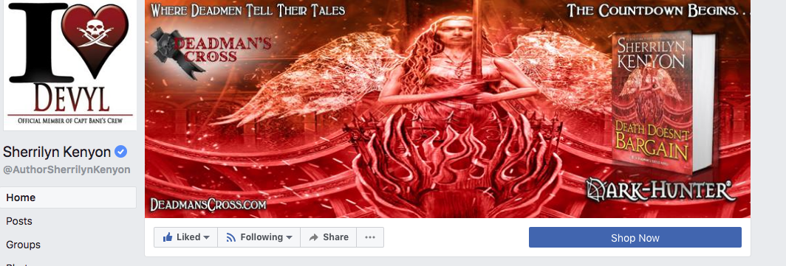
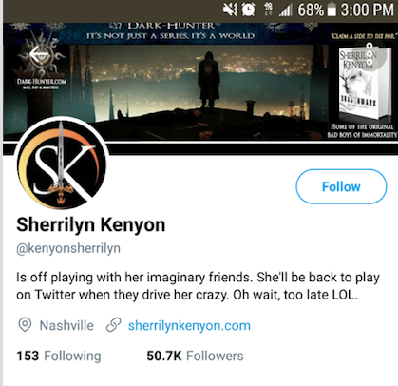

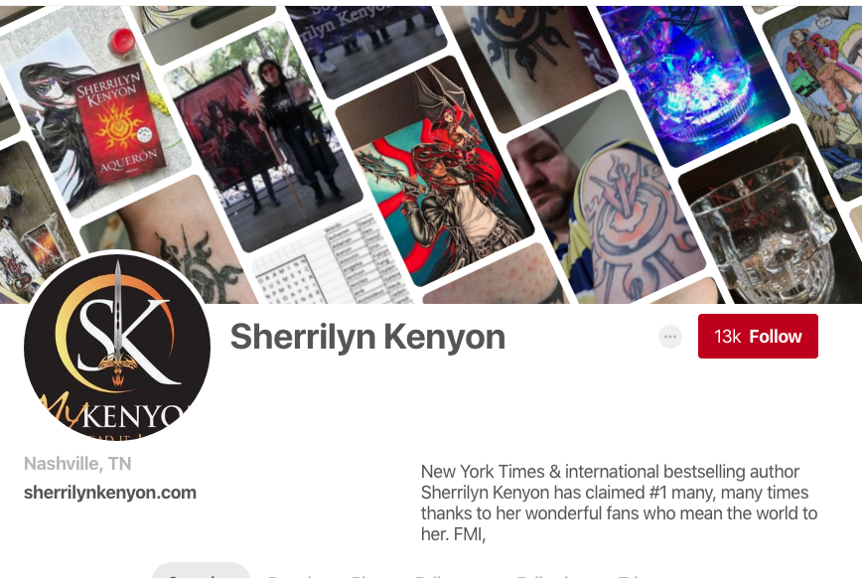
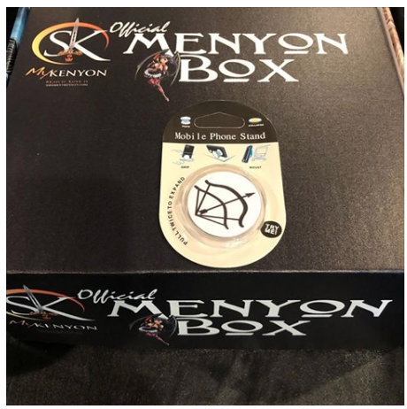
Author Brand Study

Slide 11
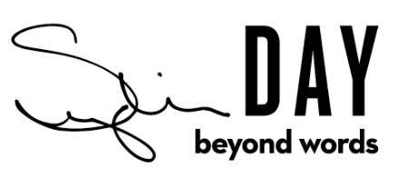
What Do you Need for Your Brand?
A Persona
what part of you will you share?
Do you use pennames?
A Logo
Can be text or an image
A Business Card
Try Moo or local printer
A Headshot
Show head and shoulders
Use natural light
High quality
A Social Presence
You need to be where your customer is!
Repurpose content
Blog
A Website
A Media Kit
https://writingcooperative.com/quick-guide-to-building-your-brand-identity-as-an-author-e20855d66773

Slide 12

Why Is It Important?
95% of book sales come from personal recommendations
70% of consumers look at social media before buying
Micro-Influencers are key
#IPGSummit18

Slide 13
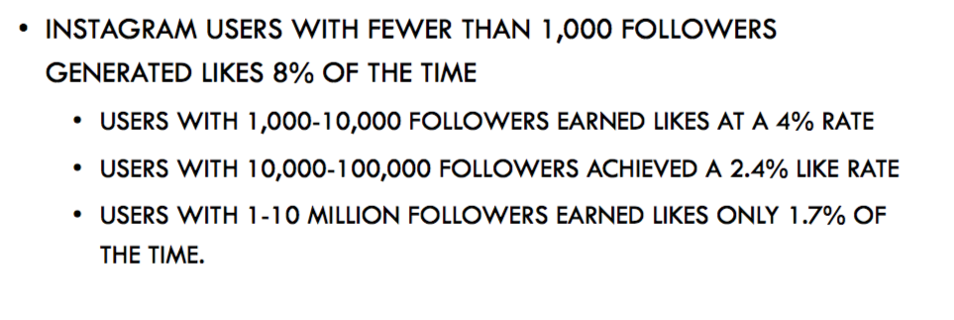
Who Are Micro-Influencers?
Readers with 1,000-10,000 followers are the sweet spot to become influencers, superfans, and street teams. It takes 1,000 Superfans to make a bestseller.
https://www.amazon.com/How-Sell-Books-Truckload-Amazon-ebook/dp/B075WL33XB/ref=tmm_kin_swatch_0?_encoding=UTF8&qid=&sr=

Slide 14
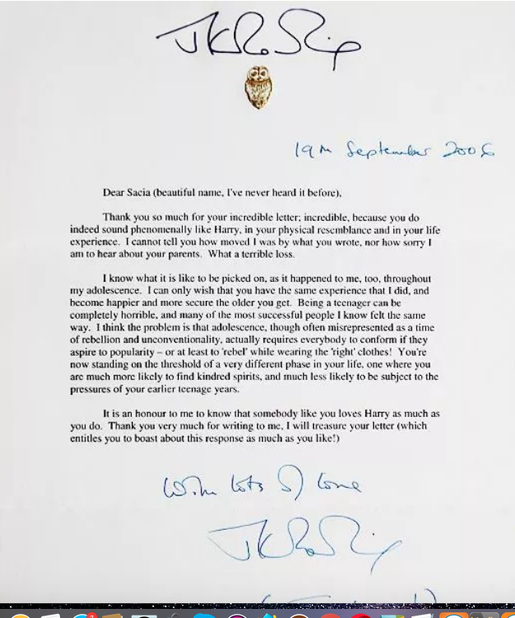
How Do You Keep in Touch with Micro-Influencers?
Answer Every Email. Every time.
Make Sure They Can Reach You.
Make Them Feel Important
Give them Creative Ways to Engage
Contests
Blog entries
Advanced Reader Copies (eBooks)
Create an Exclusive Club
https://www.amazon.com/How-Sell-Books-Truckload-Amazon-ebook/dp/B075WL33XB/ref=tmm_kin_swatch_0?_encoding=UTF8&qid=&sr=

Slide 15

Difference Between a Superfan and a Street Team
SUPER FANS
Loves Everything You Do
Buys All Your Books
Gives Social Media Love to Your Posts
Comments on Your Blog
STREET TEAM
Loves Everything You Do
Actively Engaged in Your Success
Willing to Share Your Stuff
Help You Promote
https://www.amazon.com/How-Sell-Books-Truckload-Amazon-ebook/dp/B075WL33XB/ref=tmm_kin_swatch_0?_encoding=UTF8&qid=&sr=

Slide 16
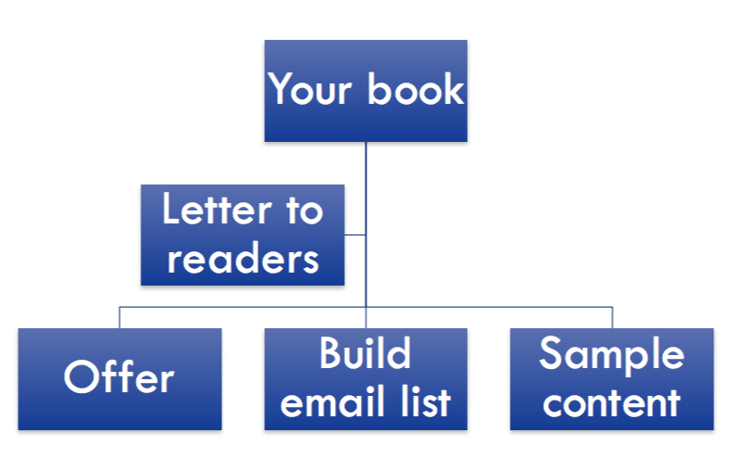
How to Grow Your Superfans
Offer Free books
Offer Exclusives to Fans
Newsletter
Sharing Offers
https://www.amazon.com/How-Sell-Books-Truckload-Amazon-ebook/dp/B075WL33XB/ref=tmm_kin_swatch_0?_encoding=UTF8&qid=&sr=
#

Slide 17
Turning Your Superfans Into Street Teams
Email your list & invite them to participate
Reward them – send gift cards, handwritten notes, swag
Spend time with them and on them
Street Teams require work!
What They Do
Follow your outline and requirements
Social Media Sharing
Blogging
Posting Event Info Nearby
Have a clear schedule and execute
Don’t be afraid to hold them accountable.
https://www.amazon.com/How-Sell-Books-Truckload-Amazon-ebook/dp/B075WL33XB/ref=tmm_kin_swatch_0?_encoding=UTF8&qid=&sr=

Slide 18
Time Saving Tricks
#

Slide 19

Tips and Tricks for Social Media
Use IMAGES as much as you can!
mind is an image processor, not word processor
Photos prevent skimming
Always add website name to photos
Use Cover Art
Always name the image something searchable
Good blog post/newsletter around 350 words.
Use RSS feed to make it the same
Repurpose blog post as other social media
https://www.amazon.com/How-Sell-Books-Truckload-Amazon-ebook/dp/B075WL33XB/ref=tmm_kin_swatch_0?_encoding=UTF8&qid=&sr=

Slide 20

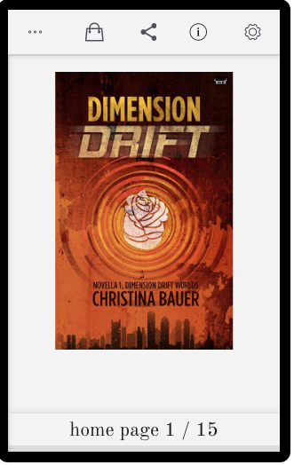
Tips and Tricks for Social Media
Available months before on-sale
Can be created from sample or full file
Retailer and social media buttons on EVERY page
Maximize profits by using your own affiliate links
Handy for email, blog, and website
One-click social media sharing

Slide 21
Guaranteed Sales Drivers
#

Slide 22
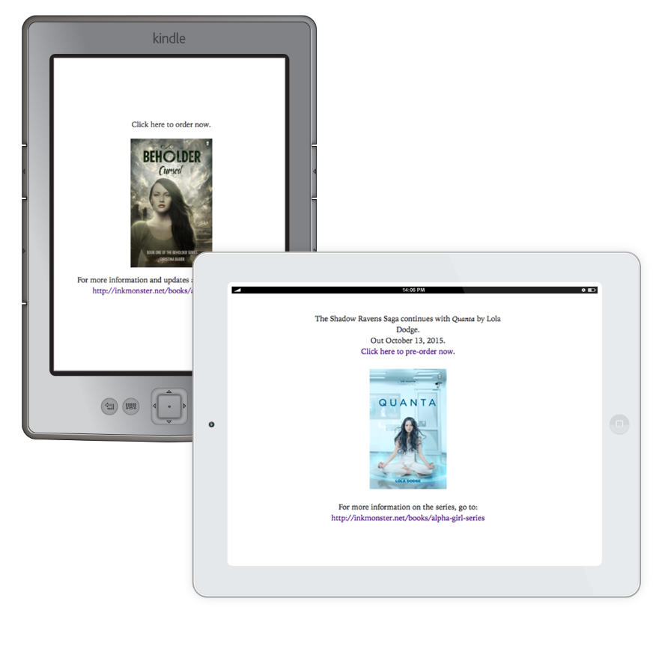
Tips and Tricks for Selling More Books
Back matter link direct to each major retailers in your back-of-book for ease of instant shopping experience
Ability to use affiliate links for extra revenue
With series, 20-50% of customers seamlessly purchase next book
Cross sell with other authors, do custom recommends
Add a chapter to get them hooked

Slide 23
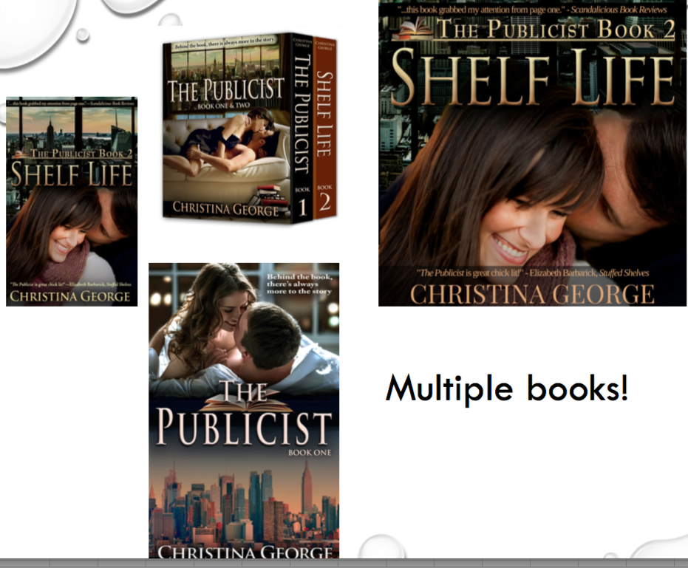

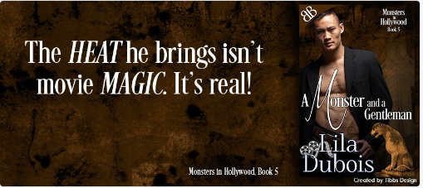
Tips and Tricks for Selling More Books
Repurpose content
Use as images in social media
Create bundles of your books, and price as if one was free
Split up long books into multiples
Create thematic bundles

Slide 24
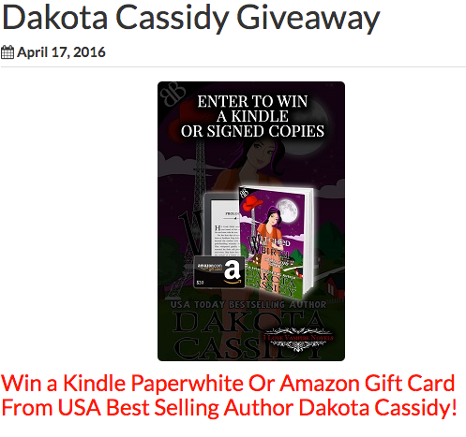

Author Generated Buzz
Website alerts
Reveals
Newsletters
Author Networks
Pledge to Buys
Social Media
“I can’t write without a reader. It’s precisely like a kiss – you can’t do it alone.” – John Cheever

Slide 25
Author Generated Buzz
Website alerts
Reveals
Newsletters
Author Networks
Pledge to Buys
Social Media
“I can’t write without a reader. It’s precisely like a kiss – you can’t do it alone.” – John Cheever

Slide 26
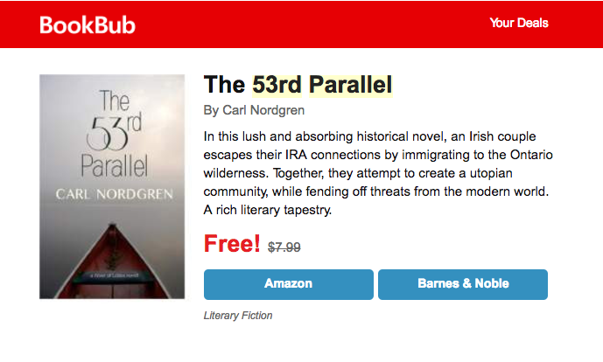
Generate Huge Demand
Affiliate Ads (Facebook,Twitter)
Bookbub
Stack these on top of each other for effectiveness

Slide 27
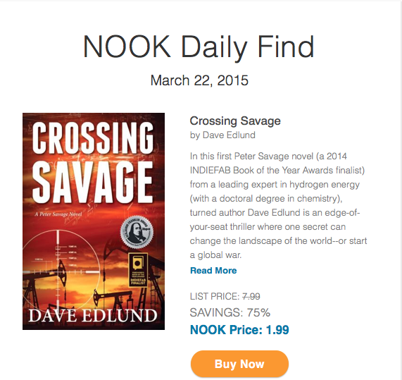
Let the Retailers Help You Promote
Kindle/Kobo/Nook Daily Promotions
Customers Who Bought
Free Promos (First in Series Free)

Slide 28
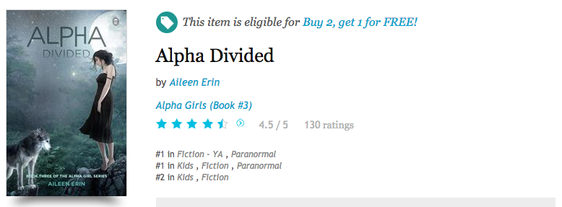
Need to Catch Them Quickly
A few things that help...
Powerful cover
Metadata that sells
Strong keywords
Proper BISACs

Slide 29
Using Metadata to Optimize Search and SEO
Metadata is a huge driver for search online and in-site
Using keywords and formatting in author bio and description
Author Pages are key on Amazon and Goodreads
Metadata is evergreen, and continues to drive sales
“Real search is about providing valuable information when it’s really needed to those who are actually looking for it.”- David Amerland, Google Semantic Search

Slide 30




Questions?
Kelly Peterson
INscribe Digital
415-489-1468
Kelly@inscribedigital.com
Find us @inscribedigital (and @ipgbooknews on Twitter)

