Slide 1

How to Become Your Own Publicist
Welcome!
Saturday, May 12th, 2018
11:00 a.m. ET

Slide 2
Overview
What Does a Publicist Do?
Why Do You Need a Publicist?
Hire One or Become Your Own?
How to Become Your Own Publicist.

Slide 3

What Does a Book Publicist Do?
Devise and execute the book platform
Branding
Acquire Endorsements
Buzz strategies
Placements on TV, radio, in print, with bloggers
Ad copy
Event Coordination
Book reading tours
Award Applications
Book Trailers

Slide 4
What Does a Book Publicist Do? (cont’d)
Create a strategy for the author’s book blog
Assemble a media kit
Pitch interviews and features
Plan the book’s launch event and book talk
Schedule, host, and promote the book’s virtual tour
Position the title for addition to a books’ list
Formulate the author’s talking points
Recommend venues with high traffic author events
Leverage the interest of special audiences & book groups

Slide 5
Why Do You Need a Publicist?
Publicity is about using various sources and means to create a Buzz and fanbase for your book and creating a brand for you as an author.
Publicity always has and still is considered the core element of any book marketing campaign

Slide 6


Slide 7
Should You Hire One or Become Your Own?
Generally, publicists run from $2,000 - $5,000 per month with a three-month minimum contract.
There is no guarantee of results.
There are good publicists and not so good ones.
If you hire a publicist, make sure it is a book publicist and use the previous list to determine what they do.
If you decide to do your own publicity, you need to be able to do (or be willing to learn to do) the things on the list.

Slide 8


How to Become Your Own Publicist
Devise and Execute Your Book Platform
What Is An Author Platform?
It is simply all the ways you are visible and appealing to your future, potential, or actual readership.
A Platform is your tribe that consists of communities of interest
Author blogs
Writing forums
Other people’s blogs
Facebook groups and pages
LinkedIn Discussion groups
Twitter #discussions and lists
Specialized social groups like ning networks
Speaking you do
Classes you teach
Public appearances

Slide 9

How to Become Your Own Publicist (cont’d)
Build Your Brand
Your brand is your promise to your audience. It tells them what they can expect from you and your work, and it differentiates what you have to offer from that of your competitors
Determine how you want to be known.
What words, ideas, concepts and feelings do you want people to associate with you?
Simplify what truly represents you and your writing best.
Your values, interests, passion, and purpose
The types of writing you want to do
The readers you want to attract
Check out websites of authors, bloggers, and other creatives. What attracts you? Notice what they are doing effectively and try adapting some of those concepts to your own brand
Create a website and/or blog that helps build and strengthen your brand.

Slide 10
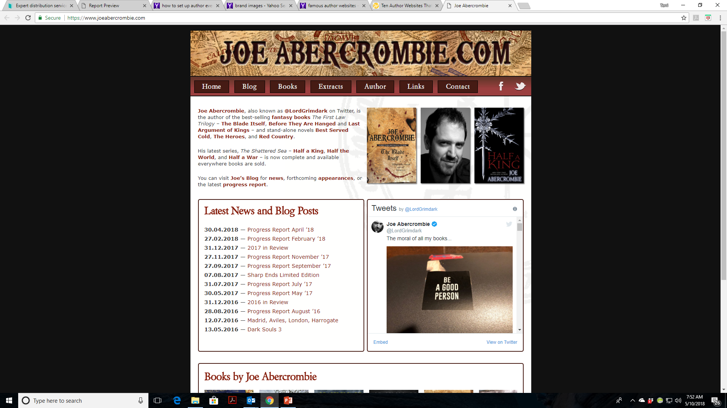

Slide 11
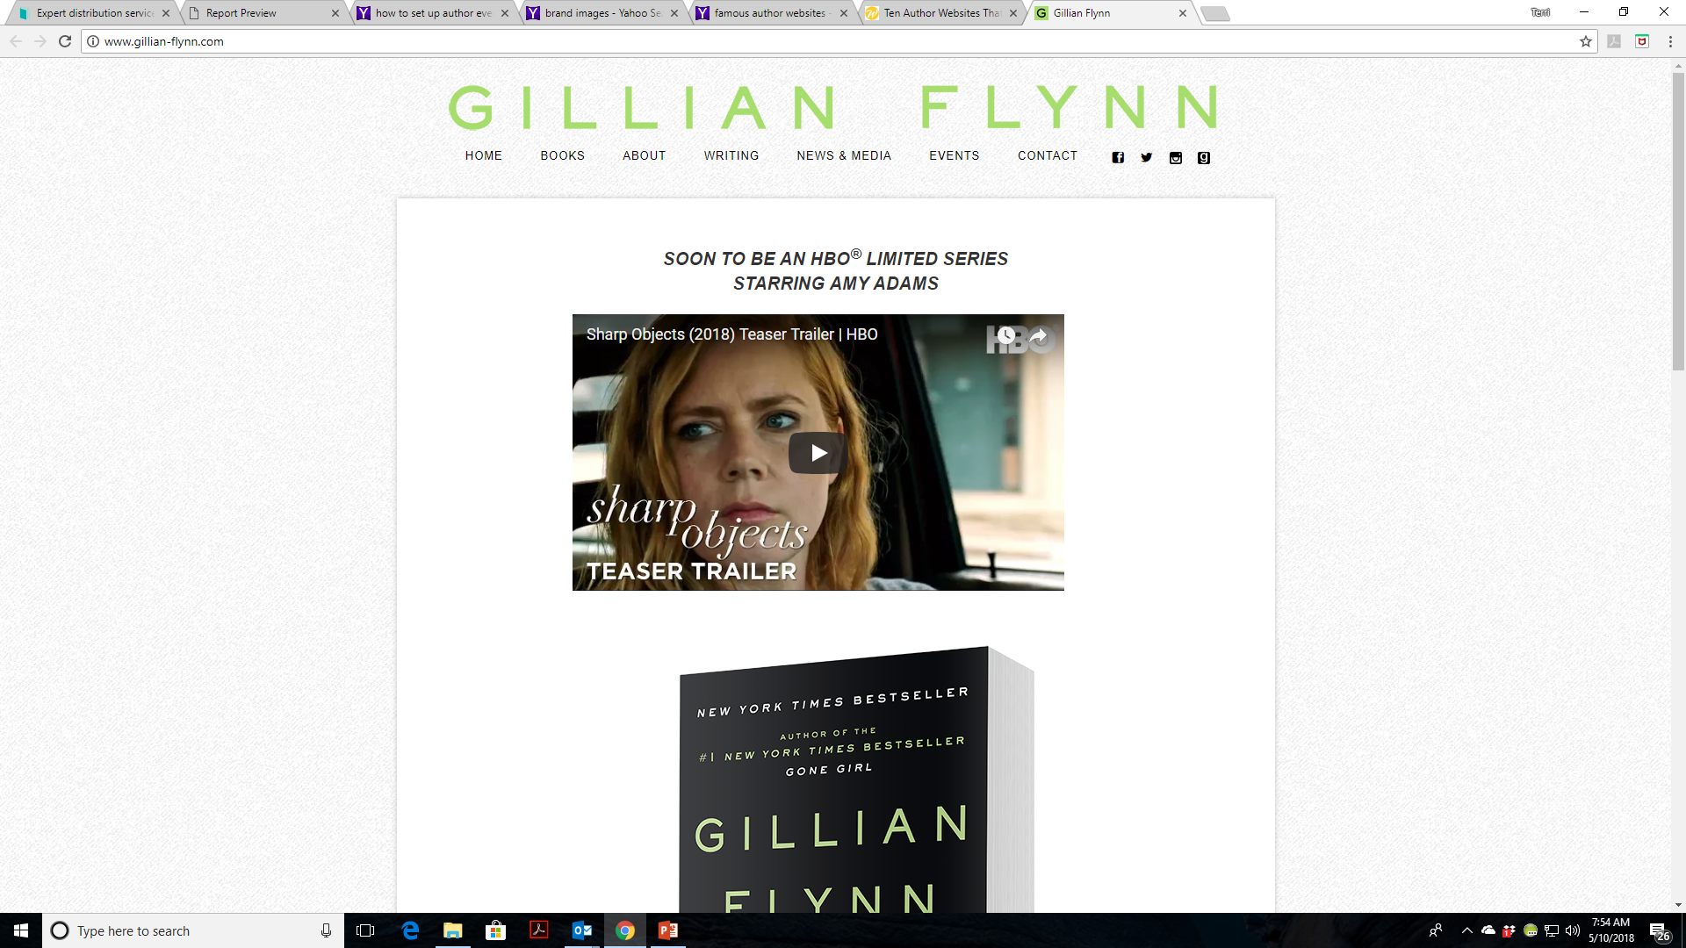

Slide 12
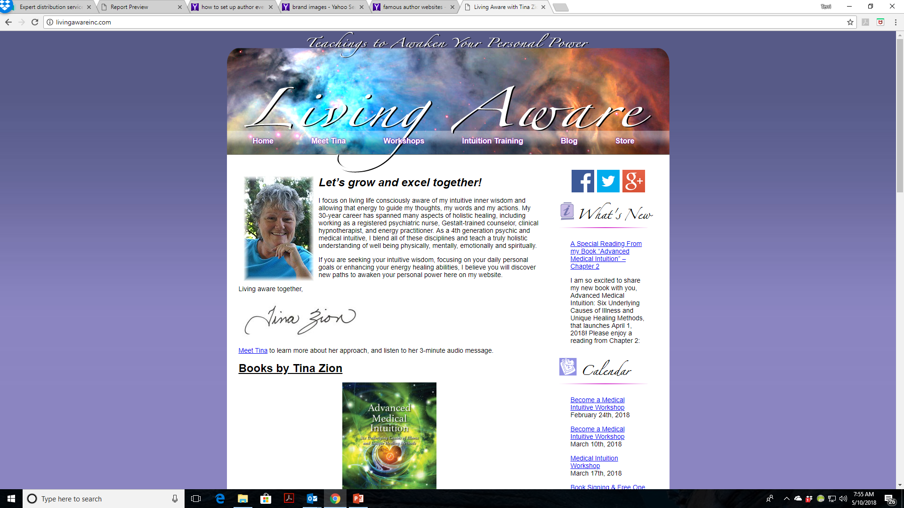

Slide 13
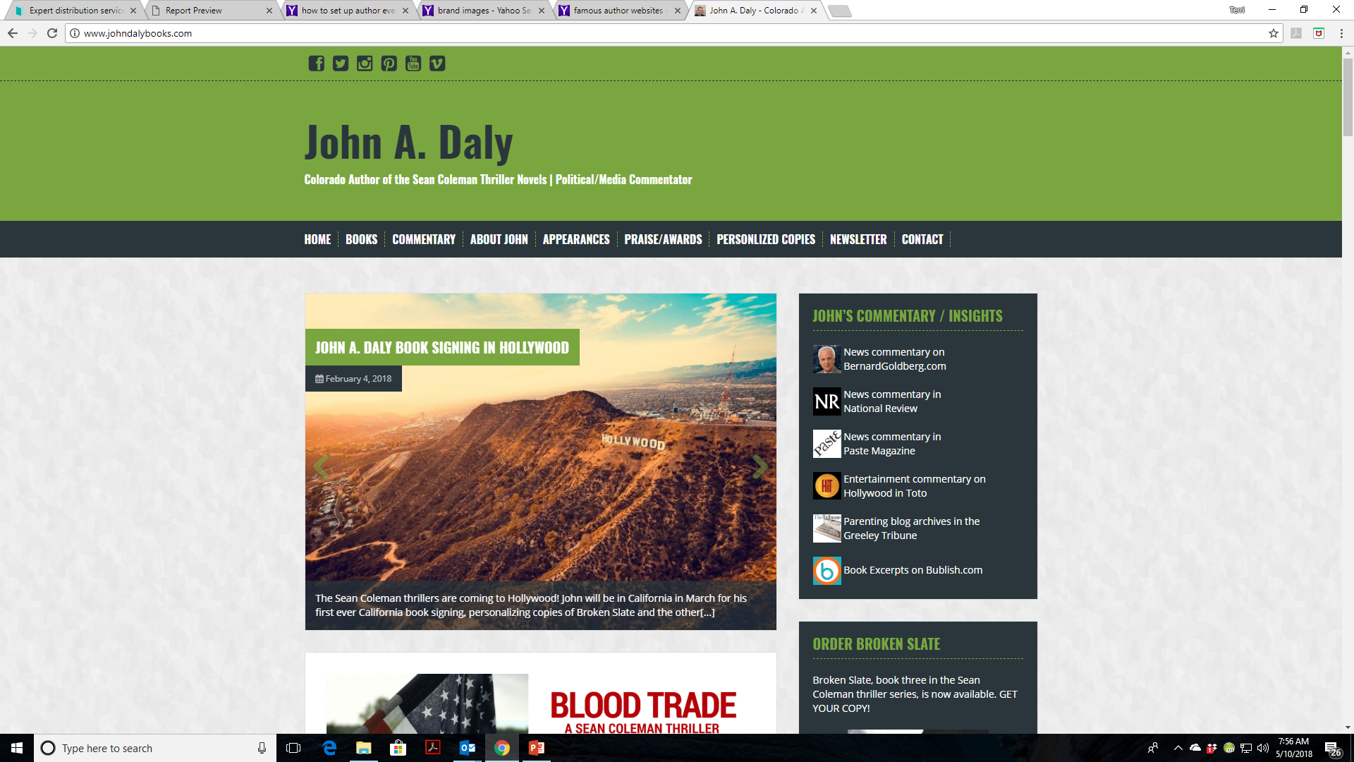

Slide 14

How to Become Your Own Publicist
Acquire Endorsements
What is the difference between a review and an endorsement?
A review is from a reader or a fan
An endorsement is from someone respected in your field and can lead to increased credibility for you and your book
Steps to getting endorsements
Make a list
Other authors
Experts you admire and/or follow
People who endorsed books similar to your
Find their contact information
Find their website and look for a contact form
See if they list their email address in their books, on their website, in their blogs
Look up their Google Plus profile to check for an email
Private message them through their personal Facebook profile if you are friends
Private message them through their Facebook page
Make an initial contact with them on Twitter

Slide 15
How to Become Your Own Publicist (cont’d)
Plan ahead to give them at least 4-8 weeks advance notice of your preferred deadline
Get creative in how you ask for the endorsement, but most importantly – ask
Follow-Up
If they agree to endorse your book, follow-up 1-2 weeks before the deadline. A gentle reminder can be helpful
Show your appreciation
Thank them and consider sending them a print copy once your book is ready.
When you get an endorsement
Put it on your website
Get it to Terri for possible inclusion in your book/cover
Get it to John for social media
Get it to Jennifer to upload to IPG and possible inclusion in the newsletter

Slide 16

How to Become Your Own Publicist (cont’d)
Placements on TV, radio, in print, with bloggers
Create a Media List
Who are your target TV programs, radio programs, publications, reporters, bloggers?
What topics or angles can you pitch each of them?
Reach out to local media first
Local newspapers, radio stations, blogs, and TV stations
Connect with reporters, TV personalities, bloggers via social media
Attend events where you can meet key contacts
Use the list whenever you have news to share
A new release
An award
A significant appearance (keynote speaker, etc.)
Begin building relationships with key people who are important to your topic
Add new media contacts as you discover them.

Slide 17
How to Become Your Own Publicist (cont’d)
Placements on TV, radio, in print, with bloggers (cont’d)
Use Google alerts or other methods to help notify you when your book or a topic your book covers is being talked about in the media
https://www.google.com/alerts
Basic information on google alerts and how to set one up https://www.bloggingbasics101.com/how-to-set-up-a-google-alert-and-why-its-a-good-idea/
Local newspapers, radio stations, blogs, and TV stations
Connect with reporters, TV personalities, bloggers via social media
Attend events where you can meet key contacts
Use the list whenever you have news to share
A new release
An award
A significant appearance (keynote speaker, etc.)
Begin building relationships with key people who are important to your topic
Add new media contacts as you discover them.

Slide 18
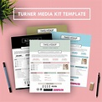
How to Become Your Own Publicist (cont’d)
Create an Online Media Kit
Place it on your website or blog where reporters, bloggers, etc. can get the information about you and your book to write an article or contact you to feature on a program
Make it easy to find, i.e. a link that says “download media kit”
What to put in your online media kit?
Press release
Contact information
Book Blurb
Photos of you and your book
Your bio
Top reviews about your book
Excerpts form your book
Links to where your book can be purchased.
For extra help in creating one https://michaelhyatt.com/how-to-create-the-ultimate-online-media-kit/
Use a template to create an online media kit https://www.canva.com/create/media-kits/

Slide 19
How to Become Your Own Publicist (cont’d)
Learn to Write a Press Release or Hire Someone to Write Them for You
Press releases are the principal tool to get your news in front of the media
What makes news:
Timing – is it really new?
Is a particular media interested in this topic?
Is it significantly different from what already exists?
Is it important in some way to a particular group of people?
Here’s the link to a press release template https://ereleases.com/press-release-template/
Send Press Releases
Use a paid PR service- dependable, but cost
Use a free service – free but not all are reliable
Create your own emailing list and send them yourself.
BQB/WriteLife uses www.PRlog.org

Slide 20
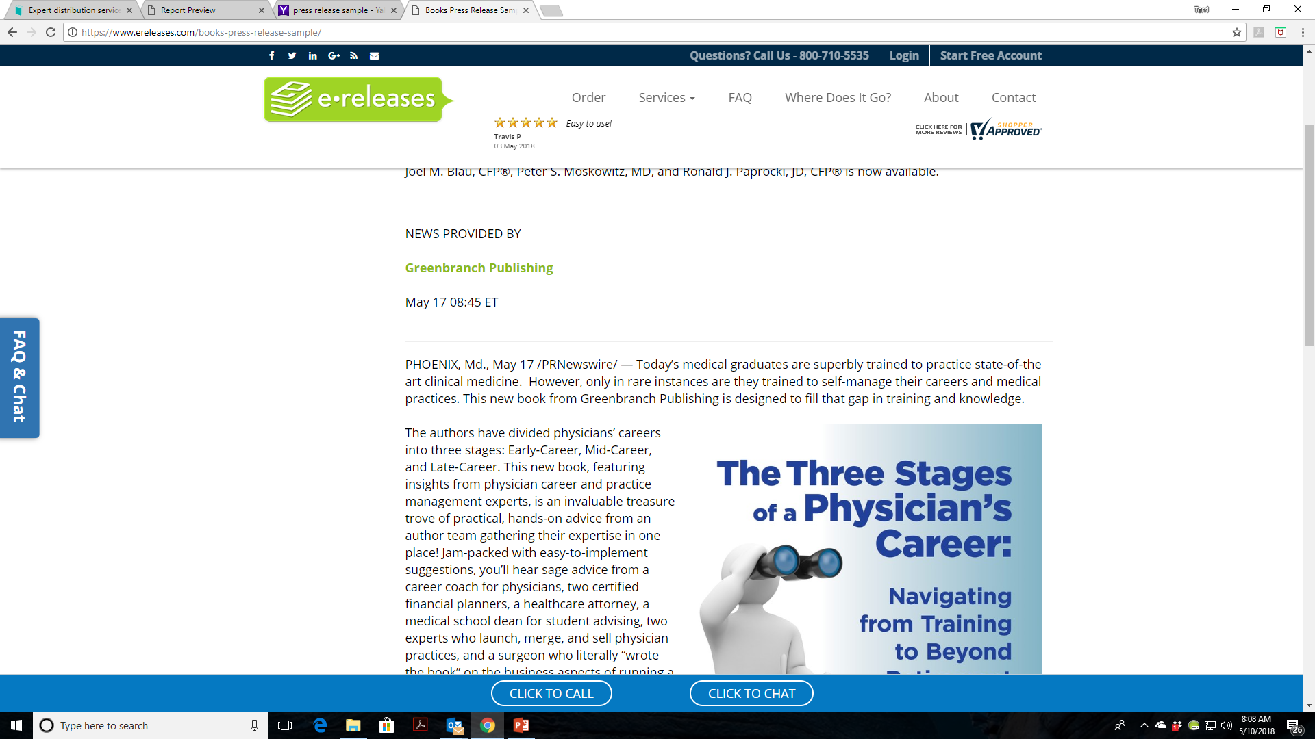

Slide 21
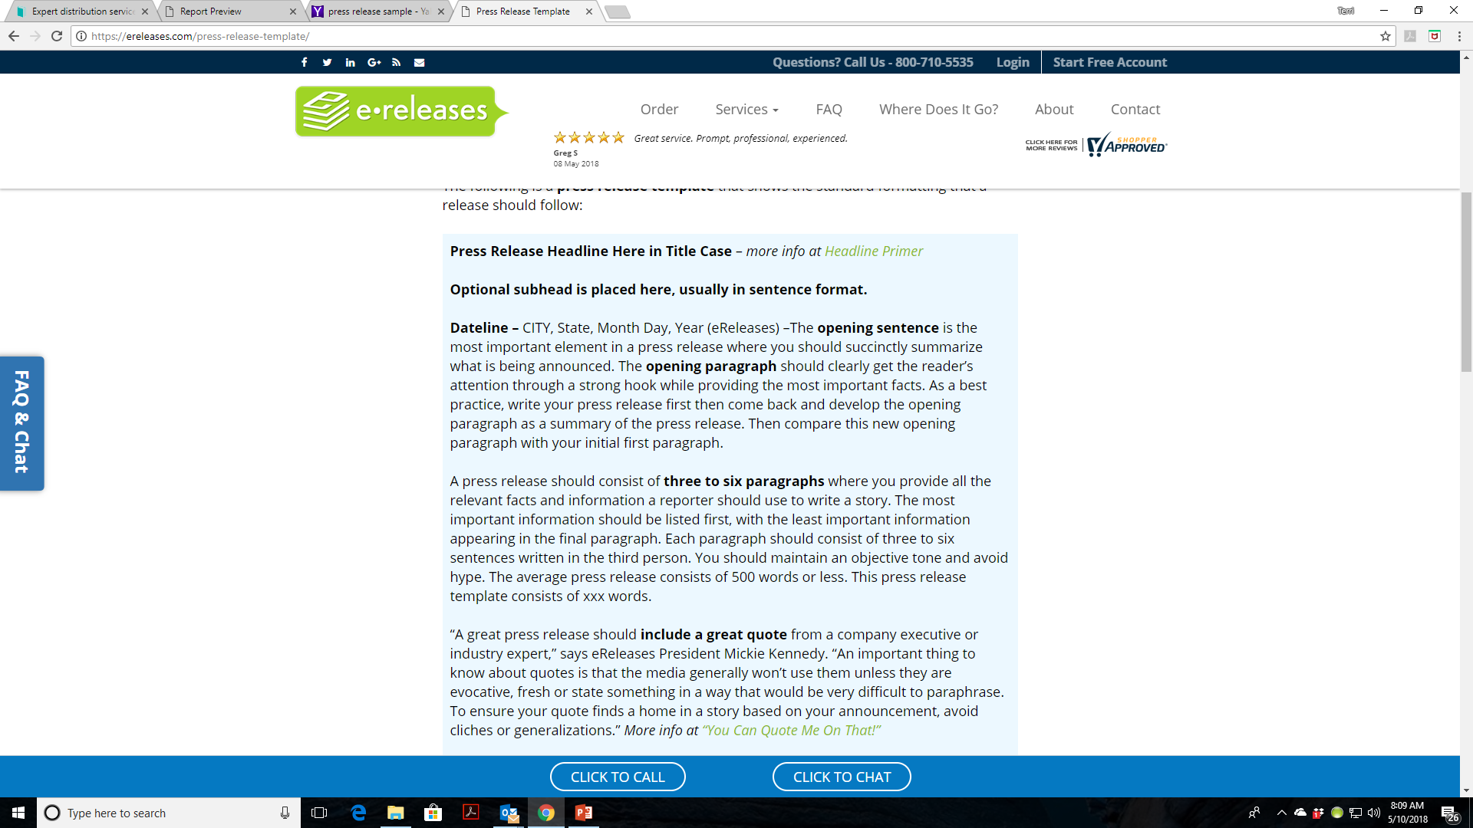

Slide 22
How to Become Your Own Publicist (cont’d)
Extend the Life of Your Media Coverage
Turn each feature or interview into its own blog post
Share behind-the-scenes photos, footage or anecdotes
Create a monthly or year-end slideshow of media highlights and milestones to post online
BQB/WriteLife uses www.PRlog.org
Find creative ways to talk about yourself as an author and your book(s)
If you can’t come up with ideas, search for ideas others have used and build on them http://brainzooming.com/7-ways-to-borrow-creative-ideas-with-a-clear-conscience/7342/

Slide 23

How to Become Your Own Publicist (cont’d)
Setting Up Events
Bookstore events (There are detailed Slides in our author portal on how to do this).
All BQB/WriteLife books are in the databases of all bookstores.
Check out library events as well.
If bookstores or libraries have book clubs or reading groups, offer to speak at them.
Think outside the box to schools, business events, book festivals
Work with nonprofits to promote their cause
Work with causes you believe in
Consider a booth at live events

Slide 24
How to Become Your Own Publicist (cont’d)
Setting Up Events
Check out local, regional, and national book events and find out how to apply to be a featured author; then make your pitch
BQB/WriteLife gets opportunities through IPG and when appropriate, passes them on to our authors
Keep in mind that when publicists are searching out and setting up events, their main goal for any event is to build your brand and your fanbase, not sell books. Once a brand and fanbase are built, the book sales will follow.

Slide 25
How to Become Your Own Publicist (cont’d)
Organizing a Book Tour
Create a timeframe for your tour
Allow a 2-3 month lead time for setting up events
Decide on the geographical area of your tour
Designate the cities and/or towns you want to consider
Make a list of the bookstores/events that you’d like to do
Think outside the box – depending on your book and book topic
Send out author press kits and a copy of your book to those you’d like to set up an event with along with a letter that expresses your interest and the date(s) you will be in their area
Place follow up calls to the bookstores/venues
After events are set, plan your travel itinerary
There are inexpensive ways to travel and stay – don’t let budget stop you from doing a book tour
One author I know drove, camped, and stayed with friends

Slide 26
How to Become Your Own Publicist (cont’d)
When your tour begins, contact book-oriented radio shows, newspaper lifestyle sections, and alternative weeklies along the way. Media typically needs just a few days notice.
If you are going to try to pitch TV shows in the different areas you will be visiting, that needs to be done well in advance.
Use social media to promote your events as well.

Slide 27
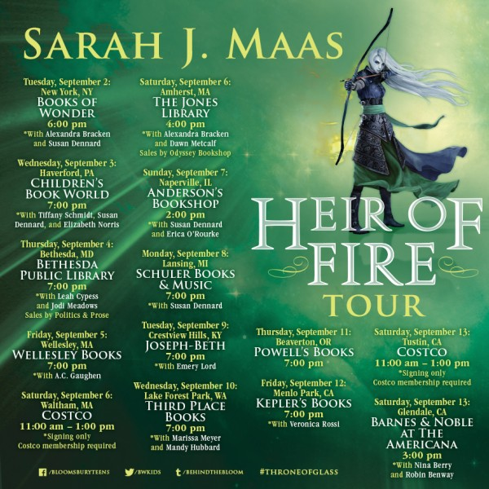

Slide 28




How to Become Your Own Publicist (cont’d)
Award Applications
Research award programs and apply where appropriate
Check out award program information sent out by BQB/WriteLife
Keep Jennifer, Terri, and John informed of any awards you are nominated for, place in, or win.
This information is passed on to IPG, put on social media, placed in our newsletter, and sometimes put out in a press release
If pdf is provided, we’ll put the emblem on your book cover file
Use your media list to announce any awards you place in or win

Slide 29
How to Become Your Own Publicist (cont’d)
Buzz Strategies
Buzz strategies are those that get people talking about you and your book(s)
According to the Word of Mouth Marketing Association, marketing strategies that have the following attributes keep customers happy and make it easy for them to discuss a product or service with their friends and peers. Such marketing methods:
Encourage communications through website forums and social networks.
Give people something to talk about with information that can be easily shared or forwarded and publicity events that inspire people to tell others about what they saw or experienced.
Create communities and connect people such as user groups, fan clubs, and message boards.
Work with influential communities by identifying influential people and informing them about the company’s plans and encouraging them to share such data.
Research and listen to customer feedback which can be done by tracking online comments to social networks and collecting survey data.
Engage in conversation by establishing blogs and a social media presence and contributing to them on a regular basis.

Slide 30
MOST IMPORTANT TAKEAWAY FOR TODAY –
If You Can’t Hire a Publicist or Do Everything a Publicist Does – Do Something!

Slide 31
Questions?
Type any questions in the chat feature here!

Slide 32
NEXT MONTH’S WEBINAR
“Social Media Sales Tricks”
Saturday, June 9th, 11:00 a.m. EST
Our guest speaker will be:
John Daly, BQB Author and Social Media Manager

Slide 33
Thanks for joining us!
Have a great weekend!
Bqbpublishing.com
Writelife.com

