Slide 1
Social Media Sales Tricks
BQB / WriteLife Publishing social media hacks to increase book sales
By John Daly

Slide 2
Maximizing your social media presence
Topics in this webinar
Make the best of your social media profiles
Using your posts to engage your audience, not sell to them
Making your posts more attractive, and more likely to be shared
How BQB and WriteLife authors can help each other on social media

Slide 3
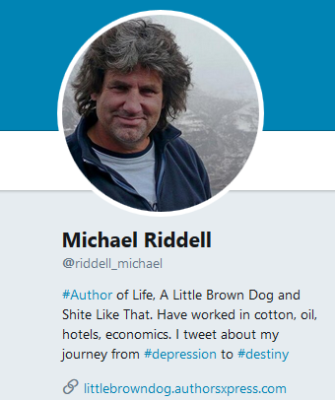
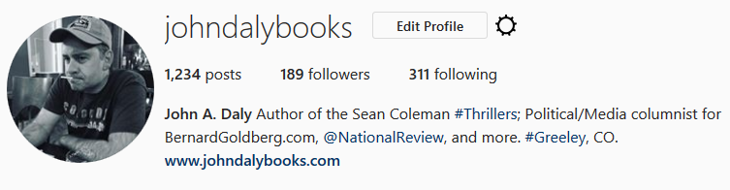
Your social media profiles are important. People shouldn’t have to guess that you’re an author
Whether it’s Twitter, Facebook, Instagram, or something else, make sure your audience knows who you are and what you write. Your profile should be somewhat professional, but it can also be fun and engaging.
Important: always include a link to your website or blog.

Slide 4
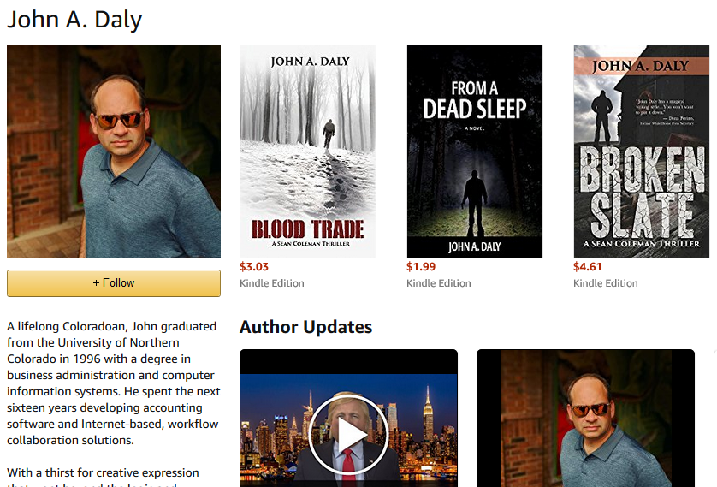
Your Amazon Author Page is particularly important. Claim it at authorcentral.amazon.com and let readers know all about you!
The more you add to your bio, the more attention you and your books will get!
Photos
Biography
Your books together on one page
Videos
Your blog posts
Links to your website and social media accounts
Events
Your author dashboard also lets you track your Amazon sales! This helps you identify which of your marketing efforts are working!

Slide 5
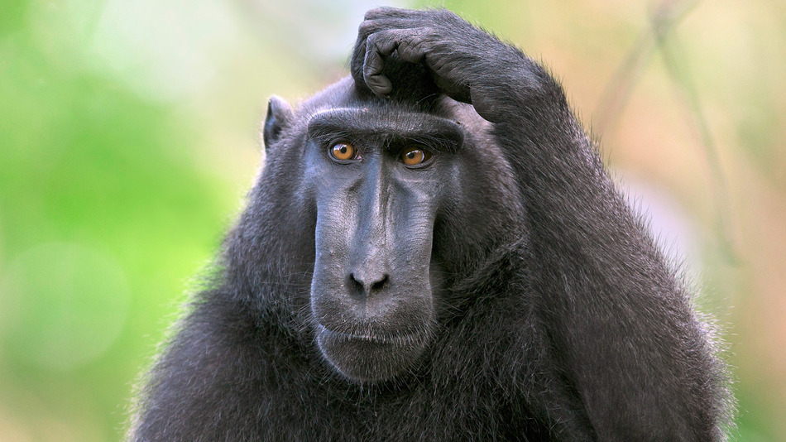
So… What kind of stuff should I post on social media? We’re glad you asked!

Slide 6

When it comes to social media marketing, focus more on the “social” and less on the “marketing”
People use social media to socialize, not to be bombarded with sales pitches. Successful social media marketing is mostly about building relationships, not the hard sell.
The 80/20 Rule
Dedicate 20% (or less) of your content to promoting your book(s).
Dedicate the other 80% (or more) to things that interest your audience and engage them in conversations. And make sure to let your personality shine through!

Slide 7
Building a relationship with your audience (the 80%)
Get noticed by the kind of people who might be interested in your book(s)
Follow the social media accounts of influencers on topics related to your book, whether they’re fellow authors or experts in a relevant field.
Engage with those influencers. Share and respond to their posts, and they may do the same for you (which will introduce you to their followers).
Follow the people who engage (positively) with you on social media, and respond to their questions and comments.
Share interesting content that is either directly or indirectly related to the kind of things you write about.
Share things about your life: funny stories, pictures from your travels, favorite things, pet peeves, etc (don’t give away highly personal information).

Slide 8

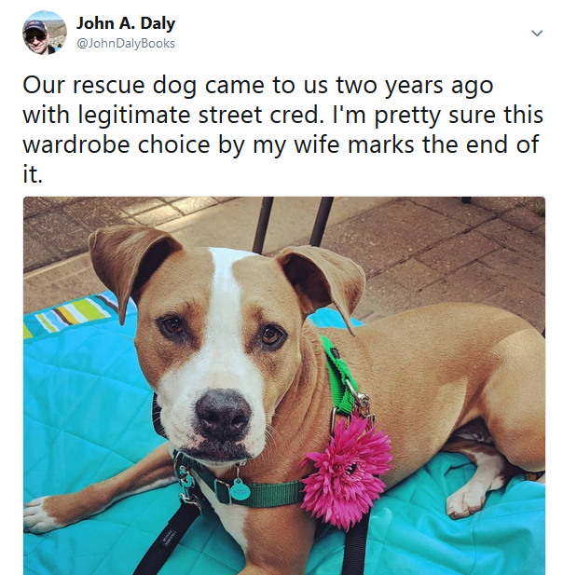
Examples of engaging (non-marketing) posts

Slide 9
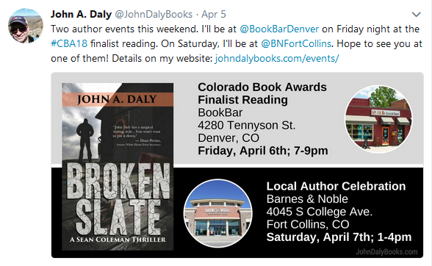
Promotional posts for your book(s)
(the 20%)
There are several methods for presenting your books on social media
A short synopsis
Reviews
Blurbs
Sales/Promotions
Giveaways
Author events
Award announcements
On these types of posts, always include a link back to your website or a book order page.

Slide 10

Sprucing up your posts
(a picture is worth a thousand words)
Some statistics:
Instagram has become the second most popular social media network in the world.
Facebook posts with photos get three times more engagement than those without them.
On Twitter, tweets with images get shared 150% more than text-only tweets.

Slide 11


Some cool (and free) picture tools to make your social media posts look great!

Slide 12
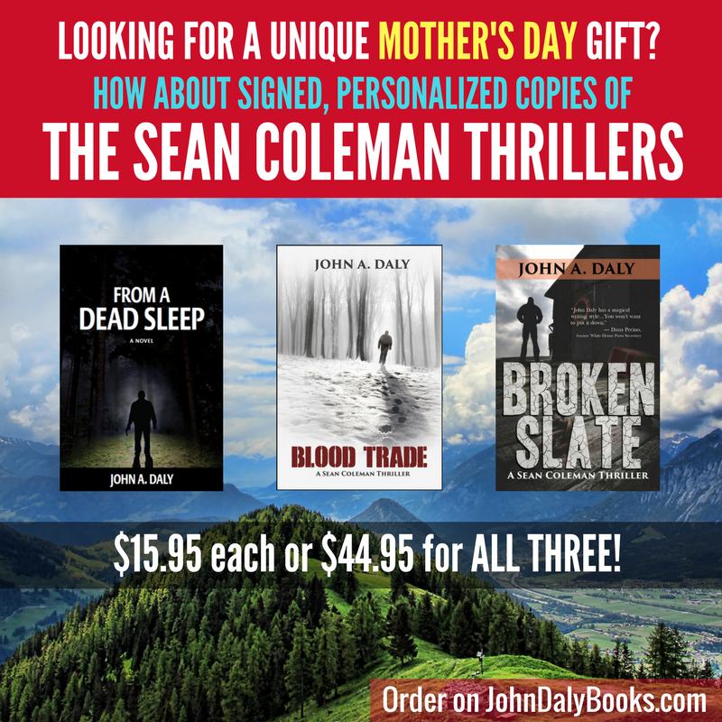

Canva is a free online tool that lets you easily create snappy-looking memes and ads

Slide 13
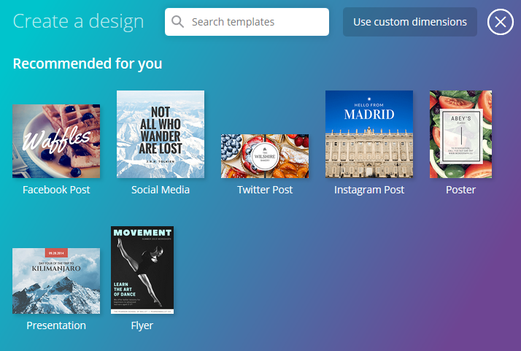
Just go to canva.com, create a free account, and start creating your designs
Canva lets you select from pre-made templates that are optimized (in size and shape) for Facebook, Twitter, Instagram and other social media sites.
OR
You can create a design from scratch!

Slide 14
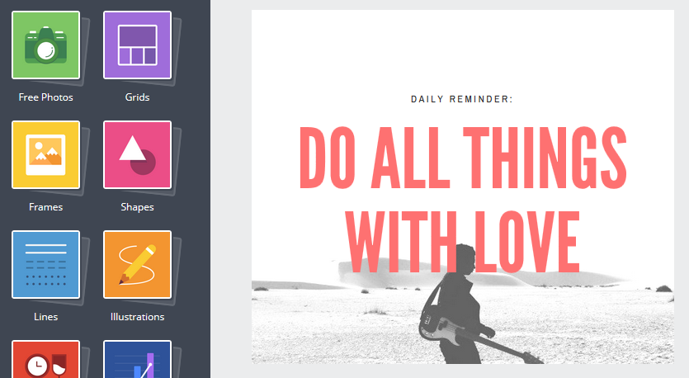
Canvas’ design/editing tools
Stock photos
Backgrounds and Image Filters
Layout Grids
Fancy Text
Shapes
Icons
Lines
More!
While you CAN purchase advanced layouts and tools for a small price, there’s plenty you can do with just the free stuff.

Slide 15


Canva offers lots of free stock photos, but for many more, try Unsplash.com

Slide 16
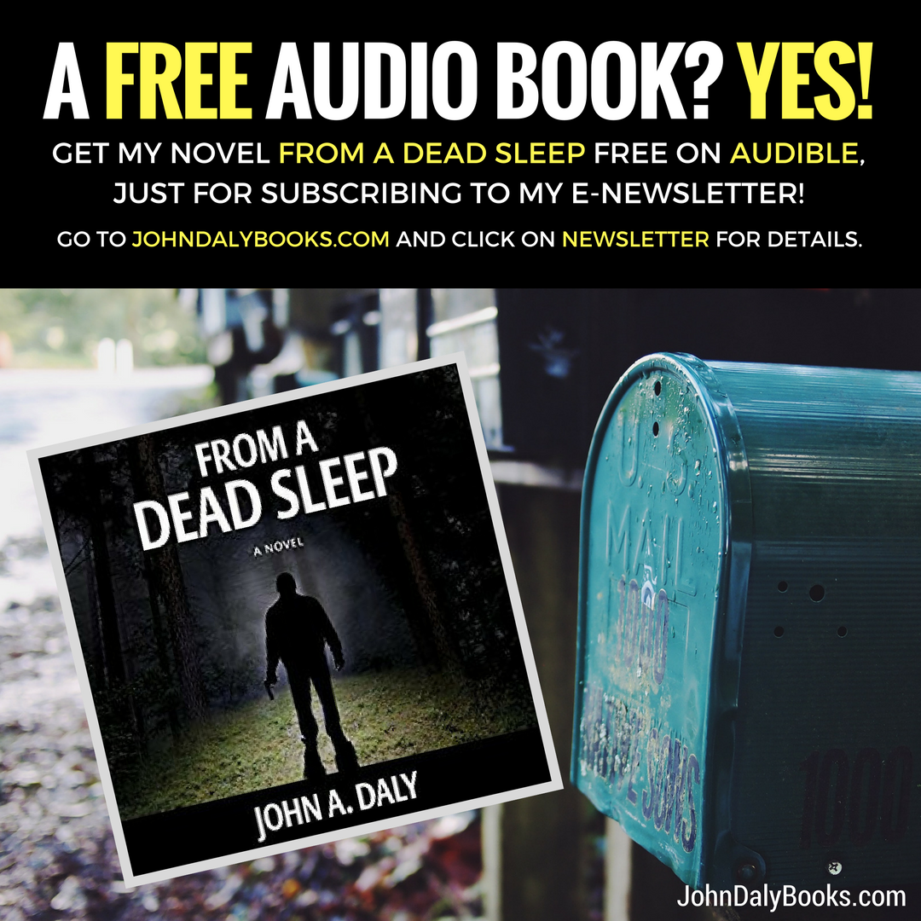

Don’t forget to brand your work!
When you’re done with your design, you can download it to your computer as an image file.
But before you do that, make sure you’ve branded your work (preferably with your website URL). That way, potential readers can easily figure out how to find out more about you and your book(s)!

Slide 17
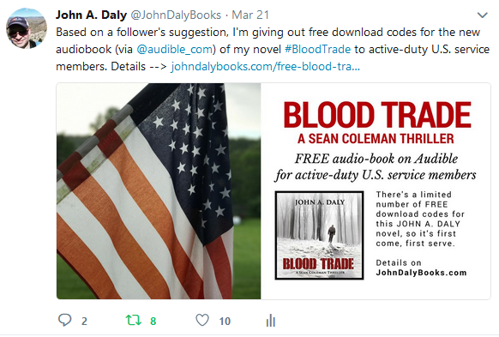
Incorporate your creations in your social media posts, along with other shareable elements
Adding #hashtags to your posts make them more searchable by relevant keywords or phrases (like your title, genre, topic, etc.), but don’t go crazy with them. Too many hashtags make a post look spammy.
@Tag relevant people, companies, or organizations in your posts. They’ll be alerted, and they might even share your posts.

Slide 18
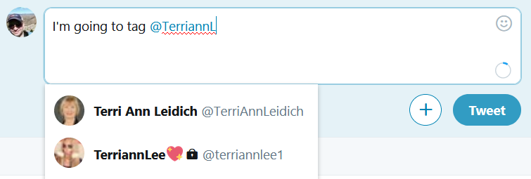
How do you “tag” a person or organization on social media?
Whether you’re on Twitter, Facebook, or Instagram, just type an ‘@’ before typing in the name of the person or organization you want to tag. Once the desired account appears in the pop-up combo-box, select it!

Slide 19
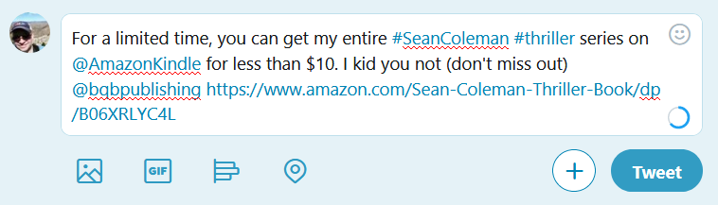
If you want BQB or WriteLife to share one of your posts, just tag us (We’ll help spread the word!)

Slide 20
Want to do your fellow BQB/WriteLife authors a favor? Share or retweet some of their posts!
The more times a post is shared, the more people will see it. Your fellow BQB/WriteLife authors will always appreciate you helping to spread their message.
Make sure you’re following the BQB and WriteLife accounts on Twitter, Facebook, and Instagram. Since we regularly share posts from our authors, following us is an easy way of seeing which of our authors are on social media, and what they’re saying.
Feel free to follow the authors individually as well!

Slide 21

Happy socializing! Happy selling!

