Slide 1

Harnessing the Power of BookBub
Welcome!
Saturday, September 8th, 2018
11:00 a.m. ET

Slide 2
What We’ll Talk About
What is BookBub
BookBub’s Marketing Tools
Getting More BookBub Followers
Using BookBub Ads
Launching a New Book
Featured New Release Pricing

Slide 3
What Is BookBub
It’s a site and newsletter dedicated solely to promoting eBooks and Authors to Readers.

Slide 4
How Did BookBub Get Started?
They created a newsletter that promotes free and on sale eBooks to readers.

Slide 5
Why is BookBub Powerful?
They have a following of millions of people all over the world
Their followers are targeted into book genres
They send several targeted emails each week
They have developed the audience that authors are looking for

Slide 6
There Are Two Ways to Join
As a reader
You get to choose the genres you want to be notified about – so not “junk” information
You’ll receive emails about featured deals and new releases
You can sign in to the website for an overview of the genres you’re interested in
You can follow friends to see what books they’re interested in
You can follow your favorite authors or genres
Get a list of authors under specific genres

Slide 7
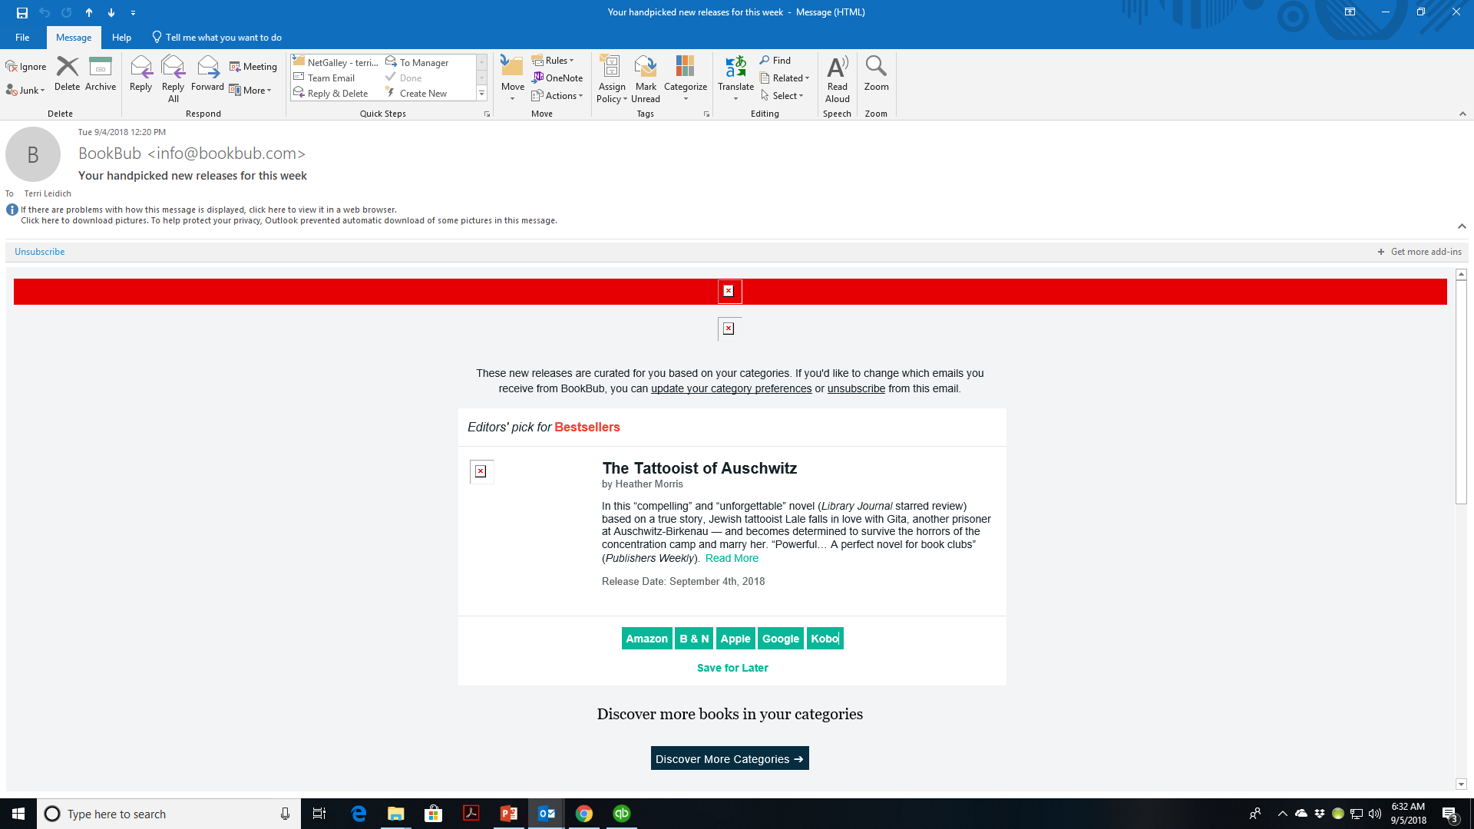

Slide 8
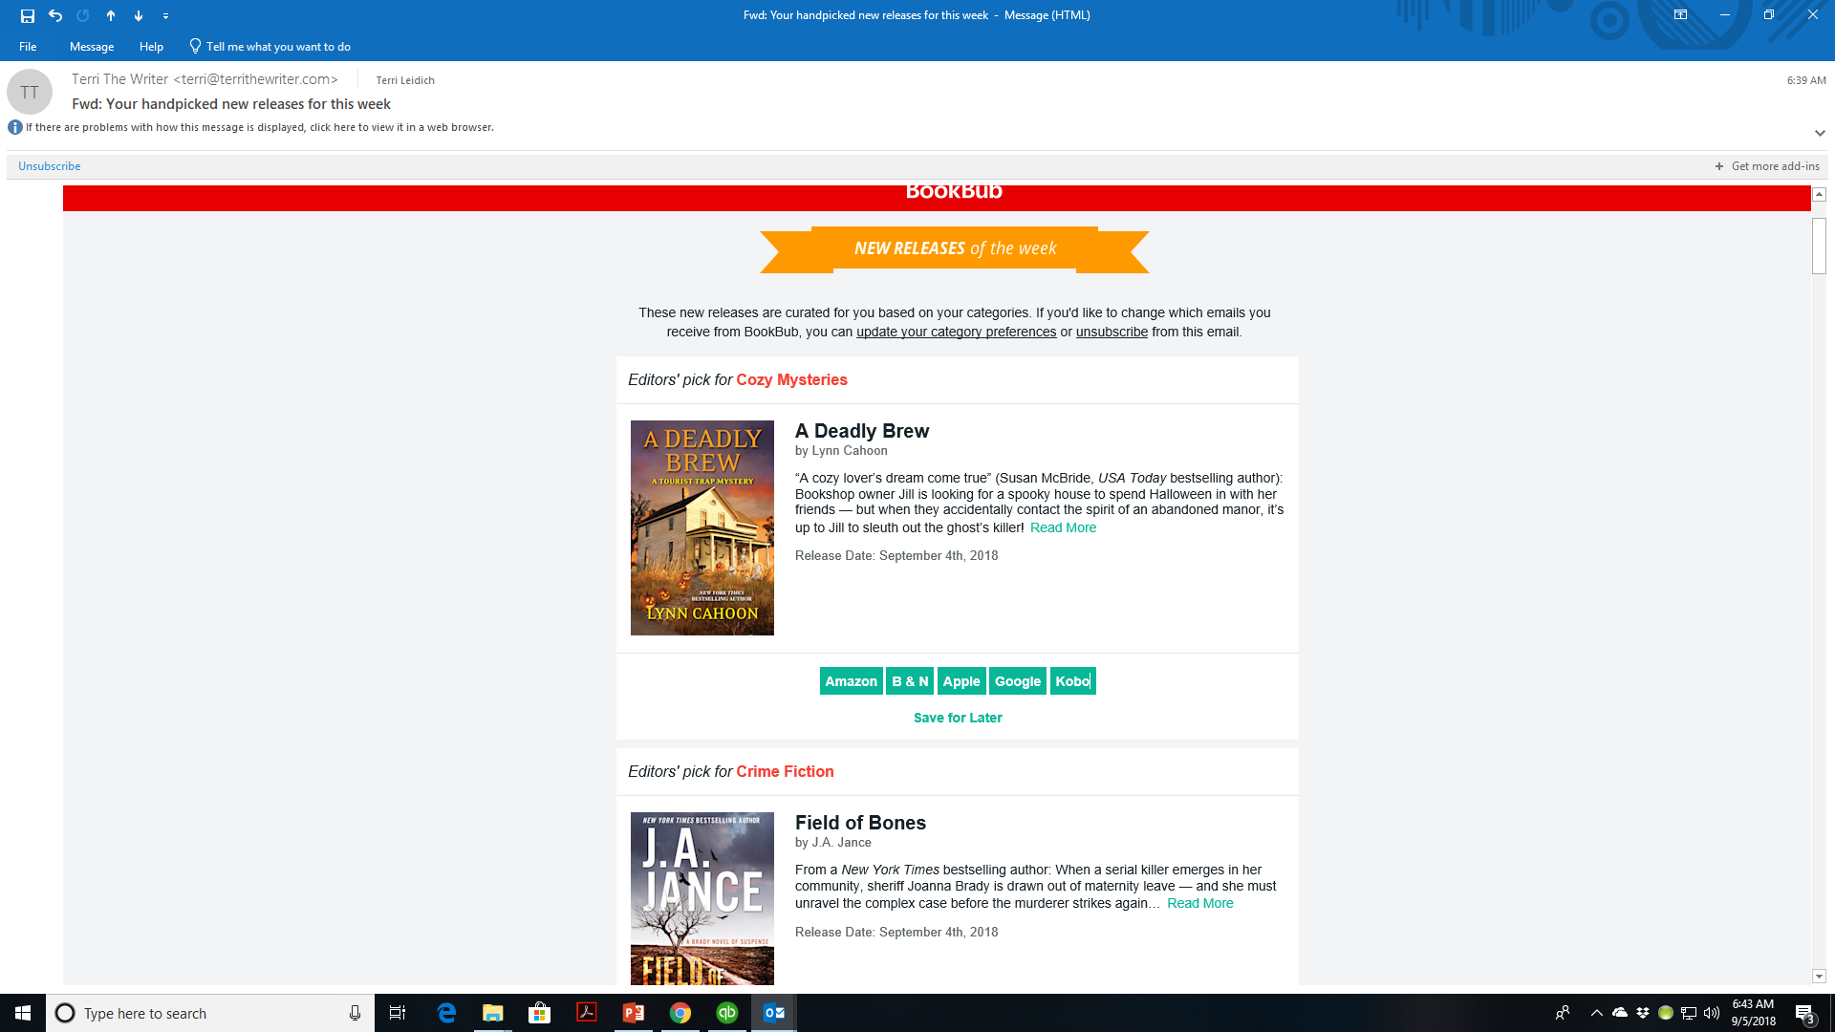

Slide 9
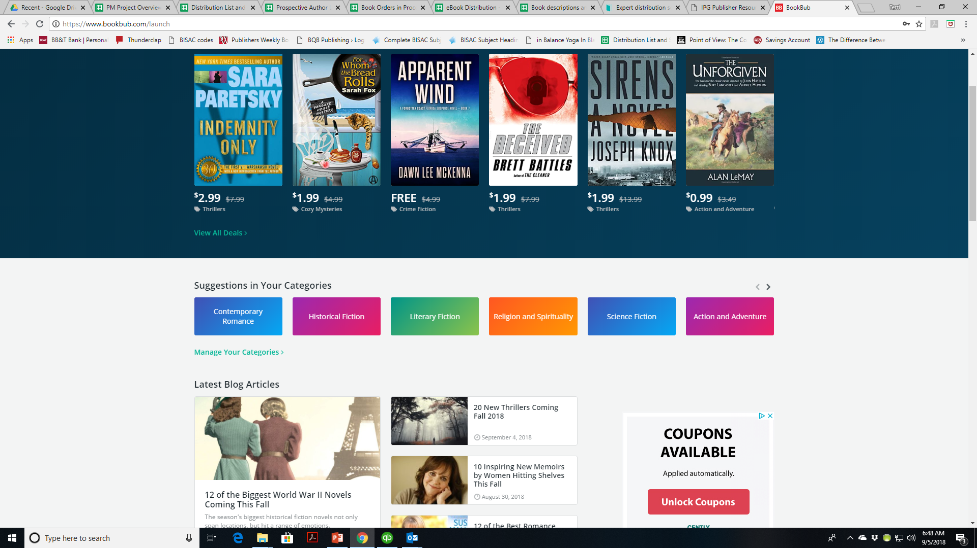

Slide 10
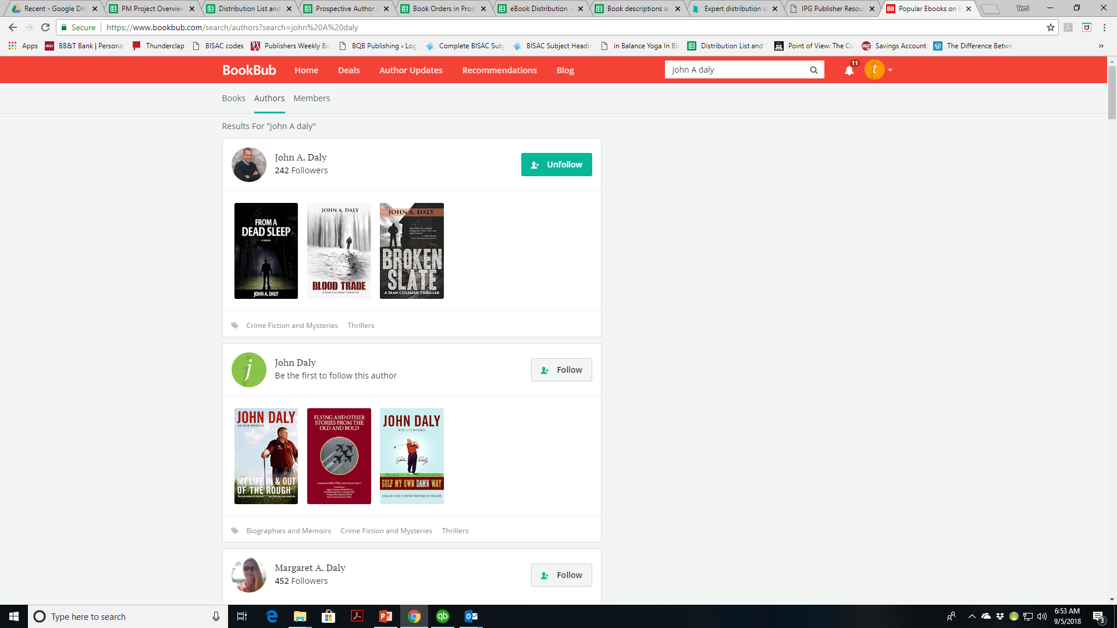

Slide 11
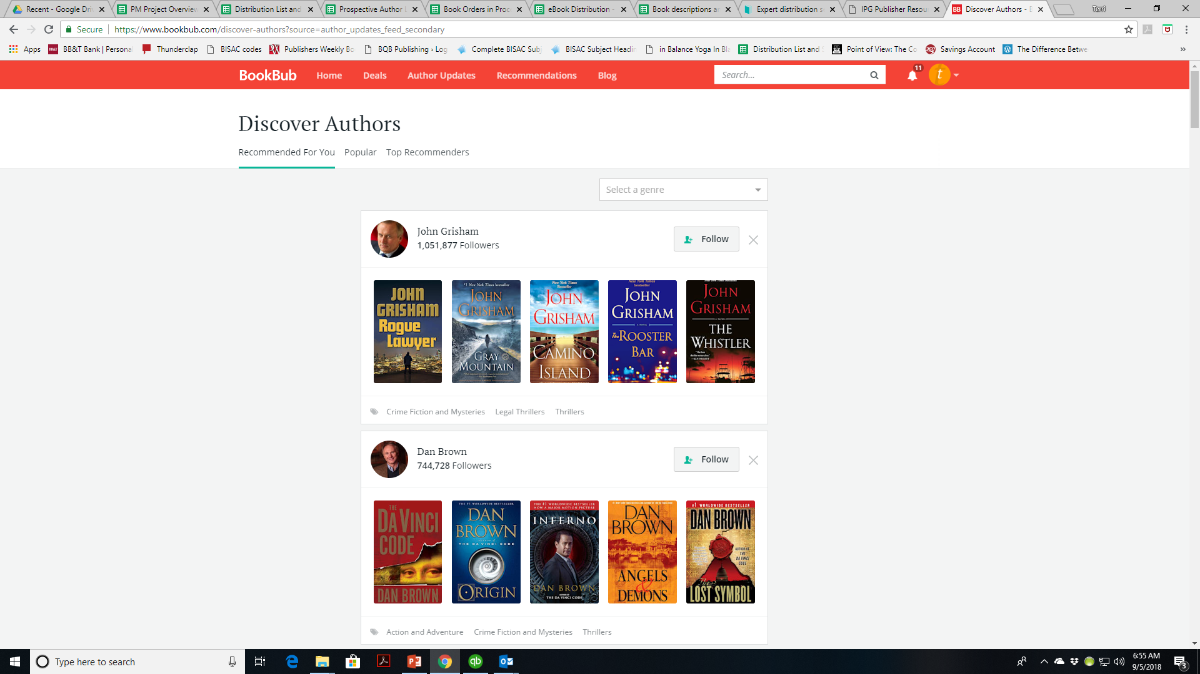

Slide 12
There Are Two Ways to Join Cont’d
2. As an Author
Partners Overview
Submit New Deal
Partner Dashboard
Claim an Author Profile
BookBub Partners Blog
Partner FAQ

Slide 13
The Features of Joining as an Author
You can:
Claim your author profile
Have a Partner Dashboard that allows you to place ads and featured deals
Follow the Partners Blog that offers marketing information
Place preorder alerts on an books you have releasing
Place ads to promote your book at any time
Apply for a Featured New Releases ad
NOTE: THE PINK ARROWS ON THE NEXT PAGE INDICATE THE PROMOTIONS THAT YOU CAN (and we encourage you to) DO WITH BOOKBUB. (The Featured Deals are the only ones that BQB/WriteLife does)

Slide 14
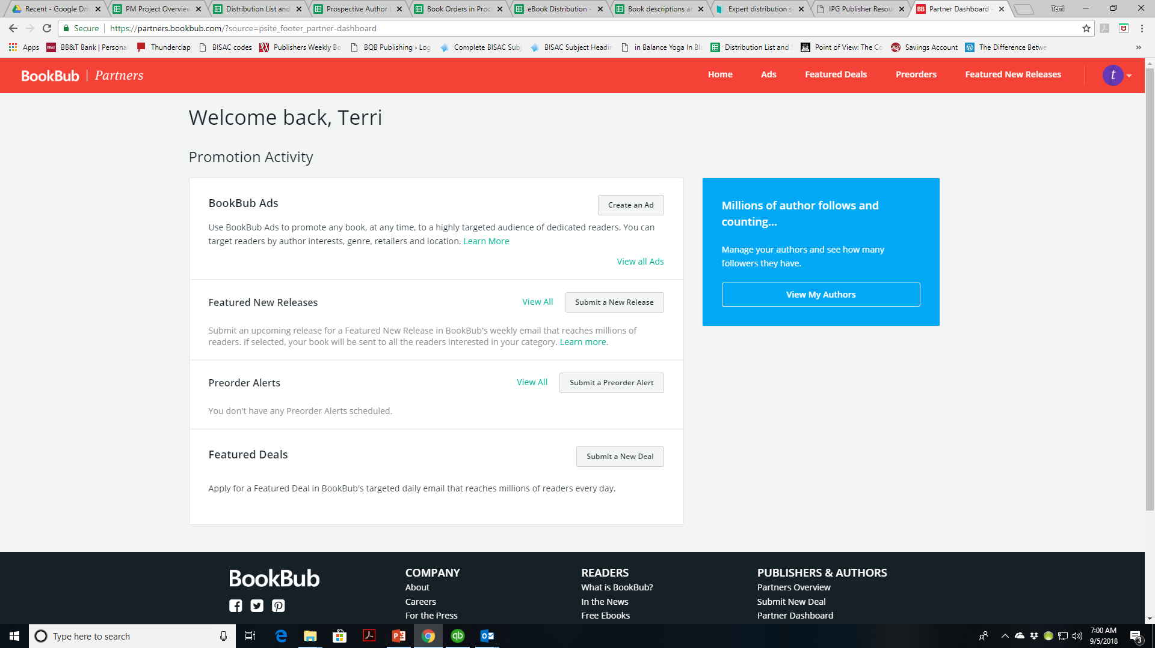

Slide 15
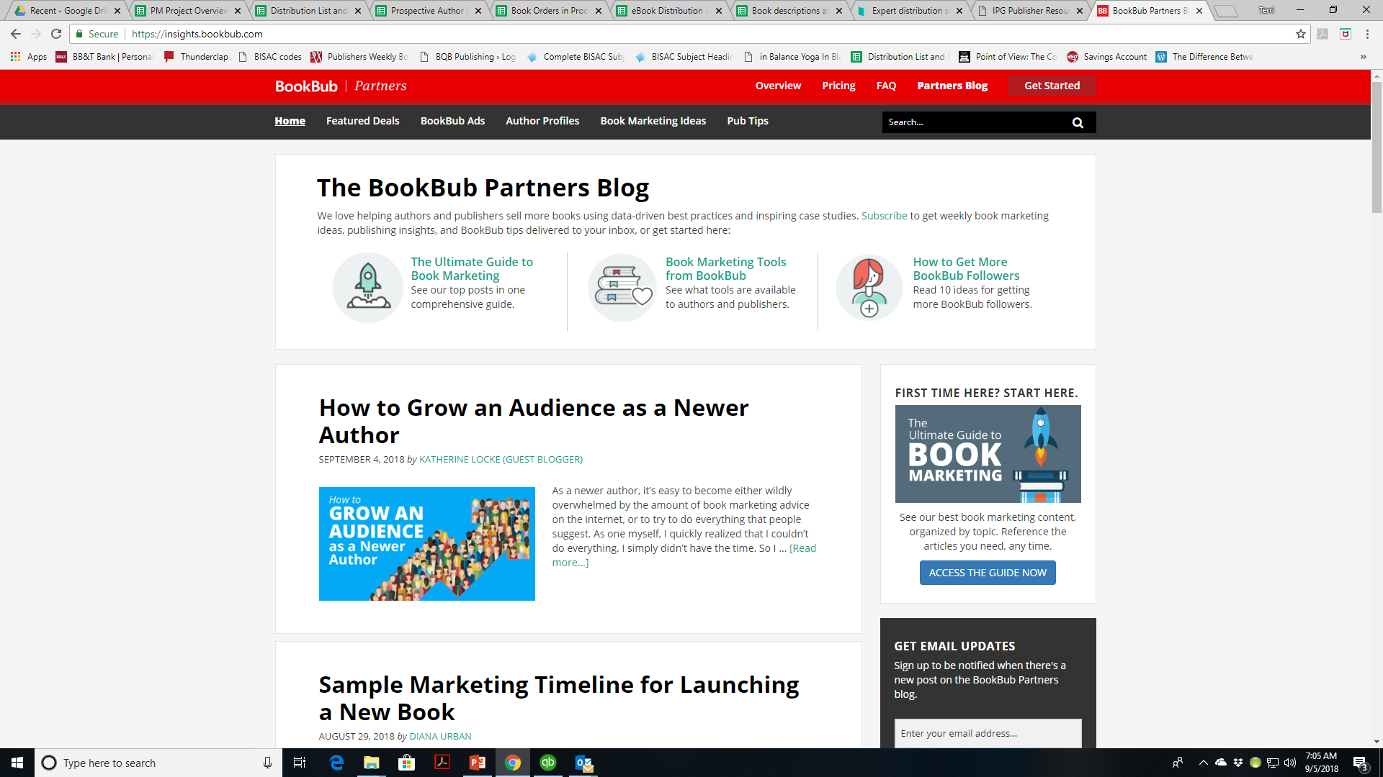

Slide 16
Which Way Should You Join?
Both
As a reader you can follow your genre and keep up with new books that are releasing and deals that are being offered
As an author you can create a following and build your brand

Slide 17
What We Do with BookBub
On an ongoing basis, BQB/WriteLife books are submitted to BookBub for a featured deal in their targeted daily email – both nationally and internationally (generally for a $.99 sale)
When we are offered a deal by BookBub, we look at what genre and territory they are offering and the cost of the ad. If we believe we can make our money back, we take the ad
BookBub may offer a US deal (in their US emails only); an international deal (UK, AU, CA, IN); or a combined deal (US, UK, AU, CA, IN)

Slide 18
What We Do with BookBub Cont’d
Once we accept the deal, we:
Pay for the Featured Deal (which can range from $80 - $1,000 depending on the genre)
Set the price campaign (typically $.99) and the dates for which the campaign will run
We generally set the campaign for one week before and at least one week after the Featured Deal promo, which runs for one day
If BookBub offers us an International only deal, we still set the price for the US as well and do additional marketing around it
Notify the author, Red Coat PR (that does additional marketing), and John Daly (for our social media push)
The cost of the Featured Deal is logged into that author’s royalty statement and the author and BQB/WriteLife share the cost that goes against the royalties
The effect of a Featured Deal ranges widely from huge success and making thousands of dollars for both the author and BQB/WriteLife to just breaking even.

Slide 19
What You Can Do With BookBub
As a reader
Follow authors
Post reviews
Create a booklist
Connect with friends
Buy your eBooks through BookBub links
Support deals from your favorite authors, including BQB/WriteLife Authors

Slide 20
What You Can Do With BookBub
As an Author
Claim your Author Profile
Build a Following
Use BookBub Promotion opportunities to market your book(s)

Slide 21
Increase your Discoverability on BookBub
As an Author
Add Your Photo
Add a Biography
Add Genres
Add a recently released or upcoming book

Slide 22
Why Build a Following on BookBub
Why build a following?
To build your author brand and your fanbase
Why use BookBub to do it?
They have a targeted audience of readers
What having a following on BookBub can do:
They will get notified by BookBub for: a new release, a preorder alert, or discount.

Slide 23
Ways to Build a Following on BookBub
Add a BookBub follow button to your website
Add a call-to-action (follow me on BookBub) to your newsletter
Promote your BookBub Author Profile on your social media
Run a BookBub Ads campaign to promote your profile
You can target an ad promoting your Author Profile to an audience of readers who’ve expressed interest in similar authors
To target an author, simply enter the author’s name in the “Refine by Author” section of the ads creator
Add a link “follow me on BookBub: to your email signature
Add a ClickToTweet link to your Author Profile bio to make it easy for your fans to share that they just followed you.
It’s free – go to http://clicktotweet.com/basic Paste in a tweet, uncheck the CAPTCHA box, and click Generate New Link
For more ideas, read the full article at https://insights.bookbub.com/ideas-for-getting-more-bookbub-followers/

Slide 24
BookBub Author Options
Recommend a book you love
This is a free way for author to engage with readers. Sharing recommendations can help you engage with power readers and boost your visibility
For more info on how to do this https://insights.bookbub.com/ways-authors-recommend-books-readers/
Set up preorder alerts
Driving preorder sales can help build buzz and momentum for a new book https://insights.bookbub.com/introducing-bookbub-preorder-alerts/
They’re economical at a cost of $.02 per eligible US follower
Create BookBub ads
Promote any book, at any time, to a highly targeted audience
There is a per click cost but you can set a budget of as low as $100 or $200 and zero in on the exact audience you want
For more info https://insights.bookbub.com/promoting-a-new-release-with-bookbub-ads-case-study/
Tips for targeting readers with BookBub ads https://insights.bookbub.com/successful-advertisers-tips-targeting-readers-bookbub-ads/
Submit an upcoming release for a Featured New Release in BookBub’s weekly email
There is a cost that can range from $300-$1,500 depending on the genre of your book
For more info https://insights.bookbub.com/introducing-featured-new-releases/

Slide 25
Launching a New Book with BookBub
Use BookBub Preorder Alerts (https://insights.bookbub.com/introducing-bookbub-preorder-alerts/)
There is a cost - $.02 per eligible follower
Remind fans when the book launches
Use BookBubs free feature – New Release Alerts
Must be submitted within six months of release
(https://insights.bookbub.com/introducing-featured-new-releases/
Will be hand selected
For pricing go to https://www.bookbub.com/partners/featured_new_releases_pricing
Costs are based on category
They are as low as $120 for children’s titles, up to $420 for Historical Romance, $830 for Thrillers, and the top pricing of $,1500 for Historical Fiction
Submit it for a Featured New Release (https://insights.bookbub.com/introducing-featured-new-releases/

Slide 26
Keeping BackList Titles Active on BookBub
Be an active author by recommending other books and authors
Consider a BookBub ad (pay per click) every 3-4 months
Follow other authors of your genre
Promote the dickens out of your new releases and have backlist titles linked to them
Promote your BookBub Author Profile on your social media to keep pushing new readers to your books

Slide 27
MOST IMPORTANT TAKEAWAY FOR TODAY –
The tools are there. It’s up to you to use them.

Slide 28
Questions?
Type any questions in the chat feature here!

Slide 29
NEXT MONTH’S WEBINAR
Going From Unknown Author to Well-Know Author
Saturday, October 13th
11:00 a.m. EST

Slide 30
Thanks for joining us!
Have a great weekend!
Bqbpublishing.com
Writelife.com

