Slide 1
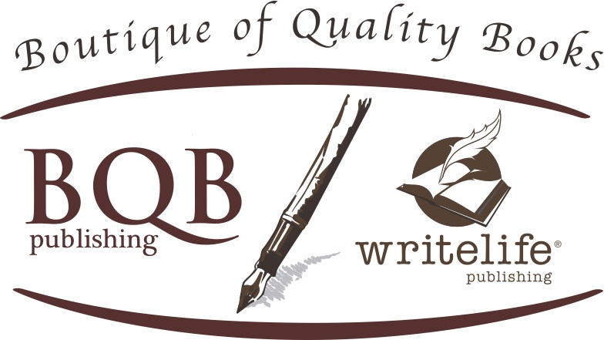
Going From Unknown Author to Well-Known Author
Welcome!
Saturday, October 13th, 2018
11:00 a.m. ET

Slide 2
WARNING!
Going from an unknown author to a well-known author takes work from you, the author.
Writing a book is just a first part, the rest is continuous marketing from either you or someone you hire. If you don’t do the continuous work, you won’t get the sales or the well-known author status. (It’s that simple)
But the most important part is to not get so caught up with expectations that you don’t enjoy the process!

Slide 3
What We’ll Talk About
Building Your Brand
Growing Your Audience in General
Building Your Fanbase
Putting Boots on the Ground
The Importance of Designing and Following a Marketing Plan
Working With BQB/WriteLife

Slide 4
Building Your Brand
What is an Author Brand
An author brand is a “message of an experience only you can provide that tells the reader what they can expect from you and why they should care about your books.
It’s your promise to your audience.
“A brand is what other people say about you when you’re not in the room.”
Branding will automatically happen, so it’s important you help guide it.
Designing Your Brand
Who is your ideal reader, and why?
How is your work unique from other authors in your genre?
Who are you comparable authors and how are they branding themselves?
What facts, feelings, and interpretations define you and your books?
What themes connect all the books you’ve written and/or want to write?

Slide 5
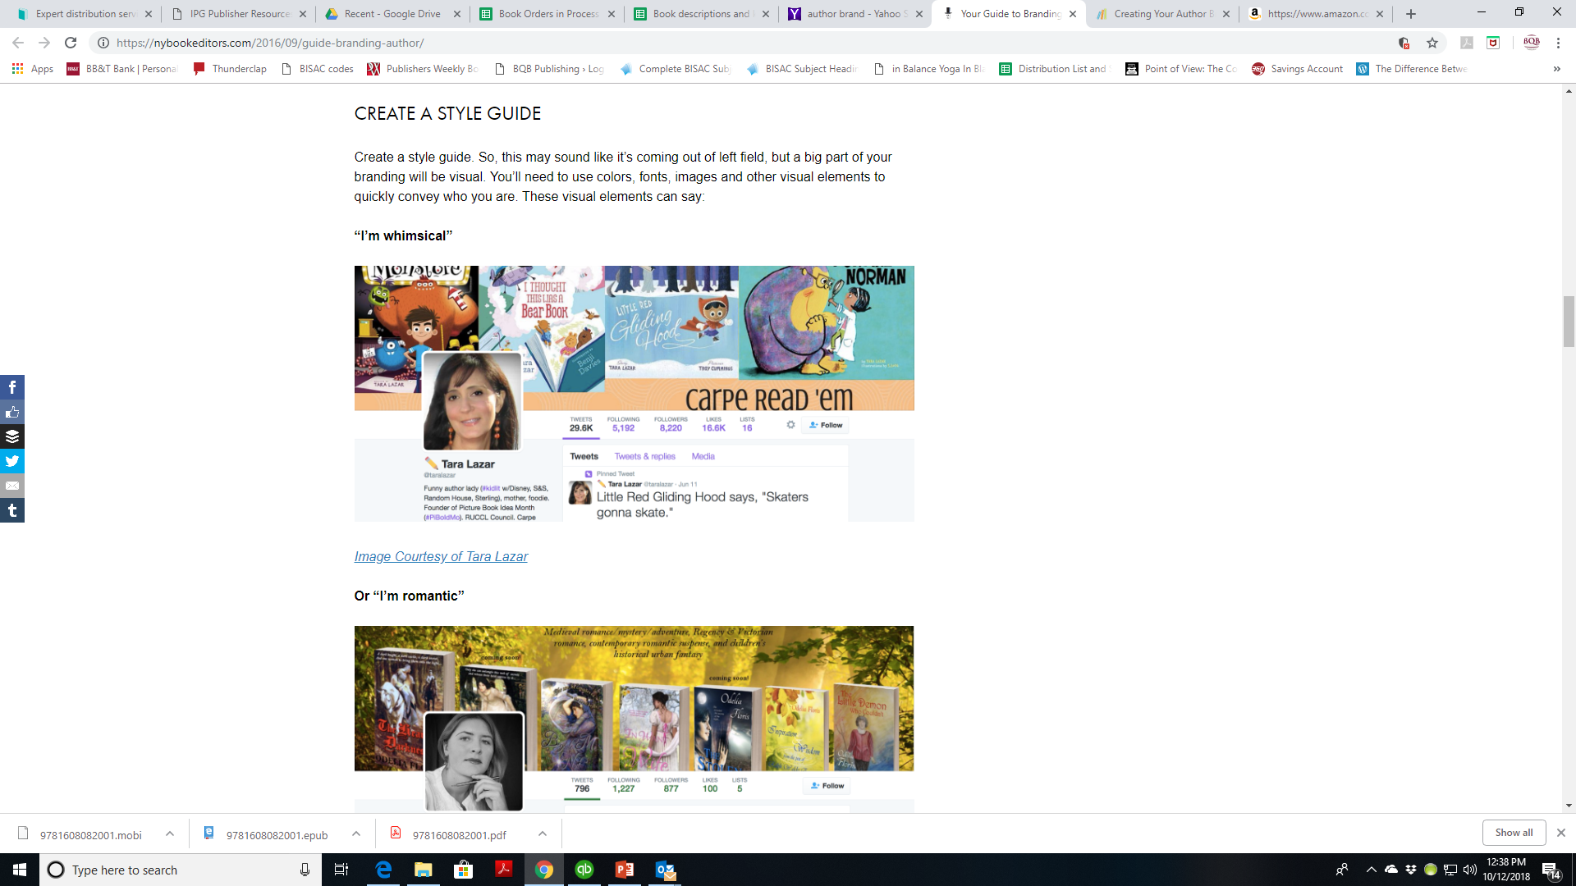

Slide 6
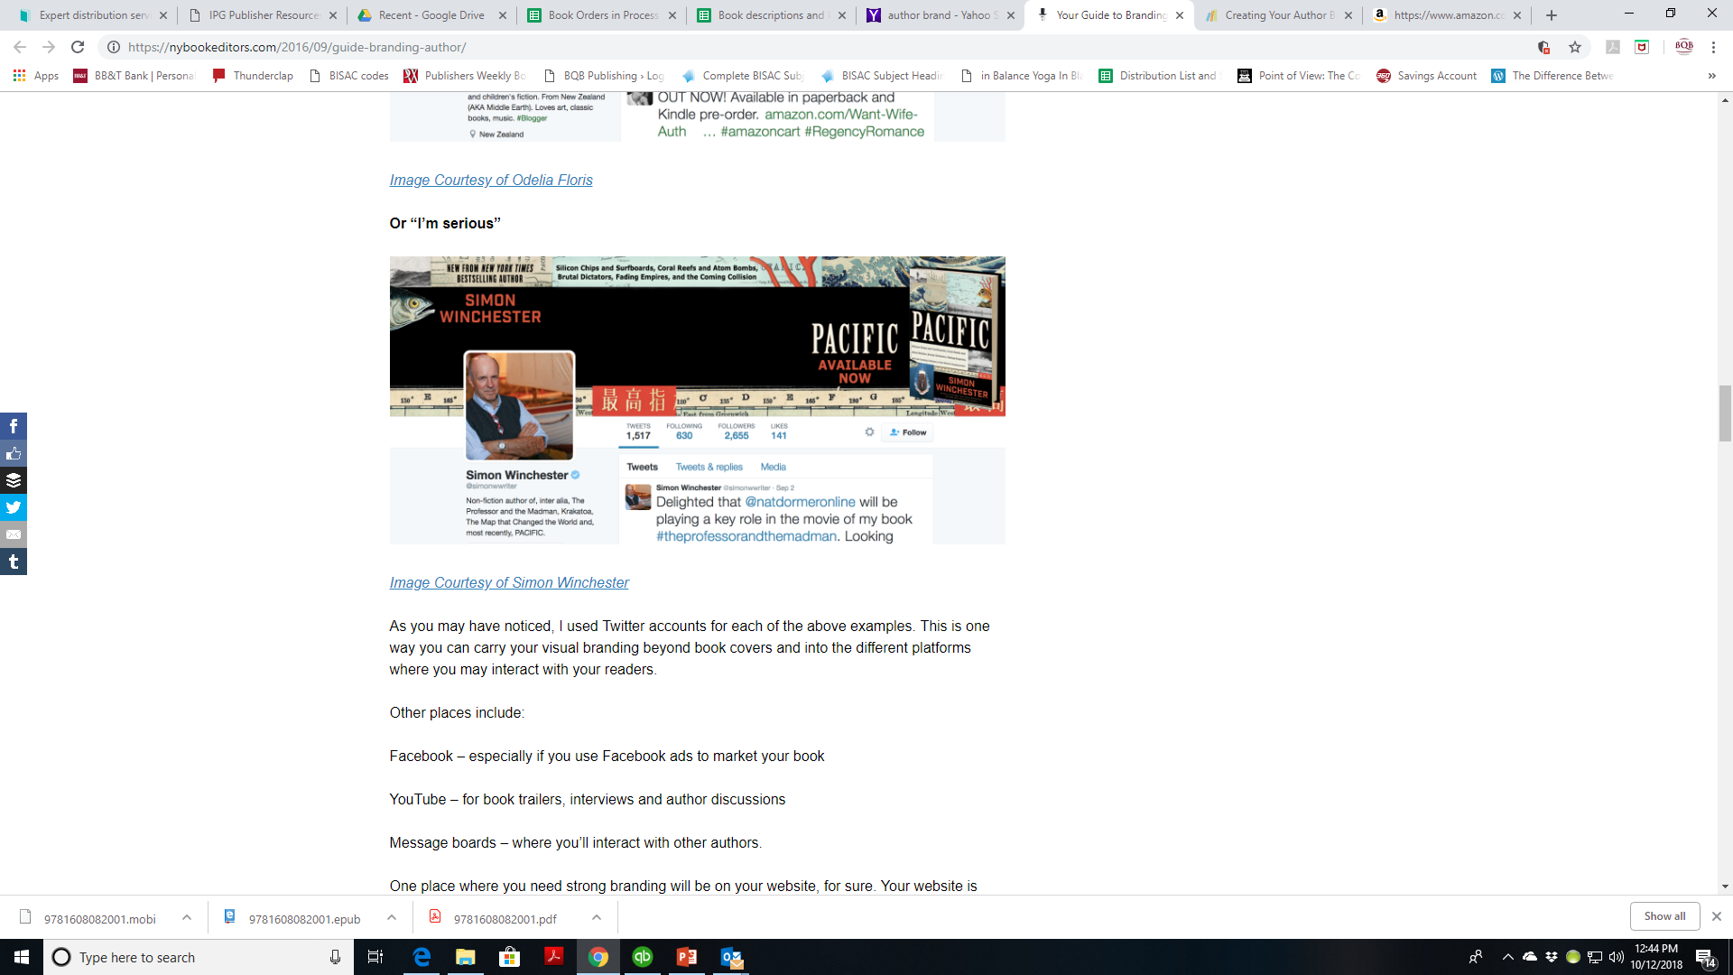

Slide 7
Building Your Brand cont’d
Important Parts of Your Brand
Your Bio http://blog.bookbaby.com/2014/03/how-to-write-a-great-author-bio/
Your Photo
Your tagline (i.e. – “I write YA stories with elements of snark and vulnerability.”
Your Facebook page
YouTube
Logo
Social Media Profiles
Business Cards
Bookmarks

Slide 8
Growing Your Audience in General
Website – Gotta have one!
A place for readers to learn about you
Gets you into Internet Searches
Gives you a platform from which to grow your brand and your fanbase
If you need help contact Julie Bromley signedbooksandstuff@gmail.com
Grow a mailing list
Use a newsletter
Through your website
Design eye-catching graphics for social media
Canava https://www.canva.com/
https://insights.bookbub.com/how-successful-authors-use-social-media-content-ideas/
https://insights.bookbub.com/creative-ways-authors-images-social-media-marketing/
Be Active on Social Media
Twitter
Instagram
Facebook
If you don’t know how or don’t have the time, contact BQB/WriteLife’s very own author PA (personal assistant) Julie Bromley signedbooksandstuff@gmail.com

Slide 9
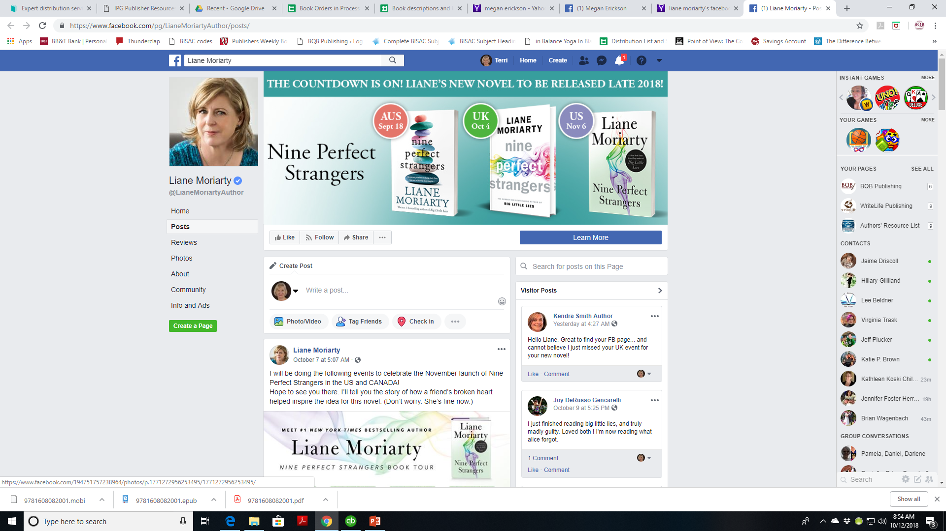

Slide 10
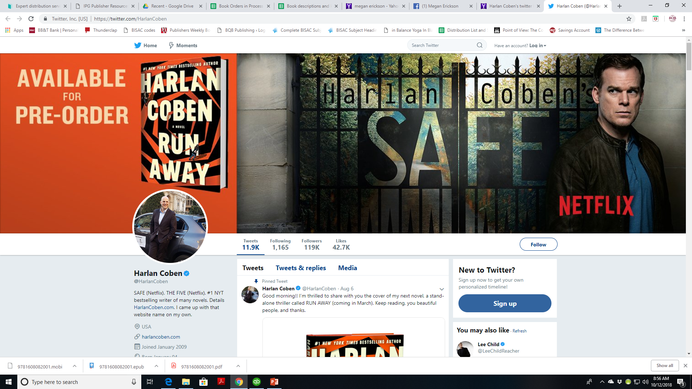

Slide 11
Growing Your Audience in General cont’d
Participate in events
Bookstore events
Book festivals (apply to be a presenting author)
Book festivals (if you aren’t selected as a presenting author, attend and build relationships)
Appear on Podcasts
As an “expert” on the writing process, the creative life, selling books, coming up with ideas for books, etc.
Recommend other author’s books
BookBub is a great venue to do that with
In your newsletter
On social media
On your YouTube Channel

Slide 12
Growing Your Audience in General cont’d
Cross-promote with comparable authors
Newsletter swaps
Interview another author or get interviewed by them (on Facebook, in newsletters, etc.)
Blog about your work or things connected to your writing
Offer to write guest posts for other people’s blogs
Use videos https://insights.bookbub.com/ways-authors-use-videos-to-engage-with-readers/

Slide 13
Building Your Fanbase
What is a Fanbase?
Readers who diligently follow you and your books.
How to Turn Readers Into Fans
Grab them with your profiles
Amazon
Goodreads
BookBub
Share information with them
Success like Amazon rankings, appearances, etc.
Show some love by encouraging feedback, addressing concerns, etc.

Slide 14
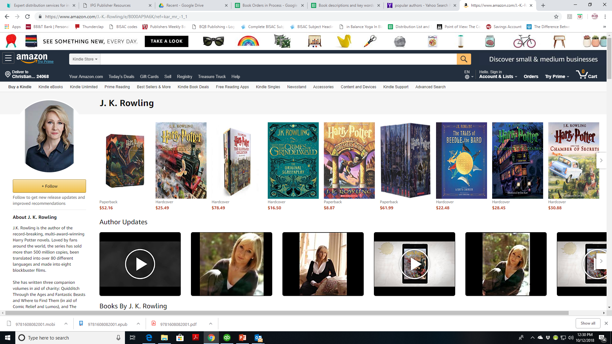

Slide 15
Building Your Fanbase
Create Reader Communities
Build a street team (fans who volunteer to promote an author. Their goal is to incite word-of-mouth buzz for a book. Some authors use Facebook groups to organize their street teams and recruit new members.)
To post reviews of your books (on Amazon, etc.)
To share info about you on their social media
To distribute swag (bookmarks, pens, etc.) to potential readers
To pitch one of your books at their local library or indie bookshop
Create a fan club
Host a read-along group that you participate in
Here’s a great article about Building Fans and creating buzz about your book(s) https://insights.bookbub.com/ways-to-use-facebook-groups-to-build-book-buzz/

Slide 16
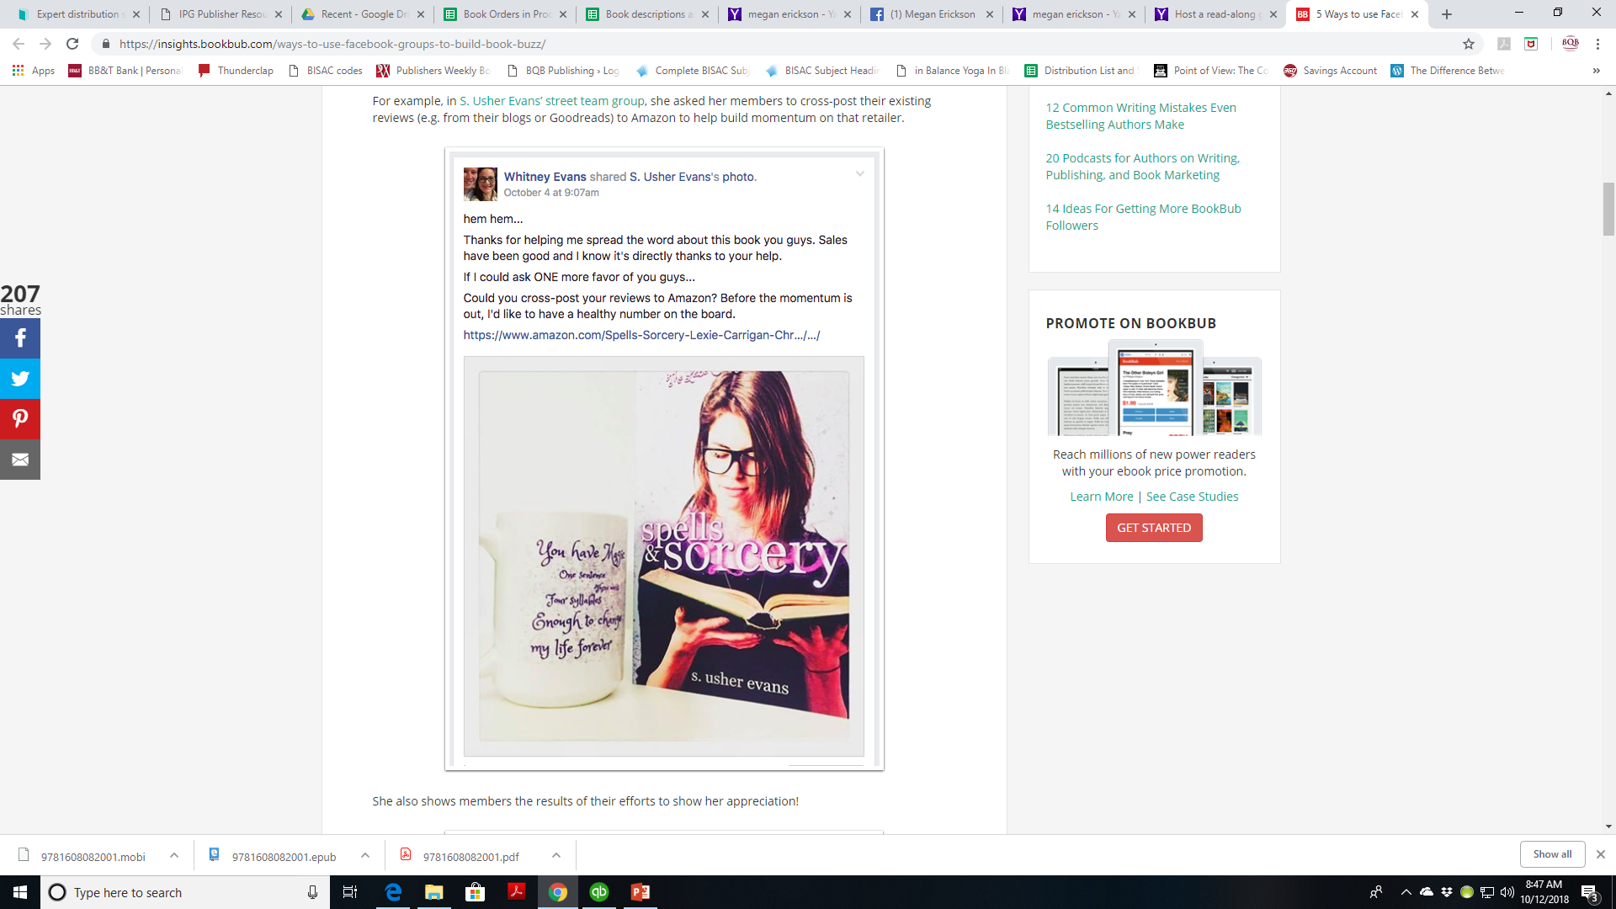

Slide 17
Building Your Fanbase cont’d
Do Facebook Events for Fans
Do Facebook Q&A Sessions by creating an event and sending invitations
Guests who RSVP receive notifications reminding them of the event as the date approaches.
Host a Facebook Live chat for fans
Reveal the inspiration for a book
Show a sneak peek of an upcoming release
Reveal the title of an upcoming release
Reveal the cover of an upcoming release
Introduce new characters
Announce a book’s release
Ask for ideas from fans on what you should write your next book about
Do a pre-recorded video where you answer fan’s questions
Do a Facebook Live A&A from a conference

Slide 18
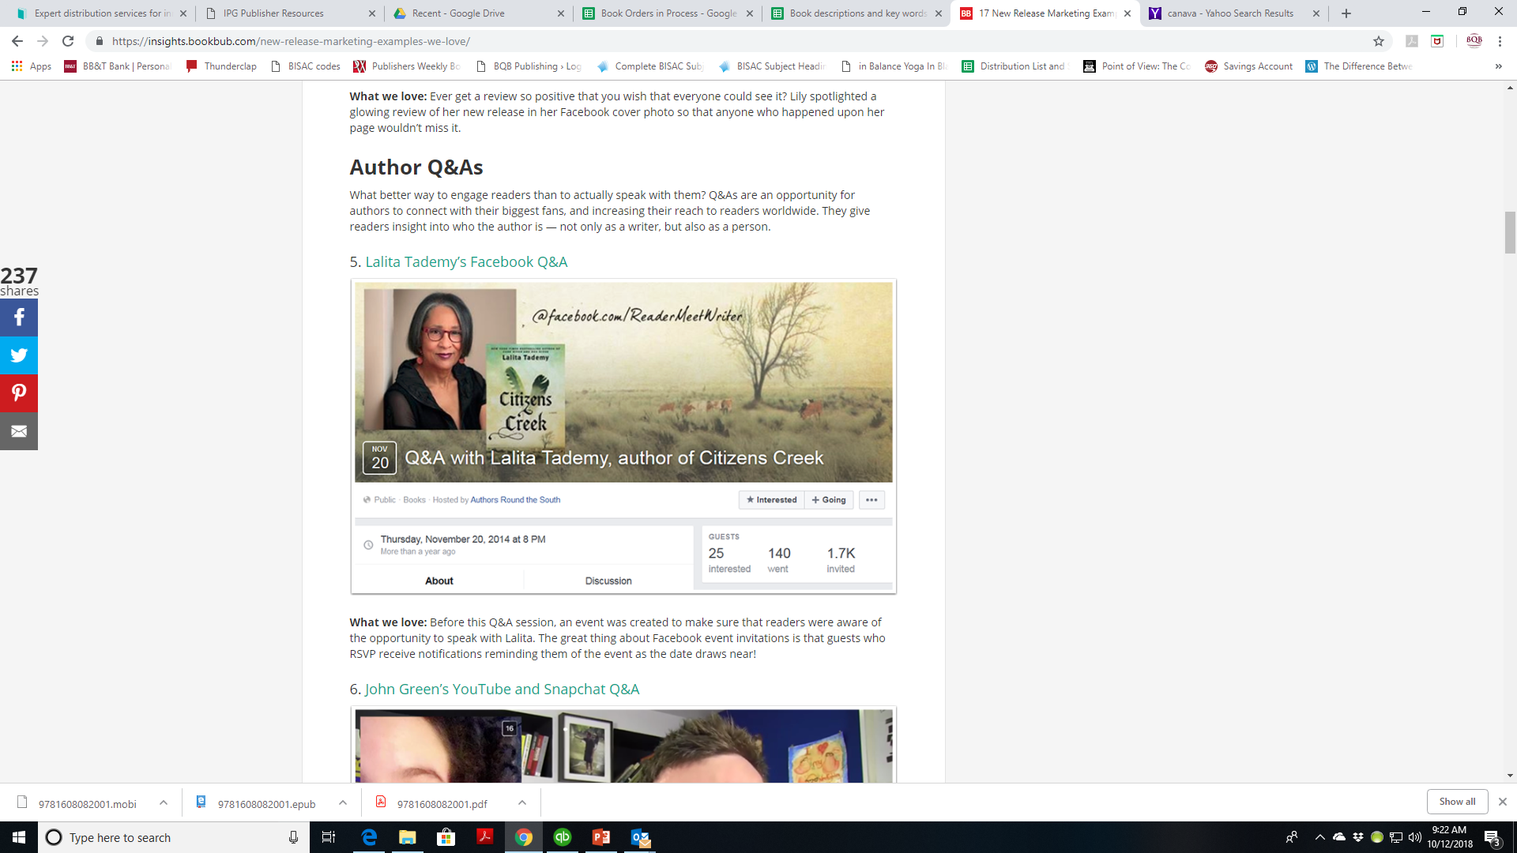

Slide 19
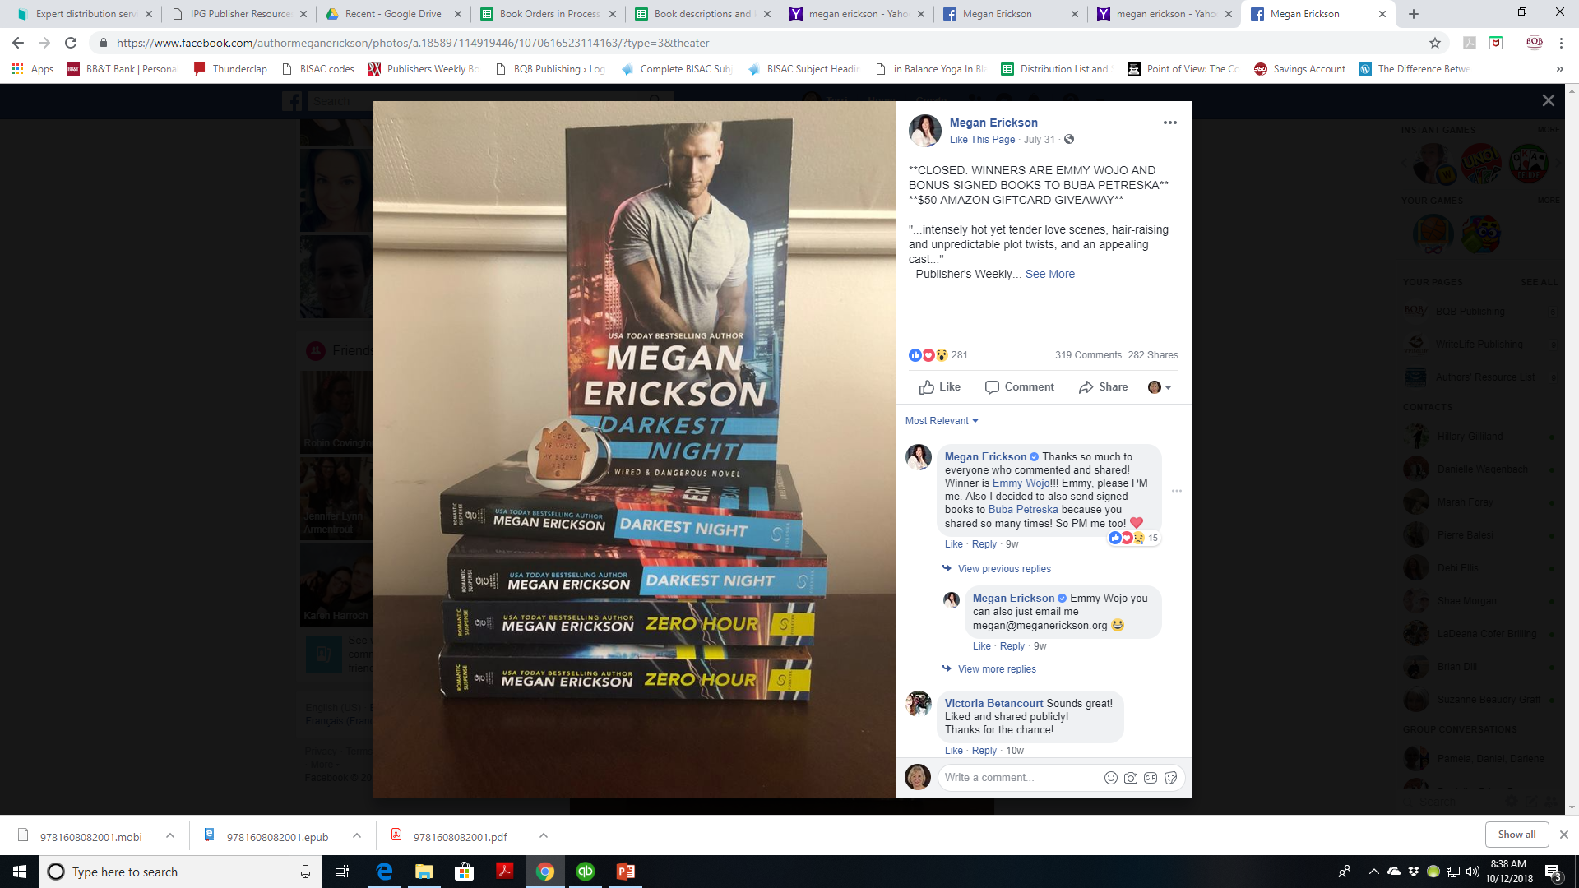

Slide 20
How Can Readers Discover You?
BookBub
Recommendations from Friends and Family
Recommendations from Authors they follow
Launch a Facebook group with other authors to announce new releases, hold monthly joint giveaways, etc.
https://insights.bookbub.com/new-release-marketing-examples-we-love/
Partner with relevant local organizations
Children’s/YA authors coordinate with local schools or PTA’s to appear at events
For a sci-fi book, host a signing at a sci-fi convention
If your story takes place at a particular location, run a promotion with that location
Etc.

Slide 21
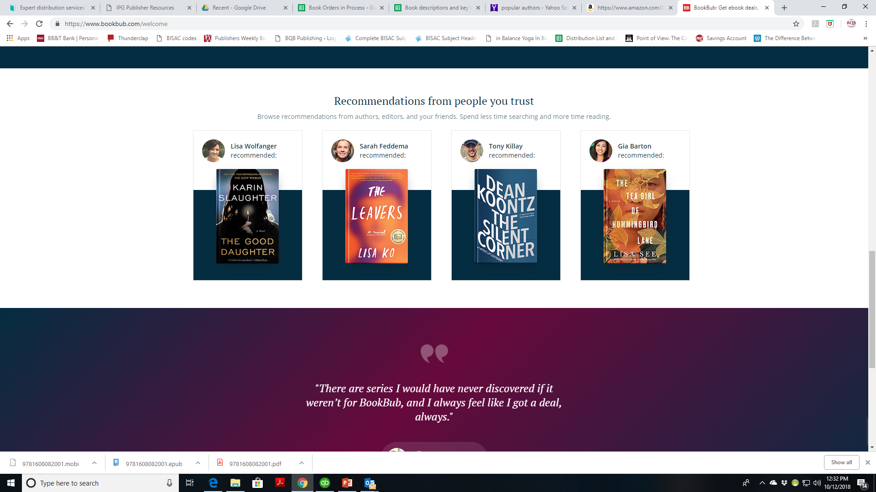

Slide 22
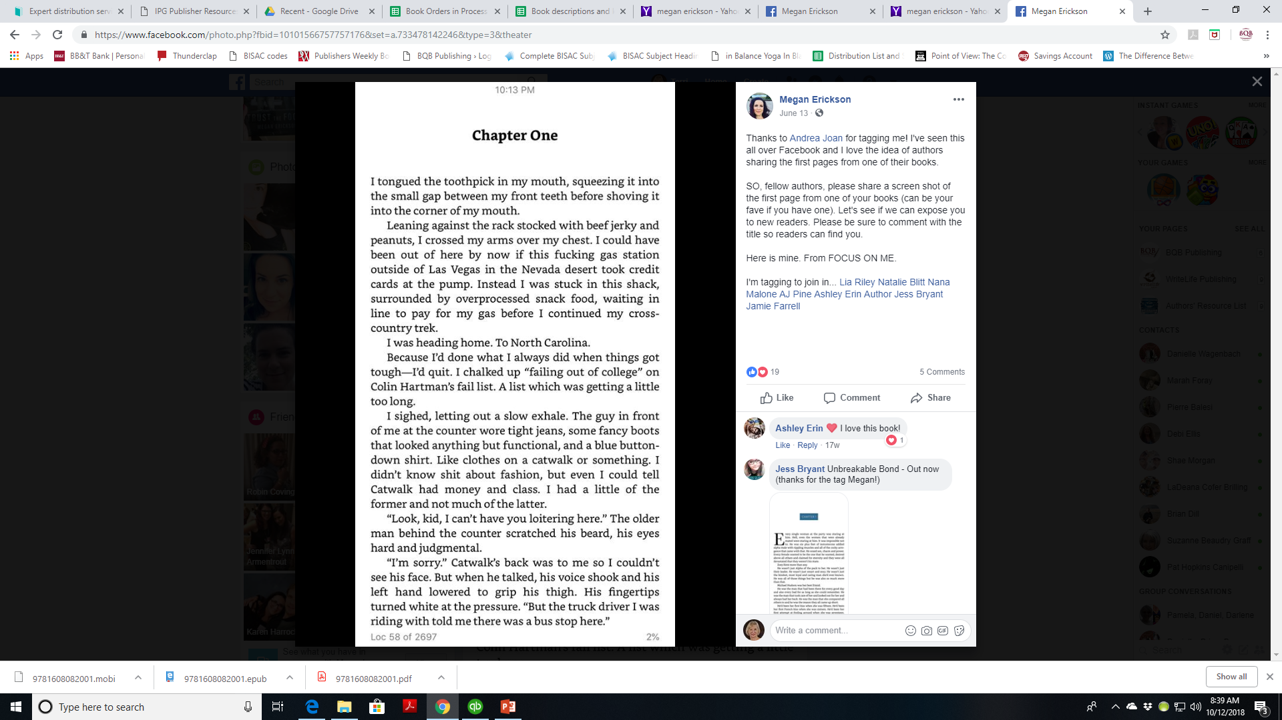

Slide 23
Boots on the Ground
Getting “out there” for people to meet you and learn about you and your books
IPG’s (our print distributor) trade sales manager said that authors and publishers who put “Boots on the Ground” help them in selling our books. The stronger brand an author has, the stronger sales pitch distributors can make.
Participate on panels you’re invited to
Do book signings at bookstores or conferences
Give a talk at a relevant conference
Be creative
To help launch her book SoulStroller, Kayce Stevens Hughlett had cookies made in the shape of flipflops (from the cover of her book) and brought them to bookstores along with a copy of her book.
When illustrator Ed Pokoj does book signings for the book What Does a Princess Really Look Like, he does an illustration for his signature.

Slide 24
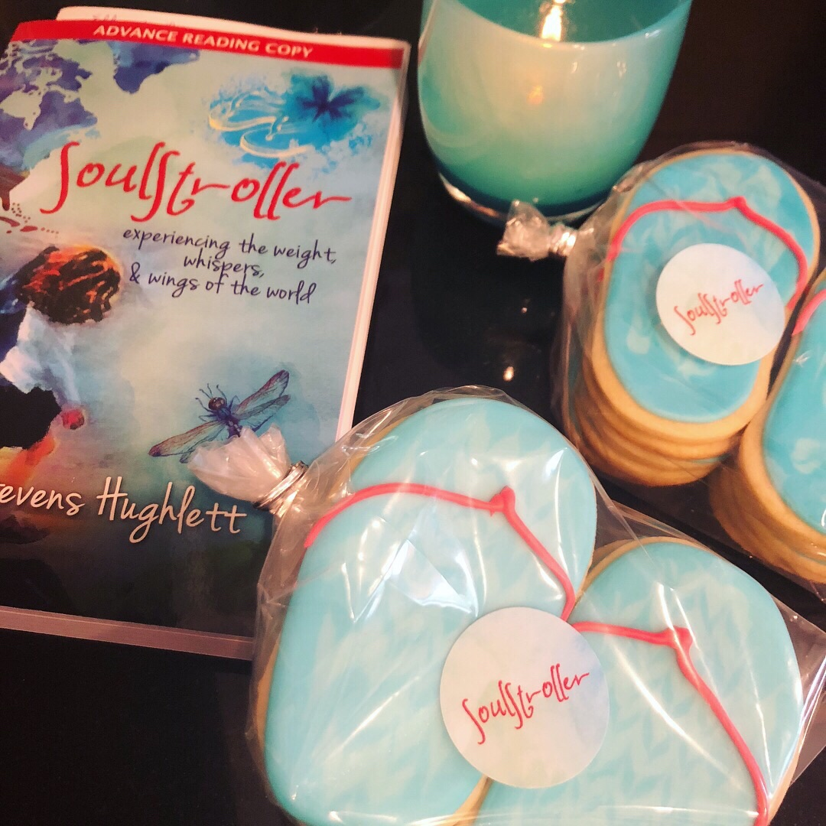

Slide 25
Boots on the Ground cont’d
WriteLife author Tina Zion does workshops all around the world on her books, Become a Medical Intuitive, Advanced Medical Intuition, and Reiki and Your Intuition
WriteLife author Nina Norstrom teaches at prisons with her workbook Mirror, Mirror, on the Wall, Where Does My Self-Love Fall
BQB Author Geanna Culbertson is continually creating tours to bookstores, schools, and book festivals for presenting, signing, and talking about her Crisanta Knight Series
BQB Author Mark Loewen has a very strong social media campaign for his Brave Like a Girl series which Includes the children’s picture book What Does a Princess Really Look Like.
BQB author Sharon Phennah helped make the BookBub Promotion of her book You Can’t Iron a Wrinkled Birthday Suit successful with additional promotion

Slide 26
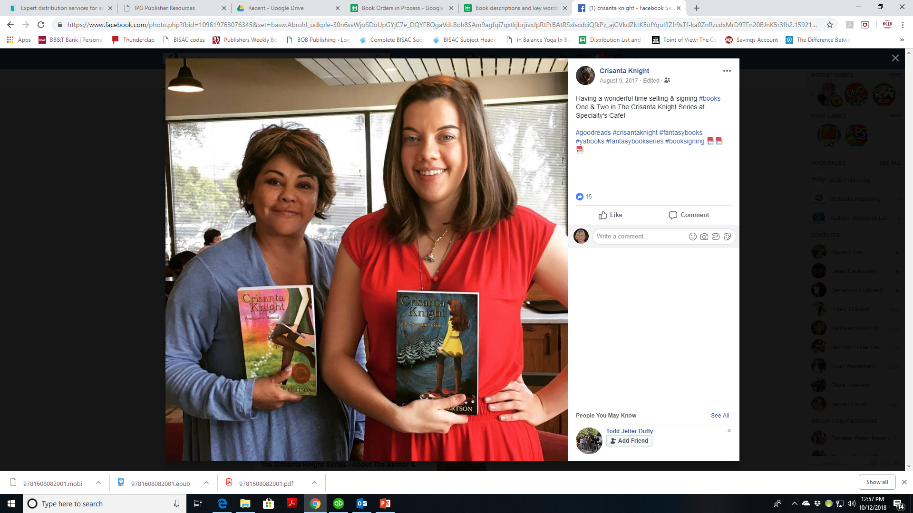

Slide 27
The Importance of a Marketing Plan
Without planning, it won’t happen
Get it in writing
Put it into a calendar
Creating a marketing plan helps start the creative process of thinking of things you can do and ways you can do it
It puts you in the mindset of being an author

Slide 28
Working with BQB/WriteLife
When we secure a BookBub promotion, help spread the news of the sale
Attend our monthly webinars and use the information to learn and grow
Use the training we provide on our author portal
Take advantage of the participation opportunities we provide at book festivals and shows
When we open new content opportunities, (i.e. audiobooks), make sure you participate

Slide 29
MOST IMPORTANT TAKEAWAY FOR TODAY –
The tools are there. It’s up to you to use them.

Slide 30
Questions?
Type any questions in the chat feature here!

Slide 31
NEXT MONTH’S WEBINAR
Keeping Backlist Titles in the Spotlight
Saturday, November 10th
11:00 a.m. EST

Slide 32
Thanks for joining us!
Have a great weekend!
Bqbpublishing.com
Writelife.com

