Slide 1

KEEPING YOUR TITLES (FRONTLIST AND BACKLIST) IN THE SPOTLIGHT
Welcome!
Saturday, November 10th, 2018
11:00 a.m. ET

Slide 2
Define the Terms
Frontlist Titles
Books that are either pending release or have released in the last six months are considered frontlist titles
Backlist Titles
Once a title has been in the marketplace for 6 months, it then becomes a backlist title.

Slide 3
What We’ll Talk About
Reviews
Giveaways
Price Campaigns
Social Media
Free Publicity Opportunities
Capitalize on Current Events
Continue Publishing New Books

Slide 4
Reviews
Reviews continue to be important for the entire life of a book
The more reviews a book has, the more intriguing it is for potential readers.
Amazon reviews continue to help trigger the features like “readers who bought this, also bought this.”
Minimum reviews needed on Amazon to trigger algorithms – 10; 50 reviews trigger more features; 100 reviews trigger all additional features.
An effective tactic to garner more Amazon reviews – reach out to top Amazon reviewers who have reviewed similar books, offering them a free copy of your book for a review. (either frontlist or backlist)
You can find these reviewers by browsing similar books and find people who have a “Top Reviewer badge.” Then, navigate to their Amazon profile page to see other books they’ve reviewed and preferences they list. If it seems as though your book is relevant to their interests, check for their contact information (if it’s public, it will be next to their profile picture). Send them an email of how you found them and why you think they’d be interested in your book. Offer them a free copy.

Slide 5
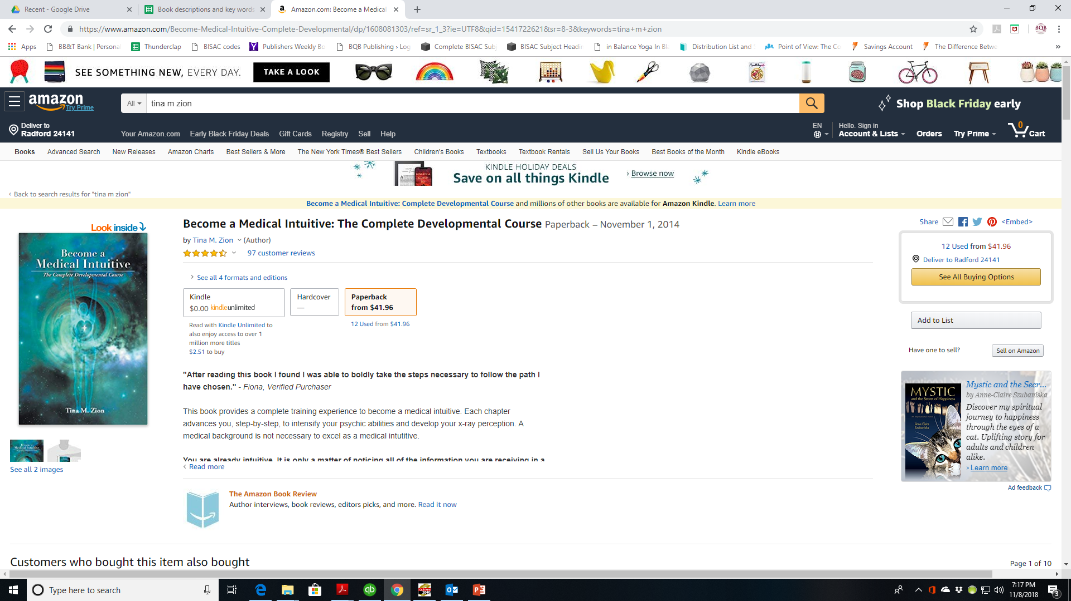

Slide 6
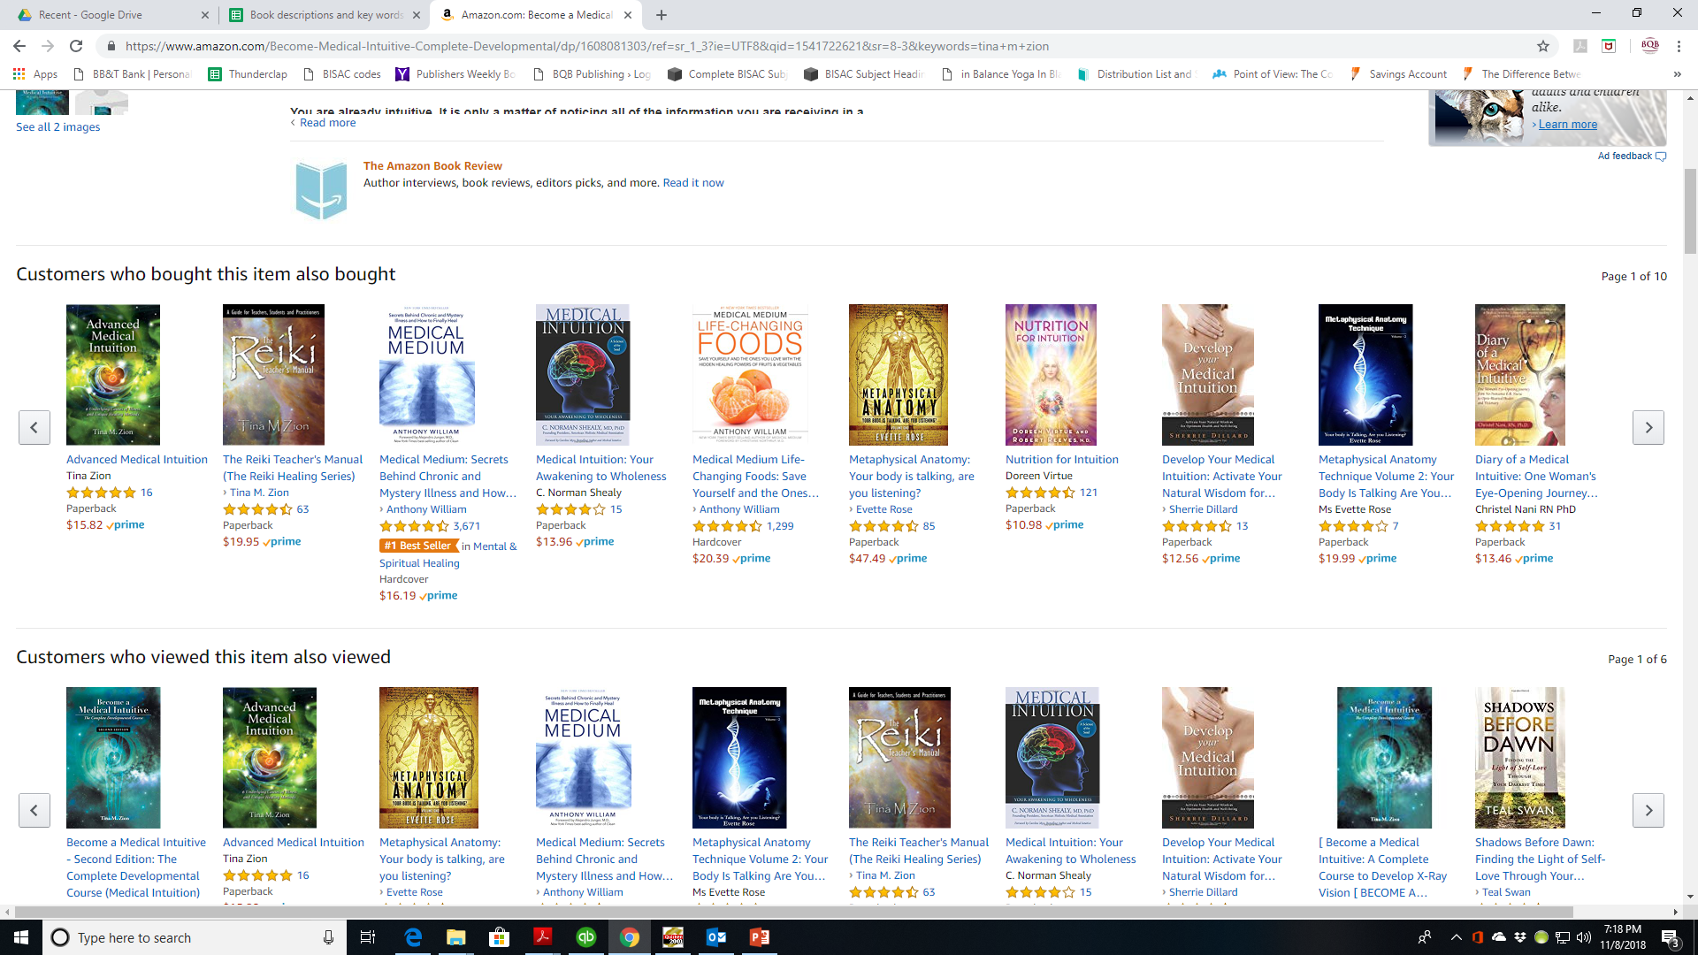

Slide 7
Reviews cont’d
Reviews continue to be important for the entire life of a book
NetGalley is specifically for garnering reviews.
Each month, BQB/WriteLife has a spot or two that is open on their NetGalley account.
Authors can pay $85 through BQB/WriteLife to have their book listed on NetGalley for reviews versus going directly to NetGalley and paying $450 for a month.
If you’re interested, email Terri with your interest. If a spot is open, you’ll be billed $85 and then your book will be featured during the month agreed upon.
When reviews come in, they are emailed to you and BQB/WriteLife puts the good ones on social media and Julie uses them for other marketing opportunities.
Ask for reviews through:
Social media
Newsletter
Speaking events
Appearances

Slide 8
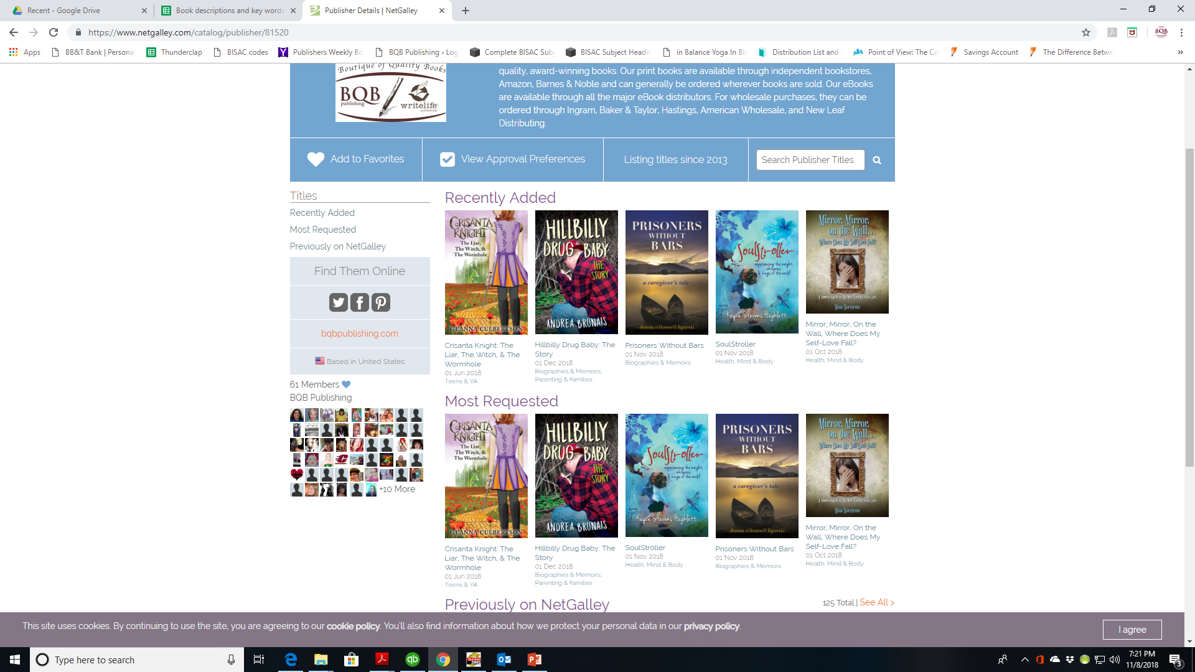

Slide 9
GIVEAWAYS
Using Giveaways to Keep Your Book in the Spotlight
Focus on discoverability rather than selling.
Do a giveaway through Amazon
https://www.amazon.com/b?node=11715260011
Do a Goodreads Giveaway (There is now a cost for this service)
Use Social Media to do a giveaway
Facebook
Instragram
Twitter
YouTube
Give the first few chapters away for free
On your website
Through a social media giveaways
Donate
Consider donating your book to hospitals, shelters, churches, libraries, doctor/dental offices, organizations or clubs

Slide 10
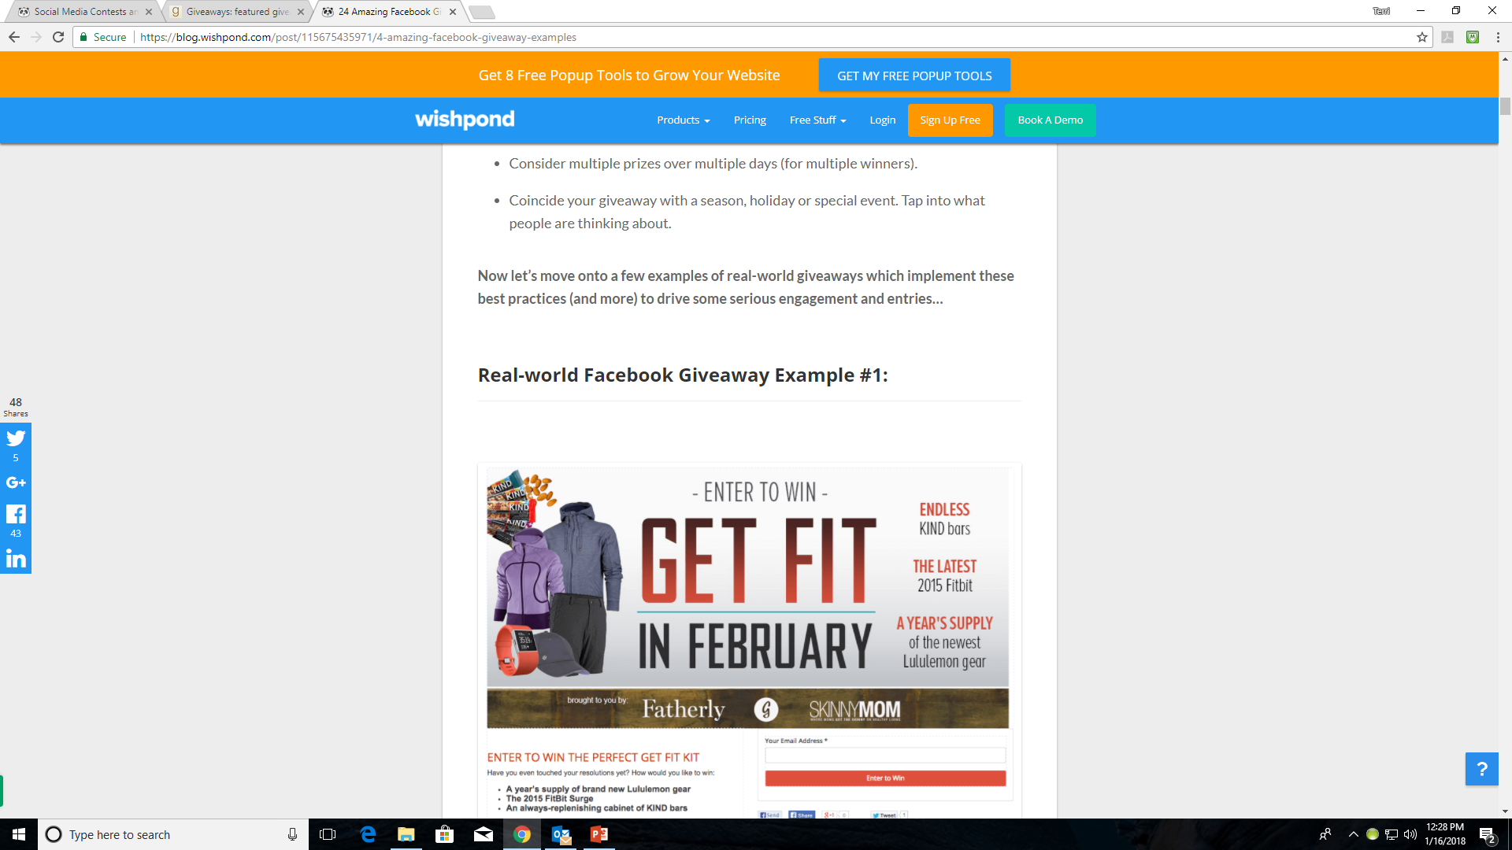

Slide 11
PRICE CAMPAIGNS
Price campaigns have to be done in conjunction with BQB/WriteLife because we have to upload the pricing into the databases
Price campaign are most effective with eBooks because set costs on print books can tip upside down very quickly.
When a price campaign is active, follow your title on Amazon and when good numbers hit, make sure you promote them on social media with a screen shot.
BookBub is a great way to do a price campaign
Newsletter promotions – BQB/WriteLife continually seek these
Pay per click advertising on BookBub (Julie Bromley can help with these)

Slide 12
Social Media Can Be a Strong Tool
Continue your social media presence and campaign long after release date
Sell your books using Pinterest
Use Pinterest to relate to the fans you already have as well as intrigue new readers with “visual stories of you, your brand, and your work.”
Use social media to encourage your fans to market your book
Participate in a podcast tour.
Strong for frontlist titles but can still work for backlist titles
Increase your visibility with guest blogging

Slide 13
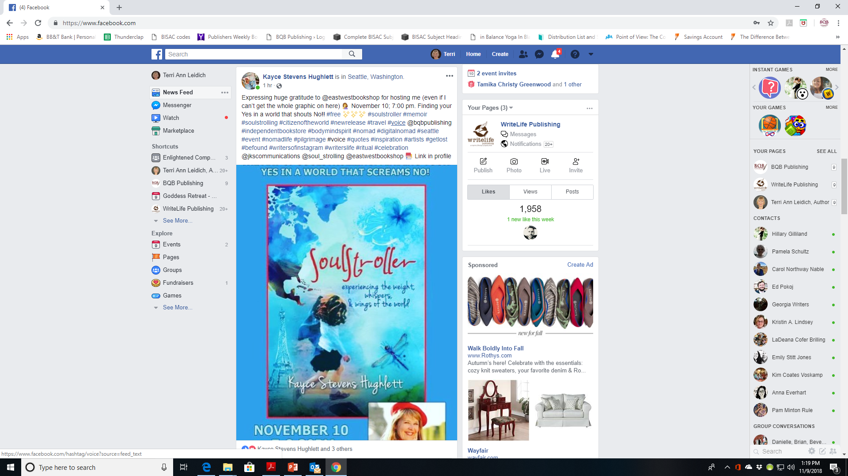

Slide 14
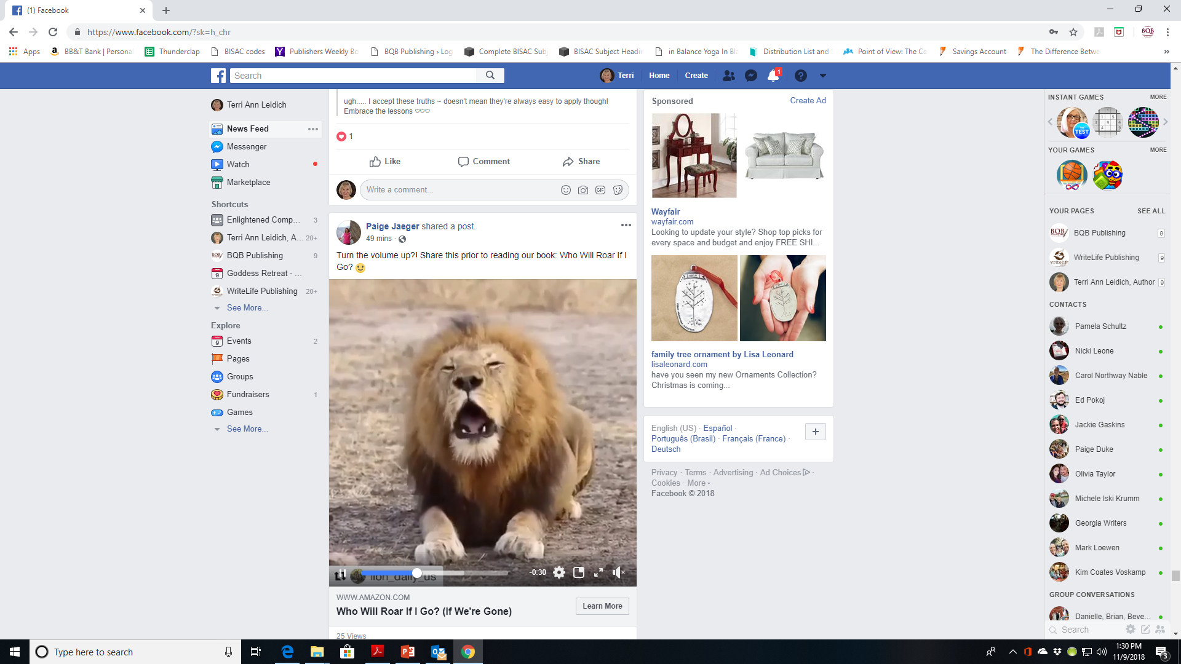

Slide 15
Watch for Free Publicity Opportunities
Sign up for HARO – a sourcing service that connects journalists with relevant experts
https://www.helpareporter.com/sources/
You’ll get an email three times per day that includes media opportunities in which you could be quoted
Find opportunities that match with your experience and/or your book(s) and response to the email address given
You may have a chance to be quoted in an articles, etc. which can help garner publicity
Appear on Podcasts
As an “expert” on the writing process, the creative life, selling books, coming up with ideas for books, etc.
Be Aware of What’s Happening in Your Community
Article or column opportunities in local papers or magazines
Local events that need speakers

Slide 16
Biotech and Healthcare
1) Looking for a psychologist to comment on how to build good habits (Gsk) 2) Seeking an Individual with an Online Master’s Degree in Counseling. (Counselor-License.com) 3) How will you stand out at #HIMSS19? (intrepidNow) 4) Health insurance companies and their relationships with doctors (Medial Economics Magazine) 5) Seeking expert on healthcare robocalls and scams (Healthline)
Business and Finance
6) Seeking Commentary on Liquidation/Funding of Crypto Companies (Finance Magnates) 7) How much should someone spend on holiday gifts? (OppLoans Financial Sense Blog) 8) Affiliate Marketers: Your Best Tips Wanted (blerrp) 9) Agents: What are the biggest mistakes sellers make? (Forbes) 10) Looking to feature successful and experienced insurance professionals (Thriveglobal) 11) No Pension. No 401(k). How to Get by on Social Security (Cheapism Blog) 12) Insurance Professional to Talk About Gym Insurance (Fit Small Business) 13) What is a medical credit card? (U.S. News & World Report) 14) Black Friday Guide (HuffPost) 15) What can HR do to be more green? (People HR) 16) How Do Installment Loans for Bad Credit Work? (US News) 17) How networking has impacted your life (Careers) 18) The best questions to ask in a job interview ( TechRepublic) 19) Leaders having difficult conversations (MichaelHyatt.com)
Entertainment and Media
20) Pushing through distractions (Mass Appeal magazine) 21) Building your social networth (Mass Appeal magazine) 22) Things HGTV doesn't tell you about buying a home (Best Company )
General

Slide 17
Capitalize on Current Events
If you can strategically promote a book during specific seasons, an annual event, or when something pops in the media, take advantage of the opportunity, i.e.
If you’re a romance writer, do a marketing push on Valentine’s Day
If appropriate, promote your book as a summer beach read or as an airplane read during the holidays
If your book features athletes overcoming great obstacles, promote it during the MLB or NFL playoffs or a relevant sporting event.
Strategically take advantage of what’s trending in the news if it’s relevant to your book(s).
Marketing strategies you can use during these times are:
Social media pushes
Price Campaign
Advertising campaign
Write articles that tie your book topic or genre to current popular interests

Slide 18
Keep Your Boots on the Ground
Continue to gain exposure through book signings, book clubs, writing groups, school visits, workshops, library readings, and local area meet ups.
Make your vacations work for you
If you’re heading to a new locale, do a little advance research and set up readings and visits at your destination’s local libraries, schools, bookstores, etc.
Attend live networking events, conferences, and expos.
Book clubs and/or reading groups review both frontlist and backlist books. Continue to seek them out.

Slide 19
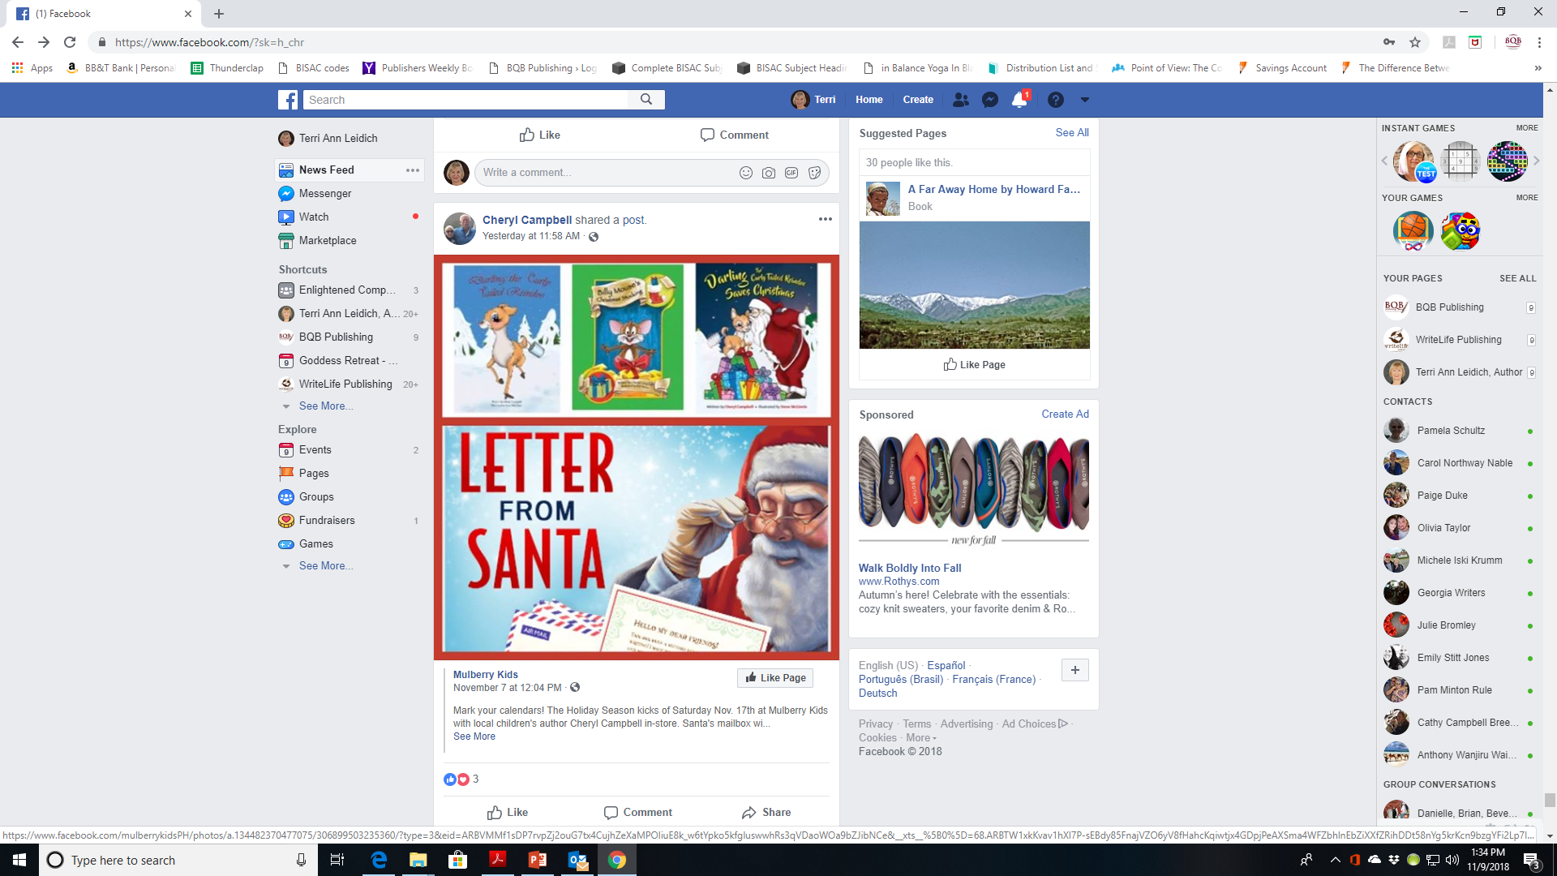

Slide 20
Keep Your Marketing Plan Updated
Update it every year
Budget for marketing – every year
Creating a marketing plan helps start the creative process of thinking of things you can do and ways you can do it
It keeps you in the mindset of being an author

Slide 21
Continue Publishing New Books
Nothing sells backlist like frontlist
Publishing new books can help you garner a wider audience
If a reader likes a book you’ve written, they’ll want to check out other books you’ve written

Slide 22
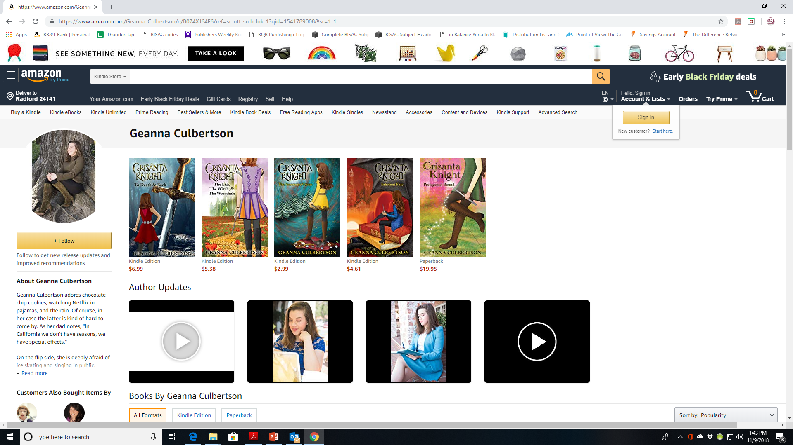

Slide 23
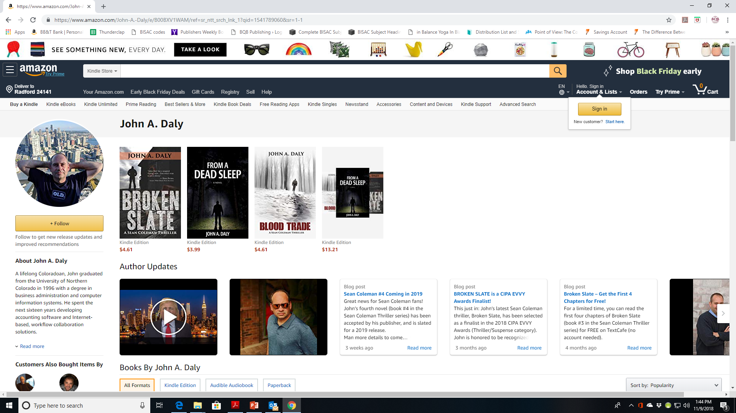

Slide 24
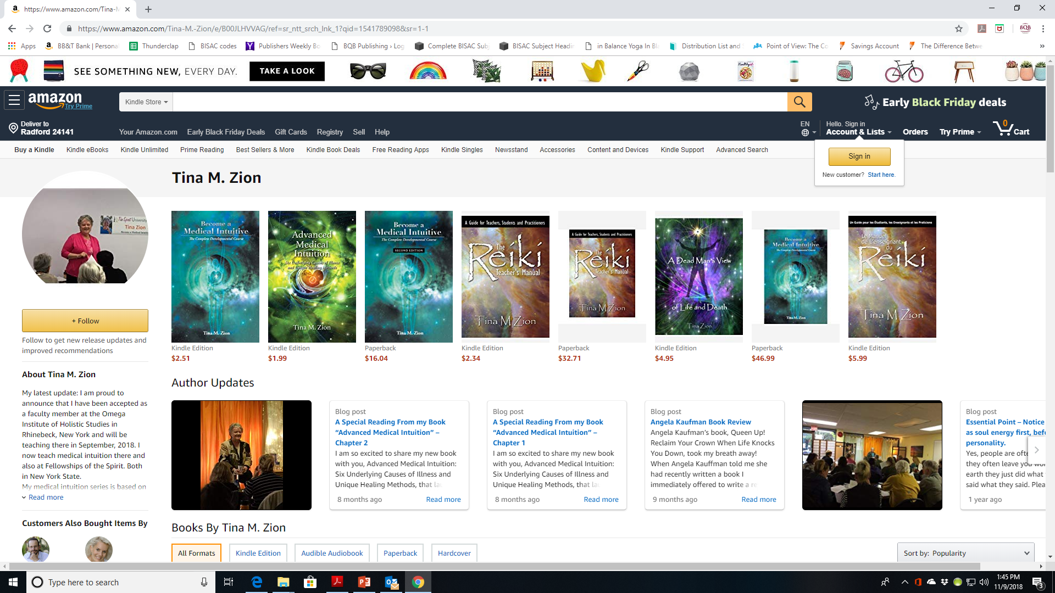

Slide 25
Continue Working with BQB/WriteLife
When we secure a BookBub promotion, help spread the news of the sale
Attend our monthly webinars and use the information to learn and grow
Use the training we provide on our author portal
Review all marketing/advertising opportunities we send your way and follow through on those that fit your marketing budget and marketing plan
Take advantage of the participation opportunities we provide at book festivals and shows – for both frontlist and backlist titles
When we open new content opportunities, (i.e. audiobooks), make sure you participate

Slide 26
MOST IMPORTANT TAKEAWAY FOR TODAY –
The tools are there. It’s up to you to use them.

Slide 27
Questions?
Type any questions in the chat feature here!

Slide 28
NEXT MONTH’S WEBINAR
NO WEBINAR IN DECEMBER
MERRY CHRISTMAS!
ENJOY THE HOLIDAYS!

Slide 29
Thanks for joining us!
Have a great weekend!
Bqbpublishing.com
Writelife.com

