Slide 1

MARKETING IS ABOUT MORE THAN YOU AND YOUR BOOK
Welcome!
Saturday, January 19, 2019
11:00 a.m. ET

Slide 2
What We’ll Talk About
Building Your Brand
Marketing Isn’t Selling
Show a Personality that’s real
Caring About Others
Building a Community

Slide 3
Building an Author Brand
A Brand Tells the World Who You Are and What You Stand for.
The key is to brand you, not your book.
Your author name should be your brand.
Does your website tell the world who you are other than a writer with books?
Does your social media talk only about your books or does it let people get to know you as your brand.
Do your website and social media offer something more than pushing your book(s)?
Choose three words that best describe you as an author/a brand. i.e. funny, adventurous, interesting.
  Then create that brand throughout your interactions with people.

Slide 4
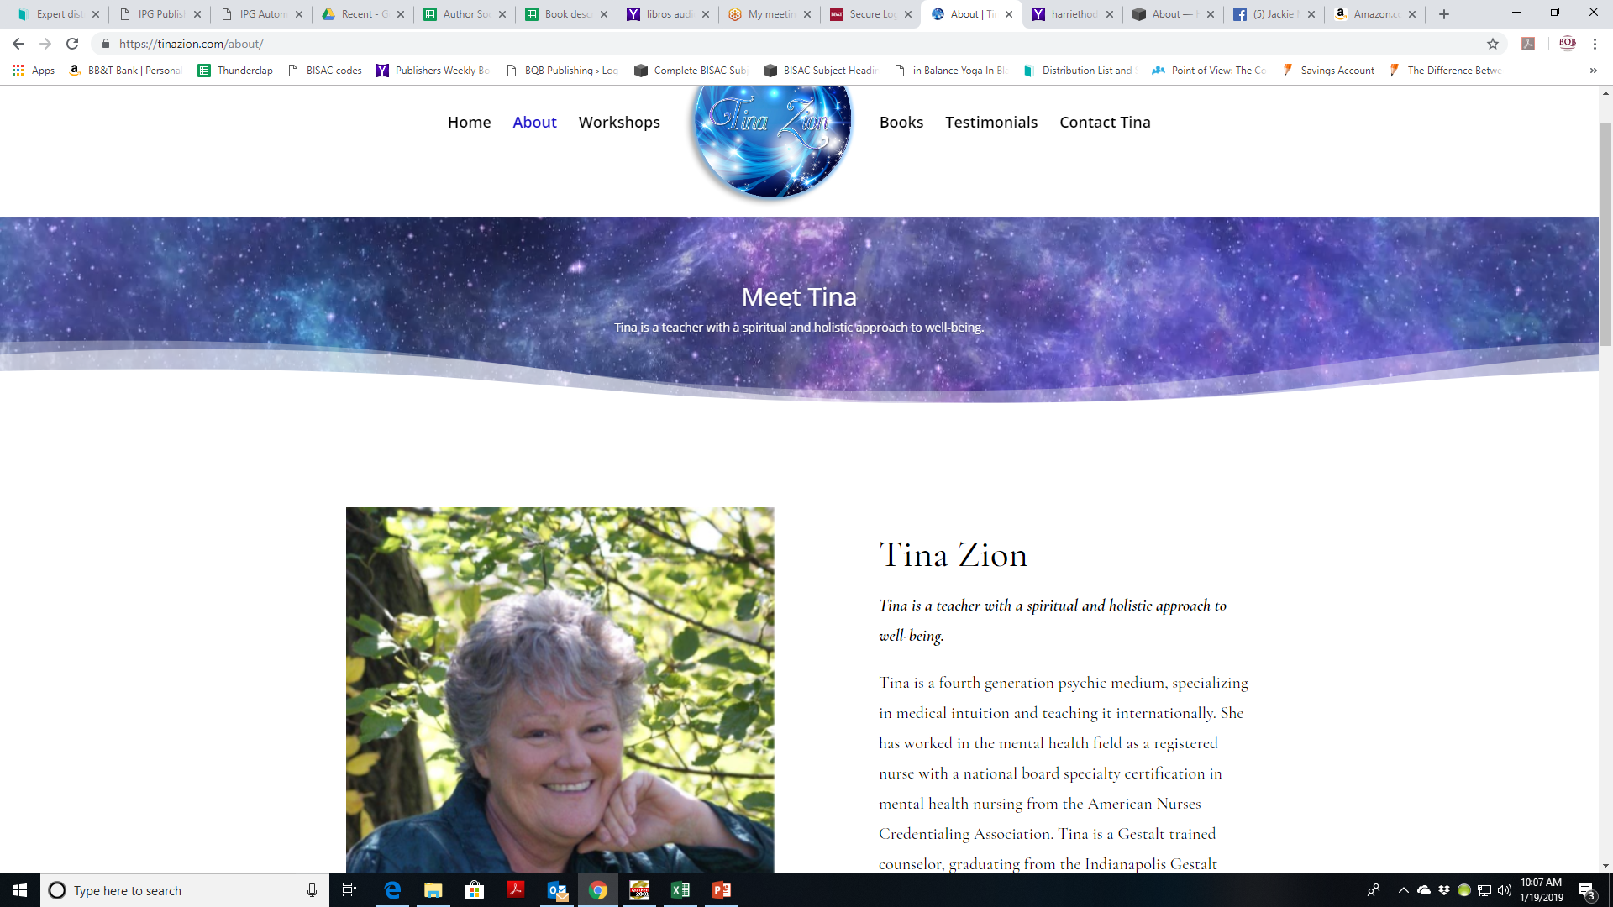

Slide 5
Marketing Isn’t Selling
  Marketing isn’t selling, it’s letting the right group of people know about the ways your book will fill their needs, whatever they may be.
  In order for that to happen, you need to be interested in other people’s needs.
  How are you interested and how do you show it?
  Remember, Dale Carnegie said it in 1928 and it’s still true today – everybody wants to know: What’s in it for me. If all of your marketing is just about you, people will lose interest.
  The more your marketing offers something to people – laughter, information, entertainment, connection, etc., the more it will draw people to you.

Slide 6
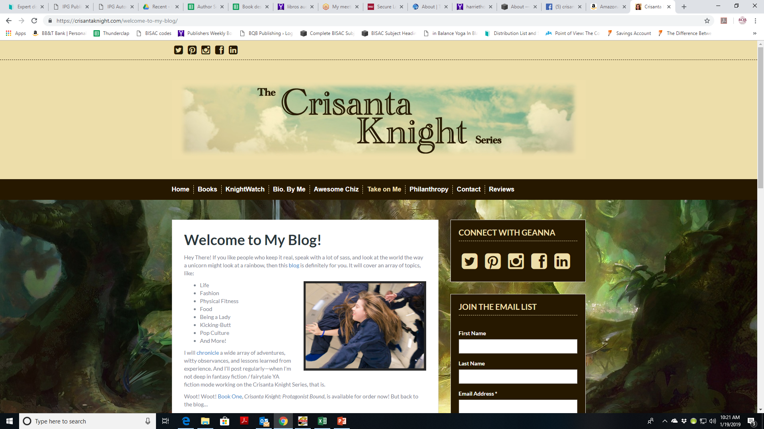

Slide 7
What Does Your Marketing Look Like?
  Take a look at your marketing efforts. What do they consist of? Are you building your brand or just trying to sell your book?
  What message do you convey with your website and social media?
  Pushing your book
  Just posts about you and your book
  Reposting information about other authors and other books
  Supporting things you care about (Warning: Try to stay away from politics)
  Supporting other authors and writers
  Contributing your knowledge and experience to help others

Slide 8
Show a Personality That’s Real
People read books from people they know, like, or know about. It’s up to you to present a personality with which people can relate and connect.
John Daly (From a Dead Sleep; Blood Trade; Broken Slate) has a great sense of humor and he shares it on social media. It helps make him approachable.
Donna Gentry Morton (Watching the Water; Seeking the Shore) shares stories on FaceBook that give us a peek into her life and helps readers want to know more.

Slide 9
Caring Can be Marketing
We all have passions and things we care about. As we share those things via our website, social media, or in person, we are giving others an opportunity to connect with us.
John Daly and his family love dogs. They foster a dog every Friday and John shares pictures and info on social media. Dog lovers respond and it opens up an opportunity for John to expand his fan base.
Geanna Culbertson (The Crisanta Knight series) loves quotes and music. Each month she shares her favorite quote and playlist on social media.

Slide 10
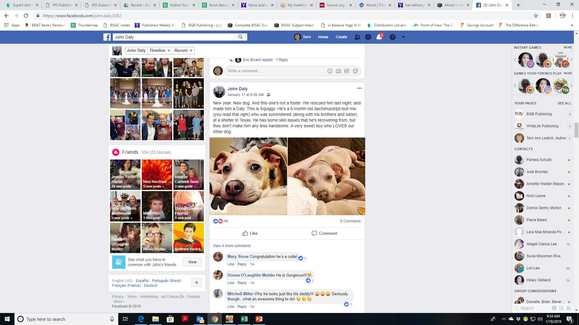

Slide 11
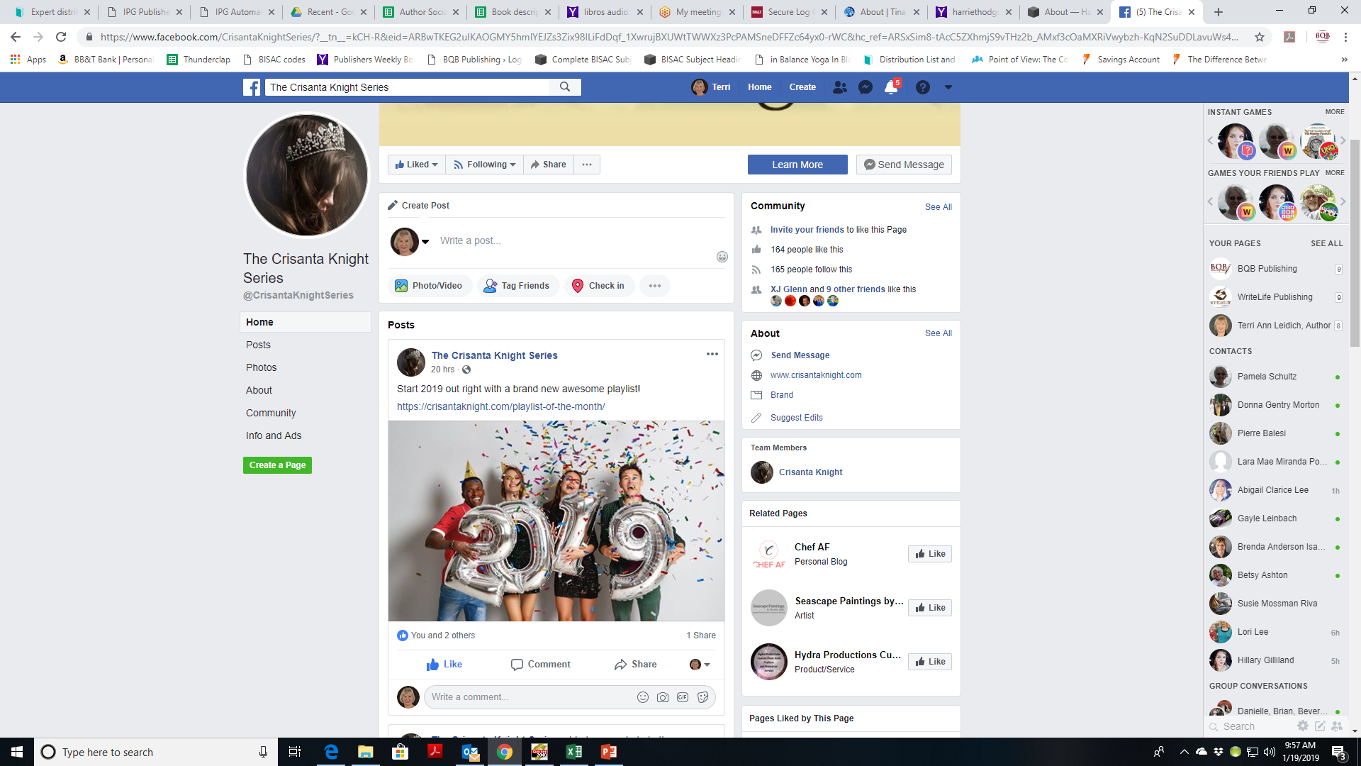

Slide 12
Caring Can be Marketing
You can also market by sharing your knowledge and helping others.
Contribute to web forums
  Find and join forums that are in conjunction with your interests and your brand
  Contribute to them freely
  Reach out. Offers to help others
  Put a link to your blog or website in your signature
  An example of a general forum is www.quora.com
    You’ll encounter all kinds of questions.
    Respond to those that will help build your brand
    Ask questions that will pull people to you who are in alignment with who you are

Slide 13
Caring Can be Marketing
Blog about things that interest you other than writing and your book.
  Aim to create a genuinely useful body of knowledge that can help and encourage others
  Jackie Madden Haugh (My Life in a Tutu; The Promise I Kept: My Journey with Dad from Home Care to Hospice) blogs often on titles like: My Year of Asking for Help; This Too Will Help. The content is relatable and poignant with a touch of humor.
Remember you can connect your blogs to your author profile on Amazon which opens up your exposure to a larger group of people.
Offer to write guest posts for other people’s blogs about a topic that is about more than you and your book(s)
  Bloggers are often looking for content for their blogs. Offer to help with content that is interesting and will draw in readers.

Slide 14
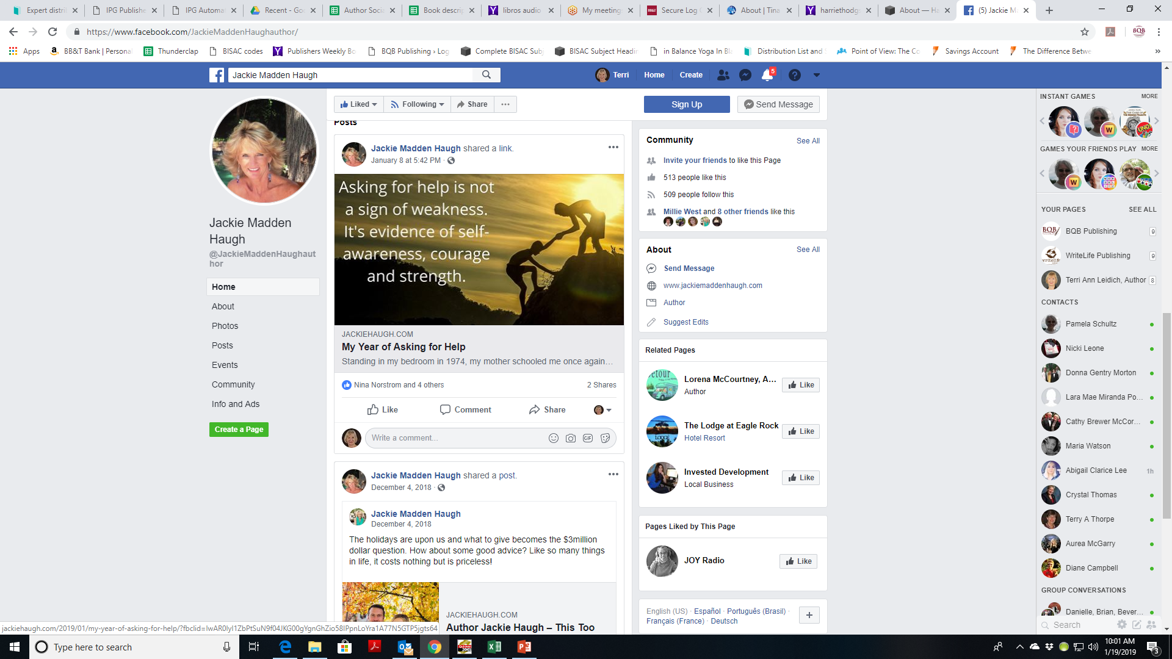

Slide 15
Caring Can be Marketing cont’d
Read and review the works of other offers
  Read the works of others and if you like it, give reviews everywhere you can.
  Nina Norstrom (Not a Blueprint: It’s the Shoeprints that Matter; and Mirror, Mirror on the Wall) does a great job of reading the works of others and giving reviews.
  Tina M. Zion (Advanced Medical Intuition; Become a Medical Intuitive; The Reiki Teacher’s Manual; and Reiki and Your Intuition) readily reviews other body, mind, spirit books, gives reviews, and will often write endorsements to be included in a book.

Slide 16
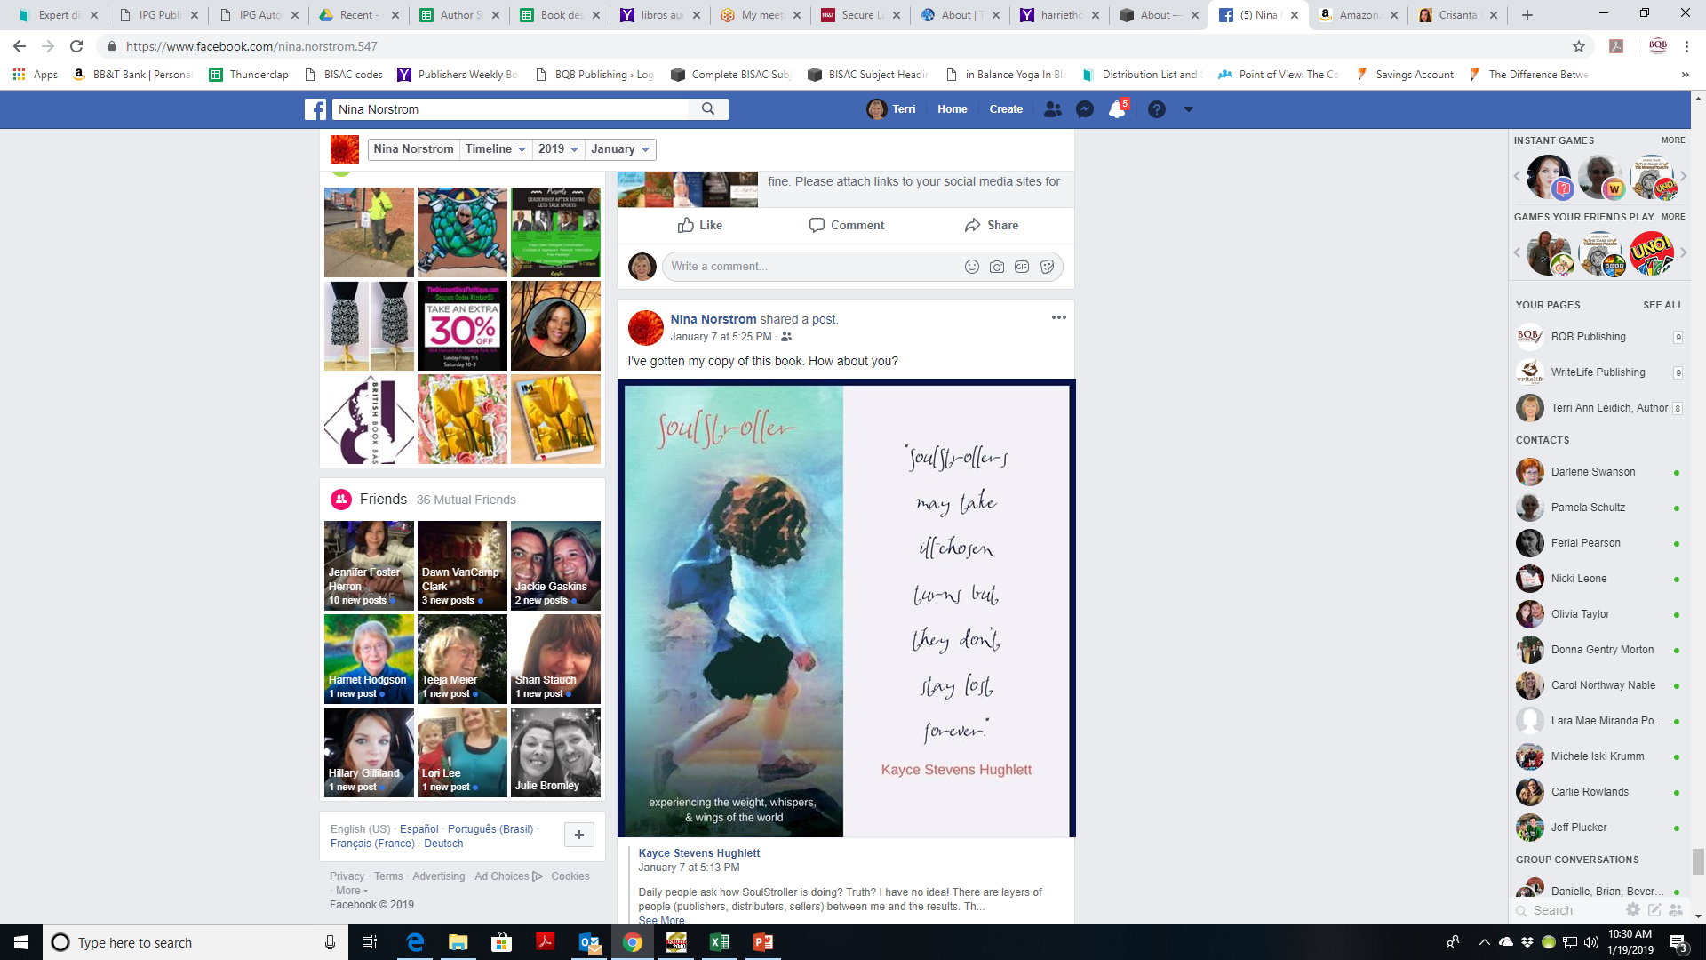

Slide 17
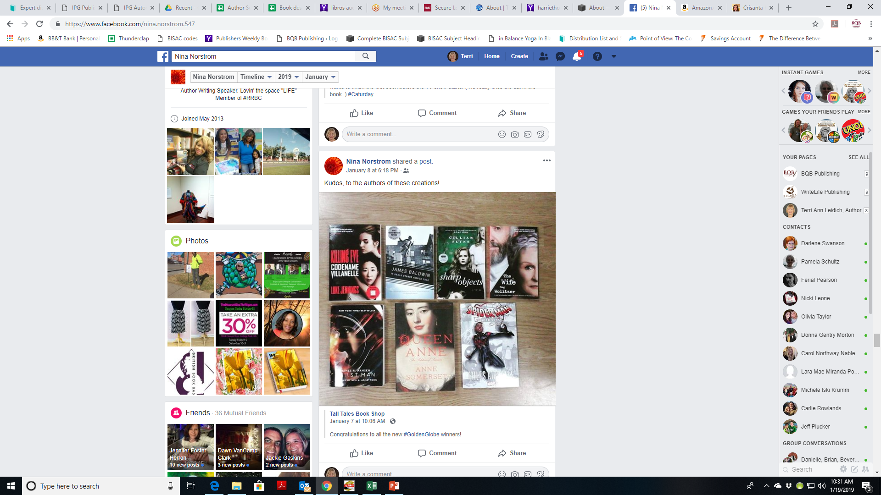

Slide 18
Caring Can be Marketing cont’d
Ways to show caring and build your brand at the same time.
Add a section on your website - Books I Love
Start out with 3 or 4 then add 1 or 2 a month
Follow other authors (big and unknown) on social media and repost
Feature other authors on your social media
If you have a blog, interview other authors
Attend book signings for authors you don’t know, post about it, and tag the authors

Slide 19
Volunteering is Caring
Sharing our time for a cause we believe in is caring, which can also be marketing.
Geanna Culbertson (The Crisanta Knight series) has sponsored Girls on the Run Los Angeles for several years now. In the process she has built relationships to the point that as she is creating her book tours, she can now reach out to members in other cities and they are helping her create events where she speaks and signs her books.
Donna O’Donnel Figurski (Prisoners without Bars) works with Brain Injury Associations to share her experience and help others.

Slide 20
Building a Community of Readers
    Be willing to share your expertise and knowledge
    Do a presentation at a local meetup group. Don’t sell – just give great information
      Have bookmarks or business cards on hand with links to where your books can be purchased
      Harriet Hodgson (Happy Again; The Caregiver series; So, You’re Raising Your Grandkids; and The Grandma Force does a lot of speaking at caregiver and grief organizations.
    Offer to contribute knowledge to writer workshops
    Interact with other authors
    Provide valuable information without being a know-it-all

Slide 21
Things That Push People Away
Social media posts that are consistently and only about you and your book.
Posts and websites that are uninviting or shout “me, me, me” which can turn off the most avid fans.

Slide 22
MOST IMPORTANT TAKEAWAY FOR TODAY –
The tools are there. It’s up to you to use them.

Slide 23
Questions?
Type any questions in the chat feature here!

Slide 24
NEXT MONTH’S WEBINAR
  Saturday, February 9th
  11:00 a.m. EST

Slide 25
Thanks for joining us!
Have a great weekend!
Bqbpublishing.com
Writelife.com

