Slide 1

ARE YOU APPROACHING YOUR BOOK(S) AS A BUSINESS OR A HOBBY
Welcome!
Saturday, February 9, 2019

Slide 2
What We’ll Talk About
The Two Approaches to Publishing and the Possible Results of Each

Slide 3
When You Decide to Pursue Publishing Your Book(s), Whether You Realize it or Not, You are Deciding to Step into the Business of Publishing –
AND IT IS A BUSINESS.

Slide 4


Slide 5
Being an Author is a Business
As an author, you have a product (your book or books) that you want people to buy.
You are responsible for creating that product, and in some form, getting it out to the marketplace.
In that process, there are expenses, income, tax responsibility, etc.
Thus – you are a business.
A hobby typically doesn’t require distribution, marketing, or tax responsibility.

Slide 6
The Two Approaches
As a Business, it is important to:
Create a marketing plan
Dedicate a marketing budget
Make it a part of your weekly activities
If you have a full-time job, treat it as a part-time job and allocate time and money accordingly
Constantly be open to learning and participating in marketing opportunities

Slide 7


Slide 8
The Two Approaches
As a Hobby, you typically don’t need to:
Create a marketing plan
Invest in its growth
Continue to grow
Be open to marketing opportunities
Have expectations of royalties or a return

Slide 9


Slide 10
Writing as a Hobby is Okay –
Just Don’t Have Unrealistic Expectations of Earning Money from a Business that You’re Treating like a Hobby.

Slide 11
You Must Invest to Create Success
If you want to make money with your writing, it will require an investment of:
Your Time
Creating your product
Creating a marketing plan
Marketing
Your Money
Getting your book(s) ready for the marketplace
Marketing
Books for selling and/or marketing

Slide 12
You Must Invest to Create Success
Businesses take an committed investment
Hobbies are for our entertainment or pleasure
Businesses can create a return on your investment
Hobbies usually do not create a return on investment
Businesses require long term investments
Many authors expect to get their investments back in a few months or a year and when they don’t, they give up.
Business owners know that building a successful business takes time

Slide 13


Slide 14
Crucial for Success as a Business
A Good Product
Well edited, not only for spelling, punctuation, etc. but for character development, story arc, etc. – you get that with BQB/Writelife
Distribution
Readers have to be able to have access to buying your book
You have that with BQB/WriteLife
Marketing
Readers have to know about it to want to buy it
While BQB/WriteLife does ongoing marketing for all of our books, it is up to each author to specifically market their book(s)

Slide 15
As a Business - Reuse Your Content
Because BQB/WriteLife is in the business of publishing, we create several revenue streams from your one product.
Print Book
eBook
Audiobook
All of these products need author marketing in order to produce income

Slide 16
As a Hobby
You created it
You can say you’re a published author
You have no intention of putting any more time or money into it

Slide 17
Businesses Need Marketing
Your book(s) is your business - it’s up to you to build your author brand and create a marketing platform for your book(s).

Slide 18


Slide 19
Creating a Marketing Plan/Platform
Marketing doesn’t just happen. It needs to be planned and created.
Businesses require marketing – hobbies don’t
The Business of Being an Author Requires You To:
Build Your Author Brand

Slide 20
Creating a Marketing Plan/Platform
What you need for a business but not a hobby
Build Your Author Brand
Author Website
Social Media
Author Profiles
Reviews and Endorsements

Slide 21
Websites That Mean Business

Slide 22
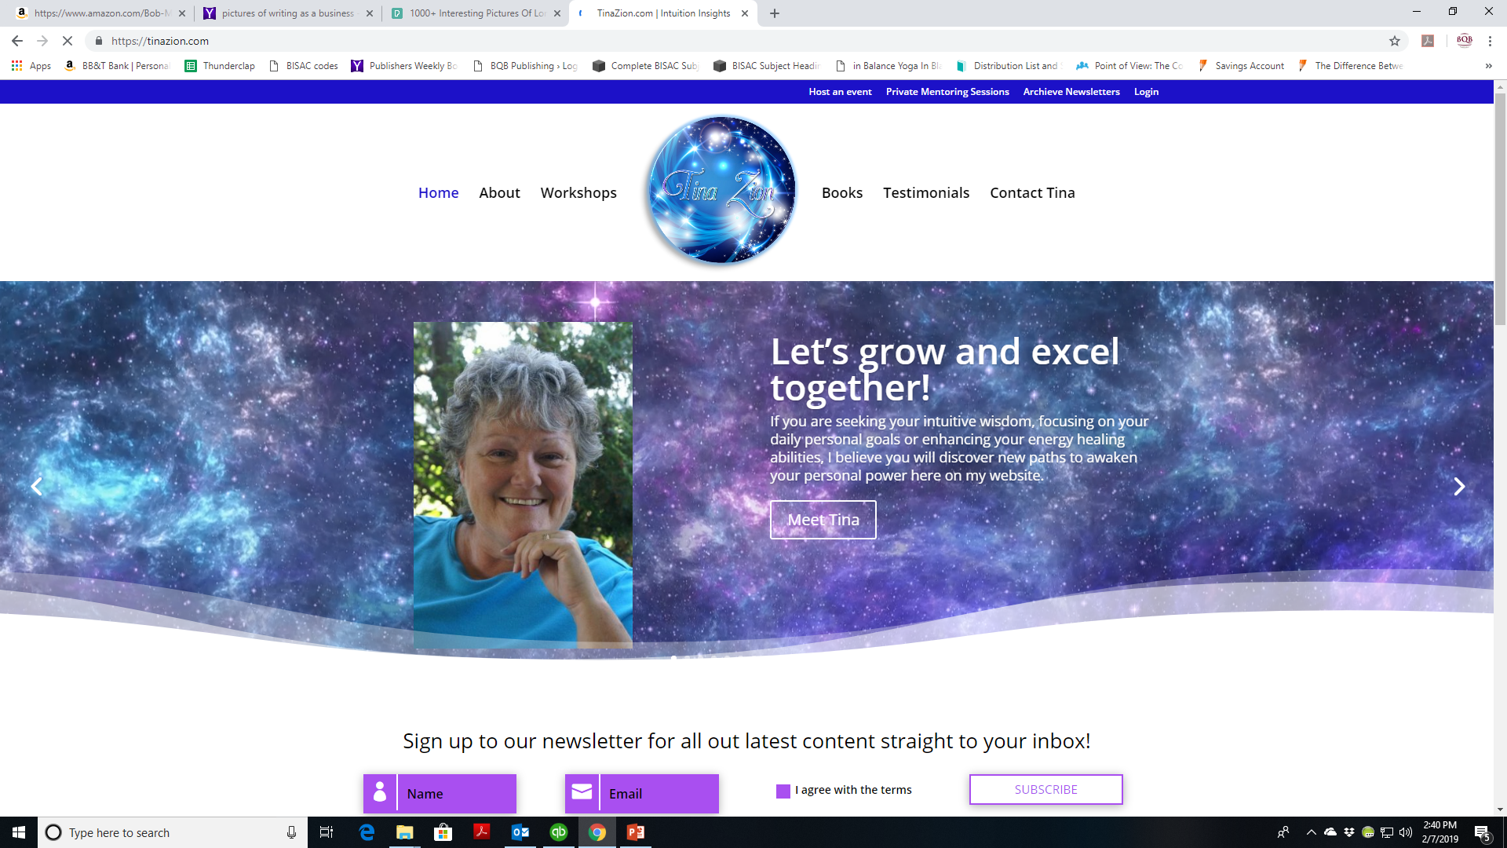

Slide 23
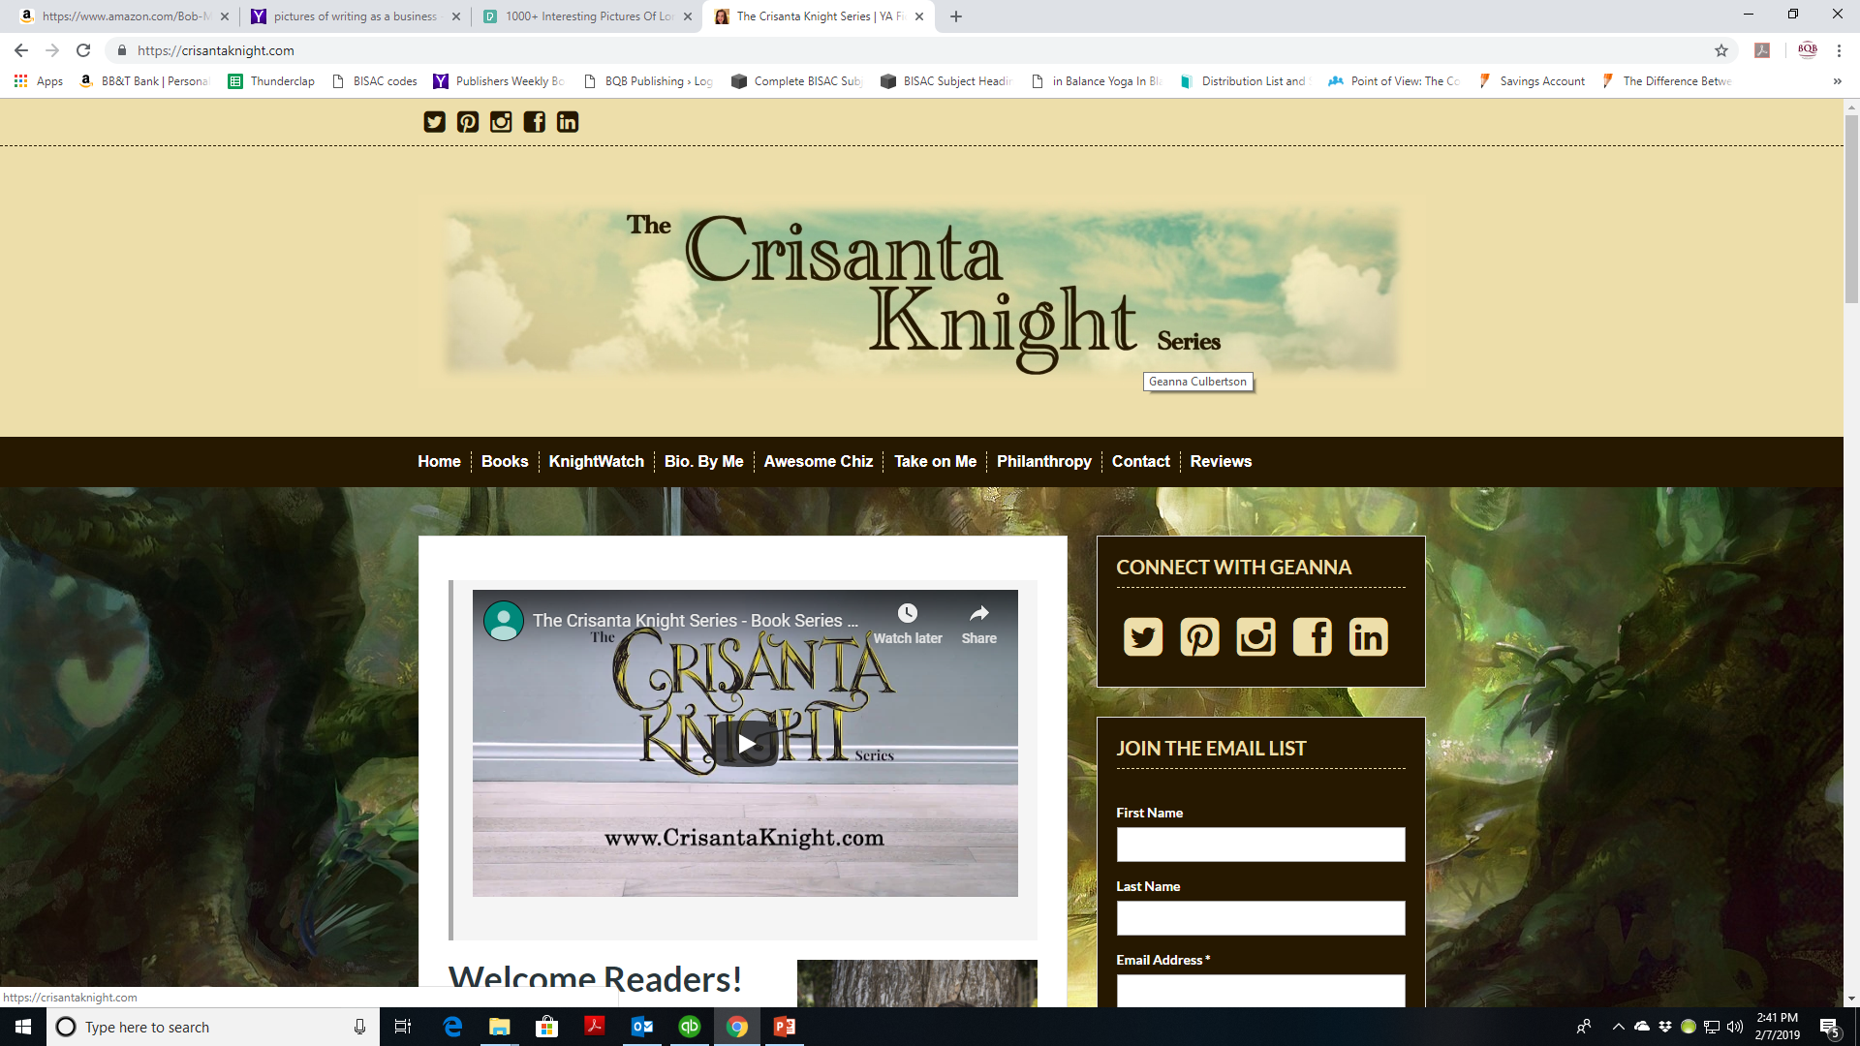

Slide 24
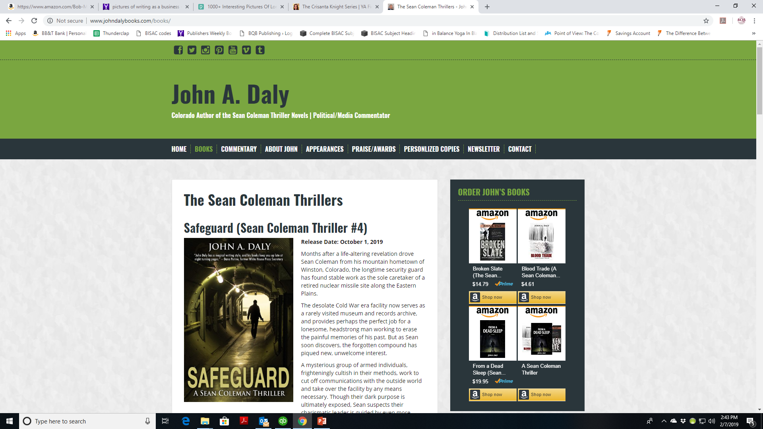

Slide 25
Social Media
That
Engages

Slide 26
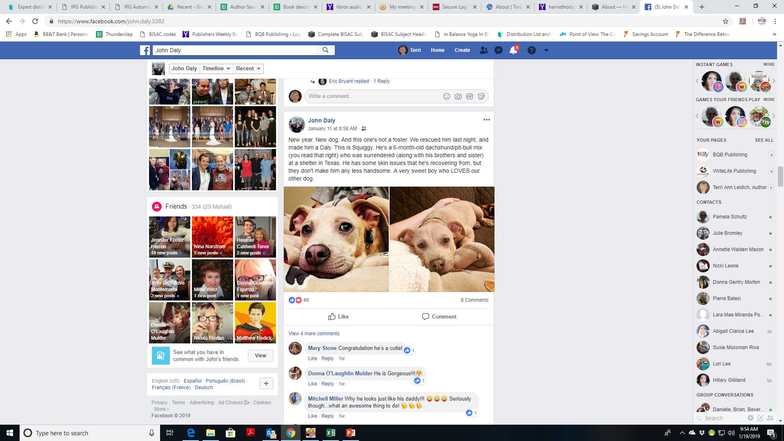

Slide 27
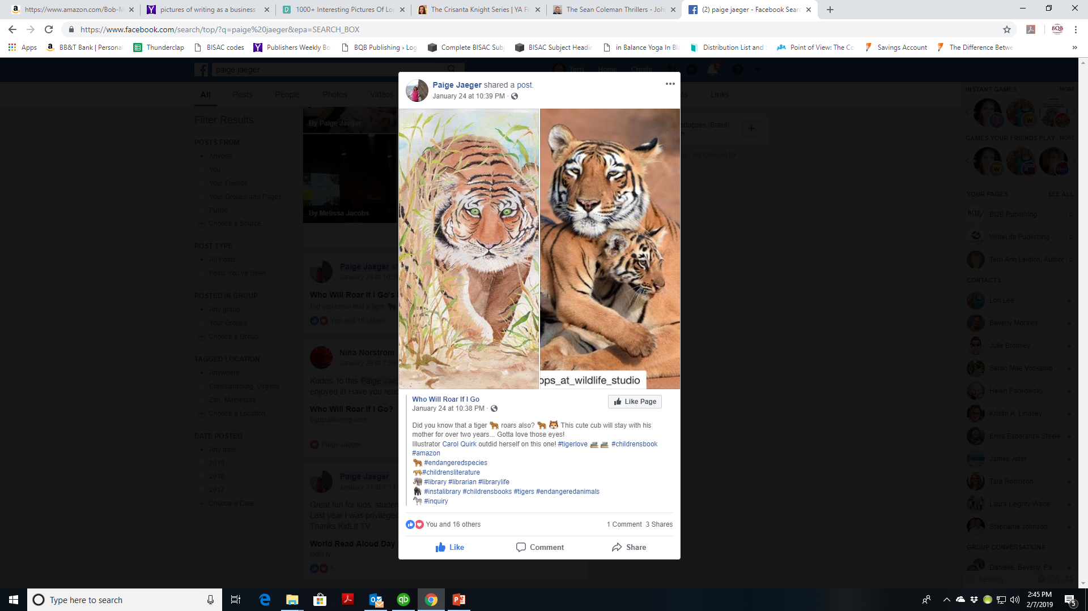

Slide 28
Author Profiles
That
Grab Attention

Slide 29
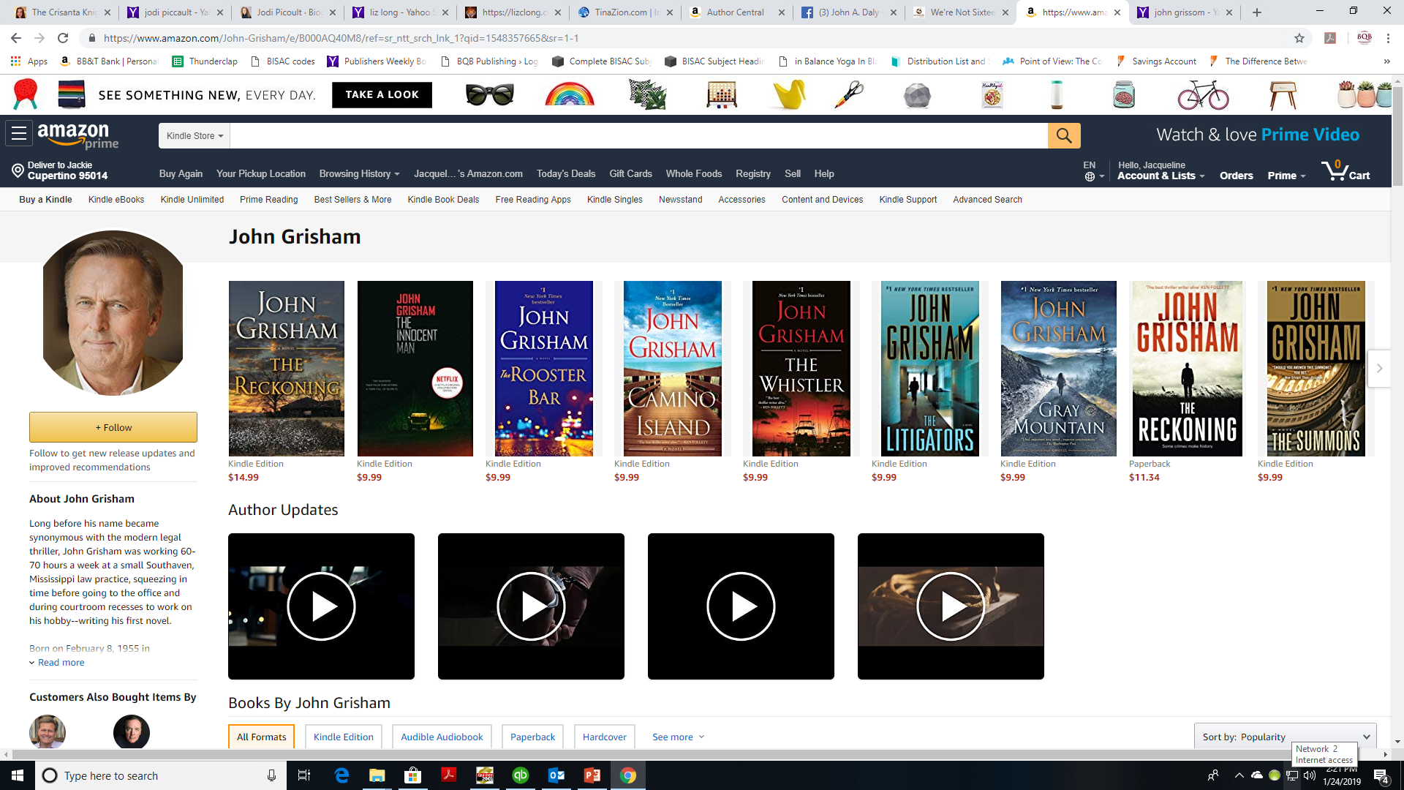

Slide 30
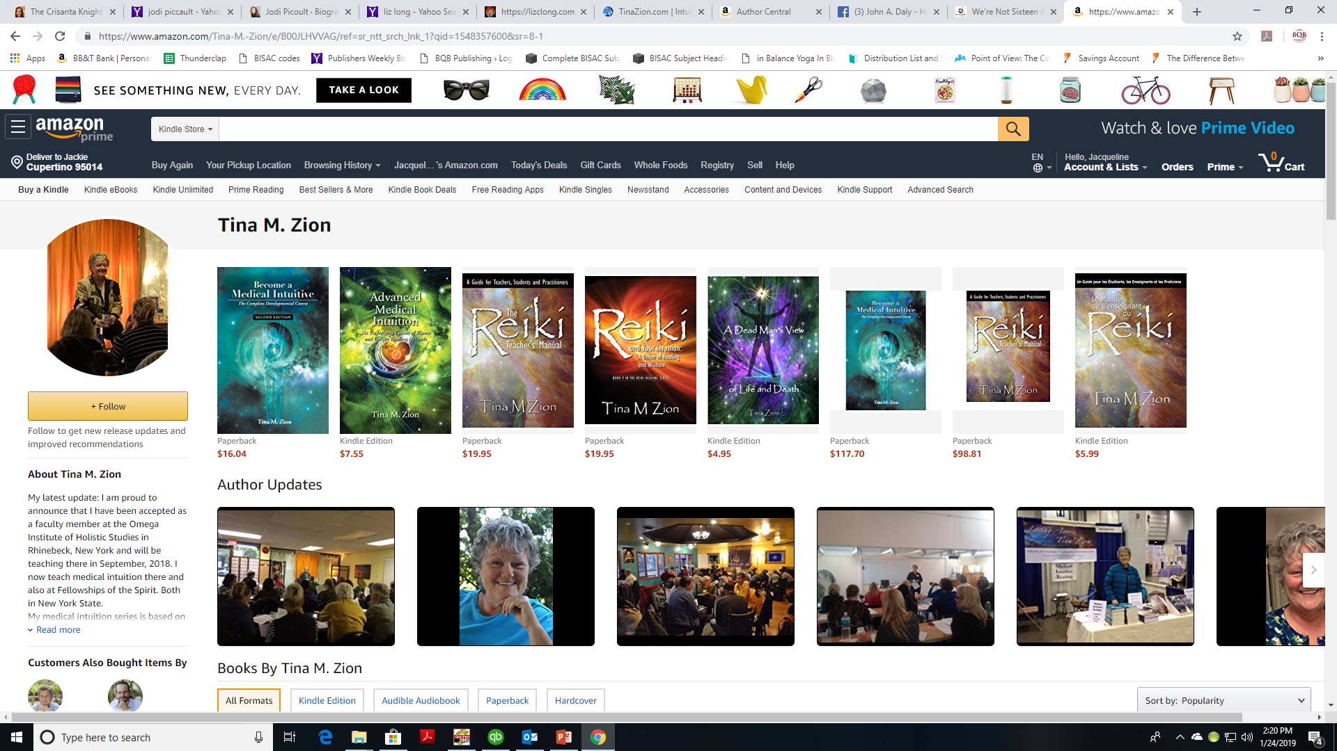

Slide 31
Reviews Help
Create
Profit

Slide 32
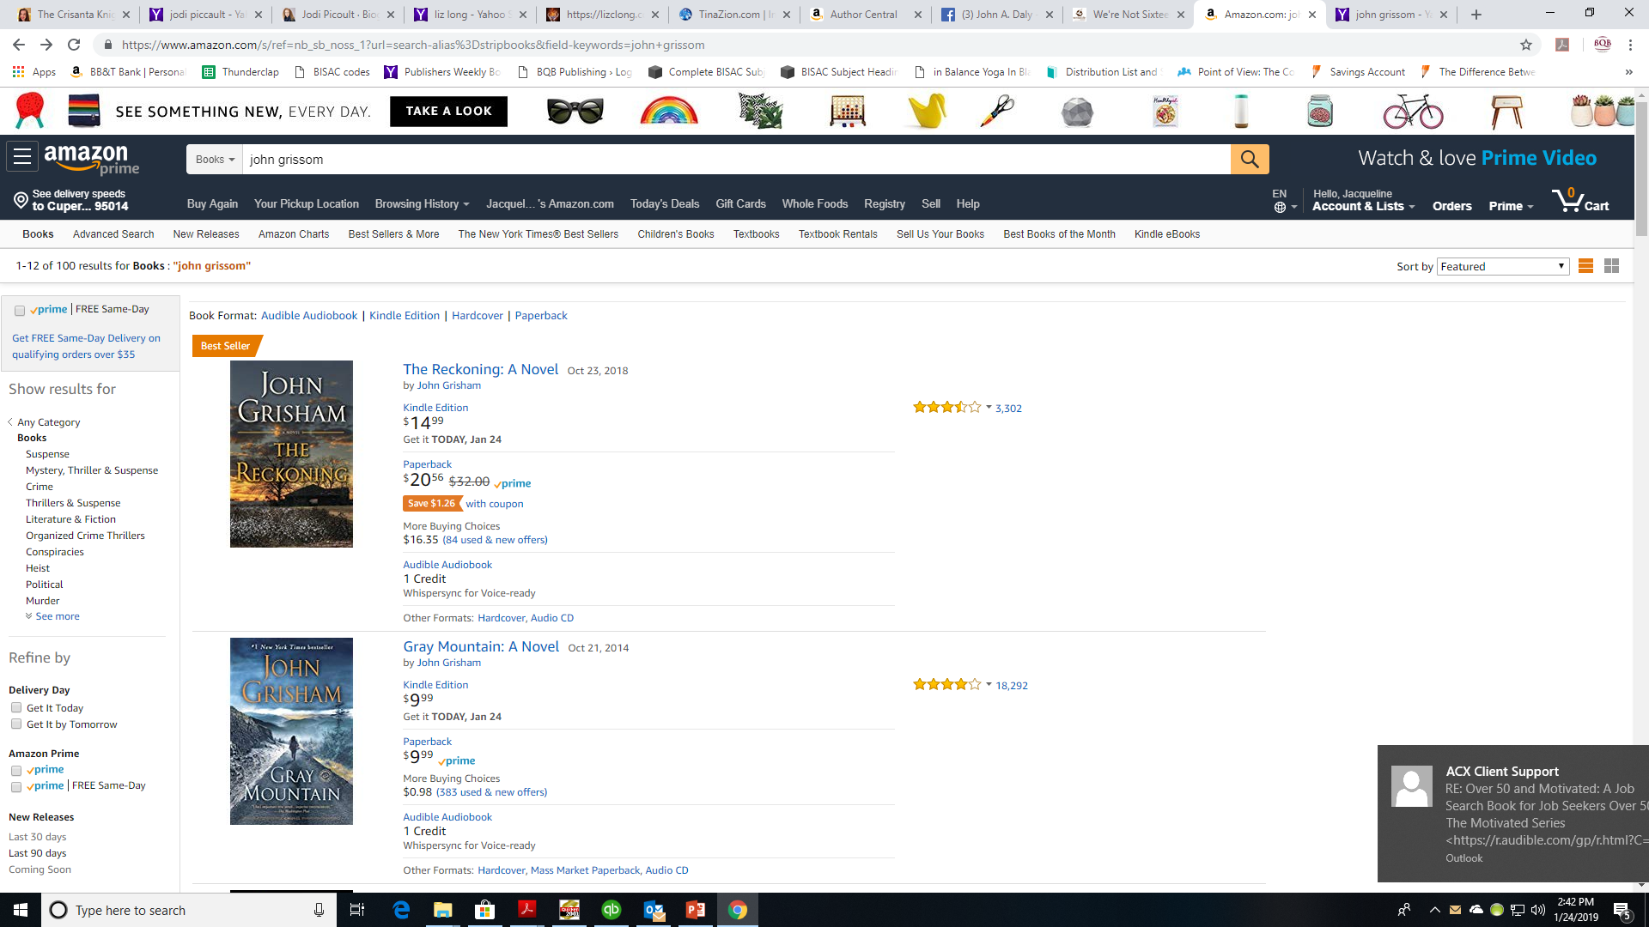

Slide 33
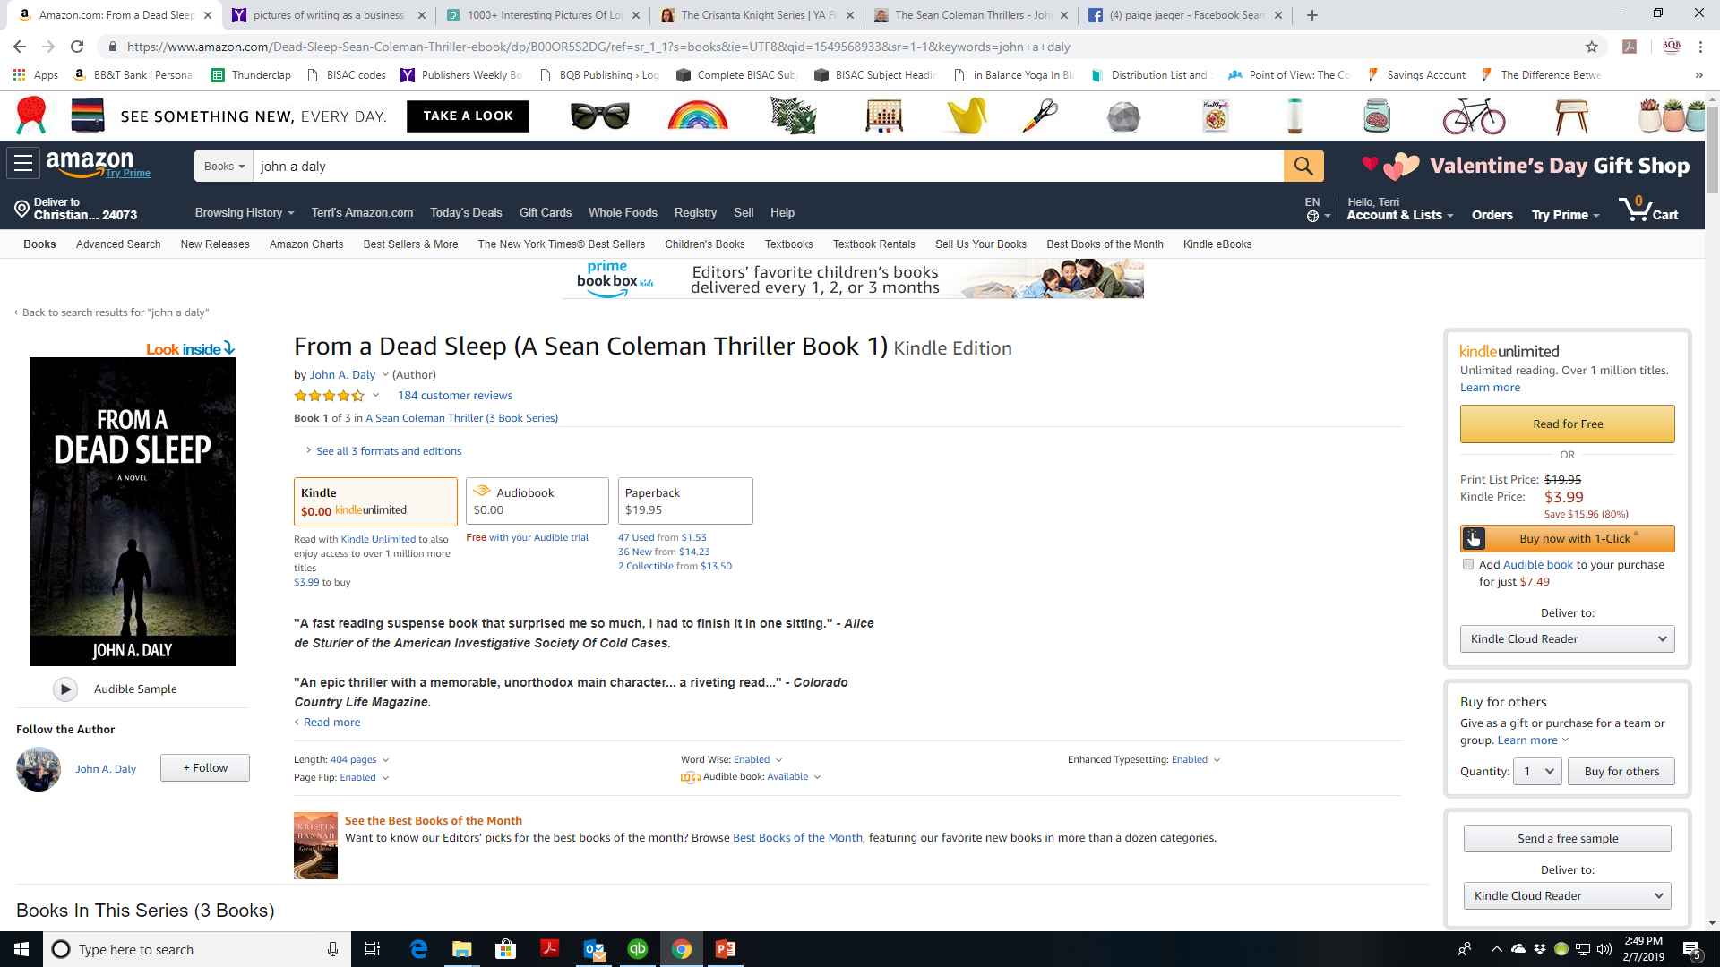

Slide 34
Learn Your Business Strengths
Make an honest assessment of your strengths:
Website Creation
Social Media
Appearances
Speaking Engagements
And put those strengths to use when you create and execute your marketing plan.

Slide 35
Businesses Need Help; Hobbies Don’t
You need others for:
Website
If you are not technically inclined or visually creative, you need help
Social Media
If you’re not going to do it, you’ll need someone to do it for you because it’s gotta be done in today’s world
Other areas – be honest with what you’ll need help with
For a hobby – you do the best you can and don’t worry about the results

Slide 36
The Results of the Two Approaches
Approaching as a business
You’ll become known as an author
You could create other opportunities such as speaking
You’ll earn royalties – maybe not right away but if you continue to invest time and money – results will come
Remember NYT bestselling books are the ones that are strongly marketed
Your publisher will be willing to publish other books by you and work with you long term to become successful

Slide 37
The Results of the Two Approaches
Approaching as a hobby
You are published but will probably not become known beyond your family and friends
You probably won’t expose yourself to other opportunities
If you receive royalties, they will be because of your publisher’s efforts and won’t be enhanced by what you do
You risk being dropped by your publisher when having your books in the marketplace costs more money than it makes.

Slide 38
Thanks for joining us!
Have a great weekend!
Bqbpublishing.com
Writelife.com

