Slide 1

What We Do To Market and Sell Your Print Books and How You Can Tag on to Those Efforts
Welcome!
Saturday, January 18, 2020
Noon - ET

Slide 2
Print Distribution – What We Do
IPG
Our print book distributor
They sell to
Amazon
Wholesalers (Ingram, Baker & Taylor)
Bookstores (indie bookstores and large entities like B&N)
Retailers (Target, Walmart)
Libraries
Online book sellers
Etc.
We keep print inventory with them
They have both inhouse and field sales reps who present our books two seasons a year
Spring/Summer (March – August)
Fall/Winter (September – February)
I present our books to them twice a year (May/November) and am presenting 6-8 months before the book releases.
The cover and metadata of your book will begin appearing online at places like Amazon, Barnes & Noble, etc. around 6-8 months before its release.

Slide 3
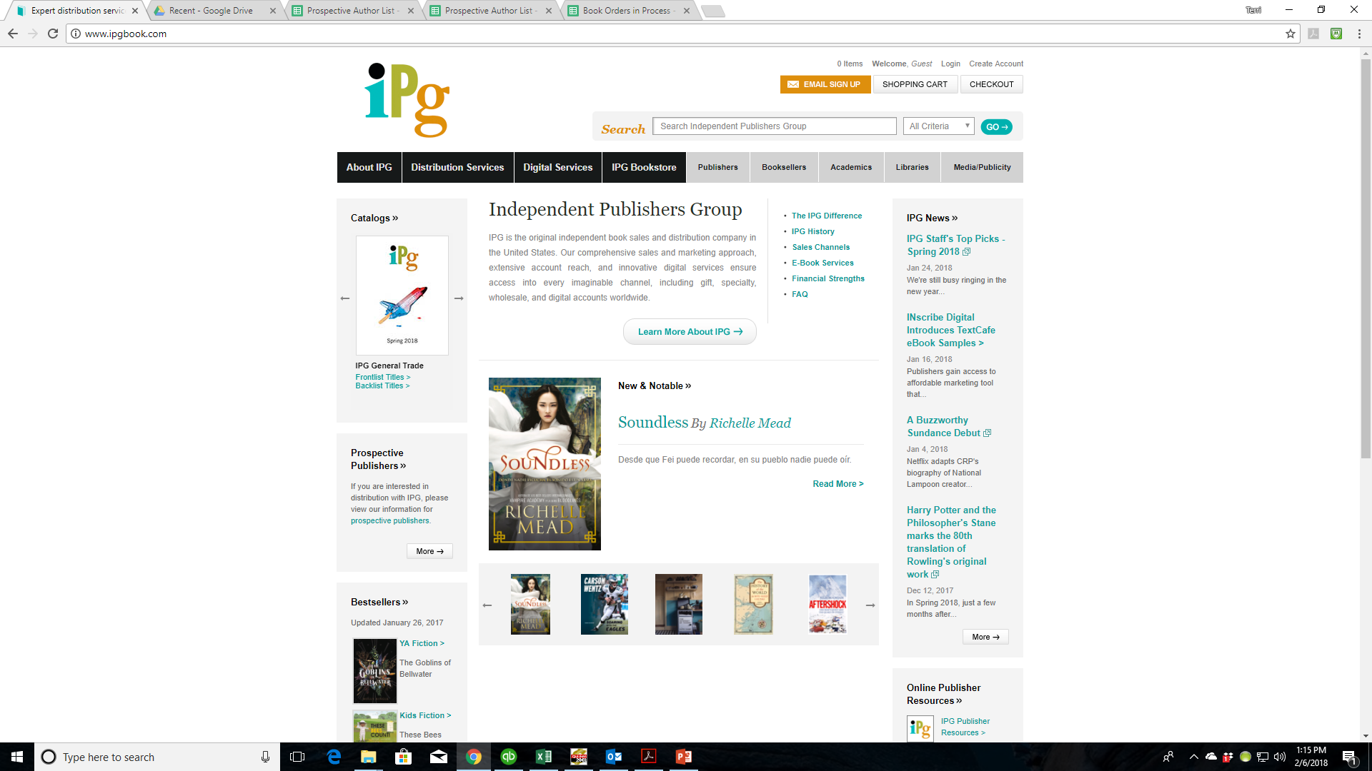

Slide 4
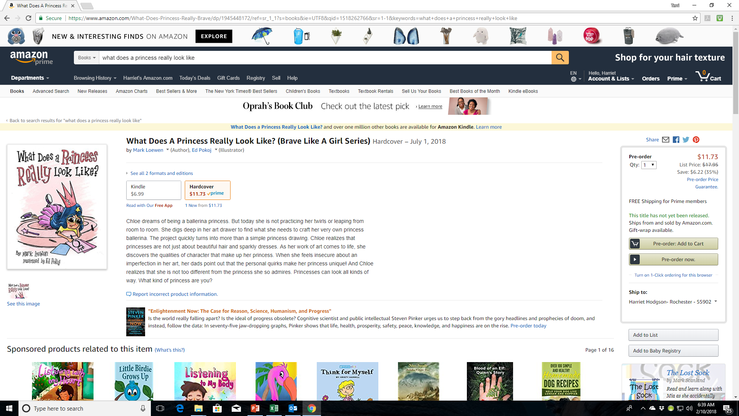

Slide 5
Print Distribution – What You Can Do
Let retailers know your print books are available through IPG (Independent Publisher’s Group www.ipgbook.com)
Have links on your website and social media that readers can click on to go directly to booksellers. (Julie can provide you with a list of links)
Watch your metadata, etc. on the different websites and let Julie know if there are typos, etc. so we can get them fixed.
Set up book signings, readings, or speaking events with bookstores so they buy your books from IPG and its wholesalers, etc.
When you set up events, get that information to Julie on the form that can be found on our author portal so she can upload it to IPG
Build your author brand and promote your book to help drive business to bookstores, wholesalers, IPG
Amazon is a top buyers of our books so make sure your Amazon profile is set up as soon as your book appears on their site and update it from time to time
Consider working with BQB/WriteLife on Amazon sponsored ads to continue to generate interest for your book(s) – Julie or Terri can provide more information on that.

Slide 6
Print Representation to U.K Bookstores - What We Do
Every couple of months, Julie can travel to London or to the larger cities in the U.K on an author’s behalf to represent the author and market their books to bookstores.
Julie will:
Identify up to 10 bookstores that will be interested in your book
Reach out to the bookstores to arrange a meeting
Travel to the store and hand them a copy of your book and them through the press kit
Ensure they understand where they can order your book from
Check in with them to see if they require further information

Slide 7
Print Representation to U.K Bookstores - What You Can Do
Email Julie – julie@bqbpublishing.com and let her know you are interested in this option.
You will cover Julie’s expenses for this service. The cost varies depending on how many books you would like her to take and how many bookstores you want her to visit.
Work with Julie to provide her with any information she needs.
Use your social media to promote the fact that Julie is doing this and what bookstores she is visiting.
Tag Julie, IPG, BQB or WriteLife, and the bookstores in your social media.

Slide 8
ARCs (Advance Review Copies)
About six months before your book releases, we create an ARC (Advance Review Copy) of it.
The cover has a banner that says “Not For Sale . Uncorrected Proof - Advance Reading Copy”
The back cover contains the book blurb as well as an overview of the marketing campaign for your book
IPG sales reps have access to the ARCs to use for their sales purposes
About 3-4 months before release, we send ARCs to top reviewers such as:
Publisher’s Weekly
Kirkus
Library Journal
School Library Journal
Horn Book Magazine
BookList
Etc. (We choose different options for each book depending on the genre, age range, etc.)
A copy of the ARC is sent to the author and ARCs are made available for purchase by the author for your marketing and early review efforts

Slide 9
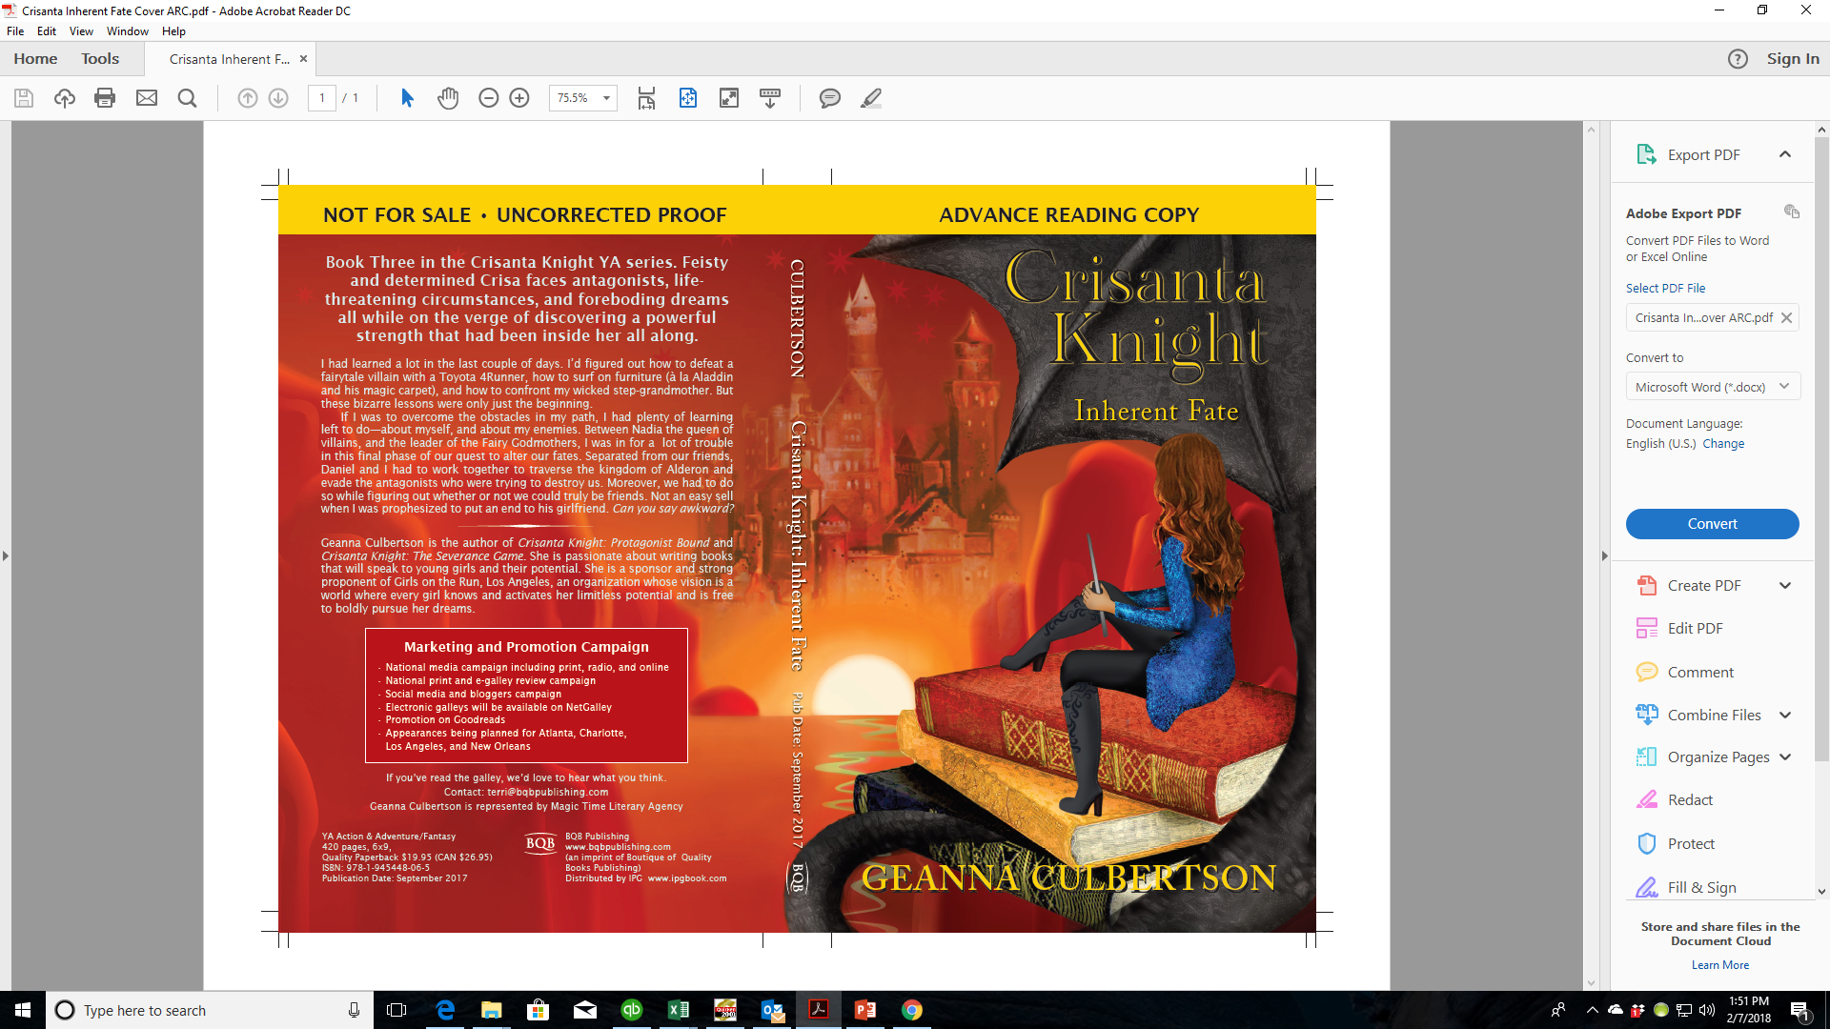

Slide 10
ARCs– What You Can Do
Create your own review list of entities and people of influence that you can send ARCs to.
When you get your copy of your ARC, let Terri know how many ARCs you want to order and use them to gain reviews and influence for your upcoming title.
ARCs can be used for obtaining reviews from influencers.
Provide local bookstores with copies of your ARC to get them interested in preordering your book for their store.
ARCs can be used at book shows to generate early interest in your book.

Slide 11
Reviews – What We Do With Them
When reviews come in, we use them in various ways:
Some are used for the front cover, back cover, or interior first few pages of your finished book
They are posted on our social media
We have a special section on our websites for reviews – the best ones are posted there
They are sent to IPG for the sales reps to use

Slide 12
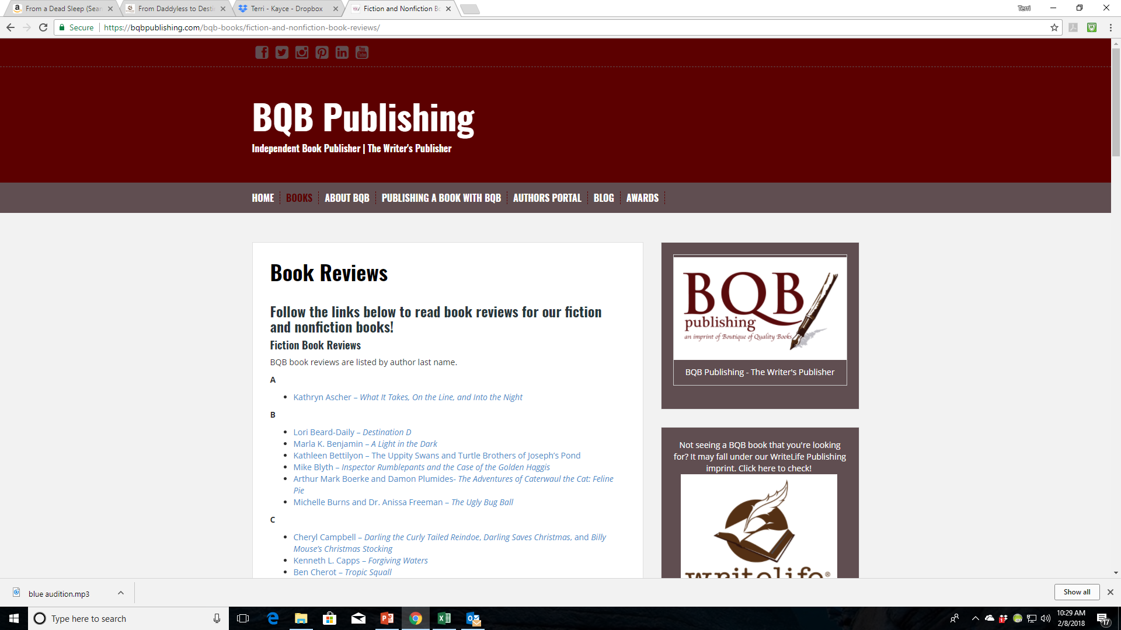

Slide 13
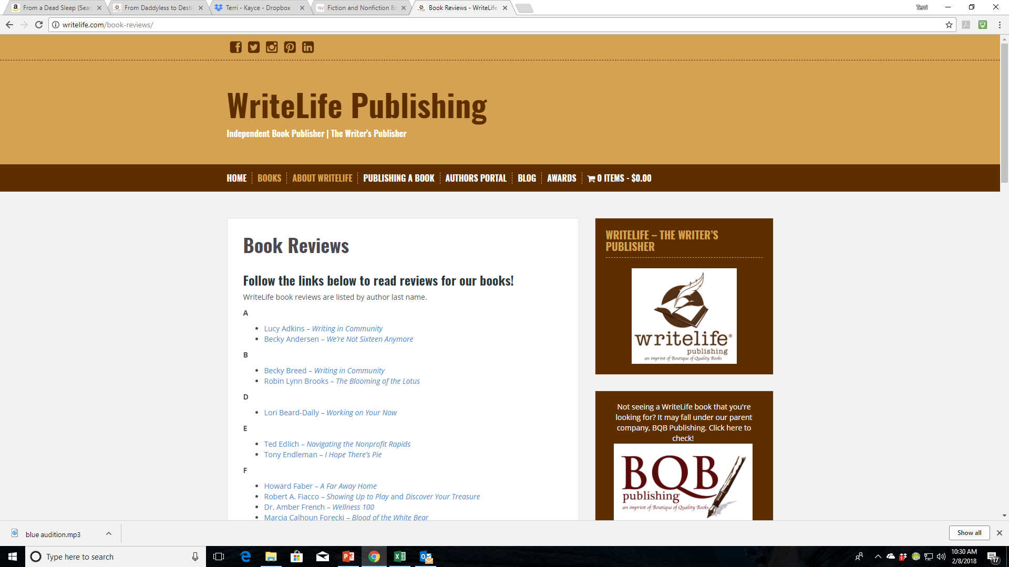

Slide 14
Reviews – What You Can Do With Them
Post them on:
Your Website
Goodreads
Your Blog
Facebook
Instagram
Twitter
YouTube
Post influencer reviews via your profile on Amazon under Editorial Reviews
For reviews in general:
Keep asking for them, even after your book is in the marketplace or has been for some time
A review posted on social media can retrigger interest in your book.
Reviews on your website can help trigger SEOs which get you listed in searches
Reviews on Amazon are important
People who buy in other places still look for reviews and author profile on Amazon
Reviews on Amazon impact the number of your books they stock and act in triggering the marketing features (people who bought this, bought these, etc.)
You need at least 10 reviews on Amazon for their algorithms to recognize your book
It takes 100 reviews on Amazon for all marketing features to kick in

Slide 15
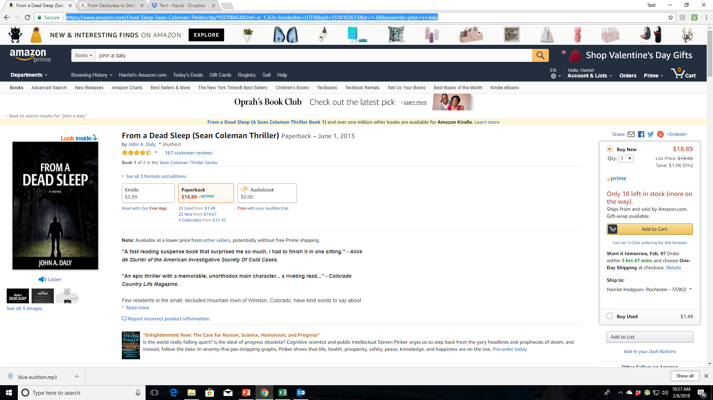
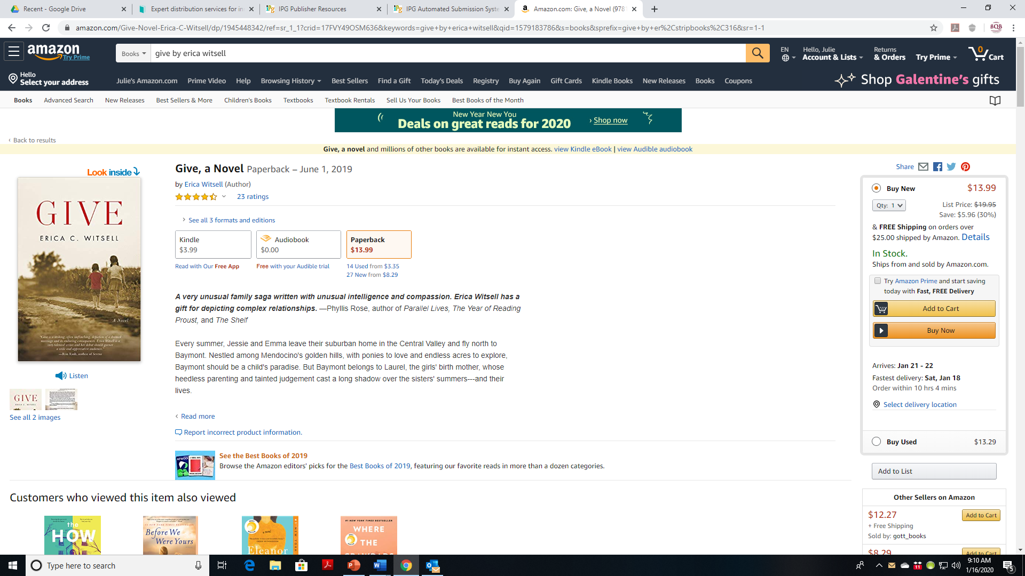
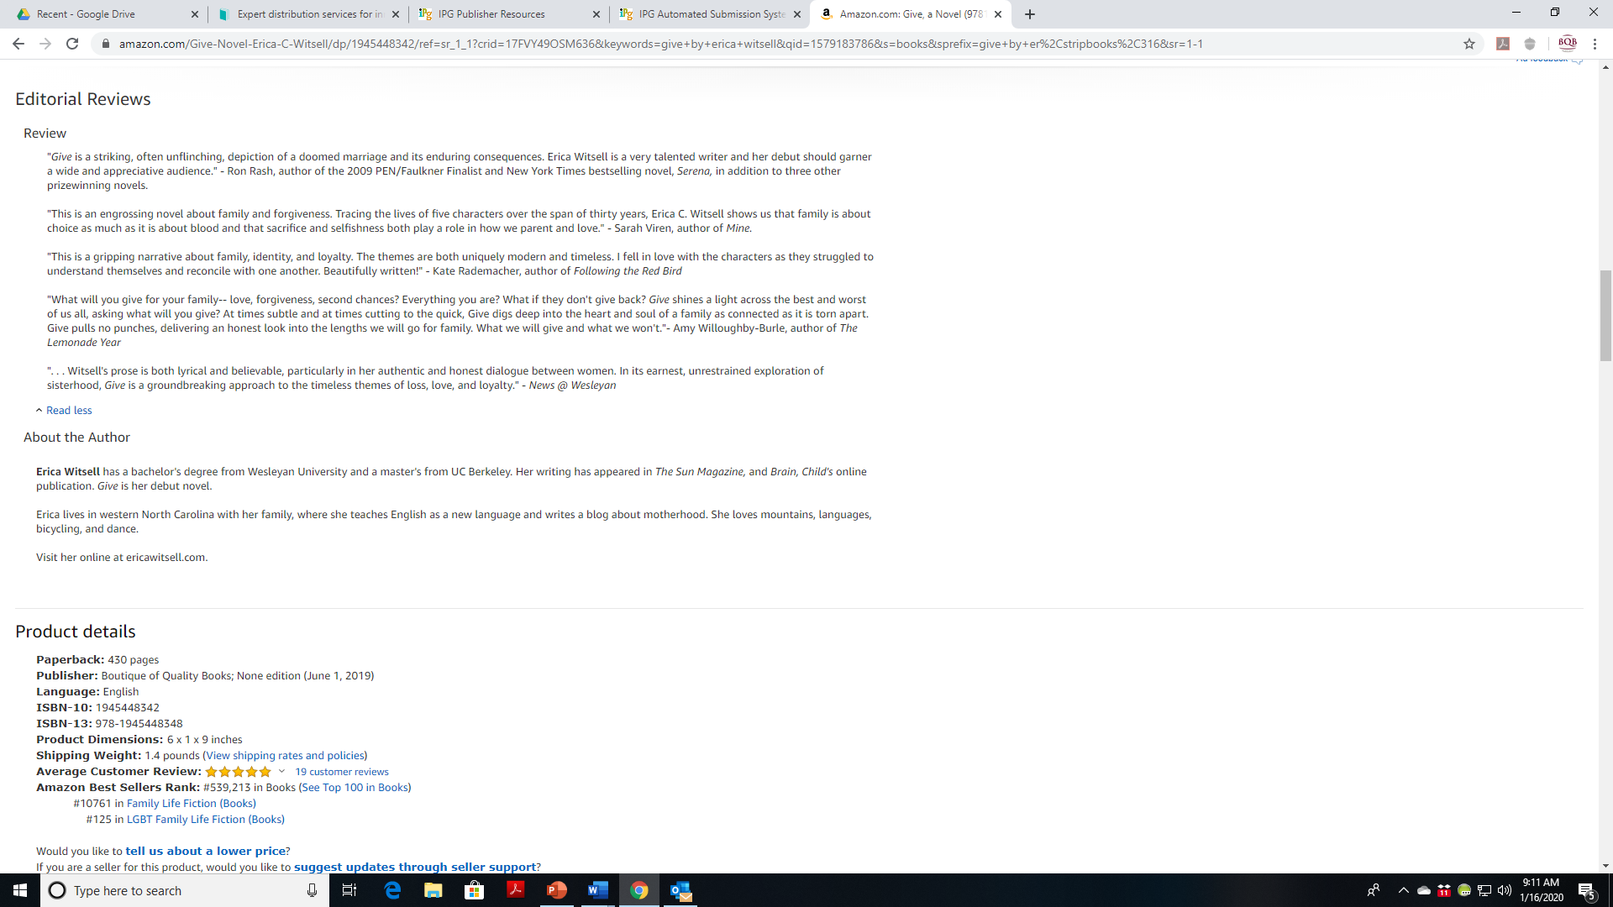

Slide 16
Social Media
Our Social Media Manager, John Daly, maintains social media accounts for both BQB and WriteLife on the following sites:
Facebook
Twitter
LinkedIn
Pinterest
Instagram
He creates posts for our books and authors on an ongoing basis and covers both new releases and back list titles.
John follows the majority of our authors and reposts, retweets, etc.
Julie and I follow BQB and WriteLife and repost and some of our followers repost as well
This is how we continue to get a larger following to you, your book(s), and your events
We have a BQB/WriteLife group on Facebook where our authors can interact with each other, ask questions, etc.

Slide 17
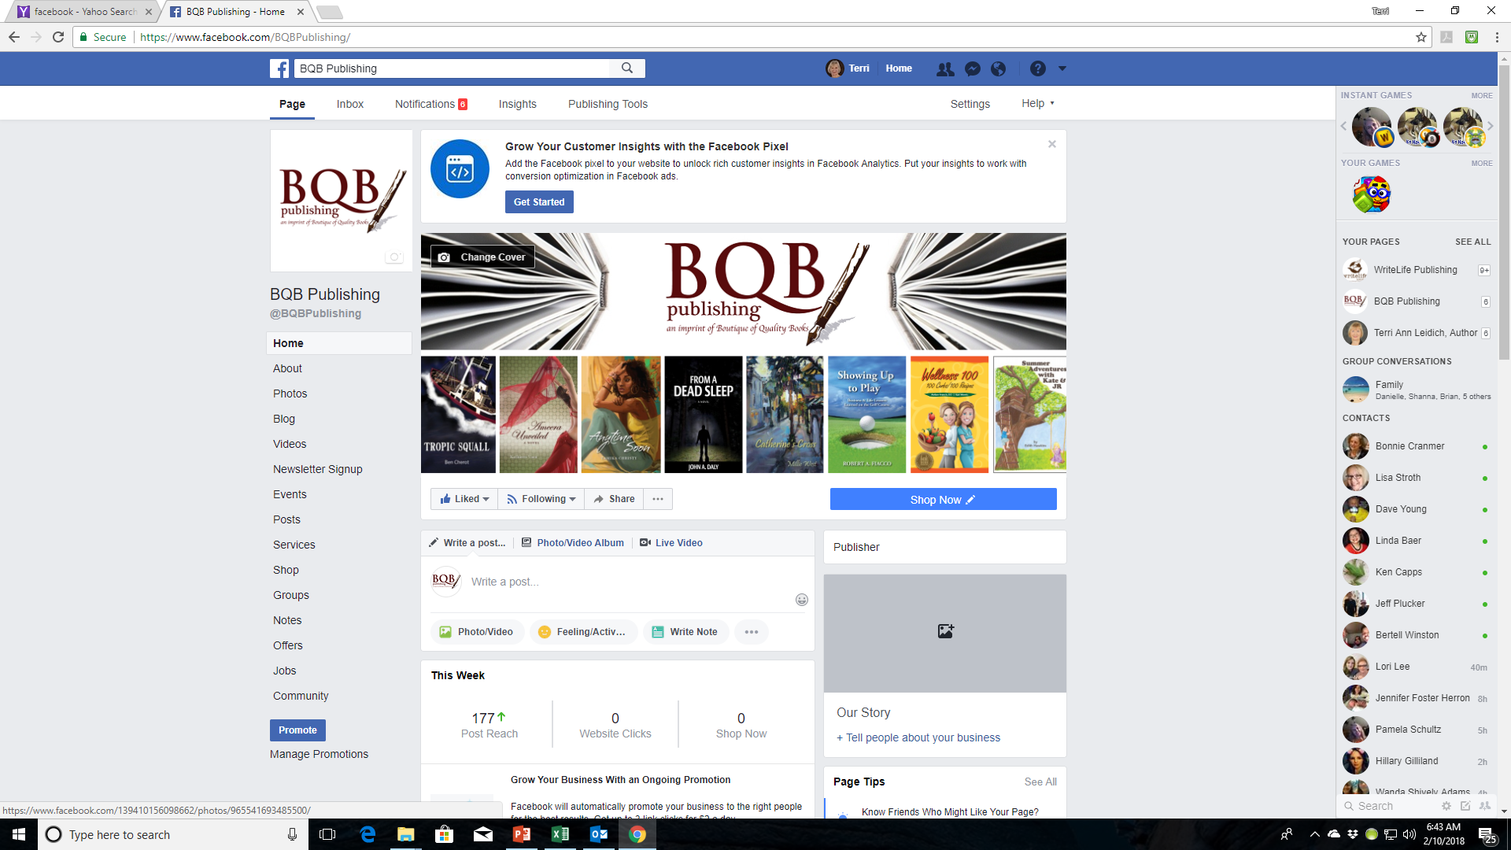

Slide 18
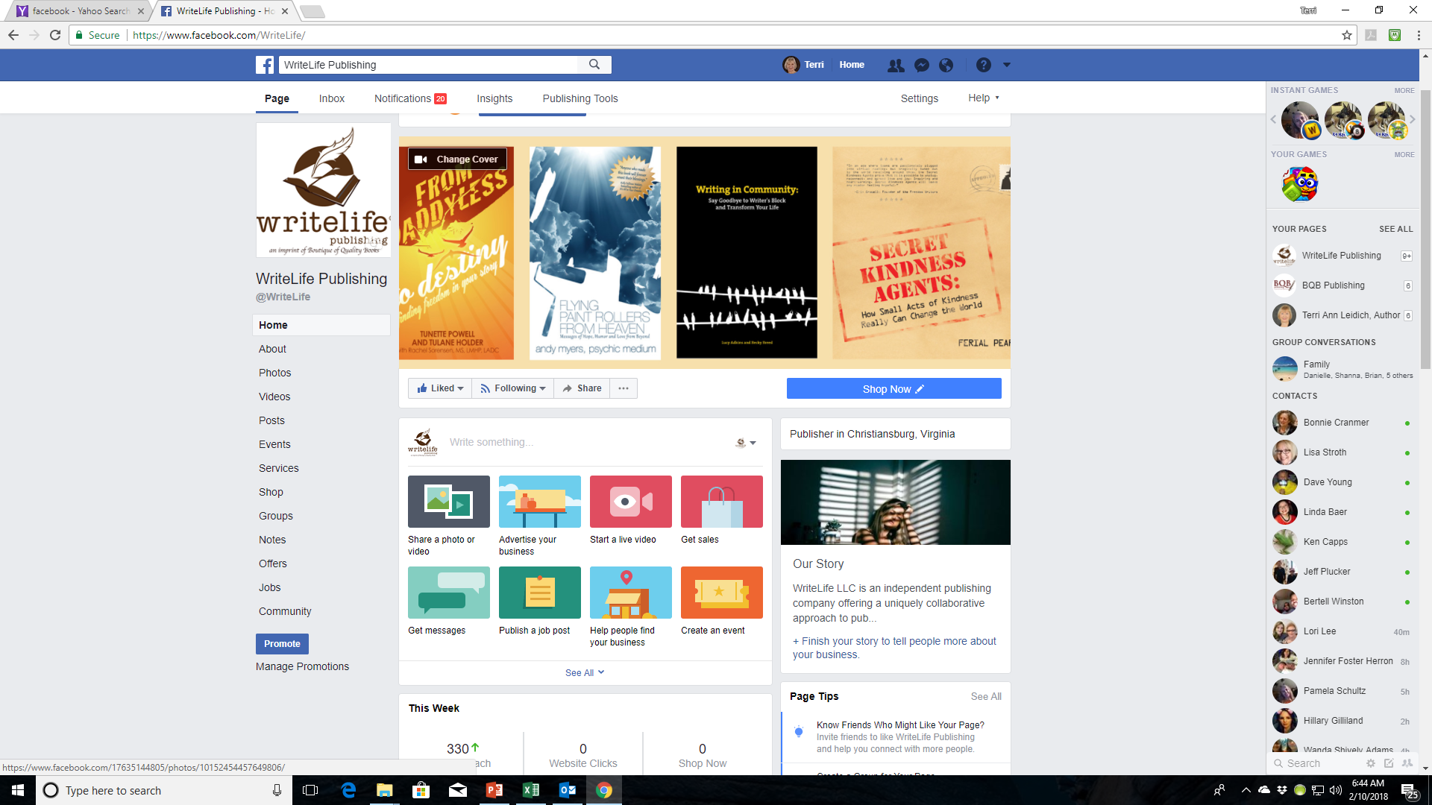

Slide 19
Social Media –What You Can Do
Make sure you follow both BQB and WriteLife on the following sites:
Facebook
Twitter
LinkedIn
Pinterest
Instagram
Repost, retweet, etc.
If it’s about an event, a story about your or your book, or a review, tag IPG (on Facebook and Instagram @IPGBook) on Twitter @IPGbooknews
Follow your fellow BQB/WriteLife authors and ask them to do the same for you
Make sure John has information on your events, your reviews, any appearances, publicity, etc. so he can put the info out on social media
Join the BQB/WriteLife group on Facebook where you can interact with each other, ask questions, etc.
To join the group on Facebook. Search groups for BQB/WriteLife Author Group and submit a request to join.
If you are a BQB/WriteLife author, John will accept your request and you can start interacting.

Slide 20
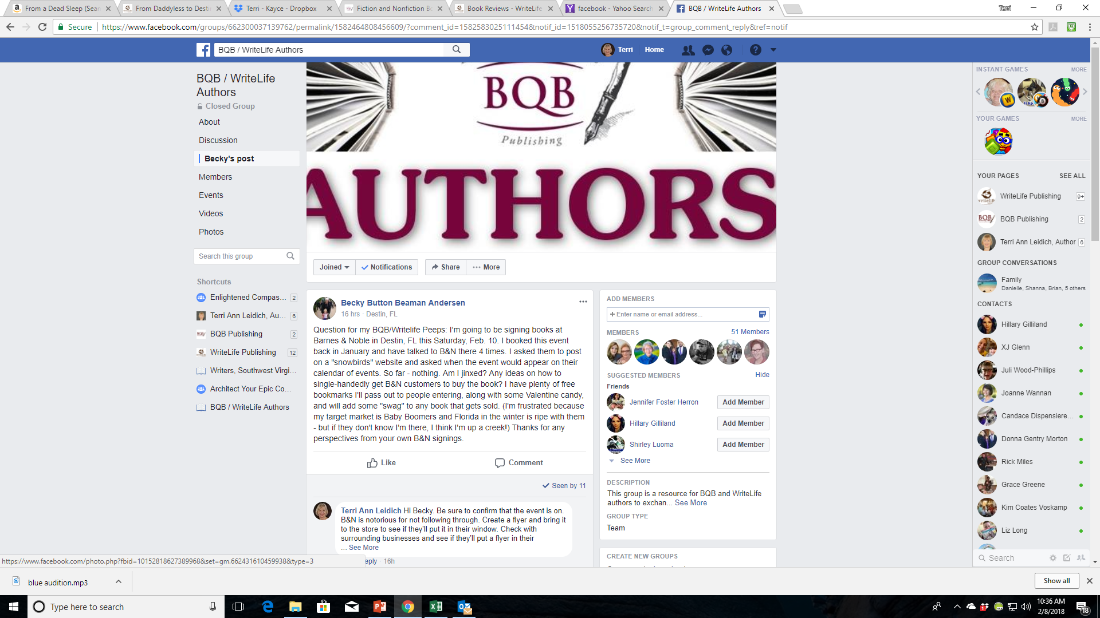

Slide 21
Newsletters
Every month, BQB/WriteLife sends newsletter to:
Booksellers
BQB/WriteLife Customers
BQB Authors
WriteLife Authors
Influential Reviewers
In this newsletter Julie provides:
New release information
Breaking news
Awards, etc.
The customer newsletter is linked to our Facebook and when it appears, John reposts the info from BQB/WriteLife, plus I repost and so do many of my followers.

Slide 22

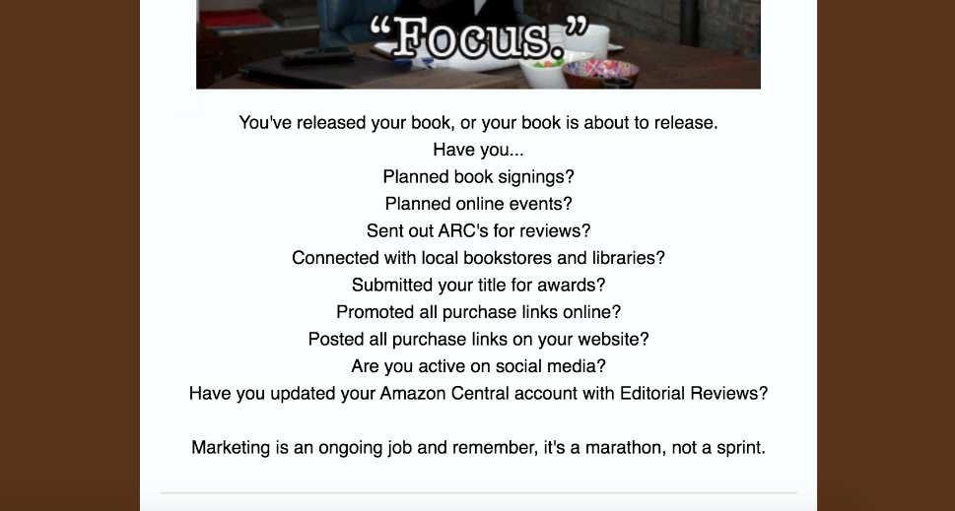
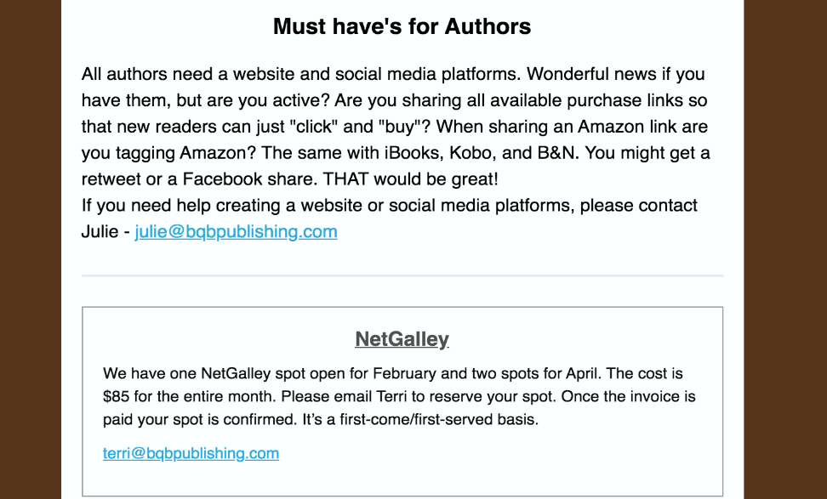
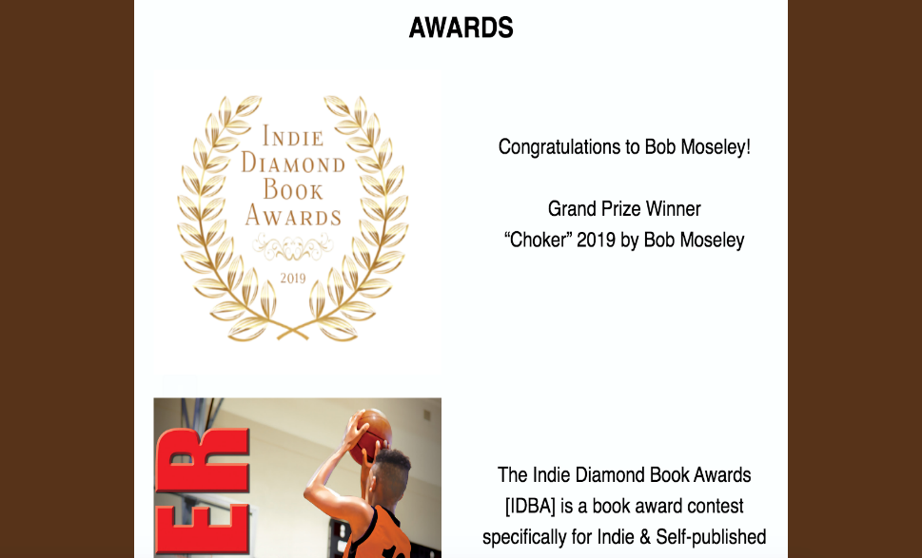
Examples from our Author Newsletter

Slide 23
Newsletter – What You Can Do
The beginning of each month, send an email to Julie (julie@bqbpublishing.com) with the following:
Awards you’ve won
Events you’ll be doing (using the event form)
Anything else that is newsworthy about you and/or your book
Repost the newsletter info when it appears on your social media
Tell the bookstores you interact with and your fanbase about our newsletter and suggest they follow it.
There are links in each newsletter that will take people to the spot where they can sign up.

Slide 24
Promotions Through IPG
Twice a month,I get a newsletter from both IPG and Inscribe describing the most recent promotion options including:
Advertising
Promotions
Publicity call outs
Award program announcements
Many of them, we just handle on this end. For others, we send out emails to either all authors, a group of authors, or a specific author
Most of the print promotion opportunities are for front list titles (those that are releasing in the current year).
We keep authors informed of marketing and promotion opportunities that you can tag into at a cost and you have the option to do so.
We continuously participate in marketing and advertising promotions that are a part of our budget.

Slide 25
Promotions Through IPG – What You Can Do
Watch for emails from BQB/WriteLife or specific emails to you from Terri or Julie and carefully consider the opportunity being offered. Then respond accordingly.
Make sure you have a yearly budget for your book(s) that will enable you to participate in these promotions.
When you become aware of promotions that are set up for your book(s), help spread the news.

Slide 26
Advertising and Marketing in General
We are continually changing and improving our inhouse marketing and the opportunities we provide to our authors.
We are expanding our marketing and advertising reach by taking advantage of opportunities from entities like Publishers Weekly, NetGalley, Amazon, etc. When we combine several books/authors together in a campaign, authors can participate at a much lower fee than if they tried these promotions on their own.
Teaching each of you, our authors, how to market is a big part of what we do to help you succeed. We will continue to look at additional ways to do that.

Slide 27
Advertising and Marketing– What You Can Do
Create a marketing budget each year so you can have time and resources to participate. The more you participate in marketing, the more your royalties will increase (both those that cost money and those that take time).
Watch for opportunities through BQB/WriteLife for advertising opportunities with NetGalley, PW Tip Sheet email, Bookseller Alliances, Amazon, etc.
Read the author newsletter year month because Julie communicates marketing opportunities in it.
Pay attention to group emails that come from Terri because that is the medium that she uses for communicating opportunities.

Slide 28
Book Shows
Each year, BQB/WriteLife either attends book shows or works with IPG or other entities to display our books and/or secure spots for our authors at them. Some of the shows we focus on are:
ABA Winter Institute
ALA Conferences
TLA (Texas Library Association)
BEA and BookCon
SIBA Fall conference
Other Independent Bookseller Association conferences if we have new releases in those areas

Slide 29
Book Shows – What You Can Do
Be open to the expense and time of attending or having your book represented if approached by Terri or Julie
Check out local book shows in your area or state
For speaking opportunities
For exhibit opportunities for you and your book or join with other authors to exhibit at some of the bigger, more expensive ones.
Become familiar with the Independent Bookseller Association for your region and stay on top of events they feature and how you could participate. The associations are:
PNBA (Pacific Northwest Booksellers Association) http://www.pnba.org
SCIBA (Southern California Indie Booksellers Association) http://www.scibabooks.org
GLIBA (Great Lakes Independent Bookseller Associaton) www.gliba.org
MIBA (Midwest Booksellers Association) http://midwestbooksellers.org
MPIBA (Mountains & Plains Indie Booksellers Assoc) http://www.mountainsplains.org
NCIBA (Northern California Indie Booksellers Association) http://www.nciba.com

Slide 30
Foreign Rights and Screen Play Options
BQB/WriteLife works with companies that specialize in Foreign Rights (publishing in other countries and/or languages) and Screen Rights (adapting your book for film or stage).
We create the opportunity for foreign publishers or filmmakers to learn about your book and preview portions of it to tweak their interest.
If offers come in, we field them and then discuss the options with the author whose book is of interest.
We handle the entire process but discuss offers with the author before accepting a contract.
These contracts are rare for us so far, but we continue to get the information in front of foreign publishers and have just begun to provide the information for appropriate books in front of filmmakers.

Slide 31
Foreign Rights and Screen Play Options – what you can do
Make sure your contract with us includes giving BQB/WriteLife those rights. If you have chosen not to include that option on your contract, your books cannot be included in those efforts.
If someone reaches out to you about foreign rights or film, let us know as we may be able to help solidify the deal or include the company or filmmaker in our communications.

Slide 32
Thanks for joining us!
Have a great weekend!
Bqbpublishing.com
Writelife.com

