Slide 1

What We Do To Market and Sell Your eBooks and How You Can Tag on to Those Efforts
Welcome!
Saturday, April 18, 2020
Noon - ET

Slide 2
eBook Distribution – What We Do
Inscribe
Our ebook distributor
They sell to eBook retailers all over the world
Amazon
Barnes & Noble
Kobo
iBookstore
Bookazine
Wheelers
Libraries via eBook retailers like OverDrive, Hoopla, Baker & Taylor, etc.
Over 100+ eBook retailers
We convert all print books we publish into eBooks and upload them to Inscribe
We pay yearly fees to keep your book active on Inscribe
We have access to 250 free eBook codes for each iBook we publish (email Julie if you wish to use some of these codes.

Slide 3
eBook Distribution – What We Do
Inscribe has a dedicated eBook marketing team that constantly works with eBook sellers on promotions and sales
Each month we receive a newsletter outlining the eBook sales campaigns that are occurring in the next few months, specifically with retailers like Amazon, Kobo, Apple, OverDrive, and Hoopla
We review the marketing opportunities, check our eBook marketing calendar and submit eBooks that are a good fit for the promotion
We market those opportunities through social media, etc.

Slide 4

Nominate for Kobo Nonfiction Price Promo Kobo Books CA - DUE THIS WEEK: Nonfiction Price Promo Price: $4.99 and under Kobo CA will be running a Nonfiction Price Promo, from March 12-16. This sale will focus exclusively on nonfiction titles, promotionally priced at $4.99 and under (excluding free). Dates: Mar 12-16, inclusive Kobo will be supporting the campaign as follows: Standalone email to CA on March 13 Carousel on the homepage leading to the sale LP for the duration of the sale Please assume that all titles submitted will be included in the sale, unless you hear otherwise from us. The latest date for submissions is End of Day, March 4th . DUE: 3/4 PRICE: FREE

Slide 5
eBook Distribution – What You Can Do
Let readers and fans know your eBooks are available through all major eBook sellers
Have links on your website and social media that readers can click on to go directly to booksellers. (Julie can provide you with a list of links)
Share purchase links on your newsletters and Blogs
Watch your metadata, etc. on the different websites and let Julie know if there are typos, etc. so we can get them fixed.
Work with John Daly and Julie to do Facebook Live events around your book to help drive business to eBook retailers
Build your author brand and promote your book to help drive business to bookstores, wholesalers, IPG
Amazon is a top eBook seller so make sure your Amazon profile is set up as soon as your book appears on their site and update it from time to time
Create marketing campaigns or virtual tours that can use the iBook store codes for your eBook(s)

Slide 6
How We Use Reviews to Market eBooks
We post them on social media with links to buy your books
We have a special section on our websites for reviews – the best ones are posted there. If one of your top reviews is not listed on the BQB or WriteLife website, contact John (Johndalybooks@hotmail.com)
Watch your metadata, etc. on the different websites and let Julie know if there are typos, etc. so we can get them fixed.

Slide 7
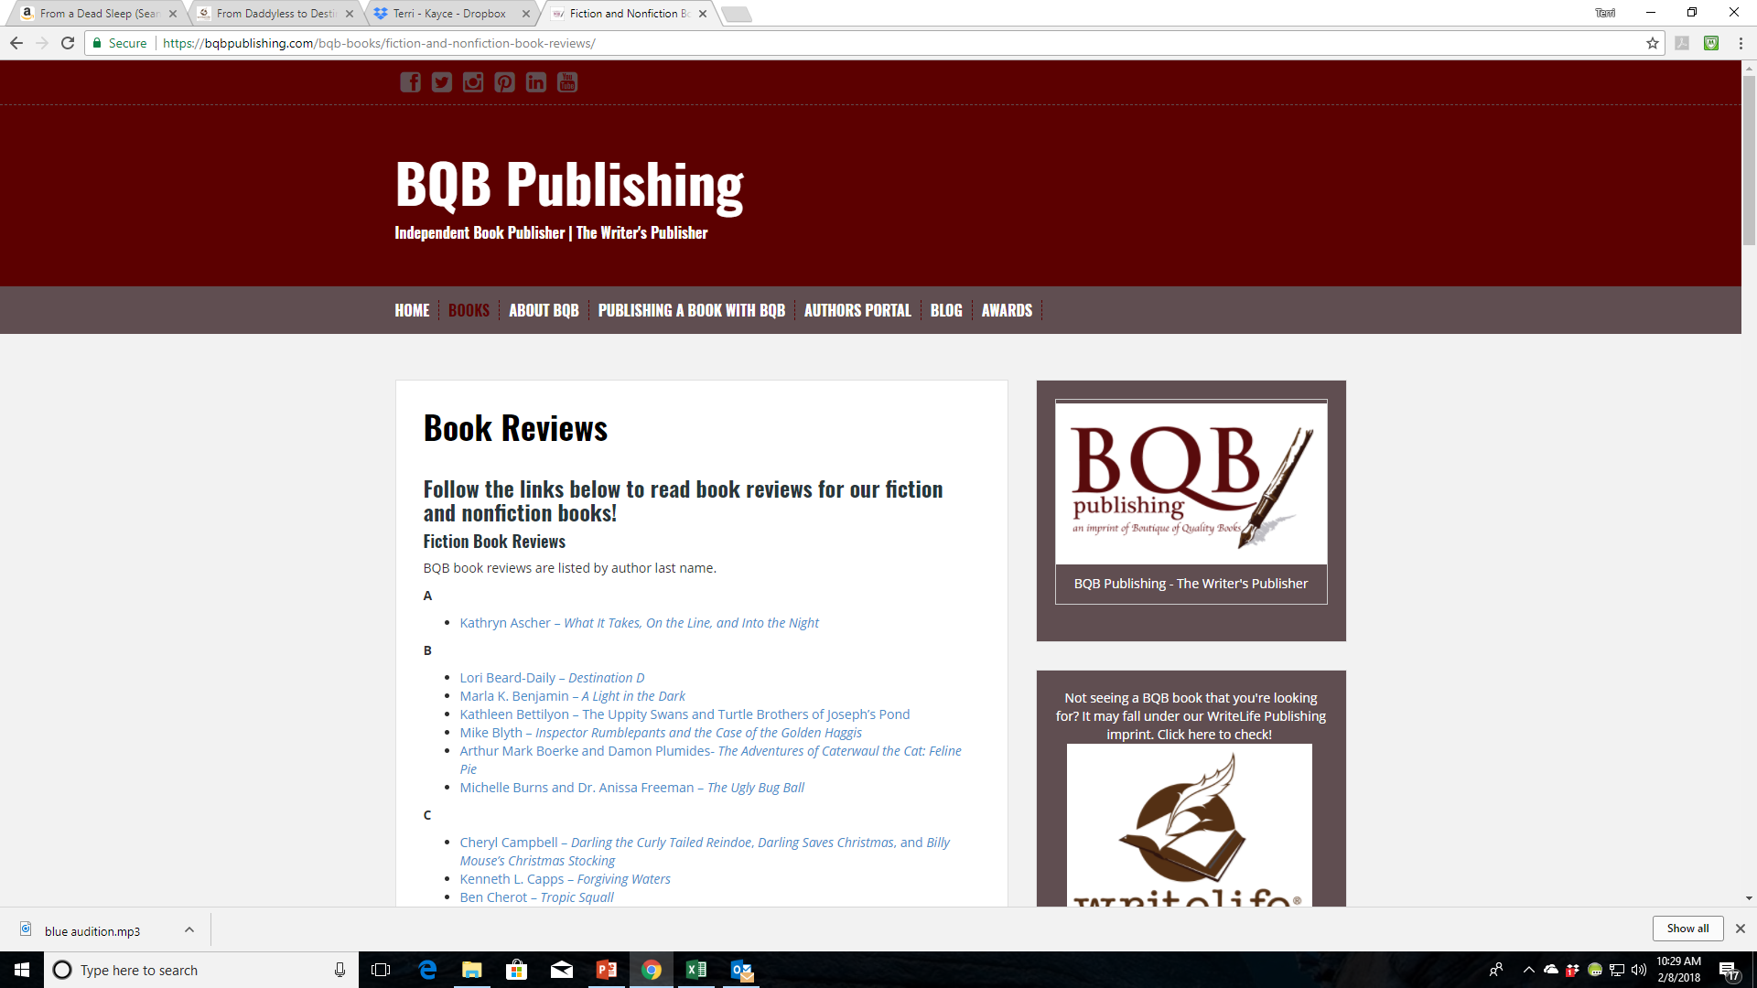

Slide 8
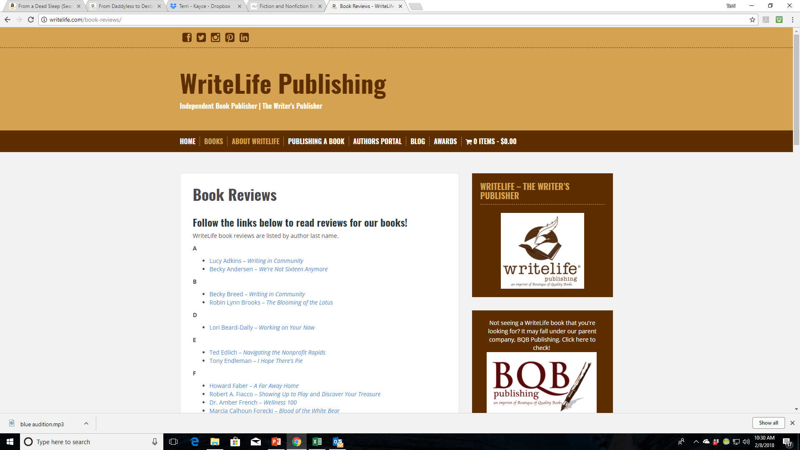

Slide 9
Using Reviews to Market Your eBooks
Post them on:
Your Website
Goodreads
Your Blog
Facebook
Twitter
Instagram
Twitter
YouTube
Newsletter
Blog
When you get a review from an influencer (even before your book is published), upload it via your Amazon Author Profile to the Editorial review section. Julie can assist you with this.
For reviews in general:
Keep asking for them, even after your book is in the marketplace or has been for some time
A review posted on social media can retrigger interest in your book
Reviews on your website can help trigger SEOs which get you listed in searches
Reviews on Amazon are important so encourage fans and followers to post a review on Amazon
People who buy in other places still look for reviews and author profiles on Amazon
Reviews on Amazon trigger other marketing features i.e., people who bought this also bought these

Slide 10
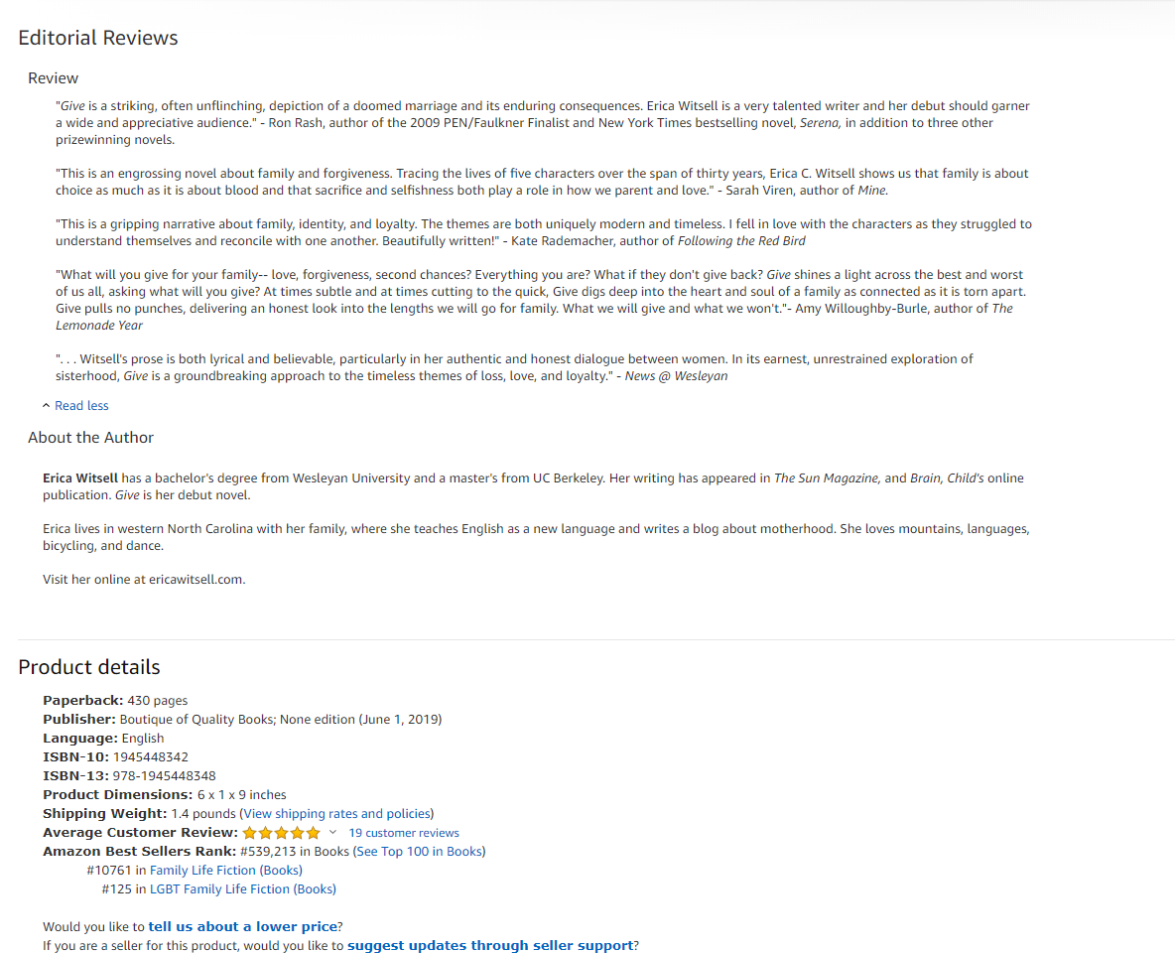

Slide 11
Social Media for marketing eBooks–What we do
Social media can be a strong marketing tool for eBooks
Our Social Media Manager, John Daly, maintains social media accounts for both BQB and WriteLife on the following sites:
Facebook
Twitter
LinkedIn
Pinterest
Instagram
He creates posts for our books and authors on an ongoing basis and covers both new releases and back list titles.
On many posts, John will include links for purchase
John follows the majority of our authors and reposts, retweets, etc.
Julie and I follow BQB and WriteLife and repost and some of our followers repost as well
This is how we continue to get a larger following to you, your book(s), and your events
We have a YouTube channel where John posts videos submitted by authors and videos from Facebook Live events we sponsor

Slide 12
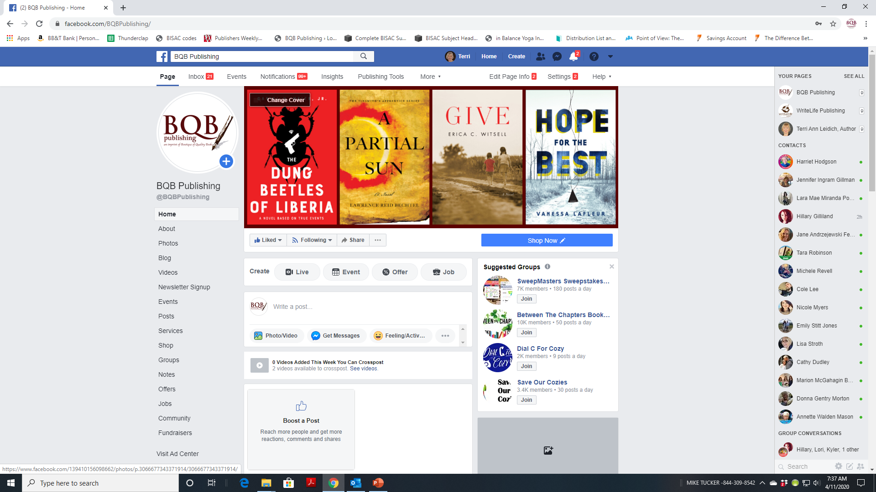

Slide 13
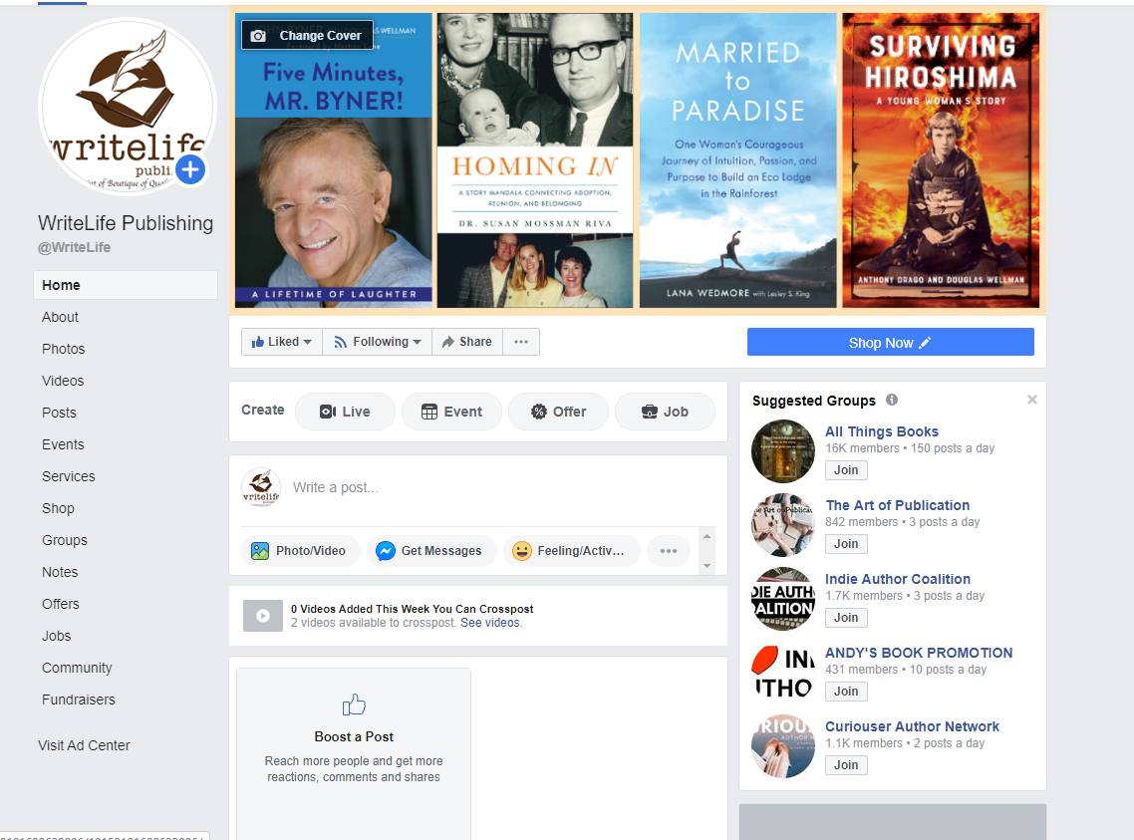

Slide 14
Social Media –What You Can Do for eBooks
Make sure you follow both BQB and WriteLife on the following sites:
Facebook
Twitter
LinkedIn
Pinterest
Instagram
Repost, retweet, etc.
If it’s about an event, a story about you or your book, or a review, tag IPG (on Facebook and Instagram @IPGBook) on Twitter @IPGbooknews
Follow your fellow BQB/WriteLife authors and ask them to do the same for you
Make sure John has information on your events, your reviews, any appearances, publicity, etc. so he can put the info out on social media
Join the BQB/WriteLife group on Facebook where you can interact with each other, ask questions, etc.
To join the group on Facebook. Search groups for BQB/WriteLife Author Group and submit a request to join.
If you are a BQB/WriteLife author, John will accept your request and you can start interacting.

Slide 15
Using BookBub (and similar programs) – They’re all About eBooks
There are several sites like BookBub, Free Booksie, etc. that have newsletters they send out on an ongoing basis to promote sales or giveaways of eBooks
BookBub is the most popular one
They sell ad space in their newsletters and publishers submit applications for the ad space
BQB/WriteLife sends submissions (on our own and through Inscribe) on an ongoing basis. When we are accepted, we run a promotion on the book either as a free eBook (if you have a series), a $.99 sale, or a $1.99 sale. The book and genre determine how we submit it
Ads in a newsletter like BookBub can really get attention to a book.
They have newsletters for the US market and for the International market (Canada, UK, Australia, India, etc.)

Slide 16
Using BookBub (and similar programs) – They’re all About eBooks- cont’d
The category and territory of the ad is determined by BookBub. On other sites, we have some input into that. Once an ad is offered to us, it is up to BQB/WriteLife to either accept or reject. We determine our response by what is offered and the price attached to it. If we feel we will recoup our investment, we say yes.
Prices on ads can run from as low as $40 to into the thousands depending on the genre category and the territory.
If we are successful in securing a BookBub, or similar ad, BQB/WriteLife pays for it and then the fee is put into the book royalty report for that particular author and BQB/WriteLife and the author split the fee and it goes against the royalties of the eBook sales.

Slide 17
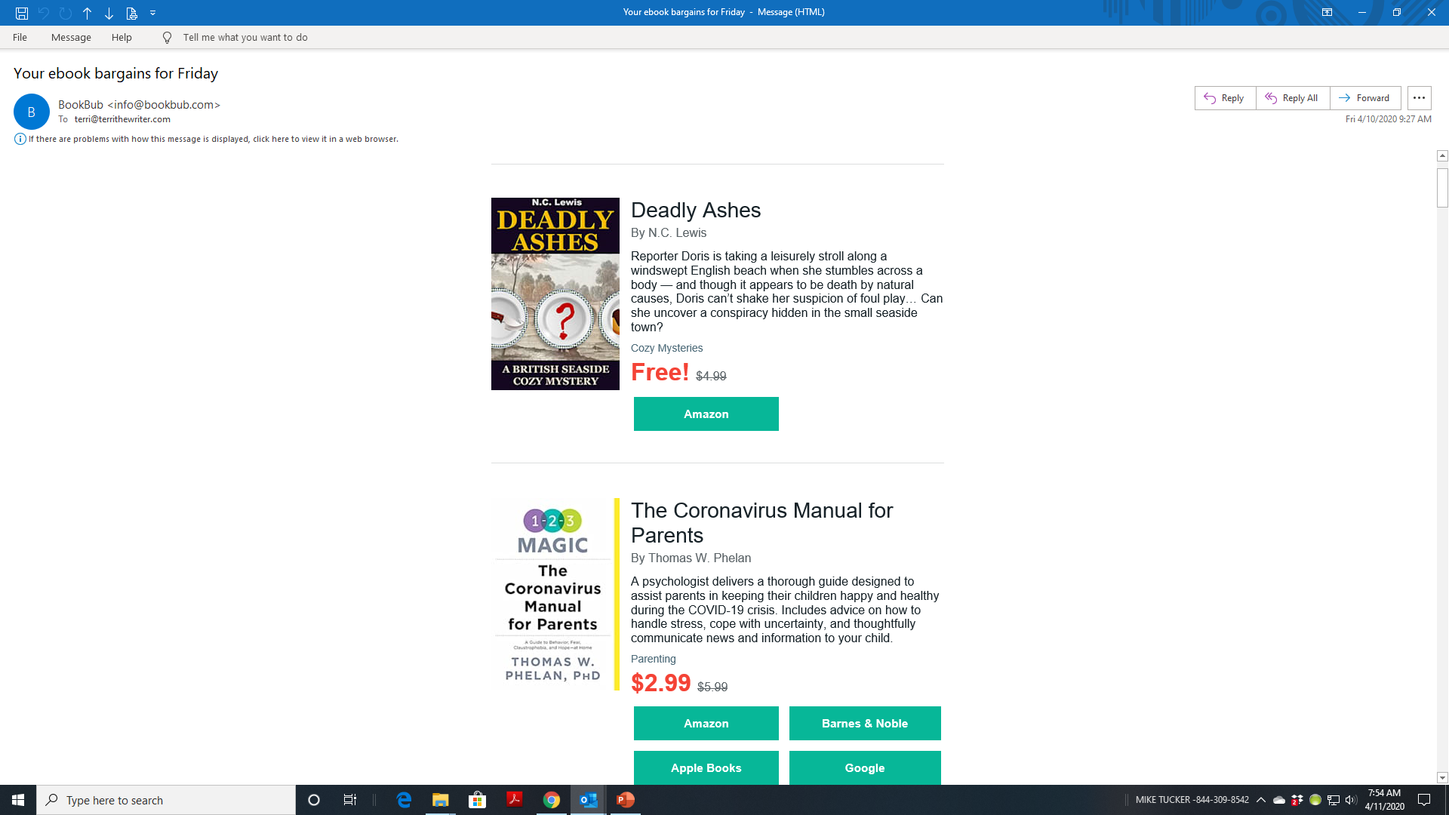

Slide 18
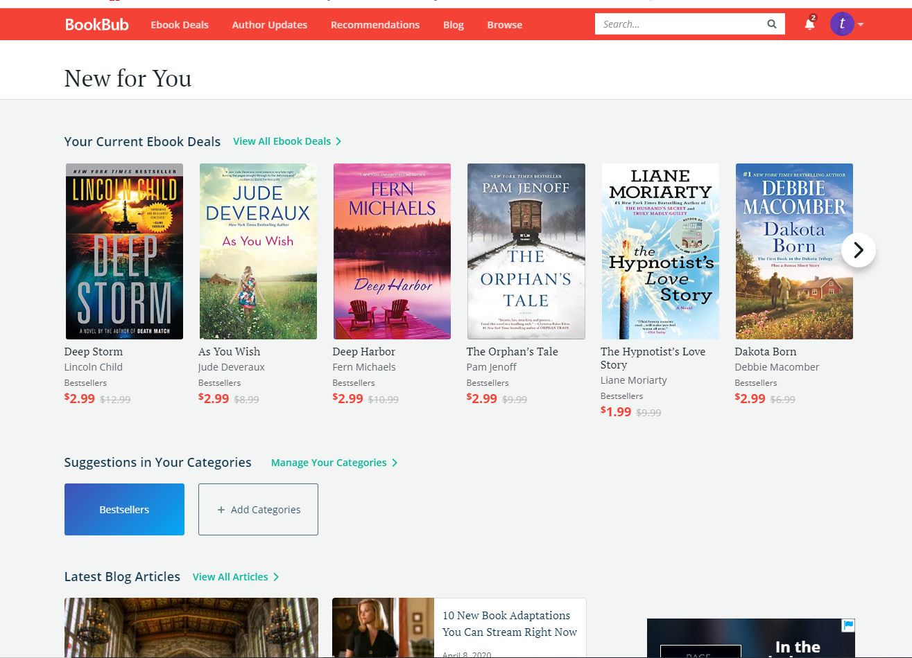

Slide 19
BookBub – What You Can Do
Register for BookBub (www.bookbub.com) as a reader so you are familiar with what they do and what books they feature.
Claim your author profile on BookBub
When you claim your author profile, you will have the opportunity for different marketing options.
When we get a BookBub (or other newsletter) ad for your book, we’ll let you know. When we do, promote it heavily on social media and retweet, repost, the social media posts from BQB and/or WriteLife
If you have an email list or newsletter, promote the special through those means.

Slide 20
NetGalley – What We Do
Keep a constant present on NetGalley, featuring 5 books a month
NetGalley is a site where bloggers, booksellers, librarians, etc. can go to discover and review new books
We post books on NetGalley the month before and the month of release. If a book is part of a series, we will also post any backlist titles that are part of the series
At the end of the month when a book has been on NetGalley, Julie will send a list to the authors of who has downloaded the book and any reviews that have been received.

Slide 21
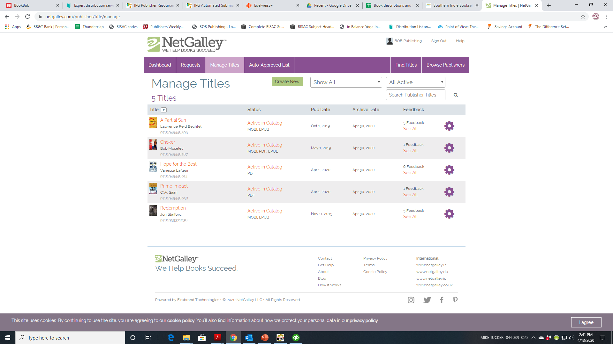

Slide 22
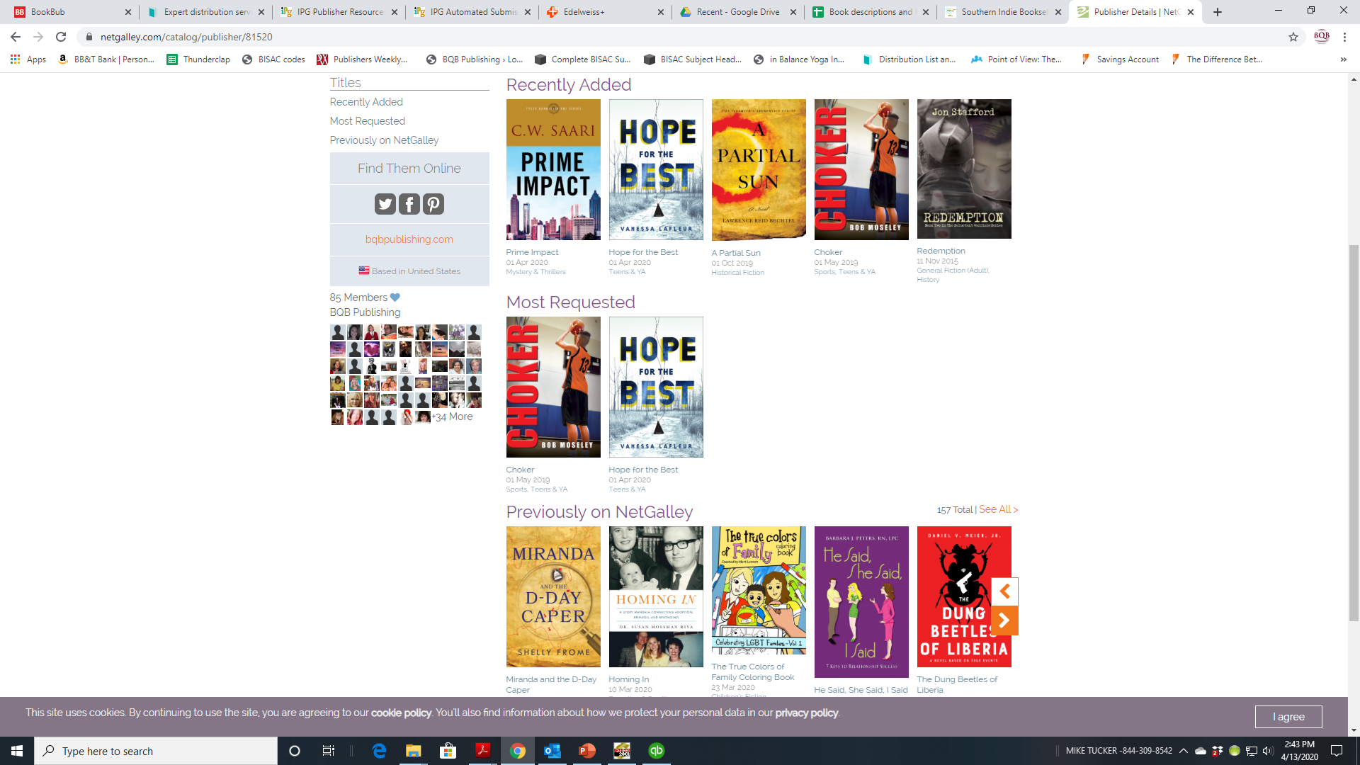

Slide 23
NetGalley – What You Can Do
Let booksellers, librarians, bloggers, etc. know when your book is on NetGalley so they can request to review it. Julie can provide you with a link.
We often have open spots that authors can have their books listed on NetGalley after the book has released or is a backlist title. The cost through us is $85 a month. If an author went directly to NetGalley, it would cost $450 per month for a listing.

Slide 24
Newsletter – What We Do
Julie creates and send three newsletters a month – 1) BQB/WriteLife Authors 2) Customers who have signed up for our newsletter 3) Booksellers
Each newsletter is created for the target market and provides information that is pertinent to that group.
For customers and booksellers, we announce new releases, awards, etc. to keep them informed about our books and authors.

Slide 25
Newsletter – What You Can Do
Create an author newsletter. It is one of the most powerful marketing tools you can use as an author.
You’re a writer. Creating a newsletter should be right in your skillset.
Author newsletters can be used to build fans and keep followers up-to-date on what’s happening with you and your book.

Slide 26
Thanks for joining us!
Have a great weekend!
Bqbpublishing.com
Writelife.com

