Slide 1
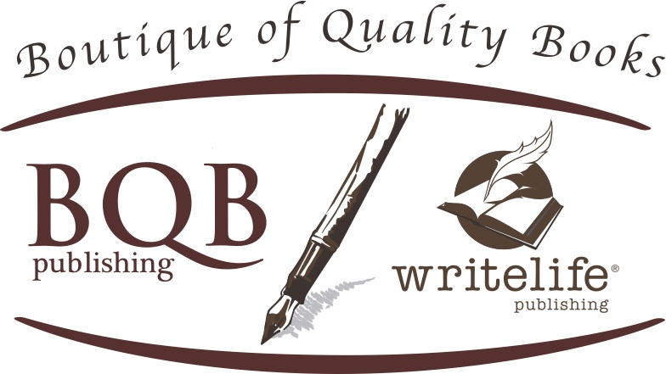
Everything You Need to Know About Audiobooks – From Creation to Marketing
Welcome!
Saturday, July 11, 2020
Noon - ET

Slide 2
Audiobook Creation
We use ACX as our major creator and distributor of audiobooks
They have a wide range of narrators
They sell to the three top audiobook retailers
  Amazon
  Apple
  Audible
They have a good quality check program

Slide 3
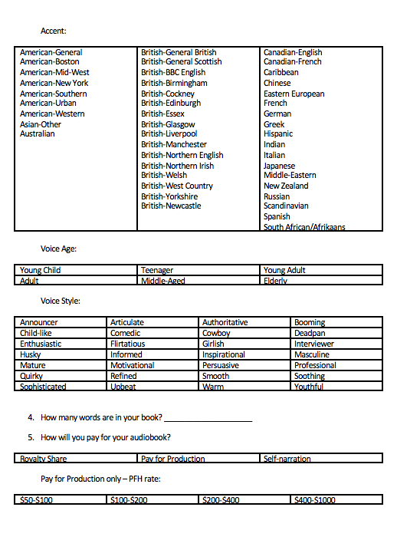
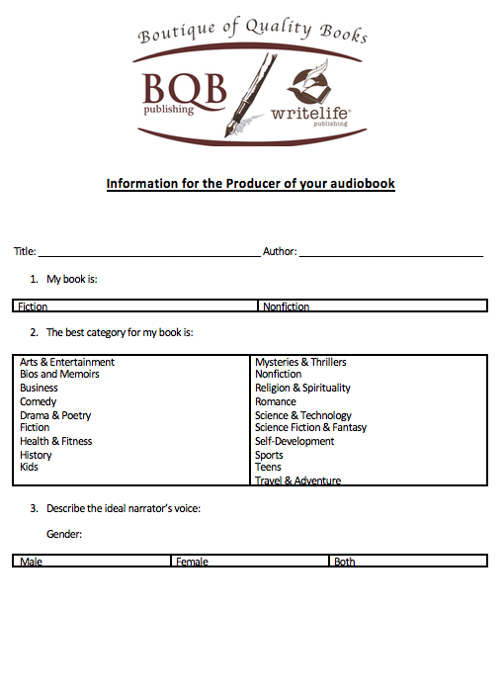
You are involved through the whole process
Before the audition script is posted, you decide on the type of producer you want to audition for your book.

Slide 4
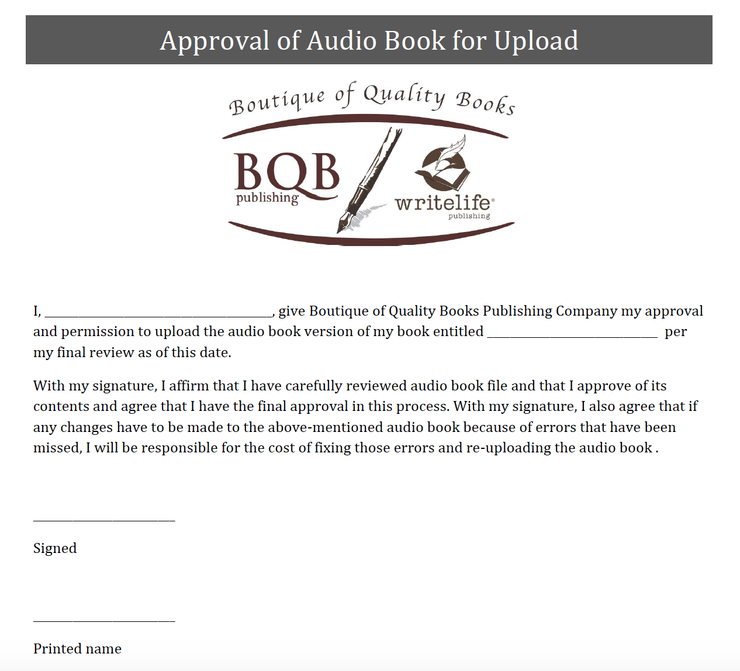
You Sign Off On The Final Audio
You will listen to every chapter and when you are happy, you will sign off on the project.
Remember, you only pay per finished hour, there is no need to rush this process.
Communication is the key to creating the perfect audiobook.
If you’re not happy with how the narrator say’s something, they will change it.

Slide 5
Audiobook Creation
When creating an audiobook through us, you have three options:
1. Pay for Production
    You work with Julie and she will help find a narrator through ACX who will narrate and produce your audiobooks.
    You will pay the per finish hour rate which can run from $100 to $300+ for a finished hour of narration. The pfh rate will depend on the narrator you choose. There are typically 9300 words in one finished hour of narration. Julie can help you estimate the final cost.
    You work with Julie and the narrator to get the final product we all want.
    You pay once the work is finished.
    When the narration is done, Julie uploads the files to ACX for a quality check.
    When ACX approves the product, they automatically upload the finished audiobook to Amazon, Apple, and Audible.
    ACX sets the price of the audiobook, we do not.
    All contracts with ACX are for seven years and automatically renew from that point unless we decide not to.
    The contract with ACX is set up as a nonexclusive so that we can also upload the files to Findaway, our audiobook distributor that sells to libraries, schools, Overdrive, Kobo, Libro.fm and a myriad of other audiobook retailers.
    You receive the royalty from us that is designated in your contract.

Slide 6
Audiobook Creation
  2. DIY (Do it Yourself)
    If you choose to do the narration yourself, let Julie know and she will send you the file specifications that we will need the audiobook created in.
    You find a local studio who can work with you to record the book and then edit and clean up the MP3 files before sending them to us.
    When the files are done, you will upload them to a dropbox folder that Julie will provide.
    Once Julie has the files, she will upload them to ACX for their quality check.
    When the quality check is completed and approved, ACX will automatically upload your audiobook to Amazon, Audible, and Apple.
    ACX sets the price of the audiobook, we do not.
    The contract with ACX is set up as a nonexclusive so that we can also upload the files to Findaway, our audiobook distributor that sells to libraries, schools, Overdrive, Kobo, Libro.fm and a myriad of other audiobook retailers.
    You receive the royalty from us that is designated in your contract.

Slide 7
Audiobook Creation
  3. Royalty Share
    If your budget does not allow money for an audiobook narration or if you do not want to put money up out front, you can work on what is called Royalty Share.
    You work with Julie and she will help find a narrator through ACX who is willing to narrate and produce your audiobooks for a percentage of the sales.
    Once a narrator is selected, you work with Julie and the narrator to get the final product we all want.
    The percentage that the narrator gets is set by ACX and the contract with ACX has to be exclusive for the seven year period so we are not able to upload the files to any other distributor.
    When the narration is done, Julie uploads the files to ACX for a quality check.
    When ACX approves the product, they automatically upload the finished audiobook to Amazon, Apple, and Audible.
    ACX sets the price of the audiobook, we do not.
    You receive the royalty from us that is designated in your contract.

Slide 8
Audiobook Distribution – What We Do
  We work with ACX and Findaway to get our books into as many retailers as possible – depending on what is available per the way the audiobook was created.
  We continue to look for additional distributors that will accept nonexclusive contracts on audiobooks.

Slide 9
Things to Know About Audiobook Distribution
Don’t be alarmed when your audiobook cost shows as $0 on Amazon or Audible. If you read the fine print, it is $0 if you buy it through their audiobook program, but we still get paid either the regular royalty we would normally earn, or a bounty if it applies.
When you search for audiobooks, your audiobook will show up on Amazon, but it will also show up under the general search for your book.
We are paid 60 days out on audiobooks.
The amount of royalty we get paid differs on the way it is produced plus the type of program it is being sold under (i.e. library, retail, etc.)
Your royalty report will have a sheet for your audiobook and will detail the amounts we are paid from the different distributors/retailers. From that, you are paid your normal royalty fee from us.

Slide 10
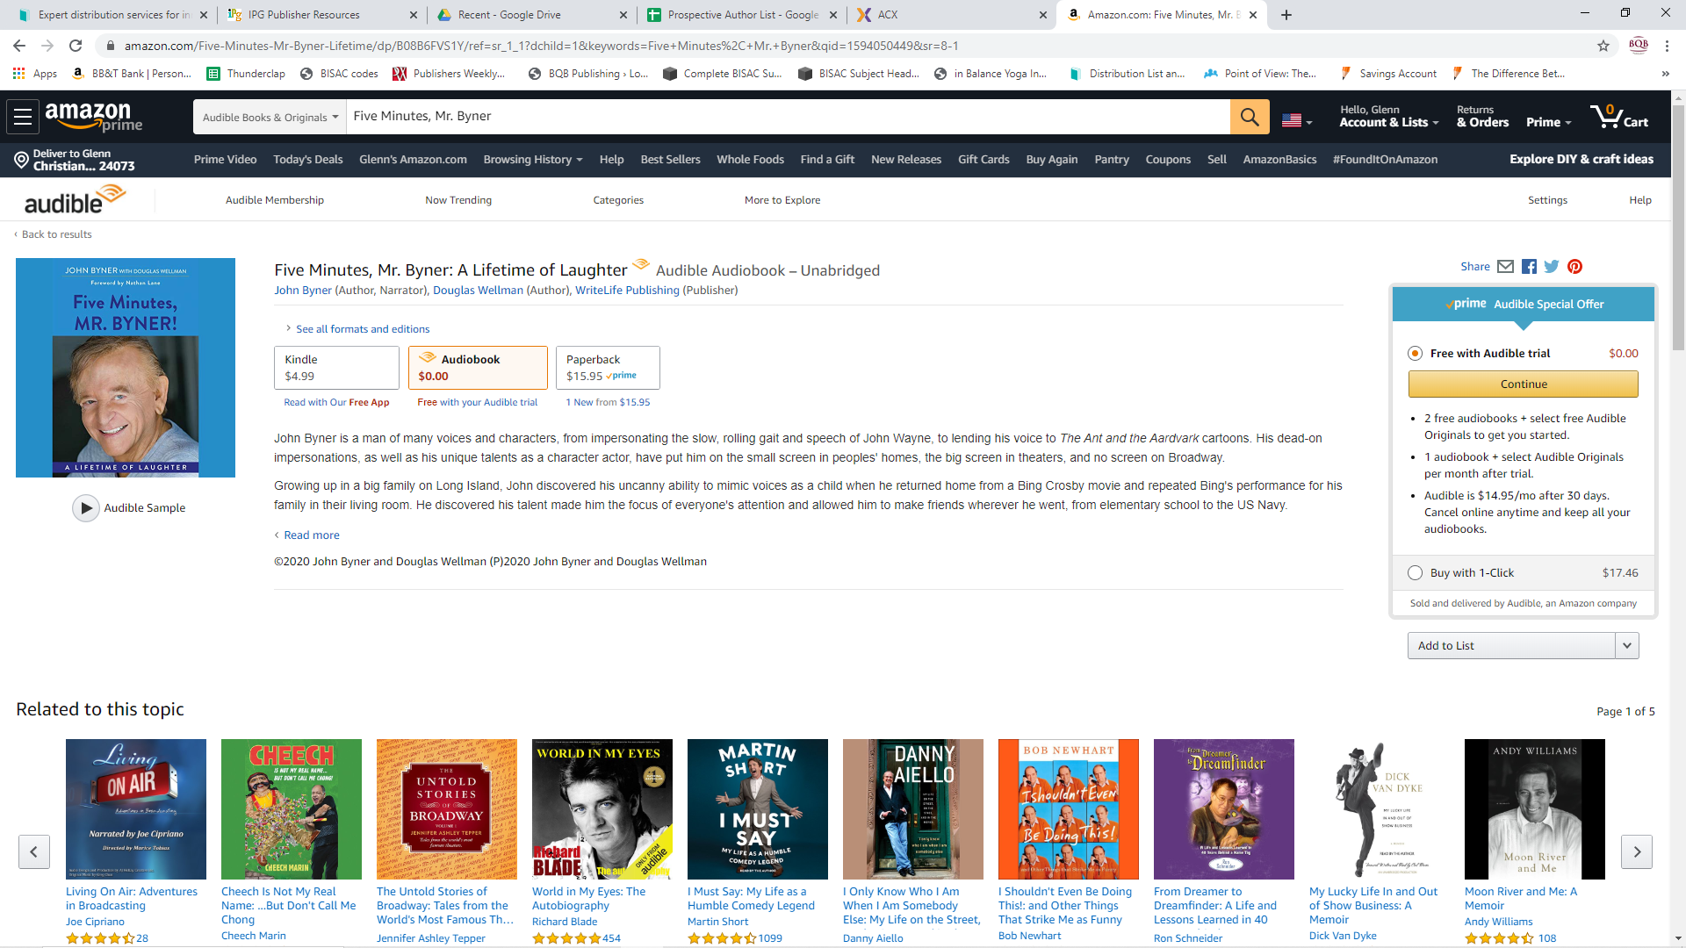

Slide 11
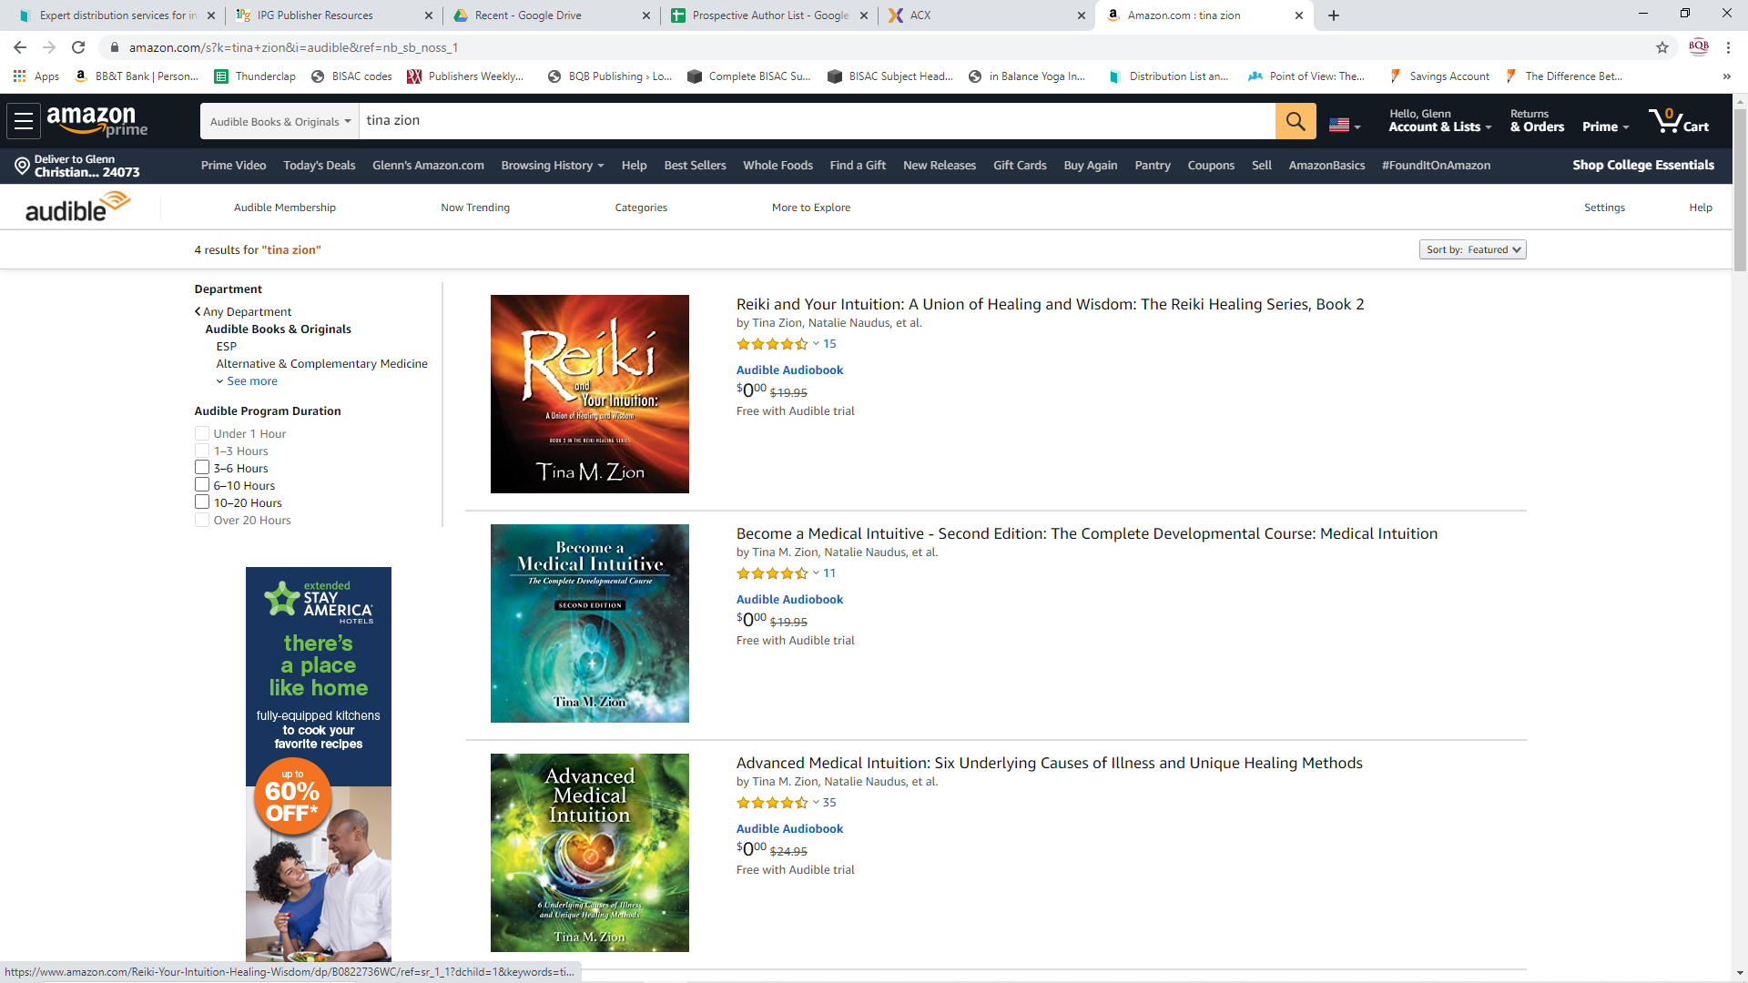

Slide 12
Audiobook Distribution – What You Can Do
Let readers and fans know when your audiobook is available and through what retailers.
Have links on your website and social media that readers can click on to go directly to your audiobooks. (Julie can provide you with a list of links).
Share purchase links on your newsletters and Blogs.
Watch your metadata, etc. on the different websites and let Julie know if there are typos, etc. so we can get them fixed.
Build your author brand to include audiobooks and promote your book to help drive business to the retailers selling your audiobook.
Amazon is a top audiobook seller so make sure your Amazon profile is set up and current.
Audible offers a “bounty” if readers join Audible’s monthly program and if your book is the very first book they purchase on that program. Work with Julie to find out how to promote this program and receive “bounties.”

Slide 13
Audiobook Marketing – What We Do
  Julie works with authors to keep you updated on the status of your audiobook and when it’s ready for sale.
  Julie sends out three newsletters (to different groups) each month and includes information about audiobooks where appropriate. We are in the process of creating a newsletter specifically for audiobook listeners.
  We periodically receive marketing opportunities for audiobooks and submit those books that are appropriate for the promotion.
  We market our audiobooks through social media.
  We continue to seek out newsletter promotion programs for audiobooks and submit audiobooks where appropriate.
  When the audiobook is available to purchase, we can request audio codes for reviews and giveaways. If you have an audiobook produced with us, please contact Julie for codes.

Slide 14
Audiobook Marketing – What You Can Do
  Once production has started, start promoting. Readers that have already read and loved your book will want to hear the audiobook. Ask them questions like…”Which celebrity would be the perfect fit to narrate my book?”
  Ask readers to share the audiobook link and the audio sample.
  Ask readers to tag a friend who they think would like an audiocopy of your book. (Julie can provide you with codes)
  Include audiobook links or information on your email, in your newsletter, on your blog.
  Use social media and all of your other marketing programs to promote your audiobook as well.
  Share your audiobook sample on your website, social media pages, blog and newsletter
  Seek out bloggers, reviewers, and marketers that specialize in audiobooks.

Slide 15
Social Media for marketing audiobooks–What we do
Social media can be a strong marketing tool for audiobooks just like it is for print and ebooks.
Our Social Media Manager, John Daly, maintains social media accounts for both BQB and WriteLife on the following sites:
  Facebook
  Twitter
  LinkedIn
  Pinterest
  Instagram
When appropriate, John will use our social media channels to promote our audiobooks.
Julie will use the retail blurb portion that is created for each of our audiobooks on social media and in other formats, where appropriate.
We continue to seek out social media opportunities for promoting our audiobooks. i.e. I recently sent you all an email about Bookstagram and how it can be used to market books – audiobooks are a great candidate for that.

Slide 16
Social Media –What You Can Do for audiobooks
Don’t forget to use your social media accounts to promote your audiobook as well.
Create videos of you reading a excerpt from your book and post it on Facebook, Instagram, YouTube, etc. – wherever videos work best.
  When you’re creating your videos, make sure to:
    Smile into the camera to connect with your viewers.
    Hold your book down so people can see your face.
    Make sure the section you read will grab viewers attention.
    After you’ve done the reading, let viewers know that your book is in print, eBook, and audiobook.
Get the retail blurb portion of your audiobook from Julie to post on social media.
  If you use this on social media, make sure you add a blurb of where the book is available and in what formats.

Slide 17
Thanks for joining us!
Have a great weekend!
Bqbpublishing.com
Writelife.com

