Slide 1

Book Marketing in the Time of COVID
Welcome!
Saturday, January 23, 2021
Noon - ET

Slide 2
Overview
  COVID has certainly challenged us all to hone our marketing skills and dig deep to find new tools to interact with each other and reach our audiences.
  The marketing tools we use and create during COVID can be used in all situations, but this is a time to really hone some of the marketing tools and skills we have.
  Don’t let this time of challenging marketing scare you off or close you down, step up to the plate and keep moving forward. We can turn this into a win when it comes to book marketing and sales.
  We are continually marketing with the tools and opportunities we have and we’ll share some of those with you in this webinar.

Slide 3
Tools You Gotta Have
Time and Interest
Marketing outline or calendar
Author website
Social Media accounts
Author Profiles
Zoom capabilities
Smart Phone or Camera for taking pictures and creating videos

Slide 4
Time and Interest
  If you don’t make time and you don’t have interest in marketing your book(s), it won’t happen.
  If you can’t or aren’t going to do it, hire someone who can and will.
  Without author marketing, significant sales won’t happen.

Slide 5
Marketing Outline or Calendar
It doesn’t have to be fancy or in a certain format, but it does need to be written down.
Items in our head can get lost; written into a document or on a calendar help ensure that they won’t be forgotten.
Creating a marketing outline or calendar can also open up your creative mind to other marketing possibilities.

Slide 6
Author Website
This is your main marketing tool for your book and building your author brand
Have your website URL on every communication you do
On your book page, make sure you have links to all the different retailers where people can buy your books so it’s easy
Sell personalized copies of your books
If you have a book published with us and also self-published books, you can use your website to sell them together and offer sales for direct sales to readers
Gather emails for your newsletter
Link your blog and/or newsletter to your website
  Both author blogs and newsletters can be a strong way to build your author brand

Slide 7
Author Website
Promote your praise and reviews on your website
Give readers additional insights into you and your books
Link videos
If you are an avid reader, create your own book club
If you are a teacher/trainer like Tina Zion, you can use your website to promote your events – virtual or live
If you get media coverage, interviews, etc., have a page on your website that you can gather this information and link to when you get the opportunity

Slide 8
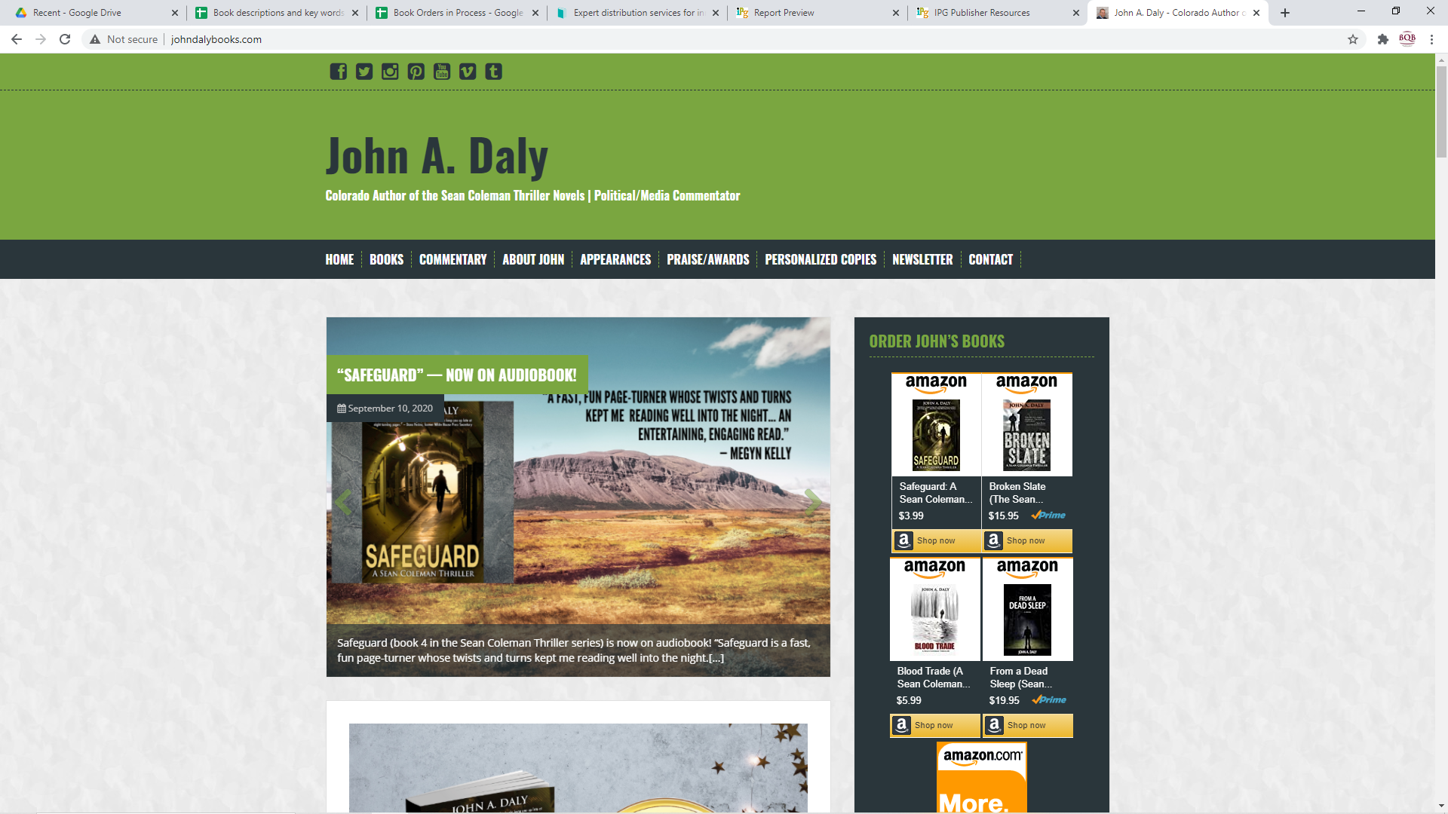

Slide 9
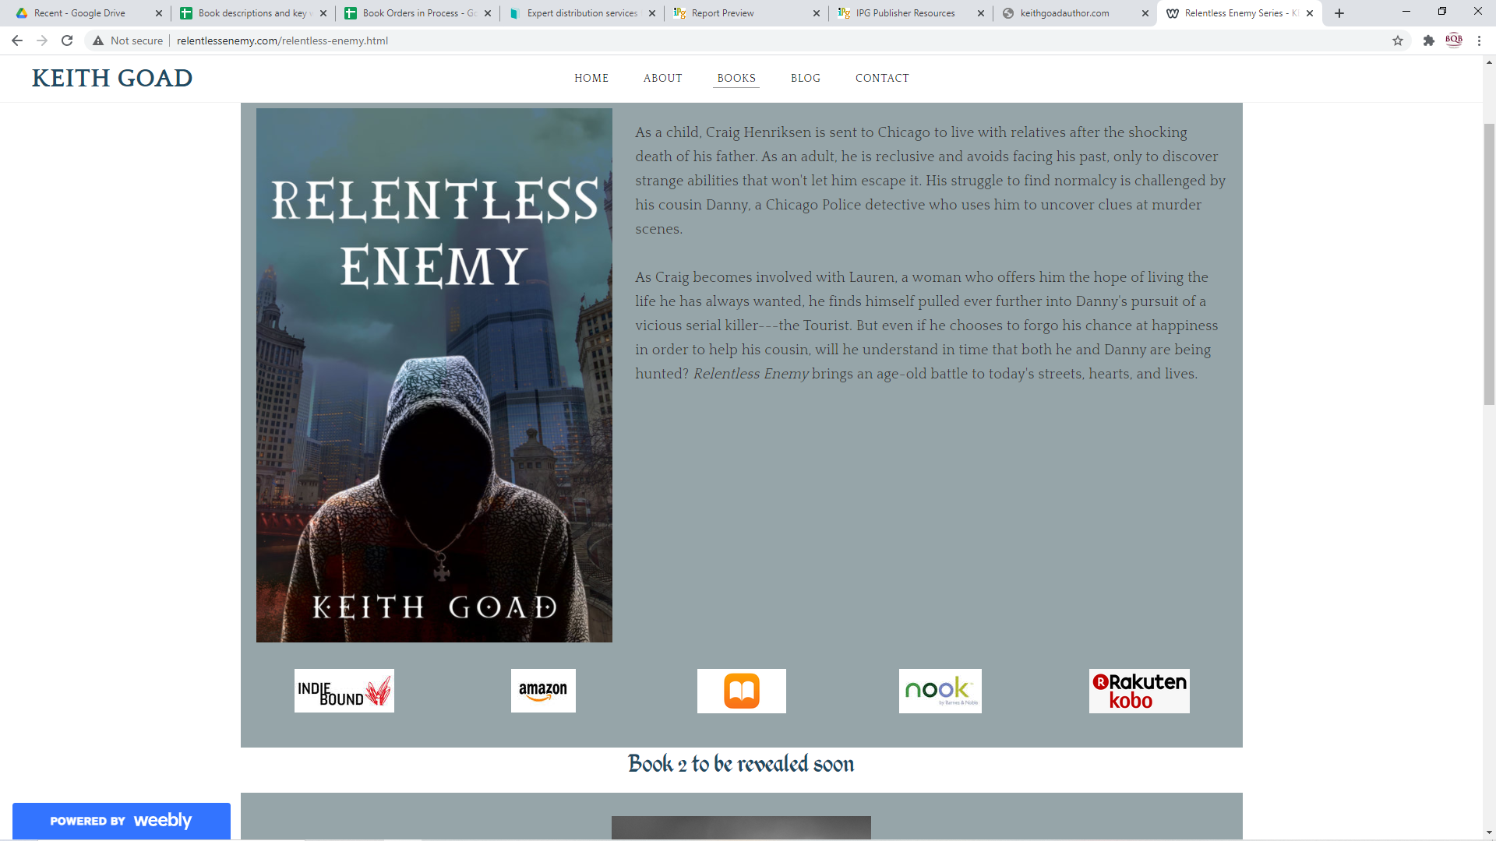

Slide 10
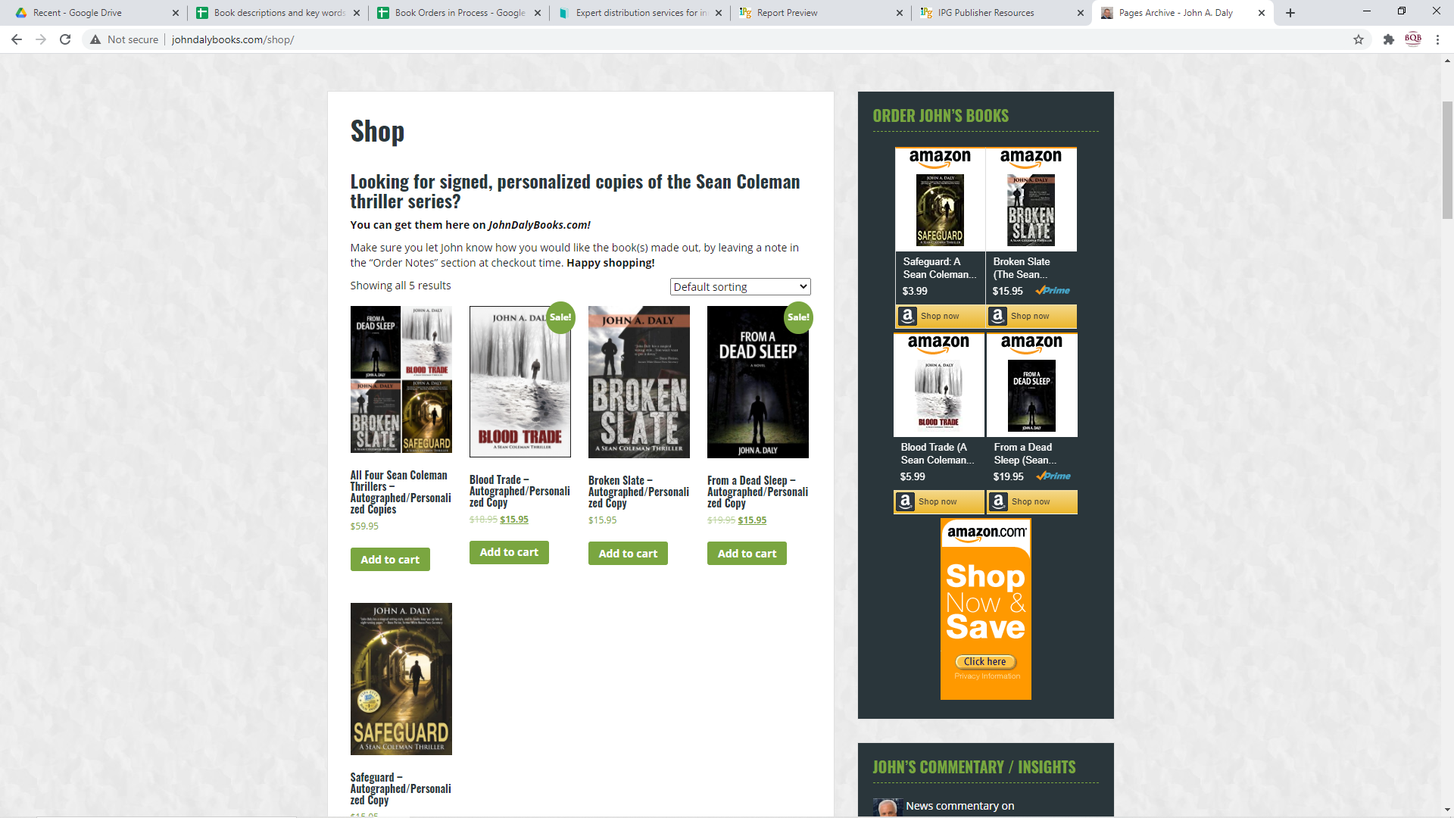

Slide 11
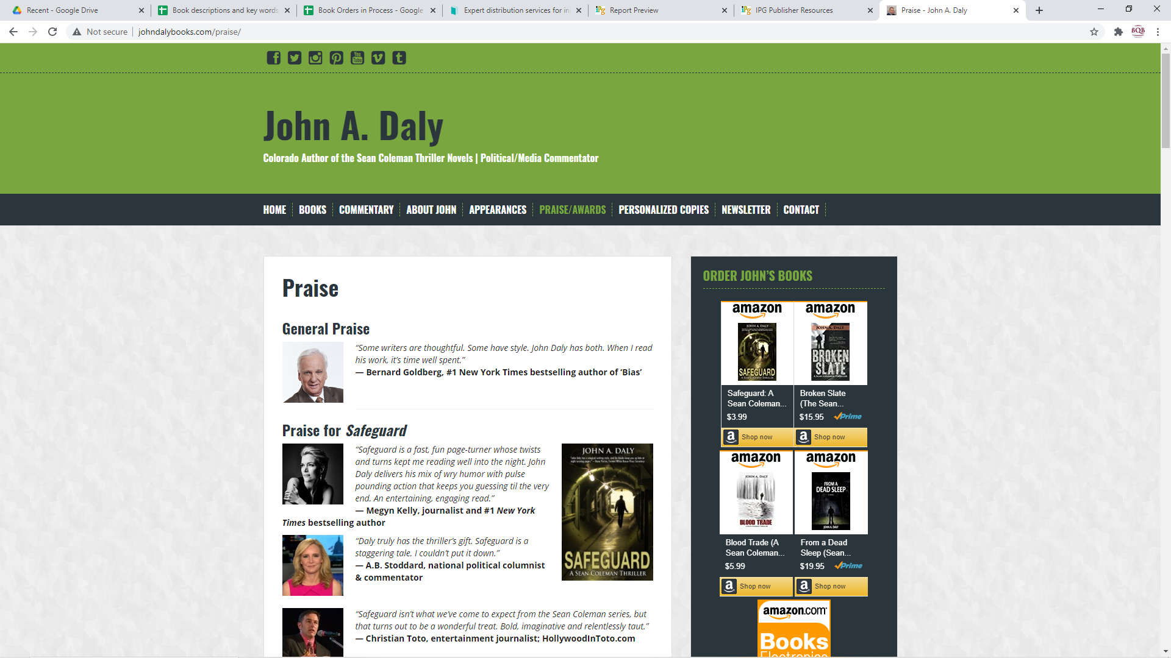

Slide 12
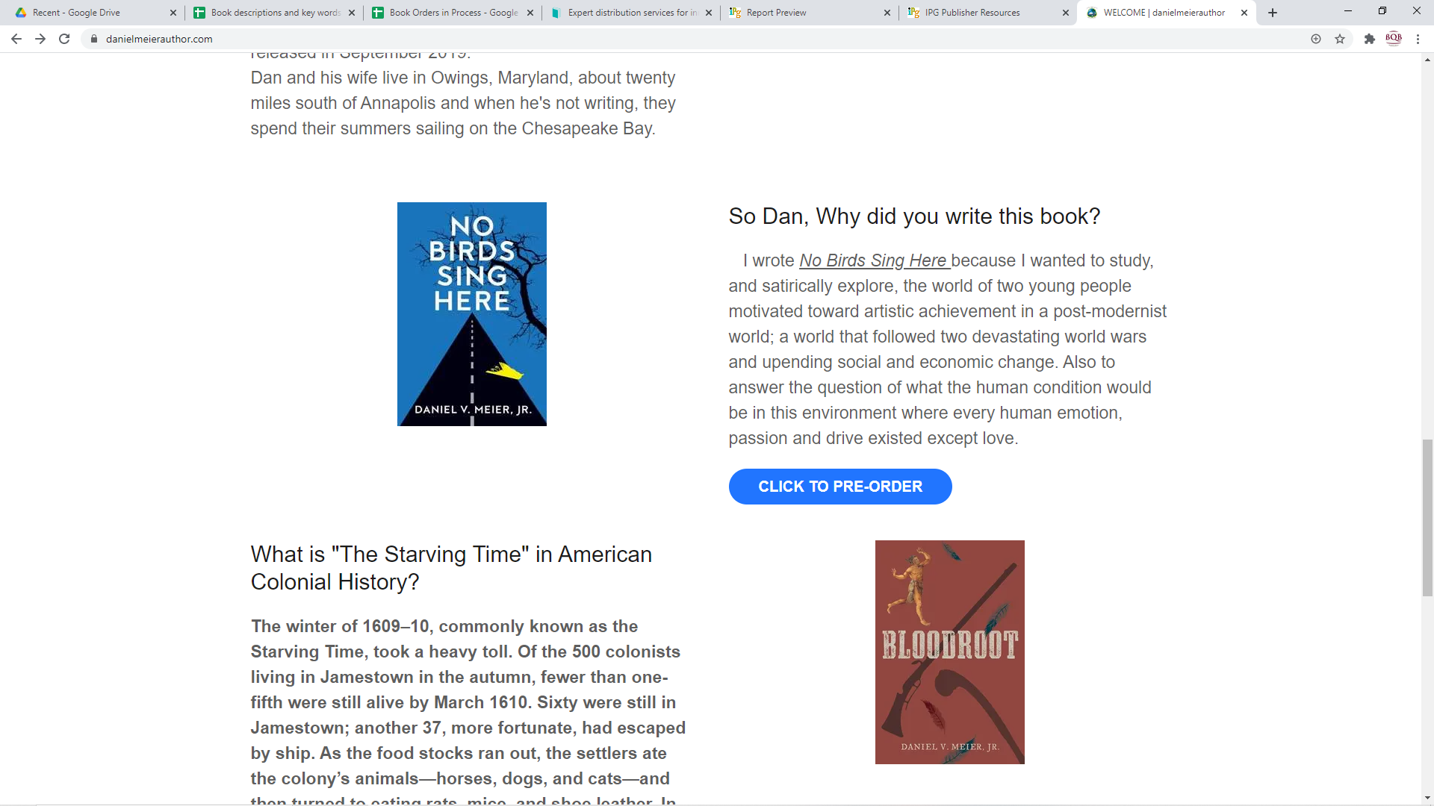

Slide 13
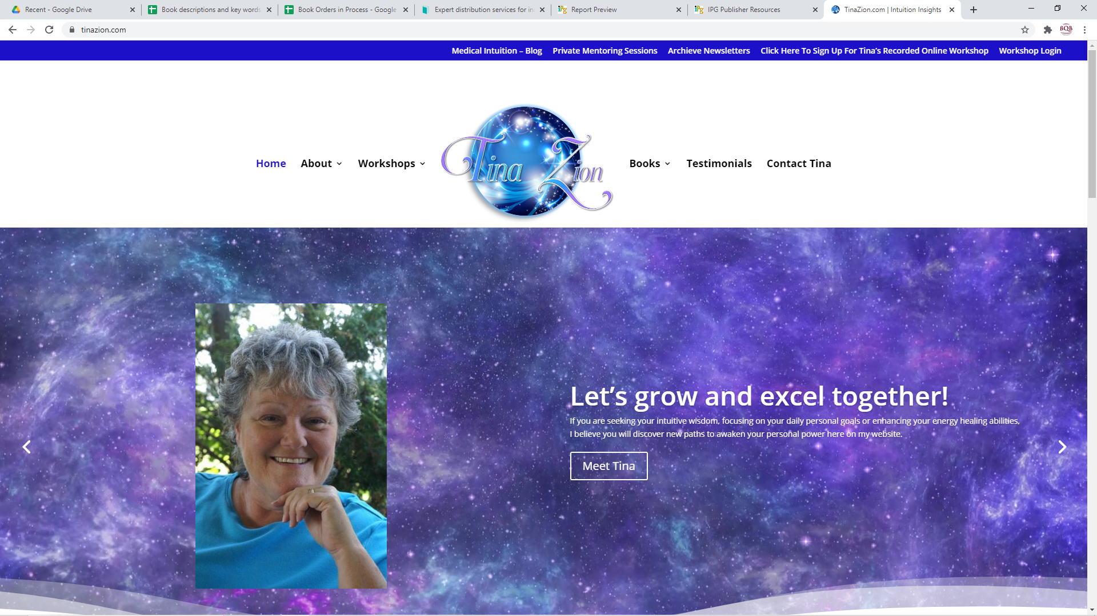

Slide 14
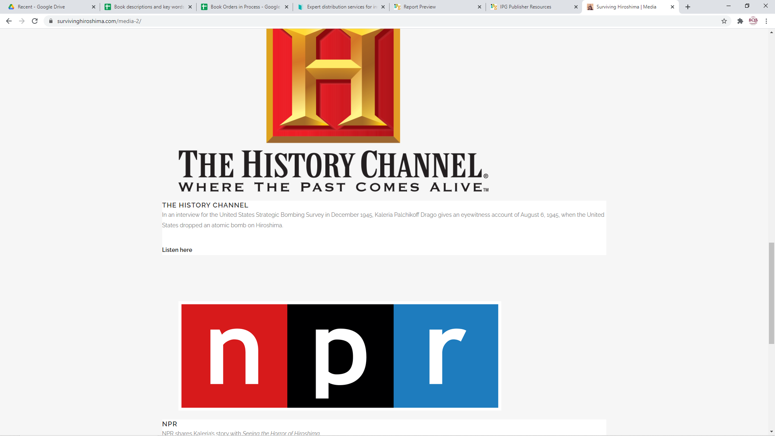

Slide 15
Social Media Accounts
    Basic Social Media Accounts you need to have:
    Facebook
    Twitter
    LinkedIn (especially if your book is business related)
    Pinterest
    Instagram
    Get familiar with these social media programs. There are plenty of tutorials for each on YouTube that can walk you through how and what to post.
    The especially important ones for book marketing seem to be Facebook and Instagram.

Slide 16
Social Media Accounts
    Set up a schedule of when to post
    You can use scheduling software to schedule some of your posts in advance - a search on the Internet will give you a synopsis of the latest tools available for this
    Make sure you share your social media URLs with Julie and John (julie@bqbpublishing.com johndalybooks@hotmail.com
    Follow BQB and WriteLife on the different social media platforms
    Join groups on the different platforms like book clubs, readers, etc.
    Margie Lukas advertises her audiobooks on Instagram on an ongoing basis and she and her sister use the groups they belong to for promoting the sales. It is effective because between 150-250 of Margie’s audiobooks sell each month.

Slide 17
Social Media Accounts
    Join the BQB/WriteLife group on Facebook where you can interact with other authors. (Find the group on Facebook and ask permission to join. John will recognize your name as an author and will let you into the group.)

Slide 18
Zoom Capabilities
    Zoom gives you the ability to do video calls and chats with book clubs, fans, etc.
    With Zoom capabilities, you can offer to do calls with book clubs, etc.
    When you interact with bookstores, let them know you have Zoom capabilities for doing readings, Q&A times, interviews, etc. Many bookstores have shifted what used to be in store events to online events. If they know you and that you are available and set up to do Zoom visits, you could be called on to do so.

Slide 19
Smart Phone or Camera for Pictures and/or Videos
  In virtual marketing, photos and videos are imperative and if you have a smart phone, you are set to do both.
  Social media is much more effective with pictures
  Pictures can enhance your website
  Julie can use pictures when she creates the A+ pages for your books on Amazon
  Videos are strong marketing tools
    On YouTube
    Connected to your book on Amazon through BQB/WriteLife
    Connected to your website
    Used on social media

Slide 20
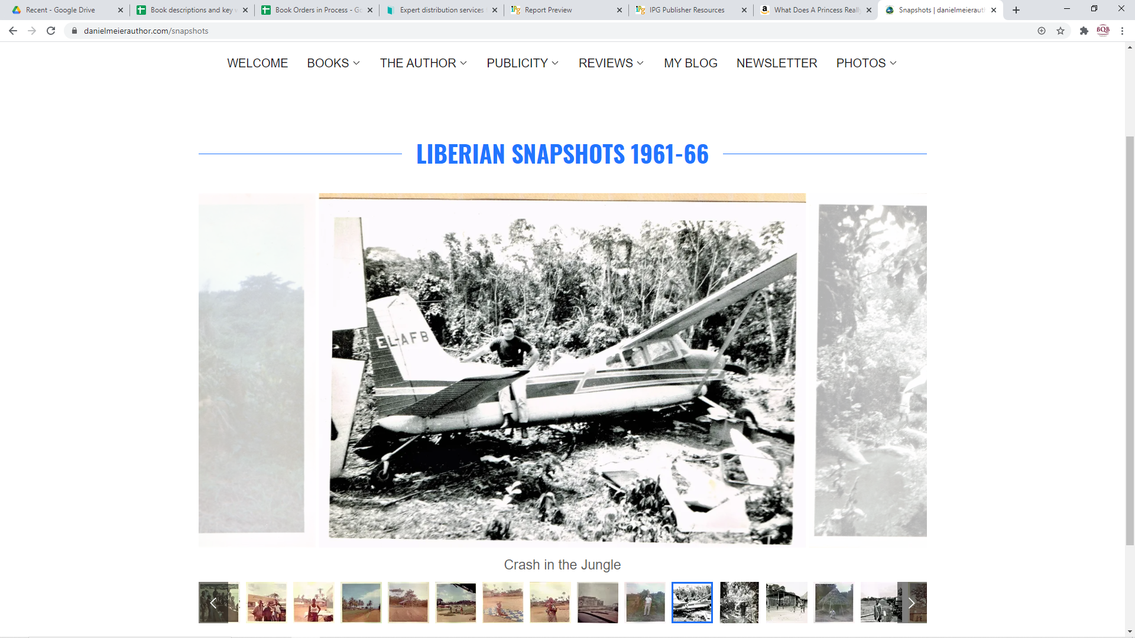

Slide 21
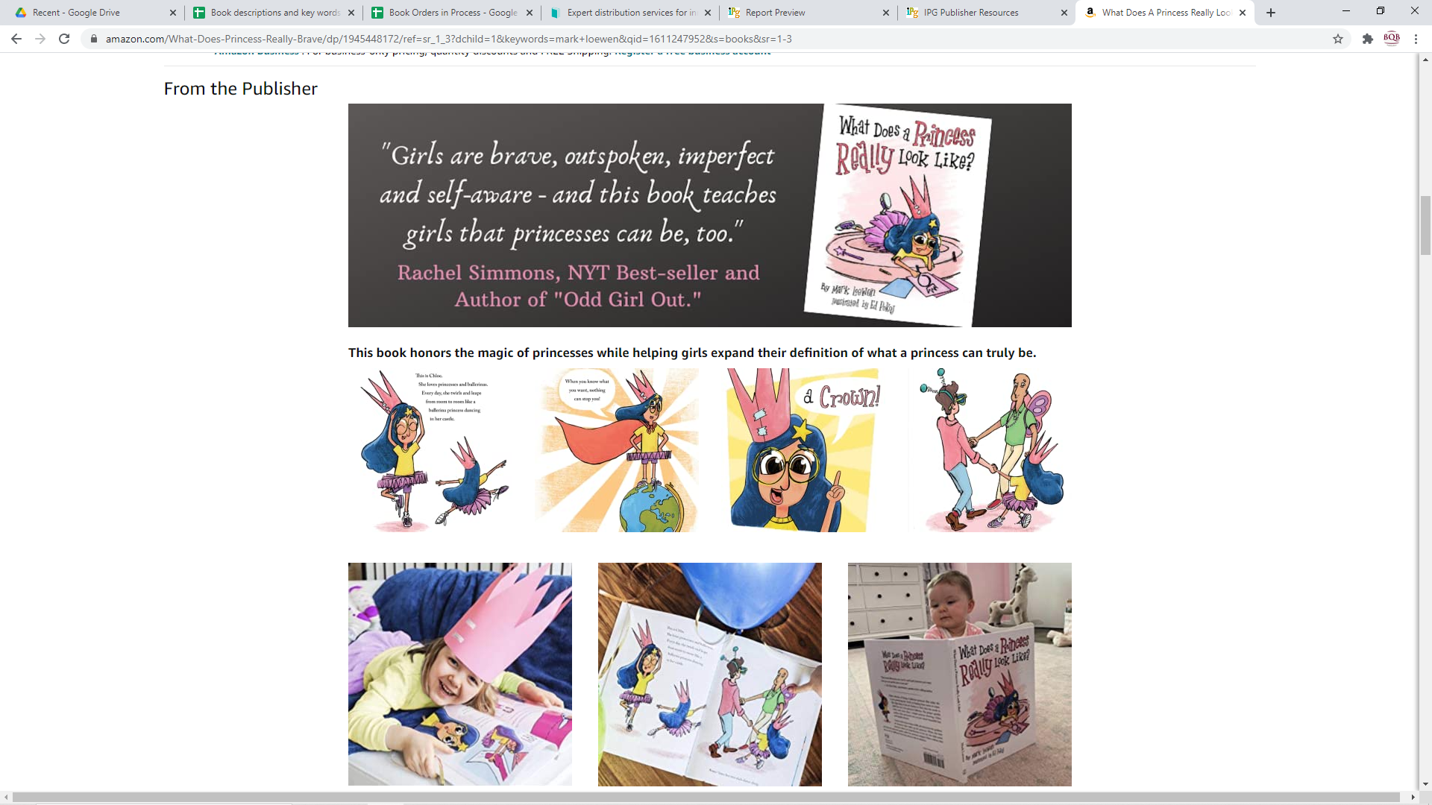

Slide 22
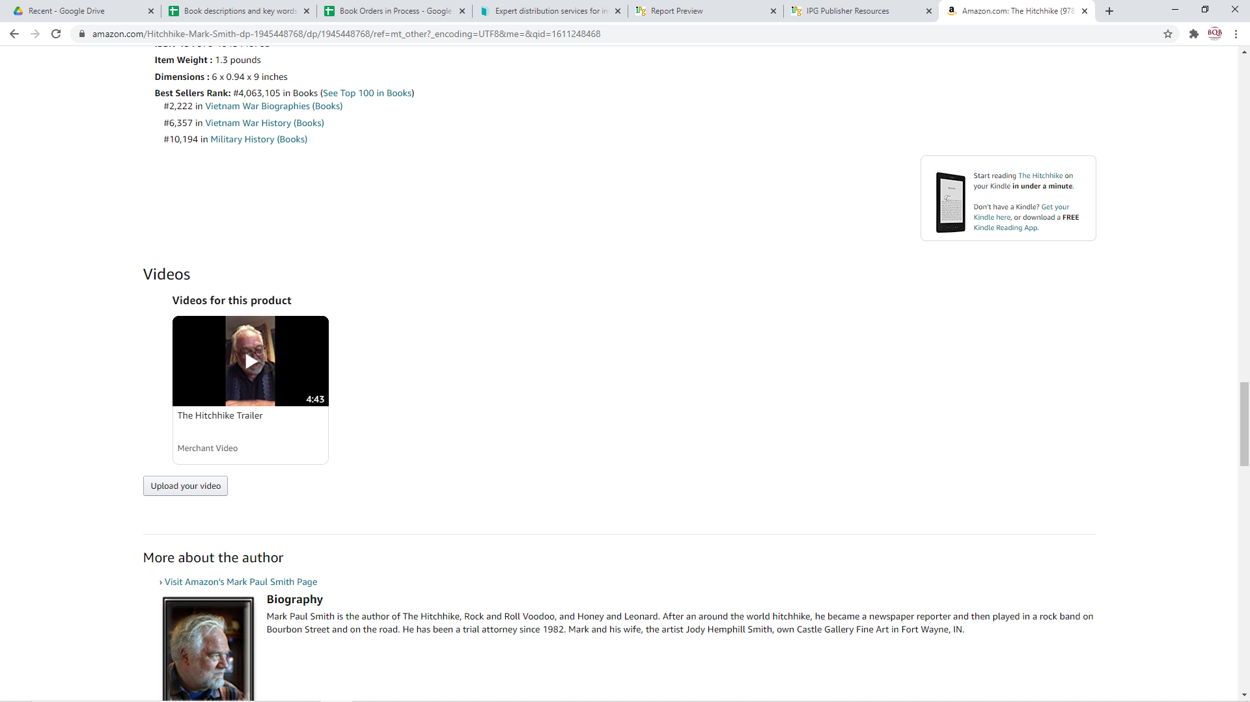

Slide 23
Types of Videos to Create
    3-5 minute videos where you the author talk about why you wrote the book. These are the videos we can upload to IPG for Amazon’s placement on your book page.
      Some good examples
      https://www.dropbox.com/s/29z9pztllfw5xag/The%20Children%27s%20Train%20by%20Jana%20Zinser.mp4?dl=0
      https://www.dropbox.com/s/3zq9x9eaa3j21h6/Mark%20Paul%20Smith%20-%20The%20Hitchhike.mp4?dl=0
      https://www.dropbox.com/s/jwwermwbt0v0y38/BLOOD%20TRADE%20VIDEO.mp4?dl=0

Slide 24
Types of Videos to Create
    Book trailers – There are specific formats for Book trailers and there is software available via the Internet for creating them. Some of the software is free. Here are some good examples:
      https://www.dropbox.com/s/rfhemurbcs0a4ds/Wiggles%2C%20Stomps%20and%20Squeezes%20Calm%20My%20Jitters%20Down%20-%20A%20picture%20book%20about%20sensory%20differences%20-%20DASH%20video.mp4?dl=0
      https://www.dropbox.com/s/xmh8u7ilzq4t07z/Book%20Video%20Trailer%20So%20You%27re%20Raising%20Your%20Grandkids%20by%20Harriet%20Hodgson%20-%20720p.mp4?dl=0

Slide 25
Types of Videos to Create
    Longer videos (Like interviews) that you post on YouTube and link to your website where you go more in-depth about you and your books. Some great examples:
      https://www.dropbox.com/s/rnn1yc6yf2ol63h/CBS%206%20News%20-%20Mark%20Loewen%20-%20What%20Does%20a%20Princess%20Really%20Look%20Like.mp4?dl=0
      https://www.dropbox.com/s/f1ryftq897v1le5/FromADeadSleepInterview.mp4?dl=0
      https://www.dropbox.com/s/85yripkdyfs6rb7/Interview%20of%20Daniel%20Meier%20-%20The%20Dung%20Beetles%20of%20Liberia.mp4?dl=0

Slide 26
Author Profiles
    Author profiles give readers (and book buyers) an opportunity to learn more about you as an author. Places where having your author profile is a must:
    Your Website
    Amazon Author Profile page (set it up by going to amazonauthorcentral.com and following the directions
    Goodreads – set yourself up as an author
    BookBub – set yourself up as an author

Slide 27
Advertising and Marketing– What You Can Do
  Create a marketing budget each year so you can have time and resources to participate. The more you participate in marketing, the more your royalties will increase (both those that cost money and those that take time).
  Watch for opportunities through BQB/WriteLife for advertising opportunities with NetGalley, PW Tip Sheet email, Bookseller Alliances, Amazon, etc.
  Read the author newsletter year month because Julie communicates marketing opportunities in it.
  Pay attention to group emails that come from Terri because that is the medium that she uses for communicating opportunities.

Slide 28
What We Do/How You Can Help
  Monthly Newsletters
  Authors
  Booksellers
  Readers
  The beginning of each month, send an email to Julie with the following:
  Awards you’ve won
  Events (even virtual) that you’ll be doing
  Outstanding reviews that you’ve received
  Anything else that is newsworthy.

Slide 29
What We Do
  NetGalley is a review site where booksellers, librarians, bloggers, etc. can read and review books.
  BQB/WriteLife maintains a page on NetGalley where we consistently have ten books available for review requests. Books can only be downloaded by people that Julie has vetted and approved.
  The month before a book is published and the month the book is published, BQB/WriteLife. If we have empty spaces in any particular month, we make those spaces available to authors for a cost of $85 per title per month. (If you were to purchase the space on your own from NetGalley, it would be $250+

Slide 30
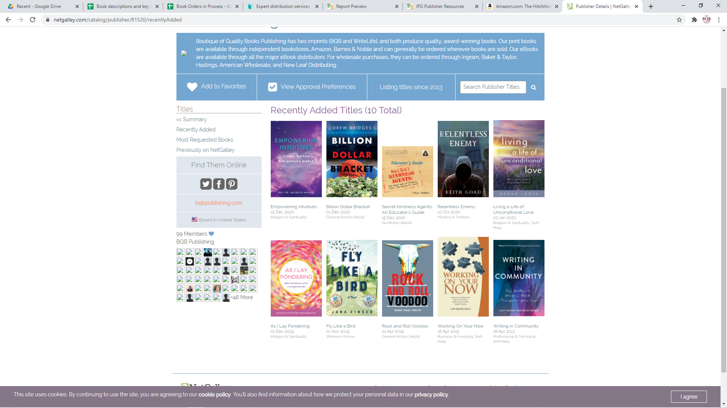

Slide 31
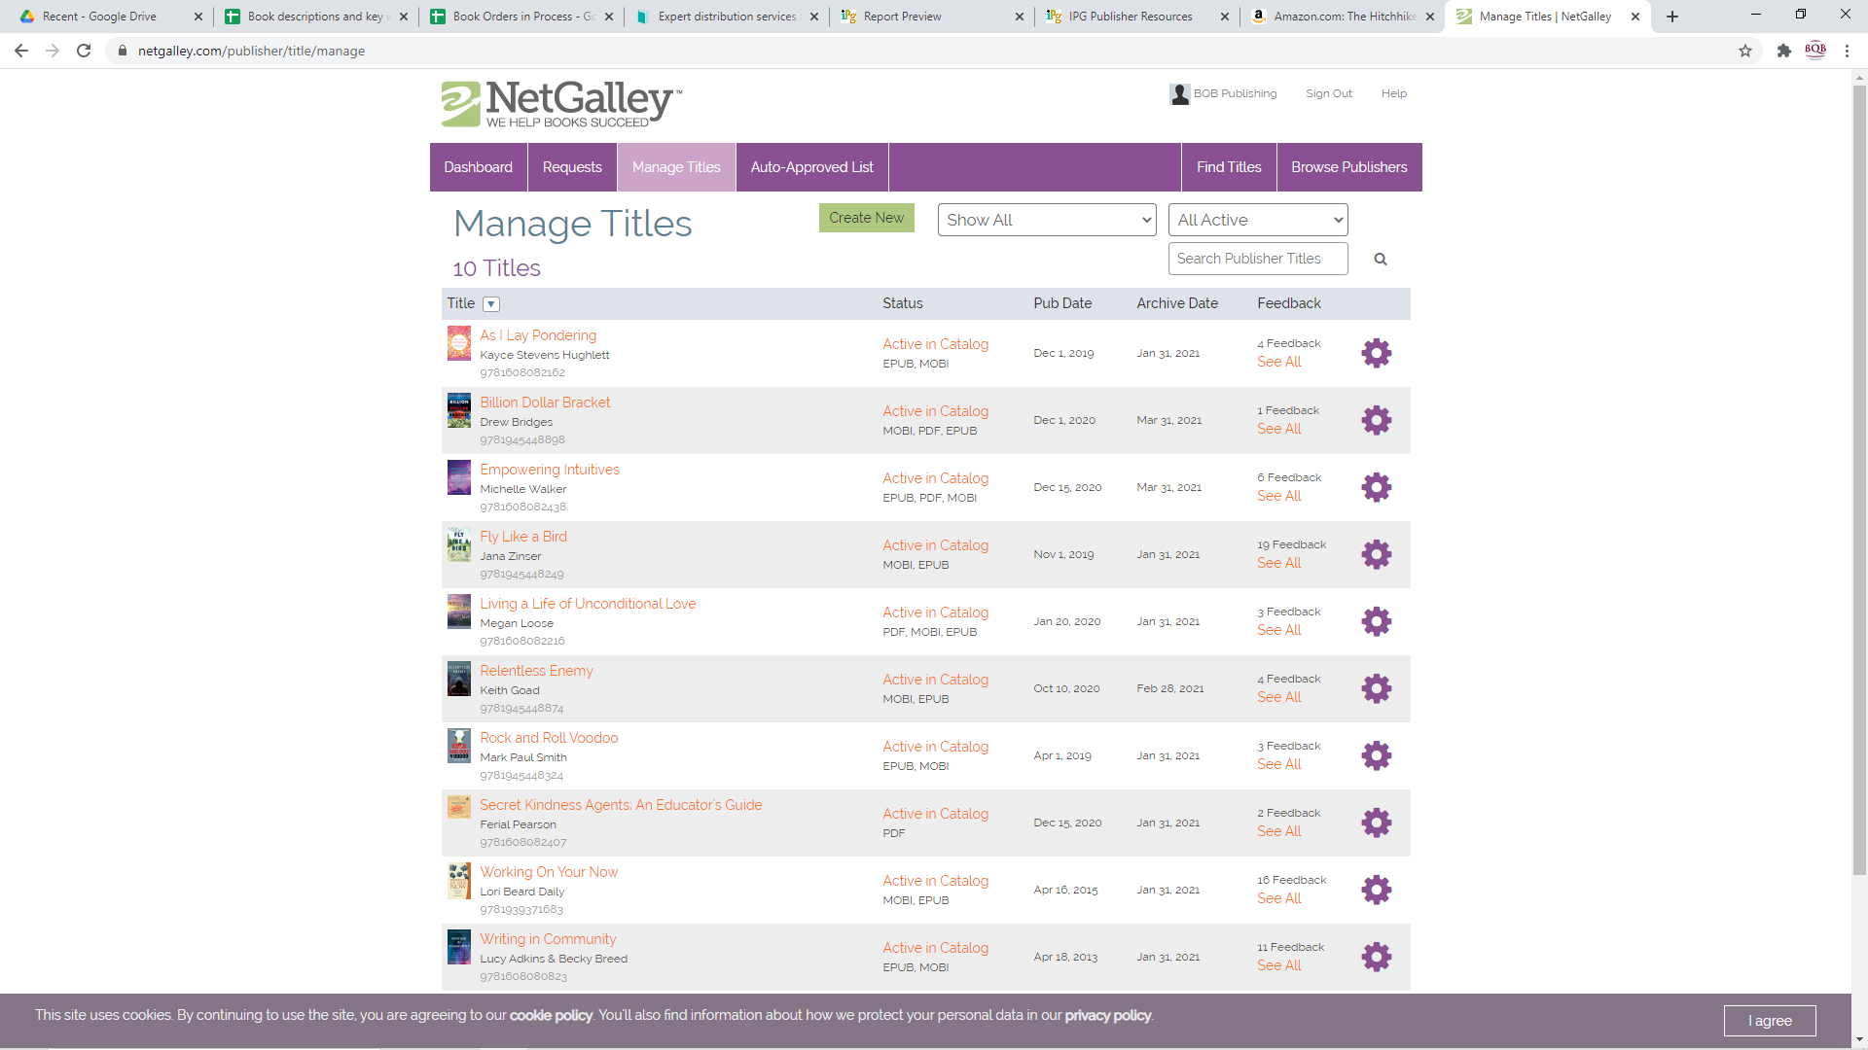

Slide 32
What We Do
  BookBub www.bookbub.com is a site that was specifically created to connect readers with sales and promotions on eBooks. They have millions of readers who have signed up to receive their promotion newsletters and publishers submit books to be featured. If a book is selected, BookBub charges the publisher for the time and space to promote it.
  BookBub newsletter promotions can generate a lot of sales and interest in a book.
  Publishers are continually vying for the space and BookBub is particular as to the books they choose. They are looking for books that have author buzz and support, reviews on Amazon, social media buzz, etc. Helping create all of these things can help us secure those spots.

Slide 33
What We Do/How You Can Help
  Weekly, I receive emails from IPG and/or Inscribe describing the most recent promotion options including
  eBook sales and promotions
  Advertising opportunities
  Publicity call outs
  Many of them, we handle on this end but there are things you can do to ensure your books qualify for many of the promotions
  Help build your reader reviews on Amazon
  If you get reviews from influencers, upload those to Amazon via your author profile
  When we notify you about a promotion or BookBub campaign, spread the news and help create the buzz

Slide 34
What We Do/How You Can Help
  Virtual Book Shows
  The book shows that are generally in person – ALA (American Library Association; BookExpo; SIBA; MIBA; etc. have been shifted to virtual shows.
  BQB/WriteLife participates in several of these a years and when we do, we offer our authors opportunities to purchase space at the shows for their books. Julie, John, and I then do all of the work to make the book covers, book blurbs, videos, giveaways, etc. live and available. In many ways, the virtual shows are offering opportunities that we didn’t have at the live shows.
  Watch the monthly author newsletter and/or emails from Terri that notify you of these opportunities and then follow the directions for submitting and participating.
  These shows offer opportunities for videos and/or book trailers so make sure you have created them and uploaded them to Terri and Julie so they have them available when opportunities arise.

Slide 35
What You Can Do
  Audiobooks - If your book(s) are not already in audio format, talk to Julie about the options of doing that. Many people buy eBooks and audiobooks together or when we do a promotion on a print or eBook, sales on audiobooks usually go up. Putting your book into every format available is a strong marketing tool, whether we’re in COVID or not.
  Keep Writing – Whether it is poems or short stories that you offer on your website for free or another full length book that is published, the more an author writes, the more their brand is built and the more opportunity we have for promotion.

Slide 36
Thanks for joining us!
Have a great weekend!
Bqbpublishing.com
Writelife.com

