Slide 1


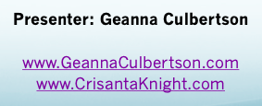

Slide 2
Contributors
Amy Hufft – Vice President of Global Brand Marketing & Communications SHOPIFY
Chris Kneeland – Co-founder & CEO of Cult Collective
Matt Kerbel – VP Brand Marketing Homie
Ryan Berman – Founder Courageous
Also VPs and Execs from Budweiser, Peloton, Netflix, and more!

Slide 3

Understand Your Brand Purpose

Slide 4

Amy Hufft – Vice President of Global Brand Marketing & Communications, SHOPIFY
Mission vs. Brand Purpose
What are You Teaching People?
Your North Star
The Mind of the Consumer
Commerce & Social Impact

Slide 5
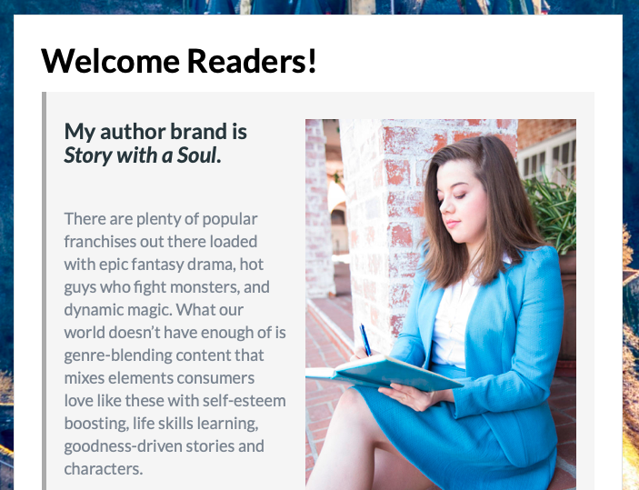
ss

Slide 6
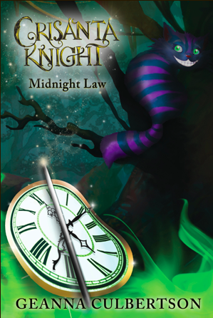


Slide 7

Differentiation, Exploration, & Long-Term Vision

Slide 8

Run the Other Way
It’s Like Tetris
Marketing Doesn’t Have to Look Like Marketing
Setting up for Long-Term Success
Playing the “Infinite Game”
Future-Proofing Your Strategy

Slide 9

Lessons of Advertising

Slide 10

“Advertising isn’t dead, it’s just woefully overfunded.” – Chris Kneeland, Cult Collective Audience Engagement Firm
Marketing vs.
Mark Downing

Slide 11
Rules of Ads
Make it super simple for people to find you when they are searching for solutions that you provide.
Make it super obvious why people should choose you over other alternatives.
Give a reason to talk about you to others in their lives.

Slide 12
The Four Ad Paths
Drive Innovation
Deliver Exceptional Value
Enable Unbeatable Convenience
Earn Affinity & Advocacy

Slide 13
Key Takeaways
Simple to find you, obvious to choose you, fun and relevant to talk about you
Your marketing team should work hand-in-hand with the people making policy, pricing, and so on because they need to create it together
Building a Brand vs. Building a Business

Slide 14

Tips for Creating Ads

Slide 15

Concise + Direct
Is This Too Long???
Experimentation
All Drives Home
Staying True to Branding
Creativity Drives Commerce
Being Open to Brainstorming
Build Trust as a Brand

Slide 16



Slide 17


Slide 18
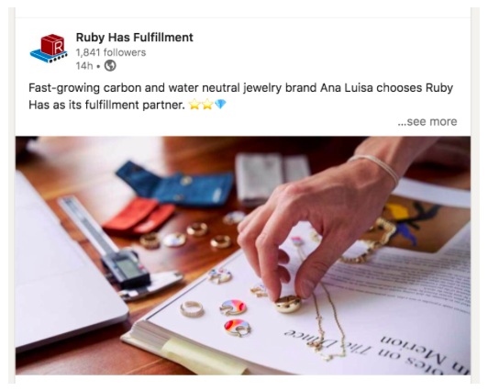

Slide 19
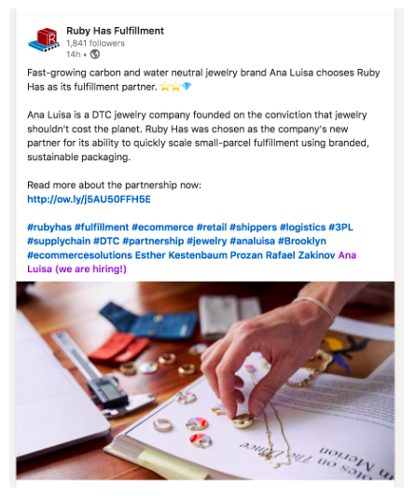

Slide 20

Crafting a Return on Courage

Slide 21
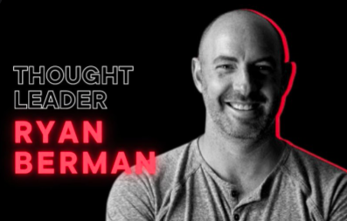
Genuine Social Media Connections
What are You Afraid of?
How do you eat an elephant? --- With a pack of strategic lions.
Watch Your Back vs. Got Your Back Culture
Repeaters Make Believers
Courage vs. Resilience

Slide 23

Questions?

