Slide 1

What We Do To Market Your Books and How You Can Help
Welcome!
Saturday, September 25, 2021
Noon - EDT

Slide 2
Print Distribution – What We Do
IPG
Our print book distributor (They represent thousands of publishers of all sizes)
They sell to
Amazon
Wholesalers (Ingram, Baker & Taylor)
Bookstores (indie bookstores and large entities like B&N)
Retailers (Target, Walmart)
Libraries
Online book sellers
Etc.
We keep print inventory with them.
They have both inhouse and field sales reps who present our books three seasons a year.
Spring (January – April)
Summer (May – August)
Fall (September – December)
We present our books to them, via webinar, three times a year and are presenting 6-8 months before the book releases.
The cover and metadata of your book will begin appearing online at places like Amazon, Barnes & Noble, etc. around 6-8 months before its release.

Slide 3
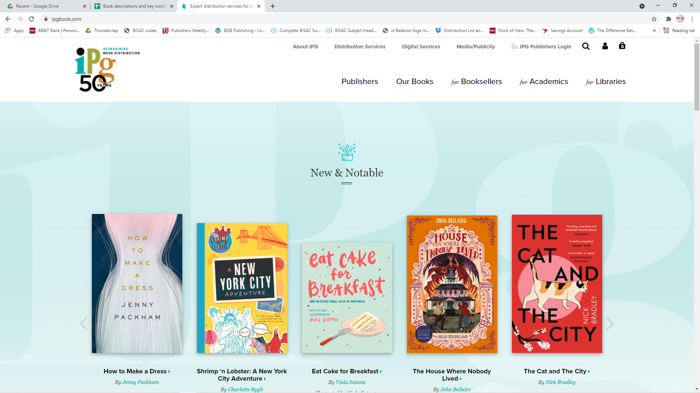

Slide 4
Print Distribution – What We Do
We set the SRP (Suggested Retail Price) of each book and it is printed on the book itself.
Amazon, Barnes & Noble, etc. may sell your book for a different price, but we always receive the wholesale price, no matter what they sell it for.
Different entities are offered different discounts off the top (i.e. Amazon receives 50% discount off of the SRP, Bookstores generally receive 40% etc.)
IPG charges us a % fee of the books we sell to cover the costs of all of the sales, etc. they do to help market and sell our books.

Slide 5
Print Distribution – What You Can Do
Let retailers know your print books are available through IPG (Independent Publisher’s Group www.ipgbook.com)
Have links on your website and social media that readers can click on to go directly to booksellers. (Julie can provide you with a list of links)
Watch your metadata, etc. on the different websites and let Julie know if there are typos, etc. so we can get them fixed.
Set up book signings, readings, or speaking events with bookstores so they buy your books from IPG and its wholesalers, etc.
When you set up events, get that information to Julie on the form that can be found on our author portal so she can upload it to IPG
Build your author brand and promote your book to help drive business to bookstores, wholesalers, IPG
Amazon is a top buyers of our books so make sure your Amazon profile is set up as soon as your book appears on their site and update it from time to time

Slide 6
Providing Sales Tools to IPG
In order to do a good job selling our books to wholesalers, book buyers, etc., IPG needs us to provide tools they can use. This is what we provide:
Complete metadata on your book (title, descriptions, pub date, ISBN, etc.)
Top competitive books
Jpg file of the cover
Chapter excerpts
ARC pdf when it’s ready
Book Trailer
Sell Sheet
International Sell Sheet
Author Photo
Marketing and publicity plan
Reading guide

Slide 7
Sales Tools We Need From You
Much of the information we provide comes from the competitive analysis form you complete right after you’ve signed your contract and we create a lot of forms, etc. from that. But some additional tools are needed from you as we move into the process.
Author Photo (high resolution)
We also use this for our website, on the Author page inside your book, etc.
Book Trailer
This is also uploaded to Amazon for your book page
We recommend you upload this on your Amazon author profile page as well
Use it for social media as well
Marketing and Publicity Plan
While there are basics that we do for every book we publish, each author should individualize their marketing plan, and the sales reps want to know about those plans.
Reading Guide
We provide a sample of a reading guide and I send an email to newly published authors asking them for one that sales reps can provide to book buyers.
However, it is never too late to provide a reading guide so that it can go on Edelweiss for the entire period we publish your book.
Reading guides are also good additions to your websites.

Slide 8
Edelweiss
Edelweiss (Above the Treeline) is a program that book buyers, bookstores, libraries, etc. use to research and order books.
IPG automatically adds every book we publish to Edelweiss
This is the information that IPG automatically puts in Edelweiss if they have it:
Metadata
Cover
Author Photo
Book Trailer
Marketing and Publicity Plan
Reading Guide

Slide 9
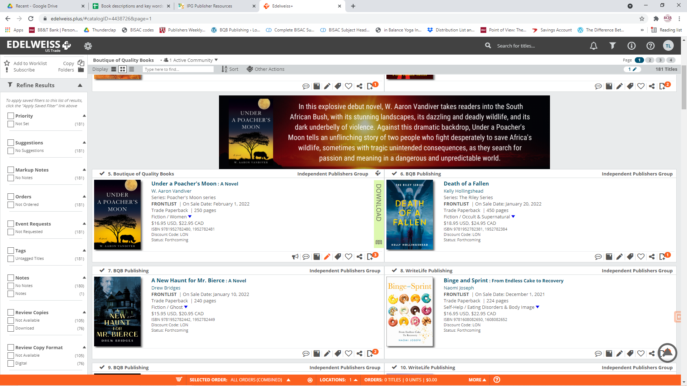

Slide 10
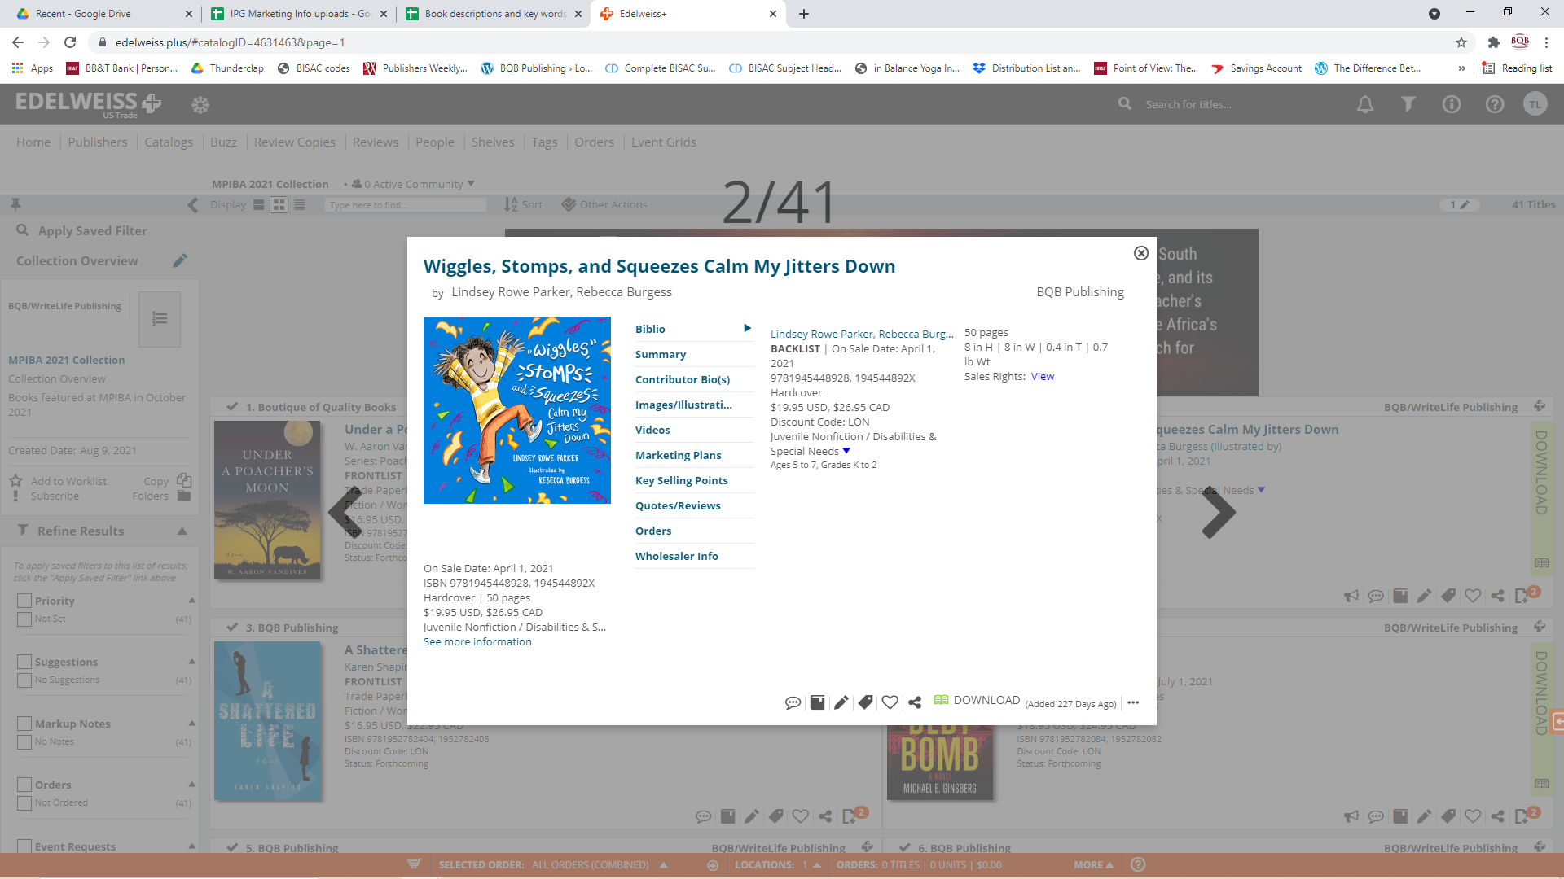

Slide 11
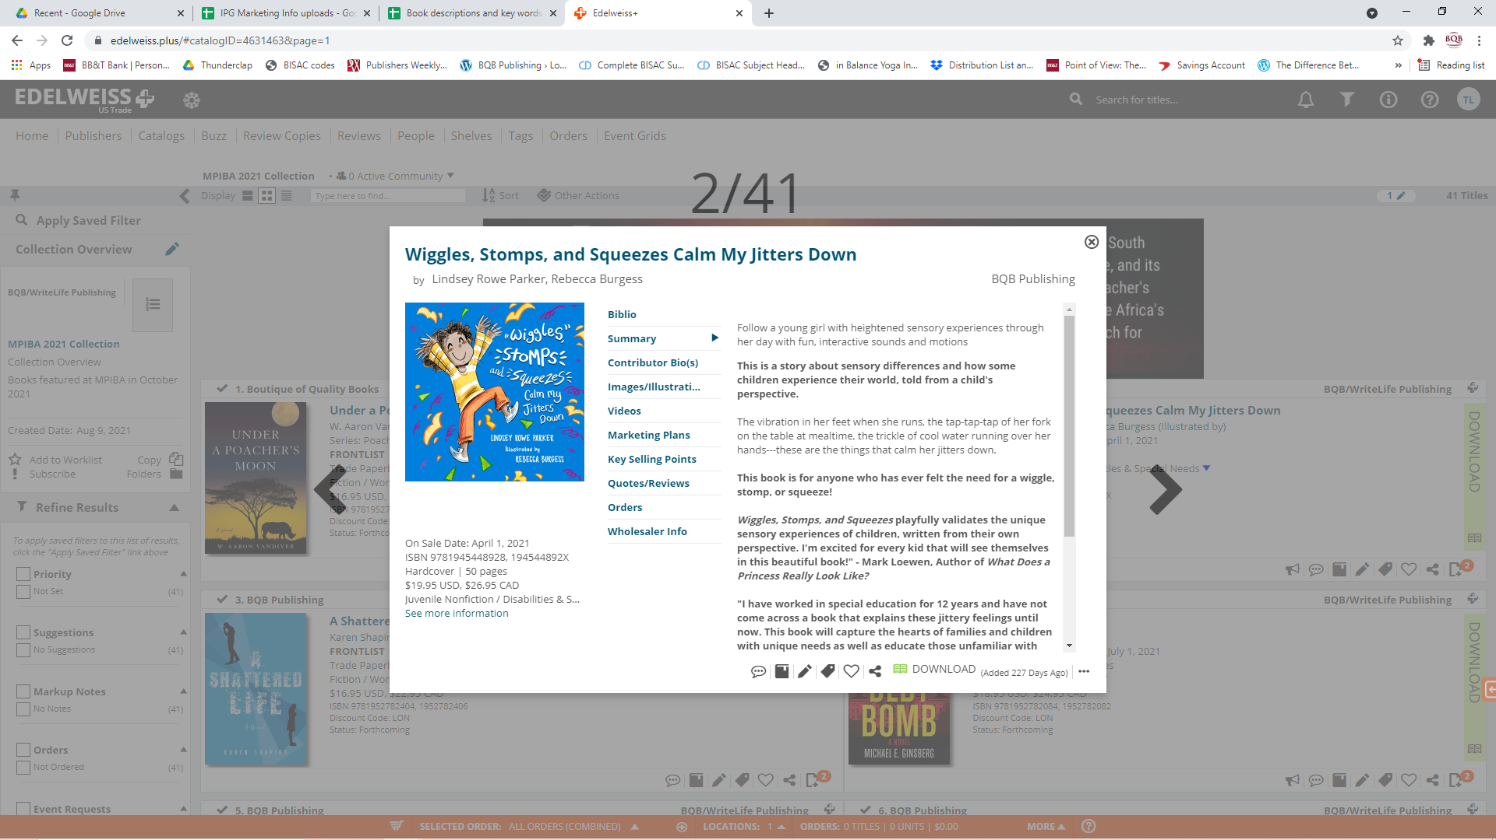

Slide 12
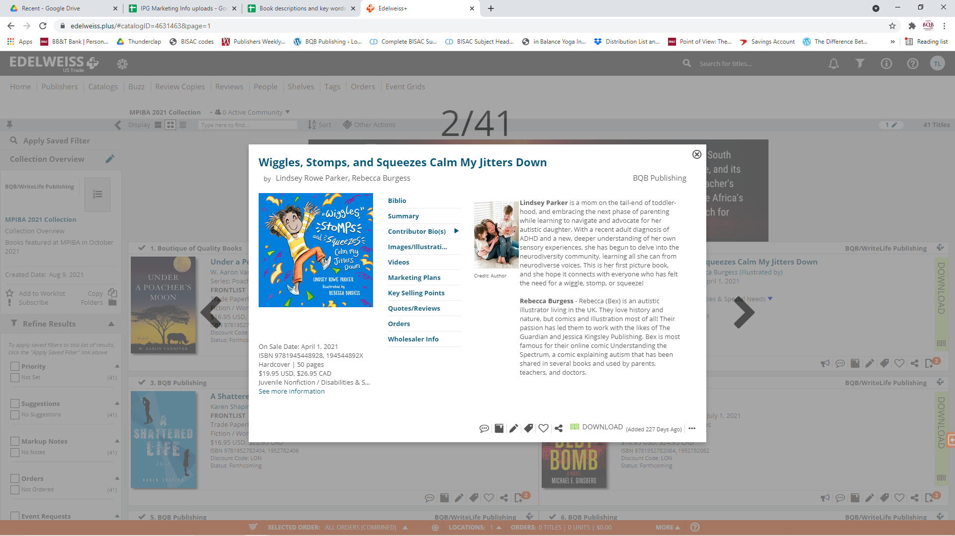

Slide 13
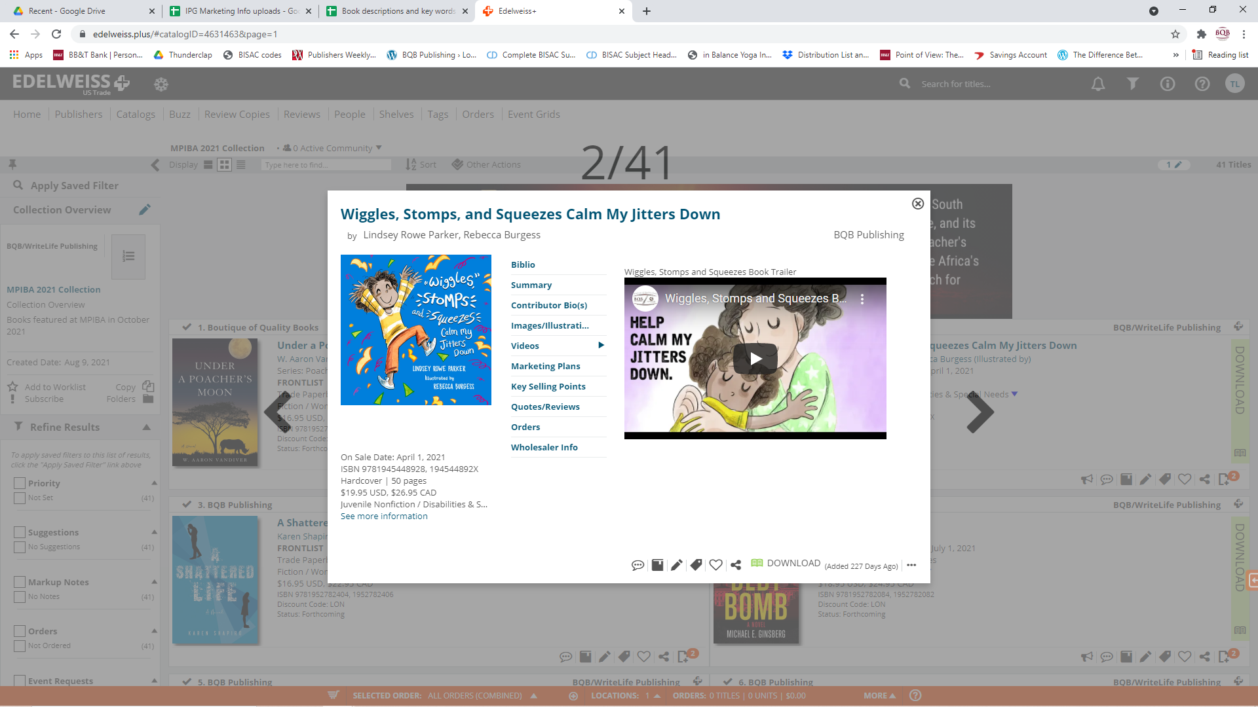

Slide 14
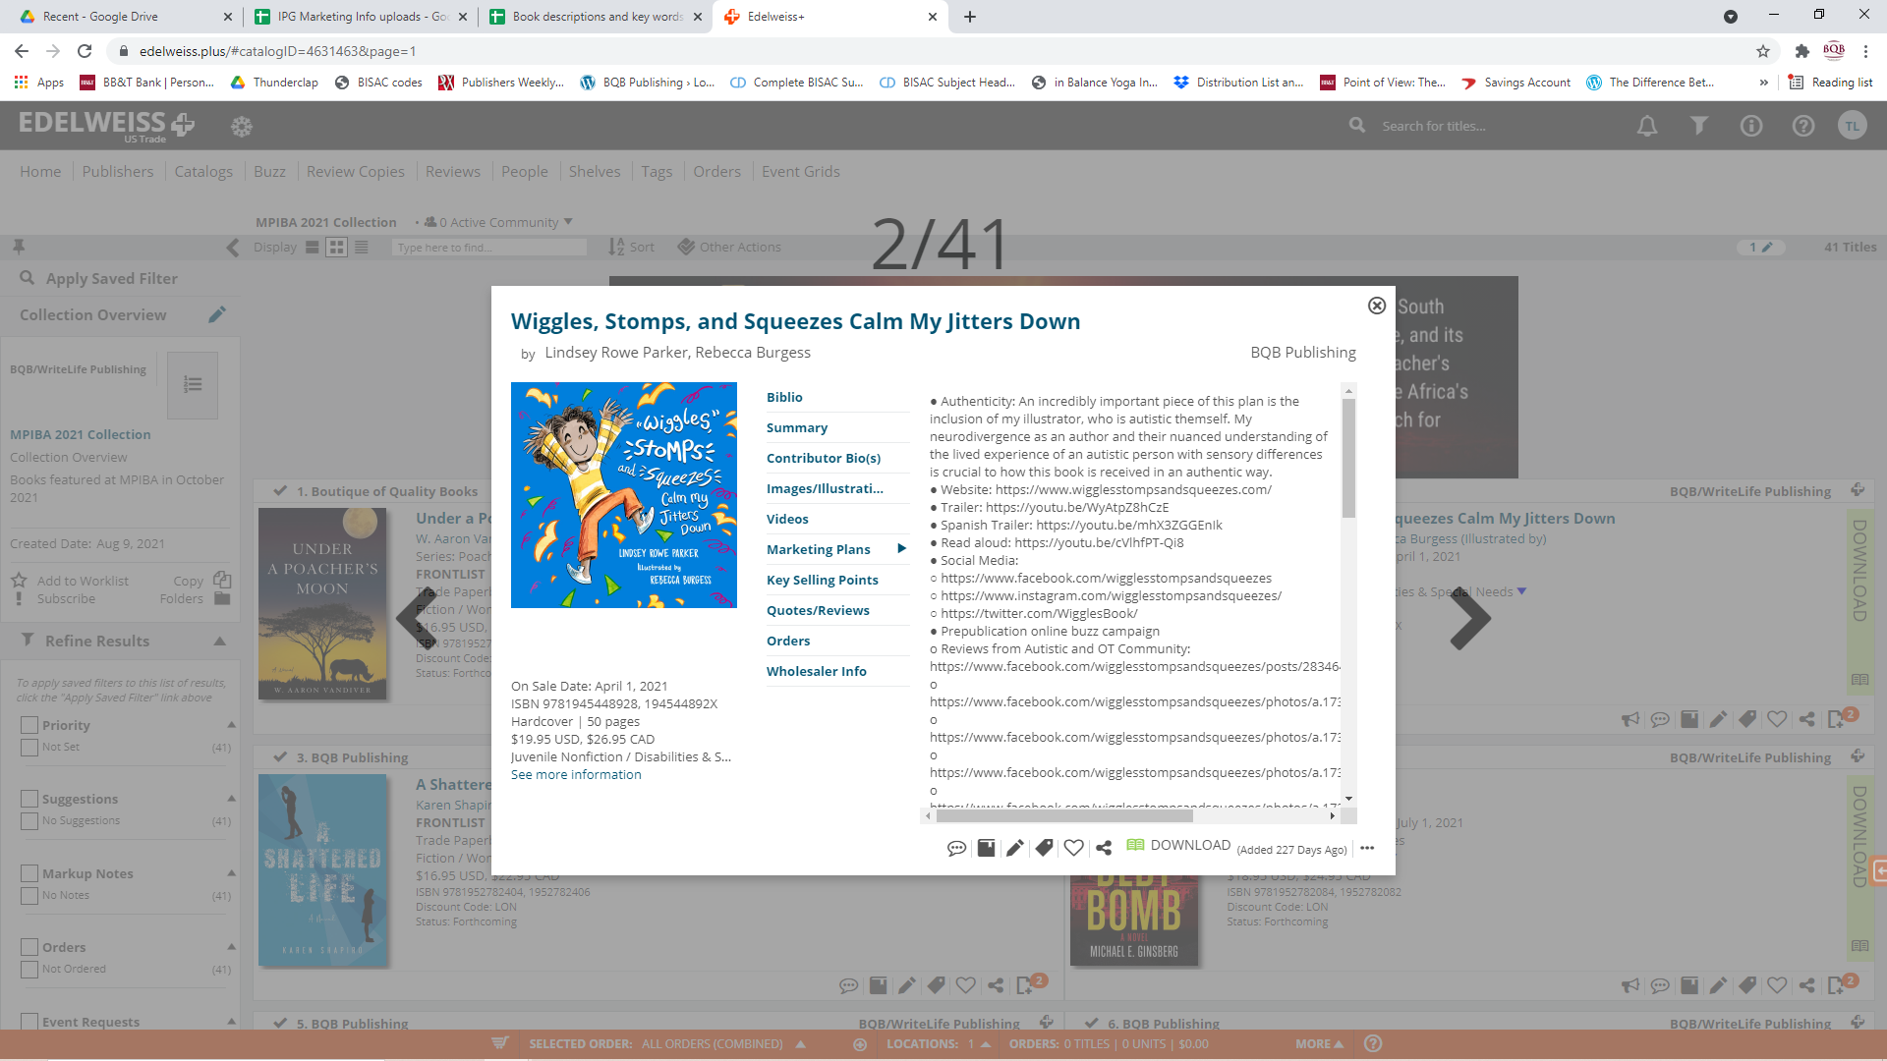

Slide 15


Slide 16
Edelweiss
We, as the publisher, have the ability to create collections of different genres, etc. to use for virtual shows or for Julie to provide those Edelweiss links in our bookseller and library newsletter.
We currently have collections for:
MPIBA
Thriller/Mysteries/Suspense
Women’s Fiction
Young Adult Fiction
Children’s books
Memoirs and Biographies

Slide 17
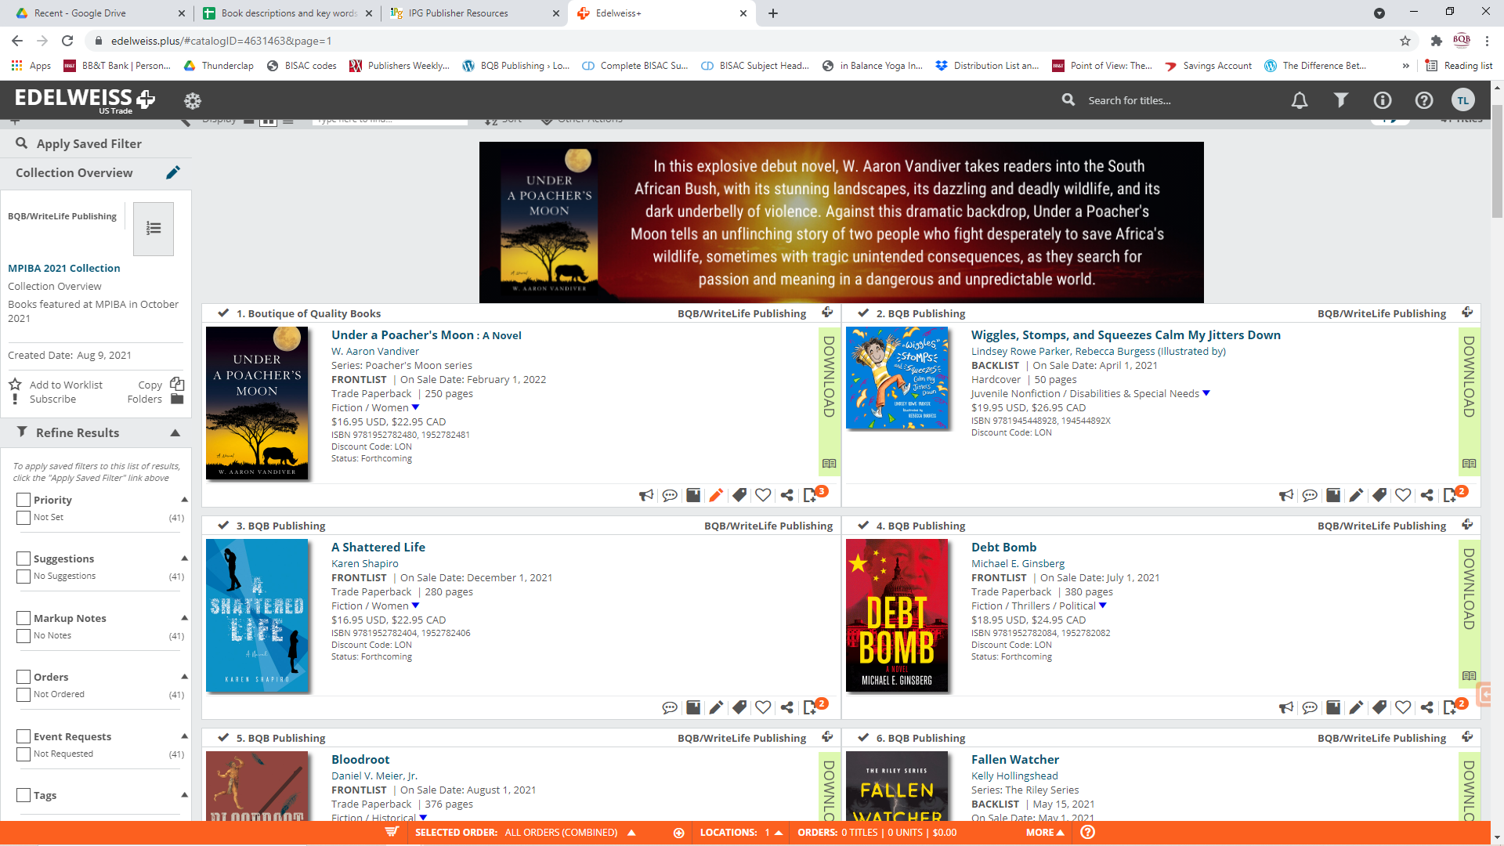

Slide 18
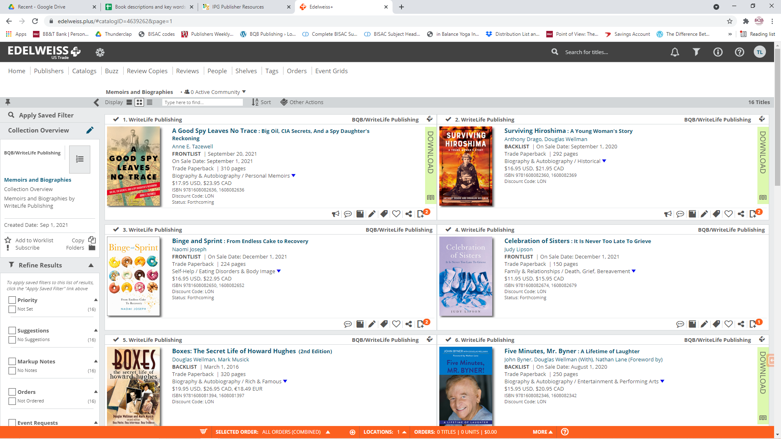

Slide 19
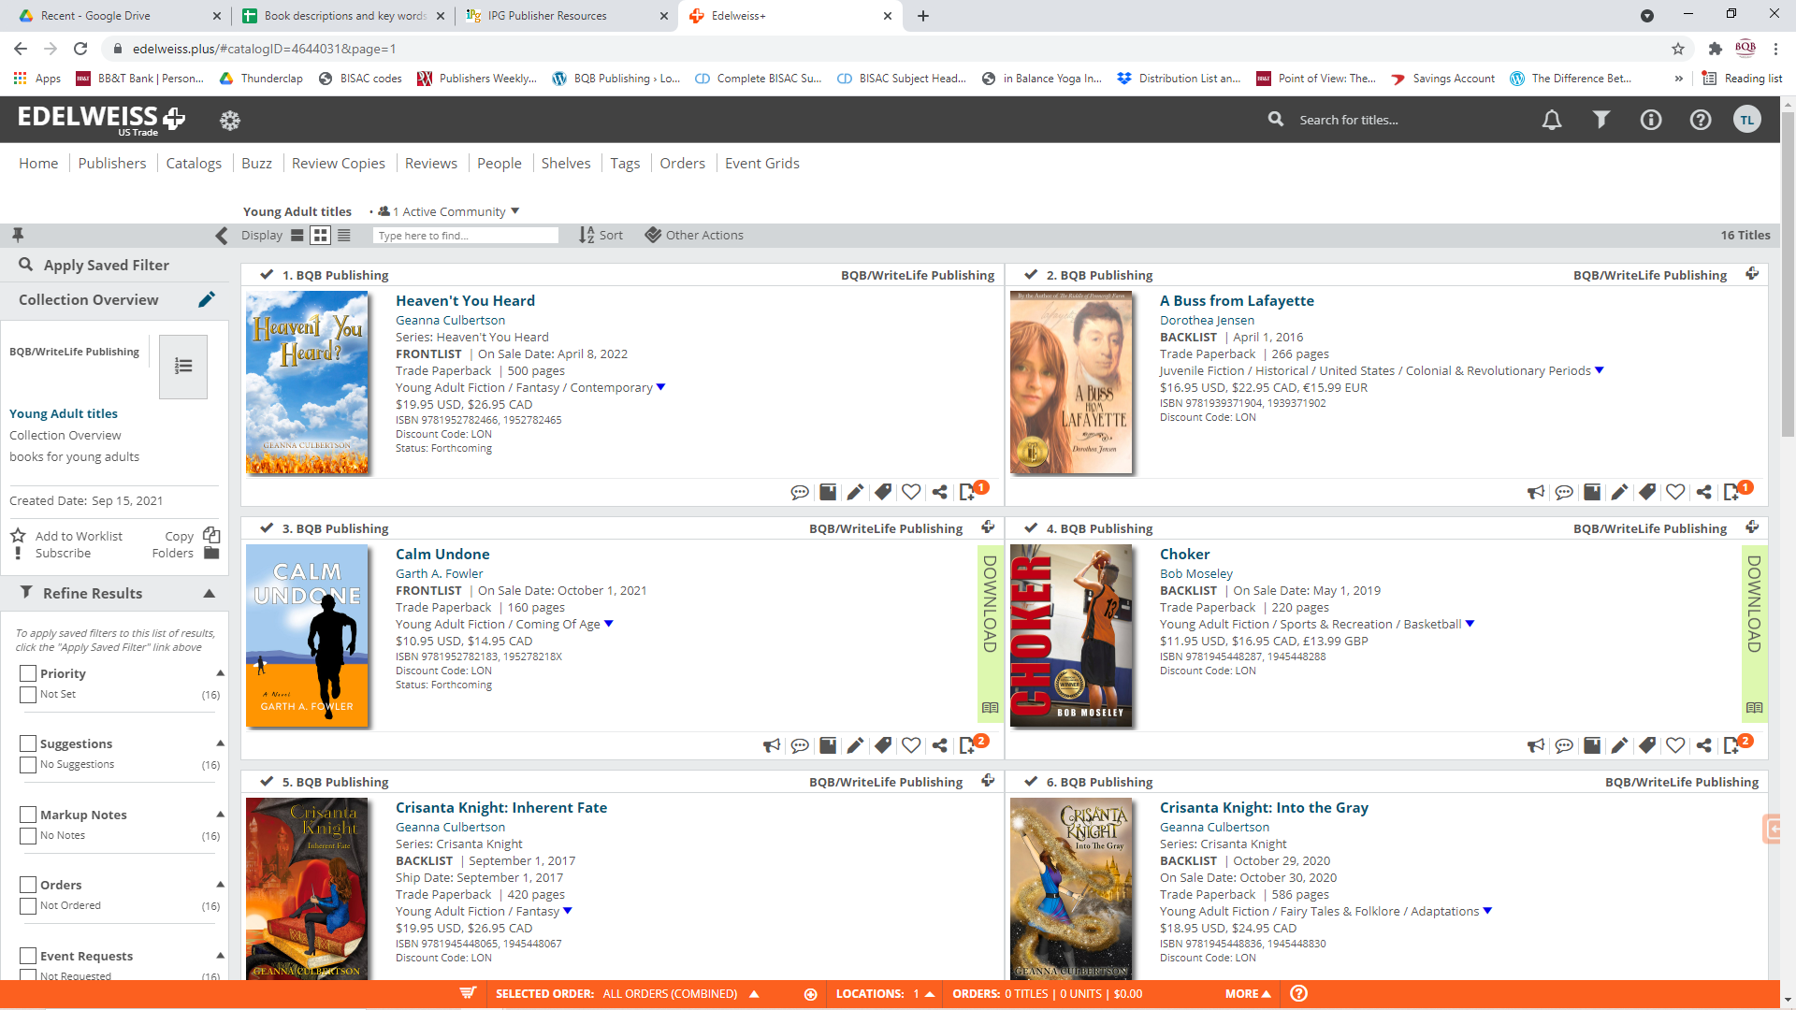

Slide 20
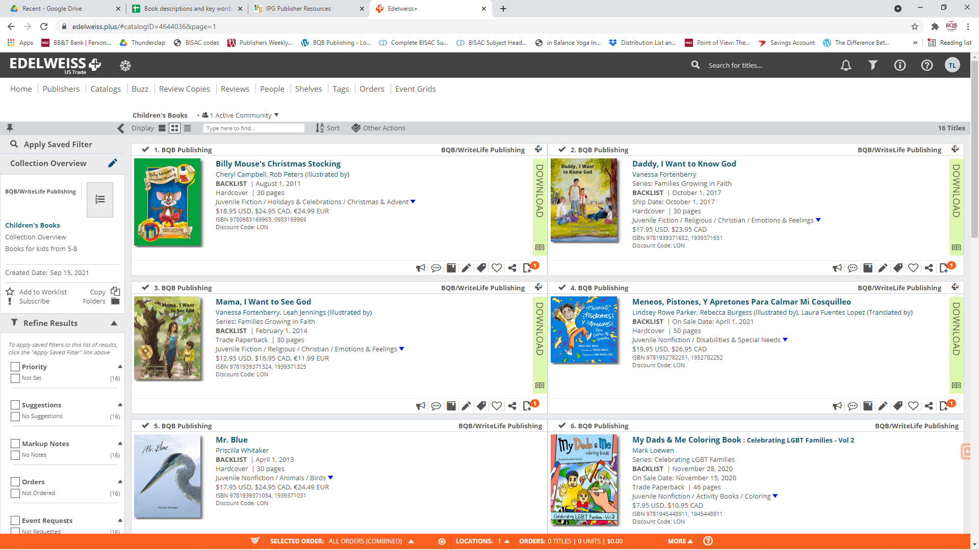

Slide 21
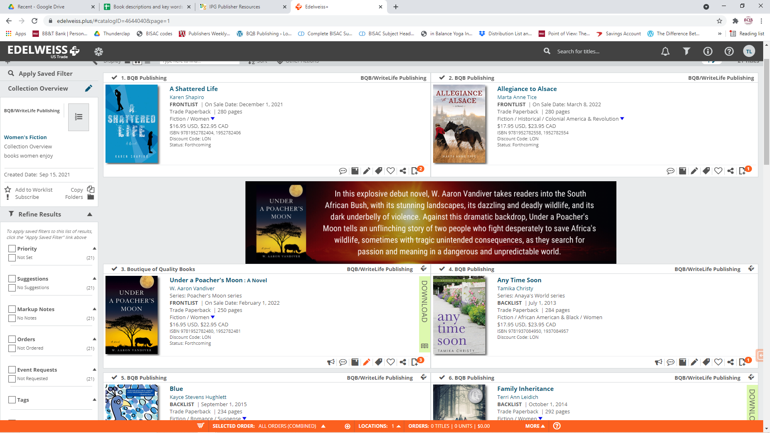

Slide 22
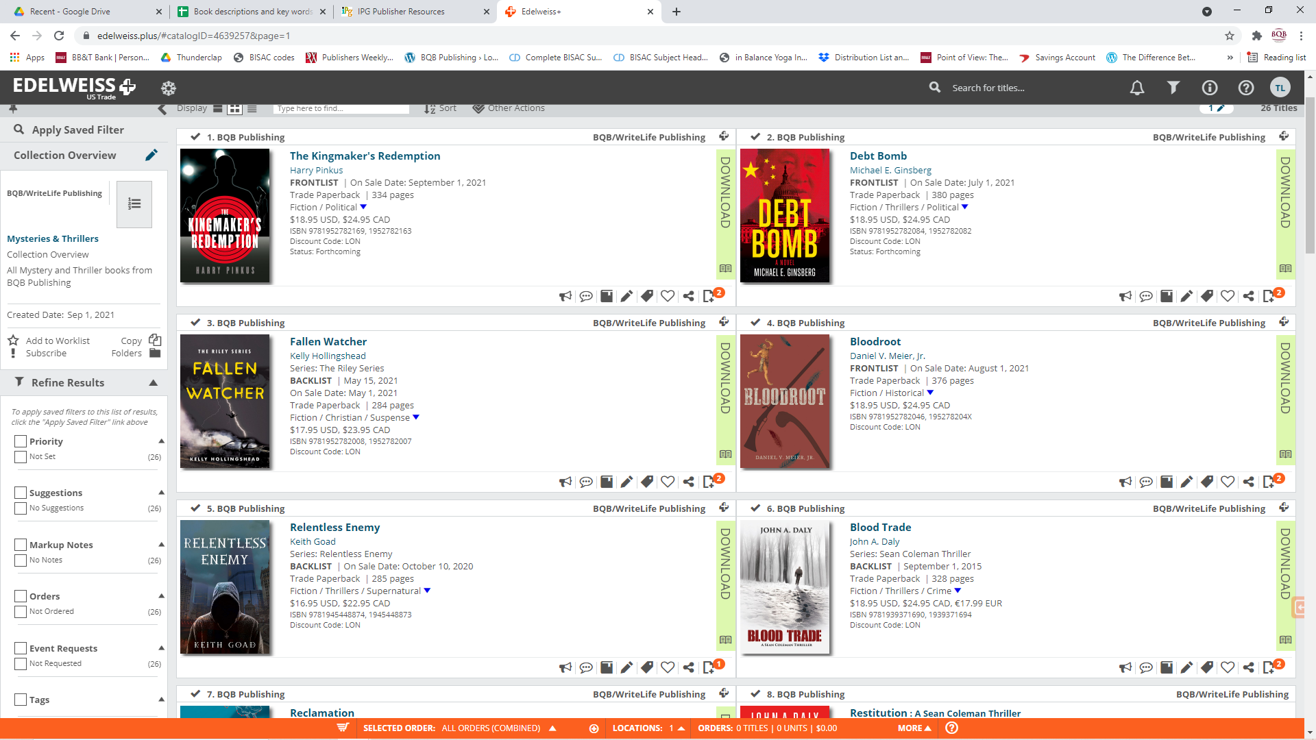

Slide 23
Edelweiss – What You Can Do
Along with providing us with the information I previously listed, you also have the option to:
Pay BQB/WriteLife $65 to have a preview copy of your book uploaded to Edelweiss
There is an extra cost of $65 to upload a preview copy of a book to Edelweiss and BQB/WriteLife isn’t able to do that for every book we publish, so we make the opportunity available to authors.
Booksellers, librarians, etc. can then download those preview copies to decide if they want to purchase your book.
The preview copy availability stays on Edelweiss for as long as we publish your book.
Pay BQB/WriteLife $240 to have a banner created and uploaded for your book to Edelweiss
Banners are also an extra cost that we make the opportunity available for authors.
See sample of the banner for Under the Poacher’s Moon that Aaron purchased.

Slide 24
Amazon – What We Do
Amazon is the overall largest purchaser of books
We are able to offer your print, eBook, and audiobook all through Amazon on one book page.
Amazon creates opportunities for publishers and authors to add additional information for readers
Via IPG, all of our book covers and metadata are uploaded to Amazon about 6-9 months before release
As a publisher, we are also able to create A+ pages for our books, which Julie does for every new book published.
This feature has not always been available so Julie is catching up with A+ pages for backlist titles as well.
As a publisher, we are also able upload videos to IPG that then get uploaded to Amazon for featuring on the book page.
These videos do not automatically post on author profile pages.

Slide 25
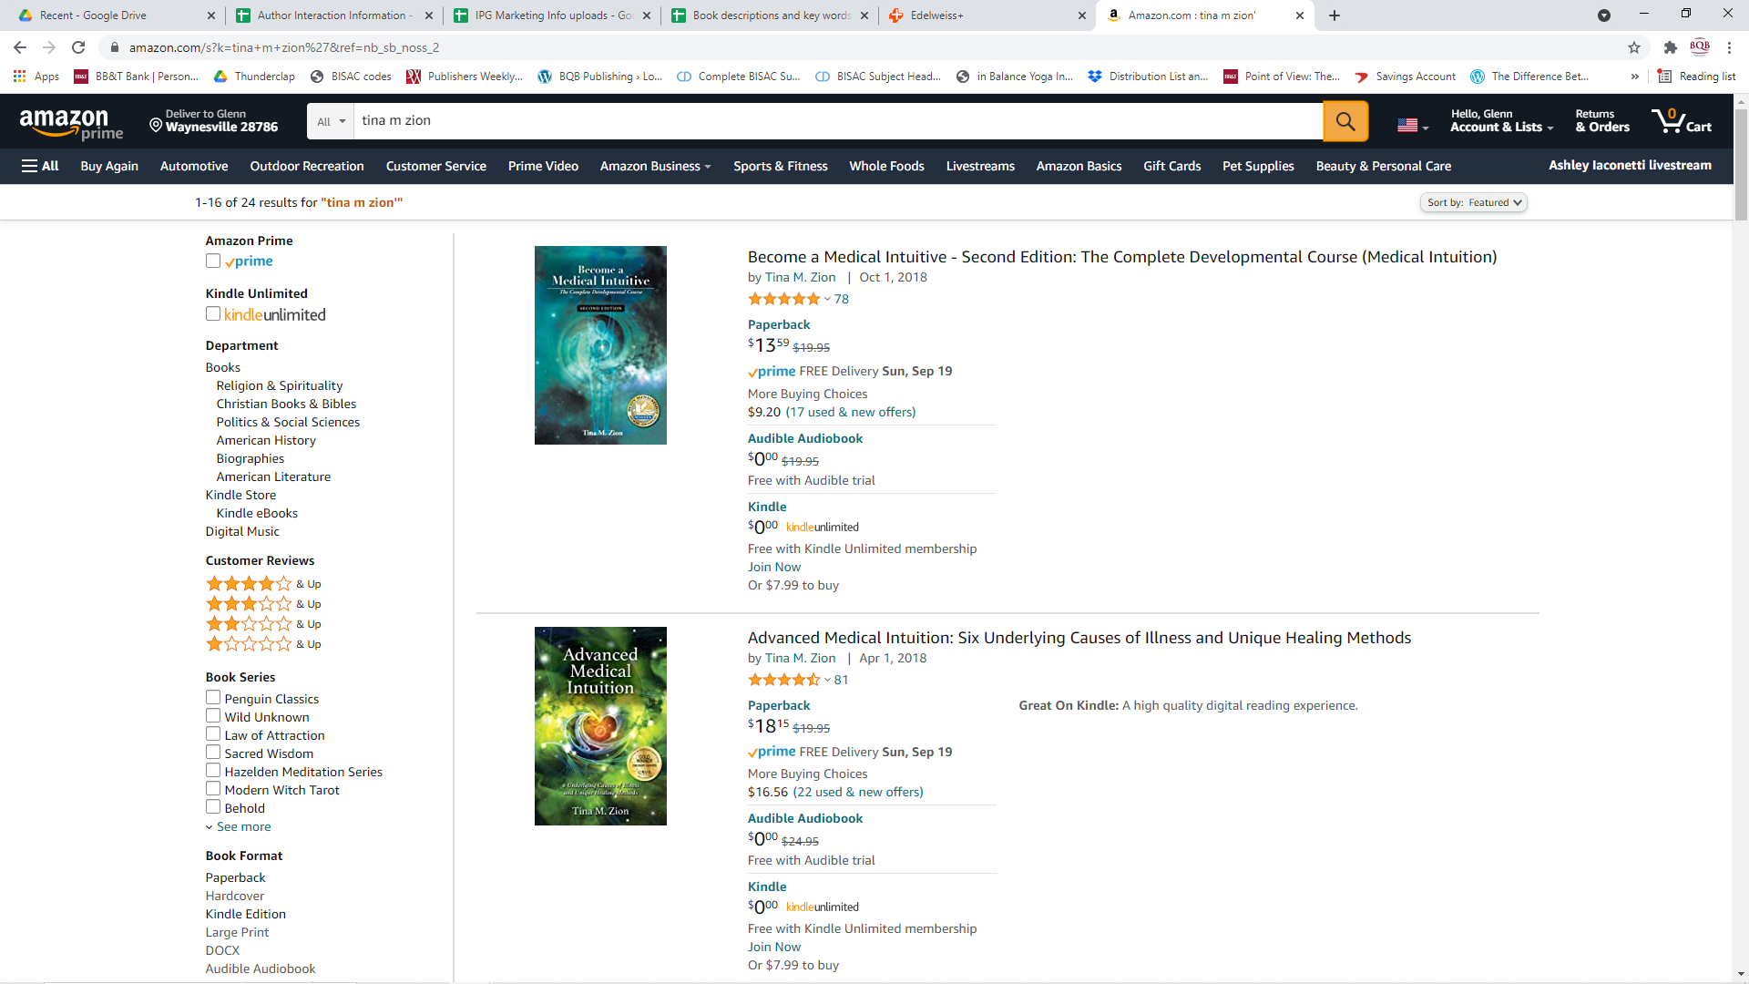

Slide 26
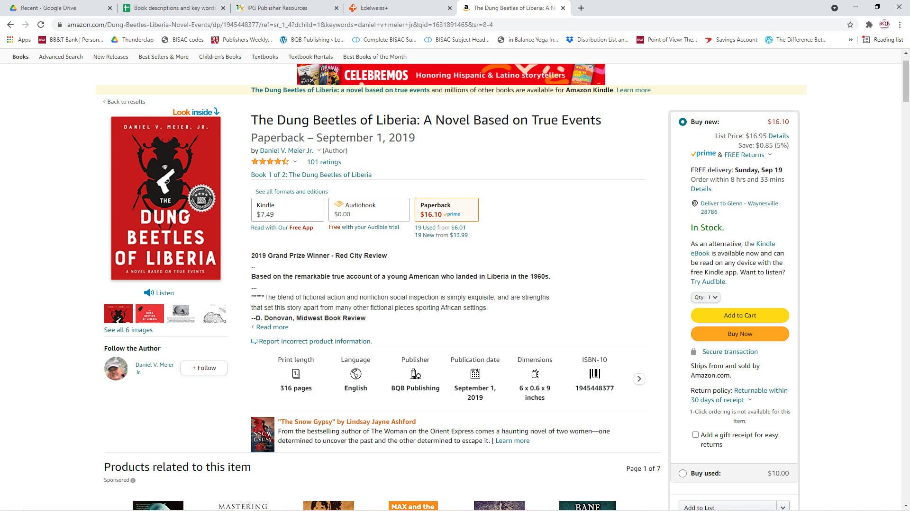

Slide 27
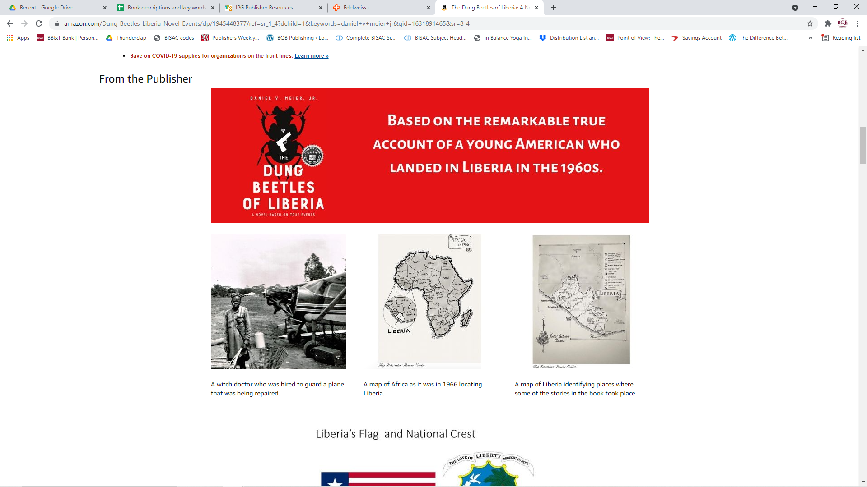

Slide 28
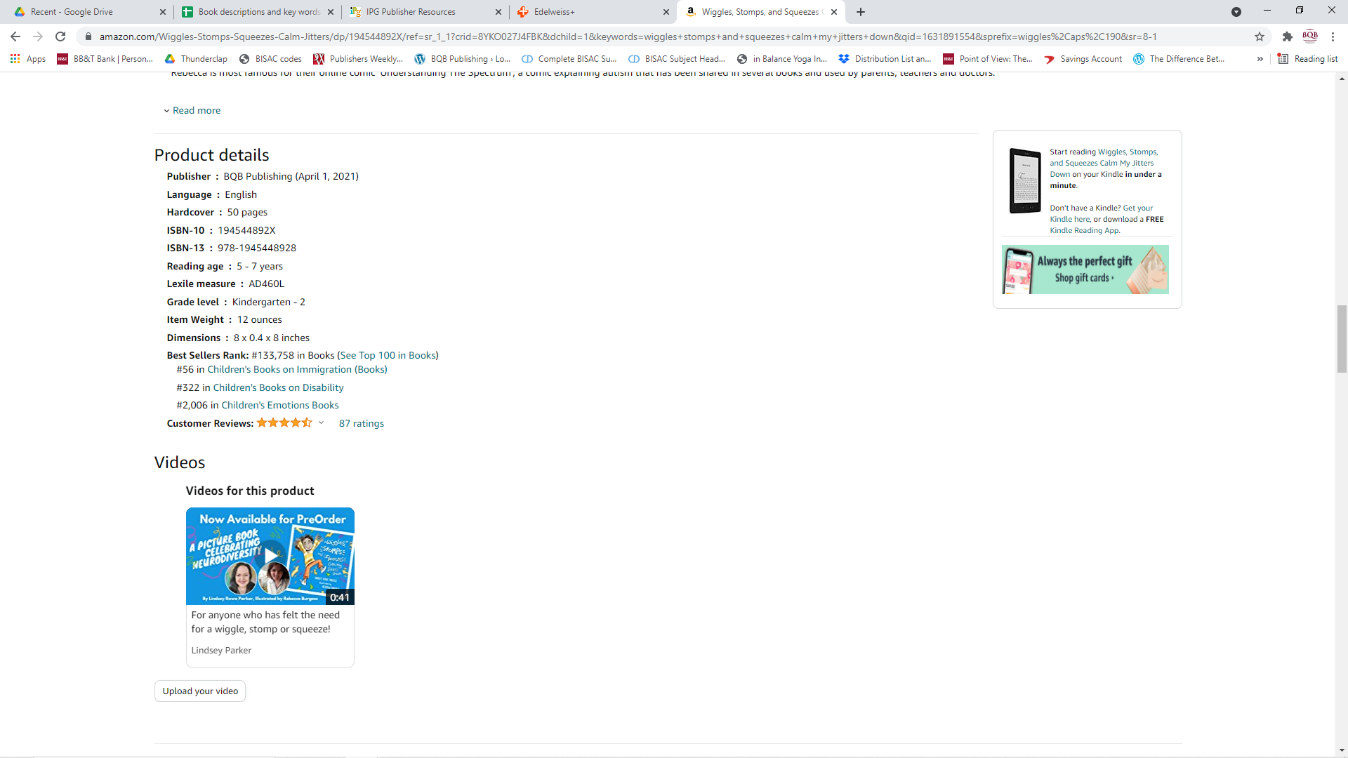

Slide 29
Amazon – What You Can Do
As soon as your book is up on Amazon, create an author profile page by going to: https://authorcentral.amazon.com and follow directions to set up the page.
Upload your videos to your author profile page.
If you create a blog or newsletter, make sure it feeds to your author profile page.
Keep your author profile page updated and make changes once a quarter.
When we release a new book for you, ensure that the book is connecting to your author profile.

Slide 30
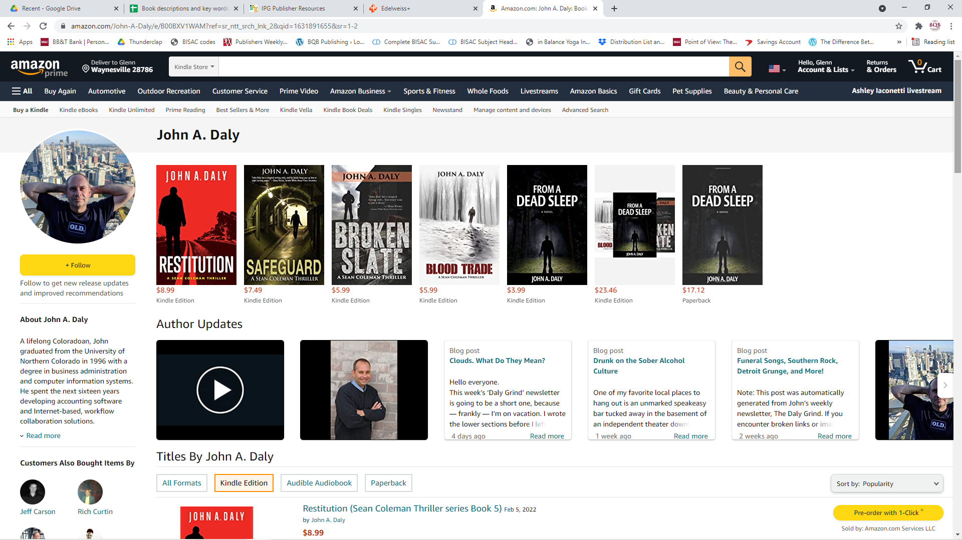

Slide 31
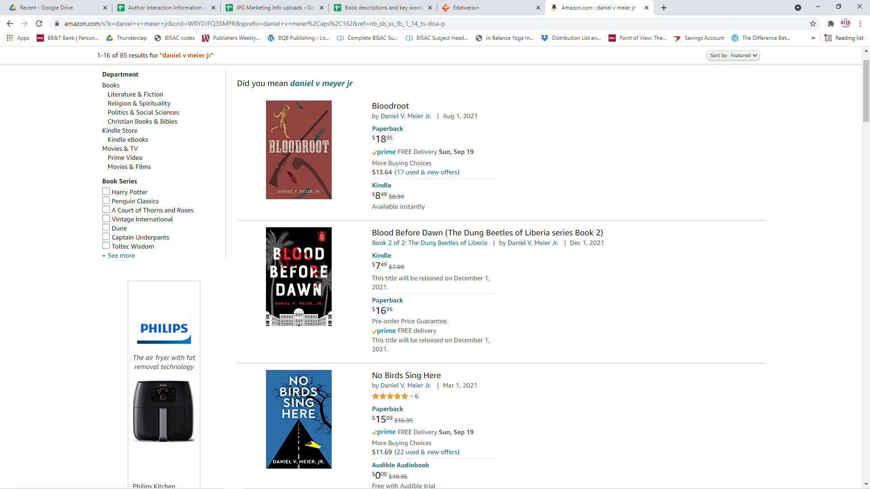

Slide 32
ARCs (Advance Review Copies)
About six months before your book releases, we create an ARC (Advance Review Copy) pdf, which Julie sends to you for sending out for reviews.
We can also print a copy with a cover that has a banner that says “Not For Sale . Uncorrected Proof - Advance Reading Copy” that authors can purchase.
The back cover will contain the book blurb as well as an overview of the marketing campaign for your book
Since Covid, most reviewers prefer pdfs, but some now want print again
About 3-4 months before release, we send ARCs to top reviewers such as:
Publisher’s Weekly
Kirkus
Library Journal
While we send to these reviewers, it is very rare that these top reviewers review our books because they have a limited number of spots and those usually go to the larger publishers. But we keep trying.

Slide 33
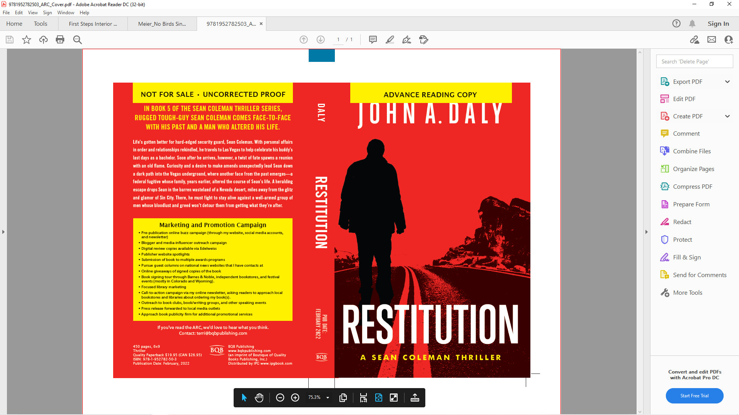

Slide 34
ARCs– What You Can Do
Create your own review list of entities and people of influence that you can send ARCs to.
ARCs can be used for obtaining reviews from influencers (authors, bloggers, paid reviewers, experts in your field, etc.)
When an author engages entities like Publishers Weekly, Kirkus, etc. to review a book, authors pay for those reviews and therefore a review is guaranteed.
I’m not crazy about Kirkus paid reviews because the reviewers do not seem to be that high quality. But, they are always an option.
Author Dan Meier’s wife, Teeja, has created an extensive list of reviewers that she sends Dan’s books to and she has been willing to share that list with BQB/WriteLife authors.
Reach out to her using the author interactive form on Google https://docs.google.com/spreadsheets/d/1rM5Tr_BAfySc4aom2Wd4IlgvWdM13iHW9sXWPT5CYw8/edit#gid=0

Slide 35
Reviews – What We Do With Them
When reviews come in, we use them in various ways:
If your book isn’t published yet, some are used for the front cover, back cover, or interior first few pages of your finished book.
They are posted on our social media.
They are sent to IPG for the sales reps to use

Slide 36
Reviews – What You Can Do With Them
Post them on:
Your Website
Goodreads
Your Blog
Facebook
Instagram
Twitter
YouTube
Post influencer reviews via your profile on Amazon under Editorial Reviews
For reviews in general:
Keep asking for them, even after your book is in the marketplace or has been for some time
A review posted on social media can retrigger interest in your book.
Reviews on your website can help trigger SEOs which get you listed in searches
Reviews on Amazon are important
People who buy in other places still look for reviews and author profiles on Amazon.
Reviews on Amazon impact the number of your books they stock and act in triggering the marketing features (people who bought this, bought these, etc.)
You need at least 10 reviews on Amazon for their algorithms to recognize your book
Amazon requires from 30-50 reviews on a book for me to nominate a book for their eBook promotions.
It takes 100 reviews on Amazon for all marketing features to kick in

Slide 37
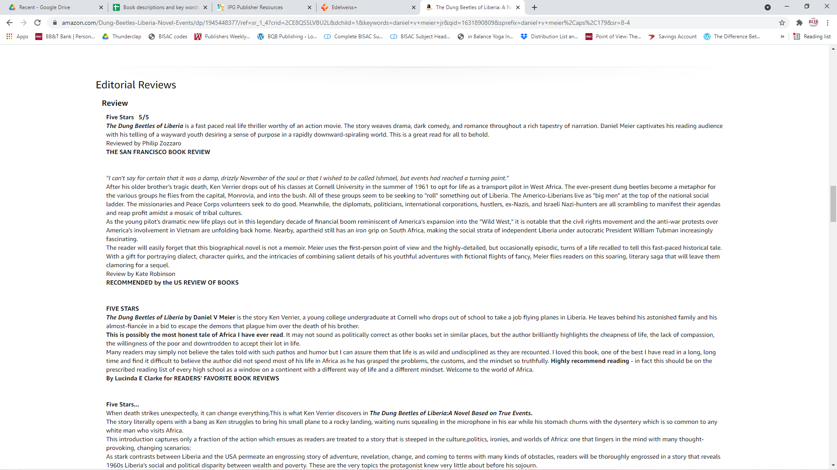

Slide 38
eBook Distribution – What We Do
Inscribe
Our ebook distributor
They sell to eBook retailers all over the world
Amazon
Barnes & Noble
Kobo
iBookstore
Bookazine
Wheelers
Libraries via eBook retailers like OverDrive, Hoopla, Baker & Taylor, etc.
Over 100+ eBook retailers
We convert all print books we publish into eBooks and upload them to Inscribe
We pay yearly fees to keep your book active on Inscribe
We have access to 250 free eBook codes for each iBook we publish (email Julie if you wish to use some of these codes.

Slide 39
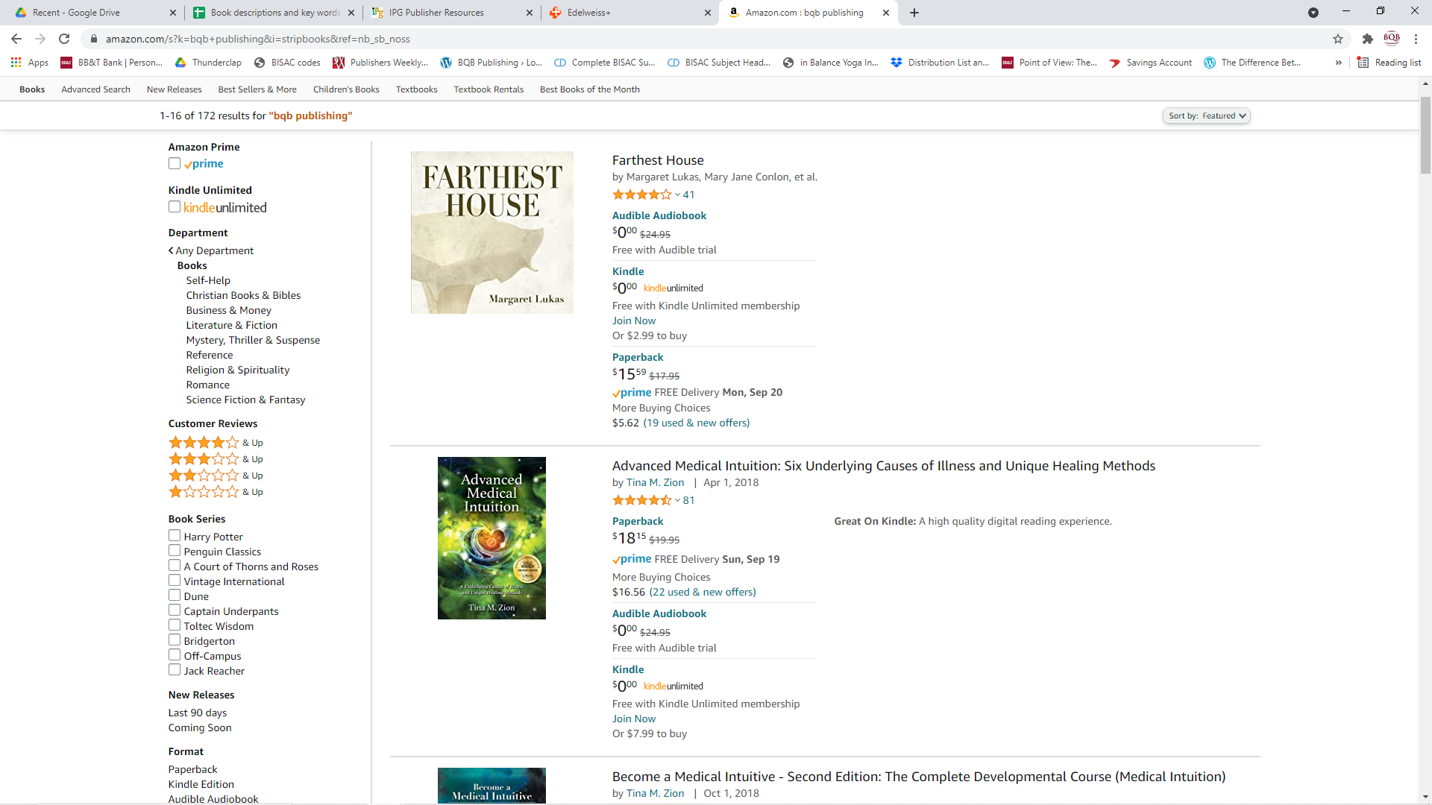

Slide 40
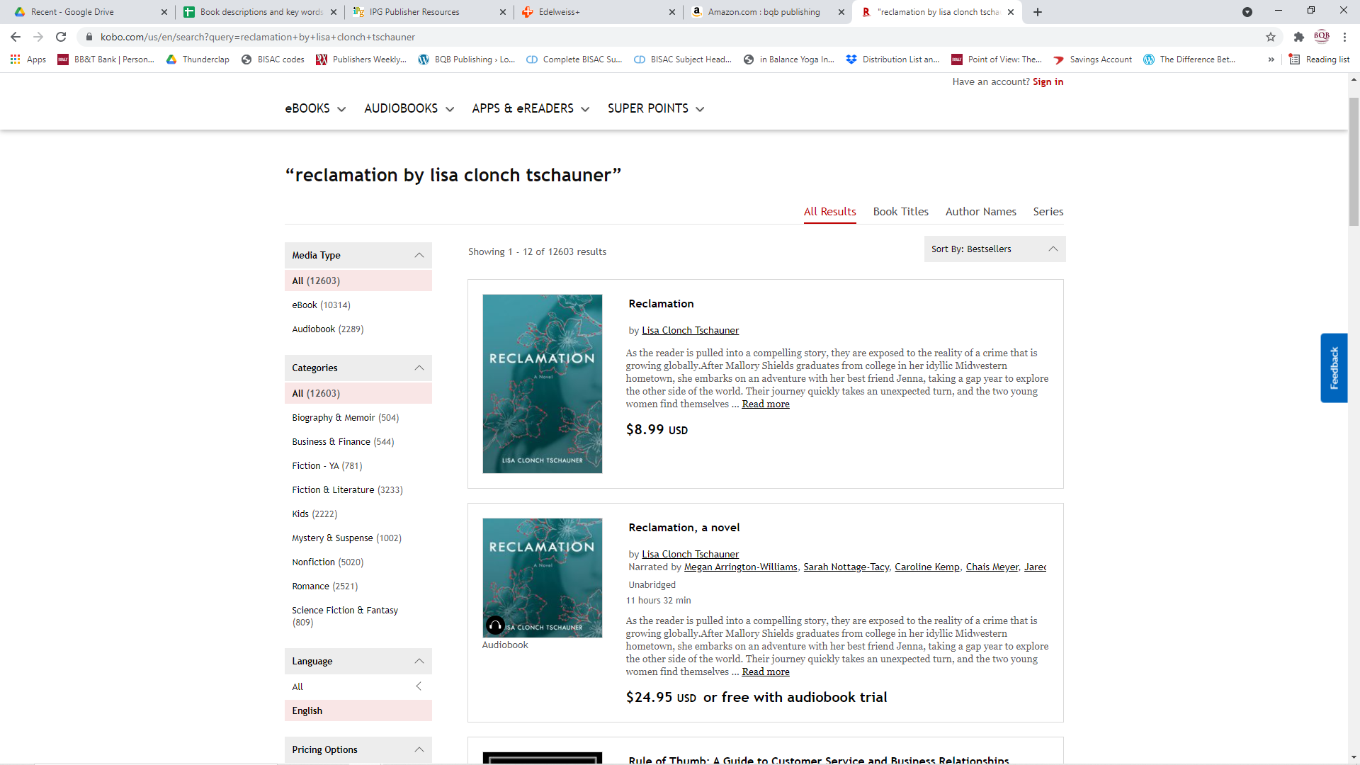

Slide 41
eBook Distribution – What We Do
Inscribe has a dedicated eBook marketing team that constantly works with eBook sellers on promotions and sales
Each month we receive a newsletter outlining the eBook sales campaigns that are occurring in the next few months, specifically with retailers like Amazon, Kobo, Apple, OverDrive, and Hoopla
We review the marketing opportunities, check our eBook marketing calendar and submit eBooks that are a good fit for the promotion
We market those opportunities through social media, etc.
If we know that our sales nominations have been accepted and will be active, we send emails to the authors who are impacted by these sales.

Slide 42

Nominate for Kobo Nonfiction Price Promo Kobo Books CA - DUE THIS WEEK: Nonfiction Price Promo Price: $4.99 and under Kobo CA will be running a Nonfiction Price Promo, from March 12-16. This sale will focus exclusively on nonfiction titles, promotionally priced at $4.99 and under (excluding free). Dates: Mar 12-16, inclusive Kobo will be supporting the campaign as follows: Standalone email to CA on March 13 Carousel on the homepage leading to the sale LP for the duration of the sale Please assume that all titles submitted will be included in the sale, unless you hear otherwise from us. The latest date for submissions is End of Day, March 4th . DUE: 3/4 PRICE: FREE

Slide 43
eBook Distribution – What You Can Do
Let readers and fans know your eBooks are available through all major eBook sellers
Have links on your website and social media that readers can click on to go directly to booksellers. (Julie can provide you with a list of links)
Share purchase links on your newsletters and Blogs
Watch your metadata, etc. on the different websites and let Julie know if there are typos, etc. so we can get them fixed.
Build your author brand and promote your book to help drive business to bookstores, wholesalers, IPG.
Amazon is a top eBook seller so make sure your Amazon profile is set up as soon as your book appears on their site and update it from time to time
Create marketing campaigns or virtual tours that can use the iBook store codes for your eBook(s).

Slide 44
Using BookBub (and similar programs) – They’re all About eBooks
There are several sites like BookBub, Free Booksie, etc. that have newsletters they send out on an ongoing basis to promote sales or giveaways of eBooks.
BookBub is the most popular one.
They sell ad space in their newsletters and publishers submit applications for the ad space.
BQB/WriteLife sends submissions (through Inscribe) on an ongoing basis. When we are accepted, we run a promotion on the book either as a free eBook (if you have a series), a $.99 sale, or a $1.99 sale. The book and genre determine how we submit it.
Ads in a newsletter like BookBub can really get attention to a book.
They have newsletters for the US market and for the International market (Canada, UK, Australia, India, etc.)

Slide 45
Using BookBub (and similar programs) – They’re all About eBooks- cont’d
The category and territory of the ad is determined by BookBub. On other sites, we have some input into that. Once an ad is offered to us, it is up to BQB/WriteLife to either accept or reject. We determine our response by what is offered and the price attached to it. If we feel we will recoup our investment, we say yes.
Prices on BookBub newsletter promos can cost from $300 - into the thousands depending on the genre category and the territory.
If we are successful in securing a BookBub, or similar ad, BQB/WriteLife pays for it and then the fee is put into the book royalty report for that particular author and BQB/WriteLife and the author split the fee and it goes against the royalties of the eBook sales.

Slide 46
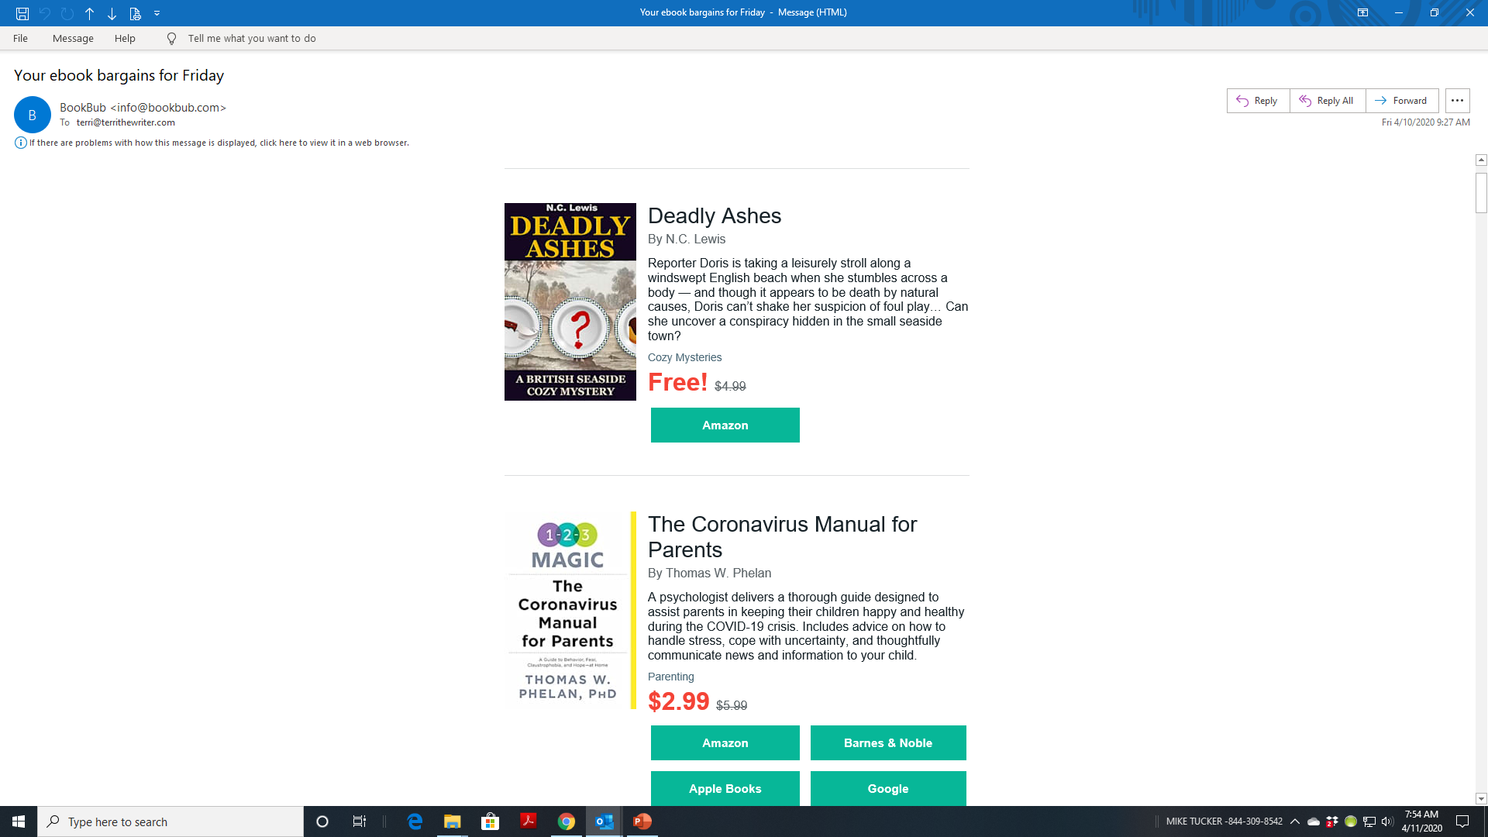

Slide 47
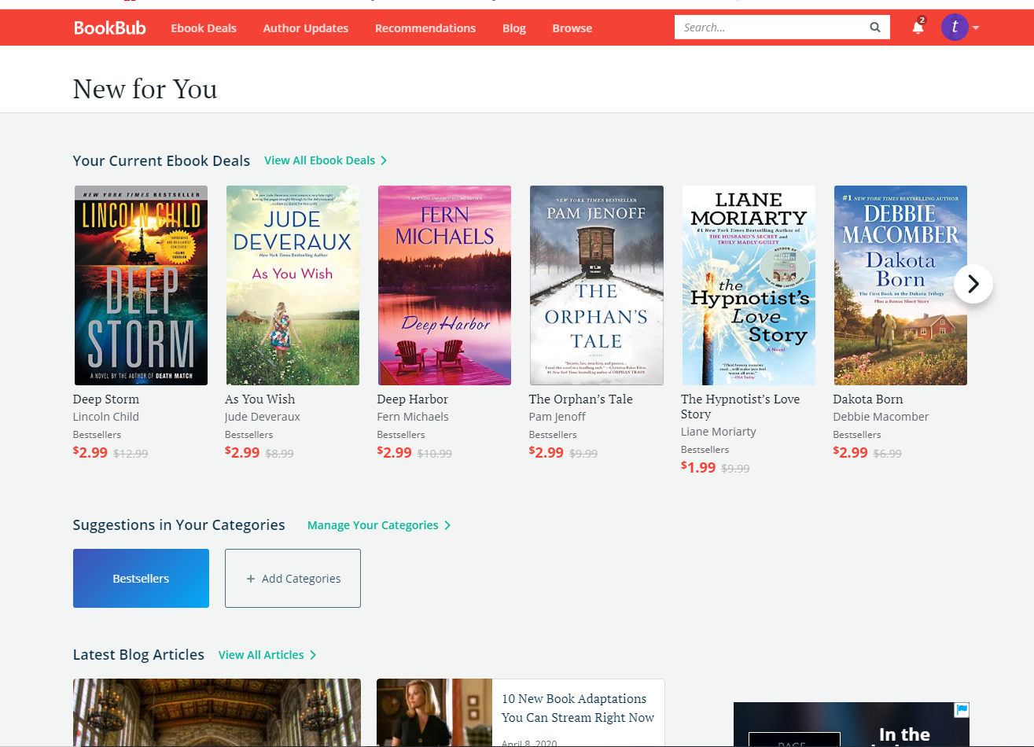

Slide 48
BookBub – What You Can Do
Register for BookBub (www.bookbub.com) as a reader so you are familiar with what they do and what books they feature.
Claim your author profile on BookBub.
When you claim your author profile, you will have the opportunity for different marketing options.
When we get a BookBub (or other newsletter) ad for your book, we’ll let you know. When we do, promote it heavily on social media and retweet, repost, the social media posts from BQB and/or WriteLife
If you have an email list or newsletter, promote the special through those means.

Slide 49
NetGalley – What We Do
Keep a constant present on NetGalley, featuring 10 books a month
NetGalley is a site where bloggers, booksellers, librarians, etc. can go to discover and review new books
We post books on NetGalley the month before and the month of release. If a book is part of a series, we will also post any backlist titles that are part of the series.
We offer the other available spots to authors at the rate of $85 per book per month. (If you went to NetGalley on your own, the cost per book, per month would be $250+)

Slide 50
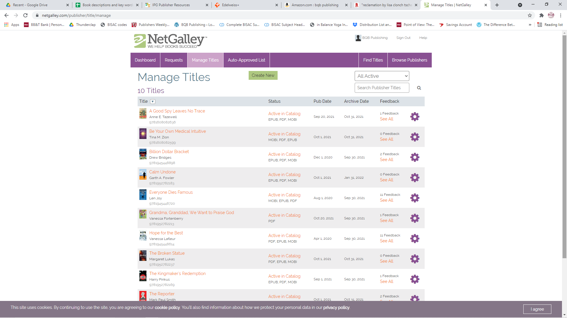

Slide 51
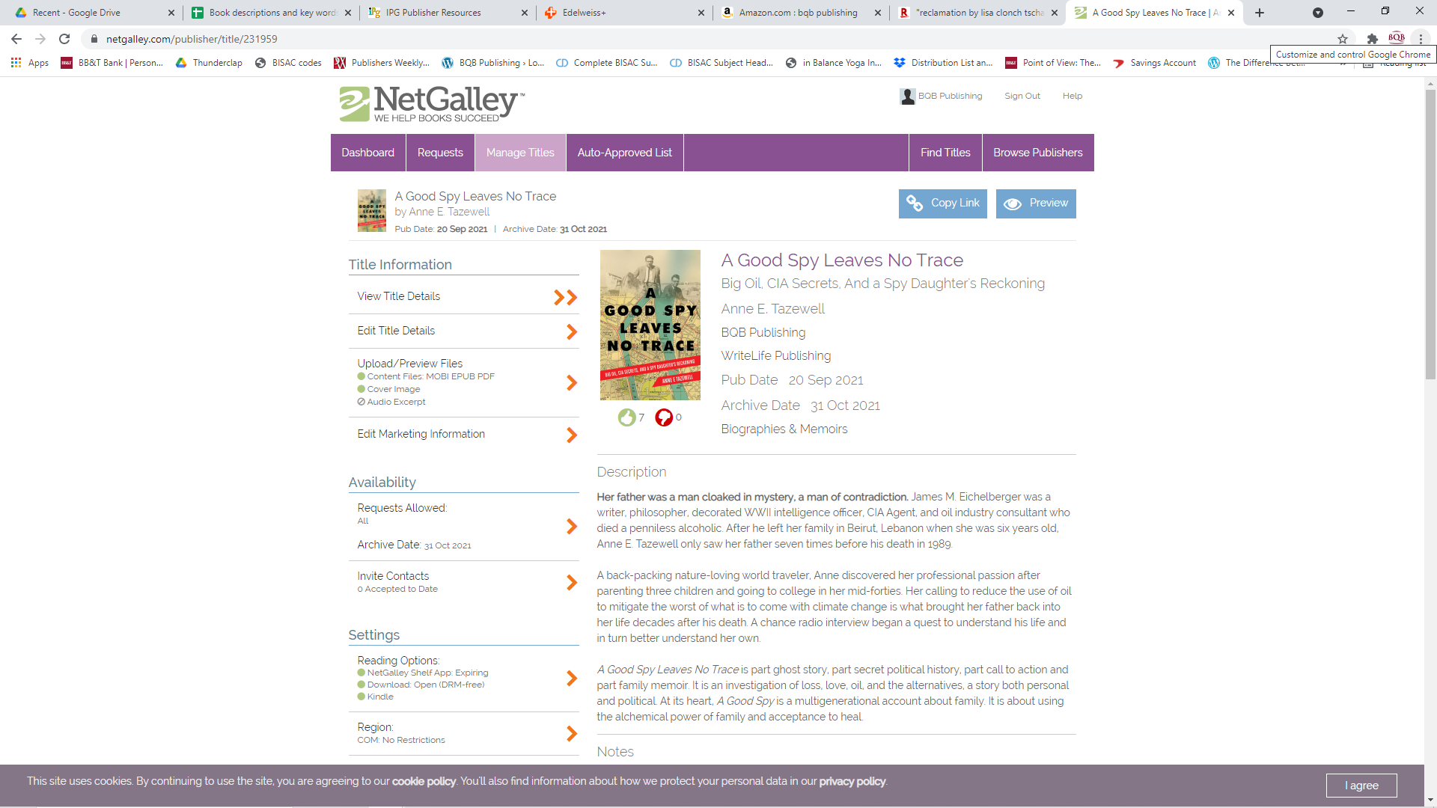

Slide 52
NetGalley – What You Can Do
Let booksellers, librarians, bloggers, etc. know when your book is on NetGalley so they can request to review it. Julie can provide you with a link.
Contact Julie if you want a NetGalley spot for your backlist title or to keep your front list title on NetGalley for a longer length of time.
When you receive reviews from NetGalley (that Julie will email to you), get them out on social media, in your newsletter, etc.

Slide 53
Audibook Distribution – What We Do
Depending on how your audiobook is created (Pay for Production, DIY, Royalty Share), we distribute your book through two distributors:
ACX
Audible
Apple
Findaway
Kobo
Overdrive
Apple
Libro.fm (through bookstores)
Other smaller
If your audiobook is created via royalty share, we are limited to distributing only via ACX.
If your audiobook is created via Pay for Production or DIY, we can distribute through all entities

Slide 54
Audibook Distribution – What You Can Do
Work with Julie to get your book created into an audiobook.
Make sure you always let readers know that your book is available in print, eBook, and audiobook.
Focus some of your marketing on audiobooks.
Julie can provide you with audiobook codes that will allow you to get reviews on your audiobook.
Use audiobook codes to reward super fans or street fans.
NOTE: On Amazon at a quick glance, it looks like your eBook and audiobook are offered for $.00 but read the fine print, that is only if a reader belongs to their monthly eBook or audiobook programs. Otherwise, they pay the price offered on Amazon.

Slide 55
Social Media – What We Do
Our Social Media Manager, John Daly, maintains social media accounts for both BQB and WriteLife on the following sites:
Facebook
Twitter
LinkedIn
He creates posts for our books and authors on an ongoing basis and covers both new releases and back list titles.
John follows the majority of our authors and reposts, retweets, etc.
Julie, Glenn, and I follow BQB and WriteLife and repost and some of our followers repost as well
This is how we continue to get a larger following to you, your book(s), and your events

Slide 56
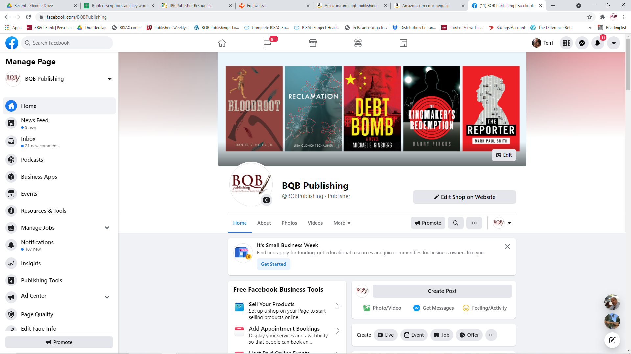

Slide 57
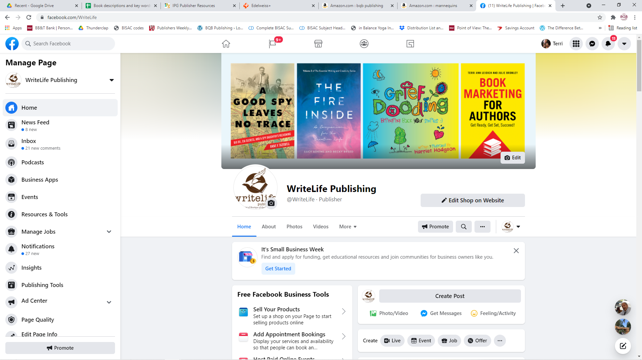

Slide 58
Social Media – What We Do
Glenn is going to start experimenting with Facebook ads to see how we can make those really work for our authors and books.
If you have experience with Facebook ads, reach out to Glenn (glenn@bqbpublishing.com) and let him know your experience.
We’re working on expanding our reach and interaction on:
Pinterest
Instagram
We have a BQB/WriteLife group on Facebook where our authors can interact with each other, ask questions, etc.
We have Street Team Facebook pages for both BQB and WriteLife
Street Teams are basically marketing teams whose whole purpose is to help promote and share information on our authors and books.
We will periodically offer free eBooks or audiobooks to the member of our street teams as a thank you for their help in marketing.

Slide 59
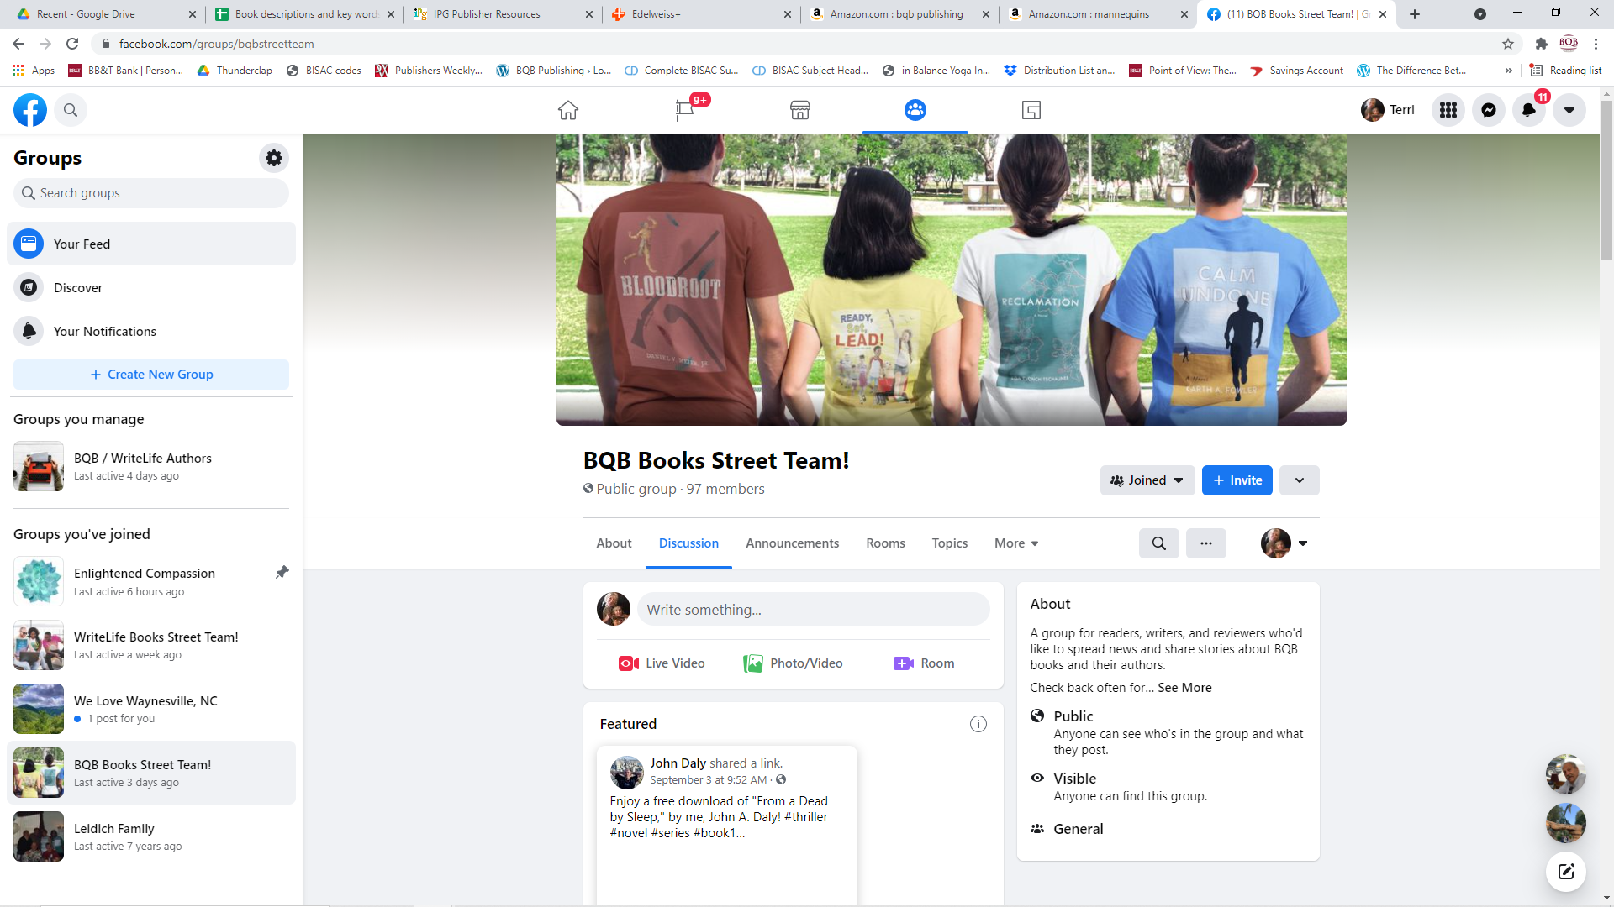

Slide 60
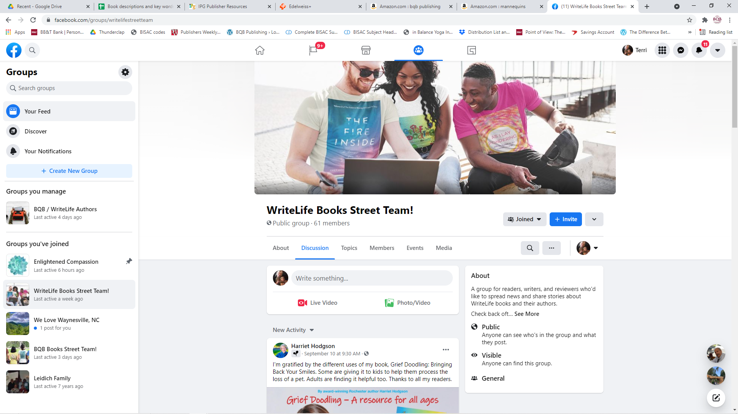

Slide 61
Social Media –What You Can Do
Make sure you follow both BQB and WriteLife on the following sites:
Facebook
Twitter
LinkedIn
Pinterest
Instagram
Repost, retweet, etc.
If it’s about an event, a story about your or your book, or a review, tag IPG (on Facebook and Instagram @IPGBook) on Twitter @IPGbooknews
Follow your fellow BQB/WriteLife authors and ask them to do the same for you
Make sure John has information on your events, your reviews, any appearances, publicity, etc. so he can put the info out on social media

Slide 62
Social Media –What You Can Do
Join the BQB/WriteLife group on Facebook where you can interact with each other, ask questions, etc.
To the group on Facebook. Search groups for BQB/WriteLife Author Group and submit a request to join.
If you are a BQB/WriteLife author, John will accept your request and you can start interacting.
Use this group to interact with Terri if you have general questions you need answered instead of using email.
F0llow the BQB and WriteLife Street Team Facebook pages.
Understand that “liking” a post doesn’t do a thing except give a warm fuzzy to the author.
The power is in sharing.
When you “like” on our Street Team pages, you are not contributing to these pages in any way.
Street Team posts should be “shared” so that the information will get to your group of followers, because that’s where your power is with Facebook.
Street Team pages are not for posting your newsletters, etc. These pages are not for self-promotion, they are for the group promotion of BQB/WriteLife authors and books.

Slide 63
Advertising on Social Media
If you decide to advertise on social media, make sure you are targeting one of two goals:
Expanding your following
If your advertising just reaches your already established following, it is redundant because your posts about your books are already reaching your followers
Getting information about your book out to an expanded audience
With Facebook advertising, you can target certain age or interest groups. Make sure you spend some time getting as close to your niche market and you can with that targeting.
On other social media, investigate the approaches that they offer. Don’t just blindly spend advertising money without understanding who you are advertising to.
Adjust your advertising to the social media you are advertising on. Don’t do a “one size fits all” approach.

Slide 64
Newsletter – What We Do
Julie creates and send four newsletters a month – 1) BQB/WriteLife Authors 2) Customers who have signed up for our newsletter 3) Booksellers 4) Librarians.
Each newsletter is created for the target market and provides information that is pertinent to that group.
For customers and booksellers, we announce new releases, awards, etc. to keep them informed about our books and authors.
Julie has also started adding links to Edelweiss groupings for our bookseller and librarian newsletters

Slide 65
Newsletter – What We Do
Our monthly newsletter provides ongoing, important information for our authors.
If you only read one correspondence from us a month, read the author newsletter.
There is repetitive information at the bottom of each newsletter because it is ongoing info that can help the new authors coming in be brought up-to-date and to help long-time authors have their memories refreshed.

Slide 66
Newsletter – What You Can Do
Read our BQB/WriteLife Newsletter each month.
Create an author newsletter. It is one of the most powerful marketing tools you can use as an author.
You’re a writer. Creating a newsletter should be right in your skillset.
Author newsletters can be used to build fans and keep followers up-to-date on what’s happening with you and your book.

Slide 67
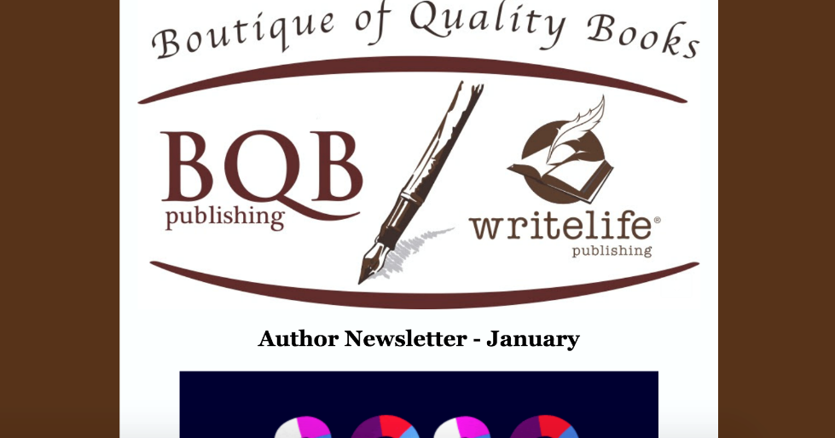
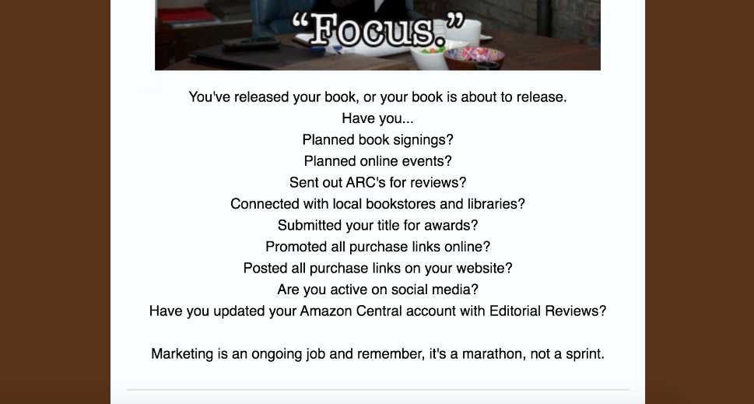
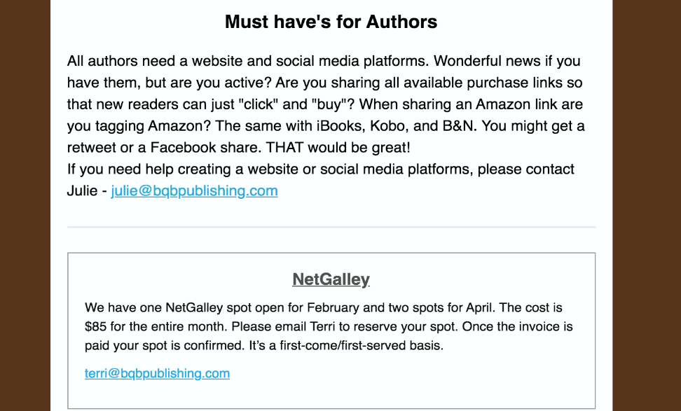
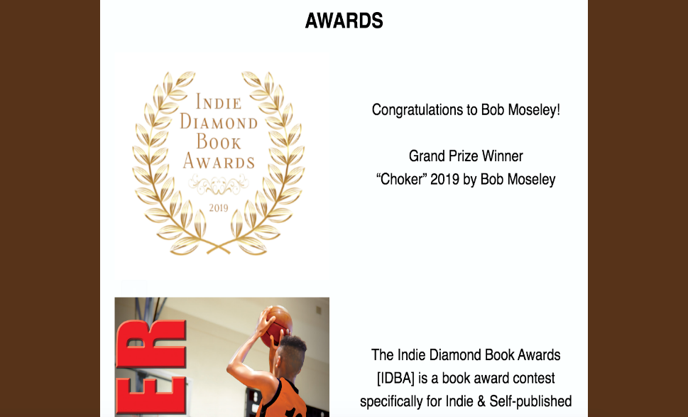
Examples from our Author Newsletter

Slide 68
Promotions Through IPG
Twice a month, I get a newsletter from both IPG and Inscribe describing the most recent promotion options including:
Advertising
Promotions
Publicity call outs
Award program announcements
Many of them, we just handle on this end. For others, we send out emails to either all authors, a group of authors, or a specific author.
Most of the print promotion opportunities are for front list titles (those that are releasing in the current year).
We keep authors informed of marketing and promotion opportunities that you can tag into at a cost and you have the option to do so.
We continuously participate in marketing and advertising promotions that are a part of our budget.

Slide 69
Promotions Through IPG – What You Can Do
Watch for emails from BQB/WriteLife or specific emails to you from Terri or Julie and carefully consider the opportunity being offered. Then respond accordingly.
Make sure you have a yearly budget for your book(s) that will enable you to participate in these promotions.
When you become aware of promotions that are set up for your book(s), help spread the news.

Slide 70
Advertising and Marketing in General
We are continually changing and improving our inhouse marketing and the opportunities we provide to our authors.
We are expanding our marketing and advertising reach by taking advantage of opportunities from entities like Publishers Weekly, NetGalley, Amazon, etc. When we combine several books/authors together in a campaign, authors can participate at a much lower fee than if they tried these promotions on their own.
Teaching each of you, our authors, how to market is a big part of what we do to help you succeed. We will continue to look at additional ways to do that.
Glenn has joined our team as our BQB/WriteLife Author Liaison for you to reach out to with questions about marketing or to brainstorm ideas that you’re tossing around. His email is glenn@bqbpublishing.com and he’s here to help you.

Slide 71
Advertising and Marketing– What You Can Do
Create a marketing budget each year so you can have time and resources to participate.
The more you participate in marketing, the more your royalties will increase (both those that cost money and those that take time).
Watch for marketing and/or advertising opportunities through BQB/WriteLife.
Read the author newsletter each month because Julie communicates marketing opportunities in it.
Pay attention to group emails that come from Terri because that is the medium that she uses for communicating opportunities.

Slide 72
Book Shows
Each year, BQB/WriteLife either attends book shows (in person or virtual) or works with IPG or other entities to display our books and/or secure spots for our authors at them.
Covid has changed the book show industry so there are no “set” shows each year. We assess each one as we are given the opportunity to exhibit.
This year we are exhibiting in person at MPIBA (Mountain and Plains Independent Bookseller Association) Fall Conference – in Denver in October.
We also did virtual exhibits at the American Library Association virtual shows in January and June.

Slide 73
Book Shows – What You Can Do
Be open to the expense and time of attending or having your book represented if approached by Terri or Julie
Check out local book shows (both in-person and virtual) in your area or state
For speaking opportunities
For exhibit opportunities for you and your book or join with other authors to exhibit at some of the bigger, more expensive ones.
Become familiar with the Independent Bookseller Association for your region and stay on top of events they feature and how you could participate. The associations are:
PNBA (Pacific Northwest Booksellers Association) http://www.pnba.org
SCIBA (Southern California Indie Booksellers Association) http://www.scibabooks.org
GLIBA (Great Lakes Independent Bookseller Associaton) www.gliba.org
MIBA (Midwest Booksellers Association) http://midwestbooksellers.org
MPIBA (Mountains & Plains Indie Booksellers Assoc) http://www.mountainsplains.org
NCIBA (Northern California Indie Booksellers Association) http://www.nciba.com

Slide 74
Foreign Rights
While Covid put a monkey wrench into the Book Shows in foreign countries these last two years, BQB/WriteLife has a foreign rights representative who is continuously looking for opportunities to sell rights of translation to foreign publishers.
Right now, foreign publishers are not offering rights as much as they used to because publishers all around the world have been negatively impacted by Covid.
Non-fiction books, as a rule, have more interest to foreign publishers than fiction, unless you are a very big selling author.
You don’t have to do a thing except make sure that right is a part of your contract with us. (And it will be unless you’ve asked for it to be removed.)
We do the rest.

Slide 75
Thanks for joining us!
Have a great weekend!
Bqbpublishing.com
Writelife.com

