Slide 1

TikTok and Libro.fm Author Webinar
Welcome!
Saturday, March 12, 2022
Noon - EDT

Slide 2
What are TikTok and BookTok
  TikTok is a social media platform for creating and sharing short videos
  Most TikTok videos are about 15 seconds even though TikTok allows up to three-minute videos
  BookTok is a TikTok subculture for books and readers
  Book lovers, book reviewers, and authors create short, entertaining videos about books and share them on TikTok with the #BookTok hashtag so readers can find them.
  BookTok has recently emerged as a marketing tool for authors and publishers
  TikTok is a newer social media that you want to get on NOW.

Slide 3
What the Media is Saying about TikTok
    “TikTok is driving book sales.” – NPR
    “BookTok has passion---and enormous marketing power.” – The Economist
    “BookTokers are completely changing publishing.” – Mic.com

Slide 4
Who’s on TikTok?
  Before using TikTok, know your target market and whether or not TikTok should be a part of your marketing strategy.
  41% are Gen Z (24 and younger)
  59% are Millenials (25-55 years old) Gen X (41-56 years old)
  2% are baby boomers (57-75 years old)
  If you write YA fiction, you definitely want to be on TikTok
  If your target market is from 25-56 years old, TikTok is a very viable marketing tool.
  If you write for the 57-75 year old market, TikTok isn’t going to have your target market.
    If your book is something that kids or grandkids would give to their parents or grandparents, TikTok could still be viable but shouldn’t be the mainstay of your marketing.

Slide 5
What You Need to Know
TikTok started as a platform mainly used by teenagers, but has expanded its reach to incorporate influencers of a myriad of demographics.
TikTok is really about creating community, and creating community is very different than creating conversations.
The #BookTok has 24B views on TikTok and counting.
The videos in the book world that get the most attention tend to be the ones that incorporate filters, music, and graphics.
That doesn’t mean you can’t make videos that are more simple.
Begin with what you’re comfortable with and then grow from there.
Analytics show that most viewers swipe away from a video after just 8 seconds. So shorter videos, usually less than 15 seconds, perform best.
TikTok users don’t have short attention spans; they have short consideration spans.
TikTok and #BookTok are not just for new releases, they can breathe life into backlist titles as well

Slide 6
What You Need to Do
First, use TikTok yourself so you understand it.
Set up your account.
Scroll through your FYP (For You Page) and see what comes up.
Use the search functionality to search under #BookTok (you’ll find thousands of book reviewers, indie bookstores, and authors using the platform in all sorts of creative ways.
Search, watch, and “like” the videos that grab your attention
Other hashtags you can search for are: #YABooks #AuthorsofTikTok #WriterTok #Bookclub #bookstore #LibrariansofTikTok #LibraryTikTok
After you’ve watched and gotten familiar with the format, you can start to use some of the ideas you’ve seen to get inspired and create your own content.

Slide 7
What You Need to Do
Lead with your authentic self, your book’s message, and connect with other people doing the same.
If you want more complete direction, there are courses you can take. Just search TikTok and BookTok courses on the internet and you’ll have a slew of choices and price ranges.

Slide 8
Getting Book Reviews on TikTok
Find a TikTok reviewer to review your book
  Identify up-and-coming reviewers who are still building a following
  Support them by liking, commenting on, and sharing their videos.
  Once you’ve established a relationship with them, message them to see if they would review your book.
  Please note that most of these reviewers like to hold a print book, so you’ll need to send them a copy.

Slide 9
How it Works
Users consume videos through their “For You” pages, which is an algorithmically programmed feed that delivers content to users based on what they have engaged with in the past.
Once a user begins viewing and engaging with a specific type of content, there is a snowball effect in which they receive more of that type of content
Hashtags (#) are important on TikTok
Typically – use 4-6 hashtags that represent your brand i.e. #authorsoftiktok, #writertok, #Booktok, etc.
Then add 4-6 hashtags that fit the content of the video #bookreview #humor #coverreveal

Slide 10
What to Share on TikTok/#BookTok
Cover reveal
Summarize the synopsis of your book
A video of you unboxing your books
Tell viewers about your writing process
Talk about the publishing process
Share quotes from your book
Give writing tips and tricks for other authors
Share quotes and illustrations from your book
Create a storytime where you tell a first-person story
Do a video in character as your novel’s protagonist

Slide 11
What to Share on TikTok/#BookTok
Read a paragraph or two from your book
Snippets of an interview (a short snippet from the interview John (of BQB) did on you is an example)
Create short videos of your events (book signings, award ceremonies, reading at a local coffee shop, library, etc.)
DON’T just do vidoes about your book(s). Mix it up.
Post videos that will help your target audience discover more about you.
Get other authors (start with BQB/WriteLife authors) who are on TikTok to read your book and do a video review that you can post on #BookTok

Slide 12
Being Smart with TikTok
Know what other authors are doing on TikTok and #BookTok
  Watch vidoes, engage with them by liking, commenting, sharing
Take Advantage of TikTok trends
Use your bio space wisely – you only have a few lines/characters
Attract your target audience in other ways
Post regularly
Use hashtags to help people discover your videos
As you’re watching other videos, if you like the audio, you can tap on the moving circle in the lower-right corner. That will bring you to a page of videos that feature music from the artist. “Add to Favorites” by tapping the button on top. You can use these “favorites” when you are creating your own videos.
Have fun!

Slide 13
Posting Videos
Note: There may be minor differences in the interface, depending on the type of phone you have. There is a great video at https://www.theverge.com/22567211/tiktok-video-how-to-beginners that will take you right through these steps.
Open your TikTok app
Tap the plus sign in the lower center of the display. You’re Now in Camera mode.
Just above that button are time limits for your video. You can choose one of three: 15 seconds, 60 seconds, or 3 minutes (We recommend 15 seconds and your actual video should be less)
To the right of the Camera button, you’ll see a link for templates that you can use to take several of your photos and put them into a prepackaged form.

Slide 14
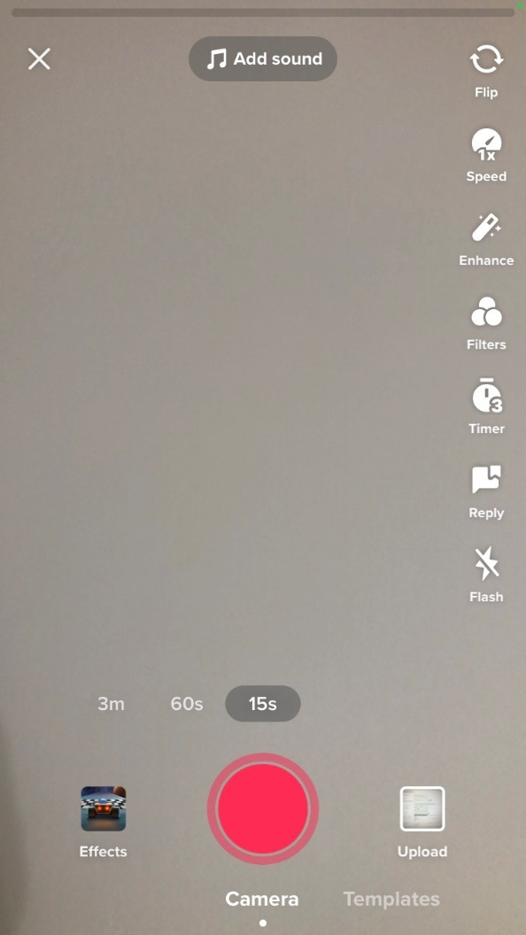

Slide 15
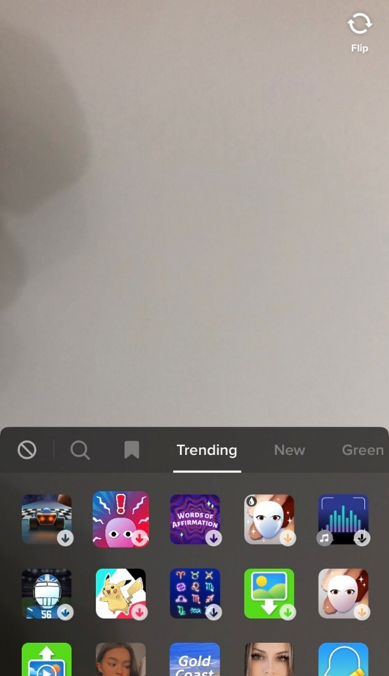

Slide 16
Posting Videos
To the left of the camera button is the Effects button that you can use to add effects as you film. (Check it out)
When you’re ready to add audio and you’re in camera mode, tap the “Add sound” button on the top of the screen. Use audio from your Favorites on the lower right or find new sounds using the Discover listing on the lower left.
For more sound options, swipe down on the page for categorized playlists and samples of available music. If you like a category tap “see all” for more selections and then tap on the flag icon to favorite any you like.
To make a video in TikTok, hit the large record button and start recording.

Slide 18
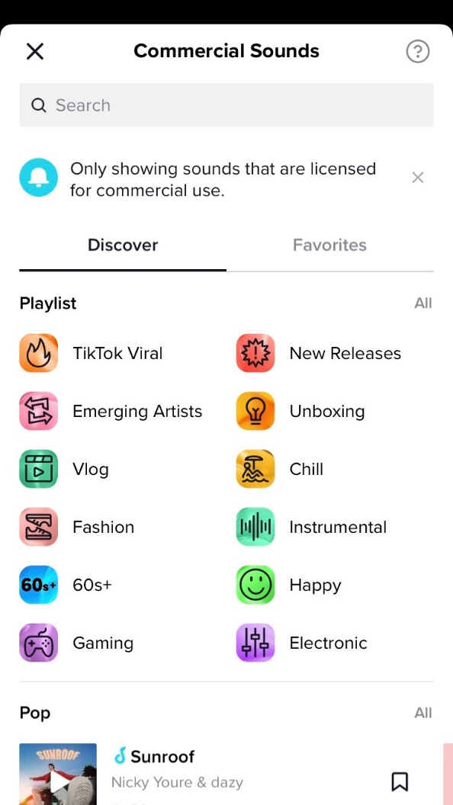

Slide 19
Posting Videos
If you’d prefer to use a video that you’ve already filmed, tap on the “upload” button at the bottom right.
Choose your video or photo and a thumbnail will appear at the bottom of the screen. If you want the photos in a different order, press on the thumbnail and move it to the left or right. You’ll see that the number in the main window changes. When you’re ready, press “Next.”
On the next screen, you’ll see a cropping box at the bottom of your video that you can use to crop it at the beginning or end. i.e. crop it to 15 seconds or less.
You can also speed up your video by 2x or slow it down by .5x by tapping on the clock icon or turn the image by 90-degree increments by tapping the square icon. When you’re ready, tap the Next button.

Slide 21
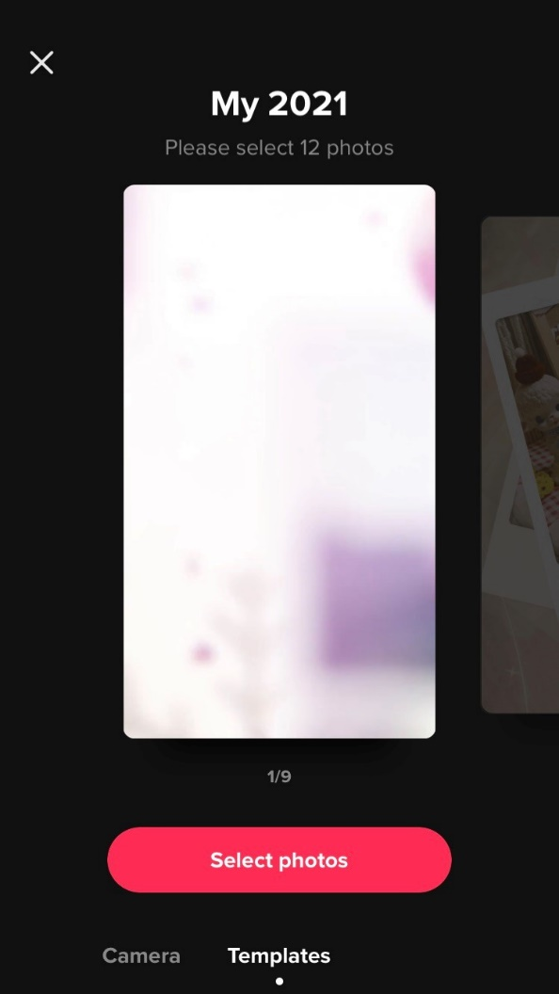

Slide 22
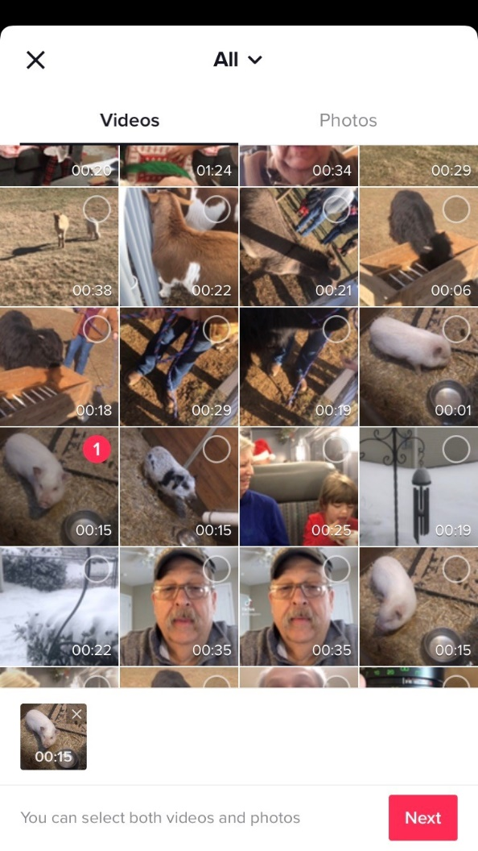

Slide 23
Posting Videos
This is where you can add sounds and effects.
You can add a filter to change the hue and do a voiceover.
You can also add captions. This is important because it makes your video more accessible, and it also allows people to watch it when they can’t have the audio on.
Don’t be afraid to play around with all the features as they can each be tweaked in several interesting ways.
You’re at the last page. Here you describe your video, put in hashtags or tag friends; add a link.
Make sure you at least use the #BookTok when you’re posting in relation to your book or writing.
You can choose whether to allow comments and whether to allow people to use your video in a TikTok Duet (where they could create a video side by side with yours) or a Stitch (where others can use parts of your video while crediting you.)

Slide 24
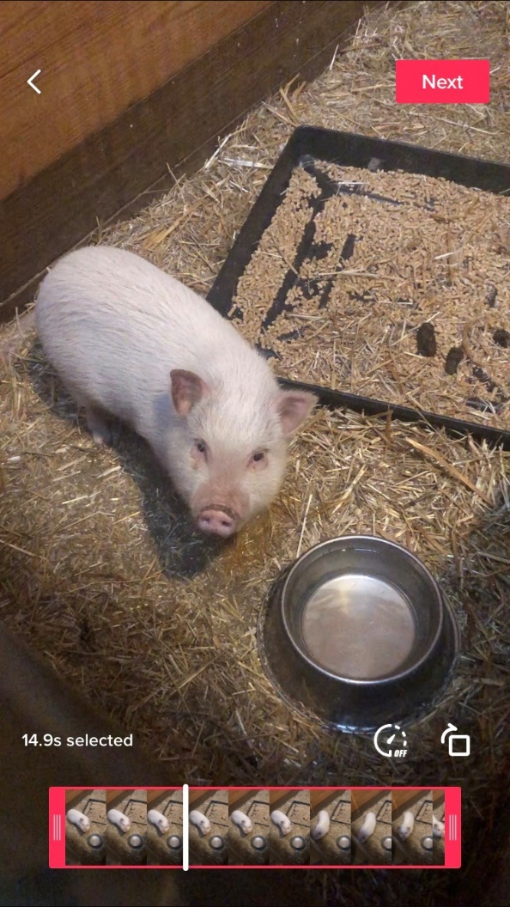

Slide 25
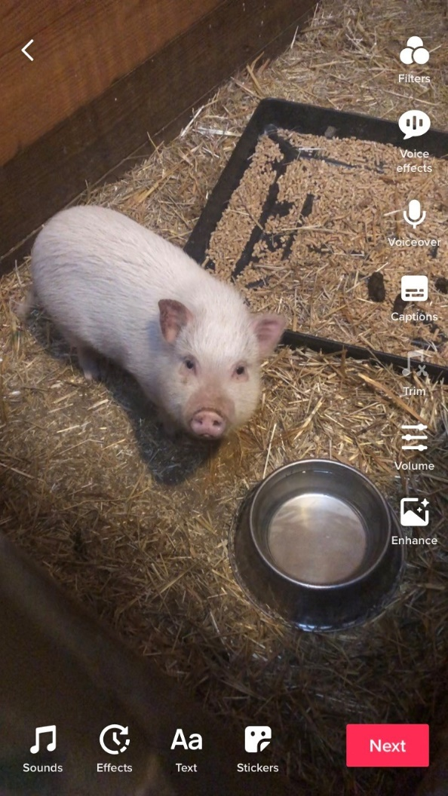

Slide 26
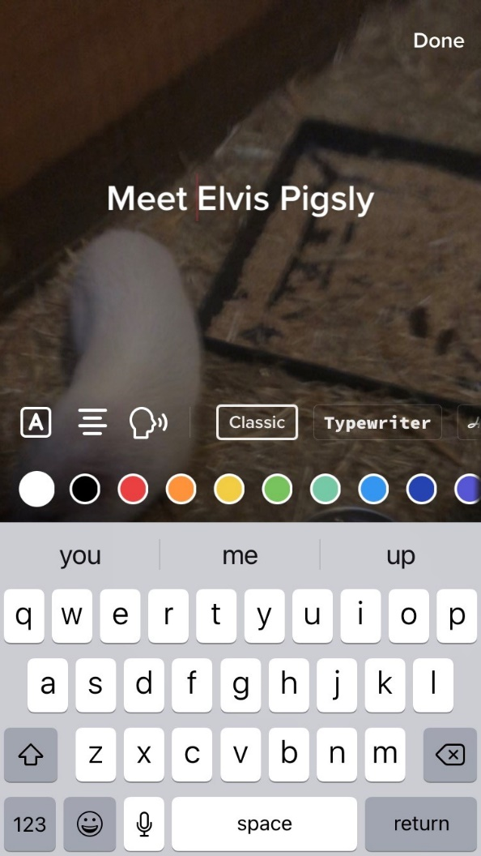

Slide 27
Posting Videos
You can decide whether you want to keep the video private, only share it with friends, or share it with the world.
If you still want to play with your video a bit, tap Drafts.
If it’s good to go, tap Post.
And you’ve got a video on TikTok

Slide 28
Ways to Get Your Videos Trending
  On TikTok, you’ll notice that many people post videos that are similar---similar sounds and similar themes. These are known as “trends”.
  Look for ways you might be able to take advantage of TikTok trends and hashtag challenges to promote your new book.
  Use trending sounds. (If you see a sound that has over ten thousand videos under it, use it. You can even put it over a video in the background of you talking and it will still boost your views.

Slide 29
Paid or Unpaid
Unpaid posts are typical for #BookTok creators
BUT, paid influencer posts can increase viewers by 100x
BQB author Lindsey Rowe Parker paid an influencer on TikTok to review her book and her following increased by thousands in just one day.

Slide 30
WHAT IS LIBRO.fm?
    Libro.fm is an audiobook retailer that lets readers buy audiobooks through their local bookstore.
    Through Libro.fm, readers can create a monthly membership, give an audiobook to a friend, or buy audiobooks for themselves or an organization. Libro.fm splits the profit from the purchase with a local bookstore of the readers choosing.

Slide 31
How it Works for Readers
    Readers create a free account and choose the bookstore that they want to support. That bookstore will get a portion of every purchase that reader makes.
    Readers sign up for a monthly membership or buy audiobooks a la carte.
    Readers can listen anywhere/anytime with the free Libro.fm app and enjoy features that make listening easier and more enjoyable, including a sleep timer, bookmarks, and more.

Slide 32
How it Works for Us
As a publisher, our audiobooks are made available to Libro.fm through our audiobook wholesaler, Findaway.
Libro.fm gives publishers an opportunity to buy a yearly marketing package to be able to market our audiobooks to readers, bookstores, and libraries.

Slide 33
How it Works for Us
Through Libro.fm, we can market our audiobooks to the following:
  Booksellers (reaches 9,000+ booksellers)
  Librarian program (reaches 3,100 librarians)
  Educator program (reaches 12,000+ K-12 and higher education teachers.
  Influencer Program (reaches 2,600+ Libro.fm ambassadors, affiliates, influencers, and media/journalists
  Kids Club (Offers readers a bestselling backlist of children’s books with a monthly price promotion under $10
  YA Club (Offers readers a bestselling backlist of YA books with a monthly price promotion under $10)
  Kiss Club (a monthly collection of romance audiobooks for $3.99 each)

Slide 34
Other Marketing Opportunities
Libro.fm is highlighting audiobooks released in 2022 by authors who are black, indigenous, and People of Color. Listeners can shop by genre, bookseller recommendations, and more.
Audiobook pages on Libro.fm include an audio sample, which allows readers to hear a snipped of the audiobook’s narration.
Enhanced audiobook pages (we can add video, quotes, audio samples, and more). Authors can request that we do this on their audiobook. There is a charge to authors for each title of $95 (one time fee).
Author Playlists- only 10 spots available – at $45 each. Authors create a form about their favorite audiobooks and Libro.fm will create a custom playlist.

Slide 35
What We Do
We upload each of our audiobooks that are eligible for Findaway
  Audiobooks that were produced via Pay For Production
  Audiobooks that were locally produced by the author and the files provided to us
  Audiobooks that were produced via Royalty Share through ACX ARE NOT eligible for Findaway or Libro.fm because ACX requires an exclusive contract on those.
Each month we receive promotion opportunities from Libro.fm for which we nominate the audiobooks that fit the category of the promotion.

Slide 36
What You Can Do
Work with Julie to create an audiobook of your title
Join Libro.fm as a reader to understand how they work
Let your fans and followers know that you have an audiobook and if they support a local bookstore, they can order your audiobook through Libro.fm to support an indie bookstore.
When your audiobook is up on Libro.fm, let your local bookstores know that they have access to your book in print, eBook (through Kobo that works with bookstores) and audiobook (through Libro.fm that works with bookstores)
Let your libraries know that your book is available in print, eBook (through the library eBook challenges) and audiobook (through Libro.fm)

Slide 37
Libro.fm has an Affiliate Program
With their affiliate program, you can earn commissions while supporting local bookstores.
By joining their affiliate program you can earn money every time someone buys an audiobook, gift, or membership if they entered the site through the customized link you are provided by Libro.fm and which you promote.
To sign up for their affiliate program, go to https://libro.fm/affiliates
When you sign up for their affiliate program as an author, you get two additional perks:
  A 3-month Libro.fm audiobook membership (good for 3 audiobooks of your choice)
  A promo code for a discount on your audiobook to share with your readers

Slide 38
Thanks for joining us!
Have a great weekend!
Bqbpublishing.com
Writelife.com

