Slide 1
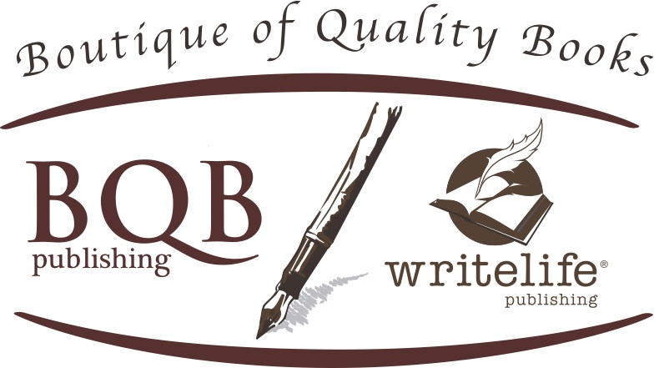
Harness the Power of Amazon Advertising and Goodreads Giveaways
Welcome!
Saturday, July 30, 2022
Noon - EDT

Slide 2
Amazon Advertising
It is just recently that we, as authors, can go in directly to place Amazon ads. Now that we have control, it can be a cost-effective way to bring our books (both frontlist and backlist) to the attention of Amazon buyers and to generate discoverability and more sales.
It should not be relied on to be your only marketing/advertising, but it can be a good way to get your cover and book information to your target market.

Slide 3
Amazon Advertising
To participate in Amazon Advertising, you must have an Amazon author profile.
If you don’t, go to https://authorcentral.amazon.com and follow the directions to set up your Amazon Author Profile.
Once you have an Amazon Author Profile, follow the directions in this PowerPoint.

Slide 4
Amazon Advertising
Go to https://authorcentral.amazon.com and sign in to your author portal account

Slide 5
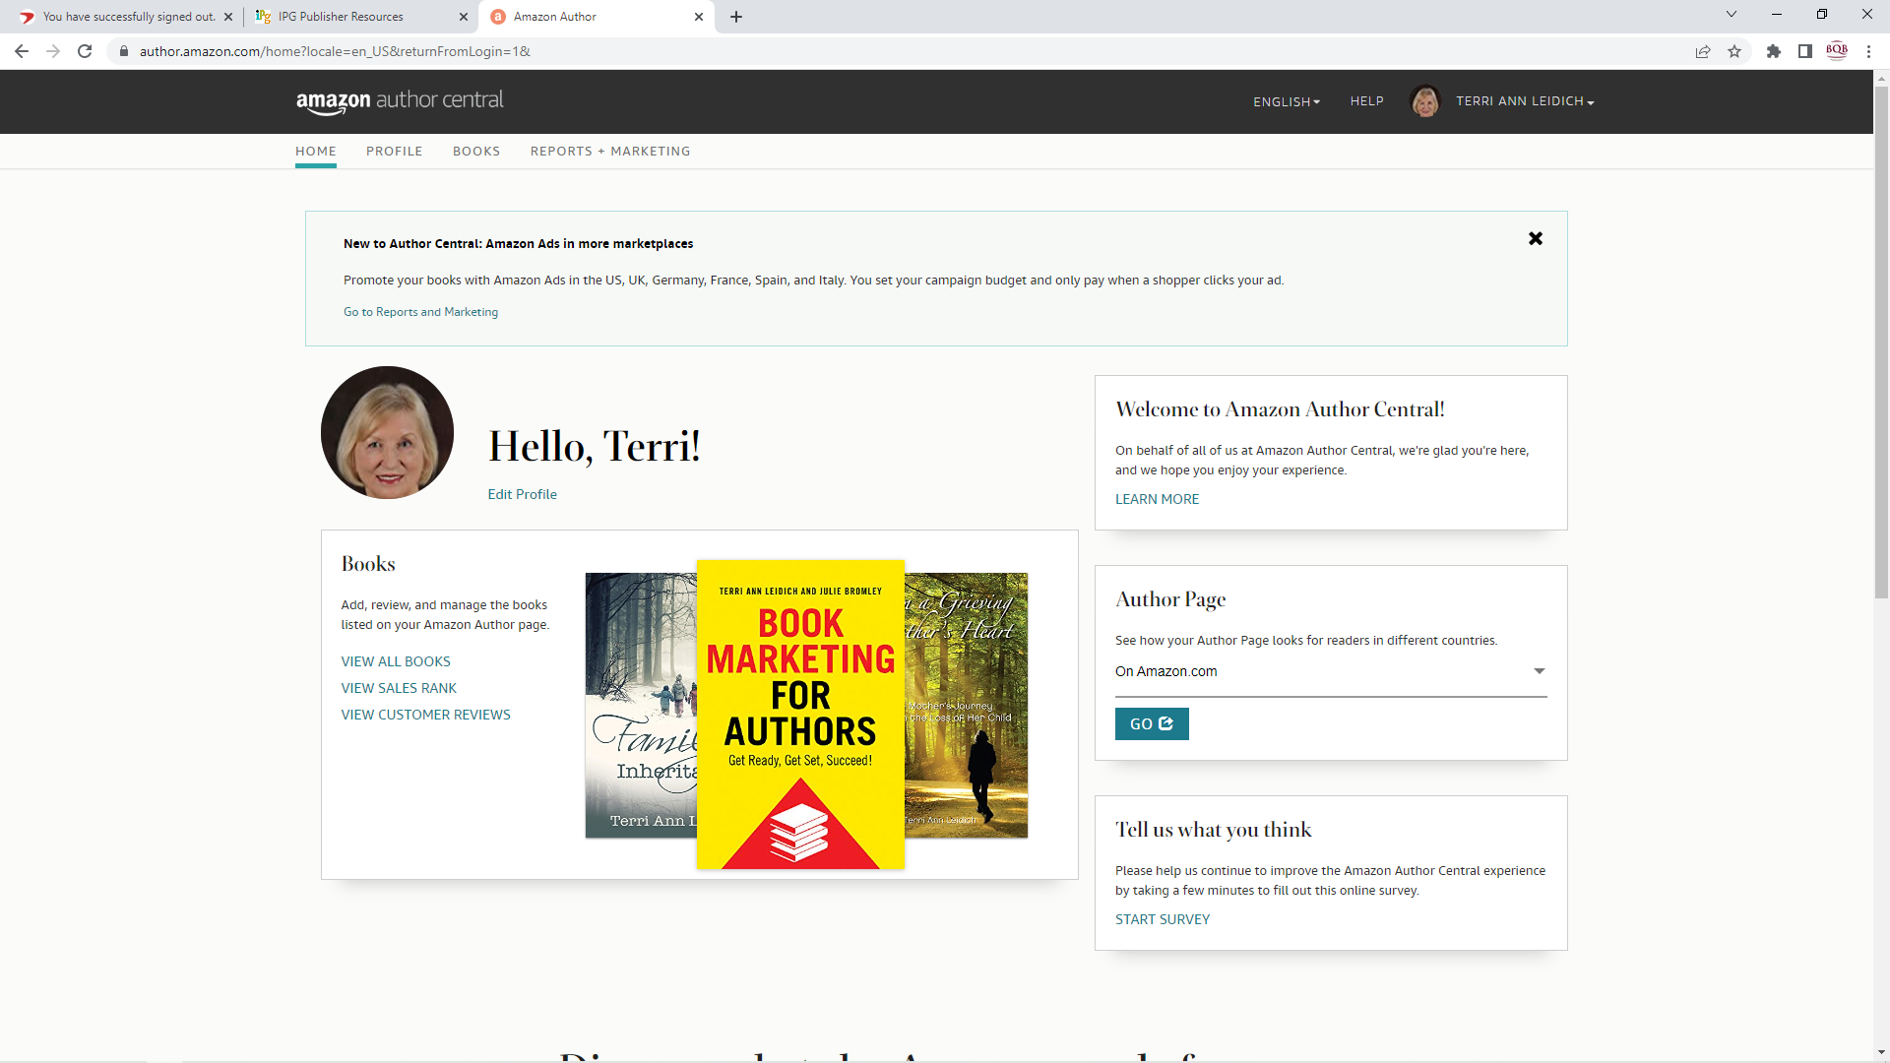

Slide 6
Amazon Advertising
Go to the top of your Hello page and click on “Marketing”

Slide 7
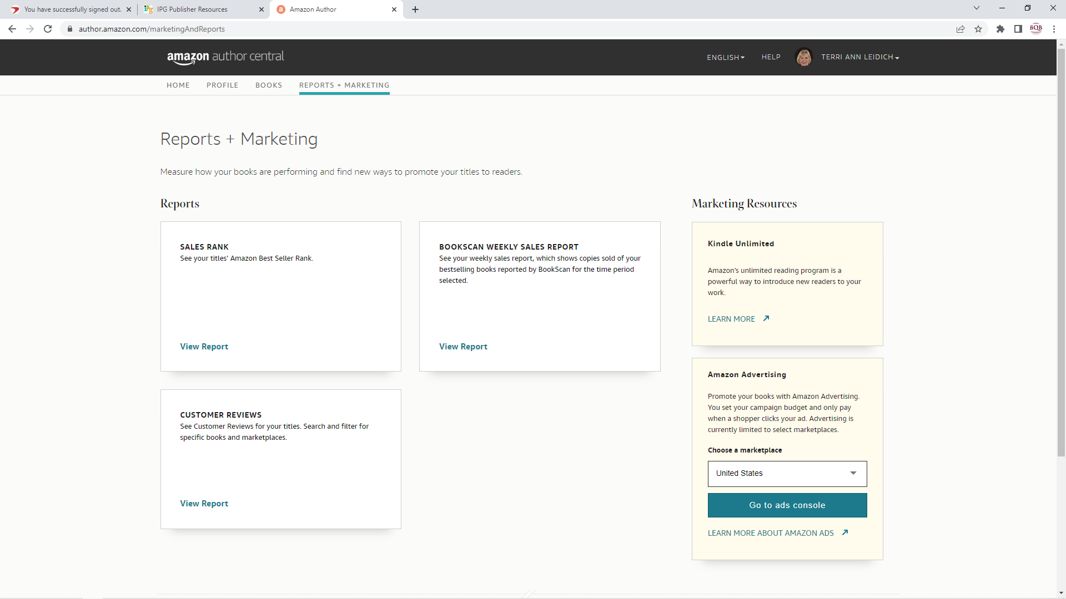

Slide 8
Amazon Advertising
Choose the Amazon Advertising Option
Choose the United States marketplace
Click on the “Go to ads console”

Slide 9
Amazon Advertising
Select the Create Campaign option

Slide 10
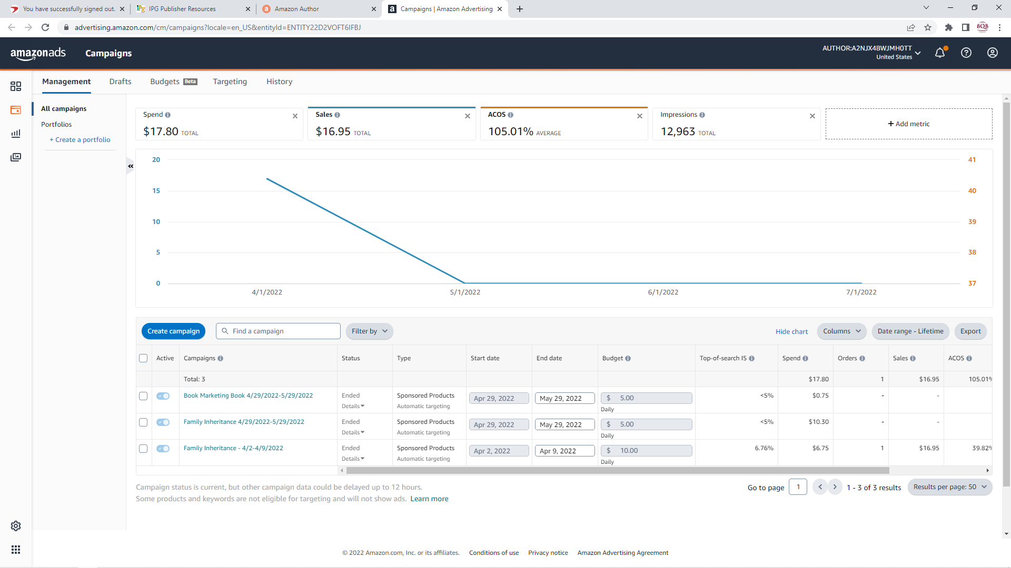

Slide 11
Amazon Advertising
Choose campaign type.( I recommend that you start with the Sponsored Ads. As you get more familiar with advertising on Amazon, you may want to try one of the other ads.)
Watch video about exploring the ad process so you understand it

Slide 12
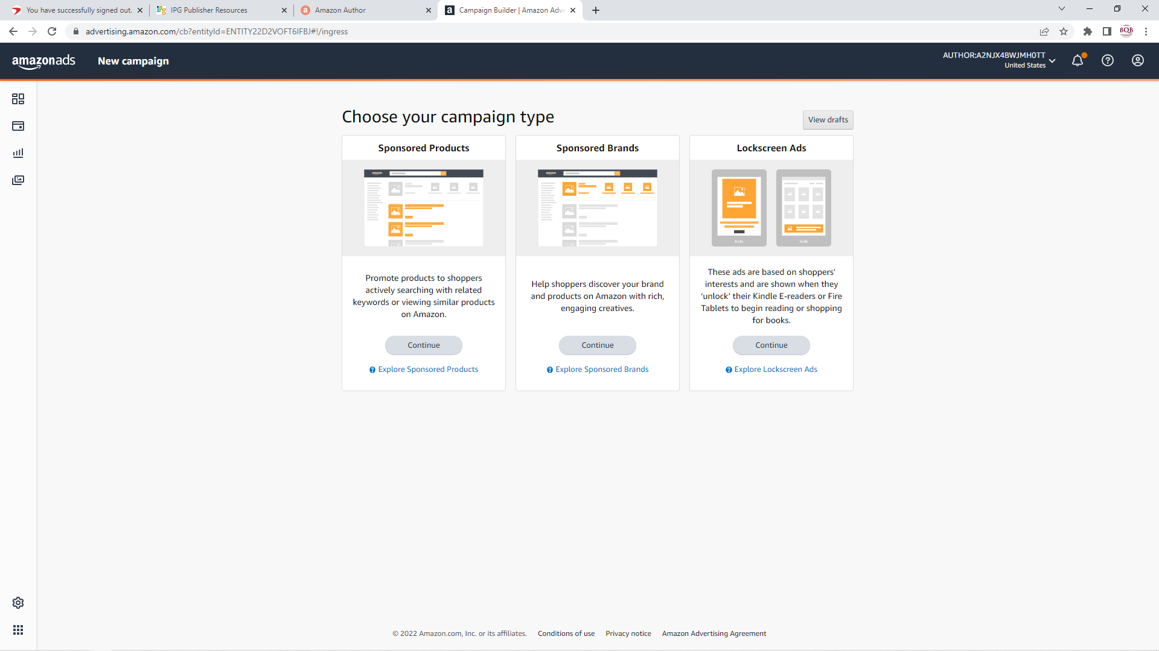

Slide 13
Amazon Advertising
Name your campaign (I named mine by the title of the book I am placing the ad for and the date I’m placing it)
Set dates of campaign. You can try a week at a time, a month at a time, etc.
Set daily budget. (For Julie and my Book Marketing for authors book, I set a budget of $5.00 a day for 30 days. For my novel, I tried $10 a day for seven days to see how that works)

Slide 14
Amazon Advertising
Choose automatic or manual targeting (I chose automatic for Amazon to target the keywords. If you’ve done a lot of research and have a clear picture of the keywords that are used on Amazon to search for your book, you can choose manual targeting and set your own keywords.)
Select bidding strategy (I started with Dynamic. I may change that as I see the results and how the dynamic strategy is working)

Slide 15
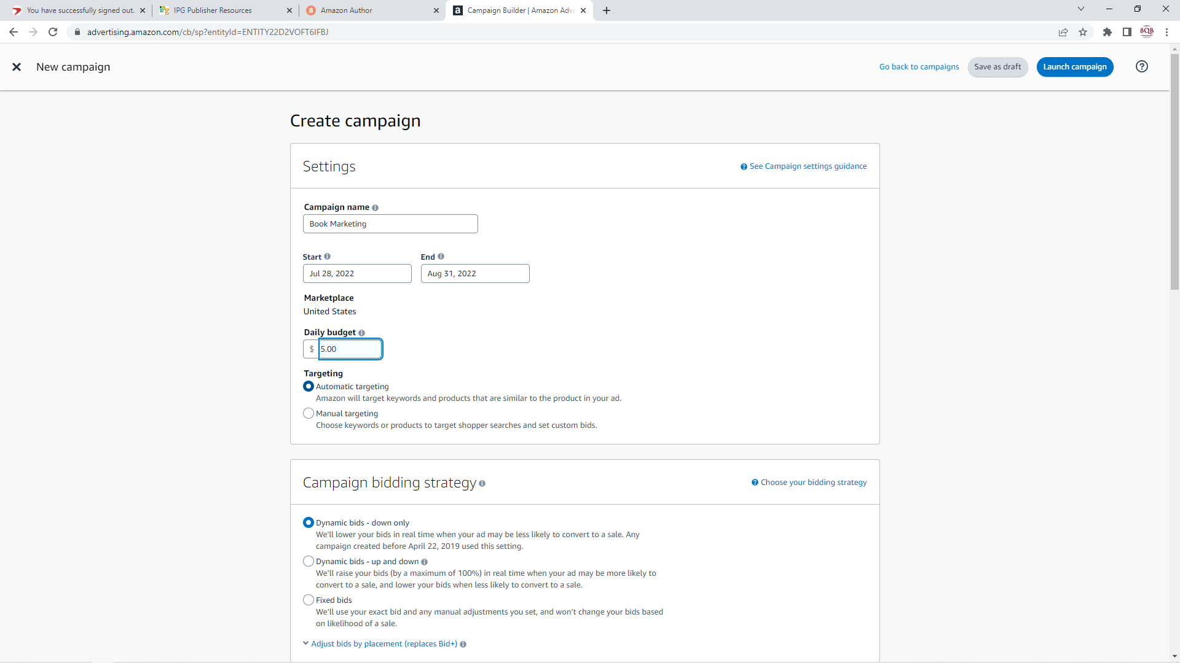

Slide 16
Amazon Advertising
Select ad format (I chose Custom text).
Put in custom text. (I used the one sentence blurb we use for marketing on mine and Julie’s book. We have one of those for each book we publish, so if you are not certain what to put, reach out to Glenn and he can provide you with the one sentence blurb we have for your book)

Slide 17
Amazon Advertising
Choose Product (At this point, all of the books – both print and ebook – that you have with Amazon will come up. The print version ASIN is all numbers. The ebook ASIN begins with BO. I chose the print version for this group of ads. Going forward, I may try the ebook version. I’ll especially consider doing some advertising on the ebook version if one of my books is being featured in an ebook promotion)

Slide 18
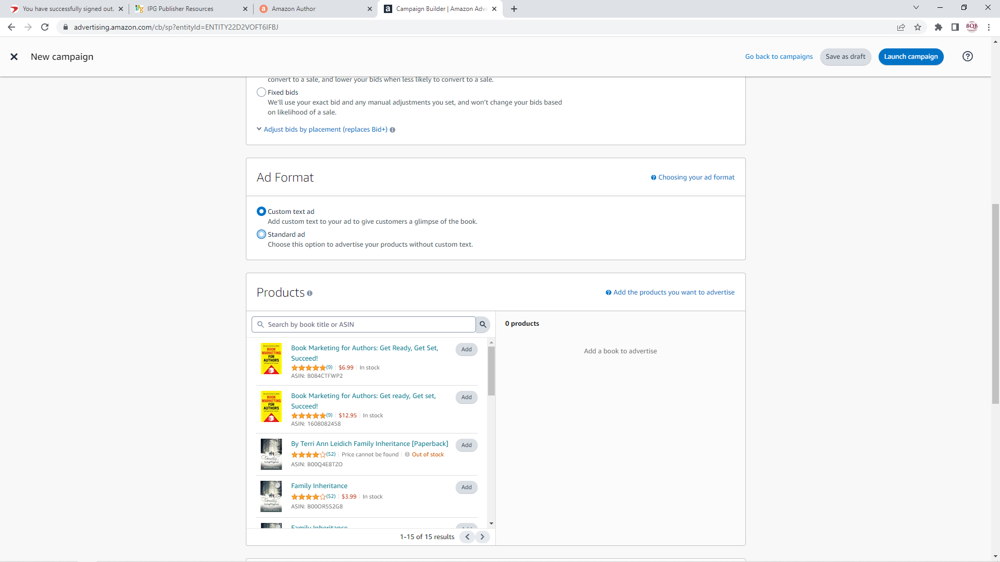

Slide 19
Amazon Advertising
Set bid (I started with the suggested bid. You can click on the link to learn more and choose what feels right for you.)
You can choose negative keyword or product targeting. (I didn’t do either of those. As you learn more about the Amazon advertising process, you may want to try this at some point).

Slide 20
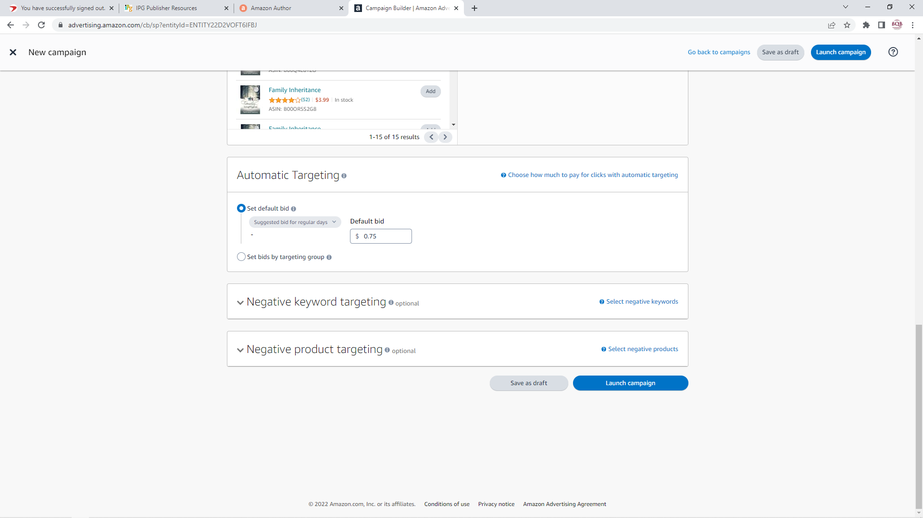

Slide 21
Amazon Advertising
Save the draft to come back to later or launch the campaign or, if you’re ready, click on Launch the Campaign and you’ll receive an email in a day or so from Amazon once your campaign is approve

Slide 22
Amazon Advertising
Enter method of payment by going back to the management tab and on the lower left hand side, click on the symbol just above the box of dots.

Slide 23
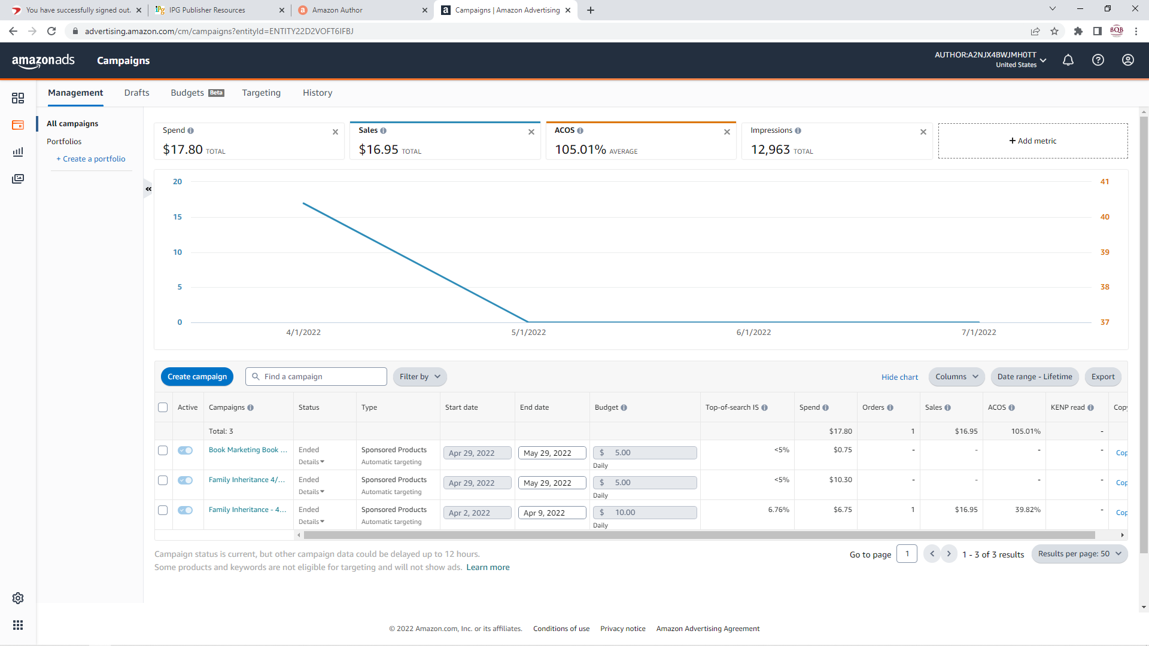


Slide 24
Amazon Advertising
Click on the Billings and Statement Option
In there you will find an option for Payment Methods and Managing Your Payment Methods where you can add your credit card information.
Charges will be made intermittently throughout your ad campaign and you’ll receive an email as to what has been charged.

Slide 25
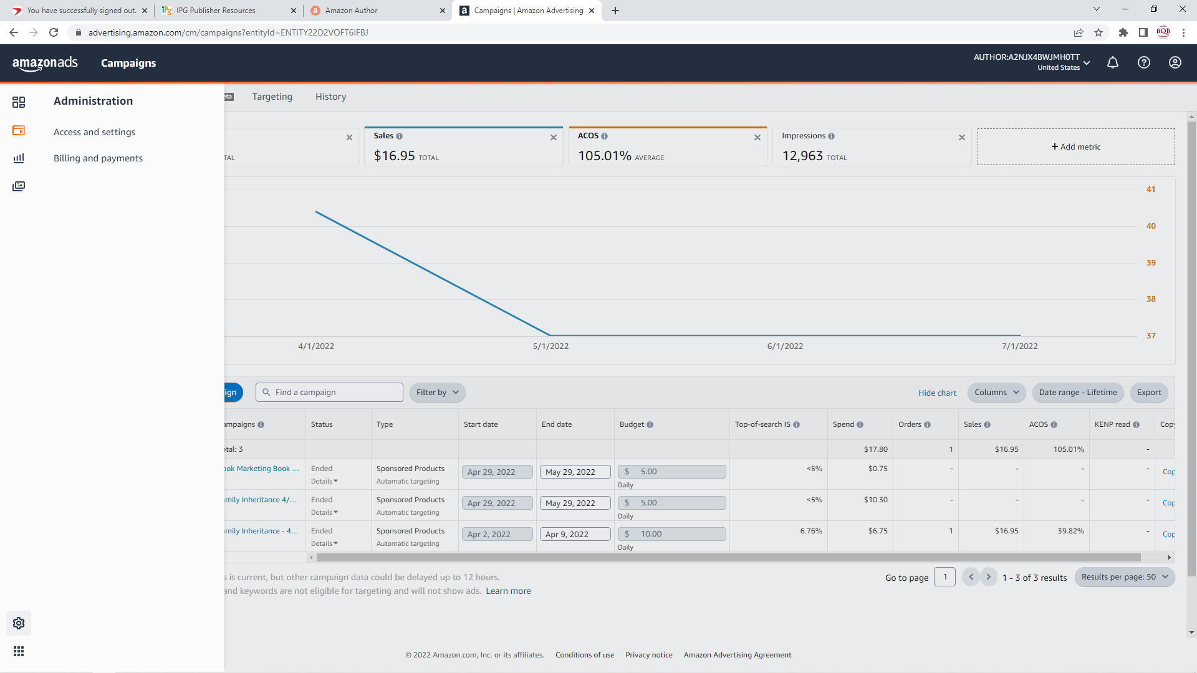

Slide 26
Amazon Advertising
Check back periodically for campaign report by going to the Campaign Management selection.
Even during a campaign, you can adjust the campaign date, budget, etc. with the selection buttons offered on the manage campaign page once you click on a particular campaign.
All campaigns that you have run will come up and you can click on options to get more details.
If you have more than one book, you can run more than one campaign at the same time.

Slide 27
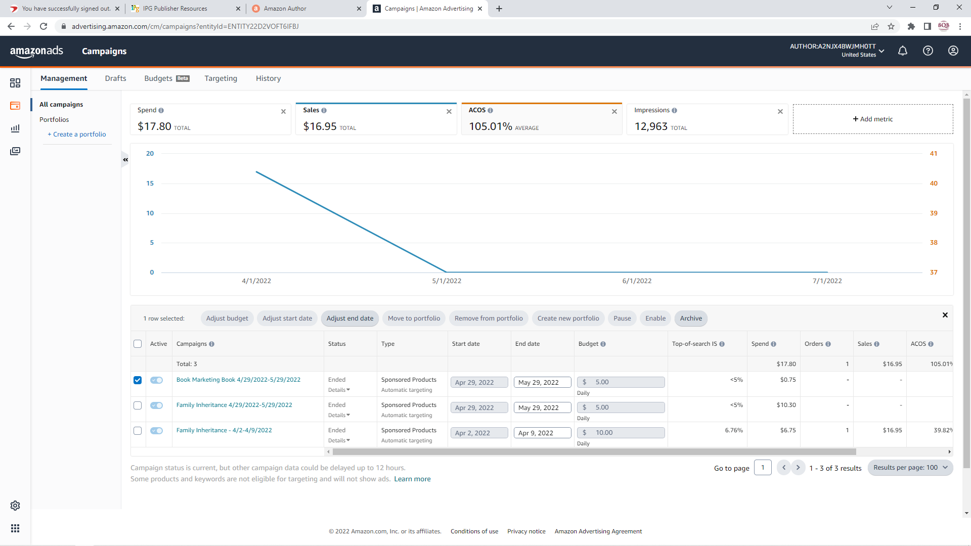

Slide 28
Amazon Advertising
Please note that all along the process, Amazon offers opportunities to learn more about each segment or to talk to an expert.

Slide 29
Amazon Advertising
Set the limits that your budget can afford and have fun with this.
I started with small limits and letting Amazon choose the keywords just to get comfortable with this process so that I could teach it to all of you.
I didn’t do any advertising during the summer but plan to ramp up again as we get into the Fall because that is prime buying season.

Slide 30
Amazon Advertising
As you experiment with this, use the Facebook BQB Group Page to let us all know how you’ve done and what you’re learning. By communicating in this way, an email doesn’t sit in my inbox waiting for me to have the time to communicate to all of us.
I look forward to learning more about this from all of you and to seeing some sales movement on both frontlist and backlist titles.
ENJOY!

Slide 31
Goodreads Giveaways
What you need to know:
Goodreads is a book discovery site.
It now has over 135 million registered members and is the largest site for readers and book recommendations in the world.
With such a strong audience, it’s a great place to promote new releases and help bring life back into backlist titles.
Goodreads’ audience is 70% female with the majority of readers between the ages of 18-54.
Goodreads offers an “ask the author” feature which you as an author can turn on or off at your discretion and you can use it to engage with potential readers.

Slide 32
Goodreads Giveaways
There are two different giveaway programs with Goodreads. A giveaway can be done for a print book or an ebook:
$119 – Standard giveaway
Book is featured in the Goodreads giveaway section
Giveaway is featured in friends’ news feeds when someone enters
Email is sent to notify the author’s followers and readers who have marked the book as Want to Read
Goodreads reminds winners to reviews the book
Entrants are required to add the book to their Want to read list

Slide 33
Goodreads Giveaways
$599 – Premium giveaway
Book is featured in the Goodreads giveaway section
Giveaway is featured in friends’ news feeds when someone enters
Email is sent to notify the author’s followers and readers who have marked the book as Want to Read
Goodreads reminds winners to reviews the book
Entrants are required to add the book to their Want to read list
Book is given a premium listing on the Giveaway section of Goodreads
A personalized email is sent to everyone who doesn’t win the Giveaway

Slide 34
Goodreads Giveaways
Details of a giveaway:
It must run for at least a week and may run for as long as a month (you choose)
There cannot be two giveaways (print and eBook) of the same title scheduled or running at the same time.
Authors pay BQB/WriteLife for the Giveaway and BQB sets it up with IPG and Goodreads.
While authors pay for the giveaway, BQB picks up the cost of the print and/or ebooks that are given to winner.
BQB/WriteLife will provide up to five print or eBook copies for a backlist title (published over a year or more ago) and up to 10 print or eBook copies for a frontlist title (upcoming release or published in the last year)

Slide 35
Goodreads Giveaways
How to book a Goodreads Giveaway through BQB/WriteLife:
Email me that you want to do a Goodreads Giveaway
I will send you an invoice and once it is paid the giveaway will be set up.
It is then recommended that you, an the author, actively promote the giveaway via social media, newsletters, blogs, etc.
Once the giveaway begins, BQB will promote it via our social media platforms.

Slide 36
Goodreads Giveaways
The information BQB/WriteLife will need to set up the giveaway:
Which program you wish to participate in – standard or premium?
Do you want to give away print books or ebooks?
Title of the book you want us to enter.
When do you want the giveaway to begin – it must be at least three weeks from the time you send in your request to me.
How long do you want the giveaway to run? It must be 30 days or less.
How many copies of your book do you want to give away?
Do you want the giveaway available to both US and Canadian readers or just US?
If you want to ship the print books to the winners, which gives you the opportunity to add a personal note, let me know and I’ll get the copies of the books to you.

Slide 37
Goodreads Giveaways
Two of our authors ran Goodreads Giveaways in June and part of July and had good results:
Daisy a Day: Hope for a Grieving Heart by Harriet Hodgson had 641 entrants in the giveaway and 597 readers on Goodreads shelved it as “Want to Read”
Blood Before Dawn by Daniel V. Meir, Jr. had 3,133 entrants and 2,906 readers on Goodreads shelved it as “Want to Read.”
That is great exposure for the cost of $119. Way to go Harriet and Dan!

Slide 38
Thanks for joining us!
Have a great weekend!
Bqbpublishing.com
Writelife.com

