Slide 1
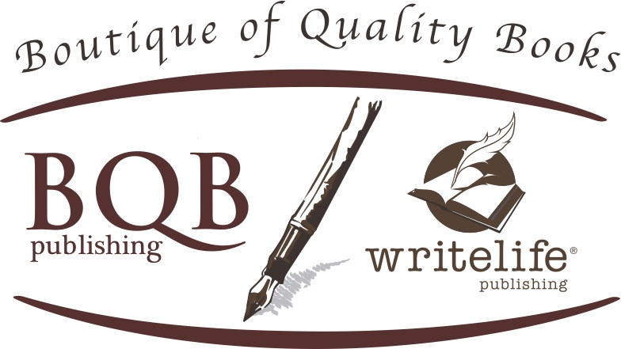
Effectively Using Social Media
To Sell Your Books
Welcome!
Saturday, July, 15th
Noon - EDT

Slide 2
Social Media and its impact
  Many readers are active on social media and use various platforms to learn about books and authors. This gives authors a good opportunity to grab readers’ attention and build a following.
  If readers on social media find you interesting, entertaining, or endearing, they’re more likely to follow you and check out your books and other work.
  The more personable or relatable you are, the more reader interest you’ll build in your brand.

Slide 3
WHERE TO PUT YOUR
ATTENTION

Slide 4
Where to put your attention
Invest your time and energy into the two or three main platforms that will “move the needle” for you:
Facebook & Instagram can be good for promoting books.
LinkedIn is good for business books.
Pinterest has a strong female following.
TikTok is where short videos are most likely to go viral. If you’re not into videos, this isn’t the platform for you.
YouTube is good for longer, more informative or insightful videos.
Some people like Twitter; it’s most useful if you can get influencers with large followings to tweet or retweet about your book.

Slide 5
Where to put your attention
Create an engaging user bio for each platform you use. Make it fun. Pretend you’re writing about yourself like you would a character in your books.
Include the fact that you’re an author, along with the title of your book(s) or series. If your books have won awards, feel free to describe yourself as an “award-winning author.”
Update your bios every couple of months, at least.
Include a website URL where people can directly or indirectly order your book(s). You want them to be able to place an order through a retail site in just one or two clicks from your user bio.
Don’t forget the power of a good Amazon profile. People often user Amazon for discovery, even if they buy the book elsewhere.

Slide 6
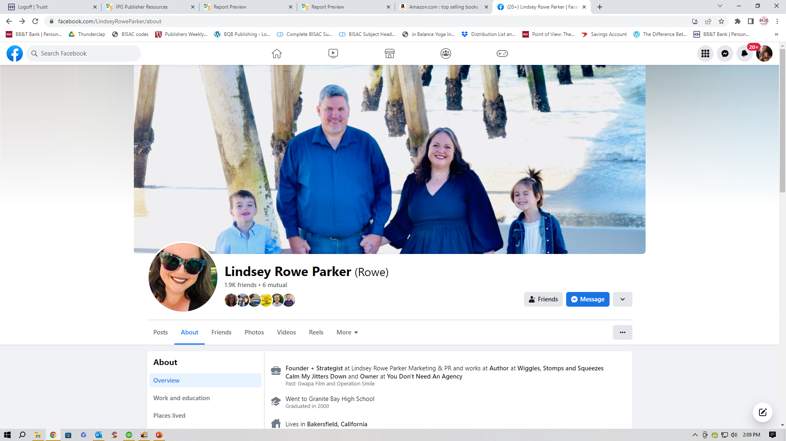
Add a profile picture and cover photo to your platforms like Facebook – they are very important.

Slide 7
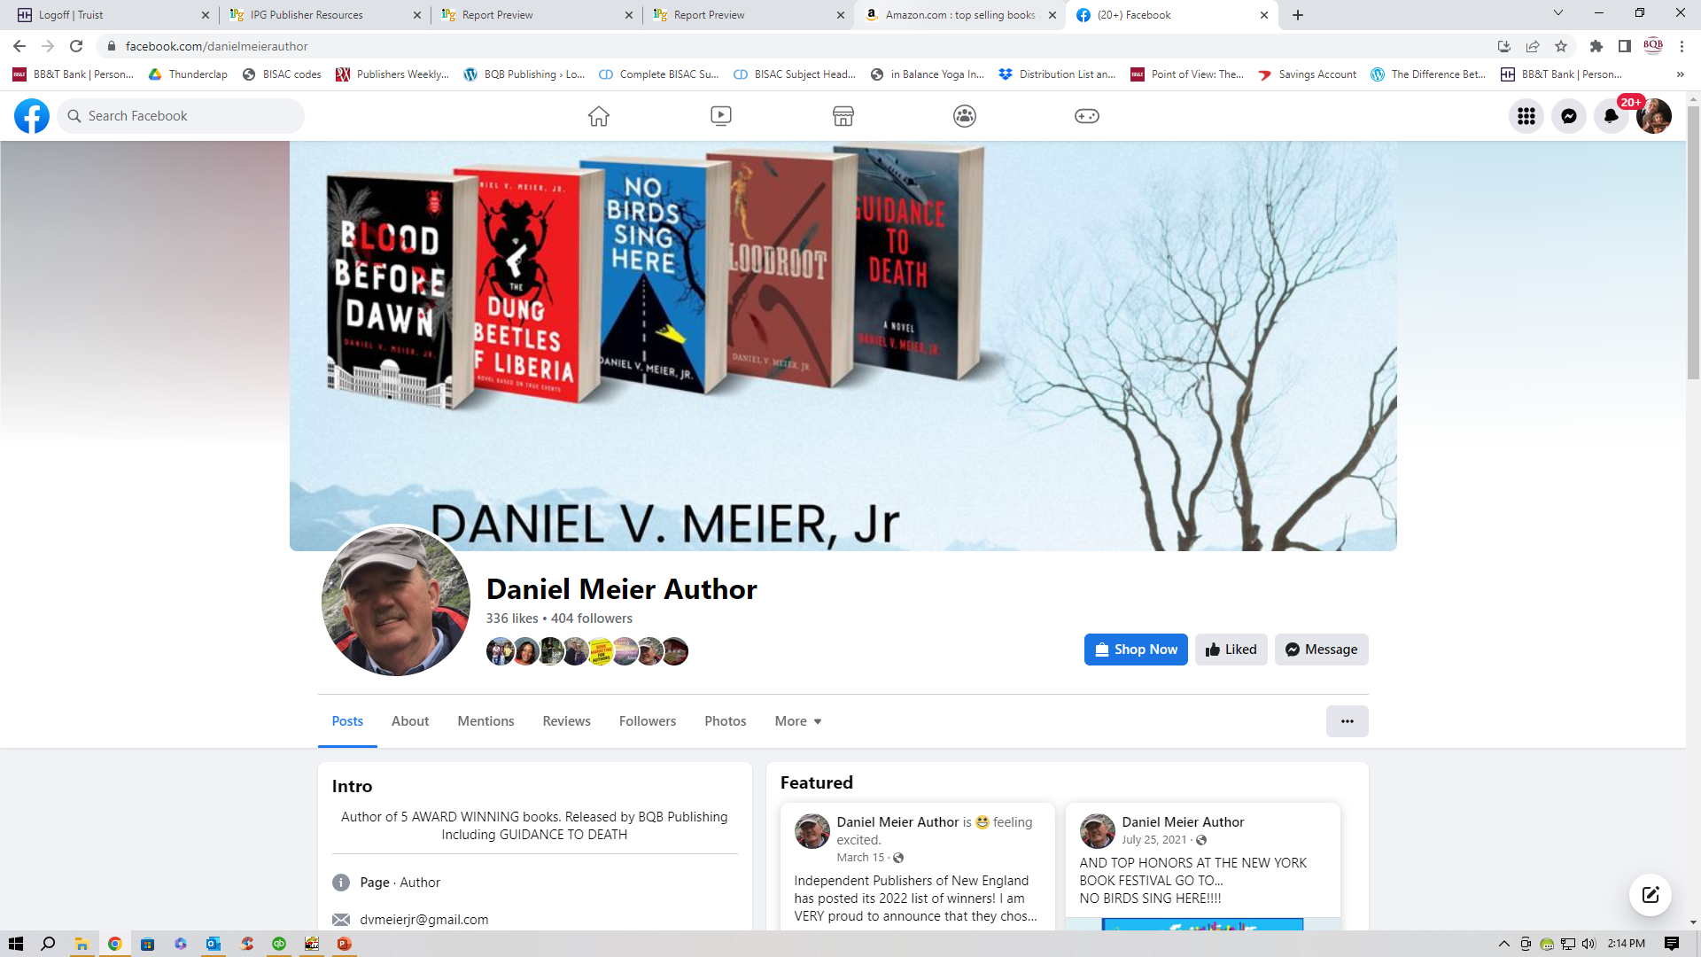
It can be effective to use your book covers in your cover photo.

Slide 8
Some bios have to be short – Each social medium platform has different length limits
Intro for Dan Meier on Facebook
Author of 5 AWARD WINNING books. Released by BQB Publishing
Including GUIDANCE TO DEATH
Intro for John Daly on Facebook
Author of the award-winning Sean Coleman Thrillers | Political/media columnist

Slide 9
Intro for Kristin Hannah on Instagram
Author of The Four Winds, The Nightingale, The Great Alone, etc. #kristinhannah #thegreatalone #thenightingale
#fireflylane #netflix #thefourwinds
tinyurl.com/KristinHannahTheWomen
Intro for Charlie Donlea on Instagram
USA Today and #1 International bestselling author of thrillers. TWENTY YEARS LATER out now in paperback, THOSE EMPTY EYES out now in hardcover
linktr.ee/CDonlea

Slide 10
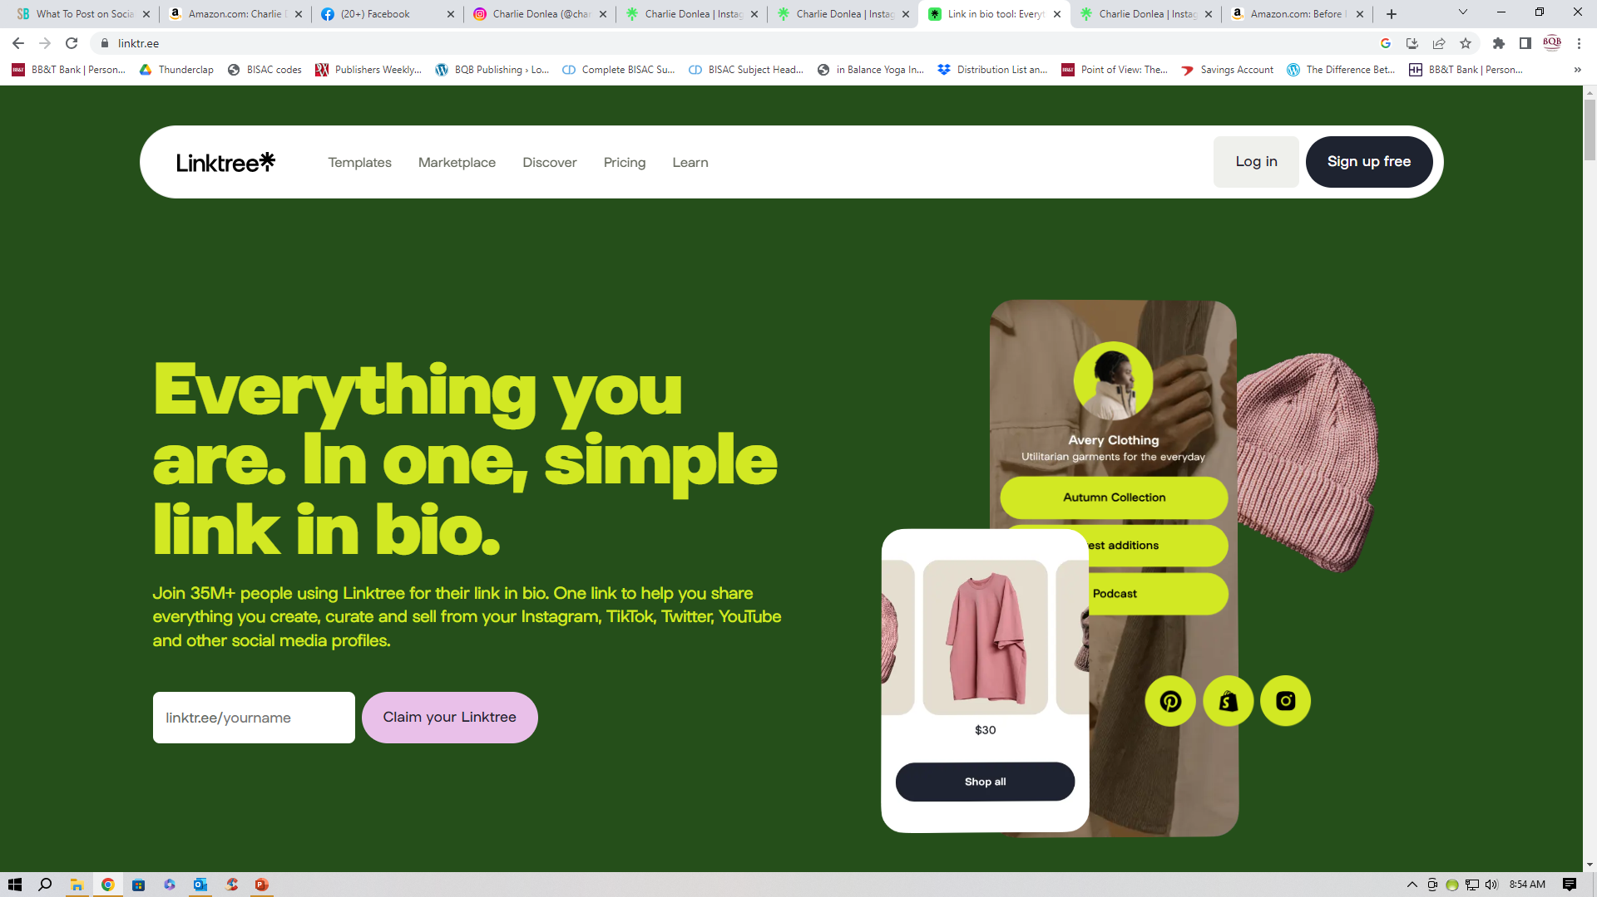
Use LinkTree to provide all links

Slide 11
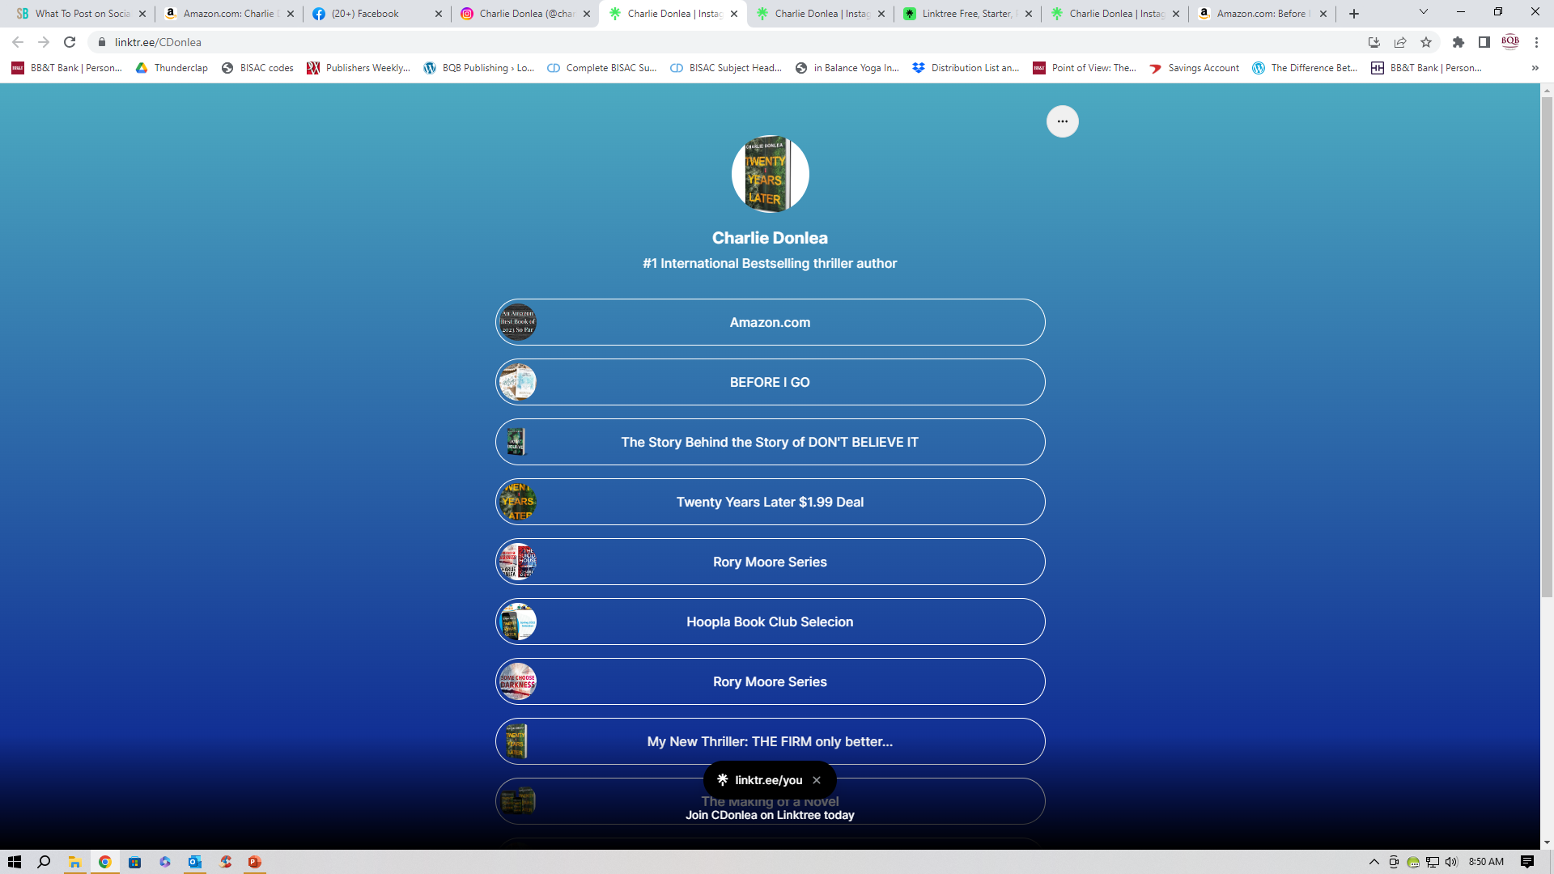
Use LinkTree to provide all links

Slide 12
One of the best Amazon Author Profiles I’ve Read
About the Author
Meet Leslie Wolfe, bestselling author and mastermind behind gripping thrillers that have won the hearts of over a million readers worldwide. She brings a fresh and invigorating touch to the thriller genre, crafting compelling narratives around unforgettable, powerhouse women. Her books are not only an adrenaline-packed ride, but they're also sprinkled with psychological insights, offering readers an immersive, authentic experience that goes beyond conventional suspense.
You might know her from the Detective Kay Sharp series or have been hooked by Tess Winnett's relentless pursuit of justice. Maybe you've followed the dynamic duo Baxter & Holt through the gritty streets of Las Vegas or plunged into political intrigue with Alex Hoffmann.
Recently, Leslie published The Girl You Killed, a psychological thriller that's pure, unputdownable suspense. This standalone novel will have fans of The Undoing, The Silent Patient, and Little Fires Everywhere on the edge of their seats.
Whether you're into the mind games of Criminal Minds, love crime thrillers like James Patterson's, or enjoy the heart-pounding tension in Kendra Elliot and Robert Dugoni's mysteries, Leslie's got a thriller series for you. Fans of action-packed writers like Tom Clancy or Lee Child will find plenty to love in her Alex Hoffmann series.
Wolfe’s latest psychological thriller, The Surgeon, will have you racing through the pages gasping for breath until the final jaw-dropping twist, delighting fans of Gone Girl and The Girl on the Train.
Discover all of Leslie's works on Amazon.com/LeslieWolfe. Want a sneak peek at what's next? Become an insider for early access to previews of her new novels, each a thrilling ride you won't want to miss.
• Follow Leslie on Amazon: click or tap the FOLLOW button under Leslie's avatar
• Follow Leslie on BookBub: http://bit.ly/wolfebb
• Website: www.LeslieWolfe.com
• Facebook: https://www.facebook.com/wolfenovels
• Visit Leslie’s Amazon store: https://Amazon.com/LeslieWolfe

Slide 13
Where to put your attention
Have a strategy for your social media. You want to build a relationship with people; getting them interested in knowing more about you and want
Pitfalls can include too many posts, too much complaining, and too hard of a sales pitch. You want to be active on social media in a way that draws people in.
If someone comments on a post, make sure you respond to them. That’s how you build relationships.

Slide 14
Where to put your attention
Find your niche – what specialized area within the publishing industry do you want to focus on? Take your passions and strengths into consideration when identifying your niche.
Choose social media platforms that best align with your niche, in regard to both readers and influencers.
Engage with other authors, writers’ groups, readers, bloggers, book enthusiasts, book hangouts, book clubs, bookstores, and influencer, etc. on social media. By engaging, we mean being interested in what they are interested in. Don’t make these interactions about you and your book. Be interesting and engaging. If witty is a part of your personality, use that too. People may seek out your profile and page if they like your interactions on another site they follow.
As BQB/WriteLife authors, take time to follow each other, “like” and share each other’s content, and review each other’s books. There is power in numbers and we have a great group to start with.
Many times if you follow someone, they will follow you back. So, seek out people you are interested in following, and most times, they will reciprocate.

Slide 15
Where to put your attention
Unsure of all the books and authors we have at BQB/WriteLife? Go to our websites – www.bqbpublishing.com and www.writelife.com to become familiar with them. Authors’ social media links are on their bio pages.
It’s all about connecting and building trust with the right audience.
You don’t have to have a huge following, you just have to reach the right people.
Develop your content strategy. Determine the voice your content will take – informative, personal, entertaining, etc.
You might use one platform to share visual content such as videos and images, another for your written content such as articles or blog posts, and another to share a combination of the two.
Make sure people are actually seeing and engaging with you. Interact with them directly (respond to and acknowledge comments).
As often as possible, include a picture with your posts as posts with pictures get people’s attention.

Slide 16
Where to put your attention
Don’t be afraid to talk about your project (book, books, series, characters, etc.) with passion. Be yourself and care about your message.
Readers are interested in writers and how our minds work. If you’re working on a new character or book, share some tidbits with readers.
Use online resources to help determine the best times of day to publish your content, depending on the platform you use.
Build and maintain a website. This serves as a central location where your audience can find everything they need to know about you as well as a resource for other content, and to buy your book(s).
Note that bookstores, sales reps, book wholesalers, etc. will often do a search for an author they are not familiar with. If you don’t have a website and social media, you almost immediately lose their attention.

Slide 17
STRONG SOCIAL MEDIA POSTS

Slide 18
Strong social media posts
  Be active on social media, just not overwhelming. On Facebook, a post a day (or even every other day) is plenty. You can get away with more frequent posts on Instagram, TikTok, Twitter, and other viral-friendly platforms.
  Use hashtags that connect with readers and influencers. #booktok is big on TikTok, and #bookstagram is big on Instagram. Any relevant topic, however, can be easily turned into a hashtag.
    A hashtag is a word or phrase preceded by # and is used on social media sites and applications to identify digital concerning a specific topic. Anyone can click on that hashtag and they will be taken to a site where all posts about that particular subject are kept.
    It is recommended that you use 8-15 hashtags on a post with Instagram and TikTok. Facebook recommends 3-5.
    Use targeted hashtags that relate to you and your book.
    Hashtags are an effective tool for content discovery, community engagement, brand building, and market research.
  Fun or interesting videos of you or anything else are good for capturing attention. Short videos are more likely to go viral. Most social-media platforms support videos.
  Mix up the type of content you share. Include photos, quotes, and videos.

Slide 19
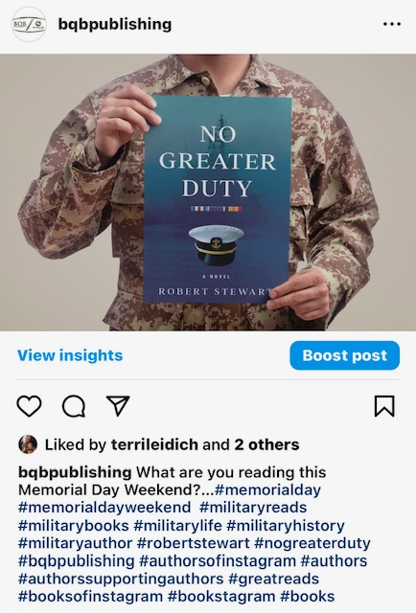

Slide 20
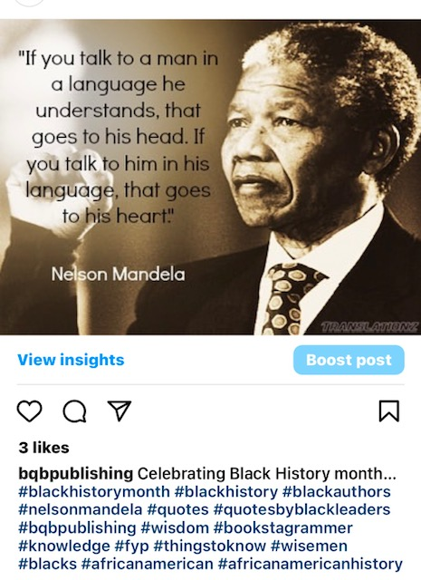

Slide 21
Strong social media posts
  Fun or interesting pictures (even pet photos!). Images and videos are always good for engagement and are more likely to be shared.
  Ask questions of your followers. It helps with engagement.
  Post a teaser for your book and ask your followers to comment.
  Post trivia questions – perhaps about your book(s) or one of your favorite authors.
  Are you doing a podcast interview or guest blog spot? Tell your followers about it.
  Followers of writers/authors love “behind the scenes” photos and insight.
  Be creative! Unique contents stands out.

Slide 22
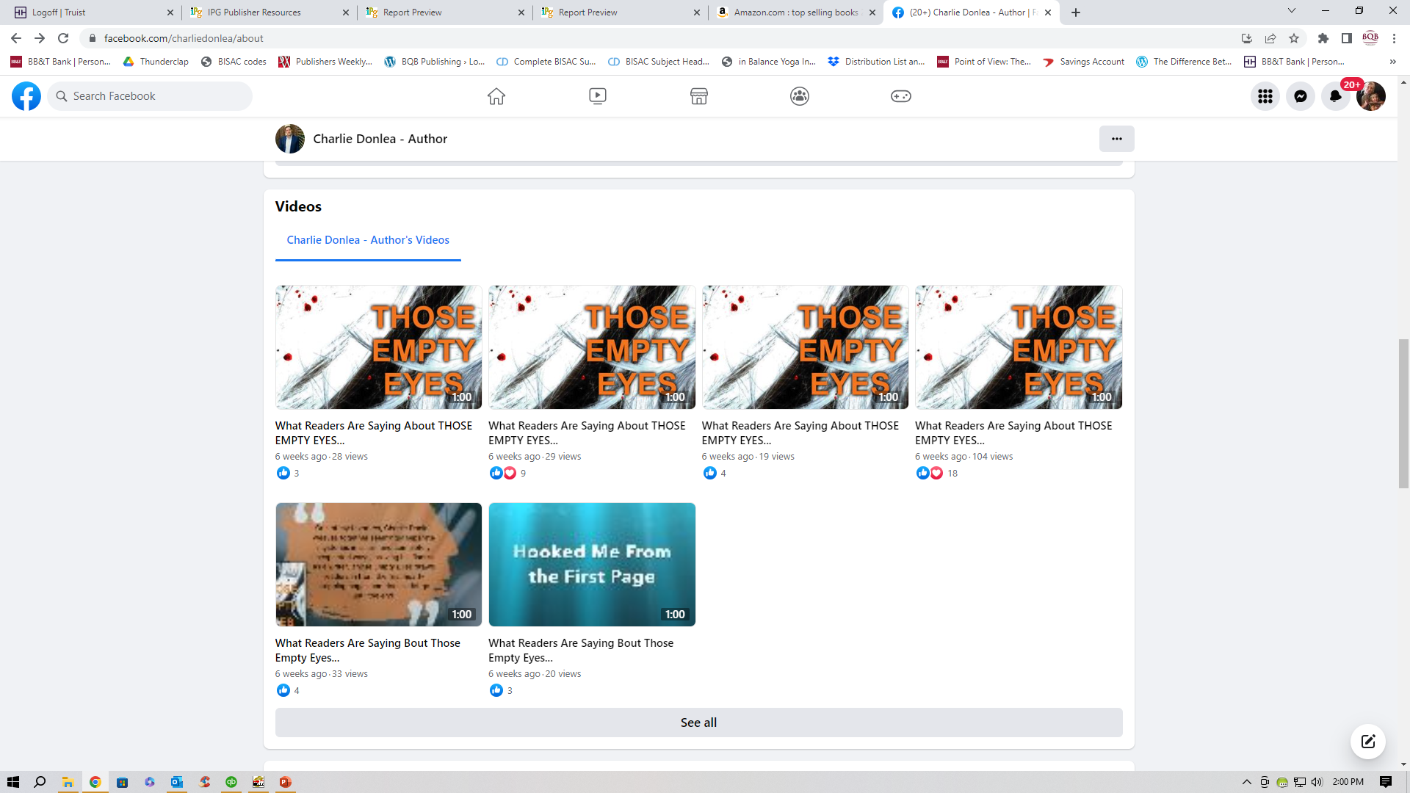
  You can turn your great reviews into videos that you post on social media.

Slide 23
Strong social media posts
  There are several methods for presenting your books on social media:
  A short synopsis
  Reviews
  Blurbs
  Sales/promotions
  Giveaways
  Author events
  Aware Announcements
  On these types of posts, always include a link back to your website, or a book order page, or a page on LinkTree, etc.

Slide 24
USING SOCIAL MEDIA TO BOOST SALES

Slide 25
Using Social Media to Boost Sales
  Having a large following or entertaining posts won’t necessarily boost your sales. Here are a few things you can do to turn followers into sales.
  Announce your upcoming events and ask followers who live in that area to come out and see you.
  Let followers know the different formats your books come in – print, ebook, audiobooks and where to find them or links where they can buy them.
  Can’t get out to bookshops to do a reading? Do one online and provide links where they can buy the book (print, ebook, audiobook). You can do the reading live or post a video.
  Let followers know about any sales that are happening for your books and the links where they can purchase them.
  Some authors provide autographed copies through their websites. If you do that, let followers know about it.

Slide 26
Using Social Media to Boost Sales
    You want to create a relationship with your followers. Most of your posts should be engaging and not just selling your books. But it is okay to let your followers know that you have books to sell and you appreciate their support, reviews, and spreading the word about you and your books. One way to do that is to add a “call to action” to some of your posts. i.e. –”I’ve got a new book coming out, here’s the link to pre-order either the print or ebook.”
    Work with BQB/WriteLife to create special sales and promotions that have specific links and promo codes. Get this information out to your social media followers with a specific time range. This can trigger people to “act now.”
    “Sharing who you are, what you’re all about, and who you help, builds trust, which is the cornerstone of social selling.”
    “Buyer decision are wrought with emotion. Social media lets you foster a positive, emotional response towards your book.

Slide 27
SOCIAL
MEDIA INFLUENCERS

Slide 28
What is a social media influencer?
An influencer is an online personality who can use their authority or popularity within their niche market to influence others into making decisions or purchases.
Book influencers are trusted by their followers.
Book influencers can be a sustainable marketing tactic.
Book influencers can help you grow your social media following. When someone with many more followers than you posts about your work and tags you, you gain a massive increase in visibility.
Celebrities of course are influencers.
Bloggers can be influencers.
Authors can be influencers.

Slide 29
How to Identify a Good Influencer
Every brand has different ideal influencers.
Your best influencers will depend on your unique ideology and goals.
Follower size shouldn’t necessarily be your priority.
If targeted accurately, influencers with smaller platforms can produce better results than huge ones.
Personality and engagement are important metrics.
Will they bring the right people and convert fans into book buyers?
Do your ideal readers hang out on their strongest platforms?
Does their content align with your own author brand?
Do they talk favorably about books similar to yours?
Do they seem convincing and authentic when promoting books?
Does their content get many interactions compared to their follower count?

Slide 30
Top Book Influencers
The most kids-friendly: Imagiantionsoup
The most comical: Readwithcindy
The most different: Lastnightsreading
The most clever: James Tullos
The most “high school” books: Gvhslibrary
The most recommended for young adults: Cait’s Books
The most diverse: The Artisan Greek
The coolest book-worm: The Peruse Project
TheGuywiththeBook
Kristen Williams – Myfriendsarefiction
Hayaisreading
Abby Endler – Crimebythebook
Triin vihur – wordchild
Simone – Simoneandherbooks
Kath-reads
Renee – Somekindofalibrary
Hanah – hanpickedbooks

Slide 31
Connecting with an influencer
Spend a few weeks consuming their content and interacting with them on social media
Comment regularly and share their posts to build a rapport with them.
If they end up following you, you can send them a private message, and eventually ask if they could help spread your word. But a relationship must be built before that.
Once you’ve built a relationship or have engaged with them for a while, send them your book and ask for a review.

Slide 32
GOING BEYOND
SOCIAL
MEDIA

Slide 33
Create a Funnel
How can you convert your social media followers into supportive fans?
Readers encounter you or your books on social media, through an influencer, or in real life.
Convinced by your marketing or reputation, they buy one or more of your books.
In the back of your book, they find your website URL.
From your website, you offer an opportunity to sign up for your newsletter.
Via your newsletter or emails, you offer them free extra content or specials for buying your book, ebook, or audiobook.
Over time, they become superfans who buy your wares and recommend you to other readers.

Slide 34
Thanks for joining us!
Have a great weekend!
Bqbpublishing.com
Writelife.com

